Slide 1
Intro

Slide 2
AI explained in 3-minutes
Car Analogy | AI Term
Bicycle | Machine Learning
Car | Generative AI Model
Gasoline | Humanity’s data (Internet)
Engine | GPU’/s (NVIDIA) Neural nets
Steering System | Transfomer
Steering Wheel | APIs Prompts
Car Factory | Training
Driving | Inferencing
Distracted Driving | Overfitting

Slide 3
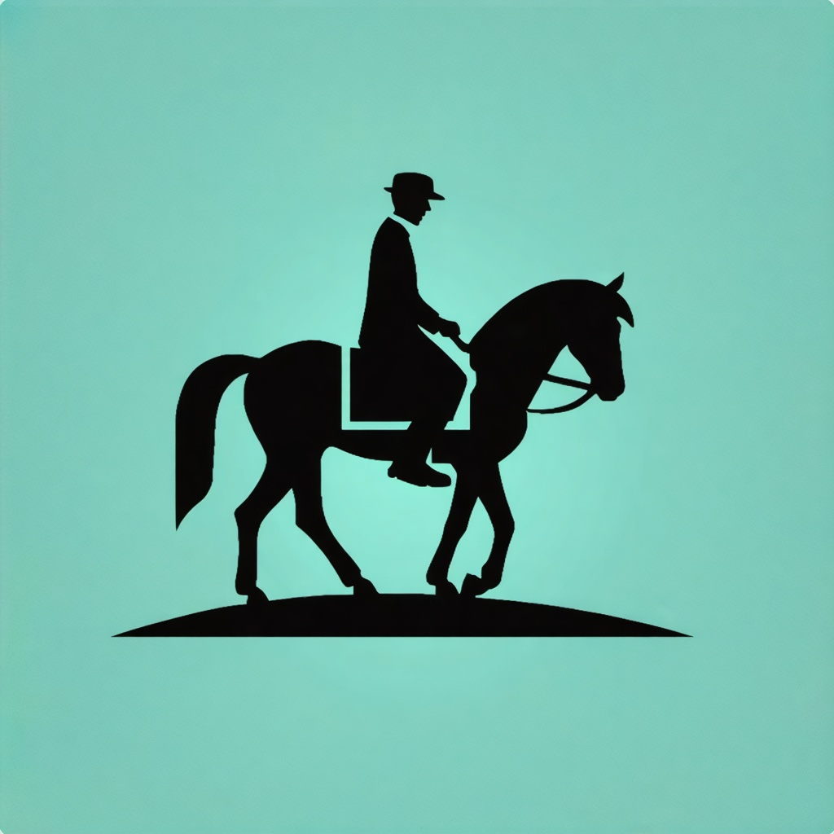

Before cars
Before AI
People rode horses
People had computers
Takes forever to get places
Information overload

Slide 4
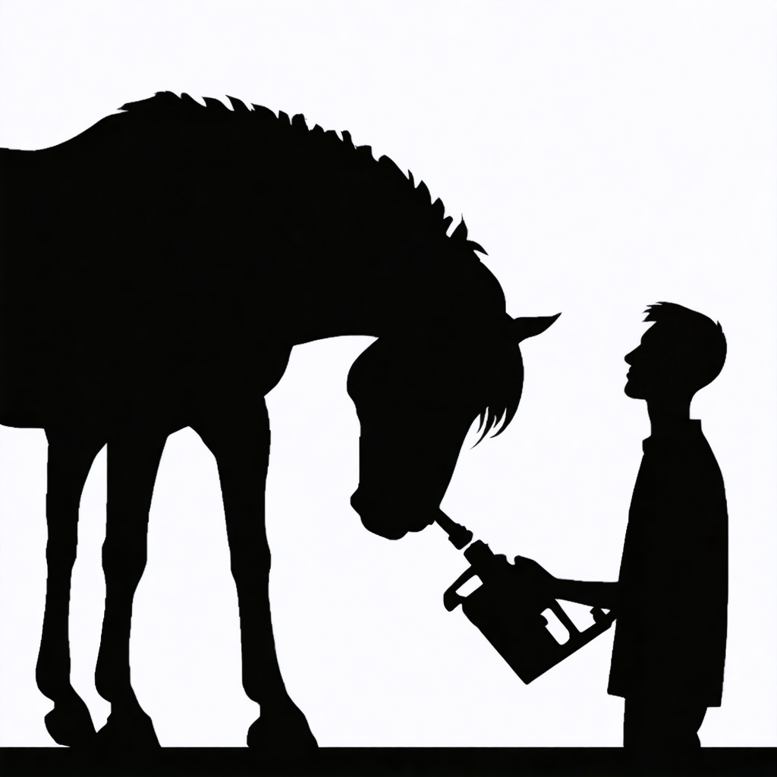

Before cars
Before AI
Processing the entire internet’s data
Feeding it new power sources
Would kill the horse
Would freeze computers

Slide 5
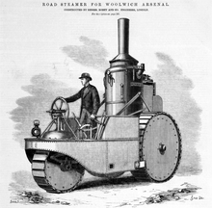
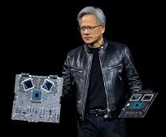

Early cars
Early AI
Engines get invented
GPU’s/Neural Nets invented
Can only go forward
Can’t pay attention (overfitting)
Basically a really fast but drunk computer
Gets stuck!

Slide 6
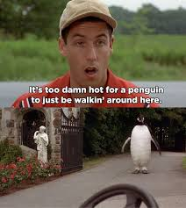
(Machine Learning)
Early Cars:
Early AI
Engines get invented
GPU’s/Neural Nets invented
Can only go forward
Easily distracted (overfitting)
Basically a really fast but drunk computer
Gets stuck!

Slide 7
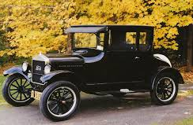


Mainstream cars
Mainstream AI
Transmissions, Steering let people control engines
Transformers let Neural Nets pay attention
Fords’s first car factory makes:
Training on the entire internet makes:
Model T
chatGPT

Slide 8
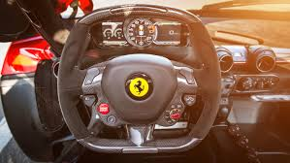

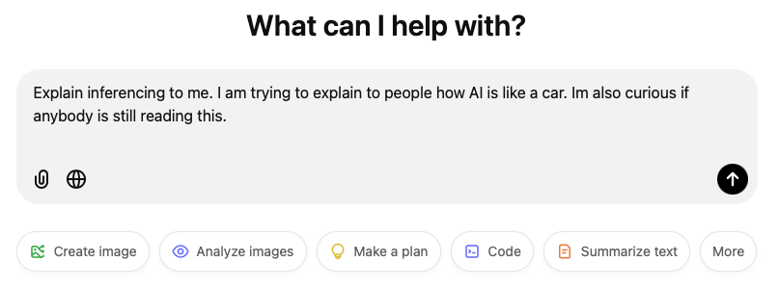
Driving a car
Using AI
Steering wheels let ordinary people drive cars
Prompts and APIs let ordinary people use AI
When you use a car it’s called
When you use AI it’s called
Inferencing
Driving

Slide 9
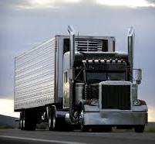
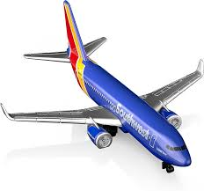
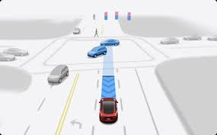
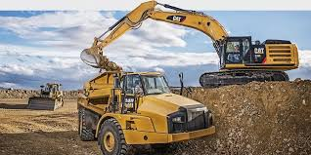
Beyond cars
Beyond chatGPT
People used controlled engines to make other valuable things
People will use transformers to make other valuable things
Cars led to
AI will lead to
The modern world
Autonomous Cars

Slide 10


Beyond cars
Beyond chatGPT
People used controlled engines to make other valuable things
People will use transformers to make other valuable things
Cars led to
AI will lead to
The modern world
Recommendation Engines
(Cheaper… Everything)

Slide 11
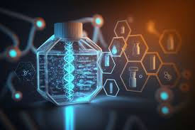
Beyond cars
Beyond chatGPT
People used controlled engines to make other valuable things
People will use transformers to make other valuable things
Cars led to
AI will lead to
The modern world
Generative Drug Discovery
(100+ year lifespans)

Slide 12
How YOU could use AI
AI = entire knowledge of humanity at your fingertips
Qualifications required:
You can read
You have grit
Build AI with AI

