Slide 1
Topcoder SRM 669, D1, 250-Pointer “SubdividedSlimes”
Nicholas Creech
EECS Department
University of Tennessee
COSC 494
October 7, 2021

Slide 2

The Problem
Given a starting slime of integer size S
Each round, cut a slime (size > 1) in two to gain points
Make cut (S = x + y ) and gain (x * y ) points
S
x
y

Slide 3
The Problem: Example
Score example:
Round = 0
Score = 0
5

Slide 4
The Problem: Example
Score example:
Round = 1
Score += (3 * 2) = 6
5
3
2

Slide 5
The Problem: Example
Score example:
Round = 2
Score += (1 * 1) = 7
5
3
2
1
1

Slide 6
The Problem: Example
Score example:
Round = 3
Score += (2 * 1) = 9
5
3
2
2
1
1
1

Slide 7
The Problem: Example
Score example:
Round = 4
Score += (1 * 1) = 10
5
3
2
2
1
1
1
1
1

Slide 8
Full Problem Statement
Given a starting slime of size S and a target score M
What is the minimum C cuts (or rounds) that will result in a score of at least M ?
S
?
?

Slide 9
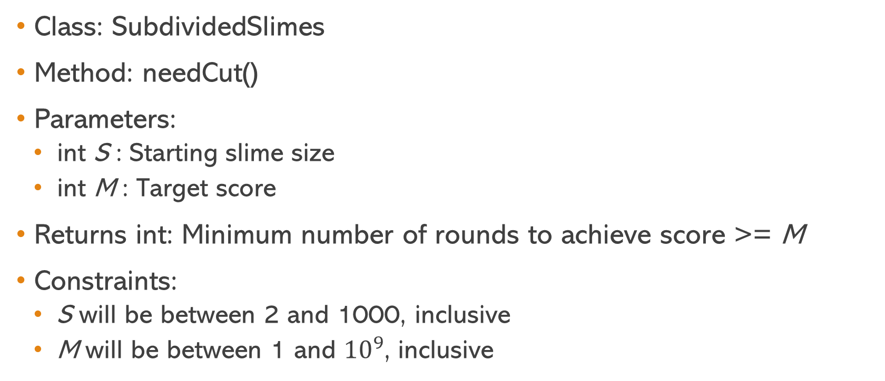
Prototype and Constraints
Class: SubdividedSlimes
Method: needCut()
Parameters:
int S : Starting slime size
int M : Target score
Returns int: Minimum number of rounds to achieve score >= M
Constraints:
S will be between 2 and 1000, inclusive
M will be between 1 and ${10}^{9}$, inclusive

Slide 10
Dr. Plank’s Hints
Suppose you make two cuts as shown
Score = a(b+c) + bc =
ab + ac + bc
S
a
b+c
b
c

Slide 11
Dr. Plank’s Hints (cont.)
Suppose you make two cuts as shown
Score = a(b+c) + bc =
ab + ac + bc
Now suppose you make two cuts as shown
Score = b(a+c) + ac =
ab + ac + bc
Score will be the same regardless of cut order!
S
b
a+c
a
c

Slide 12
Dr. Plank’s Hints (cont.)
Implication?
Allows a recursive approach where we cut S into two slimes:
One that won’t be cut (A )
One that will continue to be cut (S – A )
S
A
S - A
Continue recursion

Slide 13
Recursive Solution
Define function MX(S, C ) to be max score you can get from a starting slime of size S and C or fewer cuts
Focus on only one slime of the resulting cut
If cutting a slime of size S creates two slimes of size A and S – A, the resulting score will be A(S – A) + MX(S – A, C – 1)
S
A
S - A

Slide 14
Recursive Solution (cont.)
Do this for all possible A cut sizes and you will have the return value of MX(S, C )
Then, call MX() for every possible C value and if MX(S, C ) >= M then the answer to the problem is C cuts (or rounds)!
S
A
S - A

Slide 15

Not Quite Finished
This solution alone is simply too slow
Works fine on small test cases
Does not work well enough for the Topcoder constraints!

Slide 16
Some Optimizations (Plank’s Hints II)
1. Since cut order doesn’t matter, only check A values in MX(S, C ) from 1 to S / 2 (inclusive)
Why? Example (A, S – A) pairs for S = 5:
(1, 4), (2, 3), (3, 2), (4, 1)
Reflection about midpoint
2. If you increase A and A(S – A) + MX(S – A, C – 1) is less than it was for A – 1, then you’re done. You can never improve on the score.

Slide 17
Some Optimizations (cont.)
3. Biggest improvement: Use dynamic programming!
Cache the return of MX(S, C ) for each S and C pair in an unordered map
Removes a lot of unnecessary calculations and lookup is O(1)

Slide 18
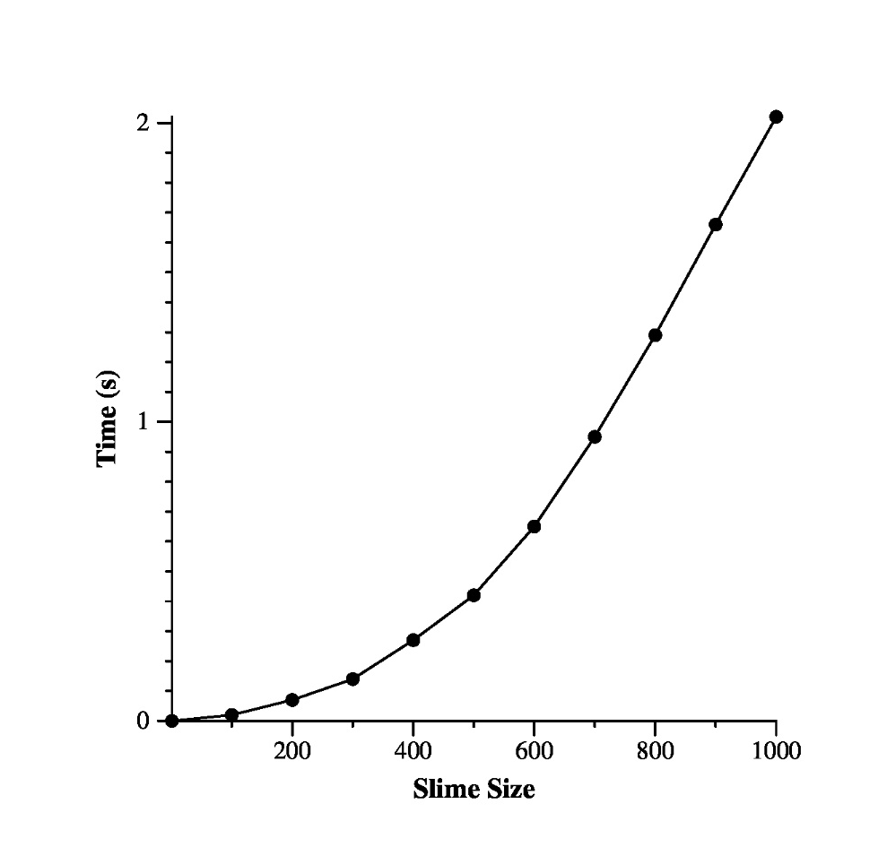
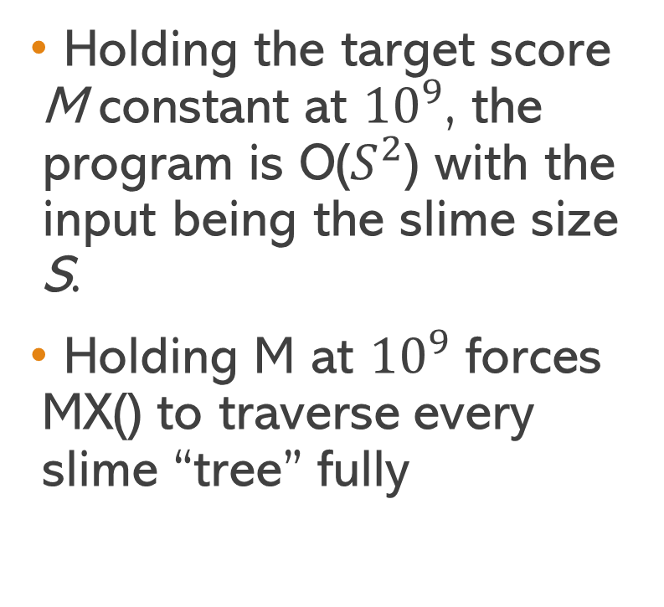
Running Time
Holding the target score M constant at ${10}^{9}$, the program is O($S^{2}$) with the input being the slime size S.
Holding M at ${10}^{9}$ forces MX() to traverse every slime “tree” fully

Slide 19
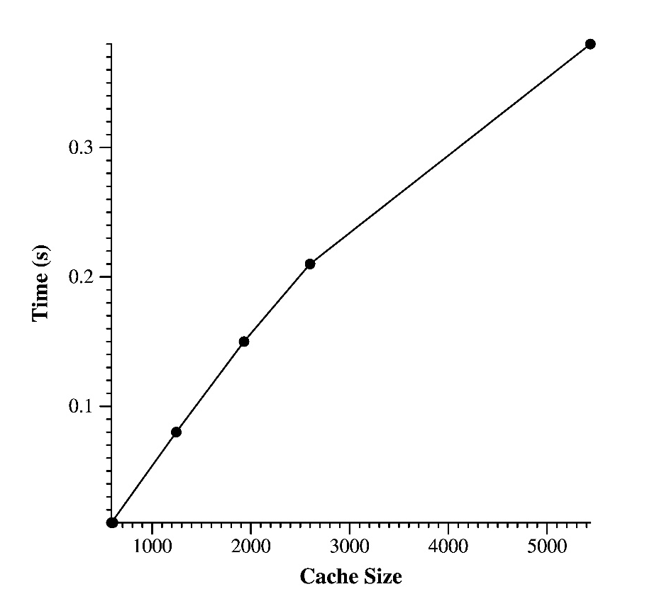
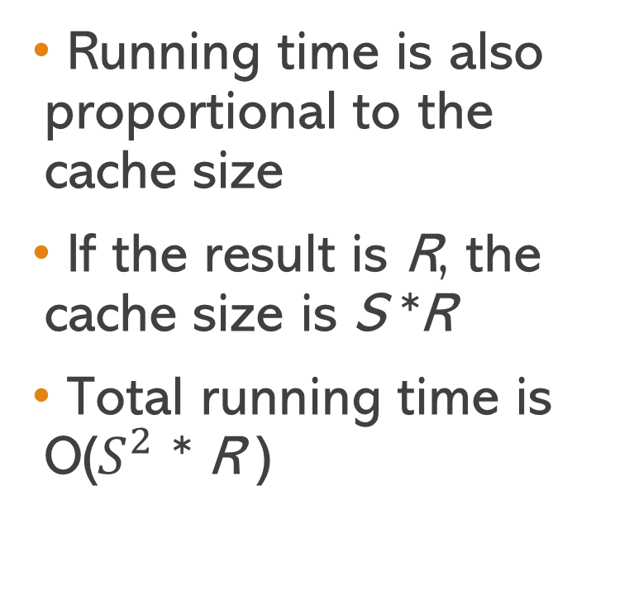
Running Time
Running time is also proportional to the cache size
If the result is R, the cache size is S *R
Total running time is O($S^{2}$ * R )

Slide 20
Machine Specs
Ran on the Hydras
Processor: Intel Core i7-6700 @ 3.40GHz (Quad Core)
Operating system: Red Hat Enterprise Linux 7
Memory: 16GB (2x8G) DDR4 SDRAM @ 2133MHz

Slide 21
Topcoder Performance
414 submitted a solution
142 (34%) of the submissions were correct
Best time was 3:51
Average correct time was 29:04

Slide 22
Topcoder SRM 669, D1, 250-Pointer “SubdividedSlimes”
Nicholas Creech
EECS Department
University of Tennessee
COSC 494
October 7, 2021

