Slide 1
Collaborative Editing of DDI Metadata:
The Latest from the CED²AR Project
Benjamin Perry, Venkata Kambhampaty, Kyle Brumsted, Lars Vilhuber, William C. Block

Slide 2
What is CED²AR?
Funded by NSF grant #1131848
Lightweight, DDI driven web application
Designed specifically for custom DDI schema
Enables search and browsing across codebooks
Provides an open API for developers
Online at www2.ncrn.cornell.edu/ced2ar-web
Notes:
--Five year NSF grant – focused on providing metadata for confidential datasets accessible in a structured fashion
-Goal build ddi browser for researchers not familiar with metadata standards
-Create a lightweight, tool that works cross platform, online or offline
-Needed for our custom DDI schema that facilities the release of confidential datasets and their metadata
Features
-Allows users to search and browse across DDI-C files with a focus on variables
-Provides a RESTful API for developers
-Provide documentation and training to educate users

Slide 3
The Challenge
Infrastructure required a simple DDI editor
Researchers not familiar with XML and DDI
Metadata was not being preserved
Notes:
-No support for simple edits to DDI
--much more powerful ddi editors existed, but were much larger and more complex solutions
--Researchers (NOT DATA CUSTODIANS/LIBRARIANS) not comfortable working with XML directly, most of their metadata was generated from conv. Scripts
-trying to edit
--Already difficult to encourage our users to produce metadata
-Too much manual intervention and time spent curating metadata
-No way to track changes over time with existing practices

Slide 4
The Solution
Build from existing application
Keep lightweight infrastructure
Automate as much as possible
Prevent steep learning curve
Notes:
-Create a solution which works inside existing web application
--Kept things accessible by maintaining zero install and fast setup
---under 10 minutes
--Kept application cross platform - optimized for desktop, but scales down to tablet and phone
-Automate as much as possible
-Create flexible system scale to our users technical abilities

Slide 5
Current Architecture
Server Instance
Desktop Instance
Tomcat 7 Server
JAR file
Web
Application
Web
Application
Database
Database
Notes:
-Currently, CED2AR runs two ways: on a server or as a desktop application
-Very similar look and feel, either setup is controlled through an internet browser
-Same backend – code is almost identical
-Very few requirements - java 7, tomcat 7. common for most server environments
-The motivation for a local version was two fold:
--Give users a sandbox environment to test ced2ar
--Providing offline functionality for restricted access environments
--Offloads the responsibility of security to the user’s computing environment

Slide 6
Additions to Architecture
3rd Party Authentication
Web Application + Editing Forms
or
Internal Authentication
Database
Local
Repo
Remote Repo
Notes:
-Keeping the existing web application, add editing forms
-Allow for external or internal authentication
-Version codebooks into source code repository, automatically schedule replication
-Have the same functionality regardless of whether ced2ar runs online or offline

Slide 7
Process
User logs into CED²AR
User uploads sparse DDI
CED²AR validates and cleans DDI
Users edit codebooks
Git passively versions edits
(optional) Changes are pushed to remote location
Notes:
-User authenticates
-User uploads partially complete DDI
--They start with a dataset in SAS, STATA, or R, convert it to DDI
--has values and variables, but little information on
-CED2AR validates the DDI, cleans up xml
-Users access web forms to collaboratively edit codebooks
-Everytime an edit is made, Git versions the changes
-Changes are pushed to a remote location on a scheduled basis, or triggered at a threshold of changes

Slide 8

1. Authentication
Support OpenID and OAuth2
  Currently configured to use Google/OAuth2
CED²AR handles identity management
Notes:
-CED2AR has the framework to OpenID and OAuth
-Currently, we are using Google with OAuth as a provider
-Identity management is defined within CED2AR. This includes permissions, roles, local user information, etc.
- Possibility to obtain permissions, roles from external system (LDAP) [planned]

Slide 9
2. Uploading and Ingest
Validates against DDI 2.5 schema
Inserts dates, citations, software references, etc.
Indexes and assigns codebook internal handle
Notes:
-Validation is done against DDI 2.5 schema or our modified DDI 2.5 schema
-CED2AR updates XML with dates, citation, and software used
-CED2AR then indexes the codebook and assigns it an internal handle, giving the codebook a unique URI for the CED2AR instance.
-Can later be linked to a digital object identifier.

Slide 10
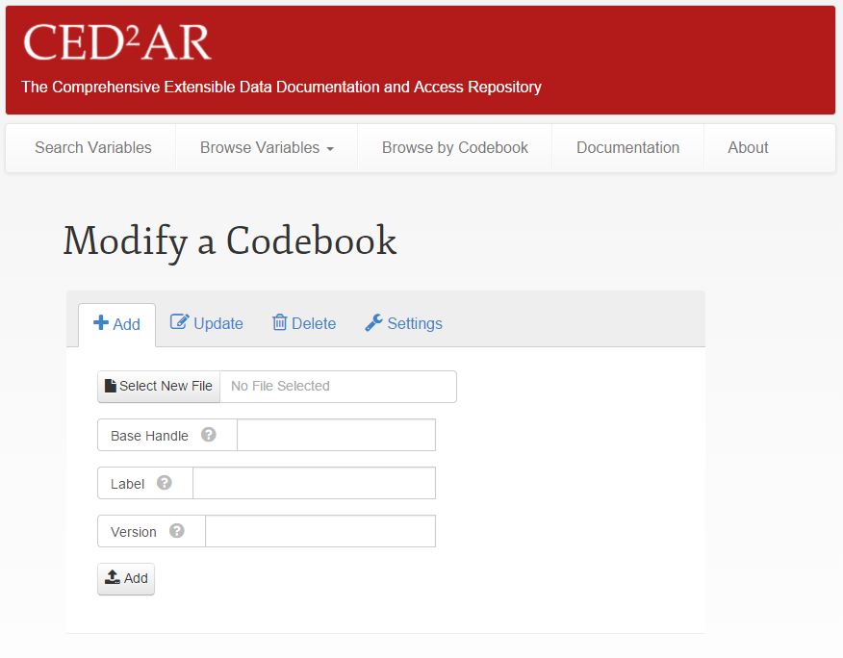
2. Uploading and Ingest
Notes:
-Entire uploading process can done through a user interface, or via the API allowing developers to batch entire directories into the upload queue.

Slide 11
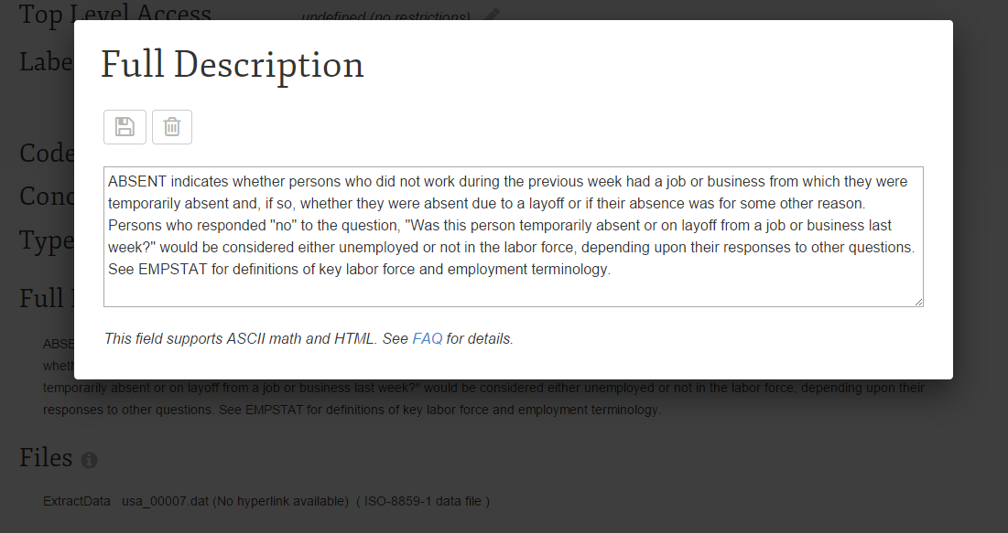
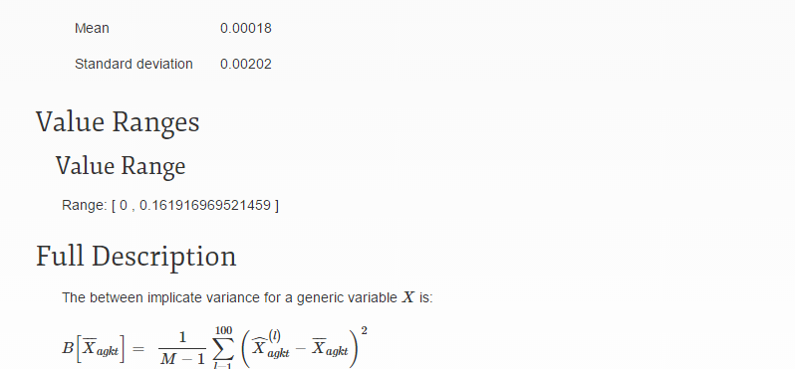
3. Editing Process
User searches or browses
Web forms provide control over content
CED²AR supports basic HTML and ASCII math
Notes:
-User can search or browse for a variable
-CED2AR supports inserting basic HTML and ASCII Math
--ASCII math is similar to LATEX, and allows for displaying mathematical equations without modifying the ddi schema
--Readable in plain text, but enhanced through ced2ar’s rendering

Slide 12
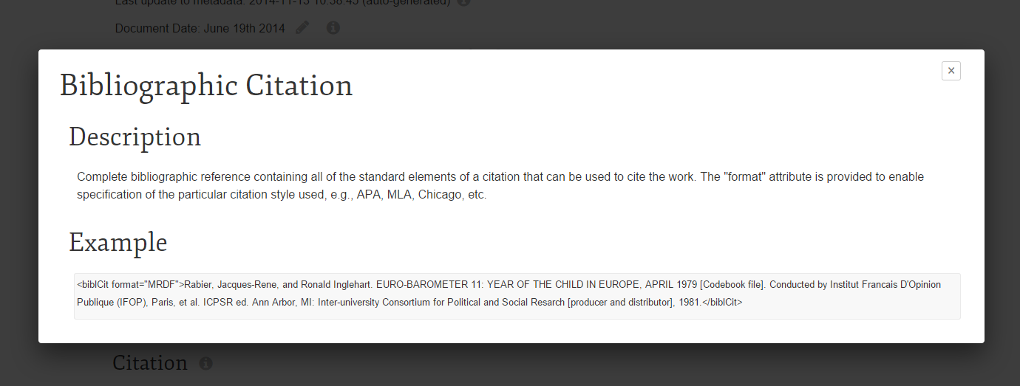
4. Editing Process
Built in documentation
Notes:
-Configuration of CED2AR driven by schema which defines some the inline help.
-Explanation of DDI fields is directly pulled from XSD HTML

Slide 13
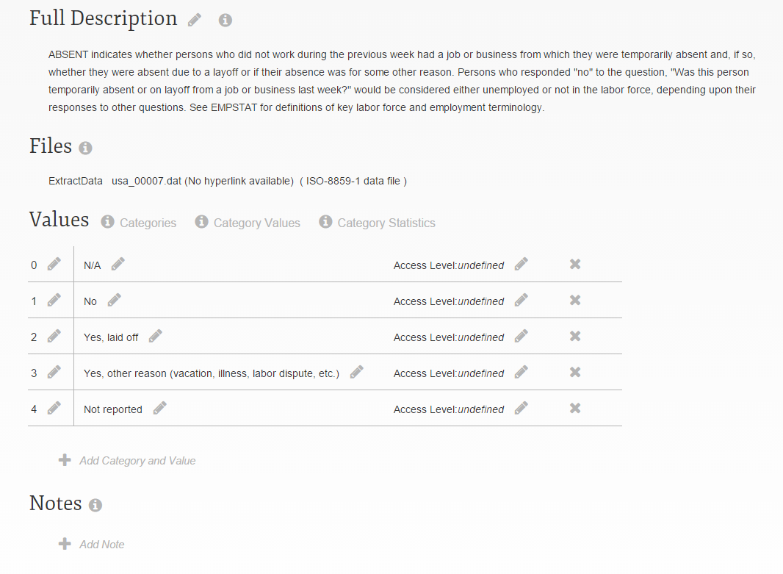
4. Editing Process
Editing a variable
Notes:
-Can edit one variable at a time
-Can specify access levels at sub variable level [THIS IS THE SMALL BUT IMPORTANT MODIFICATION TO THE DDI-C schema that we developed]

Slide 14
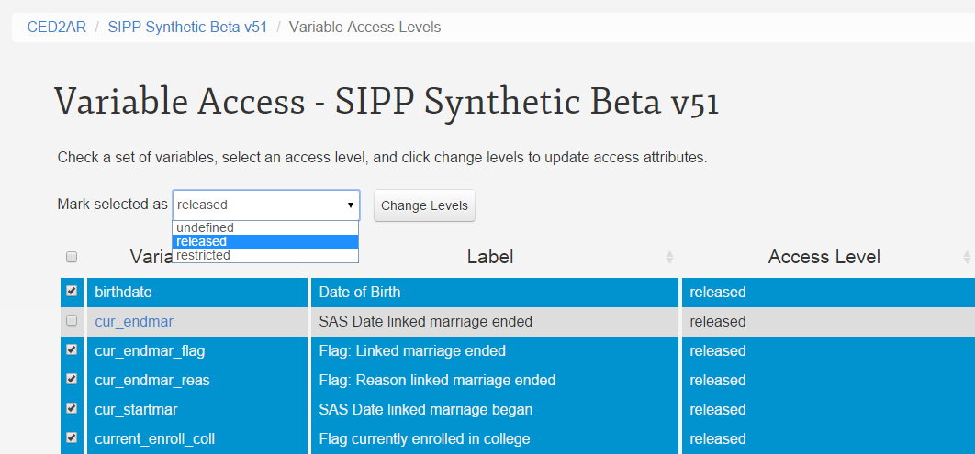
4. Editing Process
Control over multiple access levels
Notes:
-Or multiple variables at once
-By default, access levels are not defined when codebooks are INITIALLY added to CED2AR so users are forced to review
- Configuration is currently set so that only an explicit access level can be exported

Slide 15
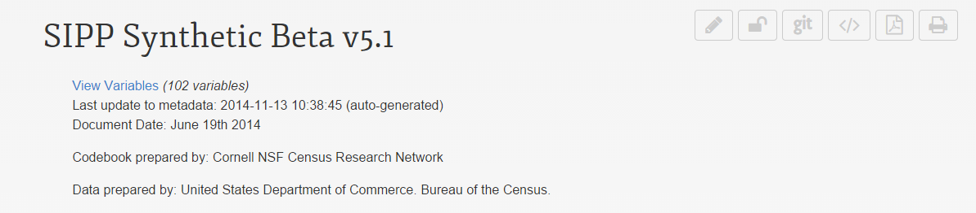
5. Versioning
Uses Git, a distributed version control system
Scheduled tasks check for changes
Once changes exceed threshold, they are pushed
Pending changes are pushed after a time limit
Notes:
So far, I've described the basic setup of the system. Now to the key backend innovation that prepares the ground for much broader scaling, while maintaining the lightweight and standards-based approach.
-Git is a distributed version control system
--Distributed meaning there is no central repository
-Git is scheduled to run in the background, regardless of the users’ actions
-Changes are documented within DDI

Slide 16
6. Remote Location
Our implementation uses Bitbucket
Commit messages describe changes
Users linked by email address
Commit hashes are stored on CED²AR
Notes:
Finally, to fully enable wide-area collaboration, we push the changes to a “remote” location
- OPTIONAL (if absent, work in a sandbox)
-Changed synchronized with cloud based repository
- Any server-based Git system
– we currently use BitBucket.com
– could also be github.com, or self-hosted
-Changes are available to view or download online INDEPENDENTLY OF CED²AR or other specialized software
-Each commit is a compilation of changes
--Within the commit message, user’s edits are referenceable by unique elements in DDI and their email address

Slide 17
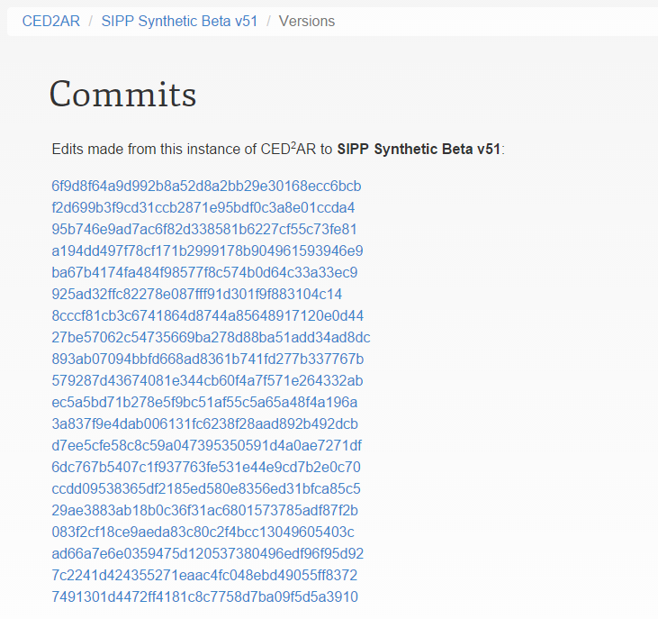
6. Versioning
Viewing version history
Notes:
-We keep track of commits made from a specific instance locally in CED2AR-
defined variable or codebook level
-commits are id’d by a unique hash

Slide 18
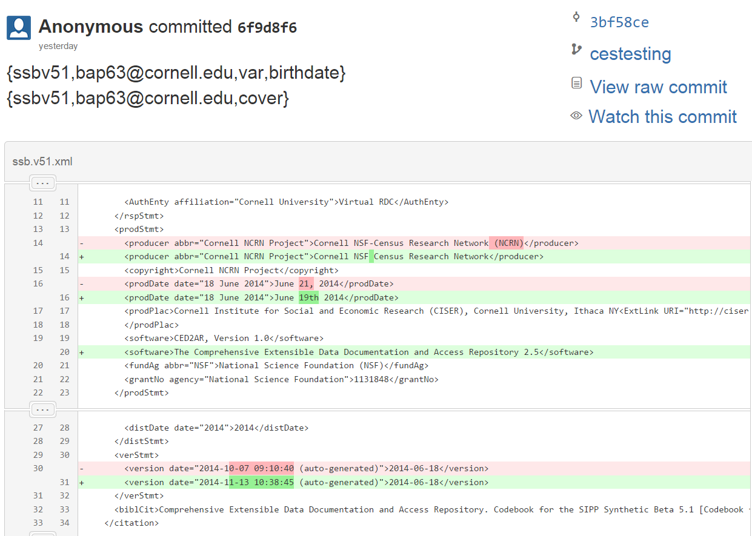
6. Remote Location
Notes:
Remote repository could be cloud based, local, or even offline
User has the possibility to disable remote pushes

Slide 19
Use Case
CED²AR Server Instance
Remote Repo
CED²AR Desktop Instance
CED²AR Desktop Instance
Notes:
-Users from multiple CED2AR instances can all interact with the same repo
-Users can use the version control software to take work offline
-Multiple users can be working on the same codebook

Slide 20
Future Work
Focusing on crowdsourcing
Enhancements to our DDI editor
Open a demo up to the public
Notes:
-Next step is open this to the public
--With that comes new challenges such as moderation, registration, and…
--Still waiting on licensing to release source code
-Enhancements to DDI editor, a richer UI to create a codebook from scratch.
-release source code to the public

Slide 21
Thank you!
Questions?
ced2ar-devs-l@cornell.edu

Slide 22
Extra Slides

Slide 23
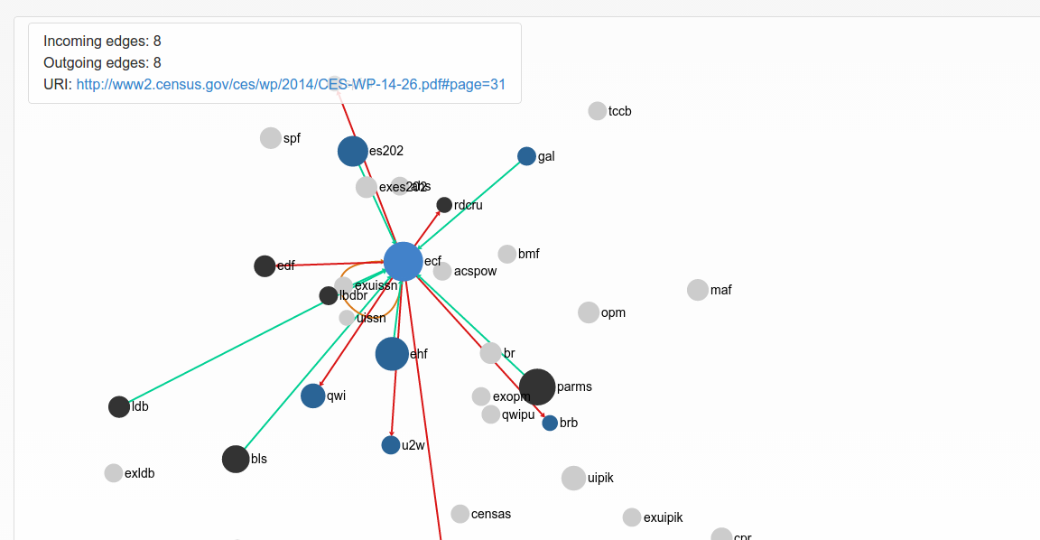
Prov

Slide 24
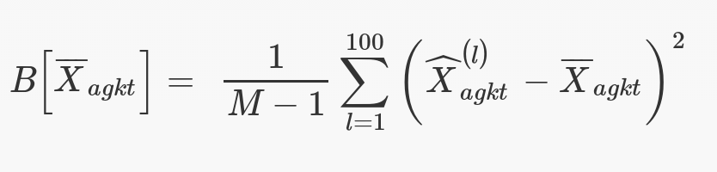
3. Editing Process
User searches or browses
Web forms provide control over content
CED²AR supports basic HTML and ASCII math
`B[\bar{X}_{agkt}] =\ 1/(M-1)sum_{l=1}^{100}(\hat{X}_{agkt}^{(l)} - \bar{X}_{agkt})^2`

