Slide 1
Formal Privacy Protection for Data Products Combining Individual and Employer Frames
John M. Abowd
December 14, 2015
Joint work with Matthew Graham, Samuel Haney, Mark Kutzbach, Ashwin Machanavajjhala, and Lars Vilhuber
Notes:
This work was done jointly with Samuel Haney at Duke University and the Census Bureau, Matthew Graham and Mark Kutzbach at the Census Bureau, Ashwin Machanavajjhala at Duke University, and Lars Vilhuber at Cornell University.

Slide 2
Disclaimer and Acknowledgments
Any opinions and conclusions expressed herein are those of the authors and do not necessarily represent the views of the U.S. Census Bureau. All results have been reviewed to ensure that no confidential information is disclosed.
Machanavajjhala acknowledges support from NSF grants 1253327, 1408982, and 1443014.
Abowd acknowledges direct support from NSF grants BCS-0941226 and TC-1012593.
Abowd and Vilhuber acknowledge support from NSF grant SES-1131848.
This paper was written while Abowd was visiting the Center for Labor Economics at UC-Berkeley.
Notes:
These are the standard disclaimer and acknowledgments. (PAUSE)

Slide 3
Background/Motivation
Currently, the Census Bureau releases the LEHD Origin-Destination Employment Statistics (LODES).
In protecting confidentiality of workers and firms, LODES utilizes:
Permanent multiplicative noise distortion factors at the employer and establishment level (plus synthetic data methods for small cells) for employment counts.
Synthetic data methods using probabilistic differential privacy for residential location.
Research goal: Develop a formal provably private protection method based on differential privacy to replace the noise distortion factors.
Notes:
First some brief background. In this research we worked with the LEHD Origin-Destination Employment Statistics (or LODES), which is an annual dataset connecting workers, jobs, and firms that is released by the U.S. Census Bureau.
On the employment side, the current protection technology uses multiplicative noise distortion factor at the employer and establishment levels along with synthetic methods for small cells. On the residence side, the current technology uses synthetic methods with probabilistic differential privacy.
Our motivation is to develop a formal provably private confidentiality protection method for employment counts by borrowing existing technology from the Computer Science literature and adapt that technology to the specific needs and constraints of a statistical data product.

Slide 4
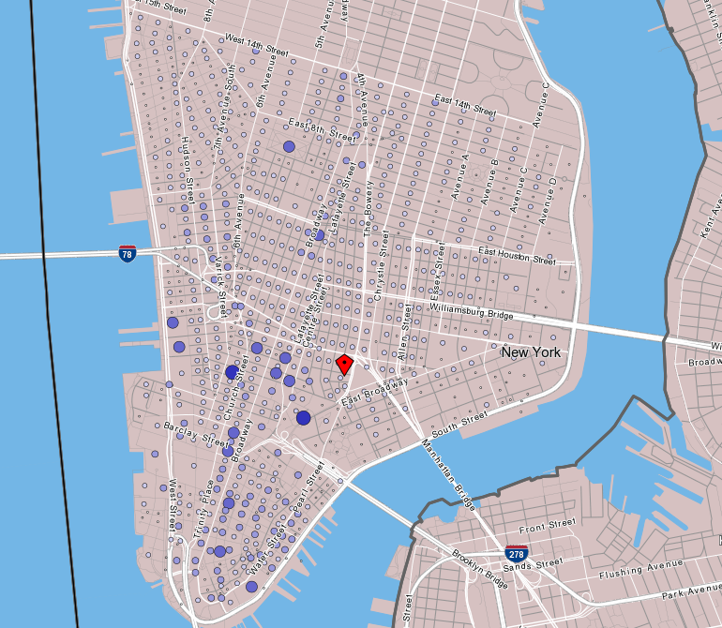
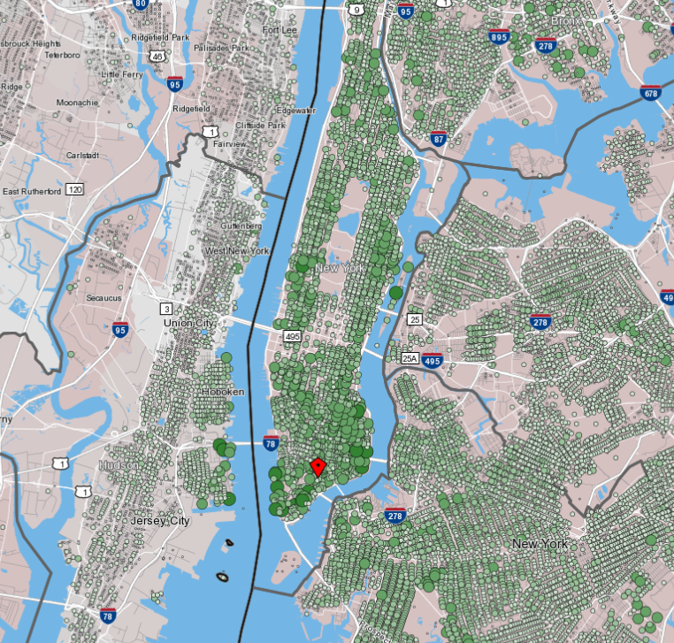
Existing LODES Data in OnTheMap Application
Employment in Lower Manhattan
Residences of Workers Employed in Lower Manhattan
Available at http://onthemap.ces.census.gov/
Notes:
The “origin-destination” part of the dataset refers to the connections between home locations and work locations. For some sense of scale, the dataset covers about 128 million jobs held by 119 million workers in 6.2 millions firms with 7.6 million establishments.
As a concrete reference, here are some images of mapped LODES data from the public OnTheMap web application, one of the major portals in which users can access the LODES data.
The map on the left shows the employment in Lower Manhattan by census block. Larger darker dots are more employment.
The map on the right shows the residential pattern of these same workers by census block. As we know, workers employed in lower Manhattan live well beyond its boundaries including in other boroughs and other states.

Slide 5
Other Federal Statistical Products with Establishment Frames
Census Bureau:
Quarterly Workforce Indicators (QWI)
County Business Patterns (CPB)
Business Dynamics Statistics (BDS)
Economic Censuses (EC)
Bureau of Labor Statistics:
Quarterly Census of Employment and Wages (CEW)
Current Employment Statistics (CES)

Slide 6
Protection of Establishment Data
QWI and CBP use similar input noise distortion methods (LODES and QWI use the same input distortion method except for cells with very small employment counts)
BDS, EC, CEW, and CES use primary/complementary suppression

Slide 7
Limitations of Current Methods
Neither input noise distortion nor suppression has provable confidentiality protection against an arbitrary user/attacker
Suppression, when used each release period on tables of the same structure, can be very substantially compromised by sophisticated spatial-temporal models (see Holan et al. JASA 2010)
Noise infusion can be substantially compromised when employment counts in a cell are small

Slide 8
Goals of New Protection System
It should answer marginal queries (employment count) over protected characteristics (e.g. sex, age, race)
It should use algorithms that have provable privacy guarantees for both individuals and employer businesses
It should perform comparably to the existing system in terms of data quality
Notes:
With provable privacy protection in place on the residence side of the dataset, our general research was focused on developing a provable privacy approach to replace the existing employment protections.
As such, we expect to continue to make marginal employment count queries over protected attributes. Any protection algorithm should protect both individuals and firms. And any new method should be comparable in quality to the existing protection system.

Slide 9



Differential Privacy (DP)
The output of a DP algorithm should be insensitive to:
The addition/removal of 1 individual, or
The addition/removal of 1 establishment.
Neighbors
Neighboring datasets differ in 1 entry:
$$D_{1}$$
$$D_{2}$$
$$\left|D_{1}\backslash D_{2}\right|=1$$
Notes:
More formally, differential privacy says that an algorithm used to protect the data should give the same result (statistically speaking) if we add or delete a single person from the database and give the same result if we add or delete a single establishment from the database.
In the context of differential privacy, it is useful to talk about the concept of neighbors, which are datasets that differ by one entry.
In this case, D1 has one additional entry that D2 does not (the red, hashed ball). And so D1 and D2 are neighboring datasets.

Slide 10

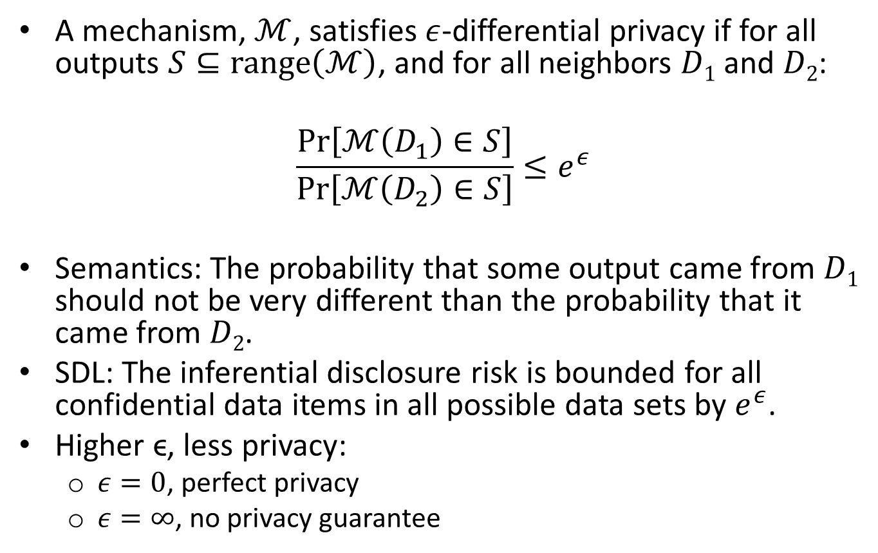
$ε$-Differential Privacy
A mechanism, $ℳ$, satisfies $ε$-differential privacy if for all outputs $S⊆\text{range}\left(ℳ\right)$, and for all neighbors $D1$ and $D2$:
$$\frac{Pr⁡\left[ℳ\left(D_{1}\right)∈S\right]}{Pr\left[ℳ\left(D_{2}\right)∈S\right]}≤e^{ε}$$
Semantics: The probability that some output came from $D1$ should not be very different than the probability that it came from $D2$.
SDL: The inferential disclosure risk is bounded for all confidential data items in all possible data sets by $e^{ε}$.
Higher ϵ, less privacy:
$ε=0$, perfect privacy
$ε=∞$, no privacy guarantee
Notes:
Given some protection algorithm, M, that satisfies differential privacy, we can say the following about these neighboring datasets:
The probability that the some output was produced from dataset D1 should not be too different than the probability that the output was produced from datasets D2.
The ratio of these probabilities is bounded by e^epsilon, where epsilon is a privacy parameter, which ideally is “not too large”. Higher epsilon is less privacy epsilon=0 is perfect privacy. Infinite epsilon is no privacy. The bound can also be stated in terms of the Bayes factor of what is learned about any confidential element given the released data v. what was known before. This is called bounded inferential disclosure in the SDL literature.

Slide 11
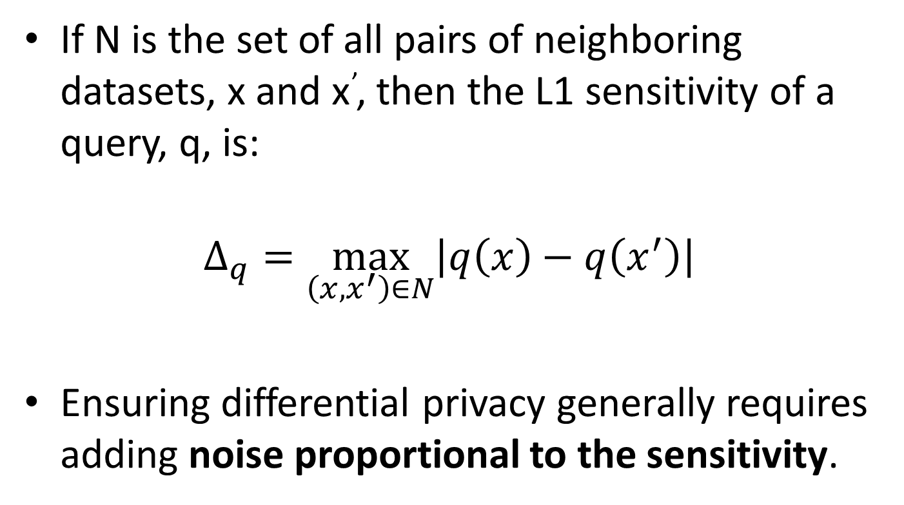
Sensitivity
If N is the set of all pairs of neighboring datasets, x and x’, then the L1 sensitivity of a query, q, is:
$$Δ_{q}=\max_{\left(x,x^{′}\right)∈N}\left|q\left(x\right)−q\left(x^{′}\right)\right|$$
Ensuring differential privacy generally requires adding noise proportional to the sensitivity.
Notes:
As we discuss algorithms that meet the requirements of differential privacy, we will utilize the concept of sensitivity, which is the maximum difference between two queries over all sets of neighboring databases. To guarantee differential privacy we need to add noise to queries that is proportional to the sensitivity.

Slide 12
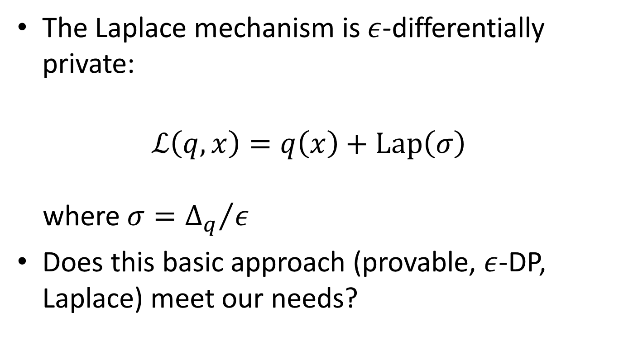
Laplace Mechanism
The Laplace mechanism is $ε$-differentially private:
$$ℒ\left(q,x\right)=q\left(x\right)+\text{Lap}\left(σ\right)$$ where $σ={Δ_{q}}/ε$
Does this basic approach (provable, $ε$-DP, Laplace) meet our needs?
Quality!
Notes:
One simple, differentially private mechanism that we considered is the Laplace mechanism, which adds noise to the numerical true query result q(x). The noise is drawn from the Laplace distribution with mean 0, scaled by the sensitivity over epsilon.
But does this “off the shelf” approach to a protection system meet our specific needs? We’ll answer this question by looking at the data quality.

Slide 13
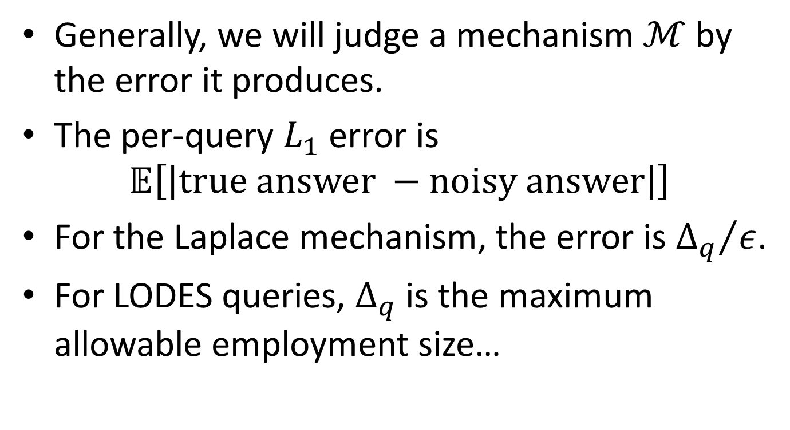
Measuring Data Quality
Generally, we will judge a mechanism $ℳ$ by the error it produces.
The per-query $L_{1}$ error is
$$𝔼\left[\left|\text{true} \text{answer} −\text{noisy} \text{answer}\right|\right]$$
For the Laplace mechanism, the error is ${Δ_{q}}/ε$.
For LODES queries, $Δ_{q}$ is the maximum allowable employment size…
Notes:
In general, we’ll judge the goodness of a mechanism by measuring the error it generates. And specifically, we will use the L1 error to judge our protection mechanisms.
For the Laplace mechanism, the error can be shown to be the sensitivity over the privacy parameter, epsilon. Which is fine if we are only protecting individuals, but becomes a problem when we also want to protect establishments, because the sensitivity is the size of the largest establishment in the dataset.

Slide 14
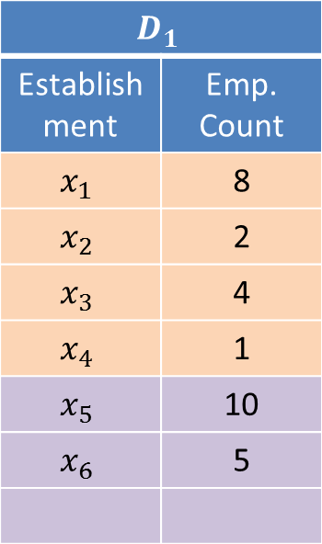
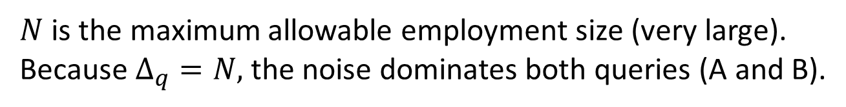
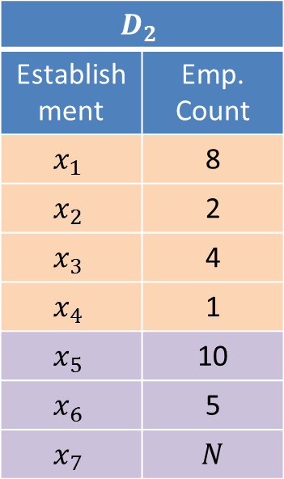
Example
$$D_{1}$$
Establishment | Emp. Count
$$x_{1 }$$ | 8
$$x_{2 }$$ | 2
$$x_{3 }$$ | 4
$$x_{4 }$$ | 1
$$x_{5 }$$ | 10
$$x_{6 }$$ | 5
$$D_{2}$$
Establishment | Emp. Count
$$x_{1 }$$ | 8
$$x_{2 }$$ | 2
$$x_{3 }$$ | 4
$$x_{4 }$$ | 1
$$x_{5 }$$ | 10
$$x_{6 }$$ | 5
$$x_{7 }$$ | $$N$$
Query on Region A
Query on Region B
$N$ is the maximum allowable employment size (very large).
Because $Δ_{q}=N,$ the noise dominates both queries (A and B).
Notes:
An example:
D1 and D2 are two neighboring databases. We look at the same query (count of employment) on two different regions of the databases. The difference between the databases is an establishment count x7 in D2 that isn’t in D1, and its size is the maximum size of an establishment and much larger than the counts of any other establishment shown here. Because, the maximum employment count, N, is so much larger than the other counts in these queries, the answers will be dominated by noise and will be useless.

Slide 15
Problem and Solution
Problem:
The sensitivity is the maximum allowable employment
The error incurred will almost always dominate the count
Solution:
Refine the definition of neighboring databases to include datasets that are “close”.
Use the local sensitivity rather than the standard sensitivity (called global sensitivity)
These adaptations still allow provable protection
Notes:
So the problem is that the sensitivity is the maximum allowable employment in an establishment and as a result, the error/noise will dominate most queries.
Our solution (which will still be provable, differential privacy) to this problem has two parts:
We change how we define neighboring datasets. Basically, we expand the neighborhood.
We make use of local sensitivity instead of global sensitivity, which limits queries’ exposure to regions of very high sensitivity.

Slide 16
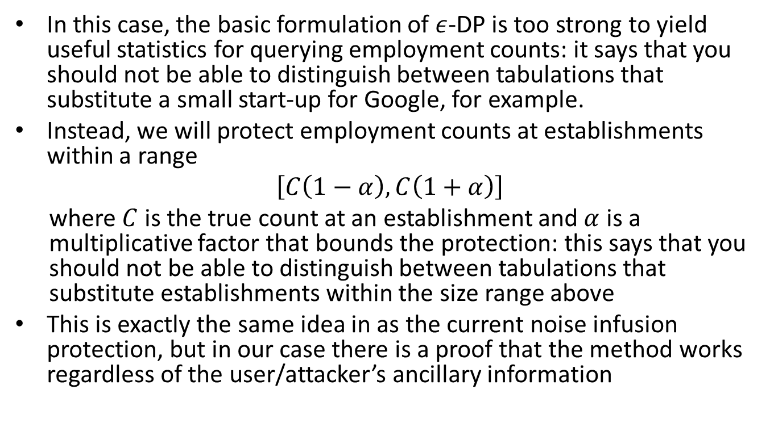
Refining the Neighbors Definition
In this case, the basic formulation of $ε$-DP is too strong to yield useful statistics for querying employment counts: it says that you should not be able to distinguish between tabulations that substitute a small start-up for Google, for example.
Instead, we will protect employment counts at establishments within a range
$\left[C\left(1−α\right),C\left(1+α\right)\right]$
where $C$ is the true count at an establishment and $α$ is a multiplicative factor that bounds the protection: this says that you should not be able to distinguish between tabulations that substitute establishments within the size range above
This is exactly the same idea in as the current noise infusion protection, but in our case there is a proof that the method works regardless of the user/attacker’s ancillary information
Notes:
To adjust this method to our situation, we protect employment counts at establishments within a range set by a multiplicative factor, alpha.
For example, if we set alpha at 10%, then we would protect the employment count at establishments between 90% and 110% of the true count.

Slide 17
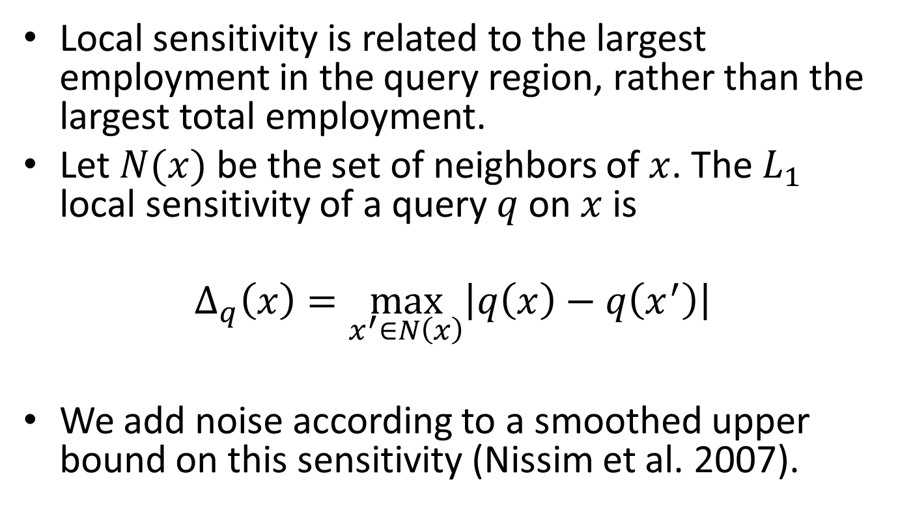
Local vs. Global Sensitivity
Local sensitivity is related to the largest employment in the query region, rather than the largest total employment.
Let $N(x)$ be the set of neighbors of $x$. The $L_{1}$ local sensitivity of a query $q$ on $x$ is
$$Δ_{q}\left(x\right)=\max_{x^{′}∈N\left(x\right)}\left|q\left(x\right)−q\left(x^{′}\right)\right|$$
We add noise according to a smoothed upper bound on this sensitivity (Nissim et al. 2007).
Notes:
Local sensitivity is defined on a dataset. Here N is the set of all neighbors of x, and the sensitivity is the maximum difference of the query between x and all its neighbors. Note that if we look at the maximum of the local sensitivity over all possible datasets, then we get the global sensitivity.
In a heterogeneous database, local sensitivity can vary widely, which is the exact feature we want to use. Instead of a single sensitivity related to the largest possible establishment for the whole dataset, we get many sensitivities that are related to the largest establishment in each region.
It is important to note that we cannot make the noise directly proportional to the sensitivity in each region because this would leak some information about the largest establishments in each region. Thus we create a smoothed upper bound of the local sensitivities based on work by Nissim et al.

Slide 18
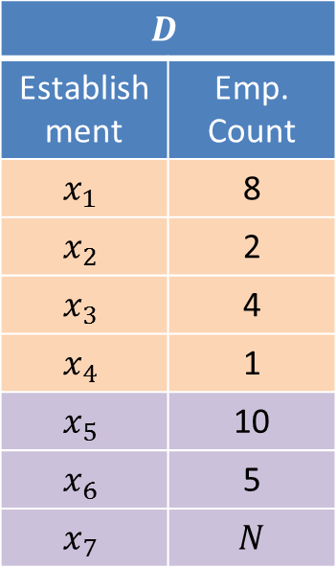
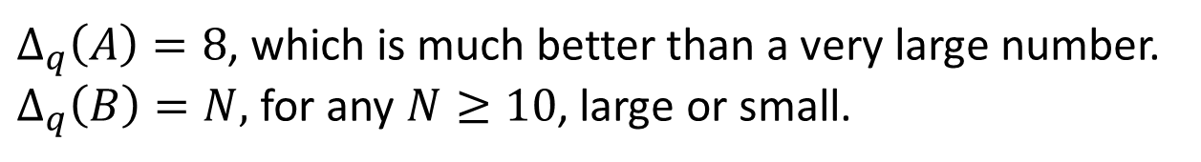
Example (Local Sensitivity)
$$D$$
Establishment | Emp. Count
$$x_{1 }$$ | 8
$$x_{2 }$$ | 2
$$x_{3 }$$ | 4
$$x_{4 }$$ | 1
$$x_{5 }$$ | 10
$$x_{6 }$$ | 5
$$x_{7 }$$ | $$N$$
Query on Region A
Query on Region B
$Δ_{q}\left(A\right)=8$, which is much better than a very large number.
$Δ_{q}\left(B\right)=N,$ for any $N≥10$, large or small.
Notes:
In this case, the local sensitivities of the query on the two regions are different. For region A, the local sensitivity is 8. And for region B, the local sensitivity is N, still assuming that N is large. If N is small, then the sensitivity for B may instead be 10 if establishment 5 is the largest one in the region.

Slide 19
Extensions (see paper)
Allow for queries on more attributes
Protect individuals under differential privacy
Investigate several different noise processes
Notes:
In our paper, we discuss the addition of more attributes (so more than just a query over a geographic region). Additionally we discuss the protection of individual under conventional differential privacy.

Slide 20
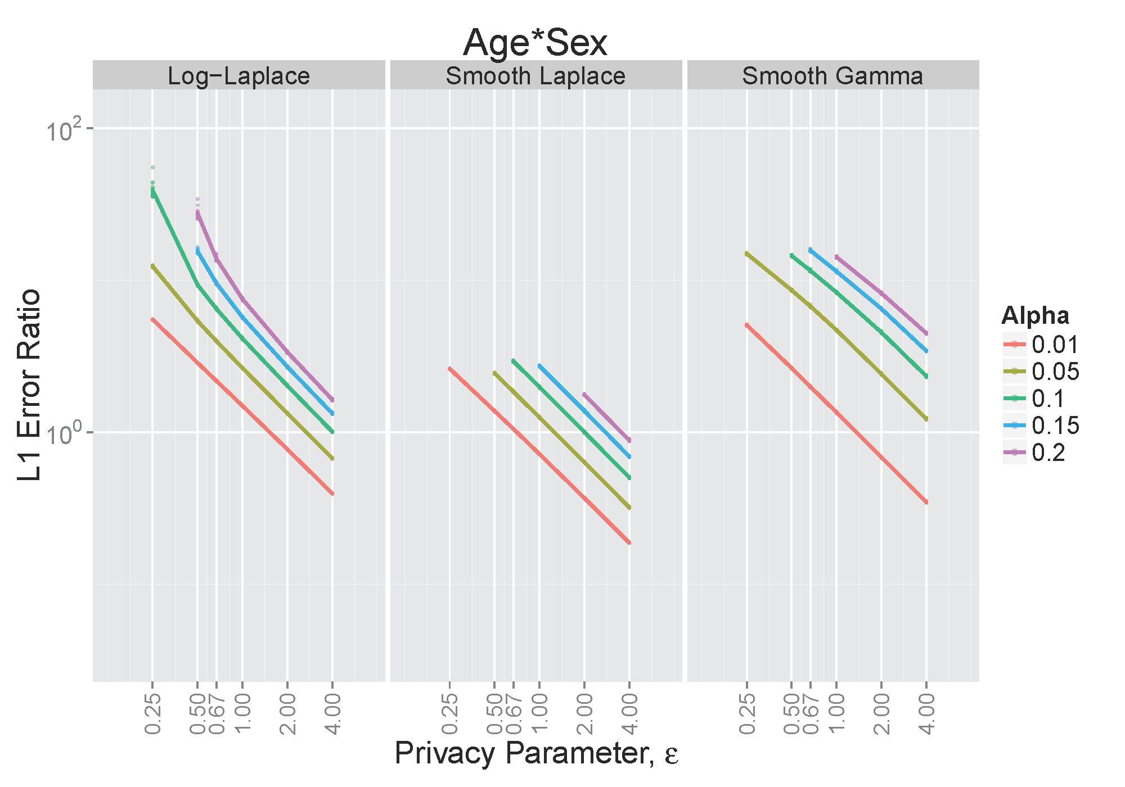
Experiments
Larger error
Lower privacy guarantee
Notes:
Lastly, I will show the result of some experiments. This is the case in which we protect counts of employment in cells defined by workplace census tract, ownership, industry (NAICS sector) – which are all public – by worker age by worker sex.
These experiments let us explore the specific tradeoffs between data quality and strength of the privacy guarantee.
Three different algorithms (Log-Laplace, Smooth Laplace, and Smooth Gamma) were used and you can read more about each of these in the paper. The x-axis is the privacy parameter, epsilon, ranging from 0.25 to 4. The y-axis is the L1 error ratio between each of these methods and the existing protection technology. And each line represents a different value of alpha, ranging from 1% to 20%. The plots are in a log-log scale.
When alpha is larger (larger neighborhood around establishment employment values), either quality is worse off (higher error ratio) or the protection is worse off (higher epsilon).
As we can see, for all methods, once we get epsilon up to around 2 (which is an odds ratio of about 7.4), the error ratio is becomes comparable.

Slide 21
Summary
We propose a system that can answer marginal queries of employment count over establishment and individual attributes with error comparable to existing protections, while providing provable protection to both establishments and individuals.
Questions?
Notes:
To summarize: with this research we propose a system that can answer marginal queries over attributes of both the establishment and the individual, while providing provable protection to both establishments and individuals. In addition, we do this in a way that produces comparable L1 error to the existing protection system.

