Slide 1
Health Assessment with RPA And CP4A
Nigel T. Crowther
3 March 2022

Slide 2

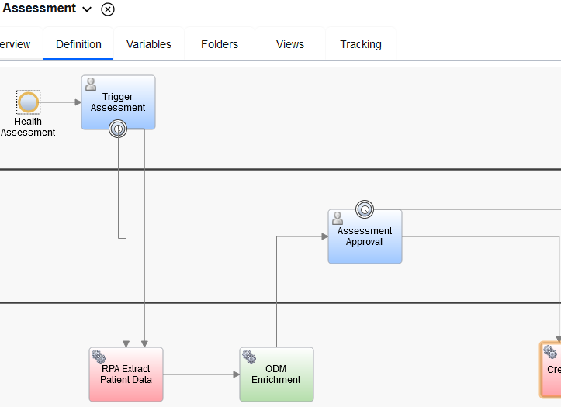
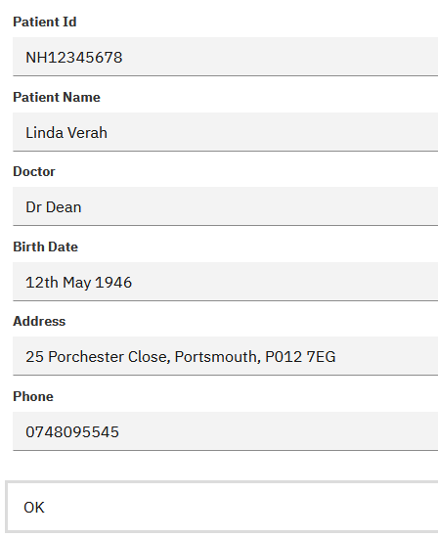
Trigger Assessment
Enter Patient

Slide 3
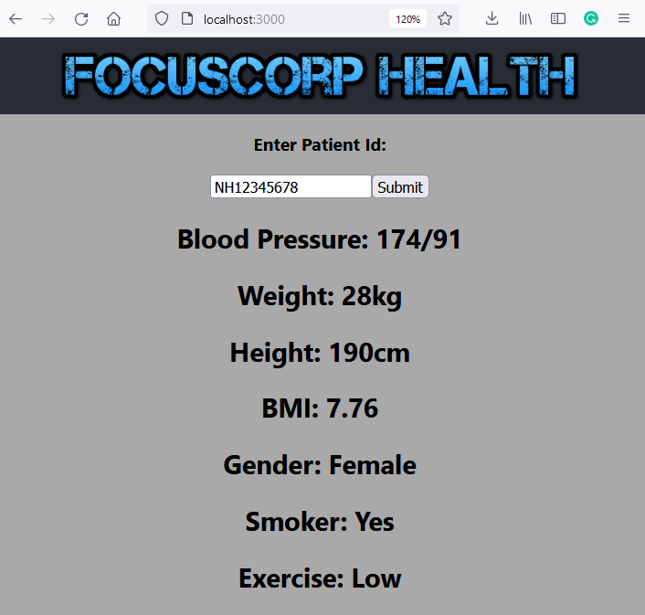

Trigger Assessment

Slide 4
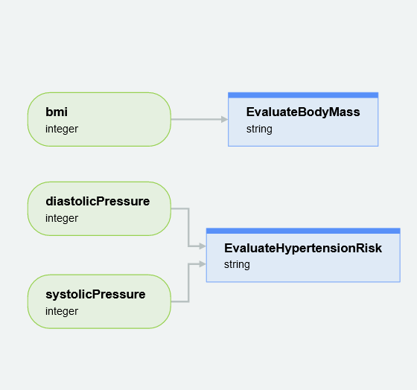

Trigger Assessment
Enrich Patient
Assessment

Slide 5
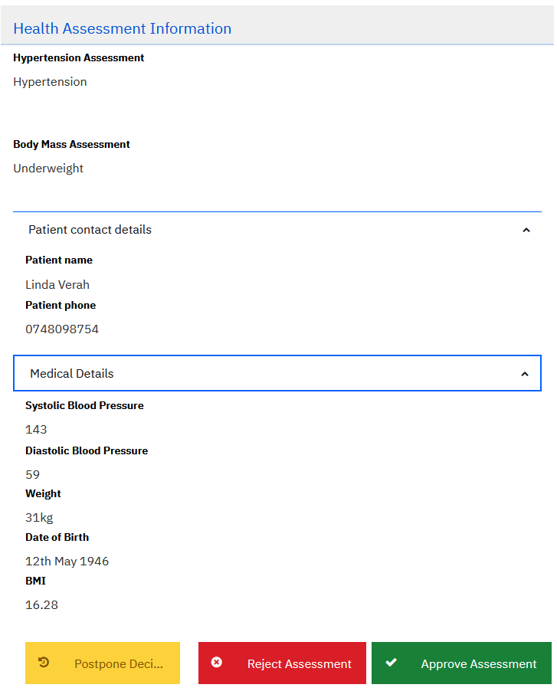
Trigger Assessment

Slide 6
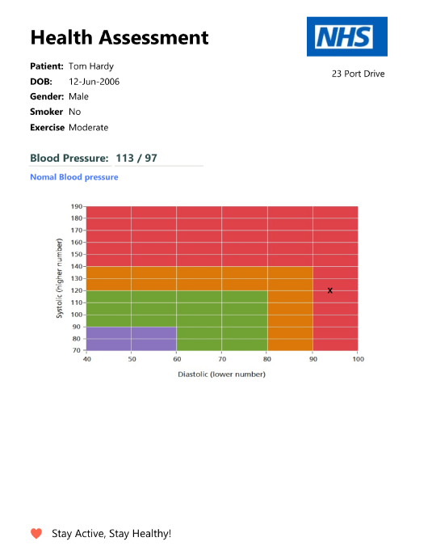
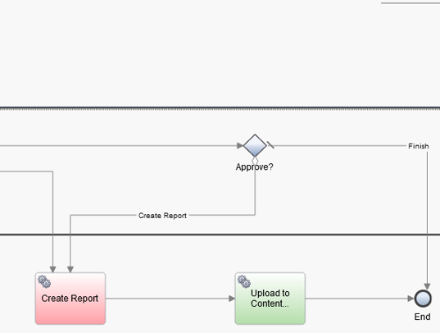
Trigger Assessment

Slide 7

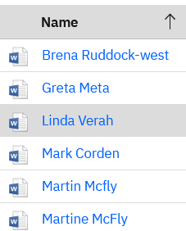
Trigger Assessment
Content
Navigator

Slide 8
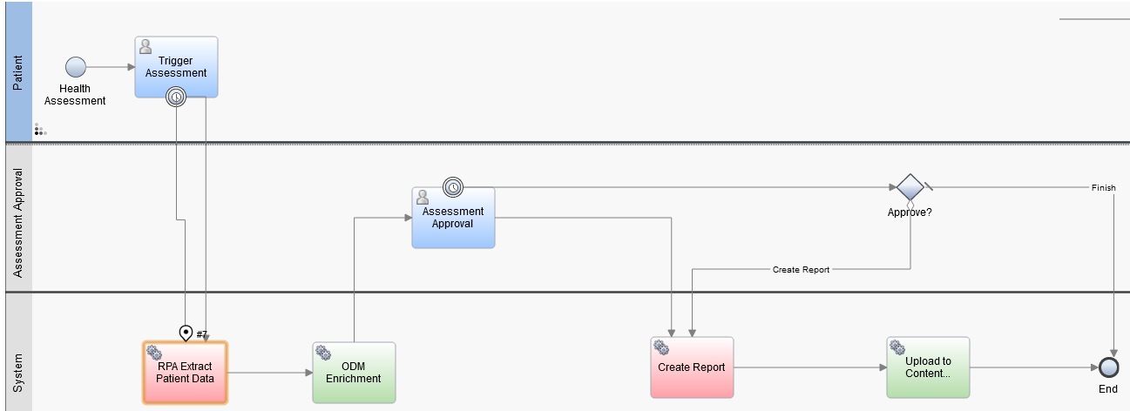
BAW – Orchestrate

Slide 9
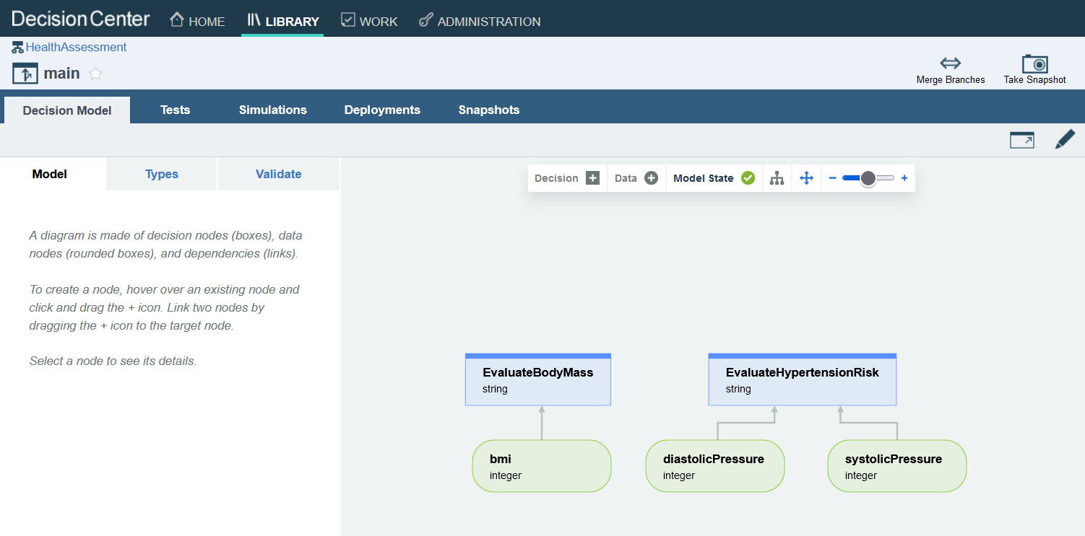
ODM – Enrich

Slide 10
RPA - Data Without APIs and Reports

Slide 11
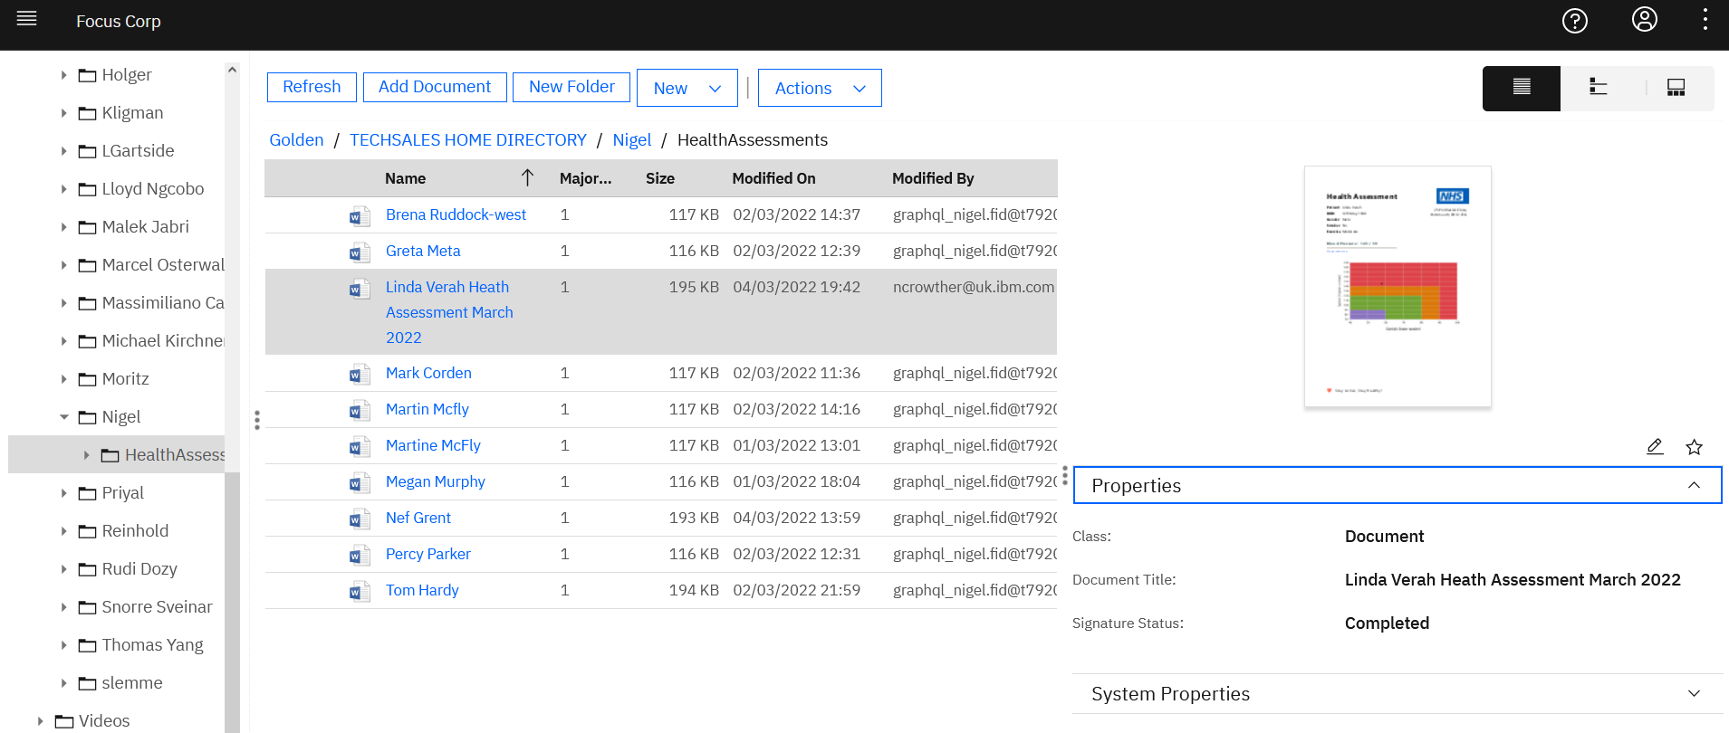
Content Navigator - Team space for docs

Slide 12
