Slide 1



IBM Agentic AI with Maximo
A smarter way to work
Nigel T. Crowther
IBM Tech Sales UKI
Notes:
Today’s conversation is about making AI real for the business—turning potential into practical outcomes.
Enterprises are under increasing pressure to scale AI investments beyond isolated pilots and proof of concepts. That’s where watsonx Orchestrate comes in. This is IBM’s platform for orchestrating AI agents, assistants, and workflows—built specifically for enterprise environments.
The platform connects to the tools already in use—whether that’s Workday, Salesforce, SAP, ServiceNow, or homegrown systems—and works across any model or automation framework. What sets it apart is the ability to bring AI agents and assistants together in one integrated workspace—so they can interact, delegate, and solve problems on behalf of the business.
The result? Less manual work, faster decisions, and a more productive, responsive business at scale.
This isn’t just automation—it’s enterprise AI that works alongside people to drive real impact.

Slide 2
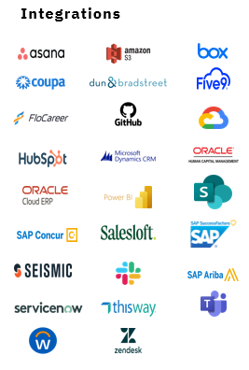
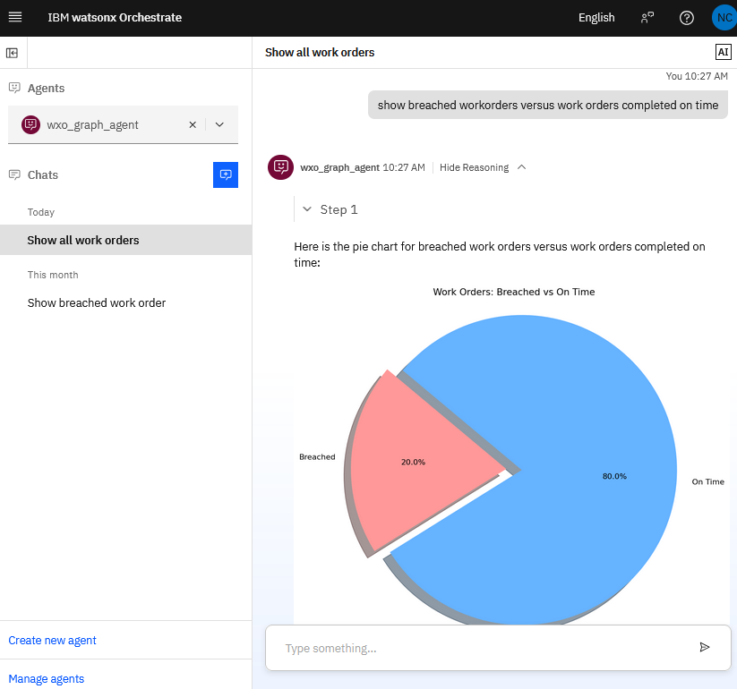
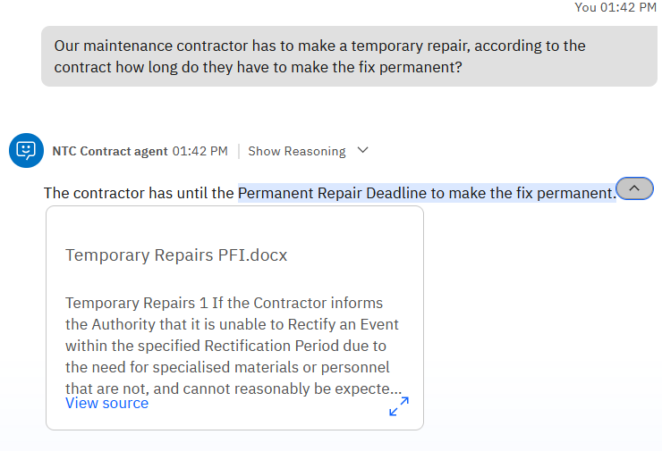
Agentic AI with Maximo. A smarter way to work.
Adhoc reporting
Answer legal questions
Unlock AI for your enterprise
Use agentic AI to create Maximo reports using natural language:
Query legal knowledge:
Integrate Maximo with virtually any existing business system
See how IBM Watsonx Orchestrate enhances Maximo with AI
IBM AI Productivity | © 2025 IBM Corporation

Slide 3

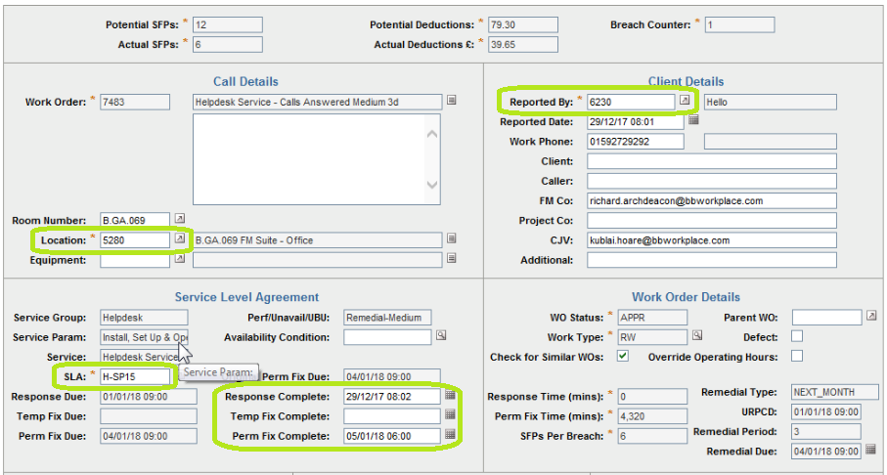
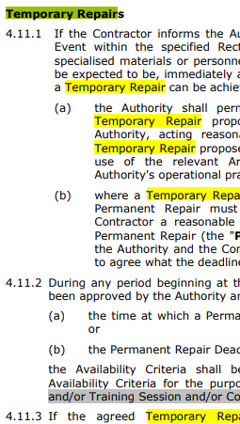
Case Study: Facilities Management
One solution: Agentic AI
Facilities Management use Maximo to manage work orders.
Work order reports created by IT.
Contract compliance managed by legal team.
Using natural language, legal questions are resolved with AI. Ad hoc reports are created within seconds using natural language.
No IT or legal departments required!
IBM AI Productivity | © 2025 IBM Corporation

Slide 4



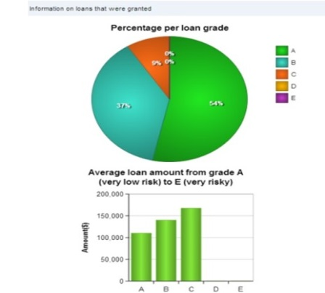
Before: Maximo with Excel and PDFs
Legal team read contracts
Contract Managers create work orders
IT create reports
Spreadsheets
Extract to Excel

Slide 5
After: Maximo with Orchestrate
Business Users use natural language to create repots and ask contract questions
Contract Managers create work orders

Slide 6

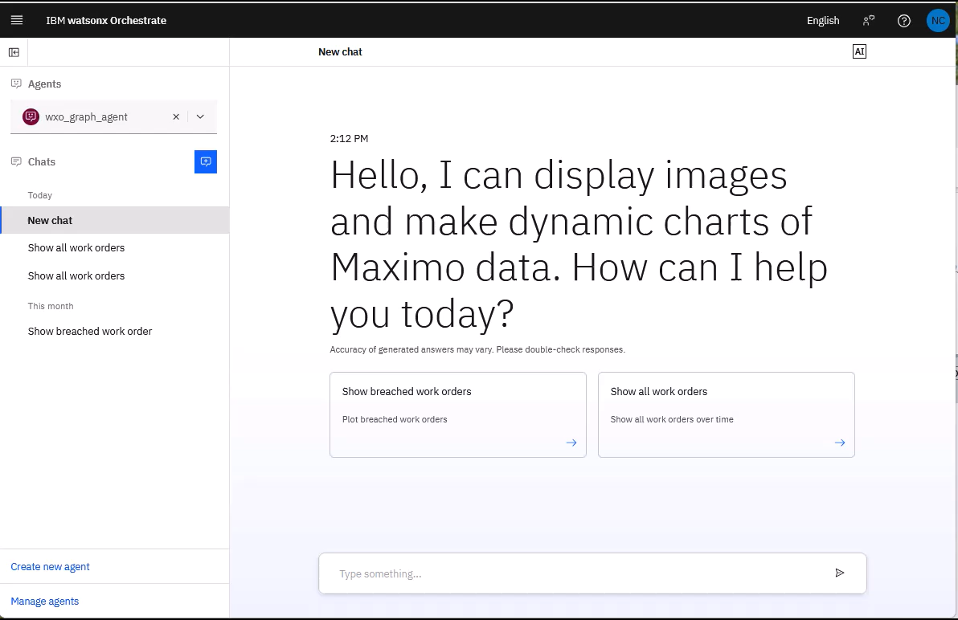
IBM AI Productivity | © 2025 IBM Corporation

Slide 7
Three ways to get started with watsonx Orchestrate with Maximo
Free trial
Experience watsonx Orchestrate with Maximo with a free trial.
Client briefing
Custom demo of IBM’s AI Assistant platform point-of-view & capabilities.
Understand how you can leverage watsonx Orchestrate with Maximo as part of your business strategy.
Agentic AI bootcamp
watsonx Orchestrate pilot developed with IBM AI engineers.
Prove watsonx Orchestrate value by deploying select use case(s).
Link →
Link →
Link →
Notes:
This slide outlines three clear paths for clients to begin their journey with IBM watsonx Orchestrate:
Sign up for a free trial. Clients can explore the platform hands-on, test out features, and begin building value quickly in a no-risk environment.
Request a client briefing. This is a tailored session where IBM experts walk through use cases, industry examples, and product capabilities that align to the client’s specific needs and objectives.
Participate in an Agentic Bootcamp. This is a collaborative working session designed to help identify a high-impact use case. From there, IBM can help advance the idea into a pilot and ultimately a full production deployment, based on the bootcamp outcomes.
These entry points provide clients with the flexibility to engage at various stages of their AI journey, whether they are exploring, evaluating, or ready to activate.
Links:
Free trial: https://www.ibm.com/account/reg/signup?formid=urx-52753
Request a client briefing: https://www.ibm.com/account/reg/us-en/signup?utm_medium=Email&utm_source=Event&utm_content=DTPWW&utm_campaign=PLACEHOLDER&utm_id=AI4Biz_watsonx_Client_Briefing_Gartner_Conference&formid=urx-52230
Agentic AI bootcamp: https://ibm.seismic.com/Link/Content/DCfCGJVfPmqH88qCq46PM3j9J6jd#/?anchorId=b4f32b7d-c3d4-4761-948a-fc2e8bc2bb72

