Slide 1
ORBIT MVP walk-through
Board Recorder
Keeps the record. Owns the ledger, routes incoming files, reads everything, and never scores.
Every screen this role can open, what each widget does, the data behind it, and how far each number can be trusted today.
orbit.ncscdude.com/mvp | Fictional data only | 12 Nov 2026
Notes:
Board Recorder. Keeps the record. Owns the ledger, routes incoming files, reads everything, and never scores.

Slide 2
What the Board Recorder can open
8 of 8 tools. In the live demo this role runs step 7.
Tool | Access | What that access means | What the tool is for
HELIOS Command | Uses | Runs some actions here. | Data in. Shows whether records loaded cleanly, how fresh each source is, and whether the board is ready to lock.
Candidate Queue | View | Read only. | The board's list of records. Shows how the list was built and where each record stands.
Panel Workspace | View | Read only. | One record, read through eight lenses, with the AI summary beside it and the scoring dock below.
Panel Oversight | View | Read only. | The Board President's controls: what the panel sees from AI and when, panel progress, re-votes and record issues.
Scoring Audit | View | Read only. | Finds scores far from the panel average and records what a person decided to do about each.
Board Statistics & Roles | View | Read only. | One board's numbers, gates and role rights. This is where the population is locked and the Order of Merit is certified.
DELTA Ledger | Owns | Runs this page's actions. | The audit trail of every action, and the gate every incoming file passes through.
Failure Tests | View | Read only. | One screen that answers: how does ORBIT test for failure, and is anything failing right now?
Notes:
The Board Recorder opens 8 of the 8 MVP tools. No tool is closed to this role.

Slide 3
How to read these slides
Each slide is one part of a real screen, captured as this role.
On every slide
The five trust words
1
A numbered marker on the screenshot matches the numbered note beside it.
Calculated live
Worked out from the records each time the screen draws. Change a record and the number changes.
Shows
What the widget puts in front of the user.
Fixed rule
A yes or no rule or a set limit. Same input, same result, every time.
Data
The object and fields it reads, and the source system in production.
Logged to DELTA
Rule
The calculation or rule that turns the data into what you see.
The action writes an entry to the audit ledger.
Sample value
Trust
How far the value can be relied on today. See the five words below.
A number typed into the demo to show the layout. It is not calculated and will not change.
Pre-written stand-in
Board Recorder
What this role can and cannot do with the widget.
Fictional text or a number standing in for AI output. No model runs in the demo.
Notes:
Green means the value is calculated, rule-based or logged. Amber means a sample value. Purple means pre-written text or numbers standing in for AI output.

Slide 4
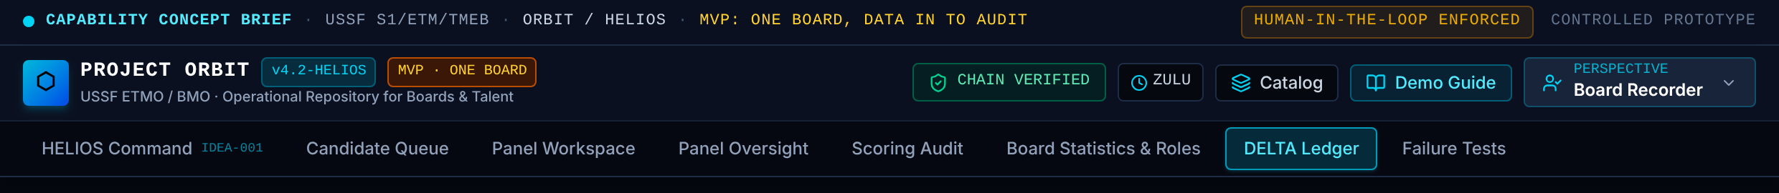
The frame around every screen: Header, tabs and footer (1 of 2)
The header, tabs and footer are the same on every page. They show who you are, what you may open, and whether the audit chain is intact.
1 Perspective menu (role)
Shows The role you are acting as. In the demo you pick it. In production it comes from your CAC sign-in and group.
Data Identity adapter: user ID to role table (5 roles in the MVP).
Rule A user with no role entry sees no tools. Every role change writes a ROLE_CHANGE entry.
Trust Fixed rule
2 Chain status badge
Shows Whether the DELTA ledger still verifies from first entry to last.
Data DeltaEntry.prevHash and hash for every entry.
Rule Recomputes each SHA-256 hash and compares it to the next entry's prevHash. Turns red on any break.
Trust Calculated live
2
3
1
4
Notes:
1. Perspective menu (role). The role you are acting as. In the demo you pick it. In production it comes from your CAC sign-in and group. Data: Identity adapter: user ID to role table (5 roles in the MVP). Rule: A user with no role entry sees no tools. Every role change writes a ROLE_CHANGE entry. Trust: Fixed rule
2. Chain status badge. Whether the DELTA ledger still verifies from first entry to last. Data: DeltaEntry.prevHash and hash for every entry. Rule: Recomputes each SHA-256 hash and compares it to the next entry's prevHash. Turns red on any break. Trust: Calculated live

Slide 5
The frame around every screen: Header, tabs and footer (2 of 2)
The header, tabs and footer are the same on every page. They show who you are, what you may open, and whether the audit chain is intact.
3 Catalog and Demo Guide
Shows Catalog lists the tools this role may open and the ones held for later. Demo Guide lists the walk-through steps for this role.
Data Tool registry and permission table.
Rule Both lists are filtered by the same permission table as the tabs.
Trust Fixed rule
4 Tool tabs
Shows One tab per tool this role may open, in the order a board moves.
Data Permission table (src/auth/permissions.ts).
Rule Hiding a tab is a convenience. Each screen checks the role again when it opens and logs a refusal.
Trust Fixed rule
2
3
1
4
Notes:
3. Catalog and Demo Guide. Catalog lists the tools this role may open and the ones held for later. Demo Guide lists the walk-through steps for this role. Data: Tool registry and permission table. Rule: Both lists are filtered by the same permission table as the tabs. Trust: Fixed rule
4. Tool tabs. One tab per tool this role may open, in the order a board moves. Data: Permission table (src/auth/permissions.ts). Rule: Hiding a tab is a convenience. Each screen checks the role again when it opens and logs a refusal. Trust: Fixed rule

Slide 6
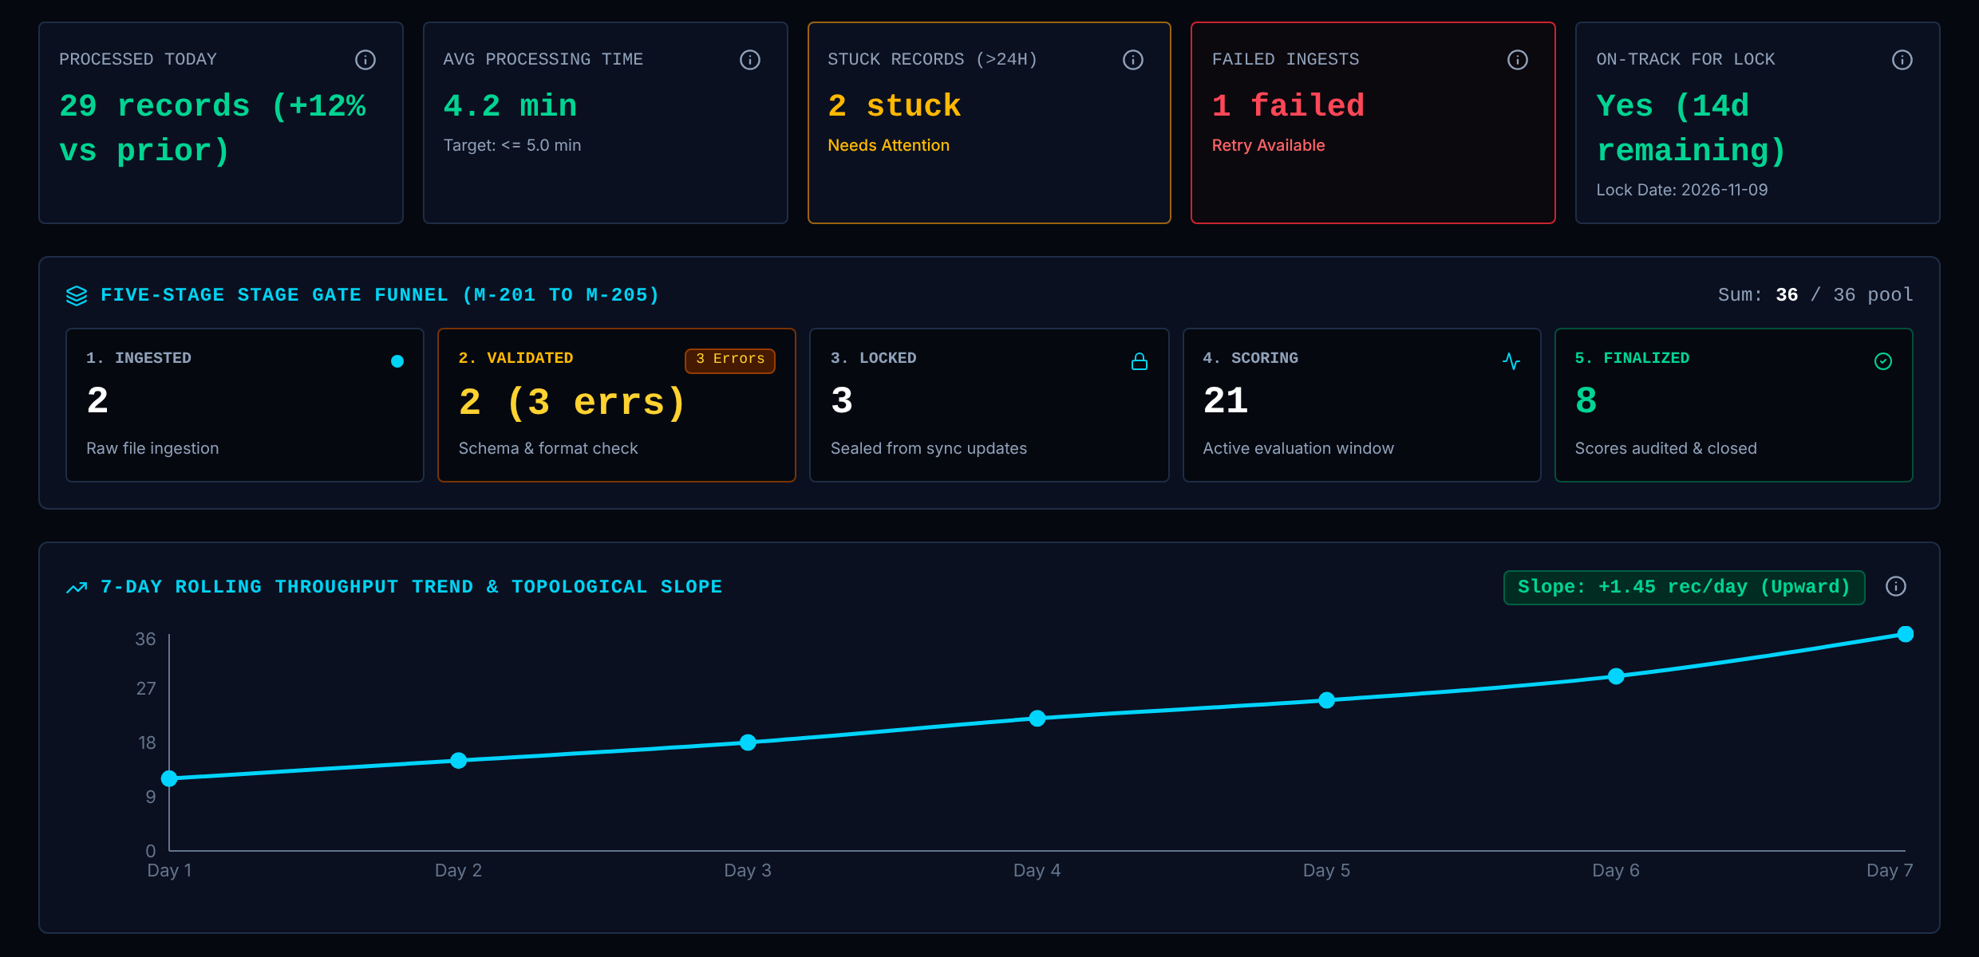
HELIOS Command: A. Pipeline and funnel (1 of 2)
Data in. Shows whether records loaded cleanly, how fresh each source is, and whether the board is ready to lock.
Board Recorder: Uses
Runs some actions here.
1 KPI strip (M-101 to M-105)
Shows Five headline numbers for the load pipeline: processed, average time, stuck, failed, on track for lock.
Data Candidate.flow: stage, errors, failedIngest.
Rule Processed = records in Scoring or Finalized. Stuck = Ingested with no failure, or Validated with errors. Failed = failedIngest is true.
Trust Calculated live for the processed count, stuck and failed. Sample value for "+12% vs prior", "4.2 min" and "Yes (14d remaining)".
2 Five-stage funnel (M-201 to M-205)
Shows How many records sit at each stage: Ingested, Validated, Locked, Scoring, Finalized.
Data Candidate.flow.stage, Candidate.flow.errors.
Rule Count of records per stage. The Validated card also counts schema errors. The five counts must add up to the pool (36).
Trust Calculated live
1
2
3
Notes:
1. KPI strip (M-101 to M-105). Five headline numbers for the load pipeline: processed, average time, stuck, failed, on track for lock. Data: Candidate.flow: stage, errors, failedIngest. Rule: Processed = records in Scoring or Finalized. Stuck = Ingested with no failure, or Validated with errors. Failed = failedIngest is true. Trust: Calculated live for the processed count, stuck and failed. Sample value for "+12% vs prior", "4.2 min" and "Yes (14d remaining)".
2. Five-stage funnel (M-201 to M-205). How many records sit at each stage: Ingested, Validated, Locked, Scoring, Finalized. Data: Candidate.flow.stage, Candidate.flow.errors. Rule: Count of records per stage. The Validated card also counts schema errors. The five counts must add up to the pool (36). Trust: Calculated live

Slide 7
HELIOS Command: A. Pipeline and funnel (2 of 2)
Data in. Shows whether records loaded cleanly, how fresh each source is, and whether the board is ready to lock.
Board Recorder: Uses
Runs some actions here.
3 Throughput trend (M-106)
Shows Records processed per day over seven days, with the trend slope.
Data None live in the demo.
Rule Production rule: least-squares slope of the 7-day processed counts. The slope function exists and is unit tested.
Trust Sample value. The seven points and the +1.45 slope are fixed in the demo.
1
2
3
Notes:
3. Throughput trend (M-106). Records processed per day over seven days, with the trend slope. Data: None live in the demo. Rule: Production rule: least-squares slope of the 7-day processed counts. The slope function exists and is unit tested. Trust: Sample value. The seven points and the +1.45 slope are fixed in the demo.

Slide 8
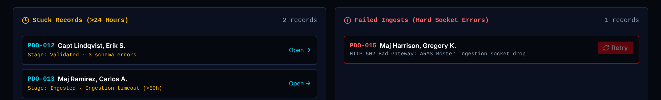
HELIOS Command: A. Stuck and failed records
Data in. Shows whether records loaded cleanly, how fresh each source is, and whether the board is ready to lock.
Board Recorder: Uses
Runs some actions here.
1 Stuck records list
Shows Each record that has not moved, with its stage and the reason. Open jumps to the record.
Data Candidate.flow.stage and flow.errors.
Rule Same rule as M-103. The demo does not measure elapsed hours; it uses stage plus errors.
Trust Calculated live
Board Recorder Opens the record. Read only.
2 Failed ingests list
Shows Records whose load failed, with the error text, and a Retry button.
Data Candidate.flow.failedIngest and flow.errors.
Rule Retry clears the failure, moves the record to Validated and writes PIPELINE_RETRY to DELTA.
Trust Calculated live + logged to DELTA
Board Recorder Retry is disabled.
1
2
Notes:
1. Stuck records list. Each record that has not moved, with its stage and the reason. Open jumps to the record. Data: Candidate.flow.stage and flow.errors. Rule: Same rule as M-103. The demo does not measure elapsed hours; it uses stage plus errors. Trust: Calculated live Board Recorder: Opens the record. Read only.
2. Failed ingests list. Records whose load failed, with the error text, and a Retry button. Data: Candidate.flow.failedIngest and flow.errors. Rule: Retry clears the failure, moves the record to Validated and writes PIPELINE_RETRY to DELTA. Trust: Calculated live + logged to DELTA Board Recorder: Retry is disabled.

Slide 9
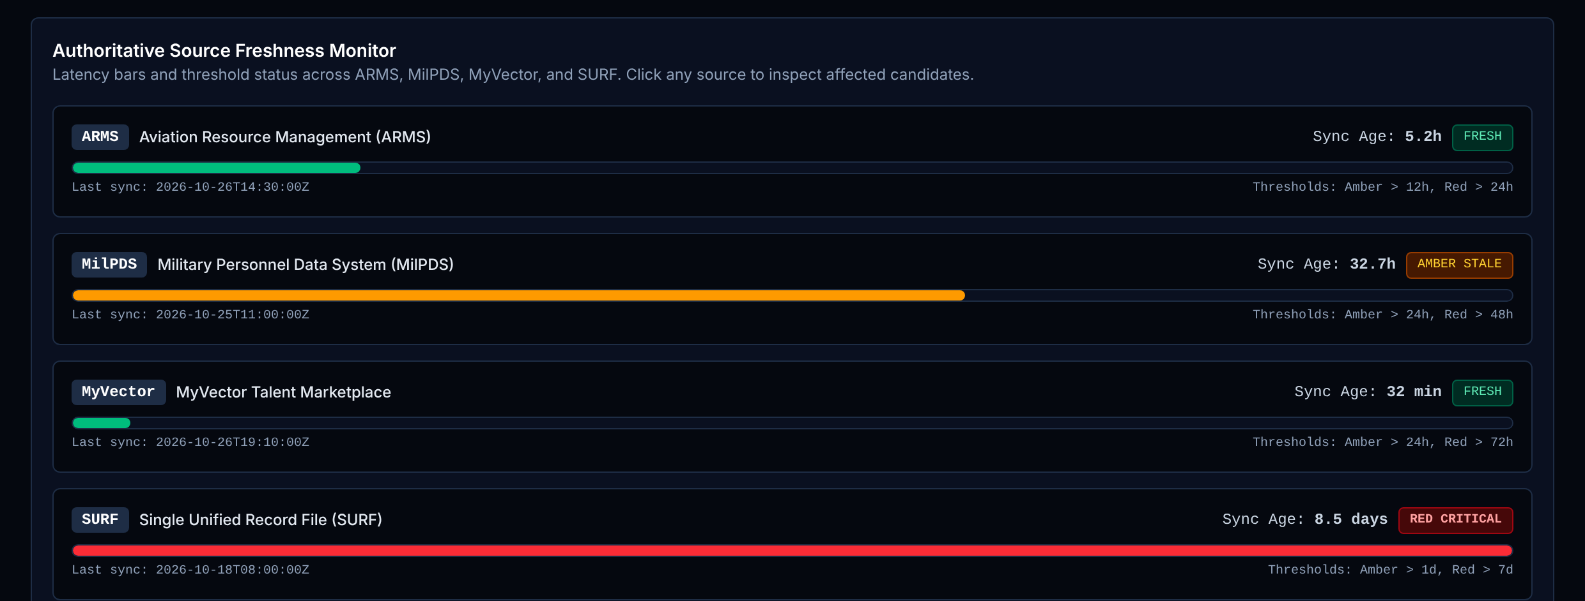
HELIOS Command: B. Source freshness
Data in. Shows whether records loaded cleanly, how fresh each source is, and whether the board is ready to lock.
Board Recorder: Uses
Runs some actions here.
1 Source freshness monitor (M-301 to M-304)
Shows For ARMS, MilPDS, MyVector and SURF: time since last sync, a bar against the limits, and a status. Selecting a source lists the records it affects.
Data SourcePipeline: last sync time, amber and red limits.
Rule Limits: ARMS amber over 12h, red over 24h. MilPDS 24h and 48h. MyVector 24h and 72h. SURF 1 day and 7 days.
Trust Fixed rule for the limits. Calculated live for the ages: last sync to the data snapshot time (5.2h, 32.7h, 32 min, 8.5 days). The sync times are fictional.
1
Notes:
1. Source freshness monitor (M-301 to M-304). For ARMS, MilPDS, MyVector and SURF: time since last sync, a bar against the limits, and a status. Selecting a source lists the records it affects. Data: SourcePipeline: last sync time, amber and red limits. Rule: Limits: ARMS amber over 12h, red over 24h. MilPDS 24h and 48h. MyVector 24h and 72h. SURF 1 day and 7 days. Trust: Fixed rule for the limits. Calculated live for the ages: last sync to the data snapshot time (5.2h, 32.7h, 32 min, 8.5 days). The sync times are fictional.

Slide 10
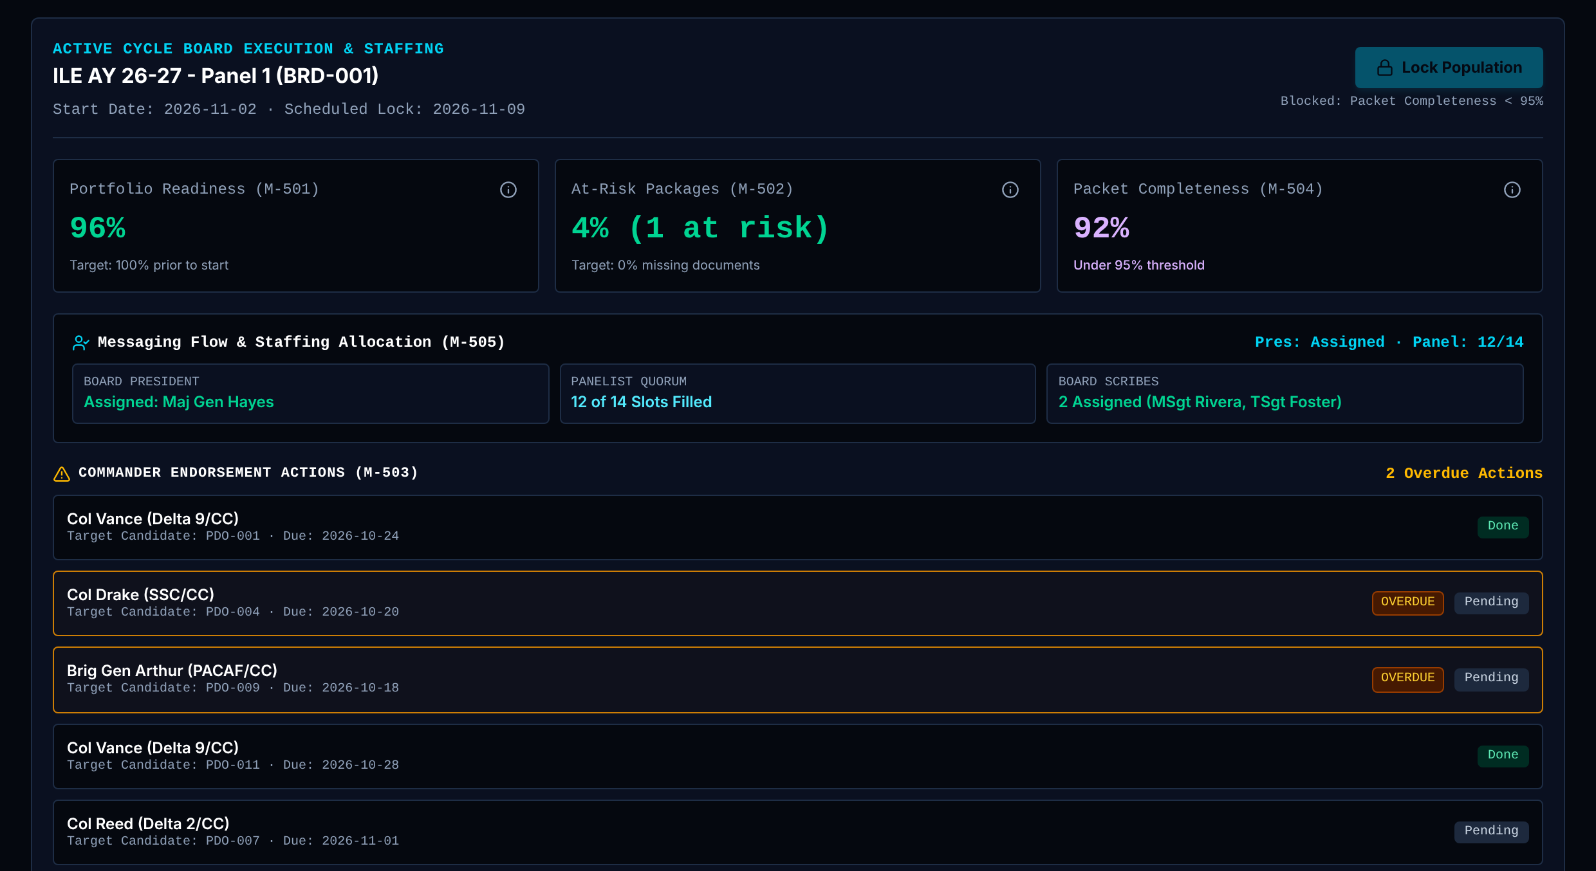
HELIOS Command: C. Readiness and lock (1 of 2)
Data in. Shows whether records loaded cleanly, how fresh each source is, and whether the board is ready to lock.
Board Recorder: Uses
Runs some actions here.
1 Board card and Lock Population
Shows The board, its start and lock dates, and the Lock Population button.
Data Board; metric M-504.
Rule The button works only for the BMO Lead and only when packet completeness is 95% or more. Locking writes POPULATION_LOCK.
Trust Fixed rule + logged to DELTA
Board Recorder Button disabled.
2 Readiness gauges (M-501, M-502, M-504)
Shows Portfolio readiness, at-risk packages, and packet completeness against the 95% lock gate.
Data Candidate.packetReadiness.complete.
Rule Packet completeness = complete packets divided by records (33 of 36 = 92%).
Trust Calculated live for packet completeness. Sample value for readiness 96% and at-risk 4%.
3 Staffing (M-505)
Shows Whether a President is assigned, how many panelist seats are filled, and the scribes.
Data StaffSlot: role, assigned, name.
Rule Counts assigned seats by role. Green at 12 or more panelists.
Trust Calculated live
1
2
3
4
Notes:
1. Board card and Lock Population. The board, its start and lock dates, and the Lock Population button. Data: Board; metric M-504. Rule: The button works only for the BMO Lead and only when packet completeness is 95% or more. Locking writes POPULATION_LOCK. Trust: Fixed rule + logged to DELTA Board Recorder: Button disabled.
2. Readiness gauges (M-501, M-502, M-504). Portfolio readiness, at-risk packages, and packet completeness against the 95% lock gate. Data: Candidate.packetReadiness.complete. Rule: Packet completeness = complete packets divided by records (33 of 36 = 92%). Trust: Calculated live for packet completeness. Sample value for readiness 96% and at-risk 4%.
3. Staffing (M-505). Whether a President is assigned, how many panelist seats are filled, and the scribes. Data: StaffSlot: role, assigned, name. Rule: Counts assigned seats by role. Green at 12 or more panelists. Trust: Calculated live

Slide 11
HELIOS Command: C. Readiness and lock (2 of 2)
Data in. Shows whether records loaded cleanly, how fresh each source is, and whether the board is ready to lock.
Board Recorder: Uses
Runs some actions here.
4 Commander actions (M-503)
Shows Endorsement actions owed by commanders, with due dates and overdue flags.
Data CommanderAction: record, commander, due, status.
Rule Overdue = Pending and due before the demo's reference date (26 Oct 2026).
Trust Calculated live against a fixed reference date
1
2
3
4
Notes:
4. Commander actions (M-503). Endorsement actions owed by commanders, with due dates and overdue flags. Data: CommanderAction: record, commander, due, status. Rule: Overdue = Pending and due before the demo's reference date (26 Oct 2026). Trust: Calculated live against a fixed reference date

Slide 12
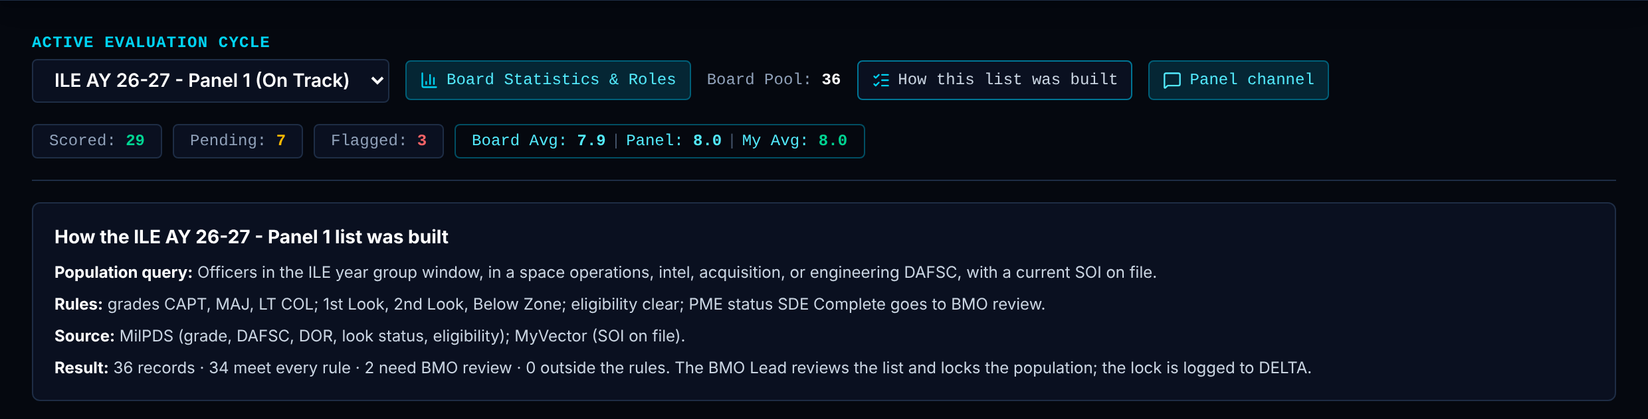
Candidate Queue: Header, counters and roster rules (1 of 2)
The board's list of records. Shows how the list was built and where each record stands.
Board Recorder: View
Read only.
1 Board header and counters
Shows The board, pool size, and counts of Scored, Pending and Flagged for the signed-in voter, plus three averages.
Data Candidate.scores, Candidate.myScore, Candidate.flagged.
Rule Board Avg = mean of every score on the board. My Avg = mean of your own scores.
Trust Calculated live for counts, Board Avg and My Avg. Sample value for "Panel": it is Board Avg plus 0.1, and My Avg shows a placeholder until you score.
1
2
Notes:
1. Board header and counters. The board, pool size, and counts of Scored, Pending and Flagged for the signed-in voter, plus three averages. Data: Candidate.scores, Candidate.myScore, Candidate.flagged. Rule: Board Avg = mean of every score on the board. My Avg = mean of your own scores. Trust: Calculated live for counts, Board Avg and My Avg. Sample value for "Panel": it is Board Avg plus 0.1, and My Avg shows a placeholder until you score.

Slide 13
Candidate Queue: Header, counters and roster rules (2 of 2)
The board's list of records. Shows how the list was built and where each record stands.
Board Recorder: View
Read only.
2 How this list was built
Shows The roster rule for this board and how many records were Included, sent to BMO review, or Excluded.
Data Roster rule (grades, look status, PME review); Candidate grade, lookStatus, eligibility, pmeStatus.
Rule Outside the grade or look rule = Excluded. Eligibility issue or listed PME status = BMO review. Otherwise Included. Production source: MilPDS query plus SOI on file in MyVector.
Trust Calculated live (same function runs in the unit tests)
1
2
Notes:
2. How this list was built. The roster rule for this board and how many records were Included, sent to BMO review, or Excluded. Data: Roster rule (grades, look status, PME review); Candidate grade, lookStatus, eligibility, pmeStatus. Rule: Outside the grade or look rule = Excluded. Eligibility issue or listed PME status = BMO review. Otherwise Included. Production source: MilPDS query plus SOI on file in MyVector. Trust: Calculated live (same function runs in the unit tests)

Slide 14
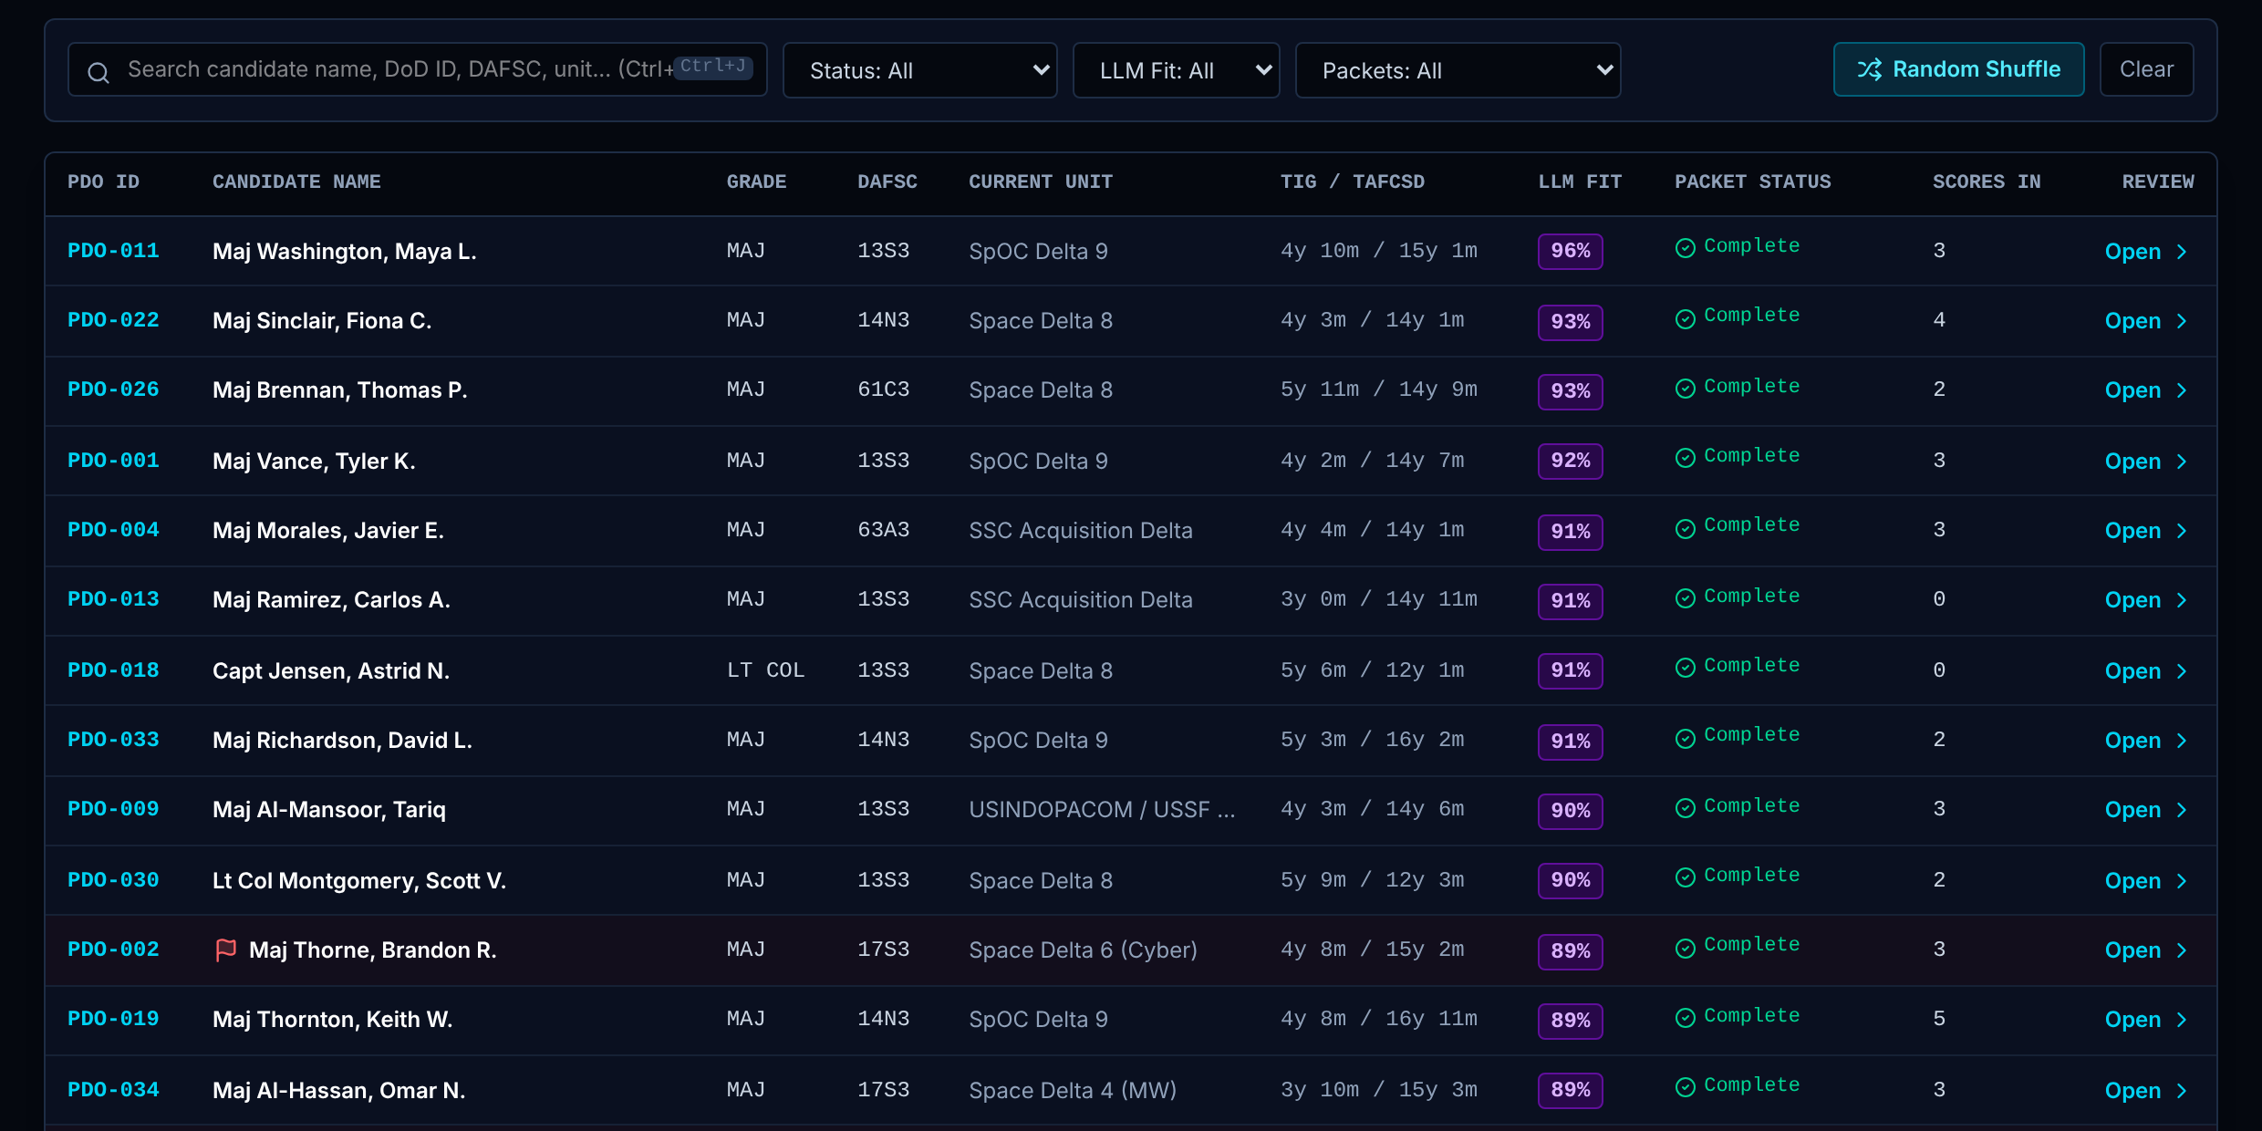
Candidate Queue: Filters, shuffle and the record table (1 of 2)
The board's list of records. Shows how the list was built and where each record stands.
Board Recorder: View
Read only.
1 Search, filters and Random Shuffle
Shows Search by name, ID, DAFSC or unit. Filter by status and packet check. Random Shuffle reorders the list.
Data Candidate fields; browser random source.
Rule Shuffle is a Fisher-Yates reorder seeded from the browser's cryptographic random source. The seed is written to DELTA as SHUFFLE so the order can be reproduced.
Trust Fixed rule + logged to DELTA
1
2
Notes:
1. Search, filters and Random Shuffle. Search by name, ID, DAFSC or unit. Filter by status and packet check. Random Shuffle reorders the list. Data: Candidate fields; browser random source. Rule: Shuffle is a Fisher-Yates reorder seeded from the browser's cryptographic random source. The seed is written to DELTA as SHUFFLE so the order can be reproduced. Trust: Fixed rule + logged to DELTA

Slide 15
Candidate Queue: Filters, shuffle and the record table (2 of 2)
The board's list of records. Shows how the list was built and where each record stands.
Board Recorder: View
Read only.
2 Record table
Shows One row per record: ID, name, grade, DAFSC, unit, time in grade and service, AI fit, packet status, your score. A row opens the record in Panel Workspace.
Data Candidate; roster check; Candidate.packetReadiness.
Rule Packet status lists exceptions. "BMO review" comes from the roster rule. AI fit follows the President's visibility setting.
Trust Calculated live for packet status and scores. Pre-written stand-in for the AI fit value: a number typed per record, not produced by a model.
Board Recorder Sees AI fit at all times. Does not score.
1
2
Notes:
2. Record table. One row per record: ID, name, grade, DAFSC, unit, time in grade and service, AI fit, packet status, your score. A row opens the record in Panel Workspace. Data: Candidate; roster check; Candidate.packetReadiness. Rule: Packet status lists exceptions. "BMO review" comes from the roster rule. AI fit follows the President's visibility setting. Trust: Calculated live for packet status and scores. Pre-written stand-in for the AI fit value: a number typed per record, not produced by a model. Board Recorder: Sees AI fit at all times. Does not score.

Slide 16
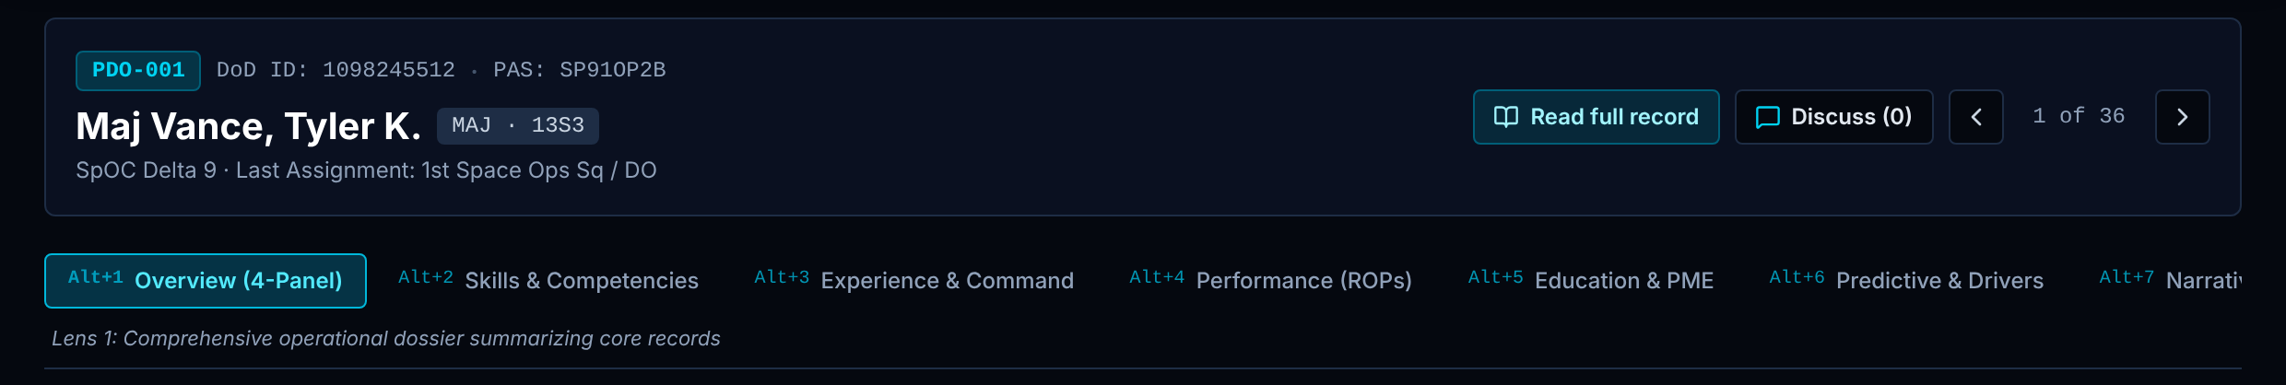
Panel Workspace: Record header and the eight lenses
One record, read through eight lenses, with the AI summary beside it and the scoring dock below.
Board Recorder: View
Read only.
1 Record header
Shows Record ID, name, grade and DAFSC, unit, last assignment. Buttons: Read full record, Discuss, previous and next.
Data Candidate identity fields. Full text: SOI, commander comments, appraisals.
Rule Opening a full-text document writes RECORD_OPEN. Chat posts are blocked if they contain health-related words.
Trust Calculated live + logged to DELTA
Board Recorder Reads the record and the chat. Cannot post or score.
2 Lens tabs (Alt+1 to Alt+8)
Shows Eight views of the same record: Overview, Skills, Experience, Performance, Education, Predictive, Narrative and SOI, Eligibility and Freshness.
Data One Candidate object. A lens changes the view, never the data.
Rule Every voter sees the same eight lenses in the same order.
Trust Fixed rule
1
2
Notes:
1. Record header. Record ID, name, grade and DAFSC, unit, last assignment. Buttons: Read full record, Discuss, previous and next. Data: Candidate identity fields. Full text: SOI, commander comments, appraisals. Rule: Opening a full-text document writes RECORD_OPEN. Chat posts are blocked if they contain health-related words. Trust: Calculated live + logged to DELTA Board Recorder: Reads the record and the chat. Cannot post or score.
2. Lens tabs (Alt+1 to Alt+8). Eight views of the same record: Overview, Skills, Experience, Performance, Education, Predictive, Narrative and SOI, Eligibility and Freshness. Data: One Candidate object. A lens changes the view, never the data. Rule: Every voter sees the same eight lenses in the same order. Trust: Fixed rule

Slide 17
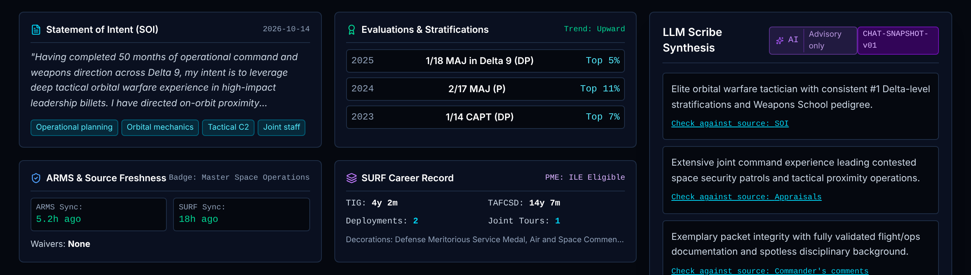
Panel Workspace: Lens 1: Overview (1 of 2)
One record, read through eight lenses, with the AI summary beside it and the scoring dock below.
Board Recorder: View
Read only.
1 Statement of Intent
Shows Opening lines of the SOI, its date, and topic tags.
Data Candidate.soi: text, date, tags. Production source: MyVector.
Rule Shown as written. Tags are stored with the record.
Trust Calculated live display of Pre-written stand-in fictional text
2 Evaluations and stratifications
Shows Last three years: stratification statement and percentile, with a trend label.
Data Candidate.performance, Candidate.ropTrend. Production source: evaluation system (to confirm).
Rule Shown as stored. The trend label is a stored field, not computed.
Trust Calculated live display; trend is Pre-written stand-in
3 ARMS and source freshness
Shows Badge level and the last sync time of the ARMS and SURF data for this record.
Data Candidate.badgeLevel, Candidate.freshness.
Rule Shown as stored, so the voter can see how old the data is.
Trust Calculated live display
1
2
3
4
Notes:
1. Statement of Intent. Opening lines of the SOI, its date, and topic tags. Data: Candidate.soi: text, date, tags. Production source: MyVector. Rule: Shown as written. Tags are stored with the record. Trust: Calculated live display of Pre-written stand-in fictional text
2. Evaluations and stratifications. Last three years: stratification statement and percentile, with a trend label. Data: Candidate.performance, Candidate.ropTrend. Production source: evaluation system (to confirm). Rule: Shown as stored. The trend label is a stored field, not computed. Trust: Calculated live display; trend is Pre-written stand-in
3. ARMS and source freshness. Badge level and the last sync time of the ARMS and SURF data for this record. Data: Candidate.badgeLevel, Candidate.freshness. Rule: Shown as stored, so the voter can see how old the data is. Trust: Calculated live display

Slide 18
Panel Workspace: Lens 1: Overview (2 of 2)
One record, read through eight lenses, with the AI summary beside it and the scoring dock below.
Board Recorder: View
Read only.
4 SURF career record
Shows Time in grade, time in service, deployments, joint and short tours, PME status.
Data Candidate.tig, tafcsd, deployments, jointTours, pmeStatus. Production source: MilPDS and SURF.
Rule Shown as stored.
Trust Calculated live display
1
2
3
4
Notes:
4. SURF career record. Time in grade, time in service, deployments, joint and short tours, PME status. Data: Candidate.tig, tafcsd, deployments, jointTours, pmeStatus. Production source: MilPDS and SURF. Rule: Shown as stored. Trust: Calculated live display

Slide 19
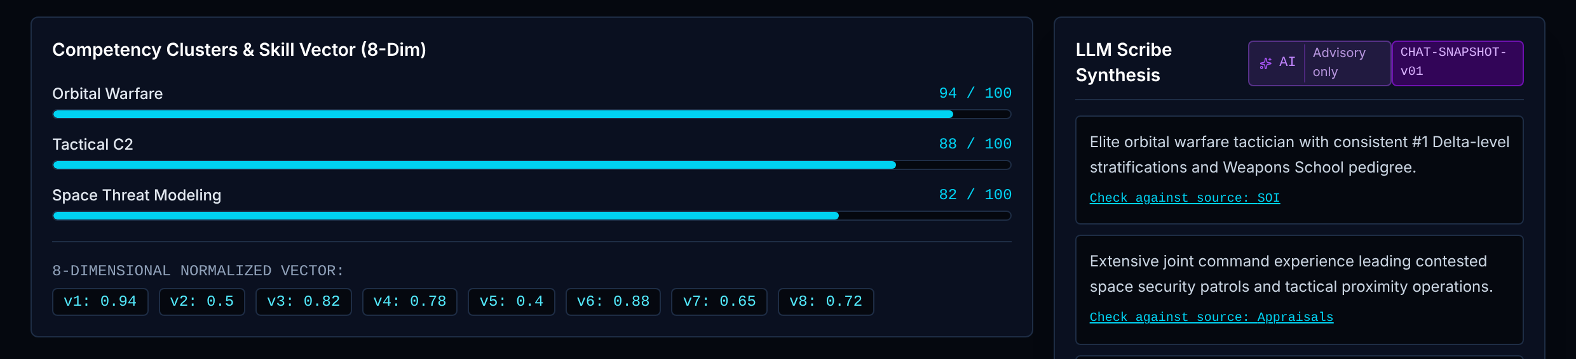
Panel Workspace: Lens 2: Skills
One record, read through eight lenses, with the AI summary beside it and the scoring dock below.
Board Recorder: View
Read only.
1 Competency clusters and skill vector
Shows Skill clusters with a level each, and an eight-number skill vector for the record.
Data Candidate.skills, Candidate.skillVector (8 values from 0 to 1).
Rule The vector feeds the similar-record and billet-fit cards.
Trust Pre-written stand-in. The eight values are typed per record. No method yet derives them from a real record.
1
Notes:
1. Competency clusters and skill vector. Skill clusters with a level each, and an eight-number skill vector for the record. Data: Candidate.skills, Candidate.skillVector (8 values from 0 to 1). Rule: The vector feeds the similar-record and billet-fit cards. Trust: Pre-written stand-in. The eight values are typed per record. No method yet derives them from a real record.

Slide 20
Panel Workspace: Lens 3: Experience
One record, read through eight lenses, with the AI summary beside it and the scoring dock below.
Board Recorder: View
Read only.
1 Command and duty chronology
Shows Duty history in date order: position, unit and dates.
Data Candidate.timeline. Production source: MilPDS duty history.
Rule Shown as stored, oldest to newest.
Trust Calculated live display
1
Notes:
1. Command and duty chronology. Duty history in date order: position, unit and dates. Data: Candidate.timeline. Production source: MilPDS duty history. Rule: Shown as stored, oldest to newest. Trust: Calculated live display

Slide 21
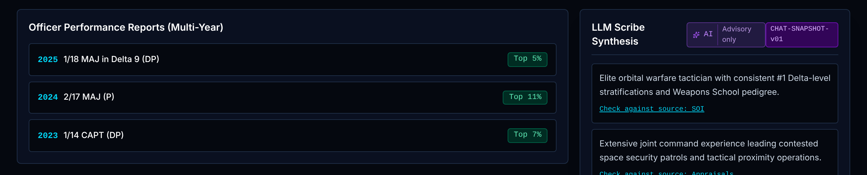
Panel Workspace: Lens 4: Performance
One record, read through eight lenses, with the AI summary beside it and the scoring dock below.
Board Recorder: View
Read only.
1 Performance reports, multi-year
Shows Each year's report: stratification, percentile and rating.
Data Candidate.performance.
Rule Shown as stored. No score is computed from it.
Trust Calculated live display
1
Notes:
1. Performance reports, multi-year. Each year's report: stratification, percentile and rating. Data: Candidate.performance. Rule: Shown as stored. No score is computed from it. Trust: Calculated live display

Slide 22
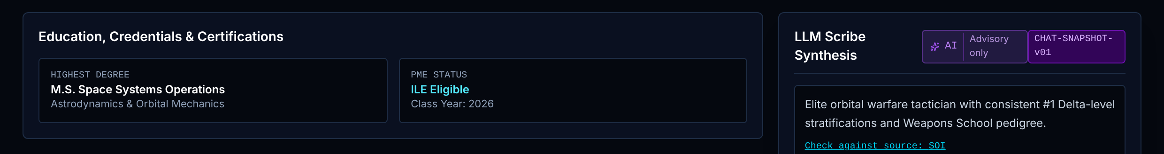
Panel Workspace: Lens 5: Education
One record, read through eight lenses, with the AI summary beside it and the scoring dock below.
Board Recorder: View
Read only.
1 Education, credentials and certifications
Shows Highest degree and discipline, PME status and year, badge, certifications.
Data Candidate.highestDegree, academicDiscipline, pmeStatus, pmeYear, certs. Production source: MilPDS education and training.
Rule Shown as stored.
Trust Calculated live display
1
Notes:
1. Education, credentials and certifications. Highest degree and discipline, PME status and year, badge, certifications. Data: Candidate.highestDegree, academicDiscipline, pmeStatus, pmeYear, certs. Production source: MilPDS education and training. Rule: Shown as stored. Trust: Calculated live display

Slide 23
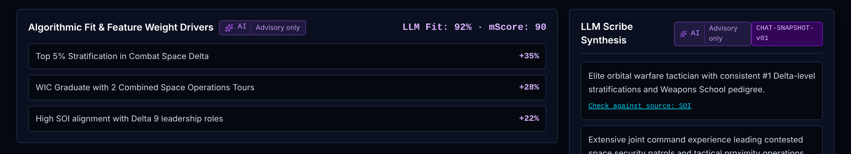
Panel Workspace: Lens 6: Predictive and drivers
One record, read through eight lenses, with the AI summary beside it and the scoring dock below.
Board Recorder: View
Read only.
1 AI fit, model score and feature drivers
Shows An AI fit value, a model score, a confidence level per source, and the features that drove the score with their weights.
Data Candidate.llmFitScore, mScore, confidence, featureDrivers.
Rule Visibility follows the President's setting. Default: shown only after the voter scores the record.
Trust Pre-written stand-in. All four are typed per record. No model runs in the demo, so these numbers have no validity evidence.
Board Recorder Always visible. Does not score.
1
Notes:
1. AI fit, model score and feature drivers. An AI fit value, a model score, a confidence level per source, and the features that drove the score with their weights. Data: Candidate.llmFitScore, mScore, confidence, featureDrivers. Rule: Visibility follows the President's setting. Default: shown only after the voter scores the record. Trust: Pre-written stand-in. All four are typed per record. No model runs in the demo, so these numbers have no validity evidence. Board Recorder: Always visible. Does not score.

Slide 24
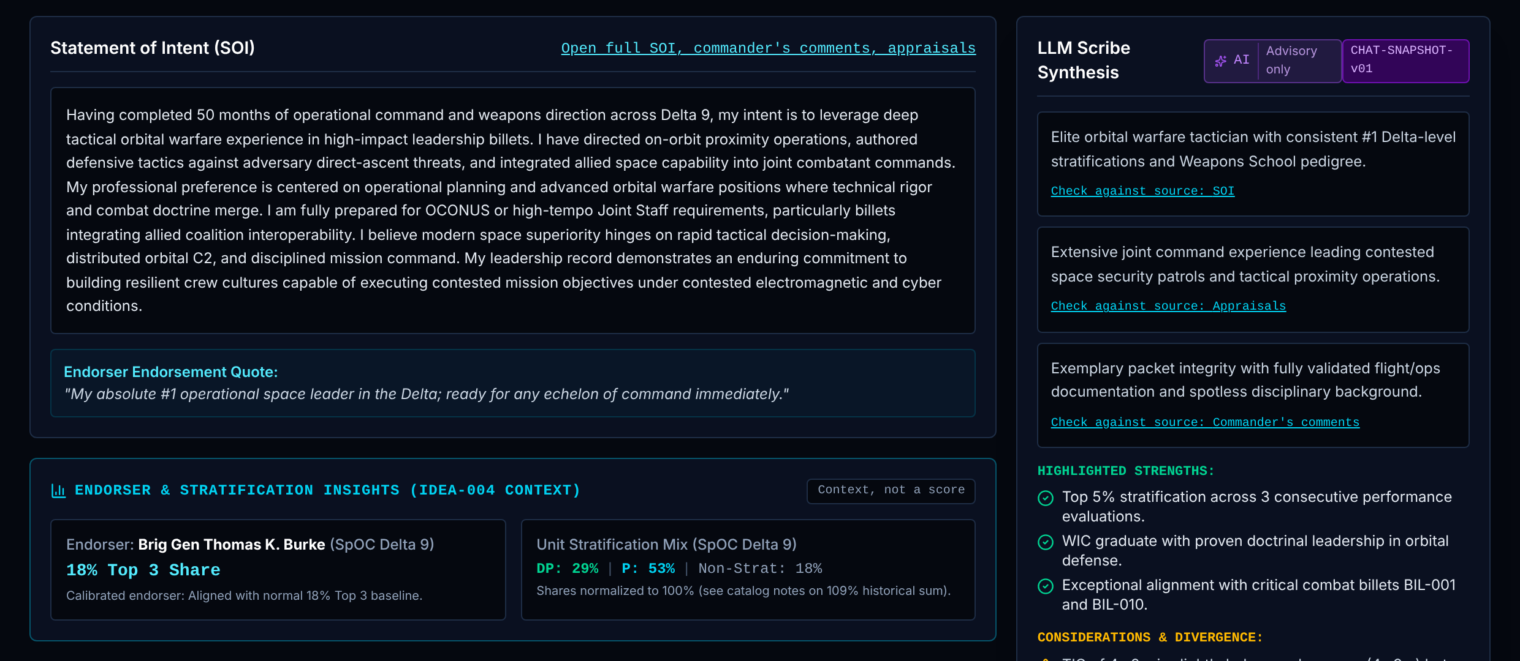
Panel Workspace: Lens 7: Narrative and endorser
One record, read through eight lenses, with the AI summary beside it and the scoring dock below.
Board Recorder: View
Read only.
1 Statement of Intent, full
Shows The full SOI text, word count, tags, endorser quote and stated preferences.
Data Candidate.soi.
Rule Shown as written.
Trust Calculated live display of Pre-written stand-in fictional text
2 Endorser context (M-404, M-405)
Shows How often this endorser places people in their top 3, and the unit's mix of DP, P and non-stratified ratings.
Data Endorser.top3SharePct, Endorser.stratMix.
Rule Context for reading an endorsement. It does not change any score.
Trust Pre-written stand-in. Values are typed per endorser. A real version needs endorsement history from the source system.
1
2
Notes:
1. Statement of Intent, full. The full SOI text, word count, tags, endorser quote and stated preferences. Data: Candidate.soi. Rule: Shown as written. Trust: Calculated live display of Pre-written stand-in fictional text
2. Endorser context (M-404, M-405). How often this endorser places people in their top 3, and the unit's mix of DP, P and non-stratified ratings. Data: Endorser.top3SharePct, Endorser.stratMix. Rule: Context for reading an endorsement. It does not change any score. Trust: Pre-written stand-in. Values are typed per endorser. A real version needs endorsement history from the source system.

Slide 25
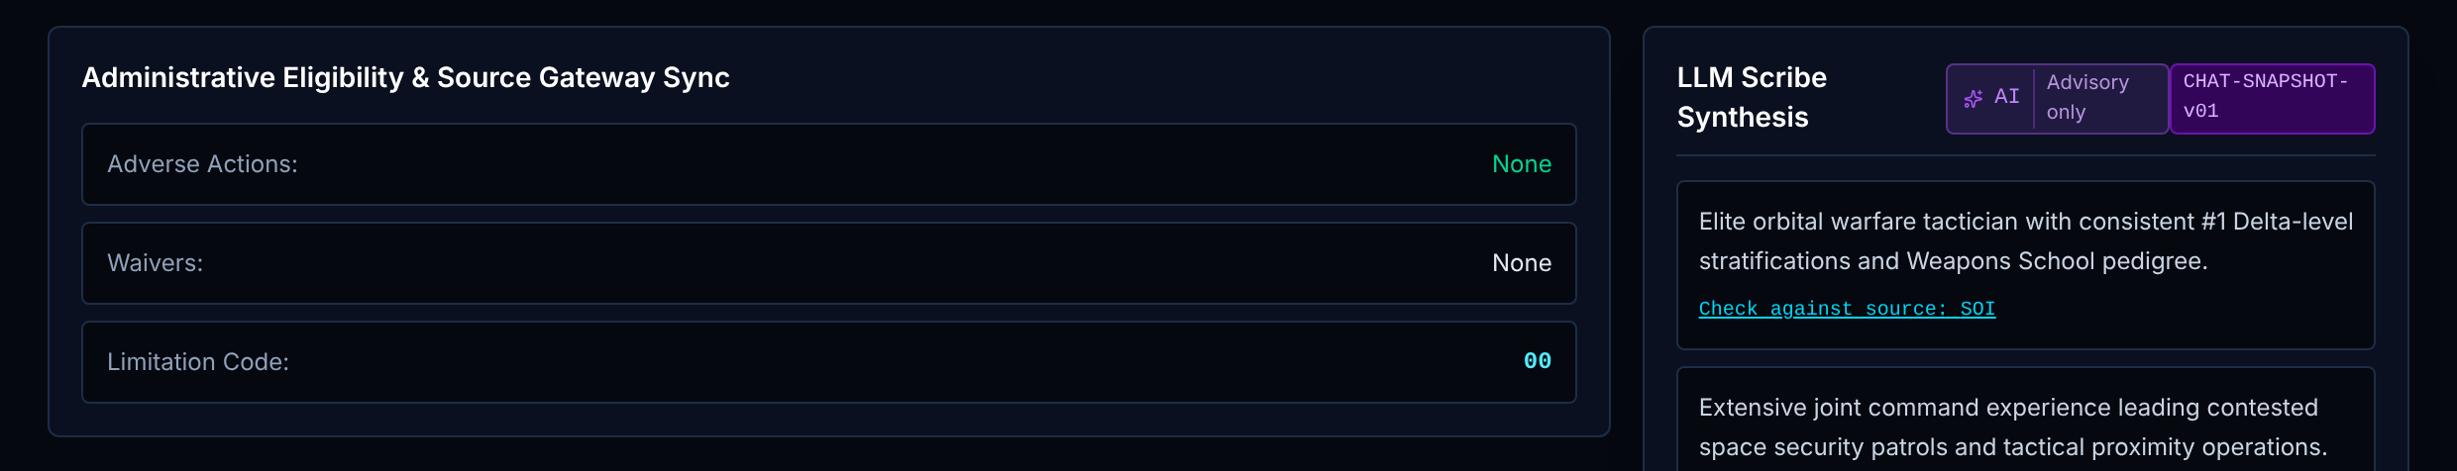
Panel Workspace: Lens 8: Eligibility and freshness
One record, read through eight lenses, with the AI summary beside it and the scoring dock below.
Board Recorder: View
Read only.
1 Eligibility and source sync
Shows Adverse actions, waivers, limitation code, and the last sync time of each source for this record.
Data Candidate.eligibility, Candidate.freshness.
Rule Shown as stored. An eligibility issue also sends the record to BMO review in the roster rule.
Trust Calculated live display
1
Notes:
1. Eligibility and source sync. Adverse actions, waivers, limitation code, and the last sync time of each source for this record. Data: Candidate.eligibility, Candidate.freshness. Rule: Shown as stored. An eligibility issue also sends the record to BMO review in the roster rule. Trust: Calculated live display

Slide 26
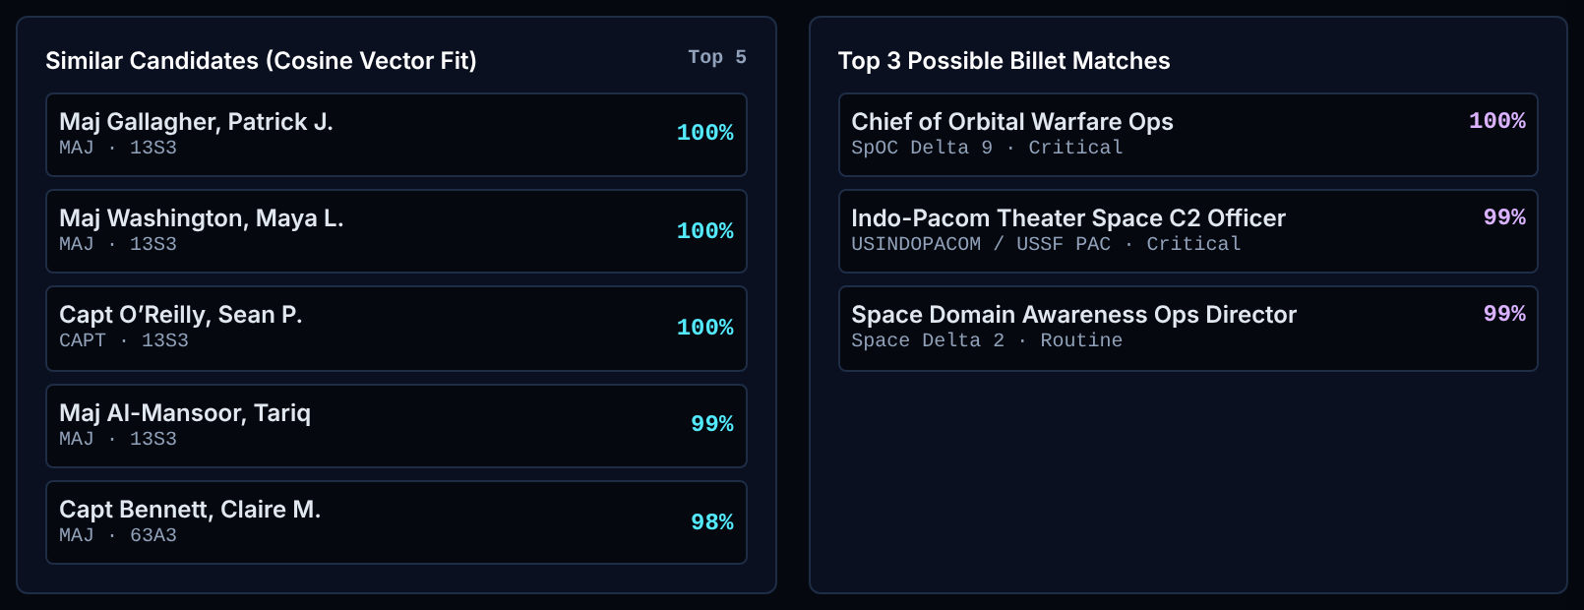
Panel Workspace: Similar records and billet fits
One record, read through eight lenses, with the AI summary beside it and the scoring dock below.
Board Recorder: View
Read only.
1 Similar records (top 5)
Shows The five records most like this one, with a similarity percentage.
Data Candidate.skillVector for every record.
Rule Cosine similarity between two 8-value skill vectors; top 5 shown. The function is unit tested.
Trust Calculated live math on Pre-written stand-in vectors. Because all values are positive, scores bunch near 98 to 100% and separate records poorly.
2 Possible billet fits (top 3)
Shows The three positions whose skill vector is closest to this record's.
Data Candidate.skillVector, Billet.skillVector.
Rule Cosine similarity; top 3 shown. Advisory only. It never feeds the score or the Order of Merit.
Trust Calculated live math on Pre-written stand-in vectors
1
2
Notes:
1. Similar records (top 5). The five records most like this one, with a similarity percentage. Data: Candidate.skillVector for every record. Rule: Cosine similarity between two 8-value skill vectors; top 5 shown. The function is unit tested. Trust: Calculated live math on Pre-written stand-in vectors. Because all values are positive, scores bunch near 98 to 100% and separate records poorly.
2. Possible billet fits (top 3). The three positions whose skill vector is closest to this record's. Data: Candidate.skillVector, Billet.skillVector. Rule: Cosine similarity; top 3 shown. Advisory only. It never feeds the score or the Order of Merit. Trust: Calculated live math on Pre-written stand-in vectors

Slide 27
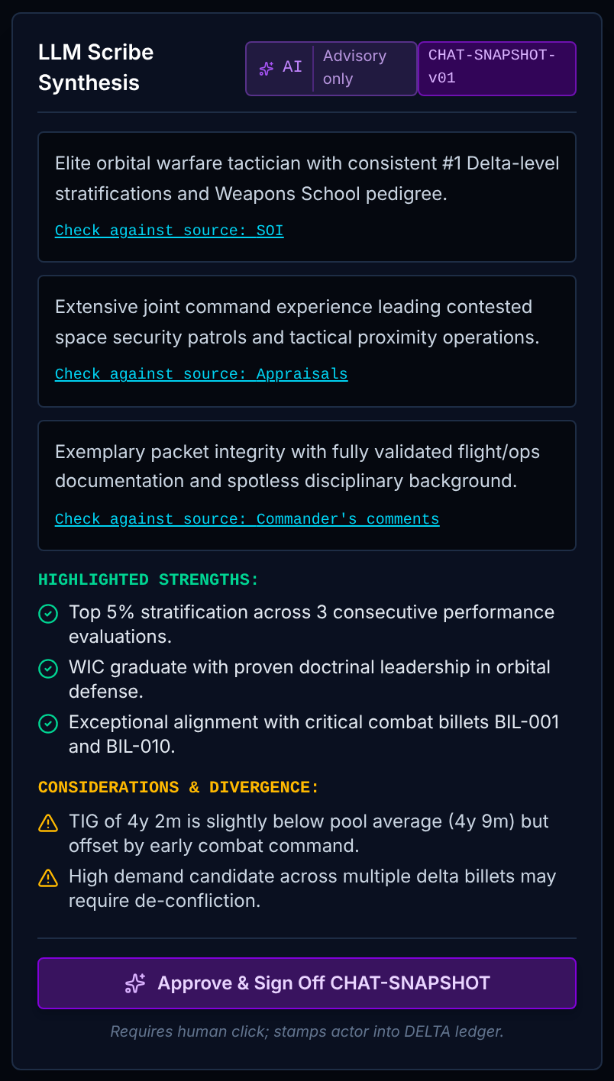
Panel Workspace: AI summary and human sign-off
One record, read through eight lenses, with the AI summary beside it and the scoring dock below.
Board Recorder: View
Read only.
1 AI summary (frozen copy)
Shows A three-paragraph summary, highlighted strengths, and considerations, each with a "check against source" link.
Data Candidate.chatSnapshot: summary, strengths, considerations.
Rule Marked "AI, advisory only". Each paragraph links to the source document so the reader can check it.
Trust Pre-written stand-in. The text is pre-written per record. No language model runs in the demo.
2 Human sign-off
Shows The button that records a named person approving the summary, or the name and time once signed.
Data chatSnapshot.signedOffBy, signedOffAt.
Rule Sign-off writes SNAPSHOT_SIGNOFF with the actor. It can be revoked, which writes SNAPSHOT_REVOKE. The Admin is refused.
Trust Fixed rule + logged to DELTA
1
2
Notes:
1. AI summary (frozen copy). A three-paragraph summary, highlighted strengths, and considerations, each with a "check against source" link. Data: Candidate.chatSnapshot: summary, strengths, considerations. Rule: Marked "AI, advisory only". Each paragraph links to the source document so the reader can check it. Trust: Pre-written stand-in. The text is pre-written per record. No language model runs in the demo.
2. Human sign-off. The button that records a named person approving the summary, or the name and time once signed. Data: chatSnapshot.signedOffBy, signedOffAt. Rule: Sign-off writes SNAPSHOT_SIGNOFF with the actor. It can be revoked, which writes SNAPSHOT_REVOKE. The Admin is refused. Trust: Fixed rule + logged to DELTA

Slide 28
Panel Workspace: Scoring dock
One record, read through eight lenses, with the AI summary beside it and the scoring dock below.
Board Recorder: View
Read only.
1 Scoring dock
Shows Score buttons from 6.0 to 10.0 in half points, Submit and Next, Flag for Discussion, and a reveal area for the model score and panel average.
Data Candidate.scores (panelist ID, value, time).
Rule One original score per voter per record. A change needs a written reason and is logged as SCORE_REVISE. The model score and panel average stay hidden until you submit, to avoid anchoring.
Trust Fixed rule + logged to DELTA (SCORE_SUBMIT)
Board Recorder No score buttons. Read only.
1
Notes:
1. Scoring dock. Score buttons from 6.0 to 10.0 in half points, Submit and Next, Flag for Discussion, and a reveal area for the model score and panel average. Data: Candidate.scores (panelist ID, value, time). Rule: One original score per voter per record. A change needs a written reason and is logged as SCORE_REVISE. The model score and panel average stay hidden until you submit, to avoid anchoring. Trust: Fixed rule + logged to DELTA (SCORE_SUBMIT) Board Recorder: No score buttons. Read only.

Slide 29
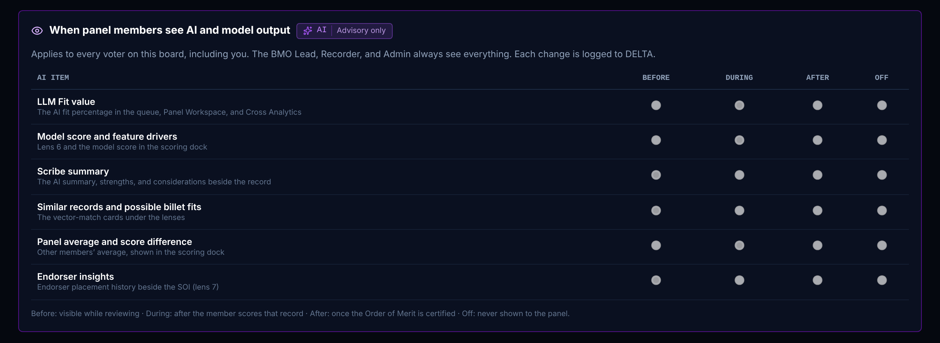
Panel Oversight: When panel members see AI output
The Board President's controls: what the panel sees from AI and when, panel progress, re-votes and record issues.
Board Recorder: View
Read only.
1 AI visibility settings
Shows Six AI items, each set to Before, During, After or Off: fit value, model score and drivers, summary, similar records and billet fits, panel average, endorser insights.
Data AiVisibility per board.
Rule Before = while reviewing. During = after the member scores that record. After = once the Order of Merit is certified. Off = never. Saving writes AI_VISIBILITY_CHANGE.
Trust Fixed rule + logged to DELTA. Demo default hides fit, model score and panel average until the member scores.
Board Recorder Reads the settings. Cannot change them.
1
Notes:
1. AI visibility settings. Six AI items, each set to Before, During, After or Off: fit value, model score and drivers, summary, similar records and billet fits, panel average, endorser insights. Data: AiVisibility per board. Rule: Before = while reviewing. During = after the member scores that record. After = once the Order of Merit is certified. Off = never. Saving writes AI_VISIBILITY_CHANGE. Trust: Fixed rule + logged to DELTA. Demo default hides fit, model score and panel average until the member scores. Board Recorder: Reads the settings. Cannot change them.

Slide 30
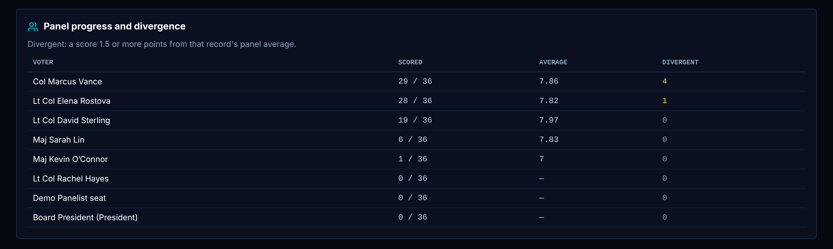
Panel Oversight: Panel progress and divergence
The Board President's controls: what the panel sees from AI and when, panel progress, re-votes and record issues.
Board Recorder: View
Read only.
1 Panel progress and divergence
Shows Per voter: records scored out of the pool, average score, and count of divergent scores.
Data Candidate.scores grouped by panelist.
Rule Divergent = that voter's score is 1.5 or more points from the record's panel average. The 1.5 limit is an ORBIT design setting with no empirical basis yet.
Trust Calculated live
1
Notes:
1. Panel progress and divergence. Per voter: records scored out of the pool, average score, and count of divergent scores. Data: Candidate.scores grouped by panelist. Rule: Divergent = that voter's score is 1.5 or more points from the record's panel average. The 1.5 limit is an ORBIT design setting with no empirical basis yet. Trust: Calculated live

Slide 31
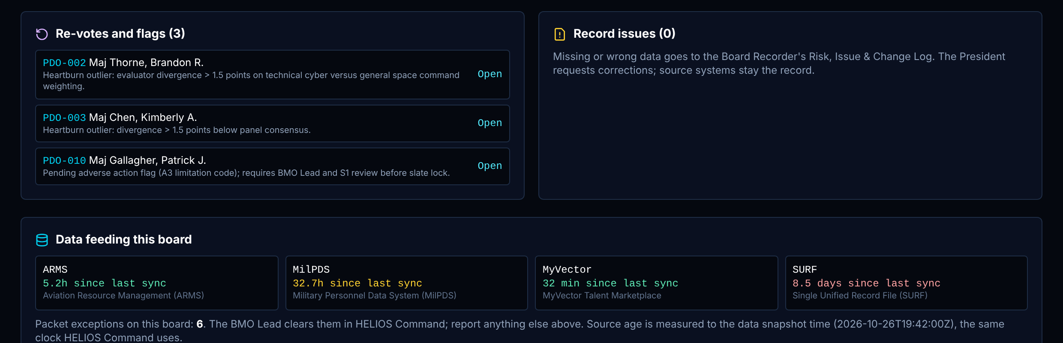
Panel Oversight: Re-votes, issues and data feeds (1 of 2)
The Board President's controls: what the panel sees from AI and when, panel progress, re-votes and record issues.
Board Recorder: View
Read only.
1 Re-votes and flags
Shows Records flagged for discussion or called for a re-vote, with the reason. Open jumps to the record.
Data Candidate.flagged, Candidate.flagReason.
Rule A flag needs a reason. Only the President calls a re-vote (REVOTE_CALL).
Trust Calculated live + logged to DELTA
2 Record issues
Shows A form to report missing or wrong data on a record to the Board Recorder.
Data Risk, issue and change log.
Rule Needs 10 or more characters. Writes RECORD_ISSUE and adds an item to the Recorder's log. The source system stays the record.
Trust Fixed rule + logged to DELTA
Board Recorder Form is read only. Works the issue in the log.
1
2
3
Notes:
1. Re-votes and flags. Records flagged for discussion or called for a re-vote, with the reason. Open jumps to the record. Data: Candidate.flagged, Candidate.flagReason. Rule: A flag needs a reason. Only the President calls a re-vote (REVOTE_CALL). Trust: Calculated live + logged to DELTA
2. Record issues. A form to report missing or wrong data on a record to the Board Recorder. Data: Risk, issue and change log. Rule: Needs 10 or more characters. Writes RECORD_ISSUE and adds an item to the Recorder's log. The source system stays the record. Trust: Fixed rule + logged to DELTA Board Recorder: Form is read only. Works the issue in the log.

Slide 32
Panel Oversight: Re-votes, issues and data feeds (2 of 2)
The Board President's controls: what the panel sees from AI and when, panel progress, re-votes and record issues.
Board Recorder: View
Read only.
3 Data feeding this board
Shows Hours since each source last synced, and the count of packet exceptions on the board.
Data SourcePipeline.lastSync; Candidate.packetReadiness.exceptions.
Rule Age = data snapshot time minus the stored last-sync time. Same function and limits as HELIOS Command.
Trust Calculated live. Matches HELIOS Command and Board Statistics.
1
2
3
Notes:
3. Data feeding this board. Hours since each source last synced, and the count of packet exceptions on the board. Data: SourcePipeline.lastSync; Candidate.packetReadiness.exceptions. Rule: Age = data snapshot time minus the stored last-sync time. Same function and limits as HELIOS Command. Trust: Calculated live. Matches HELIOS Command and Board Statistics.

Slide 33
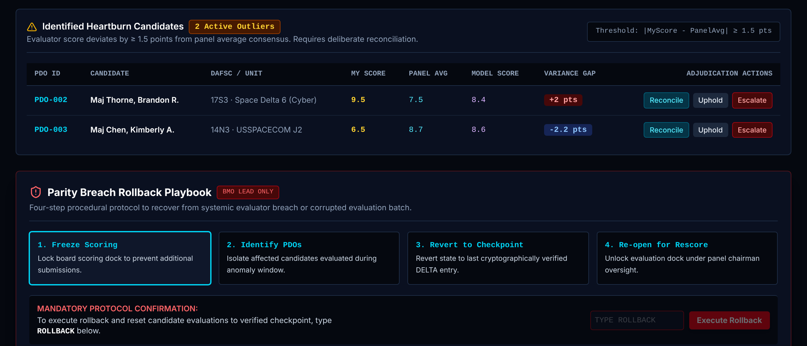
Scoring Audit: Divergent scores and rollback (1 of 2)
Finds scores far from the panel average and records what a person decided to do about each.
Board Recorder: View
Read only.
1 Divergent scores table
Shows Each record where a score sits 1.5 or more points from the panel average: the score, the panel average, the model score and the gap, with Reconcile, Uphold and Escalate.
Data Candidate.myScore, Candidate.scores, Candidate.mScore.
Rule Gap = score minus panel average. Listed when the gap is 1.5 or more either way. Every action needs a note and writes HEARTBURN_ADJUDICATE.
Trust Calculated live + logged to DELTA. In the demo "My Score" is the demo panelist seat's score for every role. The model score column is Pre-written stand-in.
Board Recorder Reads the table.
1
2
Notes:
1. Divergent scores table. Each record where a score sits 1.5 or more points from the panel average: the score, the panel average, the model score and the gap, with Reconcile, Uphold and Escalate. Data: Candidate.myScore, Candidate.scores, Candidate.mScore. Rule: Gap = score minus panel average. Listed when the gap is 1.5 or more either way. Every action needs a note and writes HEARTBURN_ADJUDICATE. Trust: Calculated live + logged to DELTA. In the demo "My Score" is the demo panelist seat's score for every role. The model score column is Pre-written stand-in. Board Recorder: Reads the table.

Slide 34
Scoring Audit: Divergent scores and rollback (2 of 2)
Finds scores far from the panel average and records what a person decided to do about each.
Board Recorder: View
Read only.
2 Rollback playbook
Shows Four steps to recover from a bad scoring batch: freeze, identify, revert, reopen. Needs the word ROLLBACK typed to confirm.
Data Scores and the DELTA ledger.
Rule Writes ROLLBACK. Demo: one person (BMO Lead or President). Production decision: needs both the BMO Lead and the President.
Trust Fixed rule + logged to DELTA
Board Recorder Cannot run it.
1
2
Notes:
2. Rollback playbook. Four steps to recover from a bad scoring batch: freeze, identify, revert, reopen. Needs the word ROLLBACK typed to confirm. Data: Scores and the DELTA ledger. Rule: Writes ROLLBACK. Demo: one person (BMO Lead or President). Production decision: needs both the BMO Lead and the President. Trust: Fixed rule + logged to DELTA Board Recorder: Cannot run it.

Slide 35
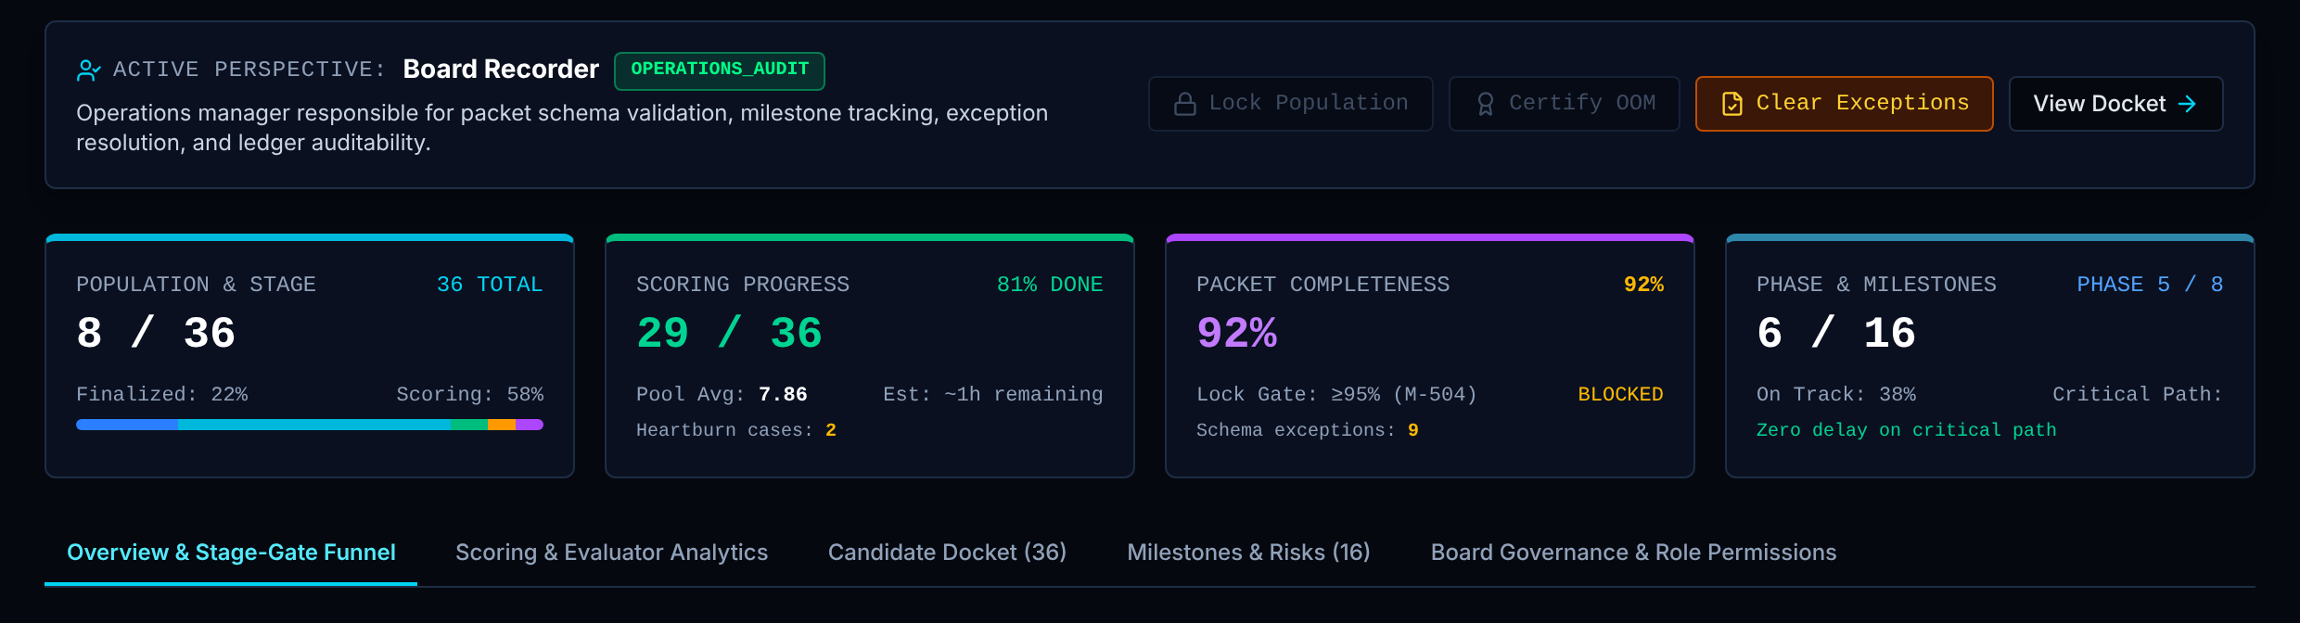
Board Statistics & Roles: Role banner and four cards (1 of 3)
One board's numbers, gates and role rights. This is where the population is locked and the Order of Merit is certified.
Board Recorder: View
Read only.
1 Role banner and gated buttons
Shows Your role, its access level, and the actions it may take: Lock Population, Certify OOM, Clear Exceptions, View Docket.
Data Role permission set; Board; packet completeness.
Rule Lock needs 95% packets. Certify writes BOARD_OOM_CERTIFY. Each button is enabled only for roles allowed to use it.
Trust Fixed rule + logged to DELTA. Enforced by the screen in the demo; by the data platform in production.
Board Recorder Reads. No action buttons.
2 Population and stage
Shows Finalized records out of the pool, with the share at each stage.
Data Candidate.flow.stage.
Rule Counts per stage divided by the pool.
Trust Calculated live
1
2
3
5
4
Notes:
1. Role banner and gated buttons. Your role, its access level, and the actions it may take: Lock Population, Certify OOM, Clear Exceptions, View Docket. Data: Role permission set; Board; packet completeness. Rule: Lock needs 95% packets. Certify writes BOARD_OOM_CERTIFY. Each button is enabled only for roles allowed to use it. Trust: Fixed rule + logged to DELTA. Enforced by the screen in the demo; by the data platform in production. Board Recorder: Reads. No action buttons.
2. Population and stage. Finalized records out of the pool, with the share at each stage. Data: Candidate.flow.stage. Rule: Counts per stage divided by the pool. Trust: Calculated live

Slide 36
Board Statistics & Roles: Role banner and four cards (2 of 3)
One board's numbers, gates and role rights. This is where the population is locked and the Order of Merit is certified.
Board Recorder: View
Read only.
3 Scoring progress
Shows Records with at least one score, pool average, divergent cases and time remaining.
Data Candidate.scores.
Rule Scored = records with one or more scores. Pool average = mean of all scores.
Trust Calculated live for counts and average. Sample value for "time remaining" and pace.
4 Packet completeness
Shows Share of records with complete documents, against the 95% lock gate, and the exception count.
Data Candidate.packetReadiness.complete, exceptions.
Rule Complete packets divided by records (33 of 36 = 92%). Same definition as M-504 on HELIOS Command.
Trust Calculated live
1
2
3
5
4
Notes:
3. Scoring progress. Records with at least one score, pool average, divergent cases and time remaining. Data: Candidate.scores. Rule: Scored = records with one or more scores. Pool average = mean of all scores. Trust: Calculated live for counts and average. Sample value for "time remaining" and pace.
4. Packet completeness. Share of records with complete documents, against the 95% lock gate, and the exception count. Data: Candidate.packetReadiness.complete, exceptions. Rule: Complete packets divided by records (33 of 36 = 92%). Same definition as M-504 on HELIOS Command. Trust: Calculated live

Slide 37
Board Statistics & Roles: Role banner and four cards (3 of 3)
One board's numbers, gates and role rights. This is where the population is locked and the Order of Merit is certified.
Board Recorder: View
Read only.
5 Phase and milestones
Shows Milestones done out of total, the current phase, and critical-path delay.
Data Milestone: phase, planned, actual, status.
Rule Done count over total. Phase is inferred from stage counts. Delay is set from board status: 0, 2 or 6 days.
Trust Calculated live for counts. Fixed rule for phase and delay (not measured from dates).
1
2
3
5
4
Notes:
5. Phase and milestones. Milestones done out of total, the current phase, and critical-path delay. Data: Milestone: phase, planned, actual, status. Rule: Done count over total. Phase is inferred from stage counts. Delay is set from board status: 0, 2 or 6 days. Trust: Calculated live for counts. Fixed rule for phase and delay (not measured from dates).

Slide 38
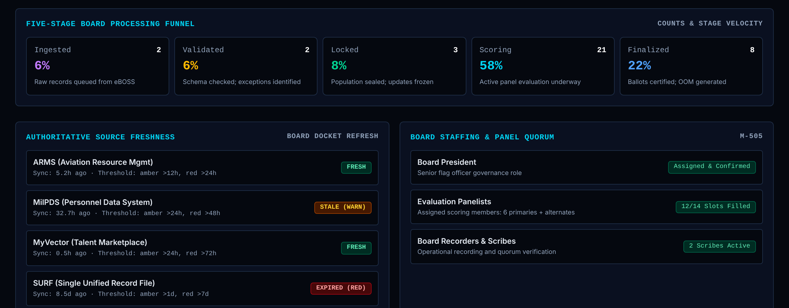
Board Statistics & Roles: Tab 1: Overview and funnel
One board's numbers, gates and role rights. This is where the population is locked and the Order of Merit is certified.
Board Recorder: View
Read only.
1 Five-stage funnel
Shows Count and share of records at each of the five stages.
Data Candidate.flow.stage.
Rule Count per stage; share = count divided by pool.
Trust Calculated live
2 Source freshness for this board
Shows Age and status of ARMS, MilPDS, MyVector and SURF data.
Data SourcePipeline last sync time.
Rule Same function and limits as HELIOS Command.
Trust Calculated live (5.2h, 32.7h, 0.5h, 8.5 days). The sync times are fictional.
3 Staffing and quorum
Shows President, panelist seats filled, and scribes.
Data StaffSlot.
Rule Counts assigned seats by role.
Trust Calculated live, with fallbacks that always show the President and scribes as assigned
1
2
3
Notes:
1. Five-stage funnel. Count and share of records at each of the five stages. Data: Candidate.flow.stage. Rule: Count per stage; share = count divided by pool. Trust: Calculated live
2. Source freshness for this board. Age and status of ARMS, MilPDS, MyVector and SURF data. Data: SourcePipeline last sync time. Rule: Same function and limits as HELIOS Command. Trust: Calculated live (5.2h, 32.7h, 0.5h, 8.5 days). The sync times are fictional.
3. Staffing and quorum. President, panelist seats filled, and scribes. Data: StaffSlot. Rule: Counts assigned seats by role. Trust: Calculated live, with fallbacks that always show the President and scribes as assigned

Slide 39
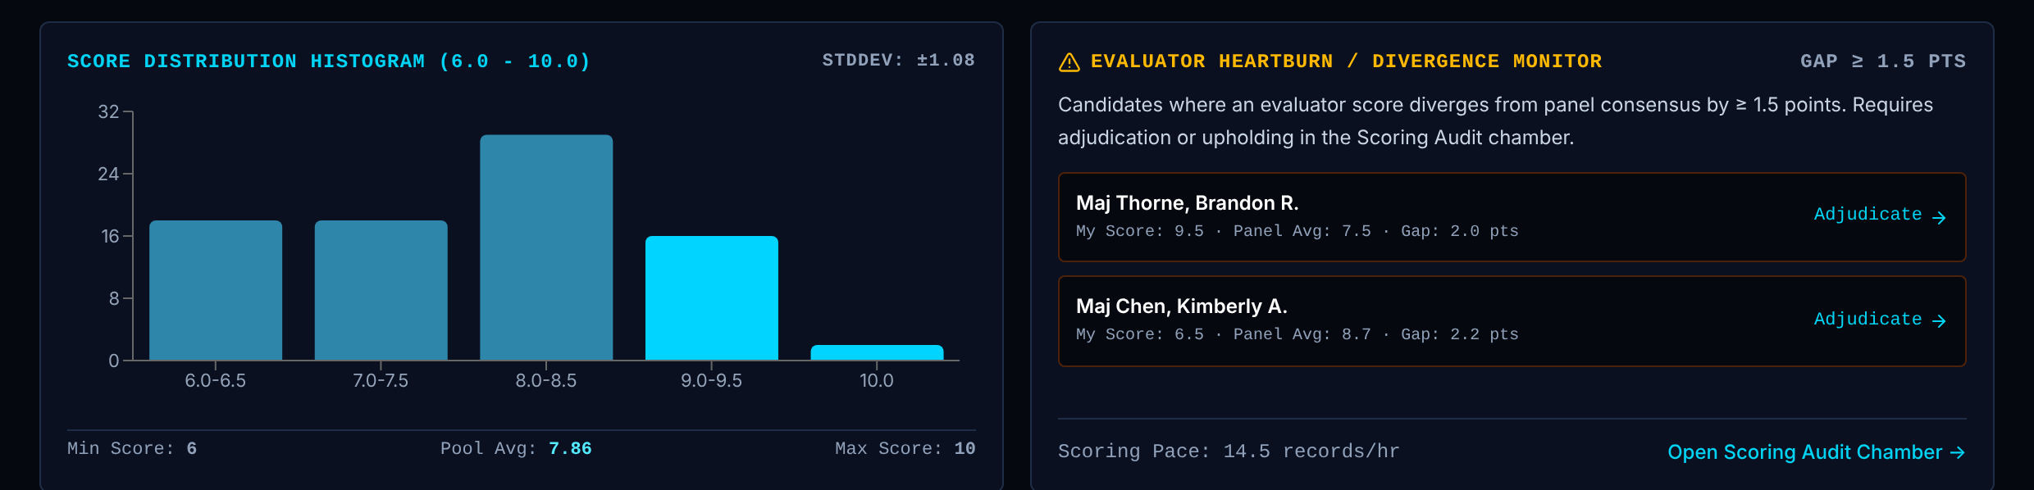
Board Statistics & Roles: Tab 2: Scoring analytics
One board's numbers, gates and role rights. This is where the population is locked and the Order of Merit is certified.
Board Recorder: View
Read only.
1 Score distribution
Shows How many scores fall in each half-point band from 6.0 to 10.0, with the standard deviation, minimum, pool average and maximum.
Data Every Candidate.scores value on the board.
Rule Population standard deviation: square root of the mean squared distance from the pool average.
Trust Calculated live
2 Divergence monitor
Shows Records where a score is 1.5 or more points from the panel average, with a link to adjudicate, and the scoring pace.
Data Candidate.myScore, Candidate.scores.
Rule Same 1.5-point rule as Scoring Audit.
Trust Calculated live for the list. Sample value for scoring pace (14.5 records per hour).
1
2
Notes:
1. Score distribution. How many scores fall in each half-point band from 6.0 to 10.0, with the standard deviation, minimum, pool average and maximum. Data: Every Candidate.scores value on the board. Rule: Population standard deviation: square root of the mean squared distance from the pool average. Trust: Calculated live
2. Divergence monitor. Records where a score is 1.5 or more points from the panel average, with a link to adjudicate, and the scoring pace. Data: Candidate.myScore, Candidate.scores. Rule: Same 1.5-point rule as Scoring Audit. Trust: Calculated live for the list. Sample value for scoring pace (14.5 records per hour).

Slide 40
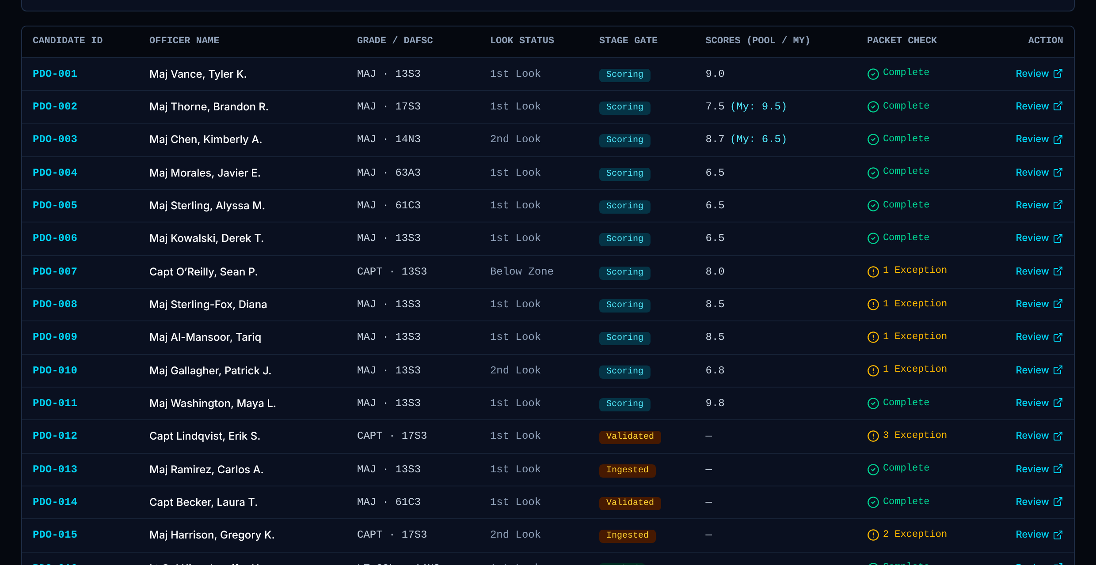
Board Statistics & Roles: Tab 3: Candidate docket
One board's numbers, gates and role rights. This is where the population is locked and the Order of Merit is certified.
Board Recorder: View
Read only.
1 Candidate docket
Shows Every record on the board with its stage, packet status and scoring status. A row opens the record.
Data Candidate: flow.stage, packetReadiness, scores.
Rule Listed from the same records as the Candidate Queue.
Trust Calculated live
1
Notes:
1. Candidate docket. Every record on the board with its stage, packet status and scoring status. A row opens the record. Data: Candidate: flow.stage, packetReadiness, scores. Rule: Listed from the same records as the Candidate Queue. Trust: Calculated live

Slide 41
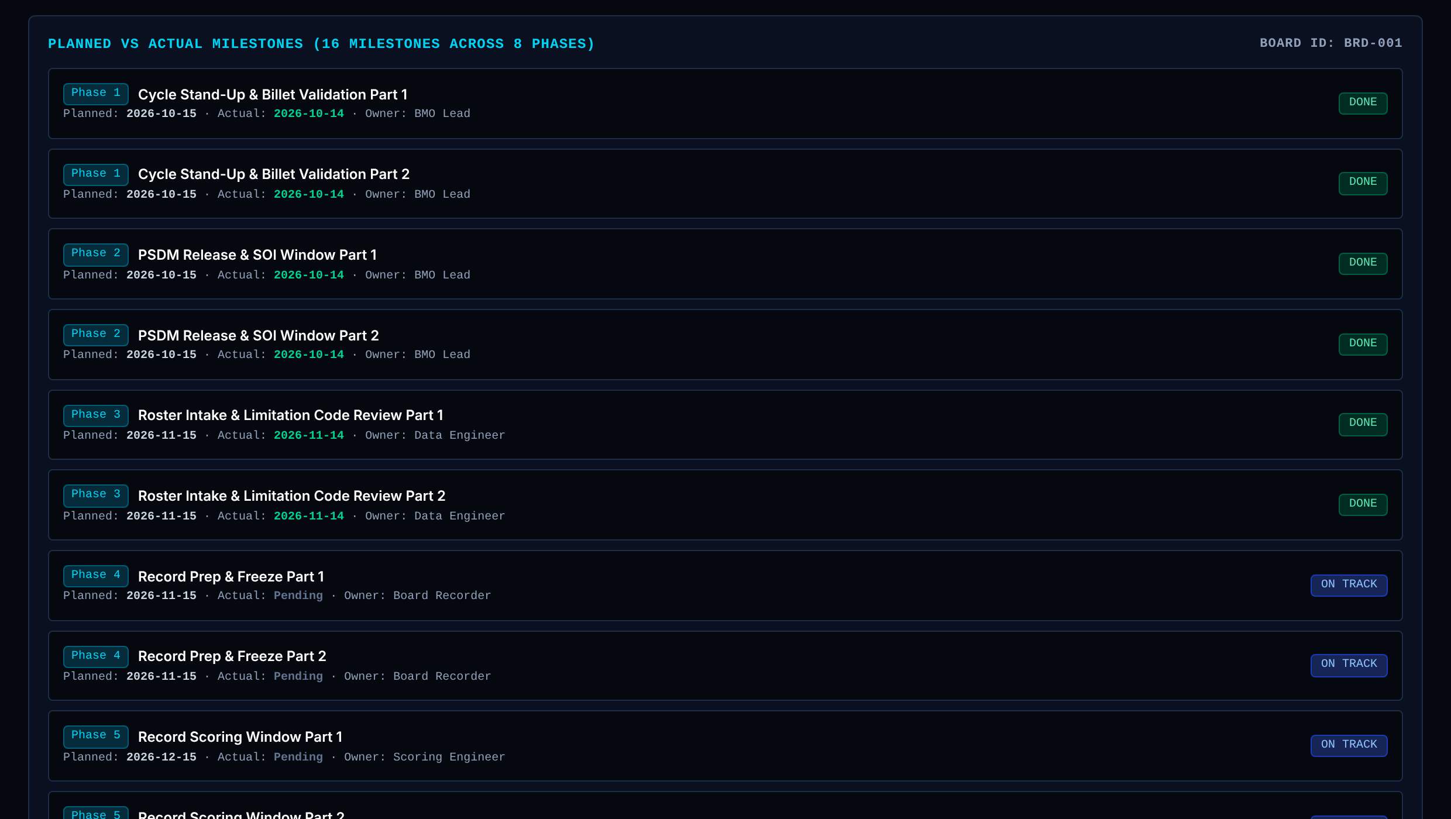
Board Statistics & Roles: Tab 4: Milestones
One board's numbers, gates and role rights. This is where the population is locked and the Order of Merit is certified.
Board Recorder: View
Read only.
1 Planned and actual milestones
Shows Sixteen milestones across eight phases: owner, planned date, actual date, status.
Data Milestone: phase, name, owner, planned, actual, status.
Rule Shown as stored. Status is a stored field, not worked out from the dates.
Trust Calculated live display
1
Notes:
1. Planned and actual milestones. Sixteen milestones across eight phases: owner, planned date, actual date, status. Data: Milestone: phase, name, owner, planned, actual, status. Rule: Shown as stored. Status is a stored field, not worked out from the dates. Trust: Calculated live display

Slide 42
Board Statistics & Roles: Tab 4: Risks and issues
One board's numbers, gates and role rights. This is where the population is locked and the Order of Merit is certified.
Board Recorder: View
Read only.
1 Risks and issues
Shows Open risks, issues and changes for this board, with owner, suspense date and mitigation.
Data Risk: type, title, owner, suspense, escalate, status.
Rule Open items only. Record issues sent by the President land here.
Trust Calculated live
1
Notes:
1. Risks and issues. Open risks, issues and changes for this board, with owner, suspense date and mitigation. Data: Risk: type, title, owner, suspense, escalate, status. Rule: Open items only. Record issues sent by the President land here. Trust: Calculated live

Slide 43
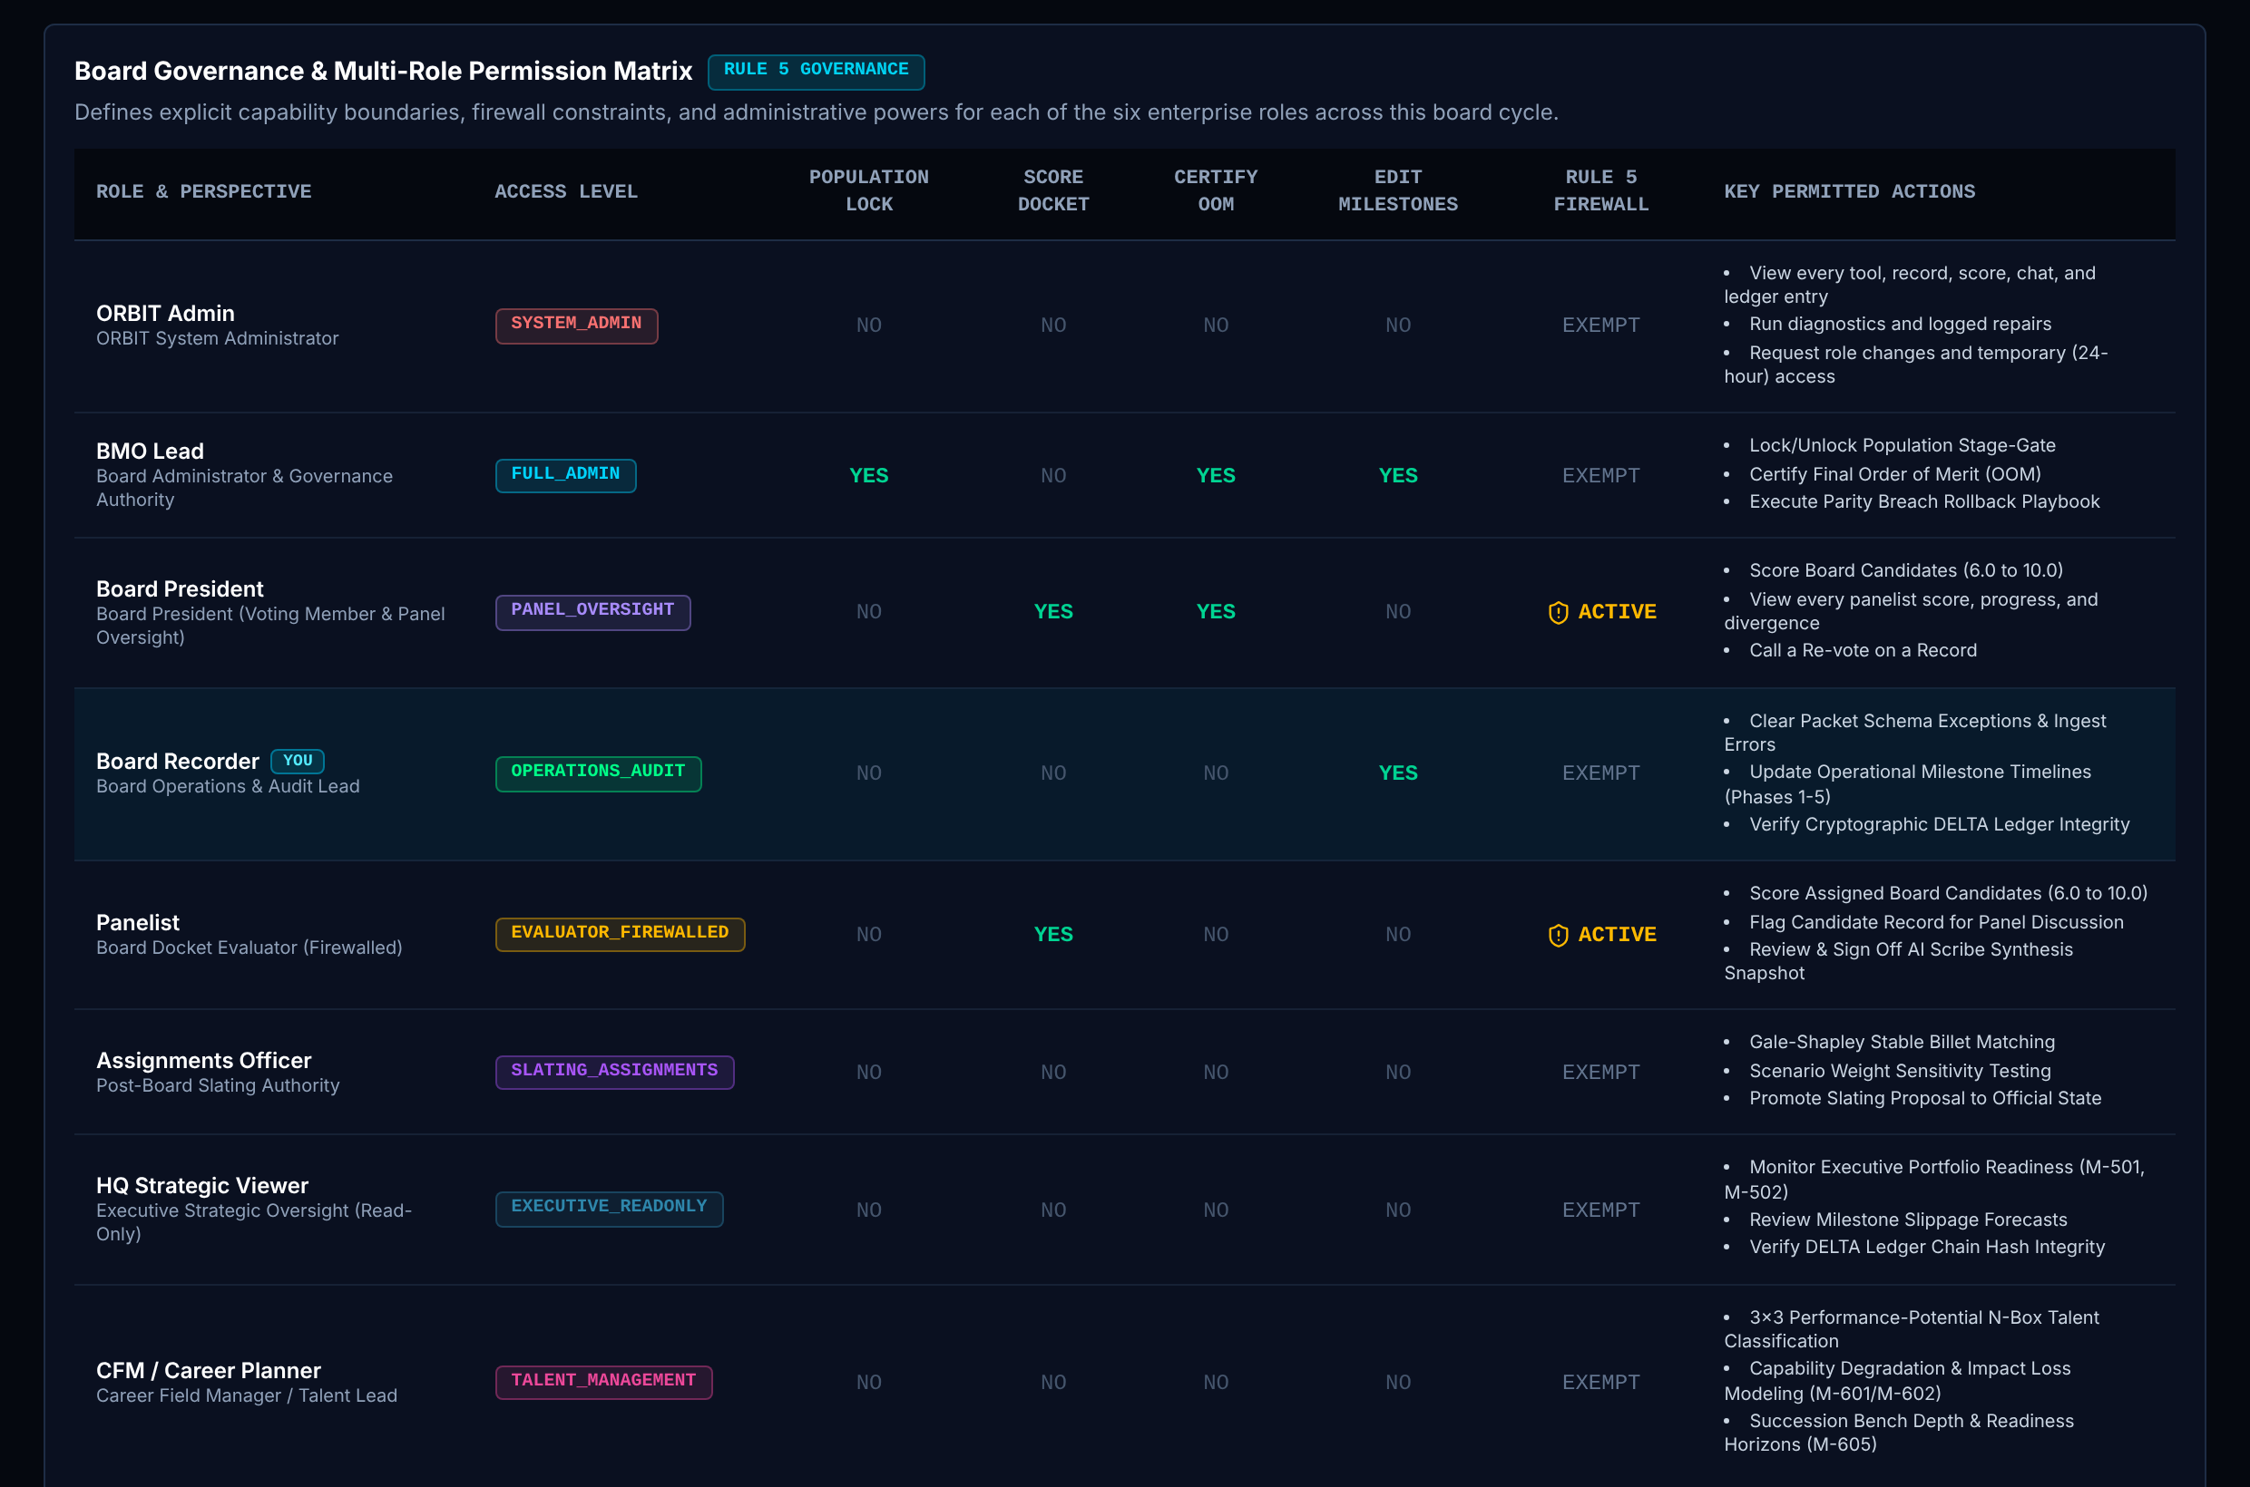
Board Statistics & Roles: Tab 5: Role permissions
One board's numbers, gates and role rights. This is where the population is locked and the Order of Merit is certified.
Board Recorder: View
Read only.
1 Role permission matrix
Shows Each role and what it may do on a board: lock, certify, score, edit milestones, manage risks, see talent data, export.
Data Board role permission set.
Rule Read-only reference. The live checks are in the permission table and in each action.
Trust Fixed rule
1
Notes:
1. Role permission matrix. Each role and what it may do on a board: lock, certify, score, edit milestones, manage risks, see talent data, export. Data: Board role permission set. Rule: Read-only reference. The live checks are in the permission table and in each action. Trust: Fixed rule

Slide 44
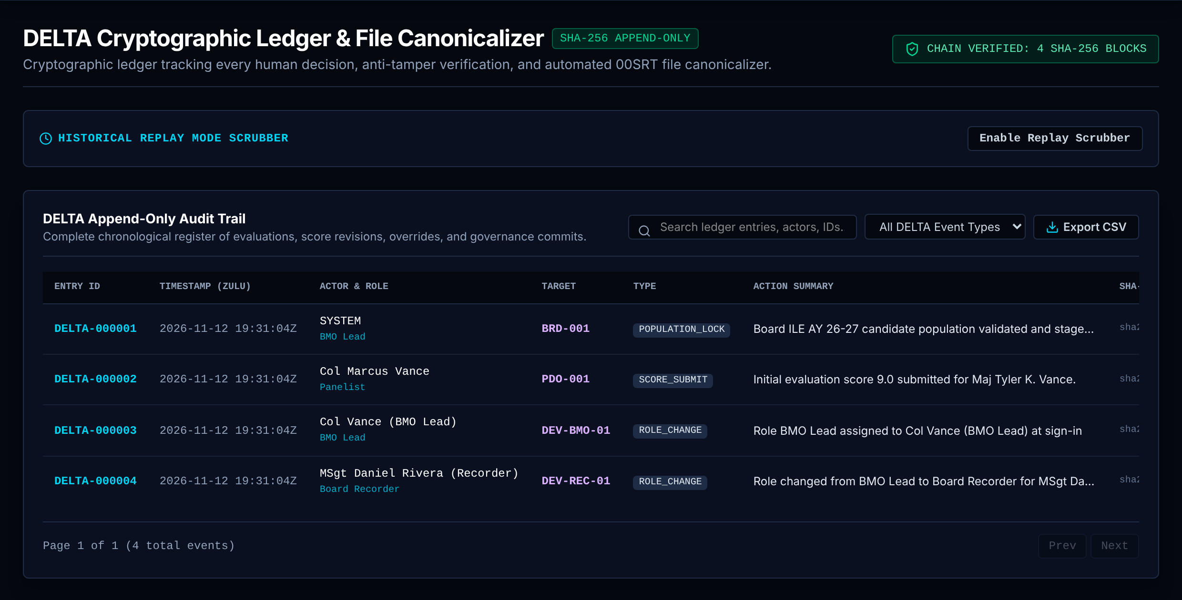
DELTA Ledger: Chain, replay and audit trail (1 of 2)
The audit trail of every action, and the gate every incoming file passes through.
Board Recorder: Owns
Runs this page's actions.
1 Chain status and tamper test
Shows Whether the chain verifies, the number of entries, and a button that simulates tampering.
Data DeltaEntry.prevHash, DeltaEntry.hash.
Rule Each entry's SHA-256 hash covers its content and the previous entry's hash. Changing any entry breaks every hash after it.
Trust Calculated live
Board Recorder Reads chain status.
2 Replay scrubber
Shows Steps the board back to any earlier entry to see what was known at that point.
Data The ordered ledger.
Rule Read only. Replays entries in order up to the chosen point.
Trust Calculated live
1
2
3
Notes:
1. Chain status and tamper test. Whether the chain verifies, the number of entries, and a button that simulates tampering. Data: DeltaEntry.prevHash, DeltaEntry.hash. Rule: Each entry's SHA-256 hash covers its content and the previous entry's hash. Changing any entry breaks every hash after it. Trust: Calculated live Board Recorder: Reads chain status.
2. Replay scrubber. Steps the board back to any earlier entry to see what was known at that point. Data: The ordered ledger. Rule: Read only. Replays entries in order up to the chosen point. Trust: Calculated live

Slide 45
DELTA Ledger: Chain, replay and audit trail (2 of 2)
The audit trail of every action, and the gate every incoming file passes through.
Board Recorder: Owns
Runs this page's actions.
3 Audit trail
Shows Every entry: ID, time (Zulu), actor and role, target, type, summary, hash. Search, filter by type, export CSV.
Data DeltaEntry.
Rule Entries are only added. A correction is a new entry. Refused actions are entries too (ACCESS_DENIED).
Trust logged to DELTA
Board Recorder Sees every entry. Owns this page.
1
2
3
Notes:
3. Audit trail. Every entry: ID, time (Zulu), actor and role, target, type, summary, hash. Search, filter by type, export CSV. Data: DeltaEntry. Rule: Entries are only added. A correction is a new entry. Refused actions are entries too (ACCESS_DENIED). Trust: logged to DELTA Board Recorder: Sees every entry. Owns this page.

Slide 46
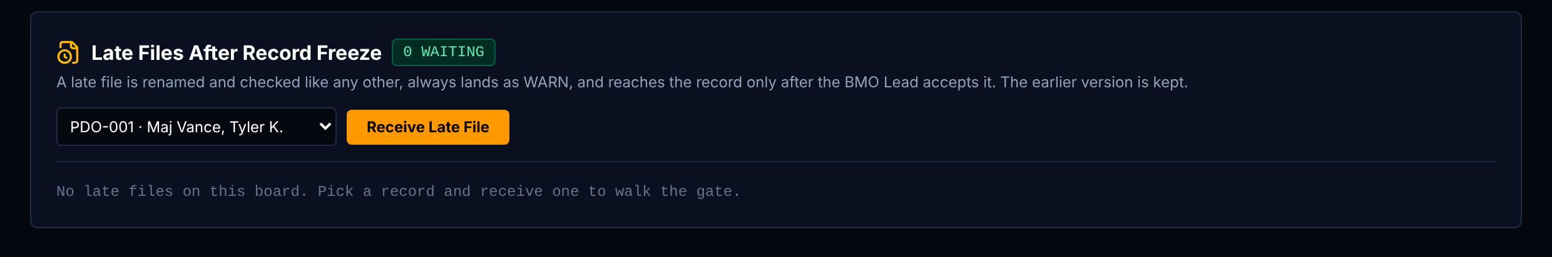
DELTA Ledger: Late files after record freeze
The audit trail of every action, and the gate every incoming file passes through.
Board Recorder: Owns
Runs this page's actions.
1 Late file gate
Shows Files that arrived after the record freeze: canonical name, gate result, who received it, and the decision.
Data CanonicalFileRecord; FILE_ROUTED ledger entries marked late.
Rule A late file is renamed to the standard, always lands as WARN, and reaches the record only when the BMO Lead accepts it. The earlier version is kept. Both steps are logged.
Trust Fixed rule + logged to DELTA
Board Recorder Receives late files. Cannot accept them.
1
Notes:
1. Late file gate. Files that arrived after the record freeze: canonical name, gate result, who received it, and the decision. Data: CanonicalFileRecord; FILE_ROUTED ledger entries marked late. Rule: A late file is renamed to the standard, always lands as WARN, and reaches the record only when the BMO Lead accepts it. The earlier version is kept. Both steps are logged. Trust: Fixed rule + logged to DELTA Board Recorder: Receives late files. Cannot accept them.

Slide 47
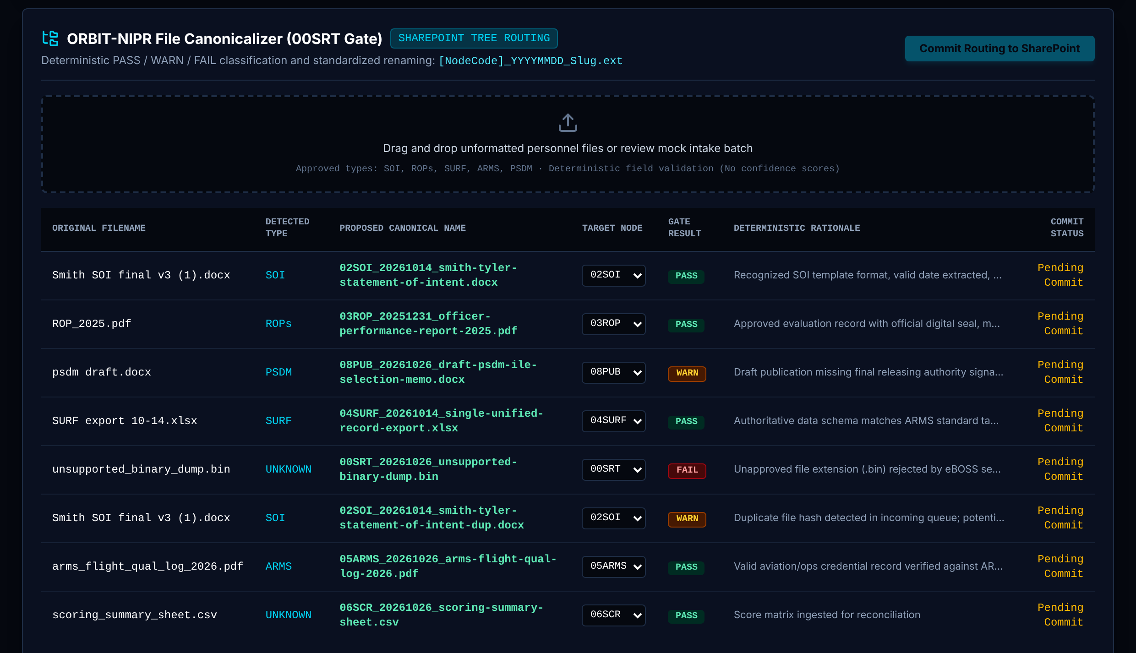
DELTA Ledger: File canonicalizer (00SRT gate)
The audit trail of every action, and the gate every incoming file passes through.
Board Recorder: Owns
Runs this page's actions.
1 File canonicalizer
Shows Each incoming file: original name, detected type, proposed standard name, target folder, gate result and reason, commit status.
Data CanonicalFileRecord: originalName, detectedDocType, canonicalName, targetNode, checkResult, reason, committed.
Rule Standard name = folder code, date, short title, extension. PASS routes. WARN waits for a person. FAIL (bad type or duplicate) is rejected. No confidence scores: every result is a yes or no rule.
Trust Fixed rule + logged to DELTA (FILE_ROUTED). Method from the AI 101 Technical capstone.
Board Recorder Routes files and commits the routing.
1
Notes:
1. File canonicalizer. Each incoming file: original name, detected type, proposed standard name, target folder, gate result and reason, commit status. Data: CanonicalFileRecord: originalName, detectedDocType, canonicalName, targetNode, checkResult, reason, committed. Rule: Standard name = folder code, date, short title, extension. PASS routes. WARN waits for a person. FAIL (bad type or duplicate) is rejected. No confidence scores: every result is a yes or no rule. Trust: Fixed rule + logged to DELTA (FILE_ROUTED). Method from the AI 101 Technical capstone. Board Recorder: Routes files and commits the routing.

Slide 48
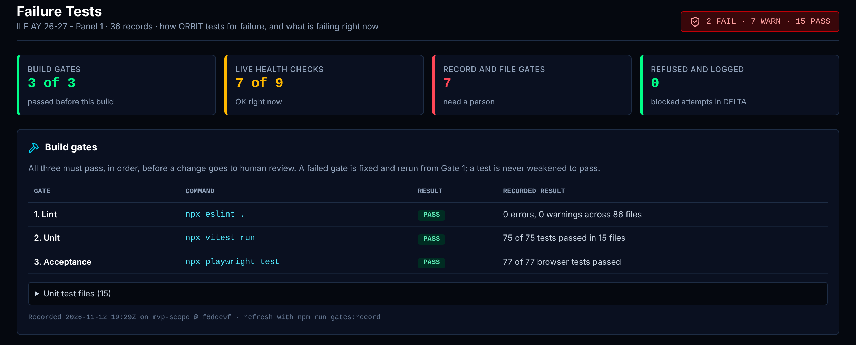
Failure Tests: Summary and build gates
One screen that answers: how does ORBIT test for failure, and is anything failing right now?
Board Recorder: View
Read only.
1 Summary and four tiles
Shows Counts of FAIL, WARN and PASS across every check on the page, and one tile per group.
Data The four sections below.
Rule Worst result in a group sets the tile color.
Trust Calculated live roll-up. It inherits Sample value values from the freshness rows.
2 Build gates
Shows The three checks every code change must pass before a person reviews it, with the recorded result.
Data Gate results file written by the test tools at build time.
Rule On this build: lint 0 errors, unit 73 of 73, browser 77 of 77. A failed gate is fixed and rerun from Gate 1. A test is never weakened to pass.
Trust Recorded from real tool output for this build. Not typed.
1
2
Notes:
1. Summary and four tiles. Counts of FAIL, WARN and PASS across every check on the page, and one tile per group. Data: The four sections below. Rule: Worst result in a group sets the tile color. Trust: Calculated live roll-up. It inherits Sample value values from the freshness rows.
2. Build gates. The three checks every code change must pass before a person reviews it, with the recorded result. Data: Gate results file written by the test tools at build time. Rule: On this build: lint 0 errors, unit 73 of 73, browser 77 of 77. A failed gate is fixed and rerun from Gate 1. A test is never weakened to pass. Trust: Recorded from real tool output for this build. Not typed.

Slide 49
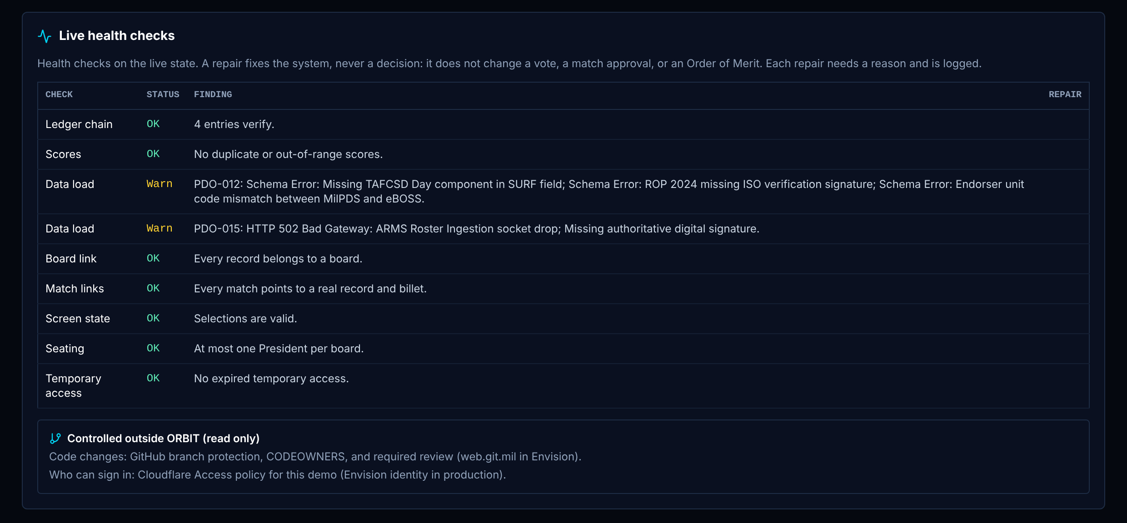
Failure Tests: Live health checks
One screen that answers: how does ORBIT test for failure, and is anything failing right now?
Board Recorder: View
Read only.
1 Live health checks
Shows Nine checks on the running data: ledger chain, duplicate or out-of-range scores, data load, board links, match links, screen state, seating, temporary access.
Data The whole app state.
Rule Each check is a yes or no test. A repair needs a reason of 20 or more characters and is logged. A repair never changes a vote, a match or the Order of Merit.
Trust Calculated live + logged to DELTA
Board Recorder Reads the findings.
1
Notes:
1. Live health checks. Nine checks on the running data: ledger chain, duplicate or out-of-range scores, data load, board links, match links, screen state, seating, temporary access. Data: The whole app state. Rule: Each check is a yes or no test. A repair needs a reason of 20 or more characters and is logged. A repair never changes a vote, a match or the Order of Merit. Trust: Calculated live + logged to DELTA Board Recorder: Reads the findings.

Slide 50
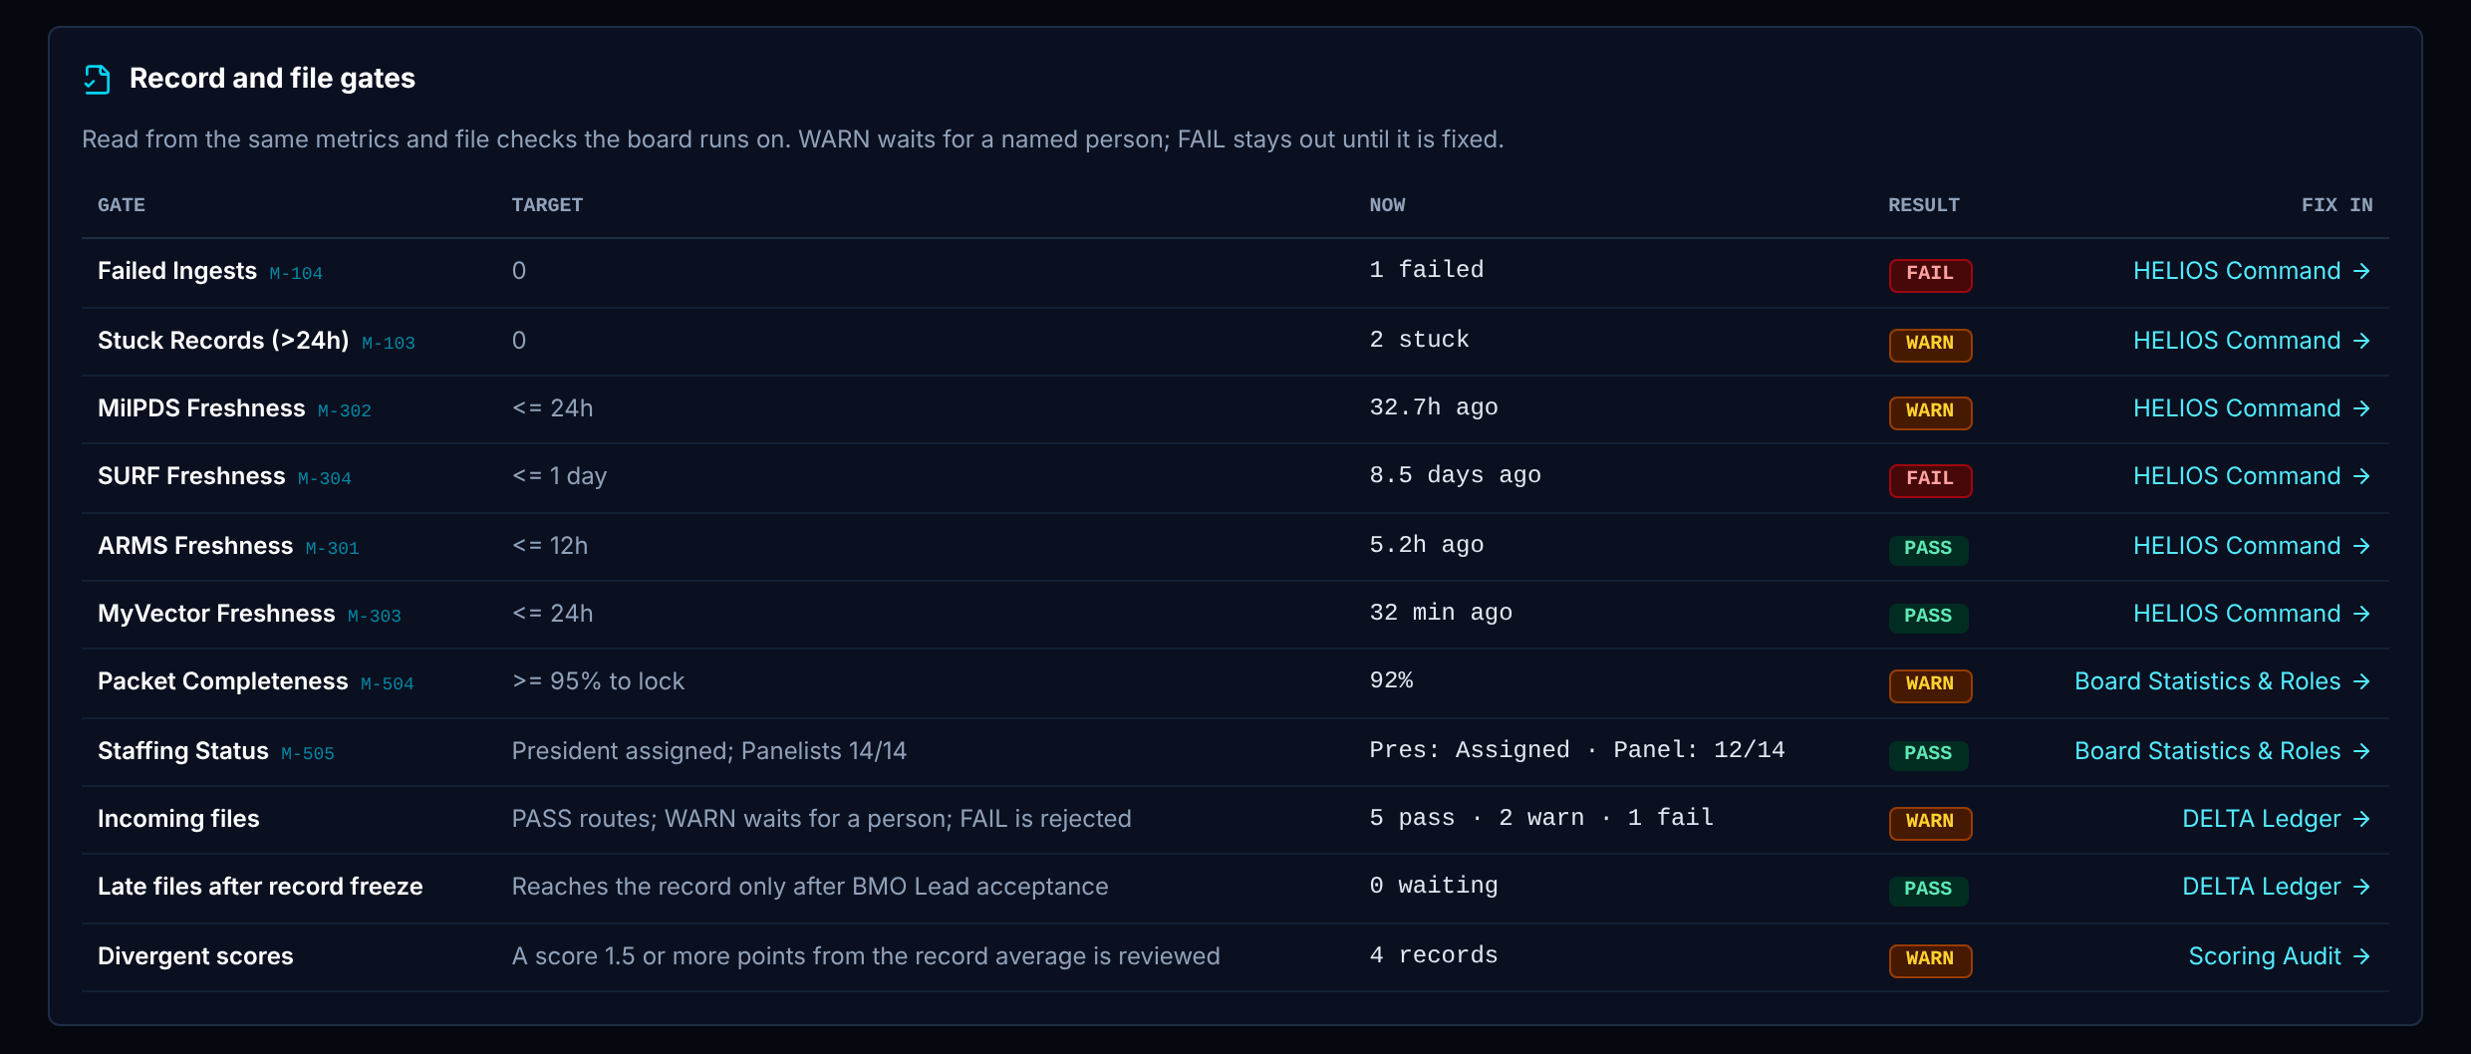
Failure Tests: Record and file gates
One screen that answers: how does ORBIT test for failure, and is anything failing right now?
Board Recorder: View
Read only.
1 Record and file gates
Shows Eleven gates with target, current value and result: failed and stuck records, four source ages, packet completeness, staffing, incoming files, late files, divergent scores.
Data The metric registry, file records and scores.
Rule Reads the same metric functions as HELIOS Command, so the numbers match that screen.
Trust Calculated live for failed, stuck, packets, staffing, files, late files and divergent scores. Sample value for the four source ages.
1
Notes:
1. Record and file gates. Eleven gates with target, current value and result: failed and stuck records, four source ages, packet completeness, staffing, incoming files, late files, divergent scores. Data: The metric registry, file records and scores. Rule: Reads the same metric functions as HELIOS Command, so the numbers match that screen. Trust: Calculated live for failed, stuck, packets, staffing, files, late files and divergent scores. Sample value for the four source ages.

Slide 51
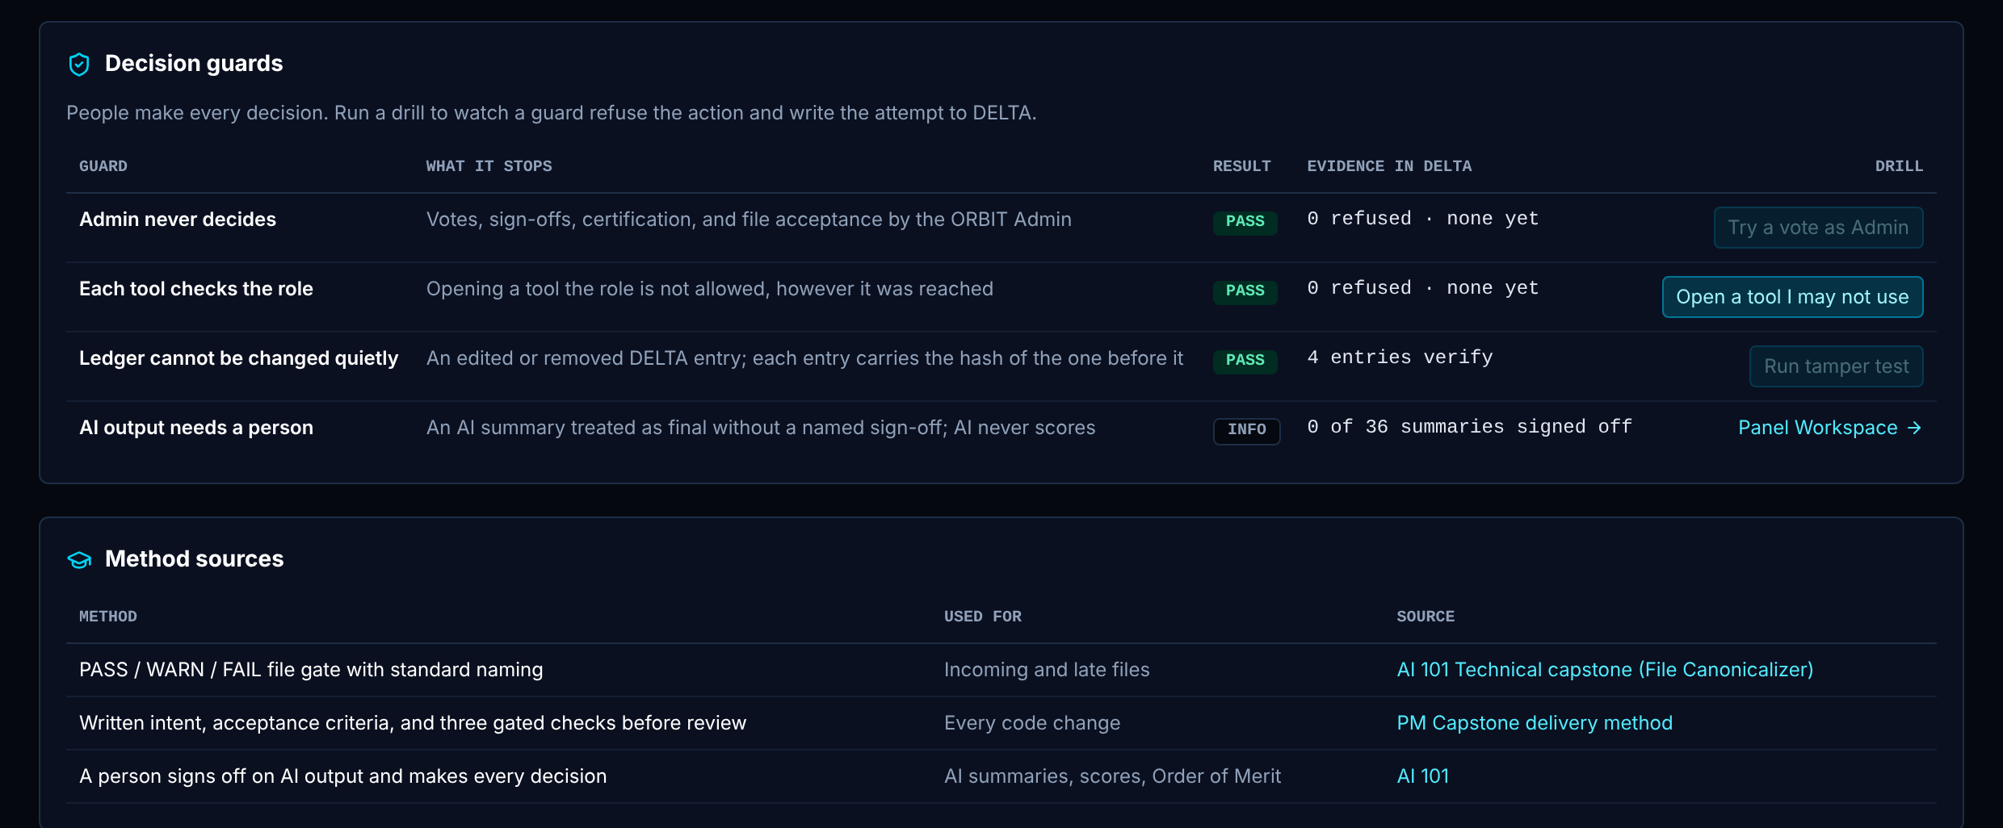
Failure Tests: Decision guards and method sources
One screen that answers: how does ORBIT test for failure, and is anything failing right now?
Board Recorder: View
Read only.
1 Decision guards
Shows Four guards with a drill button each: Admin never decides, each tool checks the role, the ledger cannot be changed quietly, AI output needs a person.
Data ACCESS_DENIED entries in DELTA; chain verification; summary sign-offs.
Rule A drill attempts the forbidden action. ORBIT refuses it and writes the attempt to DELTA, and the count on this row goes up.
Trust Calculated live + logged to DELTA
Board Recorder Runs "Open a tool I may not use".
2 Method sources
Shows Where each failure-testing method came from.
Data A short list kept in the code.
Rule Reference only.
Trust Typed list. Confirm each source before briefing.
1
2
Notes:
1. Decision guards. Four guards with a drill button each: Admin never decides, each tool checks the role, the ledger cannot be changed quietly, AI output needs a person. Data: ACCESS_DENIED entries in DELTA; chain verification; summary sign-offs. Rule: A drill attempts the forbidden action. ORBIT refuses it and writes the attempt to DELTA, and the count on this row goes up. Trust: Calculated live + logged to DELTA Board Recorder: Runs "Open a tool I may not use".
2. Method sources. Where each failure-testing method came from. Data: A short list kept in the code. Rule: Reference only. Trust: Typed list. Confirm each source before briefing.

Slide 52
What to say if asked "is that number real?" (1 of 3)
49 of 69 widgets this role sees are fully calculated, rule-based or logged. These 20 are not, in whole or in part.
Screen | Widget | Status | The plain answer
HELIOS Command | KPI strip (M-101 to M-105) | Mixed | Calculated live for the processed count, stuck and failed. Sample value for "+12% vs prior", "4.2 min" and "Yes (14d remaining)".
HELIOS Command | Throughput trend (M-106) | Sample | Sample value. The seven points and the +1.45 slope are fixed in the demo.
HELIOS Command | Readiness gauges (M-501, M-502, M-504) | Mixed | Calculated live for packet completeness. Sample value for readiness 96% and at-risk 4%.
Candidate Queue | Board header and counters | Mixed | Calculated live for counts, Board Avg and My Avg. Sample value for "Panel": it is Board Avg plus 0.1, and My Avg shows a placeholder until you score.
Candidate Queue | Record table | Stand-in | Calculated live for packet status and scores. Pre-written stand-in for the AI fit value: a number typed per record, not produced by a model.
Panel Workspace | Statement of Intent | Stand-in | Calculated live display of Pre-written stand-in fictional text
Panel Workspace | Evaluations and stratifications | Stand-in | Calculated live display; trend is Pre-written stand-in
Panel Workspace | Competency clusters and skill vector | Stand-in | Pre-written stand-in. The eight values are typed per record. No method yet derives them from a real record.
Panel Workspace | AI fit, model score and feature drivers | Stand-in | Pre-written stand-in. All four are typed per record. No model runs in the demo, so these numbers have no validity evidence.
Notes:
Use this slide when someone asks whether a number on screen is real. Say plainly which values are sample values or stand-ins for AI output.

Slide 53
What to say if asked "is that number real?" (2 of 3)
49 of 69 widgets this role sees are fully calculated, rule-based or logged. These 20 are not, in whole or in part.
Screen | Widget | Status | The plain answer
Panel Workspace | Statement of Intent, full | Stand-in | Calculated live display of Pre-written stand-in fictional text
Panel Workspace | Endorser context (M-404, M-405) | Stand-in | Pre-written stand-in. Values are typed per endorser. A real version needs endorsement history from the source system.
Panel Workspace | Similar records (top 5) | Stand-in | Calculated live math on Pre-written stand-in vectors. Because all values are positive, scores bunch near 98 to 100% and separate records poorly.
Panel Workspace | Possible billet fits (top 3) | Stand-in | Calculated live math on Pre-written stand-in vectors
Panel Workspace | AI summary (frozen copy) | Stand-in | Pre-written stand-in. The text is pre-written per record. No language model runs in the demo.
Scoring Audit | Divergent scores table | Stand-in | Calculated live + logged to DELTA. In the demo "My Score" is the demo panelist seat's score for every role. The model score column is Pre-written stand-in.
Board Statistics & Roles | Scoring progress | Mixed | Calculated live for counts and average. Sample value for "time remaining" and pace.
Board Statistics & Roles | Divergence monitor | Mixed | Calculated live for the list. Sample value for scoring pace (14.5 records per hour).
Failure Tests | Summary and four tiles | Mixed | Calculated live roll-up. It inherits Sample value values from the freshness rows.
Notes:
Use this slide when someone asks whether a number on screen is real. Say plainly which values are sample values or stand-ins for AI output.

Slide 54
What to say if asked "is that number real?" (3 of 3)
49 of 69 widgets this role sees are fully calculated, rule-based or logged. These 20 are not, in whole or in part.
Screen | Widget | Status | The plain answer
Failure Tests | Record and file gates | Mixed | Calculated live for failed, stuck, packets, staffing, files, late files and divergent scores. Sample value for the four source ages.
Failure Tests | Method sources | Sample | Typed list. Confirm each source before briefing.
Notes:
Use this slide when someone asks whether a number on screen is real. Say plainly which values are sample values or stand-ins for AI output.

