Slide 1
EZTrack
Implementation Guide

Slide 2
System Architecture
Regional pcspace Model Calibration Workflow:
edf2eeg / mef2eeg ->
channel_filter ->
time_filter ->
eeg2fsv ->
fsv2pcspace ->
fsv2heatmap
Neurology Workflow:
Event / MEF Pipeline:
report2events ->
mef_finder ->
mef_copy ->
mef2eeg ->
read_mef_header
mef2ascii
check_mef_ascii
ascii2eeg
Heatmap Pipeline:
eeg2fsv ->
fsv2heatmap ->
heatmap2jpeg (optional)

Slide 3
Toolchain Inventory
The previous System Architecture slide shows the flow among these tools. This list is simply a listing to show the parts of the system at a glance and an estimate of how complete they are at present without respect to how they relate to one another.
1 edf2eeg (100%)
2 edf2mef experiment (100%)
3 fsv2heatmap (100%)
4 mef2ascii (100%)
5 read_mef_header (100%)
6 eeg2fsv (90%)
7 fsv2pcspace (50%)
8 report2events (10%)
9 ascii2eeg (0%)
10 channel_filter (0%)
11 check_mef_ascii (0%)
12 heatmap2jpeg (optional) (0%)
13 mef_copy (0%)
14 mef_finder (0%)
15 time_filter (0%)

Slide 4
Preliminary Heatmap Pipeline Verification

Slide 5
Replace hard-coded patient_info.mat with dynamic input
info/info_patients.mat is a static database of patient information that is used throughout the EZTrack toolchain. This needs to be replaced by dynamic input to reflect how the tool will be used in a clinical setting.

Slide 6
edf2mef experiment
• mef_lib_2_1 provides an edf2mef utility to follow up on the idea of using it to validate the mef2eeg toolchain.
• Tested that mef_lib_2_1 creates the same output as mef_2_0: Will upgrade mef tools to use this package.
• The edf2mef tool didn't look like it worked. It only output one two channels, and issued a warning that the "MEF voltage conversion factor will be incorrect".
• We have EDF+ files, and this might only work with EDF.
• The next option is to attempt to convert EDF+ to EDF.
Results: edf2mef is not straightforward due to a lack of EDF to EDF+ and EDF+ to EDF utilities.
We can test by:
• Converting mef to ascii using mef_lib
• Converting ascii to edf using edfbrowser
• Comparing to the shape of the signal or montage in Christophe's original screens

Slide 7
Verify edf2eeg and eeg2fsv output
• Confirm that the edf2eeg process gives me the same results that Bhaskar got for the EDF file
he sent.
• The original EDF files were deleted in the original code. Are these simply gone now?
• Confirmed eeg2fsv produces the same results as Bhaskar for the .mat files on the hard drives.
• Compare the distribution of MEF ascii to the shape of the data in the edf2eeg .mat files.
edf apparently stores data in a contiguous stream for all channels, which may be reflected in
the .mat files.

Slide 8
Regional pcspace Model Calibration Workflow

Slide 9
Regional pcspace Model Calibration Workflow
Given reference patient data with known outcomes for a given region (temporal, parietal, etc.), create the pcspace model for that region:
edf2eeg ->
eeg2fsv ->
fsv2pcspace ->
fsv2heatmap
• Classify a known patient with this model using fsv2heatmap and compare to reference results as a validation step.
The output of this process are the values of the pcspace model stored in CSV format for each brain region of interest. This model will be used to classify the electrodes of future patients and is the key input to fsv2heatmap.
NB: Data for the initial edf2eeg / mef2eeg phase is of TB size. Model development will most likely need to be done offline through physical transfer of hard drives (encrypted if necessary) to EZTrack developers.
This is the work we are doing now with Bhaskar's data to provide the baseline for subsequent Hopkins classification.

Slide 10
Neurology Workflow

Slide 11
Neurology Workflow
• Context: Patient has undergone previous treatment attempts that have been unsuccessful. Surgical resection is now the most promising outcome. Previous scalp EEG treatment has been performed to narrow down the potential location of the EZ in preparation for a craniotomy and implantation.
• Patient is implanted on Thursday by Neurosurgery.
• Patient is connected to EEG on Friday by Neurology.
• Fellow exports Patient Event Report from NK on Monday.
• Fellow transfers report to EZTrack server
• Fellow runs eztrack command to produce a heatmap and csv:
eztrack temporal ~/reports/event_report.txt
NB: Assume id can be inferred from the MEF files on Christophe’s server,
since there’s only one grid being monitored at a time.
• Transfer csv and / or heatmap jpeg to fellow’s workstation
• Fellow prepares slides with EZTrack output with preliminary diagnosis between fellow and
attending physician on Monday.
• Information presented at Tuesday conference (Grand Rounds) within a 5 to 10 minute interval.
• Resection or patient release by Thursday.

Slide 12
Implementation Details

Slide 13
Event / MEF Pipeline: report2events -> mef_finder -> mef_copy -> mef2eeg
report2events
• Fellow exports events text file from from NK system containing seizure onset and offset times.
• Tool parses this input and extracts times in a format compatible with EZTrack.
• Someone on the EZTrack team could code up the onset / offset times if an obvious pattern
doesn’t emerge that could be parsed automatically and reliably.
• Email or FTP the report with AES 256 encryption using GPG and a job id.
• Email or FTP a CSV with a job id.
• Parsed onset / offset times are presented to the fellow for confirmation.
Output is a CSV of seizure onset / offset times with a job id (assume patient id is not yet known)

Slide 14
Event / MEF Pipeline: report2events -> mef_finder -> mef_copy -> mef2eeg
mef_finder
• Must be on-prem at JHH in order to access Christophe’s file store.
• Search XML files associated with the MEF entries by onset and offset times in input file.
Output is the collection of MEF files to copy, along with the PatientID.
• Copy matching files to local EZTrack server: mef_copy.
Each 1 hour MEF segment is ~2GB.
Estimate transfer to take ~3 mins assuming 100Mbps LAN.

Slide 15
Event / MEF Pipeline: report2events -> mef_finder -> mef_copy -> mef2eeg
mef_copy
• Copy input files to local EZTrack server in parallel.
Each 1 hour MEF segment is ~2GB.
Estimate transfer to take ~3 mins assuming 100Mbps LAN.
Output is the a collection of MEF files available locally and the PatientID.

Slide 16
Event / MEF Pipeline: report2events -> mef_finder -> mef_copy -> mef2eeg
mef2eeg
Given a collection of MEF files and the PatientID:
For each mef file, apply the following tools in parallel:
read_mef_header: save the header info to use as channel metadata (`mef_lib`)
mef2ascii: uncompress the channel readings to 32-bit ascii ints (`mef_lib`)
check_mef_ascii: run validations against the ascii values using the header results (`lein-exec`)
Finally, ascii2eeg to convert the ascii ints to the eeg format eeg2fsv expects (`lein-exec`).

Slide 17
Heatmap Pipeline: eeg2fsv -> fsv2heatmap
• eeg2fsv: Creates first singular vectors of each seizure event for each patient.
• fsv2heatmap: Saves labels, weights, and colors in CSV format given the patient fsv and
pcspace inputs.
• QA: We can look at the signatures for each electrode to identify curve associated with hot regions.
• heatmap2jpeg (optional): Uses PhantomJS to render an image suitable for import into the
slide deck to use in Grand Rounds.
- optional if a student is going to manually create the heatmap on a 3D reconstruction from the
CSV outputs

Slide 18
Hosting / Installation

Slide 19
Hosting for v0.0.1
For the first iteration, an on-prem hosting model makes the most sense given the need to find MEF files on Christophe’s file server. We can start with an Ubuntu laptop running in the EMU Control Room, e.g. Lenovo X1 Carbon.
• All scripts and executables will be on the machine when delivered.
• Matlab components will be precompiled and run through the Matlab runtime. Matlab + license will not be needed on the laptop.
• Files to be transferred via scp, USB, or shared network drives.
• Login will be a shared account for the EMU control room.
Once we verify that this part of the system is correct, providing a web-based UI running on the same server is relatively easy.

Slide 20
Data Retention Policy
EZTrack produces several large intermediate files in the course of producing the heatmap. These files will be purged when the system’s hard drive reaches 80% capacity. Given the system isn’t currently being optimized for retrieving previous results, this shouldn’t pose a problem.

Slide 21
Design principle for complex software:
Make it work,
make it right,
make it fast,
make it scale.
We are here =>

Slide 22
FUTURE WORK

Slide 23
Neurosurgery Workflow

Slide 24
Neurosurgery Workflow
Incorporates the 3D reconstruction that is already done for all ieeg patients.
• Upload 2D image.
• Click the electrode label locations.
• Apply label and EZTrack heatmap color and score.
• Allow the clinician to add other annotation.
• Other surgical tools are brought to bear, e.g. Medtronic Framelink: http://www.medtronic.com/for-healthcare-professionals/products-therapies/neurological/index.htm
• Clinical notes and surgery report contain details about what was actually done in the surgery. (by Monday)
• These notes may have information that is valuable to EZTrack...during the clinical evaluation phase, we should collect these. Capture which electrode regions were actually removed. Capture the degree to which these corresponded with EZTrack's weights.
• Patient follow-up...how long after resection before the surgery is deemed a success? At this point, record success or failure in EZTrack. We then have all the data necessary for multiple retrospective studies over time with different patient types.

Slide 25
Retrospective Study Workflow
Features for researchers or clinicians to review EZTrack's previous results.

Slide 26
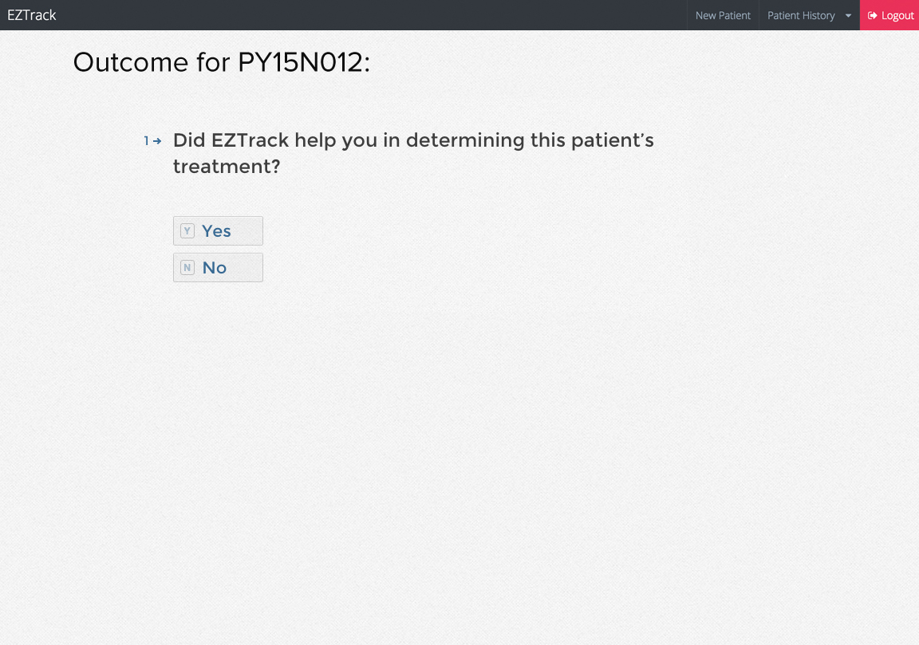
Notes:
Retrospective studies are difficult compared to clinical feedback given as close to the time of patient treatment as possible.
Discuss how we can fit this into the clinical workflow. Could this step be completed right in the operating room or in a near-term follow-up?

Slide 27
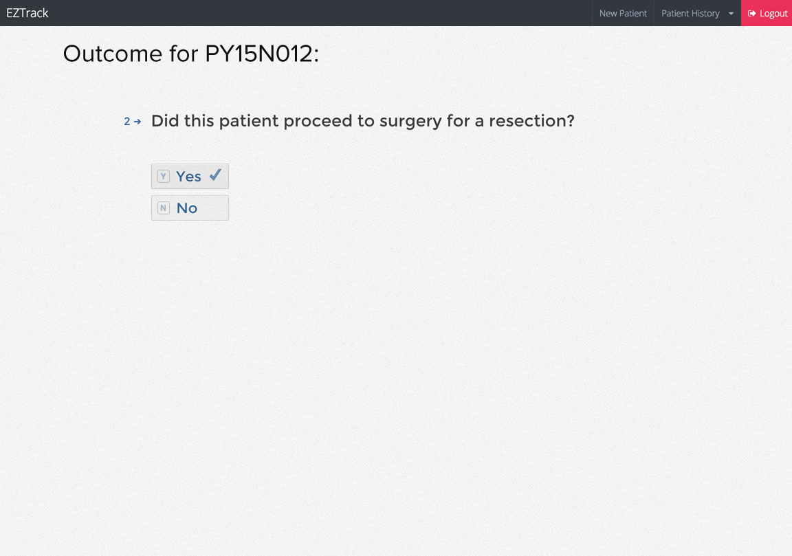
Notes:
Retrospective studies are difficult compared to clinical feedback given as close to the time of patient treatment as possible.
Discuss how we can fit this into the clinical workflow. Could this step be completed right in the operating room or in a near-term follow-up?

Slide 28
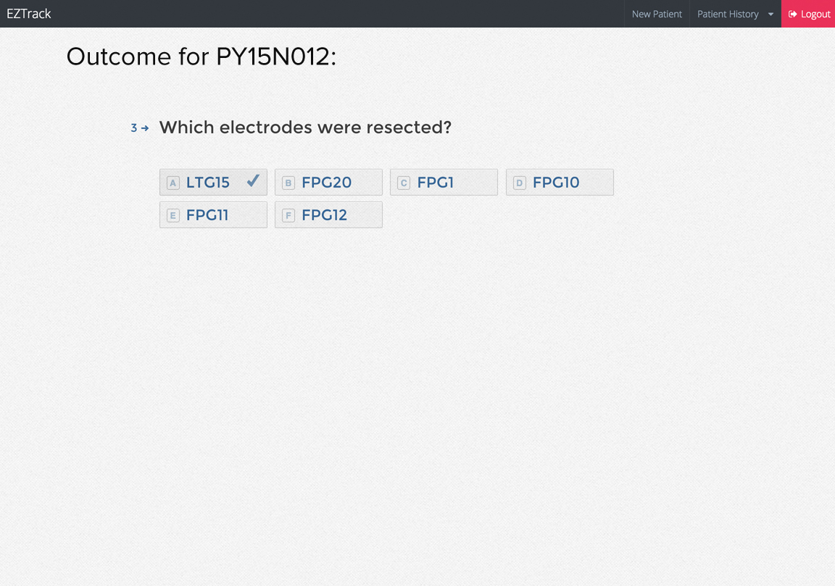
Notes:
Retrospective studies are difficult compared to clinical feedback given as close to the time of patient treatment as possible.
Discuss how we can fit this into the clinical workflow. Could this step be completed right in the operating room or in a near-term follow-up?

Slide 29
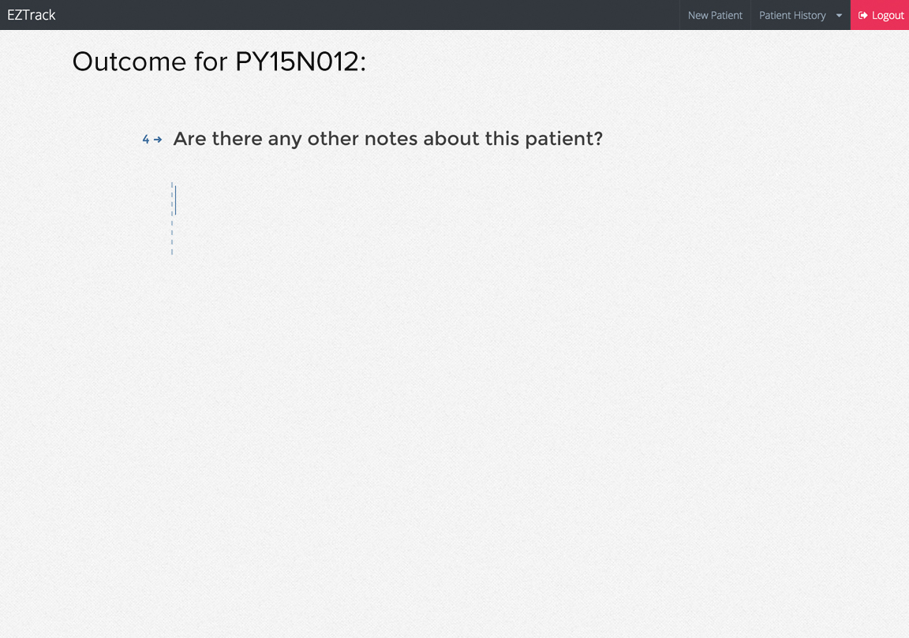
Notes:
Retrospective studies are difficult compared to clinical feedback given as close to the time of patient treatment as possible.
Discuss how we can fit this into the clinical workflow. Could this step be completed right in the operating room or in a near-term follow-up?

Slide 30
Retrospective Study Workflow
• TODO: How will users to look up previous results in EZTrack?

Slide 31
On-Prem vs. SaaS Considerations
The on-prem model will likely not scale to other clients.
Application and Host Monitoring?
System Administration?
Upgrades?
Hardware failures?
Client IT procurement / installation policies?
SaaS avoids these problems at the cost of managing HIPAA compliance and network latency.
AWS has HIPAA-compliant hosting options and we may want to investigate these:
https://aws.amazon.com/compliance/hipaa-compliance/
https://d0.awsstatic.com/whitepapers/compliance/AWS_HIPAA_Compliance_Whitepaper.pdf
Network latency can largely be managed on the EC2 side with appropriate choice of instance size.
If the client WAN is slow, however, the system’s overall latency will suffer.

