Slide 1
Soils of Coweeta
Notes:
GO TO VIEW > MASTER > SLIDE MASTER TO EDIT THE IMAGES ON THE TITLE AND DIVIDER SLIDES

Slide 2
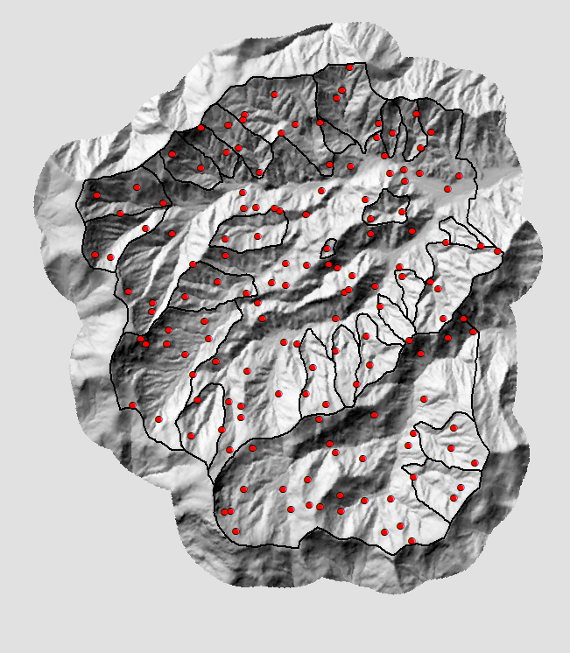
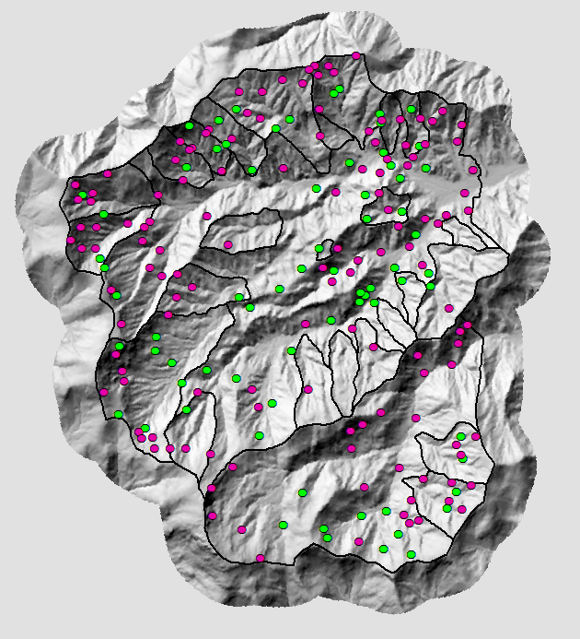
February 2021- Current
Soil Inventory Field Observations (Before Cleanup):
- 77 Pedons with Full Descriptions
- 145 Visual Observations - Including Rock Outcrops
Planned
Collected

Slide 3
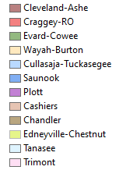
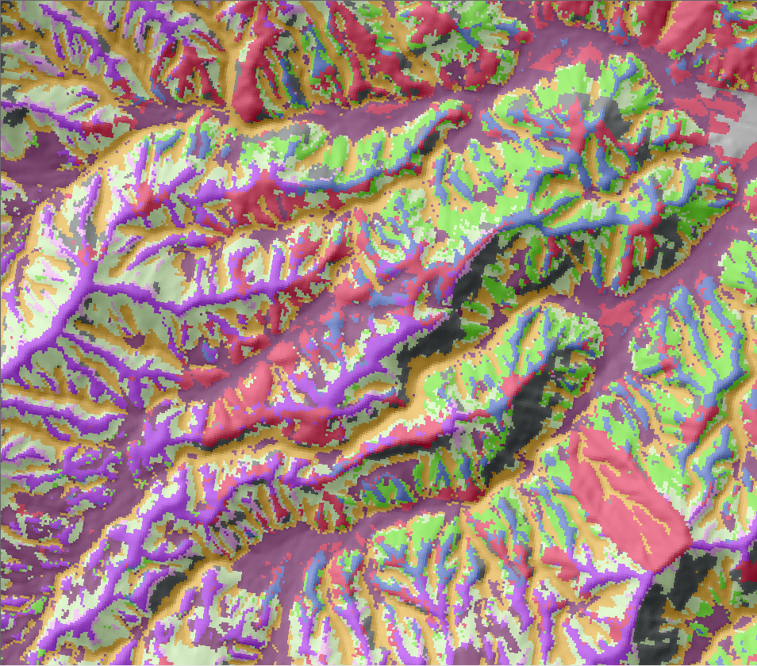
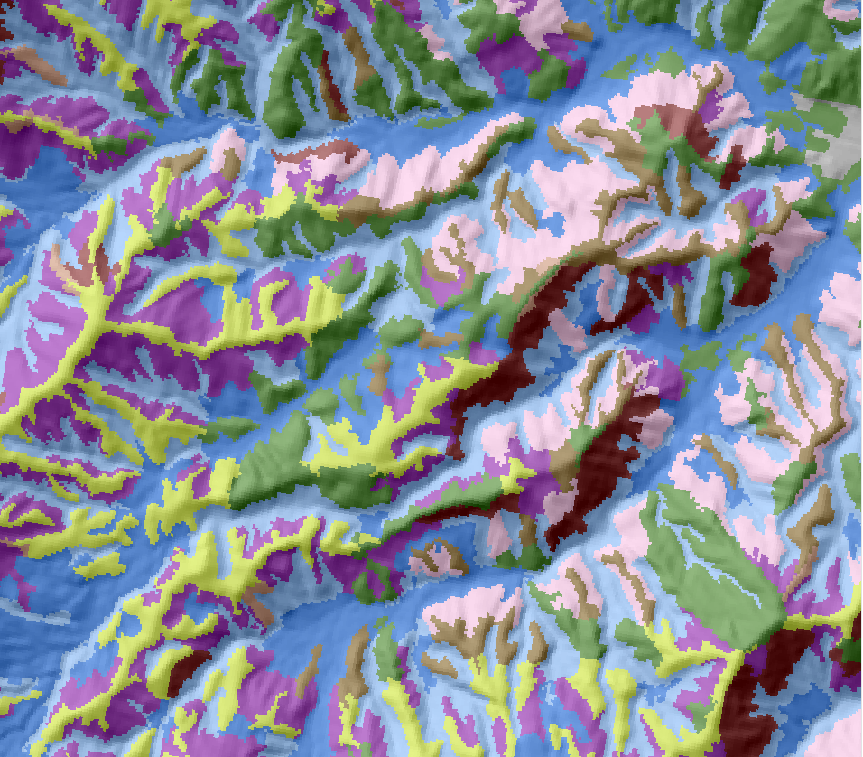
Post Training and Validation
AFTER
BEFORE

Slide 4
Soils List
Cullasaja-Tuckasegee
Cleveland-Ashe
Evard-Cowee
Edneyville-Chestnut
Saunook
Plott
Chandler
Trimont
Tanasee

Slide 5
Decision Tree
Parent Material
Colluvium
Clay films present
Clay films not present
Residuum
Shallow
Mod Deep
Very Deep
Cullasaja
Tuckasegee
Saunook
Cleveland
Bedrock
Weathered Bedrock
Ashe
Argillic
Cambic
Cowee
Chestnut
Argillic
Cambic
O Horizon
No O Horizon
Trimont
Evard
Fine Loamy
Coarse Loamy
Frigid
Meisc
Tanasee
Plott
Micaceous
Mixed
Edneyville
Chandler

Slide 6
Questions?

