Slide 1
Soil Moisture Regime at SCAN/SNOTEL Stations
newhall (PRISM)
ssurgo aridic ustic xeric udic perudic aquic undefined Sum
aridic 29 2 4 1 0 0 1 37
ustic 19 20 3 28 0 0 6 76
xeric 45 15 50 11 0 0 21 142
udic 0 17 11 338 2 0 49 417
perudic 0 0 0 0 0 0 0 0
aquic 0 2 5 32 1 0 3 43
undefined 0 0 0 0 0 0 0 0
Sum 93 56 73 410 3 0 80 715
pedons
ssurgo aridic ustic xeric udic perudic aquic undefined Sum
aridic 19 1 2 0 0 0 0 22
ustic 3 19 0 1 0 0 0 23
xeric 2 2 18 0 0 2 0 24
udic 0 1 1 27 0 3 0 32
perudic 0 0 0 0 0 0 0 0
aquic 0 0 0 3 0 3 0 6
undefined 0 0 0 0 0 0 0 0
Sum 24 23 21 31 0 8 0 107
Notes:
RHESSys

Slide 2
Soil Moisture Regime at SCAN/SNOTEL Stations
newhall (PRISM)
ssurgo aridic ustic xeric udic perudic aquic undefined Sum
aridic 29 2 4 1 0 0 1 37
ustic 19 20 3 28 0 0 6 76
xeric 45 15 50 11 0 0 21 142
udic 0 17 11 338 2 0 49 417
perudic 0 0 0 0 0 0 0 0
aquic 0 2 5 32 1 0 3 43
undefined 0 0 0 0 0 0 0 0
Sum 93 56 73 410 3 0 80 715
newhall (station sensors)
ssurgo aridic ustic xeric udic perudic aquic undefined Sum
aridic 33 1 0 0 0 0 0 34
ustic 24 9 1 2 1 0 0 37
xeric 14 2 3 1 1 0 0 21
udic 0 4 1 58 1 0 0 64
perudic 0 0 0 0 0 0 0 0
aquic 1 0 2 19 0 0 0 22
undefined 0 0 0 0 0 0 0 0
Sum 72 16 7 80 3 0 0 178
Notes:
RHESSys

Slide 3
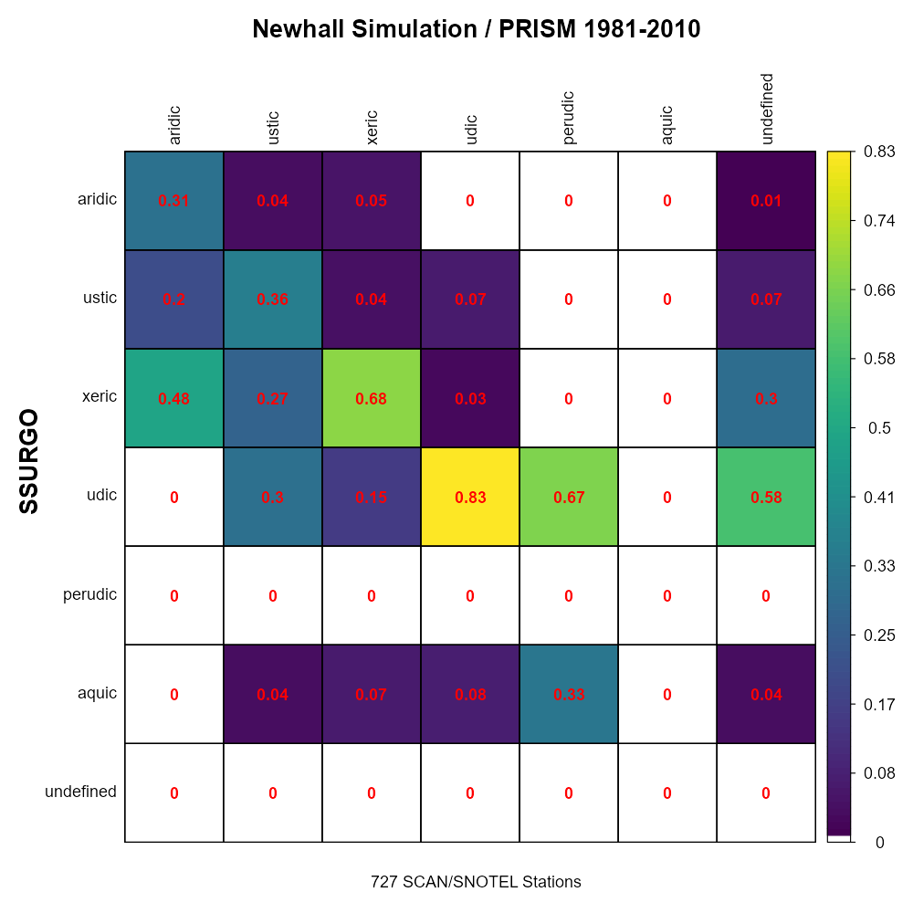
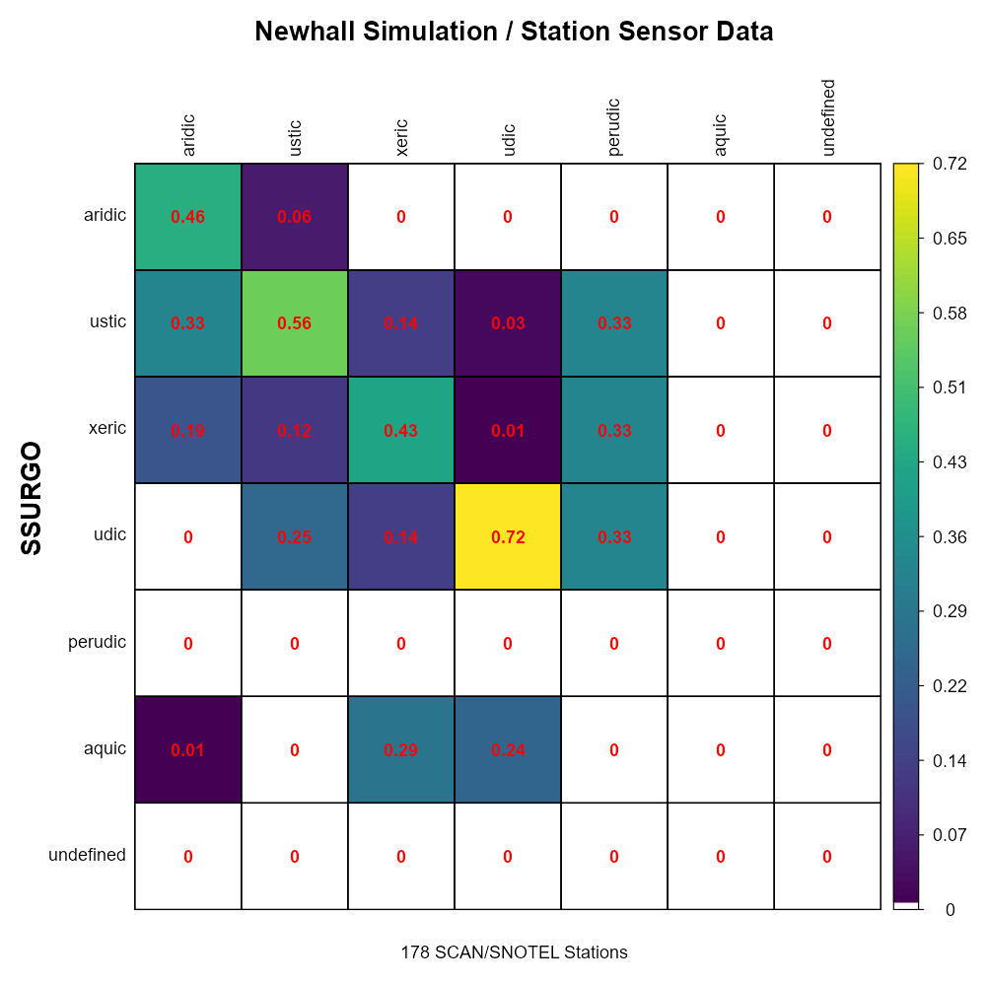
Notes:
RHESSys

Slide 4
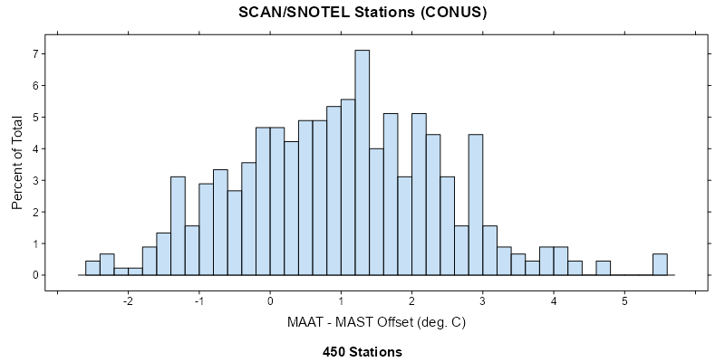
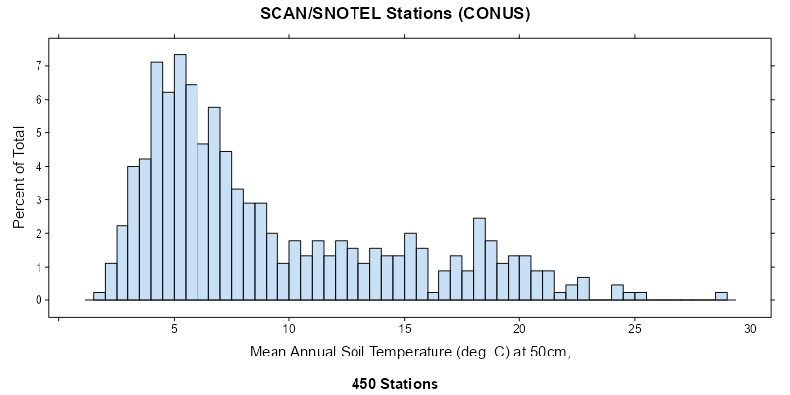
Notes:
RHESSys

Slide 5
Notes:
RHESSys

