Slide 1
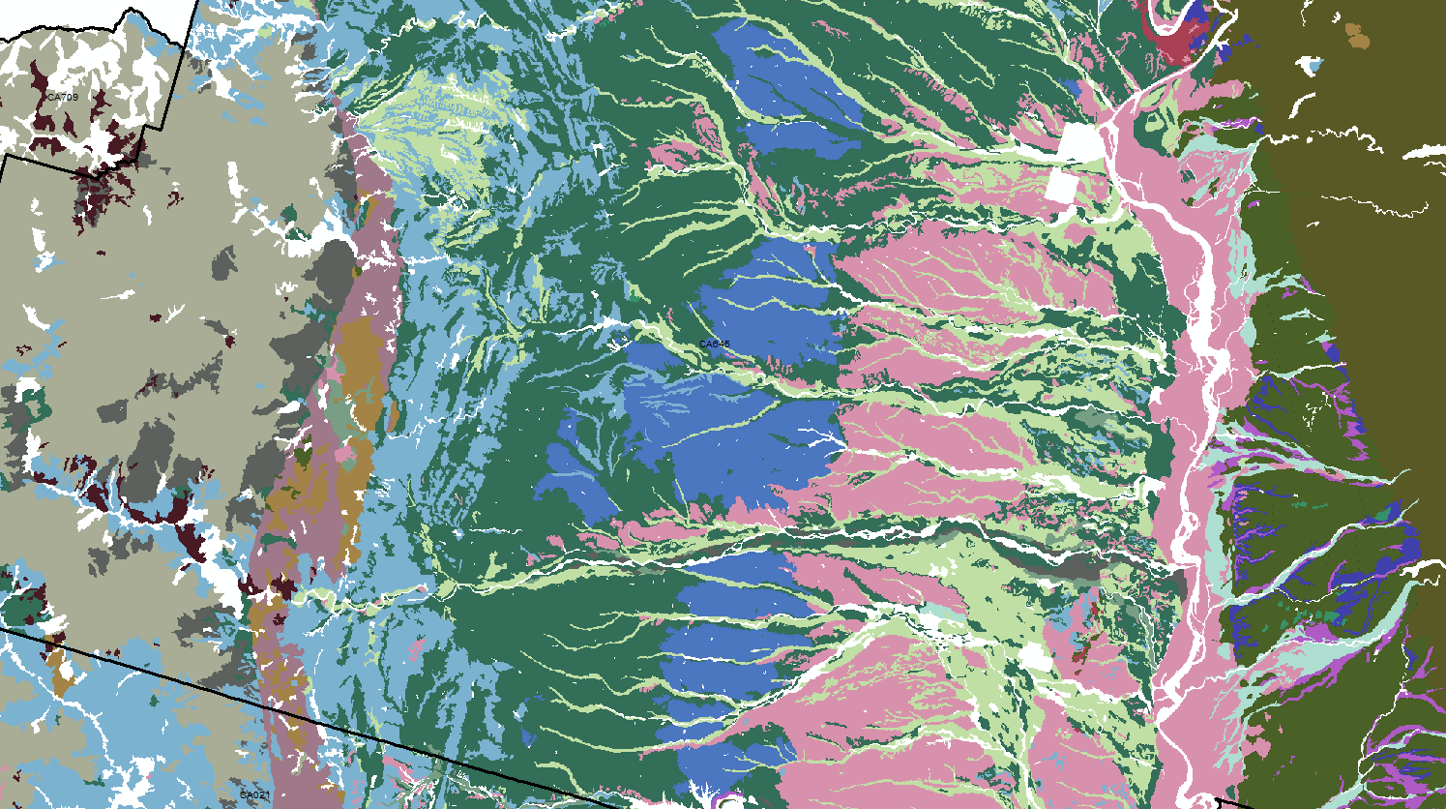
Surficial Geology (parent material normalization) Project Ideas

Slide 2
Problem We need* a simplified, internally-consistent, and pedogenically-relevant surficial geology map. Component records are a fine candidate for this task, however, `pmgroupname` is far too variable and `pmkind` / `pmorigin` records are nearly as variable. There is (reasonable) consistency within SSA but not between. *need: as a PR device (NRCS uniquely qualified and capable), as a input to DSM (currently missing), and as a unified base layer for MLRA update projects.
Solution Changes* to the `pmkind` and `pmorigin` records, by MLRA, with the paired (opposing) goals of: retaining as much detail as necessary and reducing as much noise as possible. Changes would follow guidance developed by RO/MLRA staff based on a series of progressive rank-based priorities. For example:
Merging of “like” `pmorigin` classes (granitoid, granite, etc.)
Replacement of vague `pmorigin` classes (sedimentary rock)
A second, cartographic simplification would be applied via series of rules, outside of NASIS.
*changes: obviously far more complex than can be described here.

Slide 3
What is the right balance between cleaning the source data –and- post-processing via rules
Change source data
Post-processing (rules)
Claim acres
SSURGO improved
“Complex” planning
Possibly lose history (?)
Over-simplification (?)
No acres
SSURGO unchanged
“Complex” ruleset
Derivatives always out of sync

Slide 4
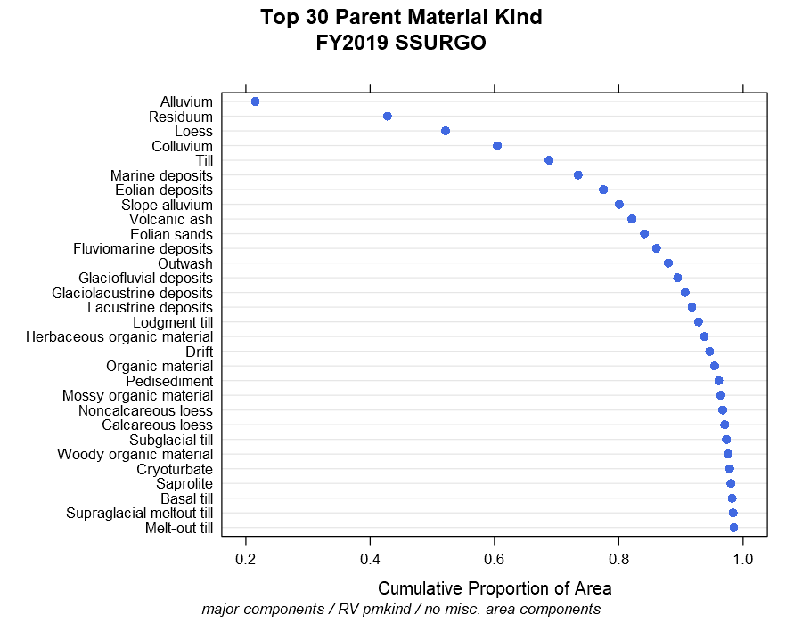
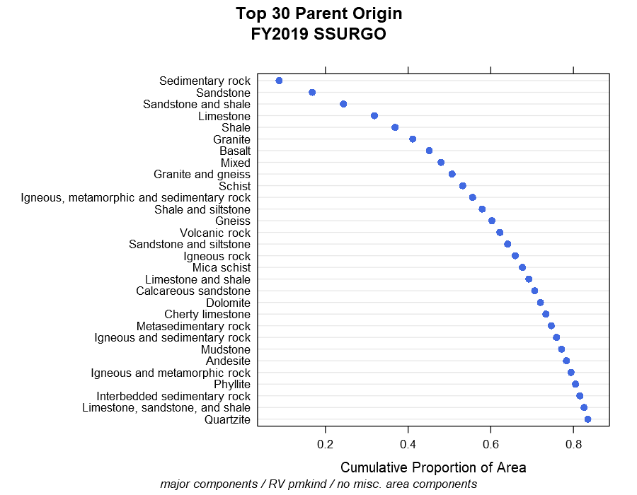
Currently…

Slide 5
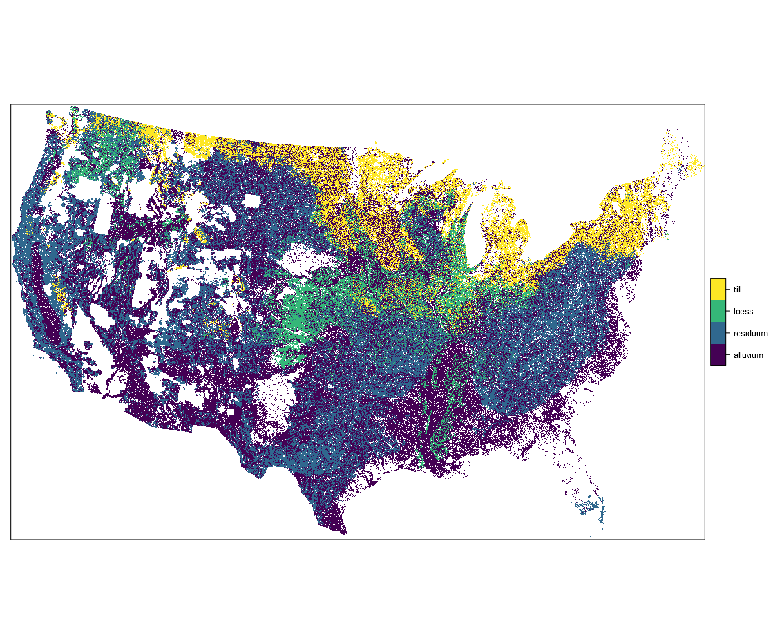
most common pmkind per 800m grid cell

Slide 6
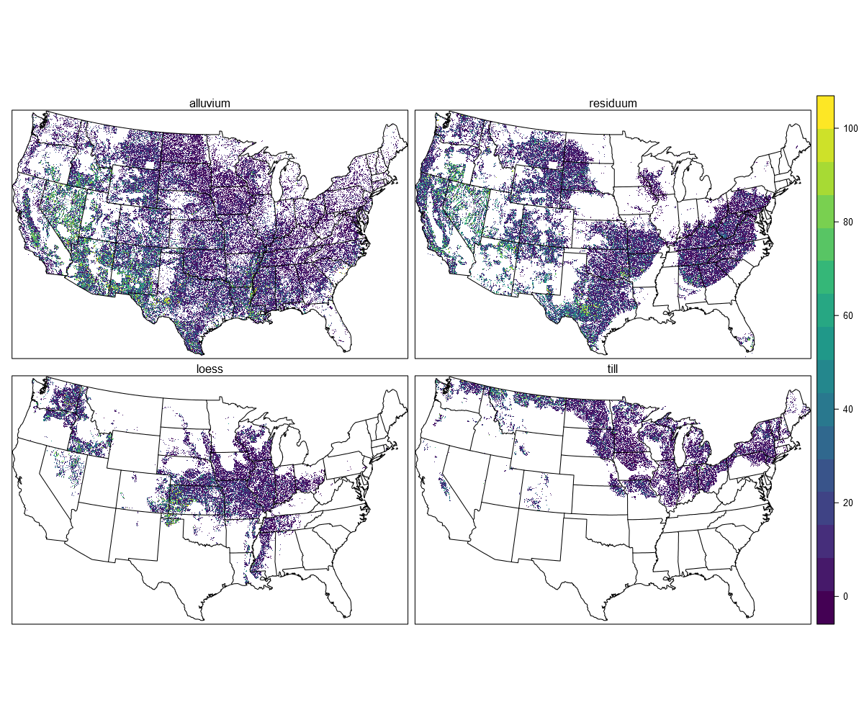

Slide 7
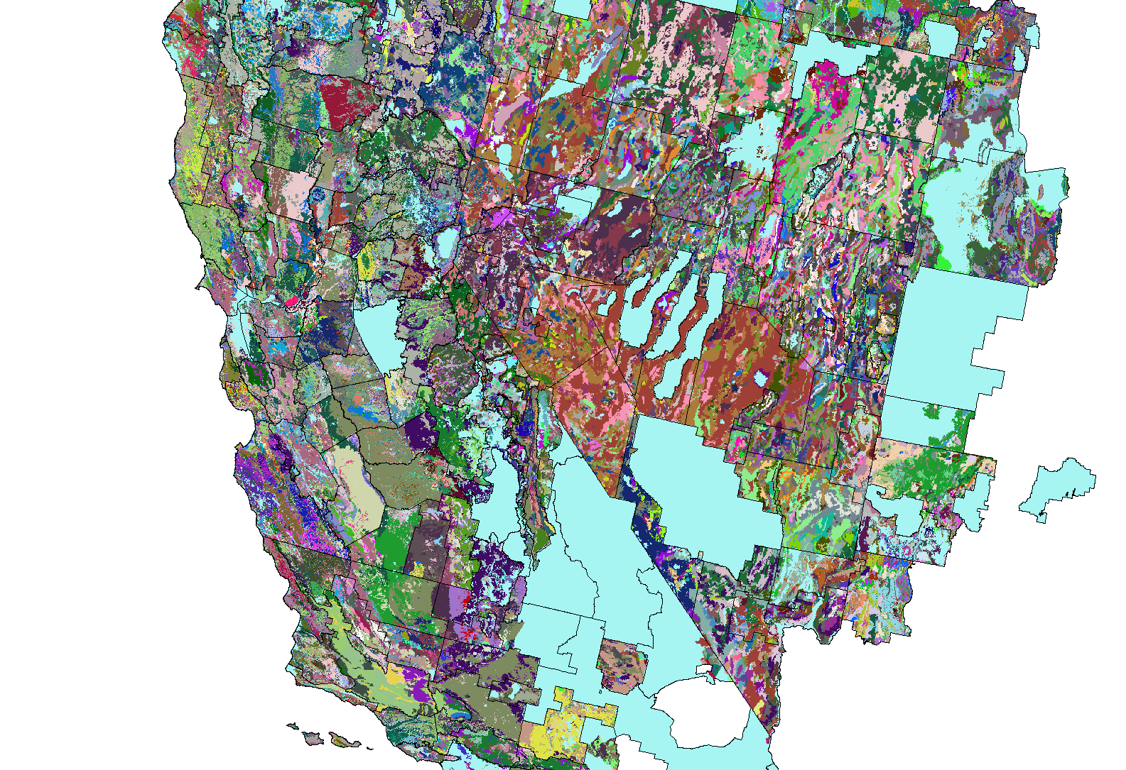
current pmgroupname

Slide 8
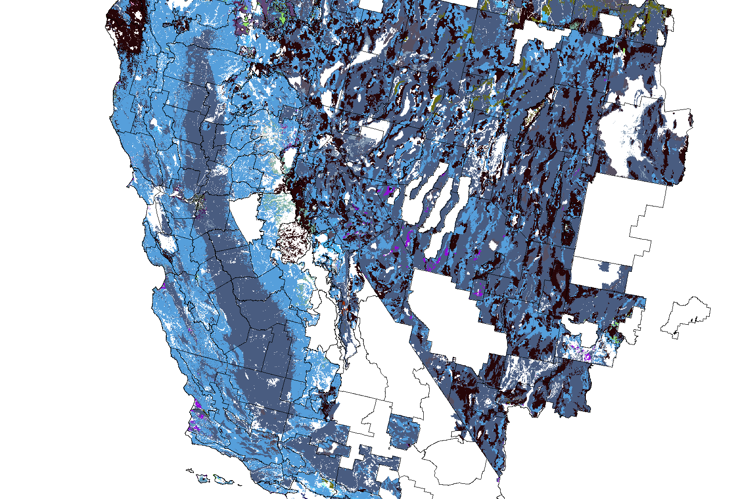
pmkind via soil series

Slide 9
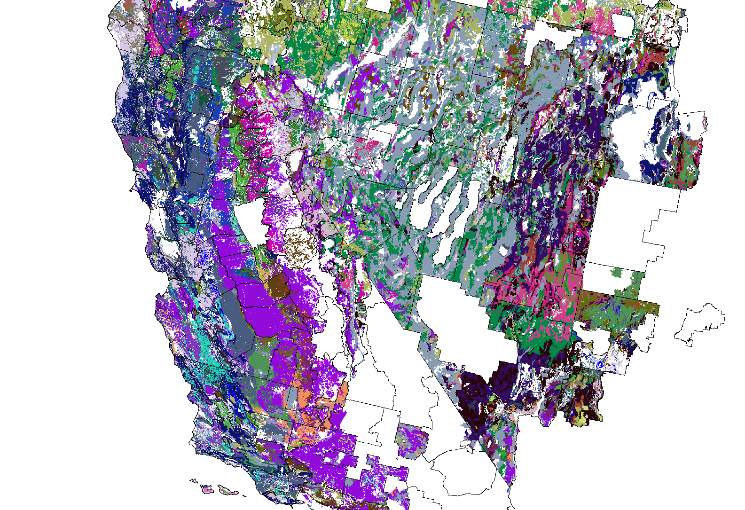
pmorigin via soil series

Slide 10
Details to figure out
How many acres can we claim per change?
Work by MLRA or major `pmkind` groups (ALL, COL/RES, glacial, volcanic, etc.)
Should the review include geomorph table clean-up too?
Strategies for grouping required (e.g. eolian deposits, eolian sands)
Strategies for un-mixing required (e.g. “sandstone and shale”)
Strategy for selecting a single “RV” pmkind/pmorigin (post-processing step)
???
Misc. Notes
Tehama Fm. and related MU good case-study
Andrew Conlin an ideal technical lead: valley, foothills, mountains mapping
Historic descriptions of pmkind/pmorigin likely correct
2D “correlation” table / rules used for cartographic simplification
 | pmorigin
pmkind

