Slide 1
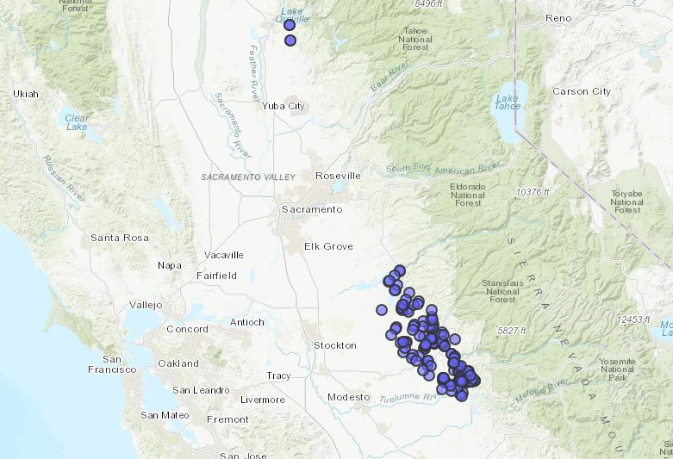
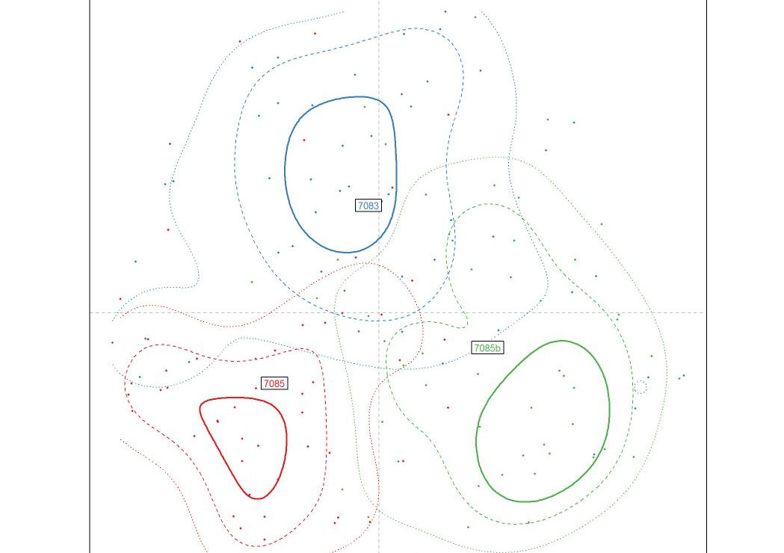
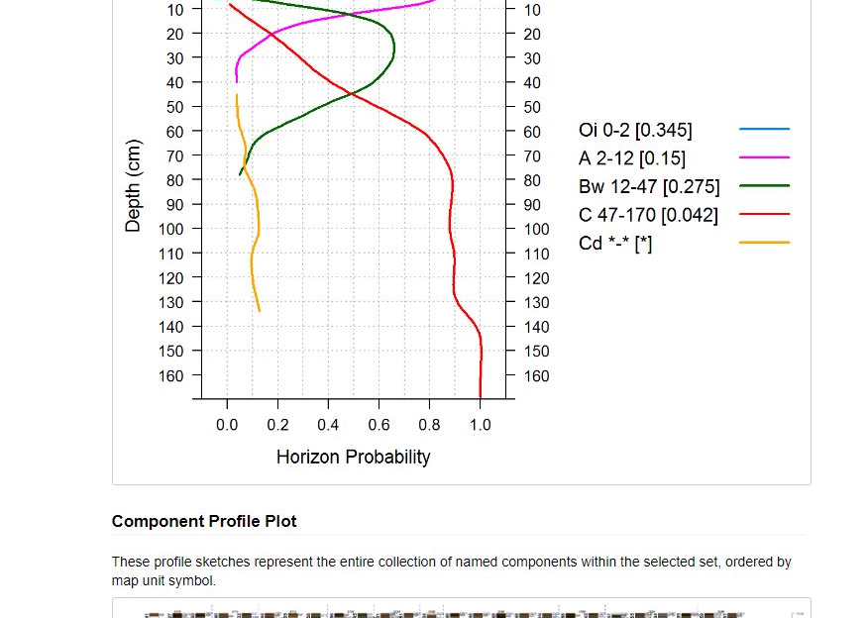

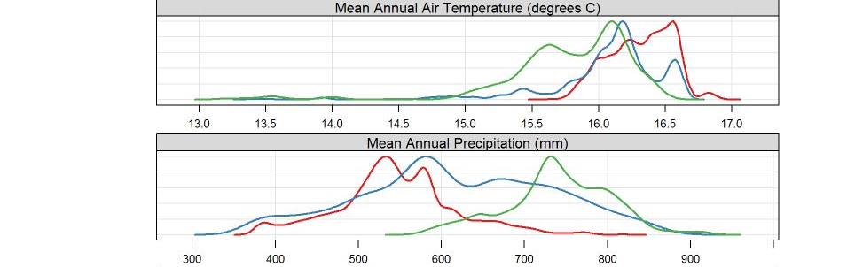
Section 3.11: soilReports

Slide 2
Goals
Introduce you to the soilReports package
Get you using soilReports in your offices
Receive feedback, criticism, or new ideas

Slide 3
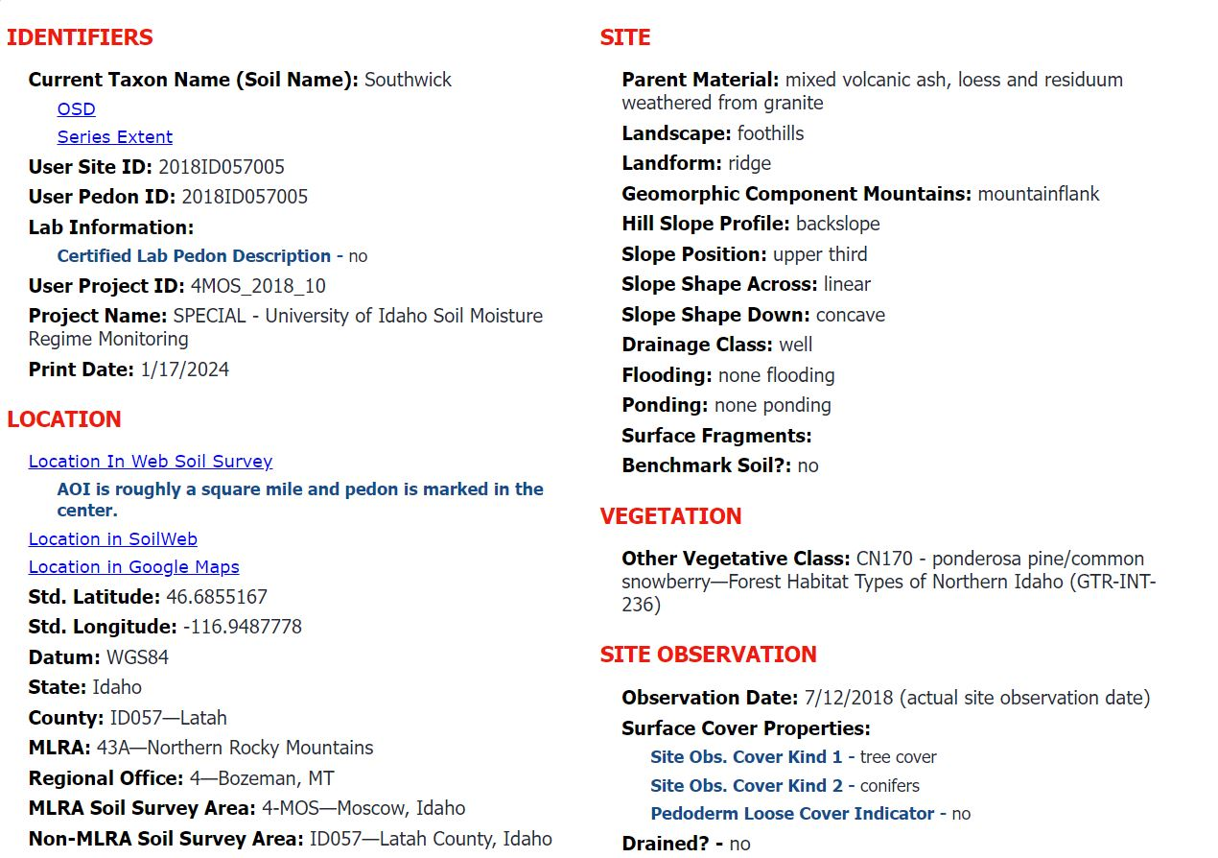
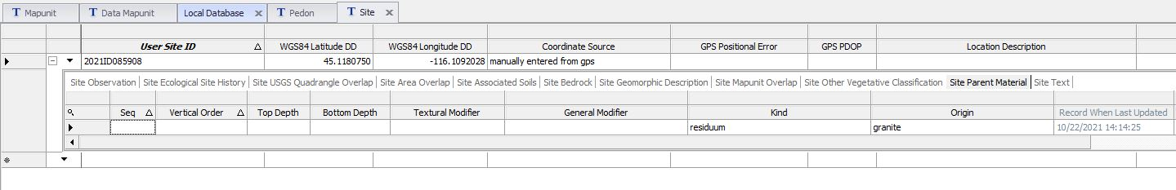
What is soilReports?
The idea behind soilReports was to create a product similar to NASIS reports
doing this in the R-environment allows more options

Slide 4
What is soilReports?
Streamlines common workflows
Standardizes common workflows
makes your life easier

Slide 5



How does soilReports work?
reportInit()
copyReport()
GitHub repository
User
config.R
report.Rmd
User inputs own data into config.R file and “executes” report.

Slide 6
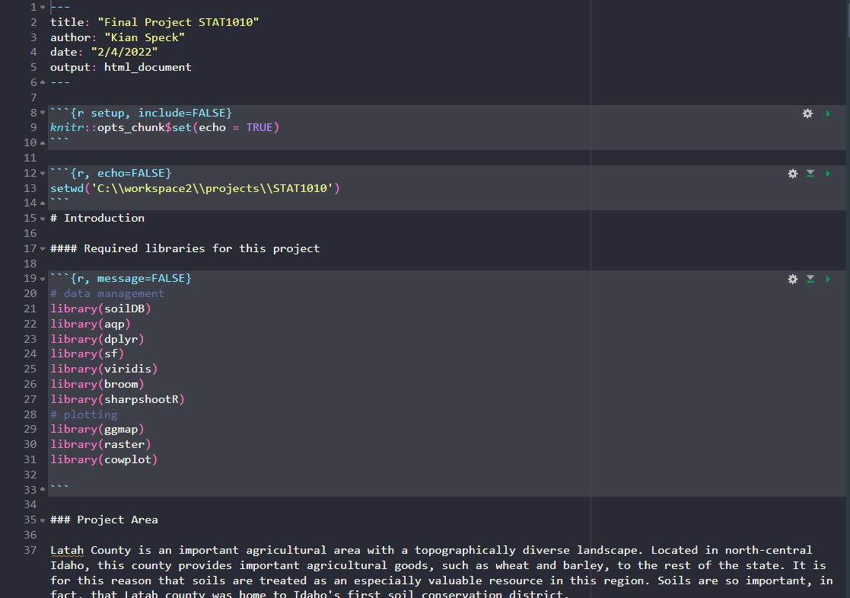
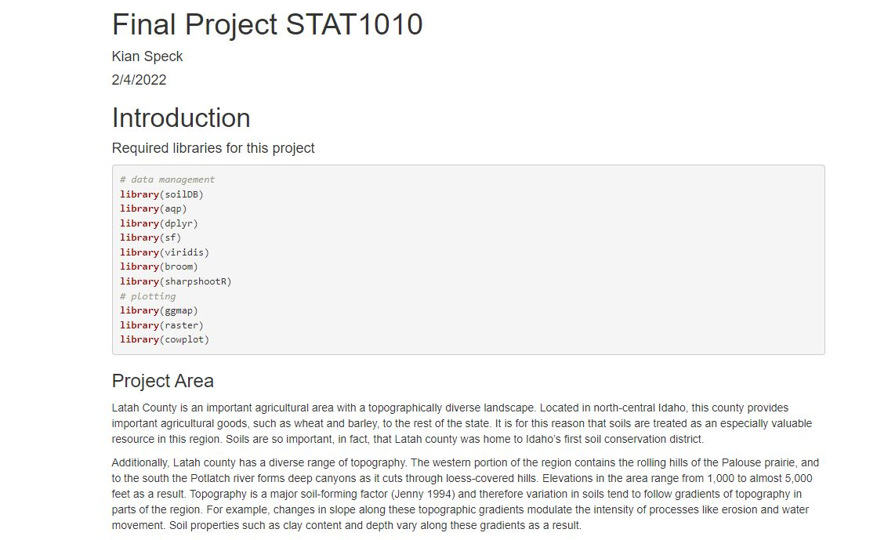
What is R Markdown?
A way to create readable, clean documents using R.
implements R code into a typical report-style document

Slide 7
Exercises
Any questions before we jump into the exercises?

Slide 8
Questions?

Slide 9

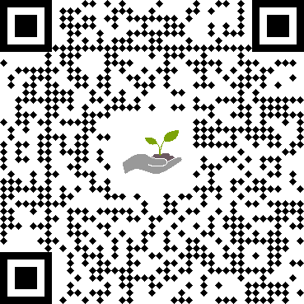
Connect with us!
Scan the QR code and visit our website at soils.usda.gov
Follow us on X, formerly known as Twitter, @USDA_NRCS_SPSD
Check out our YouTube channel @nrcssoilandplantscience
USDA is an equal opportunity provider, employer, and lender.
Scan Me!

