Slide 1
Chapter 3 - Exploratory Data Analysis
Stephen Roecker and Tom D’Avello

Slide 2
Objectives
Review methods for estimating Low, RV, and High values
Review different methods for visualing soil data

Slide 3
Range in Characteristics (RIC)
Why does the L, RV, and H clay represent?
What taxonomic unit do they refer too?
What is the L and H for texture?

Slide 4
hzname | clay_l | clay_r | clay_h | texture
Ap | 10 | 18.0 | 24 | sil
BE | 10 | 17.0 | 24 | sil
Bt1 | 20 | 25.0 | 26 | sil
2Bt2 | 35 | 40.0 | 45 | sic
2BCt | 12 | 26.0 | 35 | l
2Cd | 10 | 17.5 | 25 | l

Slide 5
Descriptive Statistics - Estimates of L, RV & H
Parameter | NASIS | Description | R function
Mean | RV | arithmetic average | mean()
Median | RV | middle value, 50% quantile | median()
Mode | RV | most frequent value | sort(table(), decreasting = TRUE)[1]
Standard Deviation | L & H | variation | sd()
Quantiles | L & H | percent rank of values, such that all values are <= p | quantile()

Slide 6
Descriptive Statistics - Numeric Data
data("loafercreek") h <- horizons(loafercreek) h$texture_class <- factor(h$texture_class) h %>% select(clay, phfield, total_frags_pct, texture_class) %>% summary()
## clay phfield total_frags_pct texture_class ## Min. :10.00 Min. :4.90 Min. : 0.00 l :265 ## 1st Qu.:18.00 1st Qu.:6.00 1st Qu.: 0.00 br :105 ## Median :22.00 Median :6.30 Median : 5.00 cl :101 ## Mean :23.63 Mean :6.18 Mean :13.88 sil : 56 ## 3rd Qu.:28.00 3rd Qu.:6.50 3rd Qu.:20.00 spm : 22 ## Max. :60.00 Max. :7.00 Max. :95.00 (Other): 52 ## NA's :167 NA's :381 NA's : 25

Slide 7
Descriptive Statistics - Categorical Data
table(h$genhz, h$texture_class, useNA = "ifany")
## ## br c cb cl gr l pg scl sic sicl sil sl spm <NA> ## 2BCt 0 6 0 3 0 0 0 0 0 0 0 0 0 0 ## 2Bt 0 5 0 1 0 0 0 0 0 0 0 0 0 0 ## A 0 0 0 1 0 97 0 0 0 1 29 7 0 3 ## BA 0 0 0 0 0 2 0 0 0 0 0 0 0 0 ## BCt 0 2 0 8 0 7 0 1 0 1 1 0 0 1 ## Bt 0 0 0 17 0 37 0 0 0 0 1 1 0 0 ## Bt1 0 1 0 13 0 57 0 3 0 1 12 0 0 2 ## Bt2 0 4 0 40 0 45 0 4 2 6 8 0 0 0 ## Bt3 0 0 0 6 0 2 0 0 0 0 0 0 0 0 ## Cr 55 1 1 1 3 1 1 1 0 0 0 0 0 10 ## Oi 0 0 0 0 0 0 0 0 0 0 0 0 4 0 ## R 43 0 0 0 0 0 0 0 0 0 0 0 0 2 ## <NA> 7 0 0 11 0 17 0 0 0 0 5 0 18 7

Slide 8
Data Inspection - Missing Data
Exclude all rows or columns that contain missing values using the function na.exclude(), such as h2 <- na.exclude(h). However this can be wasteful because it removes all rows (e.g., horizons), regardless if the row only has 1 missing value. Instead it’s sometimes best to create a temporary copy of the variable in question and then remove the missing variables, such as clay <- na.exclude(h$clay).
Replace missing values with another value, such as zero, a global constant, or the mean or median value for that column, such as h$clay <- ifelse(is.na(h$clay), 0, h$clay) # or h[is.na(h$clay), ] <- 0.
Read the help file for the function you’re attempting to use. Many functions have additional arguments for dealing with missing values, such as na.rm.

Slide 9
Graphical Methods - Descriptions
Plot Types | Description
Bar | a plot where each bar represents the frequency of observations for a ‘group’
Histogram | a plot where each bar represents the frequency of observations for a ‘given range of values’
Density | an estimation of the frequency distribution based on the sample data
Quantile-Quantile | a plot of the actual data values against a normal distribution
Box-Whisker | a visual representation of median, quartiles, symmetry, skewness, and outliers
Scatter & Line | a graphical display of one variable plotted on the x axis and another on the y axis

Slide 10
Graphical Methods - Functions
Plot Types | Base R | lattice | ggplot geoms
Bar | barplot() | barchart() | geom_bar()
Histogram | hist() | histogram() | geom_histogram()
Density | plot(density()) | densityplot() | geom_density()
Quantile-Quantile | qqnorm() | qq() | geom_qq()
Box-Whisker | boxplot() | bwplot() | geom_boxplot()
Scatter & Line | plot() | xyplot | geom_point()

Slide 11
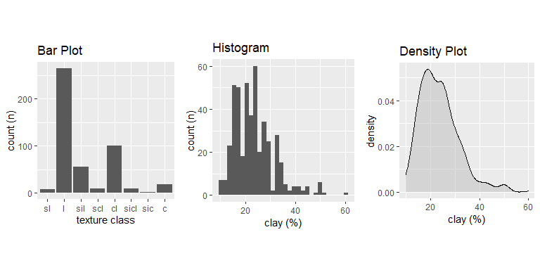
Distributions

Slide 12
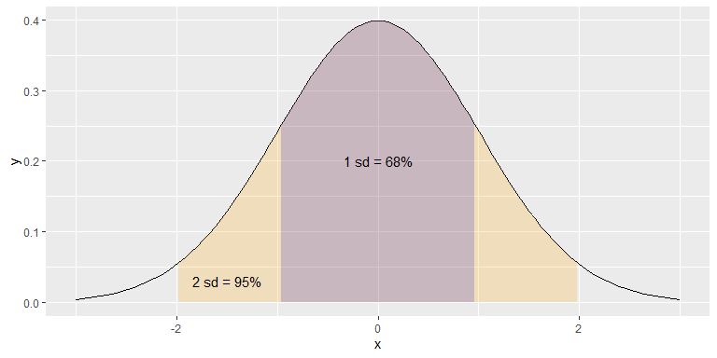
The ‘Normal’ Distribution

Slide 13
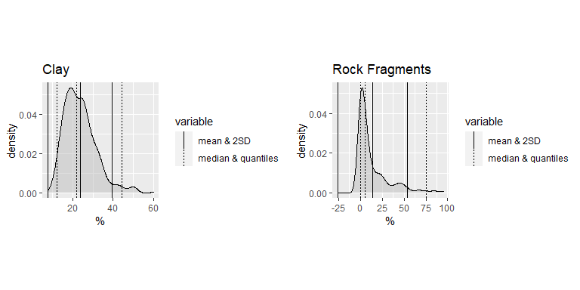
Mean & SD vs Median & Quantiles

Slide 14
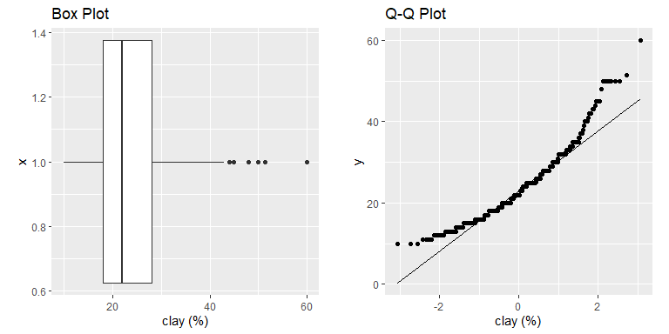
Distributions

Slide 15
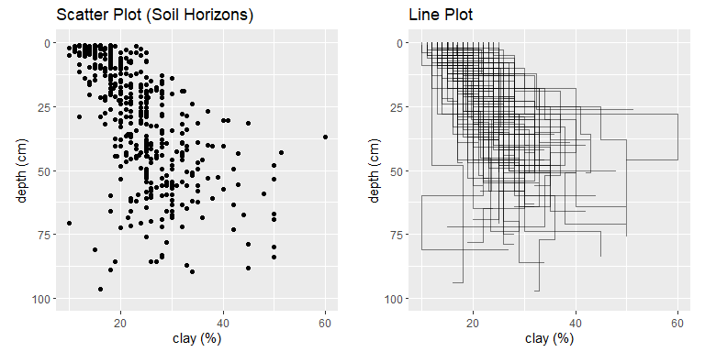
Relationships

Slide 16
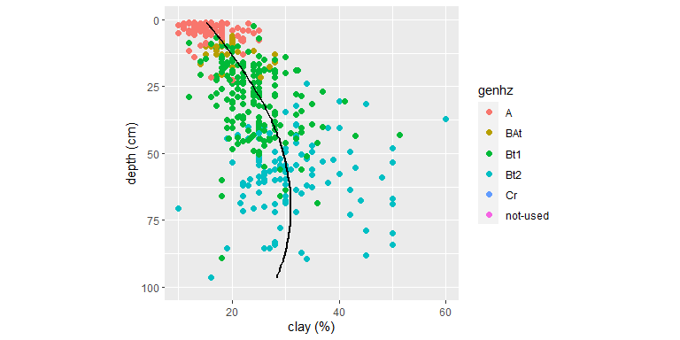
3rd Dimension - Color, Shape, Size, Layers, etc…

Slide 17
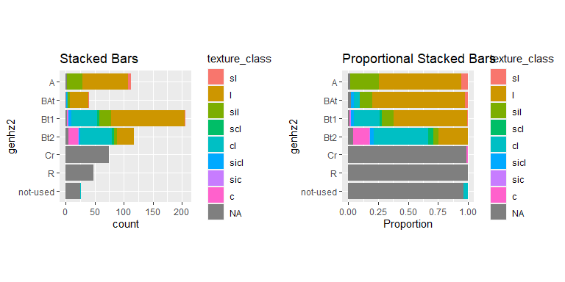
3rd Dimension - Color

Slide 18
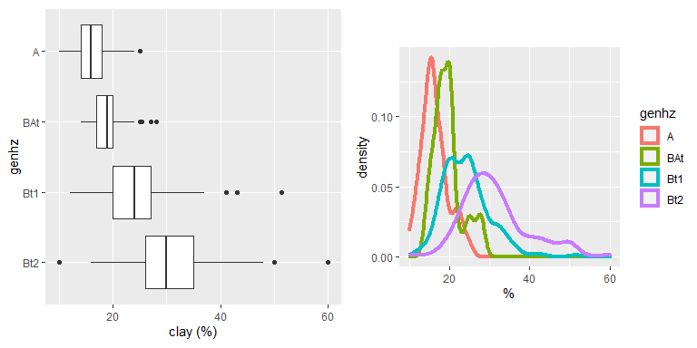
3rd Dimension - Groups

Slide 19
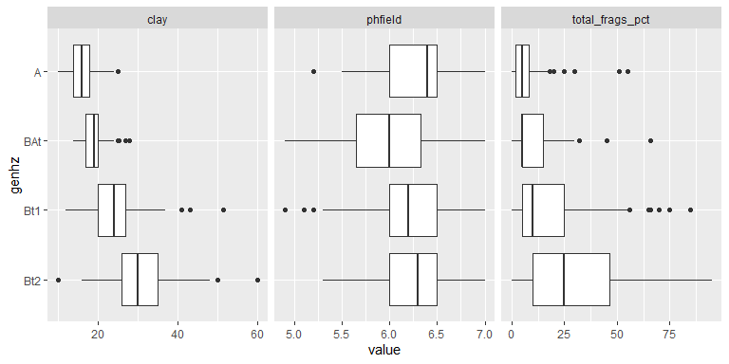
3rd Dimension - Facets

Slide 20
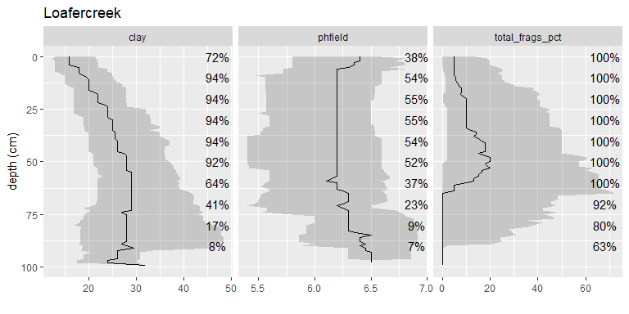
3rd Dimension - Facets

Slide 21
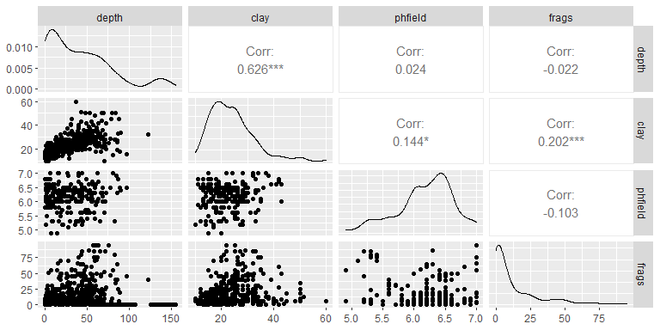
3rd Dimension - Correlation

Slide 22
ggplot2 basics
h <- horizons(loafercreek) # set figure axis and aesthetics p <- ggplot(data = h, aes(x = clay, y = hzdept, color = genhz)) # add layers p + geom_point()

Slide 23
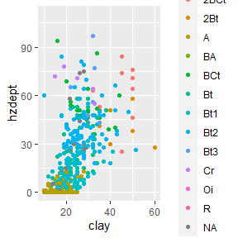

Slide 24
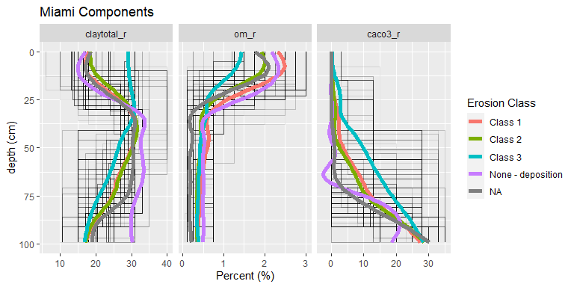
Summary of Components

Slide 25
Additional Reading
Healy, K., 2018. Data Visualization: a practical introduction. Princeton University Press. http://socviz.co/
Helsel, D.R., and R.M. Hirsch, 2002. Statistical Methods in Water Resources Techniques of Water Resources Investigations, Book 4, chapter A3. U.S. Geological Survey. 522 pages. http://pubs.usgs.gov/twri/twri4a3/
Kabacoff, R.I., 2018. Data Visualization in R. https://rkabacoff.github.io/datavis/
Peng, R. D., 2016. Exploratory Data Analysis with R. Leanpub. https://bookdown.org/rdpeng/exdata/
Wilke, C.O., 2019. Fundamentals of Data Visualization. O’Reily Media, Inc. https://serialmentor.com/dataviz/

