Slide 1
Sampling

Slide 2
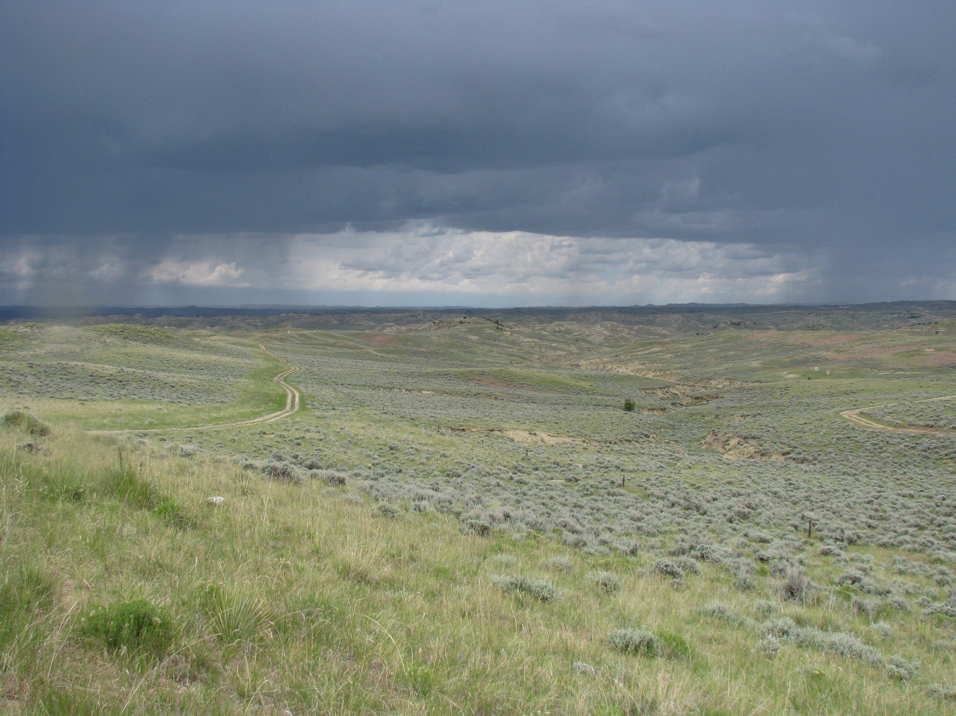
The Problem

Slide 3

Outline
Introduction
Terms
Considerations
Sampling Designs
Purposive
Probability
Weighting
Geometric
Sample size
Standard error
Confidence interval
Power Analysis
Prediction Error
Distance/area/time
Rules of Thumb
NSSH 627.8
Notes:
Why is this important? What comes first the chicken or the egg. Sampling determines what can and can’t be said about the data that you collect. If the data that is collected is not representative, no amount of statistical magic can produce meaningful results. Historically it has been said that “statistics and soils don’t work”. This statement should has said “statistical analysis of soils data is not practical”. Considering the capabilities modern computers, and the wealth of environmental covariates available, this is rarely still the case. McKenzie and Gallant (2007) favor statistical sampling strategies were sampling densities are 1 site per 250 ha (617 acres).

Slide 4
Terms
Population = the thing we’re interested in
Sample = the thing we observe
Inclusion probability = chance of inclusion in sample
Support = area/volume/thickness observed
Geo-reference = where we observe
Bulking = mixing multiple samples over a given area (e.g. horizons, satellite pedons)
Blocking = averaging multiple samples over a given area (e.g. plots, transects, clusters)
Strata = subsets/groups within the population
Inference space = what we predict
Bias = systematic error/difference from the population
Variance = random error
Feature space = multidimensional space formed by the combination of variables (e.g. clorpt/scorpan )

Slide 5
Considerations
Time/money
What to sample
When to sample
Where to sample
How to sample
Access
Strata weights (proportional vs variance)
Full description
Lab characterization
Field note
Biological soil properties
Temperature, moisture, …

Slide 6
Sample Size
Standard error
Confidence interval (type I error)
Power (type II error)
Distance/time
NSSH 627.8
Prediction error
Rules of thumb

Slide 7
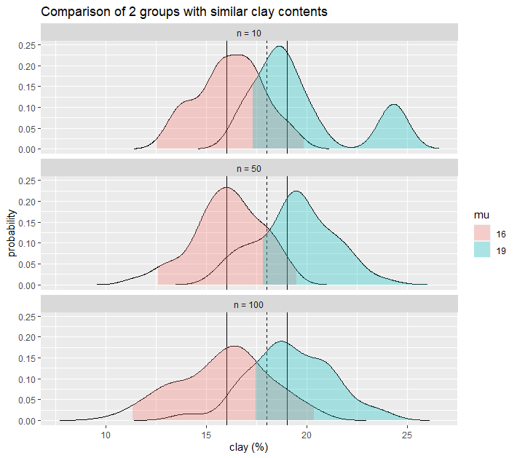
Sample Size
Standard Error approach tests whether our error is less than a threshold
Confidence Interval approach tests whether our data falls into 1 group
Power Analysis approach tests whether 2 groups overlap
The dashed line represents a taxonomic break, while the solid lines are the group means.

Slide 8
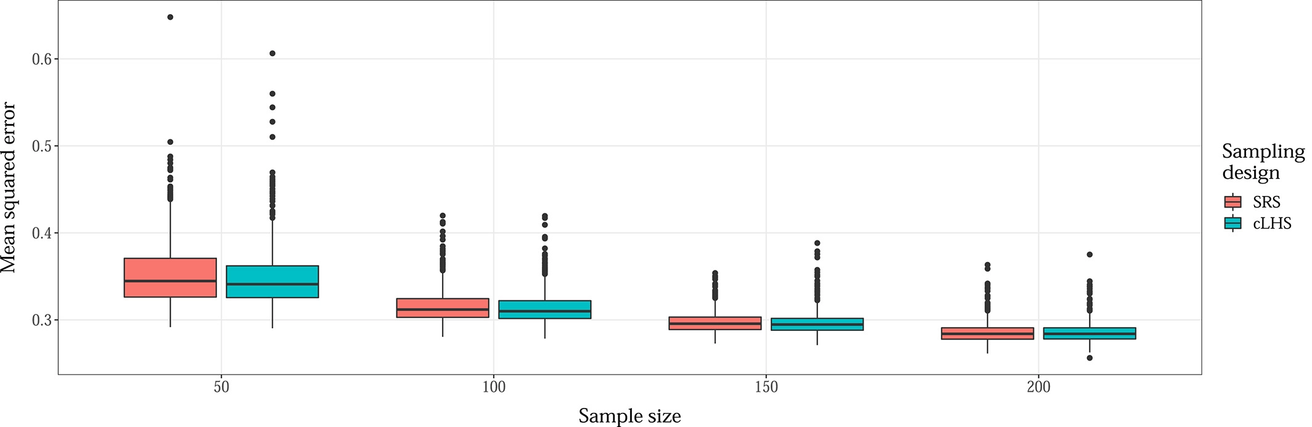
Sample Size vs Model Accuracy
From Wadoux and Brus, 2020

Slide 9
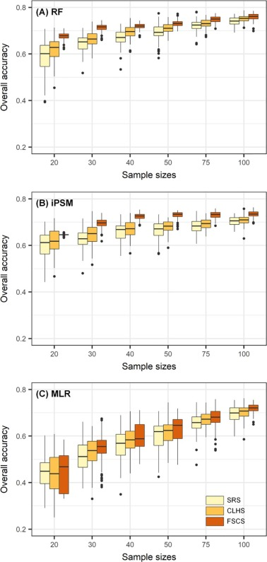

Sample Size vs Model Accuracy
From Ma et al., 2020

Slide 10
Sample Size – NSSH 627.8

Slide 11
Sampling Designs
Simple random
Stratified random
Multistage
Non-probability
Purposive (e.g. roadcuts)
Geometric (model based)
K-means (spatial coverage)
Experimental design
…
Clustered
Systematic (e.g. transect)
K-means (feature space)
Geostatistical
Balanced (e.g. Generalized Random Tessellation Stratified Sampling)
Conditioned Latin-hypercube (cLHS)
Probability (designed based)

Slide 12
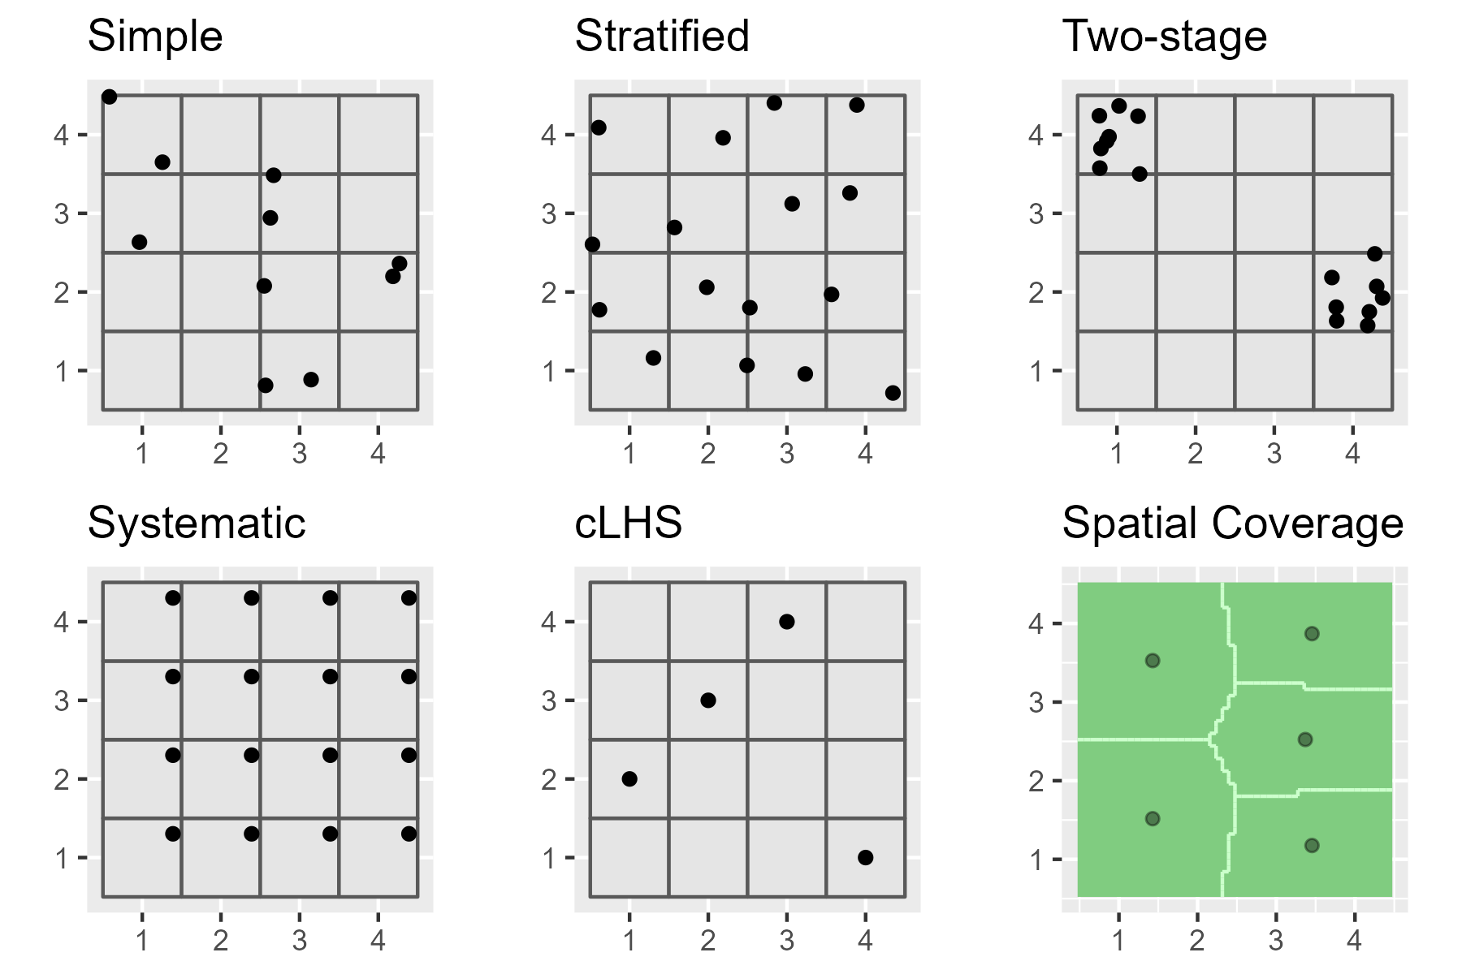
Sampling Designs

Slide 13
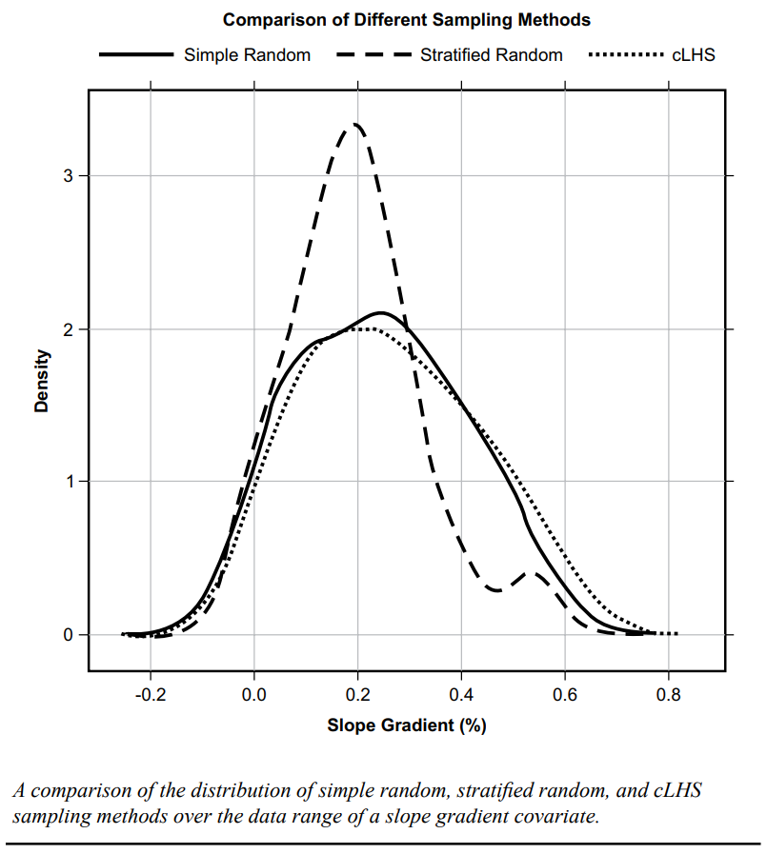
Sampling Designs

Slide 14
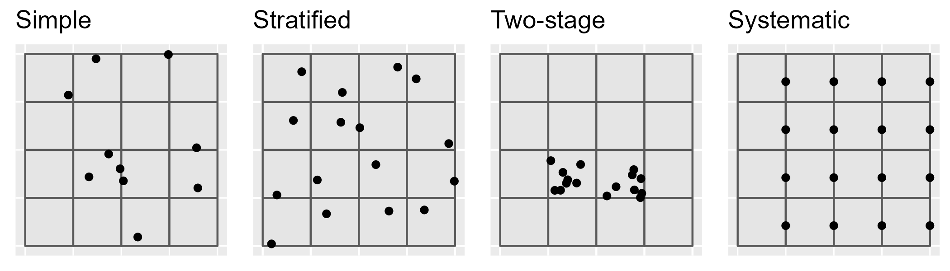
Simple-random
Advantages
Disadvantages
Use cases
Simple
Unbiased (equal probability of inclusion)
Requires little prior knowledge of the population
Howell et al. (2004) - produced a “much more sensitive, more accurate, and greater range of estimated values” than the models from the subjective samples
Inefficient (requires large numbers)
Lower accuracy
Higher cost
Samples may not be representative of the feature attribute(s)
Uneven spatial distribution (e.g. clustered)
When you don’t know anything about the underlying population
When you can afford too (e.g. GIS simulations)

Slide 15
Systematic
Advantages
Disadvantages
Use cases
Simple
Precise estimates
Even spatial coverage
Greater efficiency
Biased estimates (particularly sampling variance)
May miss individuals that don’t coincide with the sampling interval
If so, the density needs to be increased
Limited utility for areas larger than a single field
Grid may not optimally fit irregular shapes
When you want to interpolate between observations (e.g. kriging)
When you want to detect/quantify spatial trends
When you can afford too (e.g. GIS simulations)
Individual fields
Flat landscapes

Slide 16
Stratified & Two-stage random
Advantages
Disadvantages
Use cases
More efficient than simple-random
Higher accuracy
Lower cost
Sampling can be sized relative to proportion or variance
Require pre-existing knowledge of the population (which may be flawed)
If sampling is uneven, weights need to be known
May need to contrust the strata manually
When you have GIS layers that can be used as predictors (e.g. DSM)

Slide 17

cLHS
Advantages
Disadvantages
Use cases
Maximumly stratifies the predictors
Automated sample selection
Incorporates cost constraints
Can incorporate legacy points
Easily scales to multiple GIS layers
Not ideal for map validation (non – probability sample)
Not ideal for developing map unit concepts (puts points in weird landscape positions)
Difficult to find alternatives for non-accessible points
Inefficient with large GIS layers
When you have GIS layers that can be used as predictors (e.g. DSM)

Slide 18
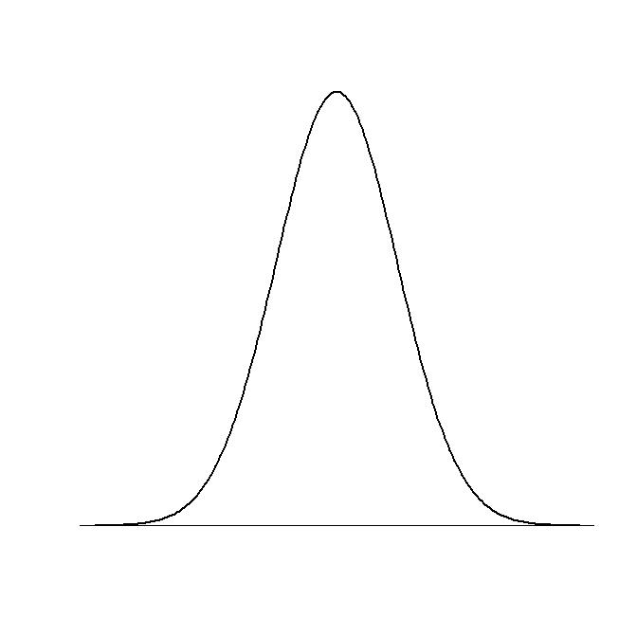
cLHS
Latin Hypercube:
Divides probability distribution of all variables
Equally probable intervals
Randomly samples inside intervals
Combines samples
Samples form a Latin Hypercube
But....
Sample combination may not
actually occur in data
Equally probable intervals
Variable 1
Variable 2

Slide 19
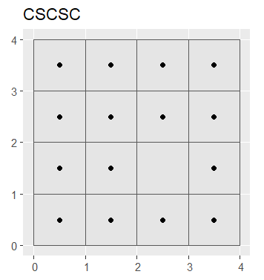
Covariate Space Coverage Sampling (i.e. k-means clustering)
Advantages
Disadvantages
Use cases
Maximumly stratifies the predictors
Automated sample selection
Can incorporates cost constraints
Can incorporate legacy points
Easily scales to multiple GIS layers
Not ideal for map validation (non – probability sample)
Ideal for developing map unit concepts (puts points in weird landscape positions)
Inefficient with large GIS layers
When you have GIS layers that can be used as predictors (e.g. DSM)

Slide 20
References
Ma, T., Brus, D. J., Zhu, A.-X., Zhang, L., & Scholten, T. (2020). Comparison of conditioned Latin hypercube and feature space coverage sampling for predicting soil classes using simulation from soil maps. Geoderma, 370, 114366. https://doi.org/10.1016/j.geoderma.2020.114366
Wadoux, A. M. J. ‐C., & Brus, D. J. (2021). How to compare sampling designs for mapping? European Journal of Soil Science, 72(1), 35–46. https://doi.org/10.1111/ejss.12962

