Slide 1
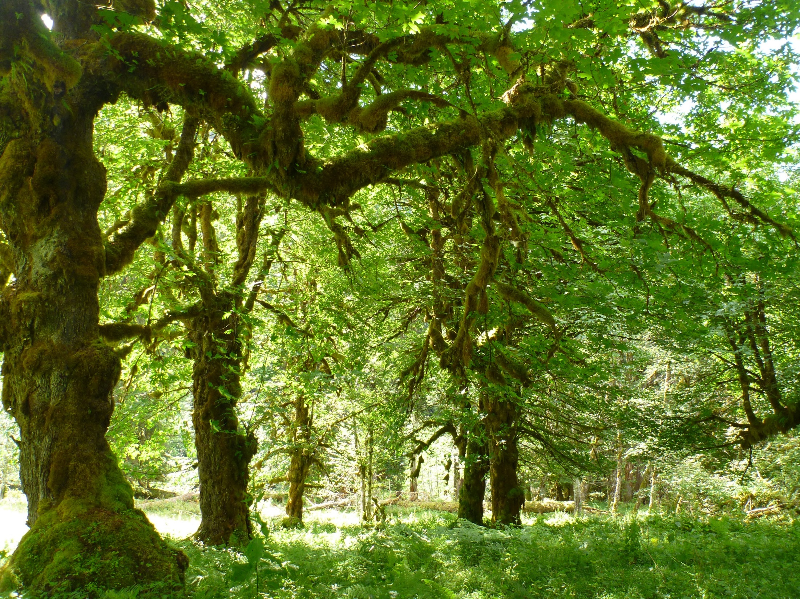
Tree-based Models Statistics for Soil Survey

Slide 2
Outline
Part 1 – CART models
Overview and Concepts
Examples
Advantages over other modeling methods
Rpart Method
Splitting criteria for Regression and Classification
Pruning with Cost Complexity parameter
Model Validation
Part 2 – Random Forest models
Random Forest Methods
Bootstrap Aggregation and Bagging
Variable Importance and OOB
Interpretation — PDPs and SHAP
Uncertainty — QRF, Shanon Entropy, etc
Spatial Validity — kNNDM CV and AOA

Slide 3
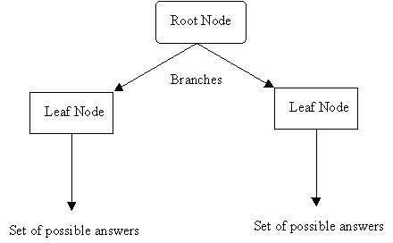
What is a Decision Tree?
Instead of fitting a model to the data, a decision tree model recursively partitions the data into increasingly homogenous groups based on values that minimize a loss function (such as Sum of Squared Errors (SSE)).
Notes:
Show of hands – who has heard of this before – tree models, classification/regression trees, random forests, etc.

Slide 4
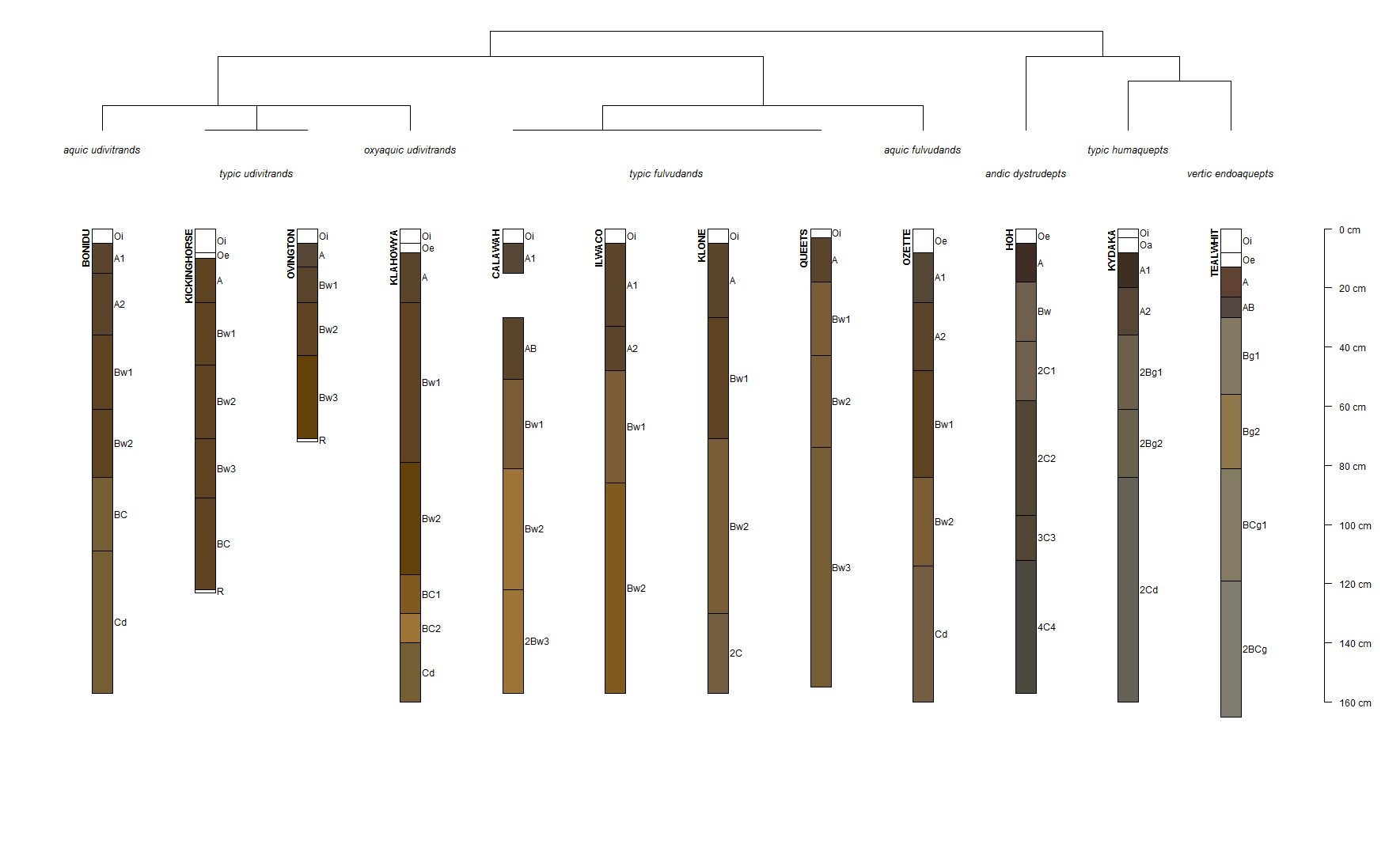
Notes:
Relate to taxonomic keys – dichotomous keys in botany, etc.
This is an OSD querry (fetchOSD and plot the SPC) w/ taxonomic dendrogram

Slide 5
Decision Tree Examples
Argillic Horizon
No
Yes
Dominant Vegetation
Base Saturation
Hardwood
Conifer, Mixed
<35%
>35%
Inceptisols
Spodosols
Ultisols
Alfisols
Notes:
Closely resembles human reasoning - heuristics

Slide 6
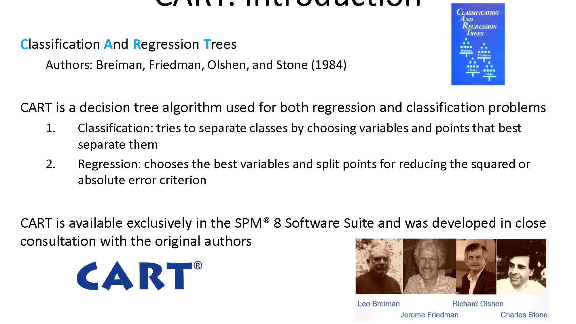
Notes:
From salford systems presentation – acquired by minitab

Slide 7

Common Issues with Regression
Missing Values
require imputation
results in record deletion
limited “high value” observations
Nonlinearity
Y = 10 + 3X₁ – 2X₂ + 0.3X₁²
difficult to account for local effects
Assumes a normal distribution
Interactions
Y = 10 + 3X₁ – 2X₂ + 0.25X₁X₂
i.e. forward / backward / stepwise regression

Slide 8

Advantages of Tree-based Models
Closely resemble human reasoning
Quickly executed
Do not assume / require normality
Handles both continuous and categorical data
Perform Regression and Classification
*Easily interpretable results
Handles missing values and dirty data
Useful for exploratory analysis and prediction

Slide 9
Tree-based Models in R
rpart
caret
randomForest
ranger
GBM / XGB

Slide 10
CART: How Splitting Works
1. Find the best split
Test every variable × threshold.
Choose the pair that maximally reduces RSS (regression) or Gini/entropy (classification).
1
2. Route observations
X < t → left.
X ≥ t → right.
Splits are always axis-aligned — one variable, one threshold.
2
3. Repeat recursively
Each child becomes a new root. Stop when node size, depth, or impurity gain criteria are met.
3
Notes:
Tree grows upside down with root at top
Mention information index for splitting in addition to Gini
Info gain is the inverse of entropy (relate to Shannon’s Entropy)

Slide 11
CART Splitting
Greedy — Each split is locally optimal. No backtracking. Early mistakes propagate.
Variables reusable — The same predictor can split at multiple depths, capturing nonlinear thresholds.
Pruning required — Fully grown trees overfit. The 1-SE rule removes splits not justified by the data.
Notes:
Tree grows upside down with root at top
Mention information index for splitting in addition to Gini
Info gain is the inverse of entropy (relate to Shannon’s Entropy)

Slide 12


CART: Feature Space Partitioning
2-FEATURE EXAMPLE — x₁ (slope) × x₂ (curvature)
HOW SPLITS WORK
Each split draws a line parallel to one feature axis — never diagonal. After k splits, the space is carved into axis-aligned rectangles. Every observation in a region gets the same prediction: the mean ȳ of training points inside it.
Classification Trees — Gini Impurity
$$G=1−\sum_{k=1}^{K}{p_{k}^{2}}$$
$$H=−\sum_{k=1}^{K}{p_{k}}\log_{2}\left(p_{k}\right)$$
x2 (curvature)
Regression Trees — Residual Sum of Squares
Δ𝑅𝑆𝑆 = 𝑅𝑆𝑆parent − [𝑅𝑆𝑆left + 𝑅𝑆𝑆right]
x1 (slope)

Slide 13
CART: Feature Space Partitioning
2-FEATURE EXAMPLE — x₁ (slope) × x₂ (curvature)
HOW SPLITS WORK
Each split draws a line parallel to one feature axis — never diagonal. After k splits, the space is carved into axis-aligned rectangles. Every observation in a region gets the same prediction: the mean ȳ of training points inside it.
SPLIT ORDER (GREEDY)
① x₁ < t₁ — first split minimizes total RSS across all features and thresholds
R1
1
R2
x2 (curvature)
t1
x1 (slope)

Slide 14
CART: Feature Space Partitioning
2-FEATURE EXAMPLE — x₁ (slope) × x₂ (curvature)
HOW SPLITS WORK
Each split draws a line parallel to one feature axis — never diagonal. After k splits, the space is carved into axis-aligned rectangles. Every observation in a region gets the same prediction: the mean ȳ of training points inside it.
R1
SPLIT ORDER (GREEDY)
① x₁ < t₁ — first split minimizes total RSS across all features and thresholds
② x₂ < h₁ — applied to left child only; best local RSS reduction
h1
2
1
R2
x2 (curvature)
R3
t1
x1 (slope)

Slide 15
CART: Feature Space Partitioning
REGRESSION TREE
2-FEATURE EXAMPLE — x₁ (slope) × x₂ (curvature)
HOW SPLITS WORK
Each split draws a line parallel to one feature axis — never diagonal. After k splits, the space is carved into axis-aligned rectangles. Every observation in a region gets the same prediction: the mean ȳ of training points inside it.
R1
SPLIT ORDER (GREEDY)
① x₁ < t₁ — first split minimizes total RSS across all features and thresholds
R2
② x₂ < h₁ — applied to left child only; best local RSS reduction
h1
2
1
x2 (curvature)
③ x₂ < h₂ — applied to right child; each node splits independently
h2
3
Key limitation — diagonal or curved true boundaries must be approximated as a staircase. This requires many splits and inflates variance. Ensembles (random forests) average many such staircases to recover smooth boundaries.
R3
R4
t1
x1 (slope)

Slide 16
Ensemble Methods & the Staircase Problem
how averaging many weak learners produces smooth, low-variance predictions
SINGLE CART TREE
FEATURE SPACE PARTITION
DECISION TREE
3
2
1
4
split 1 - root
x1 < 0.47 ?
R4
yes
1
no
R2
R5
split 2
R3
x1 < 0.31 ?
split 4
R1
yes
2
no
x1 < 0.65 ?
x2 (curvature)
4
true
split 3
yes
no
x1 < 0.16 ?
R3
R4
R5
yes
3
no
< 0.47
< 0.65
x1 >= 0.65
y = 0.29
y = 0.54
y = 0.42
R1
R2
x1 < 0.16
< 0.31
y = 0.21
y = 0.39
0.16
0.31
0.47
0.65
x1 (slope)
High Variance, Low Bias

Slide 17
Ensemble Methods & the Staircase Problem
BAGGING
RANDOM FOREST
VARIANCE REDUCTION
how averaging many weak learners produces smooth, low-variance predictions
SINGLE CART TREE
2D CART CLASSIFICATION TREE
root · split 1
x1 split
x2 split
B
A
x1 < 0.47 ?
yes
no
split 2
split 4
x1 < 0.31 ?
x1 < 0.65 ?
yes
no
yes
no
split 3
R3
split 5
R4
split 6
R5
split 7
x1 < 0.16 ?
x2 < 0.29 ?
x2 < 0.54 ?
x2 < 0.42 ?
yes
no
R1
split 8
R2
split 9
x2 < 0.21 ?
x2 < 0.39 ?
B
A
B
A
B
A
B
A
B
A
>=0.21
<0.21
>=0.39
<0.39
>=0.29
<0.29
>=0.54
<0.54
>=0.42
<0.42
x2: 0.21
x2: 0.39
x2: 0.29
x2: 0.54
x2: 0.42
x1 < 0.16
0.16 – 0.31
0.31 – 0.47
0.47 – 0.65
x1 >= 0.65
High Variance, Low Bias

Slide 18

Ensemble Methods & the Staircase Problem
how averaging many weak learners produces smooth, low-variance predictions
SINGLE CART TREE
staircase ≠ true boundary
x2
true
x1
High Variance, Low Bias
One tree fits its training sample perfectly, tracing a jagged staircase that chases noise. Change the training data slightly and the entire boundary shifts. Predictions are unstable.

Slide 19
Ensemble Methods & the Staircase Problem
BAGGING
VARIANCE REDUCTION
how averaging many weak learners produces smooth, low-variance predictions
SINGLE CART TREE
TRAINING DATA
NEW DATA (different sample)
staircase fit to this sample
same staircase applied — poor fit
fits training perfectly
6 / 12 misclassified
50% error on new data
trained on D1
x2 (curv.)
true
same model
x2 (curv.)
true
x1 (slope)
x1 (slope)
High Variance, Low Bias
One tree fits its training sample perfectly, tracing a jagged staircase that chases noise.
Change the training data slightly and the model no longer fits the data. Predictions are unstable.

Slide 20
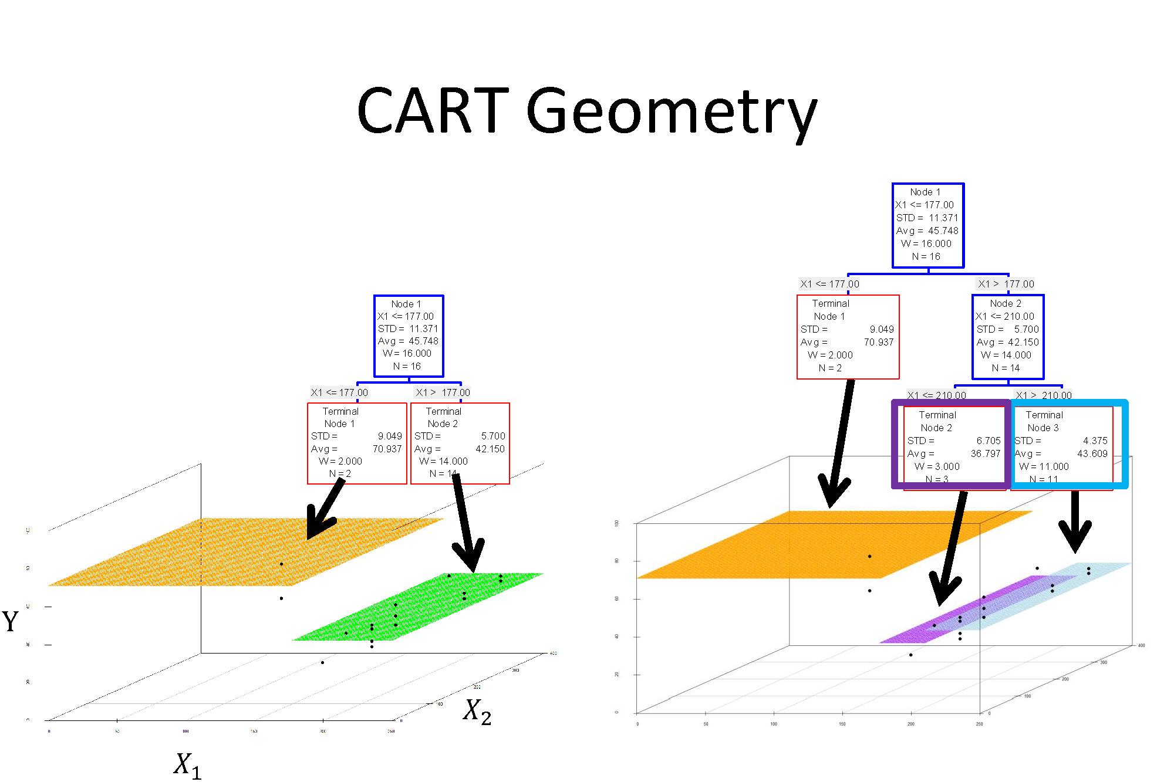

Slide 21
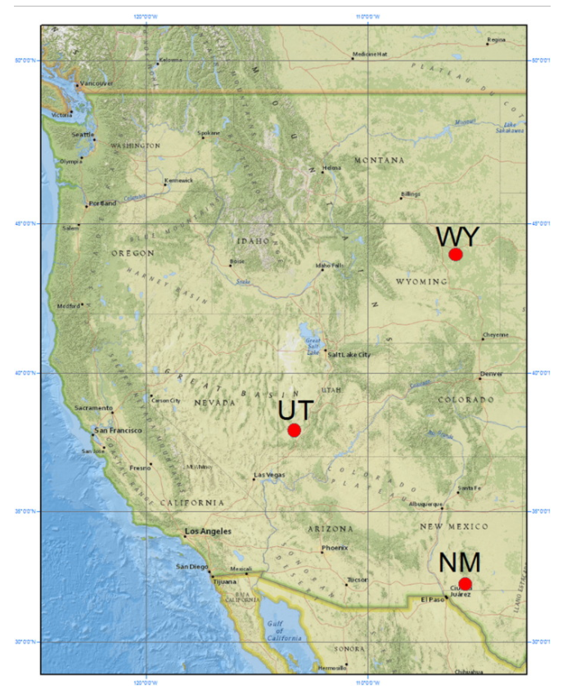
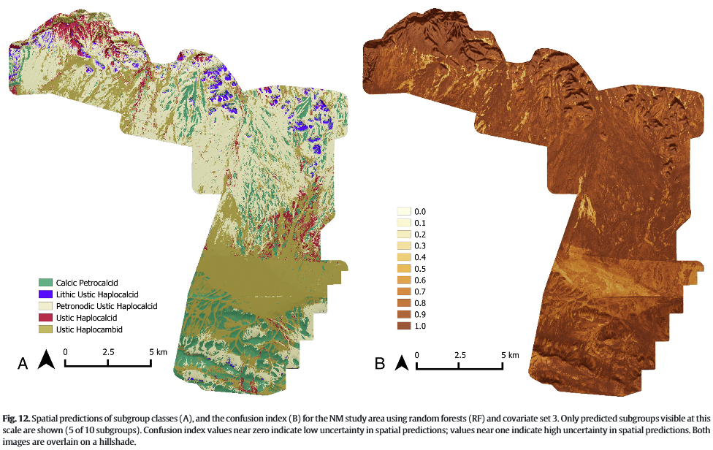
Prediction of Soil Classes
Are Very Accurate Predictors
From Brungard et al., 2015
Notes:
In predicting soil classes in across three study area in UT, WY, and NM, random forest outperformed 10 other ML classifiers
Accurate but tends to over-fit

Slide 22
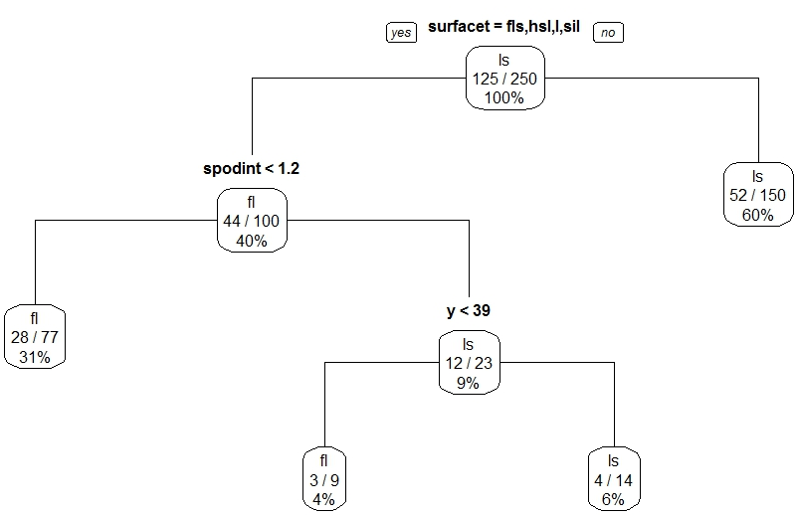
Rpart Classification Tree
Terminal nodes are categorical -- the class with the majority of votes wins.
Notes:
This is what we looked in the GLM exercises – same dataset, etc day 3/4

Slide 23
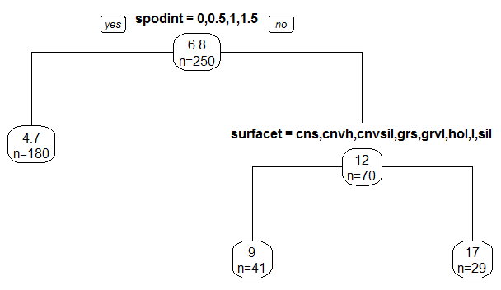
Rpart Regression Tree
Terminal nodes represent the mean of the observations in that node.

Slide 24
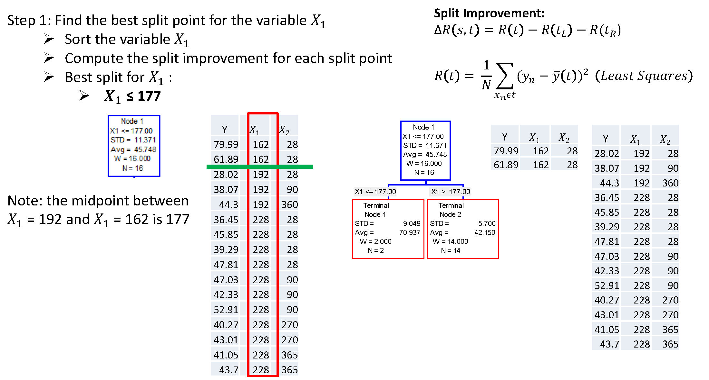
Splitting Procedure - Regression
Notes:
Concrete strength example from engineering

Slide 25
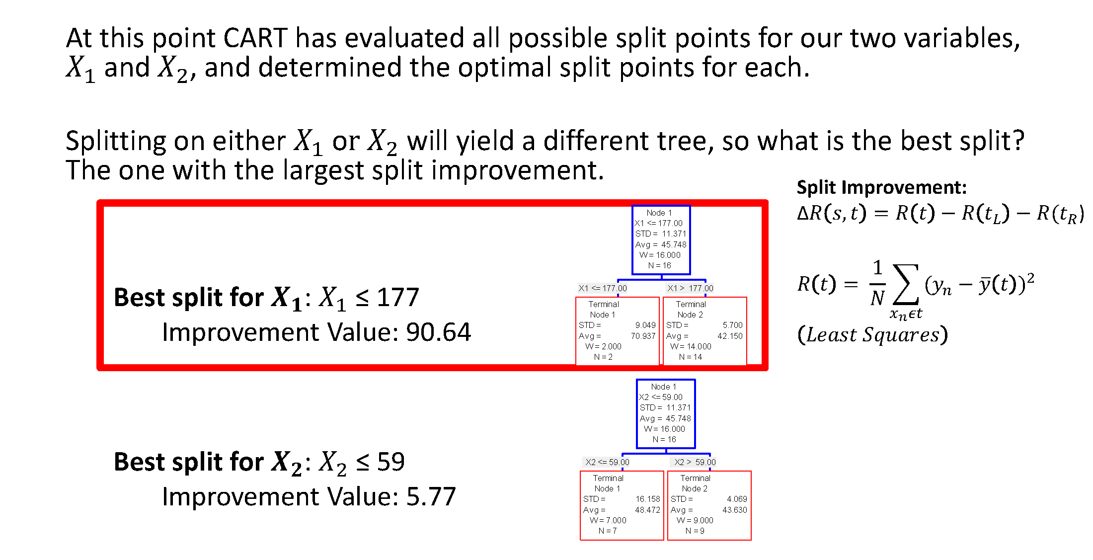
Splitting Procedure - Regression

Slide 26
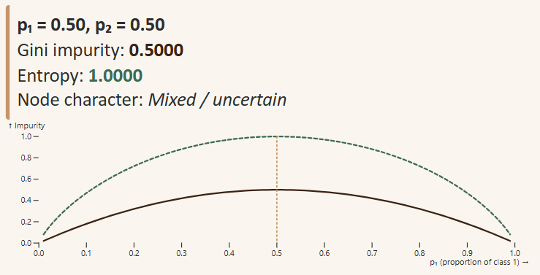
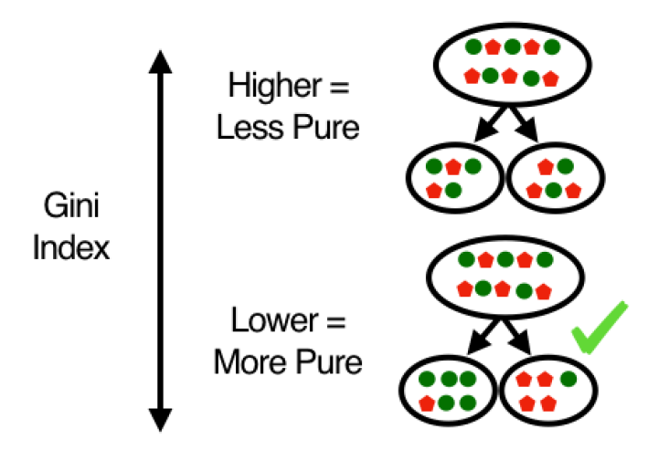
Splitting Procedure - Classification
Notes:
Mention information gain and its relation to Shannon’s Entropy from day 1

Slide 27
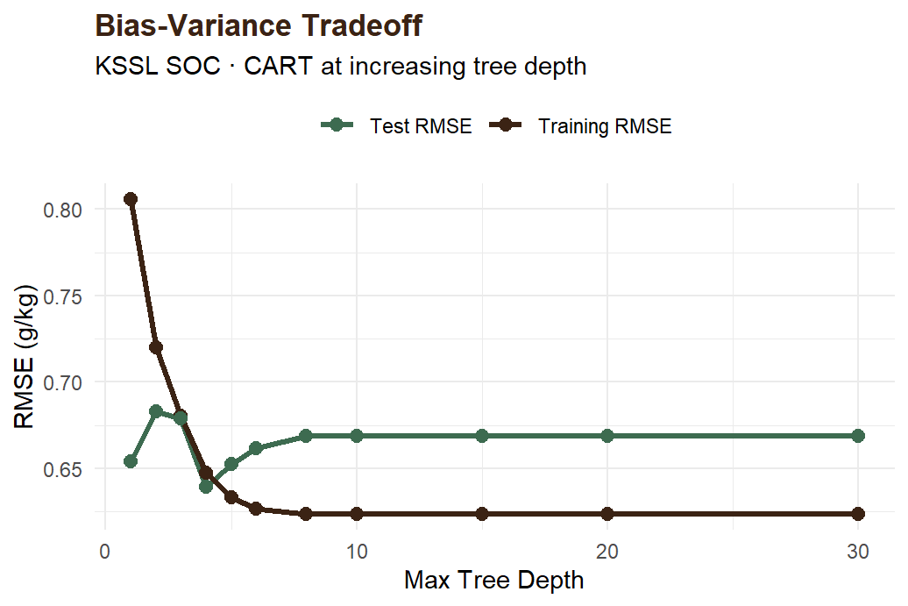
The Bias-Variance Tradeoff in Trees
Fully grown tree (max depth) — zero training error → memorized data
Low bias, extreme variance — fails on new sites
Stump (depth = 0 or 1) — single rule only
High bias, very low variance
Optimal complexity lies between these extremes
Controlled by maximum depth, minimum samples per leaf, and the complexity parameter α (cp)

Slide 28
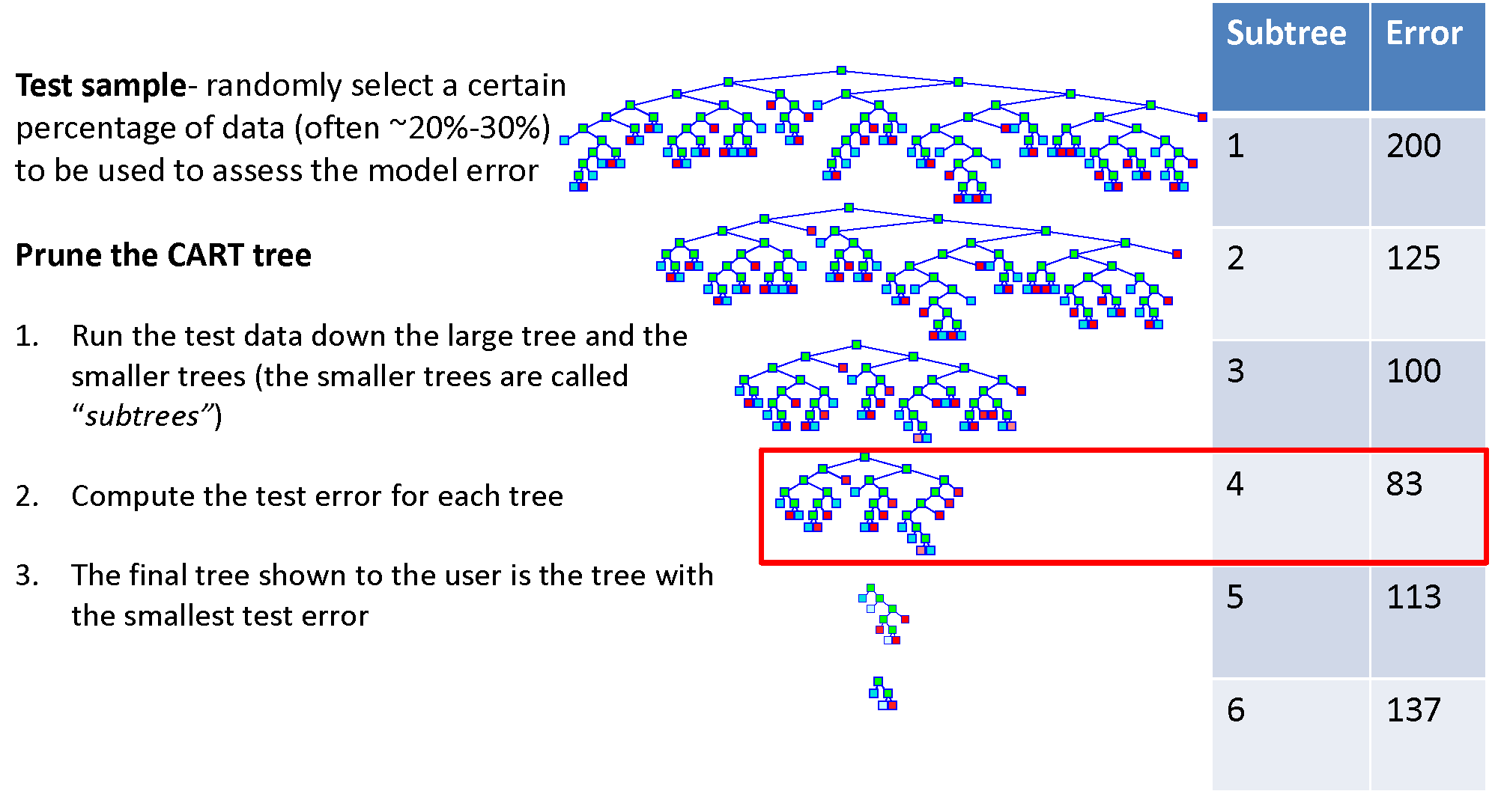
Pruning

Slide 29
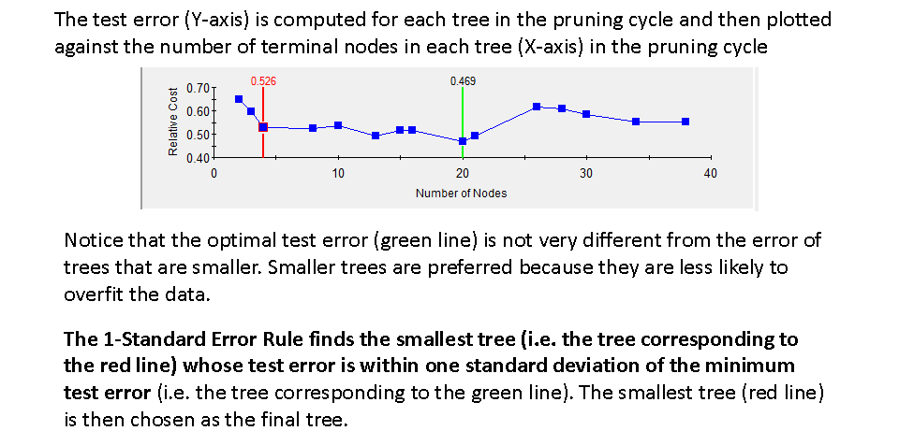
Pruning

Slide 30
Model Evaluation
Producer’s accuracy
The probability of a reference pixel being correctly classified.
Omission error – samples are omitted from the correct class
User’s accuracy
The probability that a pixel classified on the map represents that category on the ground.
Commission error – samples are added to the incorrect class
Overall accuracy
Computed by dividing the total correct (i.e., the sum of the major diagonal) by the total number of pixels in the error matrix
Notes:
Revisit from day1 - uncertainty

Slide 31
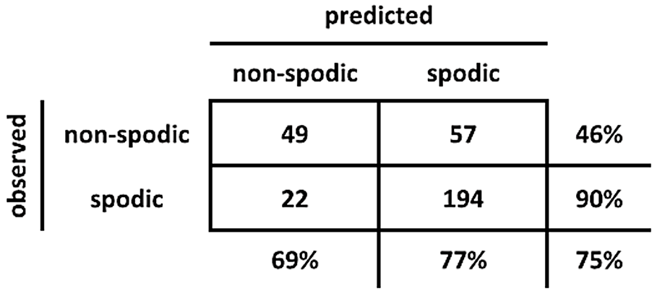

Model Evaluation
Producers’s
Accuracy
49/106
194/216
User’s
Accuracy
49/71
194/251
$$\frac{194+49}{322}$$
Overall
Accuracy
Notes:
Revisit from day1 - uncertainty

Slide 32
Exercise: Rpart
Part 1:
Exploratory Data Analysis
Part 2:
Regression trees with rpart
Pruning and cost complexity parameter
Eval with RMSE
Part 3:
Classification tree with GINI and Information Gain
Eval with confusion matrices, overall accuracy and kappa
Notes:
Link to pdf and .R script

Slide 33
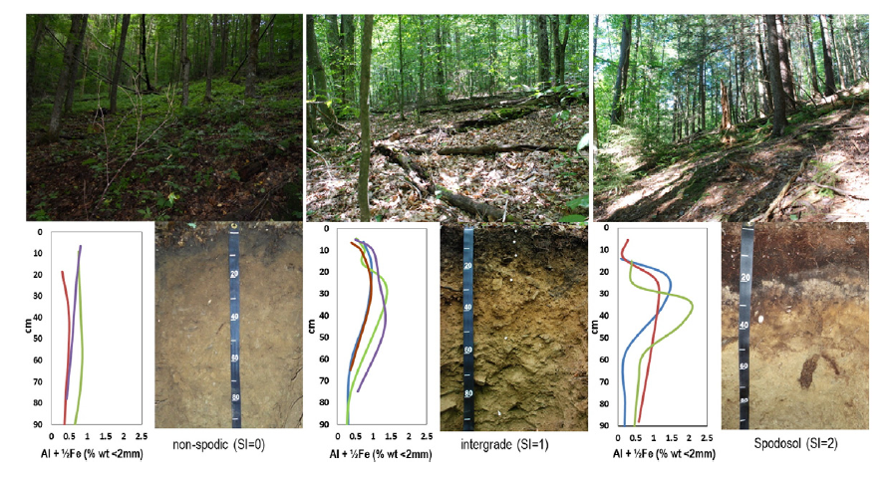
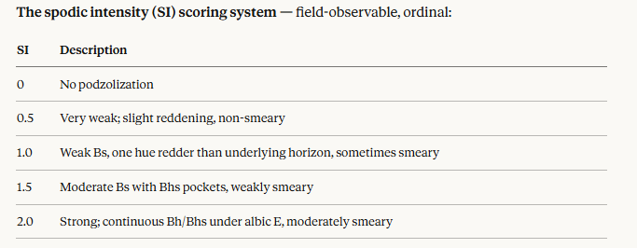

Slide 34
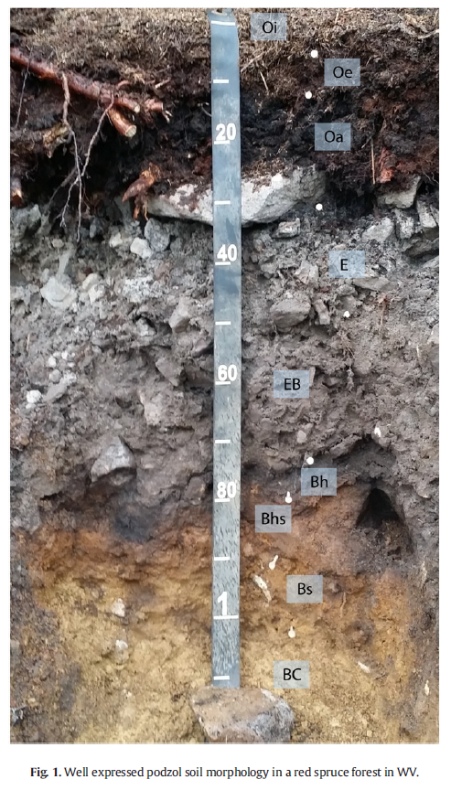
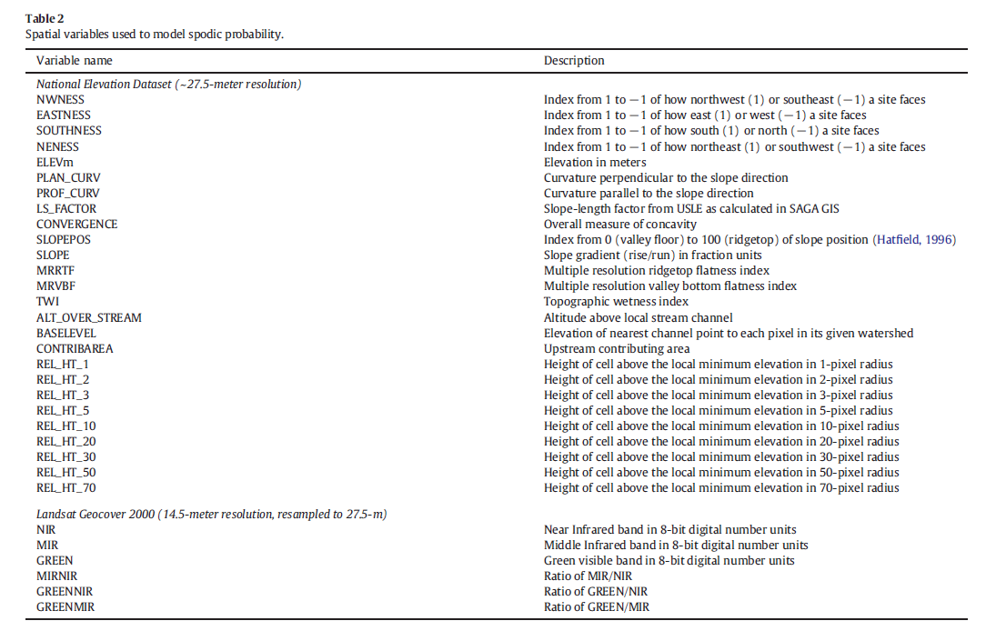

Slide 35
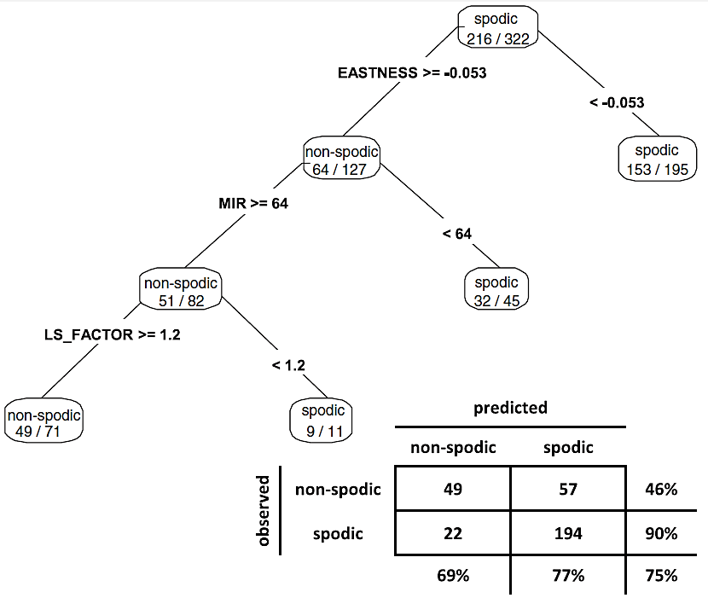
Prediction of Soil Properties
From Nauman et al., 2015
Notes:
This is what we looked in the GLM exercises in day 3/4
Confusion Matrix – whats the OA?
Will revisit this later

Slide 36


Slide 37
Exercise:
Part 1:
Correlation Plot:
Part 2:
Evaluate results from regression trees
Part 3:
Compare splitting criteria for classification trees

Slide 38
Summary - rpart
rpart(formula, data, method, control)
formula response~predictor1+predictor2+predictorx
data= specifies the dataset
method= “class” for classification tree
“anova” for regression tree
control= optional parameters for controlling tree growth
printcp( ) | displays complexity parameter (cp) table
plotcp ( ) | plots cross-validation results
summary ( ) | detailed results including surrogate splits
plot ( ) | plots the decision tree
text ( ) | labels the decision tree plot
prune ( ) | snips off the least important splits using cp
Notes:
Introduce the function - Run through an example - Then discuss the optional parameters

Slide 39
Outline
Part 2 – Random Forest models
Random Forest Methods
Bootstrap Aggregation and Bagging
Variable Importance and OOB
Interpretation — PDPs and SHAP
Uncertainty — QRF, Shanon Entropy, etc
Spatial Validity — kNNDM CV and AOA

Slide 40
Ensemble Methods & the Staircase Problem
how averaging many weak learners produces smooth, low-variance predictions
SINGLE CART TREE
staircase ≠ true boundary
x2
true
x1
High Variance, Low Bias
One tree fits its training sample perfectly, tracing a jagged staircase that chases noise. Change the training data slightly and the entire boundary shifts. Predictions are unstable.

Slide 41
Ensemble Methods & the Staircase Problem
BAGGING
VARIANCE REDUCTION
how averaging many weak learners produces smooth, low-variance predictions
SINGLE CART TREE
TRAINING DATA
NEW DATA (different sample)
staircase fit to this sample
same staircase applied — poor fit
fits training perfectly
6 / 12 misclassified
50% error on new data
trained on D1
x2 (curv.)
true
same model
x2 (curv.)
true
x1 (slope)
x1 (slope)
High Variance, Low Bias
One tree fits its training sample perfectly, tracing a jagged staircase that chases noise.
Change the training data slightly and the model no longer fits the data. Predictions are unstable.

Slide 42
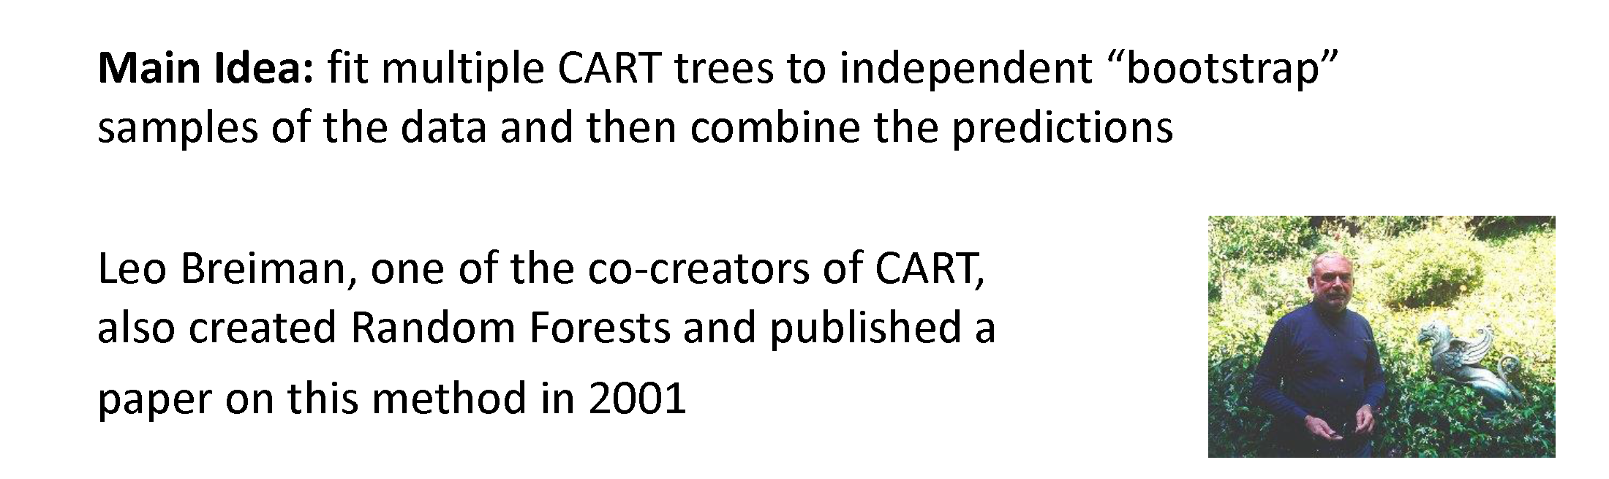
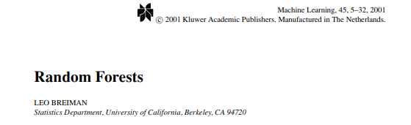
Random Forest Method
Notes:
Breiman and Cutler

Slide 43
Ensemble Methods & the Staircase Problem
→
ntrees
VARIANCE REDUCTION
how averaging many weak learners produces smooth, low-variance predictions
BOOTSTRAP + MANY TREES
5 of B trees shown
BAGGING MECHANISM — HOW VARIANCE SHRINKS
averaged boundary
D*
→
T*
→
×B
→
Σ/B
x2
Bootstrap
sample D*
Fit deep
tree T*
Repeat
B times
Average
predictions
Var(mean of B i.i.d. trees) = σ² / B → variance falls linearly with B → bias unchanged (trees still deep)
x1
Averaging Cancels Noise
Each bootstrapped tree draws a different staircase. Their staircases disagree on the noise but agree on the signal. Averaging across B trees cancels the noise — variance shrinks by ~1/B.

Slide 44
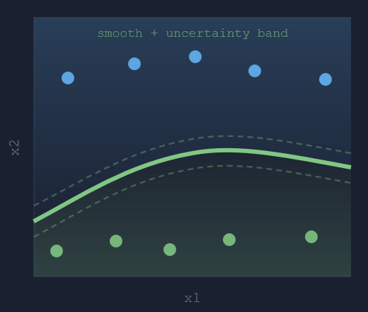
Ensemble Methods & the Staircase Problem
→
mtry
VARIANCE REDUCTION
how averaging many weak learners produces smooth, low-variance predictions
RANDOM FOREST RESULT
RANDOM FOREST — EXTRA DECORRELATION STEP
⇌
→
m < p
→
≠
→
ρ↓
At each
split…
Sample
m < p features
Trees can't
all agree
Lower
correlation ρ
Var(avg correlated trees) = ρσ² + (1−ρ)σ²/B → ρ↓ makes the first term vanish → why RF outperforms plain bagging
Expected error =
Bias
2
(f(x))
+
Variance
(f(x))
+
Irreducible noise
epistemic uncertainty
aleatoric uncertainty
REDUCIBLE · CI ANALOG
IRREDUCIBLE · PI FLOOR
Low Variance, Smooth Boundary
The ensemble boundary approaches the true curve. Random feature subsampling (mtry) further decorrelates trees so averaging is more effective. The band shows remaining epistemic uncertainty.

Slide 45

Random Forest Method
Grow a forest of many trees (ntree).
Grow each tree from an independent bootstrap sample from the training data (sample N cases at random with replacement).
For each tree at each node:
Select a random subset of predictor variables (mtry)
Use the best split on the selected mtry variables
Repeat this process until the tree is grown to the largest extent possible (no pruning)
Aggregate all trees for prediction (average for regression, majority vote for classification).
Notes:
Double random nature – mrty and bagging
Does not produce a single tree output like rpart because decisions are not made on a single binary tree….decisions are made using an ensemble of trees.

Slide 46
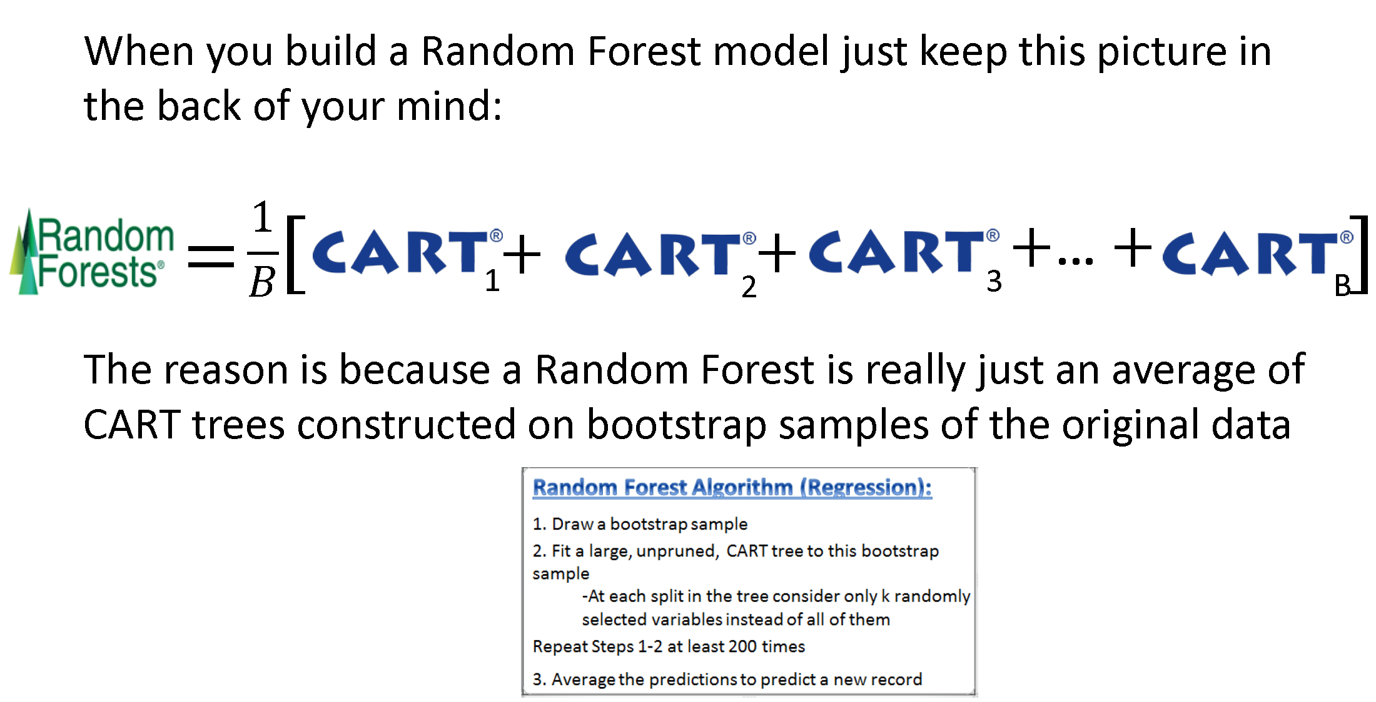
Random Forest Method

Slide 47
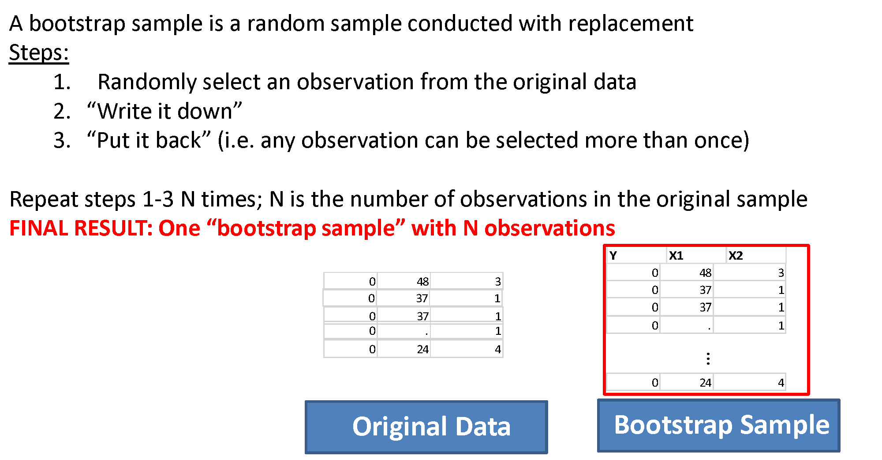
Bootstrap Aggregation

Slide 48
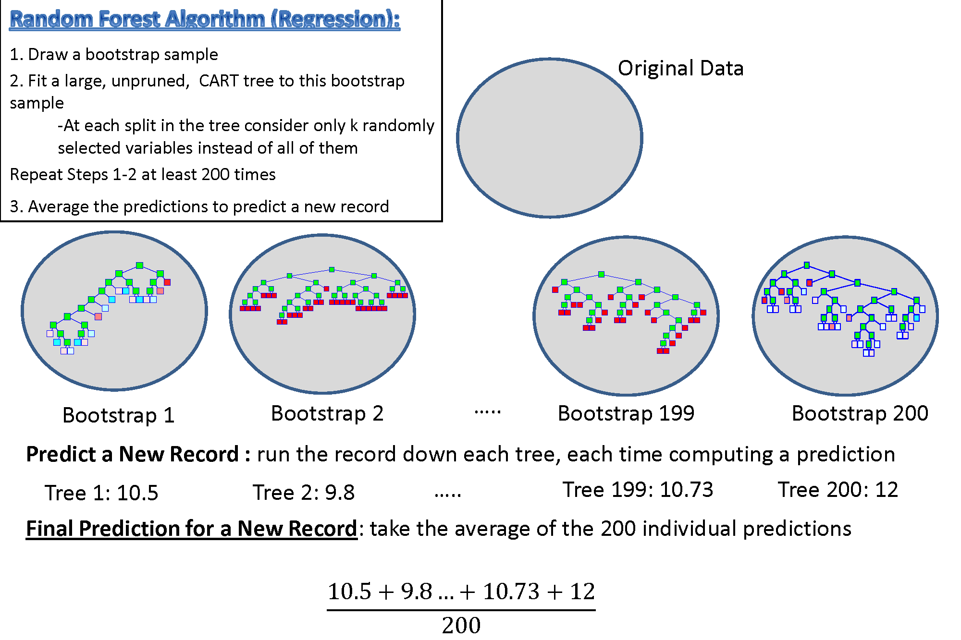

Slide 49
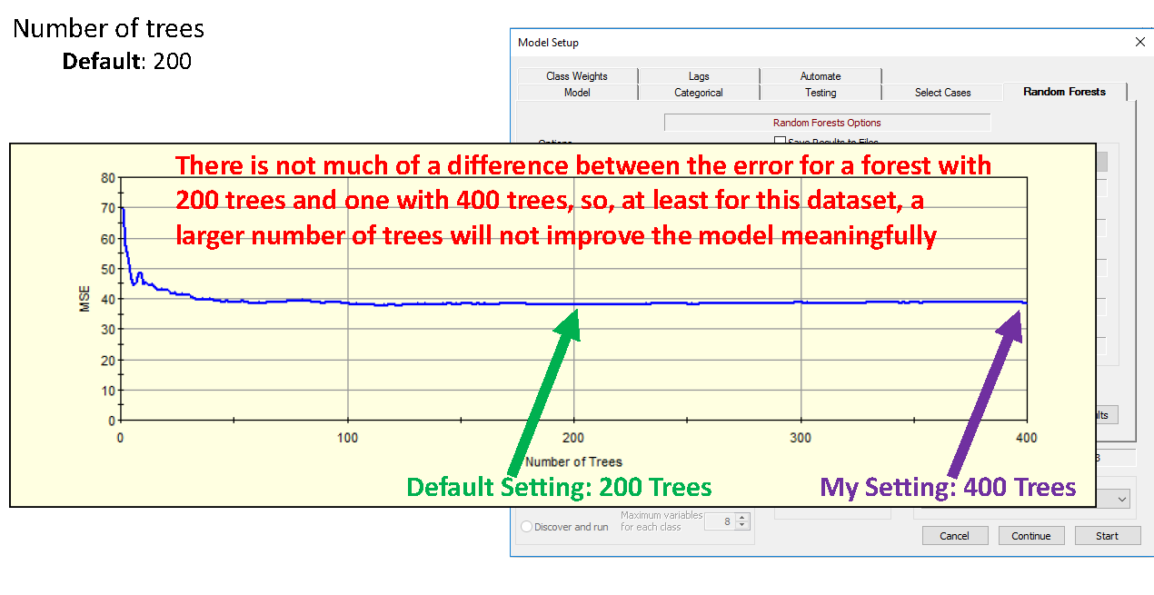
Random Forest Method - ntree

Slide 50
Regression Terms
%Inc MSE
average increase in squared residuals of the test set when variables are randomly permuted (little importance = little change in model when variable is removed or added)
Inc Node Purity
increase in homogeneity in data partitions
Mean of Squared Residuals
sum of squared residuals divided by n
% Variance Explained
psuedo R²
Notes:
The %IncMSE is the difference between the prediction errors averaged over all trees, normalized by the standard deviation of the differences.
The IncNodePurity is measured by residual sum of squares as the total decrease in node impurities as a result of splitting on a given variable, averaged over all trees.

Slide 51
Classification Terms
Mean Decrease Accuracy
the more the accuracy of the random forest decreases due to the addition of a single variable, the more important the variable is deemed
Mean Decrease Gini
a measure of how each variable contributes to the homogeneity of the nodes and leaves
Out of Bag Error
proportion of times that the result is misclassified, averaged over all samples

Slide 52
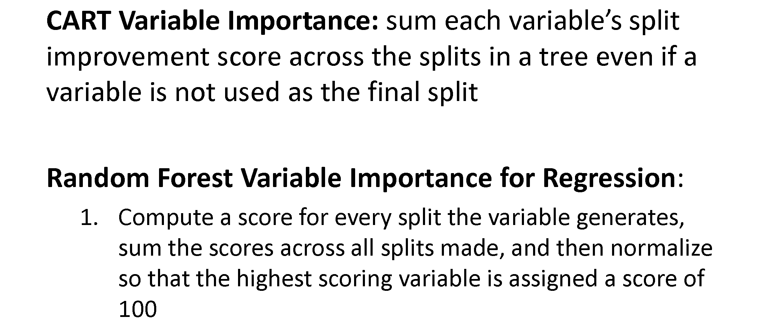
Variable Importance
The importance of each variable is estimated by observing how much the prediction error increases when out-of-bag (OOB) data for that variable are permuted while all others are left unchanged.

Slide 53
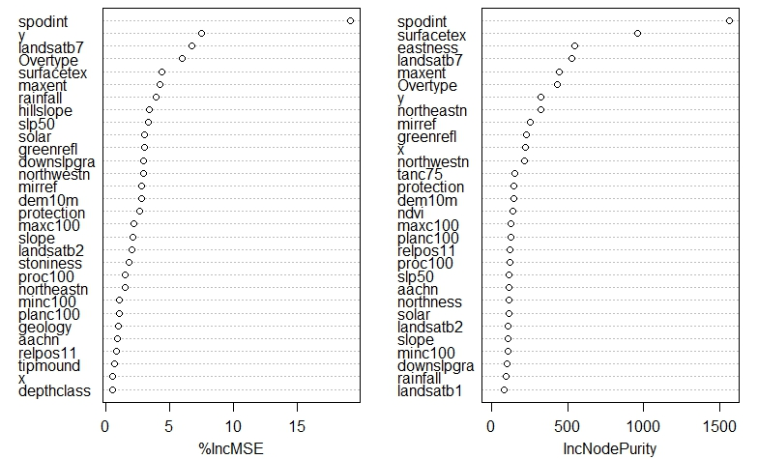
Variable Importance
Notes:
Useful to reduce multicolinearity

Slide 54
Gradient Descent for Model Tuning
Used to Determine the Optimal Combination of Input Parameters
Build a table all reasonable input parameters
ntree
mtry
nodesize
Build models for every possible combination and compare OOB error estimates across each model
The final model will have the ideal set of parameters that minimizes the OOB error estimate
Notes:
Relate to deep learning and the gradient descent origins
Computationally intensive!! Runn many many different models
Need for something like Ranger

Slide 55
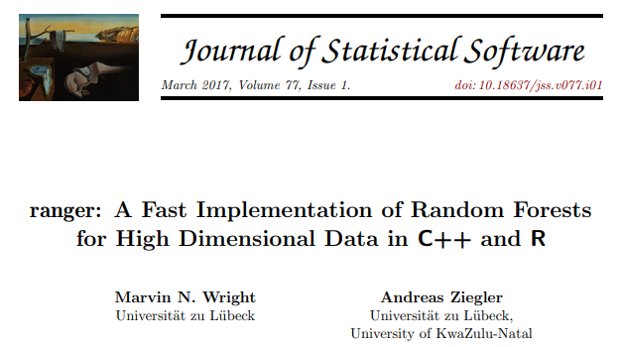
Ranger package
Notes:
Mention the exercise

Slide 56
Boosting Algorithms
Adaboost
GBM - Gradient Boosting Machine
XGB – Extreem Gradient Boosting
Boosting Methods:
Fit a decision tree
Fit a second decision tree to model residuals
Add models together and repeat this process for n iterations
Need to balance Performance with Over-fitting

Slide 57
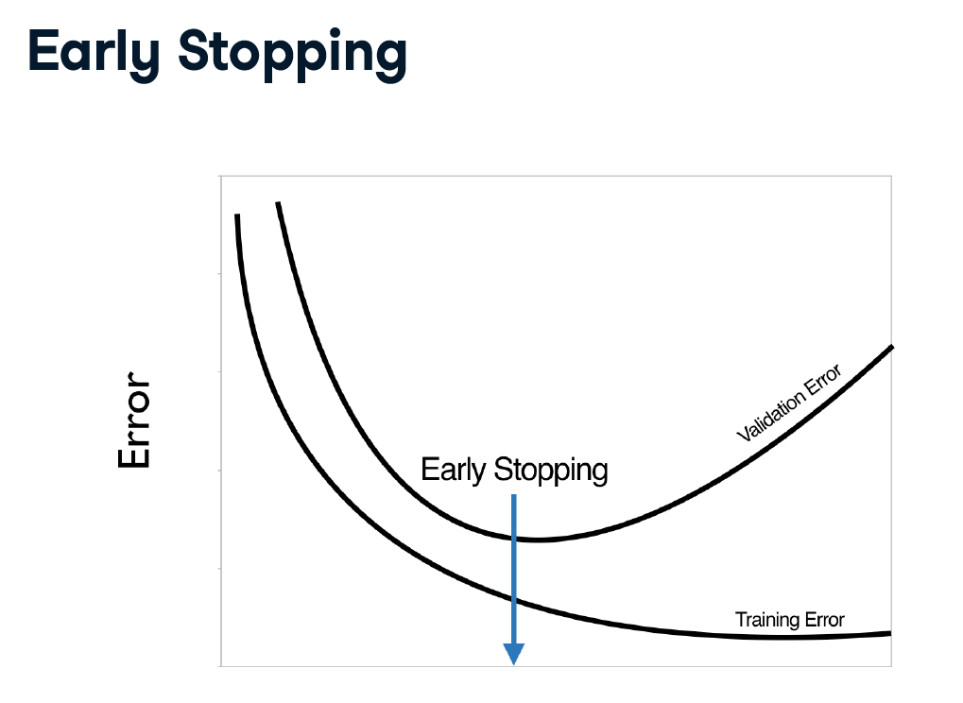
Training Epochs

Slide 58

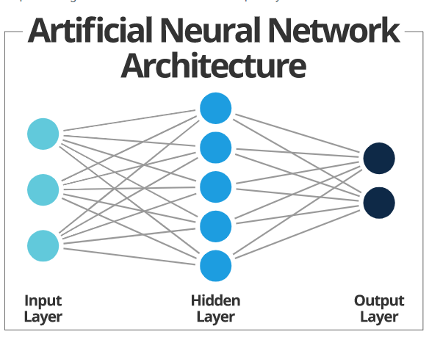
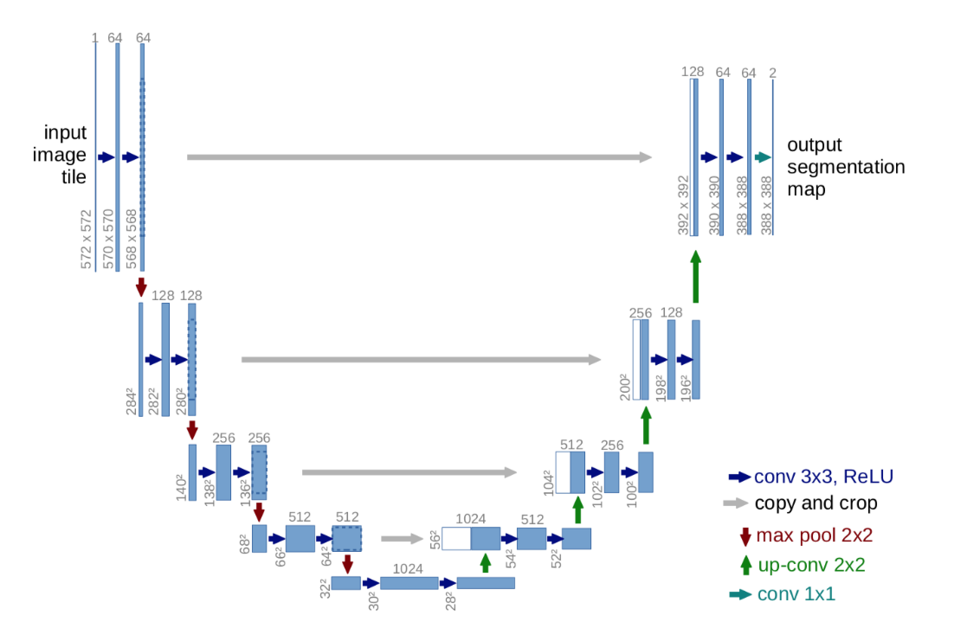
Deep Learning State of the Art in Classification Highly Accurate – very black box CNN for Image Processing (a. la. Unet) Hidden Layers and Activation Weights/Bias More info here
Notes:
1,000’s of parameters
sigmoid vs ReLU - backpropigation

Slide 59
Exercise: Random Forest
Part 4:
Random Forest for Classification
Gradient Descent for Model Tuning
Part 5:
Fast Random Forest with Ranger
Benchmarking with system.time
Part 6:
Prediction with Random Forest
Mapping Land Cover from NAIP Imagery
Notes:
Link to pdf and .R script

Slide 61
Exercise: Random Forest
Part 4:
Effect of gradient descent
Part 5:
Performance boost with ranger
Part 6:
Mapping Land Cover from NAIP Imagery
Producing probability surface for land cover map
Notes:
Link to pdf and .R script

Slide 62
Summary - randomForest
randomForest(formula, data, importance)
formula response~predictor1+predictor2+predictorx
data= specifies the dataset
mtry= number of randomly sampled variables at
each node
ntree= number of trees to grow
importance= if TRUE, allows user to examine variable importance
varImpPlot ( ) | variable importance plot
importance ( ) | variable importance statistics
plot ( ) | plots out of bag (OOB) error rate versus number of trees
print( ) | model summary statistics

Slide 63
Exercise Summary:
Built regression and classification models with rpart
Built regression and classification models with random forest
Evaluated model predictions with an independent validation set
Used gradient descent for model tuning
Employed benchmarking to quantify performance increases from ranger
Mapped land cover from NAIP Imagery
Notes:
Interpret model outputs
Predict with rpart and random forest

Slide 64
Summary – Tree Models
Tree-based models are quick, intuitive, nonparametric, and are often ideal for exploratory data analysis and prediction
Both rpart and randomForest packages perform internal validation (rpart=10-fold cross validation; randomForest=OOB error estimates)
In general, tree-based models are robust against multicollinearity and low n, high p datasets
Caveats
Outliers (model stability and over-fitting)
Model parameters (pruning for rpart; ntree and mtry for randomForest)

Slide 65
Review Questions
Why is random forest often referred to as double random?
How does random forest perform internal validation?
True or false – numerical and categorical data can be used in the creation of a classification tree?
What are some differences between rpart and randomForest?
Why is random forest often referred to as double random?
How does random forest perform internal validation?
True or false – numerical and categorical data can be used in the creation of a classification tree?
What are some differences between rpart and randomForest?
Why is random forest often referred to as double random?
How does random forest perform internal validation?
True or false – numerical and categorical data can be used in the creation of a classification tree?
What are some differences between rpart and randomForest?
Why is random forest often referred to as double random?
How does random forest perform internal validation?
True or false – numerical and categorical data can be used in the creation of a classification tree?
What are some differences between rpart and randomForest?

Slide 66
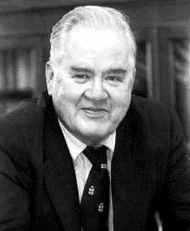
Always Remember…
“The combination of some data and an aching desire for an answer does not ensure that a reasonable answer can be extracted from a given body of data.”
–John Tukey

Slide 67


