Slide 1
Introduction to R and RStudio
Stephen Roecker, Skye Wills, Katey Yoast and Tom D’Avello

Slide 2
Outline
Course Overview
Review Course Objectives
Why is this training needed?
Why is course organized this way?
What is R?
Why should I use R?
What can R do?
How do I get started?
RStudio interface
What are packages?
How to navigate the Help tab
How to save files
Manipulating data
Loading & viewing data
Filtering, transforming, merging, aggregating and reshaping data
Exporting data

Slide 3
Course Objectives
Develop solutions to investigate soil survey correlation problems and update activities
Evaluate investigations for interpretive results and determine how to proceed
Summarize data for populations in NASIS
Analyze spatial data to investigate soil-landscape relationships
Help to pursue the question “why”

Slide 4
Why is this training needed?
Long standing goal of the Soil Science Division to have a course in statistics (Mausbach 2003)
Opportunities to learn these techniques are limited, especially at the undergraduate level (Hennemann and Rossiter 2004)
Consistent methodology (data analysis, data population, sampling design, etc.)
There is continually a greater need to use these techniques:
Mapping of lands at high production rates (MacMillan, Moon, and Coupé 2007; Kempen et al. 2012; Brevik et al. 2016)
Ecological Sites (Maynard et al. 2019)
Soil survey refinement (disaggregation) (Chaney et al. 2016; Ramcharan et al. 2018)

Slide 5
Why is course organized this way?
Our best judgement for assembling into 24 hours what could be 6 University level courses
Mixture of slides and script enabled web pages is new for NRCS
The web content is a long-term investment and should serve as a permanent reference
Feel free to provide guidance for improving the class for future offerings

Slide 6
What is R? - Open Source Project
a software environment: statistics, graphics, programming, calculator, GIS, etc…
a language: vocabulary to explore, summarize, and model data

Slide 7
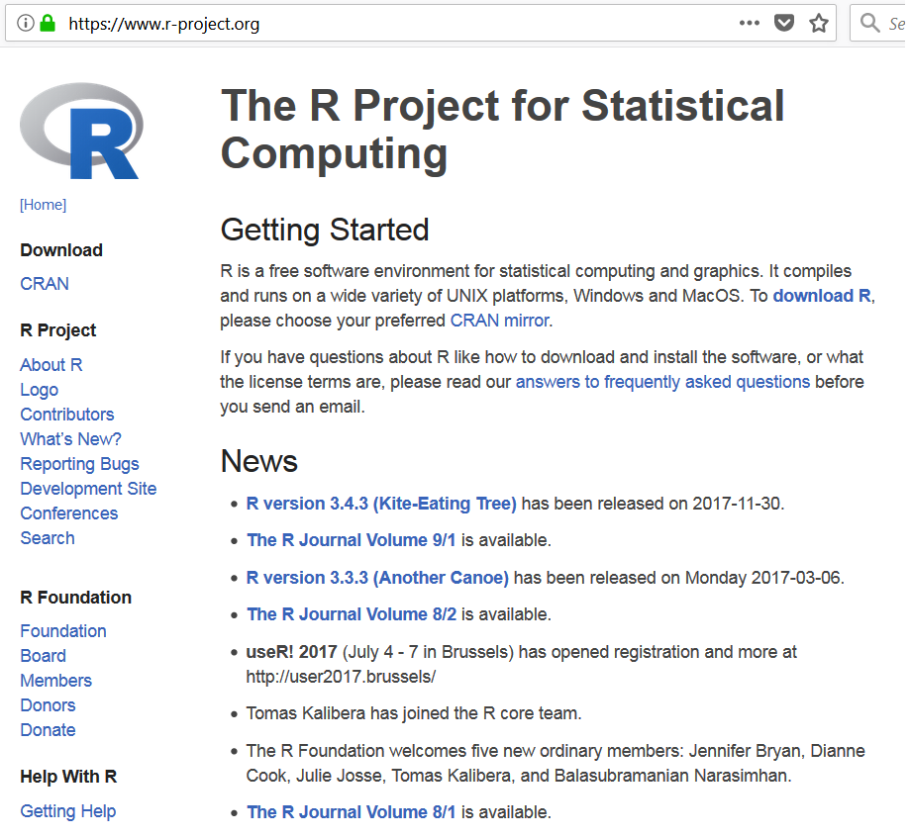

Slide 8
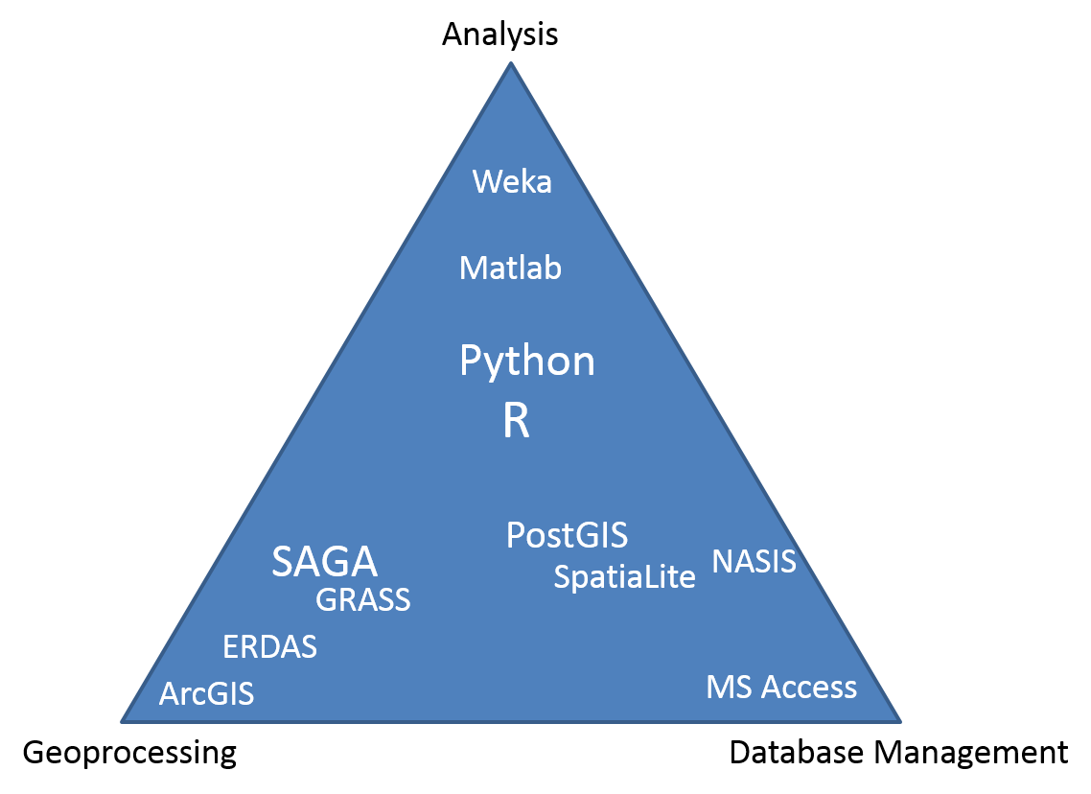
What is R? - “One Tool”"
ODBC and GDAL link R to nearly all possible formats/interfaces

Slide 9
Why should I use R? - 3 Reasons!
Cost. R is free! “Free as in free speech, not free beer!”
Reproducible Research (self-documenting, repeatable)
repeatable:
code + output in a single document (‘I want the right answer, not a quick answer’ - Paul Finnell)
easier the next time (humorous example)
numerous Excel horror stories of scientific studies gone wrong exist (TED Talk)
scalable: applicable to small or large problems
R in a Community
Numerous Discipline Specific R Groups
Numerous Local R User Groups (including R-Ladies Groups)
Stack Overflow
Learning Resources (quantity and quality)
R books
(Free Online) R Books
R is ‘becoming’ the new norm (paradigm shift?). “If we don’t accept these challenges, other who are less qualified will; and soil scientists will be displaced by apathy.” (Arnold and Wilding 1991)

Slide 10
What can R do? - Packages
Base R (functionality is extended through packages)
basic summaries of quantitative or qualitative data
data exploration via graphics
GIS data processing and analysis
Soil Science R Packages
aqp - visualization, aggregation, classification
soilDB - access to commonly used soil databases
soilReports - handful of report templates
soiltexture - textural triangles
Ecology R packages
vegan - ordination, diversity analysis, etc…
dismo - species distribution modeling

Slide 11
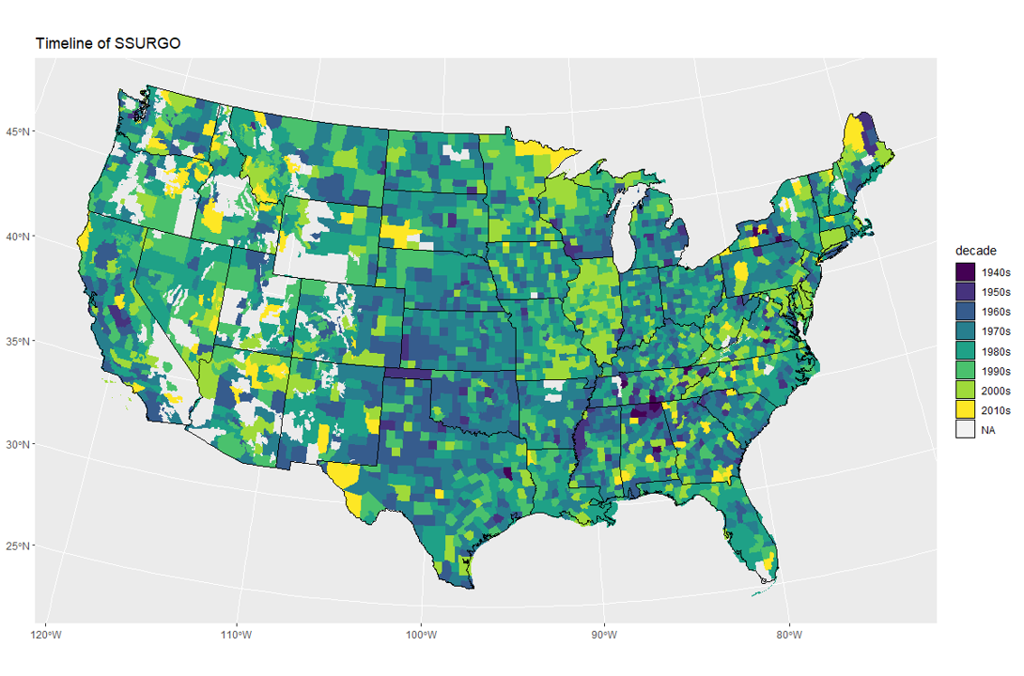
What can R do? - Create Maps

Slide 12
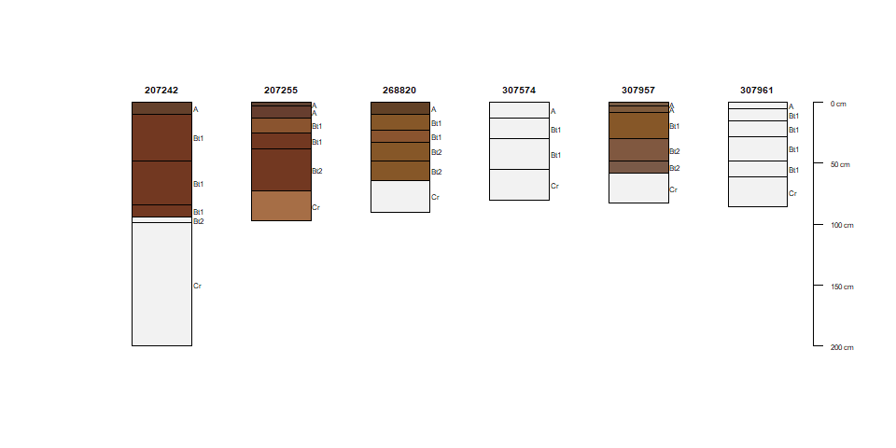
What can R do? - Draw Soil Profiles

Slide 13
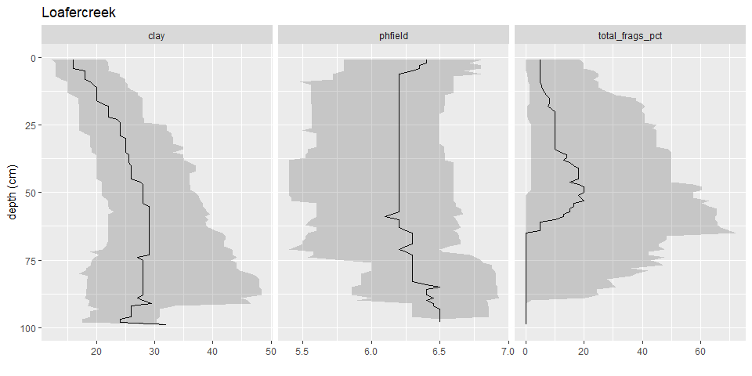
What can R do? - Draw Depth Plots

Slide 14
What can R do? - Estimate RIC
genhz | variable | pct10 | median | pct90
A | clay | 13 | 16 | 22
BAt | clay | 16 | 19 | 25
Bt1 | clay | 18 | 24 | 32
Bt2 | clay | 22 | 30 | 44
Cr | clay | 15 | 15 | 15
A | phfield | 6 | 6 | 7
BAt | phfield | 5 | 6 | 6
Bt1 | phfield | 5 | 6 | 7

Slide 15
What can R do? - etc…
Query and import data from NASIS or SDA
Develop reports, websites, presentations
Construct a sampling plan
Develop pedotransfer functions (e.g. NASIS calculations)
Digital soil mapping

Slide 16
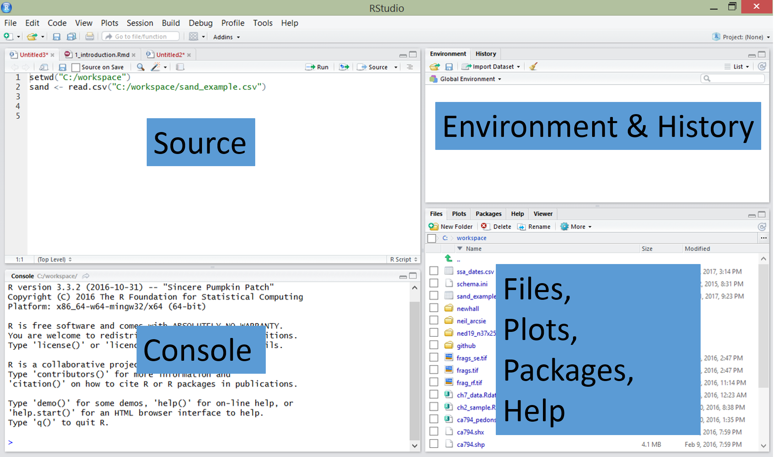
RStudio - Integrated Development Environment

Slide 17
Rcmdr (R Commander): A Graphical User Interface for R
Rcmdr Tutorials by Andy Chang & G. Jay Kerns
install.packages(Rcmdr) library(Rcmdr)

Slide 18
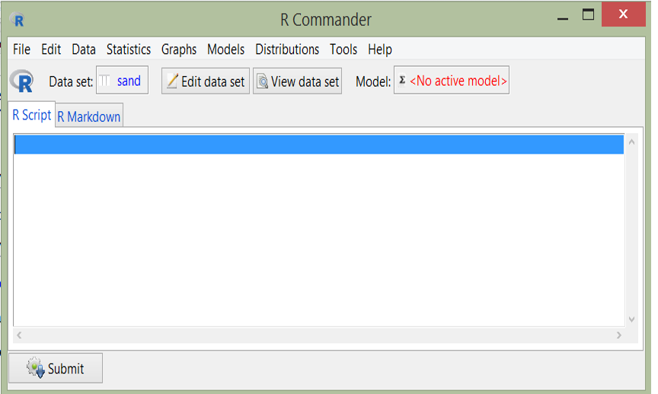

Slide 19
Discussion
Can you think of a situation where an existing hypothesis or convientional wisdom was not repeatable?

Slide 20
(Free) R Learning Resources
Introductory R Books
R for Data Science
RStudio Cheatsheets
Quick-R
Advanced DSM R Books
Predictive Soil Mapping with R
Using R for Digital Soil Mapping (not free)
Soil Spectral Inference with R (not free)
Soil Science R Tutorials
aqp and soilDB tutorials
ISRIC World Soil Information Example Training Courses
ISRIC World Soil Information YouTube Channel
NEON Tutorials
Pierre Roudier

Slide 21
Arnold, R. W., and L. P. Wilding. 1991. “The Need to Quantify Spatial Variability.” In SSSA Special Publications, edited by M. J. Mausbach and L. P. Wilding, 1–8. Madison, WI, USA: Soil Science Society of America. https://doi.org/10.2136/sssaspecpub28.c1.
Brevik, Eric C., Jeffrey A. Homburg, Bradley A. Miller, Thomas E. Fenton, James A. Doolittle, and Samuel J. Indorante. 2016. “Selected Highlights in American Soil Science History from the 1980s to the Mid-2010s.” CATENA 146 (November): 128–46. https://doi.org/10.1016/j.catena.2016.06.021.
Chaney, Nathaniel W., Eric F. Wood, Alexander B. McBratney, Jonathan W. Hempel, Travis W. Nauman, Colby W. Brungard, and Nathan P. Odgers. 2016. “POLARIS: A 30-Meter Probabilistic Soil Series Map of the Contiguous United States.” Geoderma 274: 54–67. https://doi.org/10.1016/j.geoderma.2016.03.025.
Hennemann, G R, and D G Rossiter. 2004. “Training Needs for the Next Generation of Soil Surveyors.” In International Conference on Innovative Techniques in Soil Survey, Cha’am, Thailand, 21-26 March 2004, 22–26. Cha-Am, Thailand: Land Development Department. http://www.css.cornell.edu/faculty/dgr2/Docs/ChaAm/ChaAmKeynoteHennemann.pdf.
Kempen, Bas, Dick J. Brus, Jetse J. Stoorvogel, Gerard B. M. Heuvelink, and Folkert de Vries. 2012. “Efficiency Comparison of Conventional and Digital Soil Mapping for Updating Soil Maps.” Soil Science Society of America Journal 76 (6): 2097–2115. https://doi.org/https://doi.org/10.2136/sssaj2011.0424.
MacMillan, Robert A., David E. Moon, and Ray A. Coupé. 2007. “Automated Predictive Ecological Mapping in a Forest Region of b.c., Canada, 2001–2005.” Geoderma 140 (4): 353–73. https://doi.org/10.1016/j.geoderma.2007.04.027.
Mausbach, M. J. 2003. “The Importance of Statistical Documentation - Keeping Soil Survey Information Relevant in the 21st Century.” In 2003 National Cooperative Soil Survey Conference, 3–6. Plymouth, Massachusetts: National Cooperative Soil Survey. https://www.nrcs.usda.gov/Internet/FSE_DOCUMENTS/nrcs142p2_051833.pdf.
Maynard, Jonathan J., Travis W. Nauman, Shawn W. Salley, Brandon T. Bestelmeyer, Michael C. Duniway, Curtis J. Talbot, and Joel R. Brown. 2019. “Digital Mapping of Ecological Land Units Using a Nationally Scalable Modeling Framework.” Soil Science Society of America Journal 83 (3): 666–66. https://doi.org/10.2136/sssaj2018.09.0346.
Ramcharan, Amanda, Tomislav Hengl, Travis Nauman, Colby Brungard, Sharon Waltman, Skye Wills, and James Thompson. 2018. “Soil Property and Class Maps of the Conterminous United States at 100-Meter Spatial Resolution.” Soil Science Society of America Journal 82 (1): 186–201. https://doi.org/https://doi.org/10.2136/sssaj2017.04.0122.

