Slide 1

Introduction to Git and GitHub
GIS714
Spring 2025

Slide 2
Introduction to Git and GitHub
Part 1: Git concepts and vocabulary
Part 2: Collaborating with GitHub
Part 3: Hands-on activity - Open your own Pull Request

Slide 3


vs.
Open-source version-control software on your computer
Probably already installed on your OS:
git --version
Company owned by Microsoft that hosts Git Repositories in the cloud
Alternatives: Bitbucket, GitLab, GitHub Enterprise
Provides features for sharing code, collaborating, raising issues, project tracking and more

Slide 4

What is “version-control” any ways?
“a system that records changes to a file or set of files over time so that you can recall specific versions later.” - git-scm.com
Keeps track of multiple versions of a set of files (branches)
Allows you to move back to older versions without deleting current work (revert/reset/checkout)

Slide 5
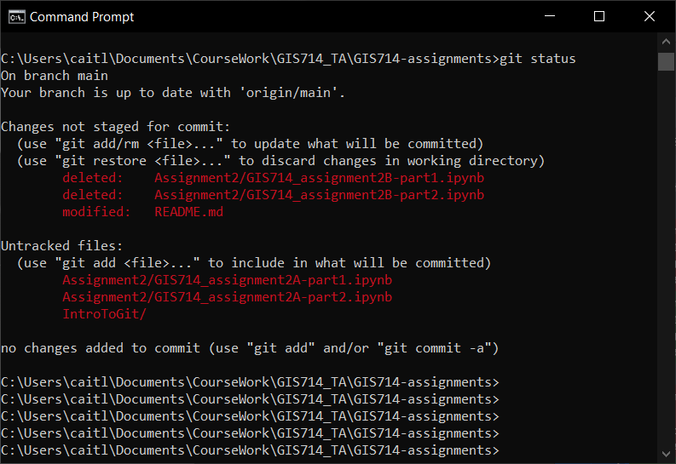
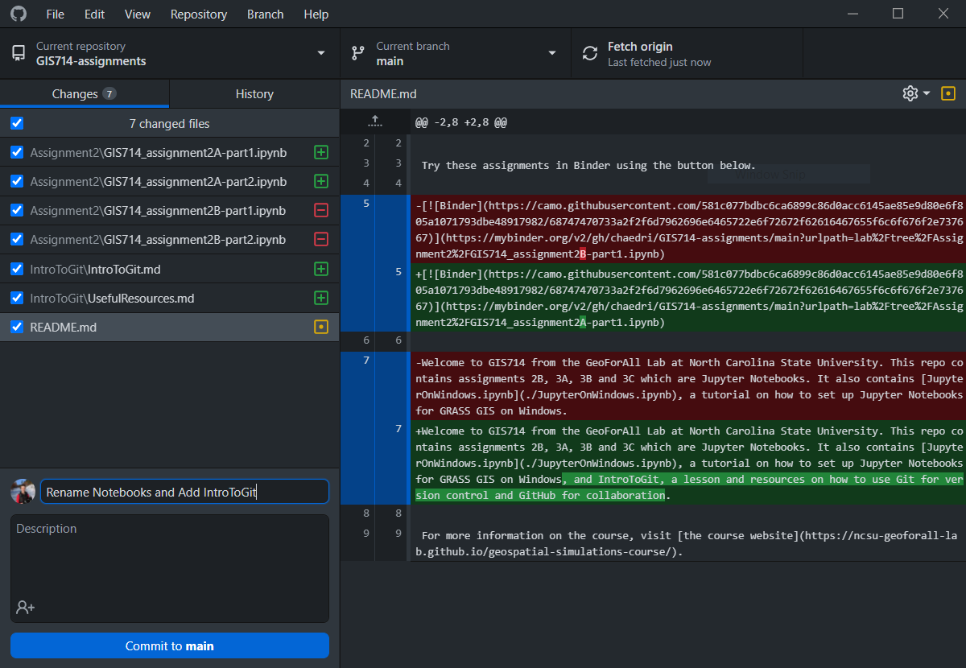
How do I use Git on my local machine?
Command Line Interface (CLI)
Install Git
Configure SSH Key Authentication with GitHub
Graphical User Interfaces
GitHub Desktop, GitKraken, SourceTree

Slide 6
Basic Git: Get Started
Get started:
1. git init
2. Download/clone existing repo
- .git (hidden folder)
- .gitignore
- README
- yourfiles

Slide 7
Basic Git: Commit
Commit your changes:
Changes to your files
1. git status to see current state of directory
2. git add files that you want to commit
3. git commit changes with descriptions (“-m” flag)
1st Commit
2nd Commit

Slide 8
Basic Git: Branch
Make a branch
Branch
1. git commit
2. git branch new-branch-name
3. git checkout new-branch-name
1st Commit
… shortcut for 2 and 3:
git checkout –b new-branch-name

Slide 9
Basic Git: Branch and Merge
Develop New Feature
Branch
Merge
Branch
Main
1st Commit
Now, main has your new feature!

Slide 10
So, what about GitHub?
GitHub
Branch
“I just pushed some changes”
“Let me pull the changes you just made so I can test them!"
Main
Pull
Push
Local Machine
Branch
Main

Slide 11
So, what about GitHub?
GitHub
Branch
“I just pushed some changes”
“Let me pull the changes you just made so I can test them!"
Main
Clone
Local Machine
Branch
Main

Slide 12
Collaborating with GitHub
Your Awesome Repository
Your Awesome Repository
My Copy of Your Awesome Repository
Fork
/ Sync
Pull Request
My Copy of Your Awesome Repository
I make some changes to your repository

Slide 13
Collaborating with GitHub
Your Awesome Repository with my new additions!
Your Awesome Repository
My Copy of Your Awesome Repository
Fork / Sync
Pull Request
My Copy of Your Awesome Repository
Push
Remote
Pull
Local
Branch
Main

Slide 14
Collaborating with GitHub
Your Awesome Repository with my new additions!
Your Awesome Repository
My Copy of Your Awesome Repository
Upstream
Fork / Sync
Origin
Pull Request
Pull Request
Pull Upstream
My Copy of Your Awesome Repository
Push
Remote
Pull
Local
Branch
Main

Slide 15
Collaborating with GitHub
Your Awesome Repository with my new additions!
Your Awesome Repository
My Copy of Your Awesome Repository
Fork
Pull Request
Upstream
Origin
Pull Upstream
Push
Pull
Remote
Local
Branch
Main

Slide 16
In Summary
Fork
Upstream
Sync
Origin
Pull Request
Remote
Pull Upstream
Pull
Commit your changes:
Push
1. git status to see current state of directory
2. git add files that you want to commit
git commit –m “{description}”
Local

Slide 17
Try it Yourself
chaedri/GIS714-PR-tests

Slide 18
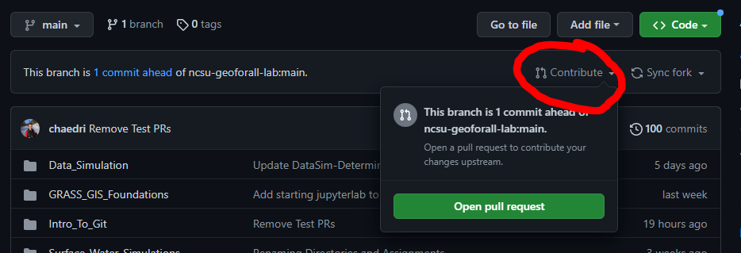
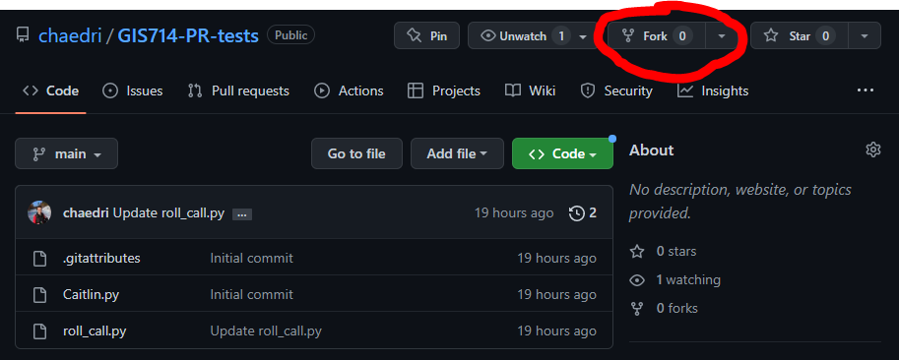
Try it Yourself
chaedri/GIS714-PR-tests
5. Pull Request
1. Fork
your-handle/GIS714-PR-tests
4. git push*
2. Clone (either with GUI or command line*)
*to clone and push from the command line, you’ll have to set up GitHub authentication:
https://docs.github.com/en/authentication
3. git add and commit

