Slide 2
RECREATIONAL USE
The recreational use of sUAS is the operation of an unmanned aircraft for personal interests and enjoyment.
For example, using a sUAS to take photographs for your own personal use would be considered recreational;
using the same device to take photographs or videos for compensation or sale to another individual would be considered a commercial operation.

Slide 3
RECREATIONAL USE – SAFETY GUIDLINES
Follow community-based safety guidelines, as developed by organizations such as the Academy of Model Aeronautics (AMA).
Fly no higher than 400 feet and remain below any surrounding obstacles when possible.
Keep your sUAS in eyesight at all times, and use an observer to assist if needed.
Remain well clear of and do not interfere with manned aircraft operations, and you must see and avoid other aircraft and obstacles at all times.

Slide 4
RECREATIONAL USE – SAFETY GUIDLINES
Do not intentionally fly over unprotected persons or moving vehicles, and remain at least 25 feet away from individuals and vulnerable property.
Contact the airport and control tower before flying within five miles of an airport or heliport.
Do not fly in adverse weather conditions such as in high winds or reduced visibility.
Do not fly under the influence of alcohol or drugs.

Slide 5
RECREATIONAL USE – SAFETY GUIDLINES
Ensure the operating environment is safe and that the operator is competent and proficient in the operation of the sUAS.
Do not fly near or over sensitive infrastructure or property such as power stations, water treatment facilities, correctional facilities, heavily traveled roadways, government facilities, etc.
Check and follow all local laws and ordinances before flying over private property.
Do not conduct surveillance or photograph persons in areas where there is an expectation of privacy without the individual’s permission (see AMA’s privacy policy). http://suas.modelaircraft.org/ama/images/sUAS_Safety_Program_web.pdf

Slide 6
COMMERCIAL USE OF UAS
Any commercial use in connection with a business, including:
Selling photos or videos taken from a UAS
Using UAS to provide contract services, such as industrial equipment or factory inspection
Using UAS to provide professional services, such as security or telecommunications
Using UAS to monitor the progress of work your company is performing

Slide 8
COMMERCIAL USE - Remote Pilot requirements:
Must be at least 16 years of age
Must hold a remote pilot airman certificate with a small UAS rating or be under the direct supervision of someone holding a remote pilot airman certificate
Must pass the applicable Transportation Security Administration (TSA) vetting
https://www.youtube.com/watch?v=v-d1RuTFvbs
https://www.faa.gov/regulations_policies/handbooks_manuals/aviation/media/remote_pilot_study_guide.pdf

Slide 9
COMMERCIAL USE – UAS requirements:
Must weigh less than 55 lbs.*
Must undergo pre-flight check by remote pilot in command (a.k.a. you or the person supervising the operation)

Slide 10
COMMERCIAL USE – location requirements:
Operations in Class B, C, D and E airspace are allowed with the required Air Traffic Controller (ATC) permission
Operations in Class G airspace are allowed without ATC permission

Slide 11
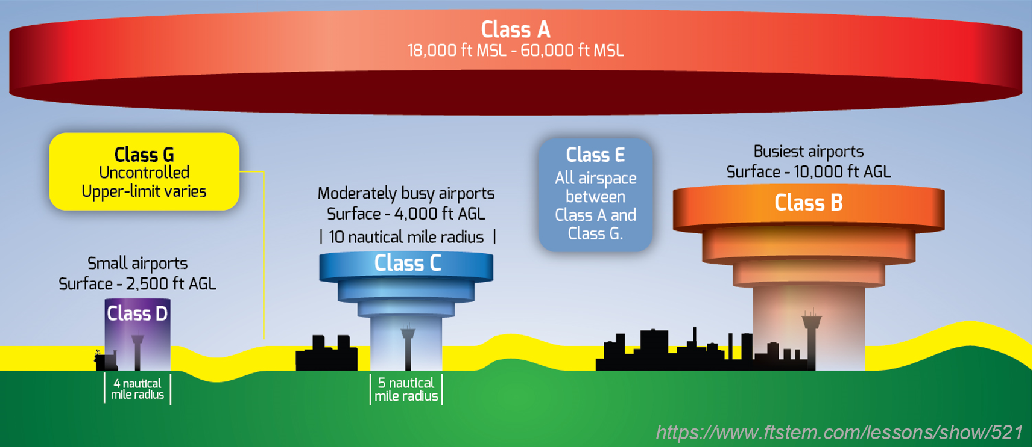
National Airspace System Classification

Slide 12
Class A – PROHIBITET
Class B/C/D May operate with permission from local Air Traffic Control
CLASS E/G – May operate while following all other regulations

Slide 13
Airspace map
Chart reading tutorial http://c-aviation.net/airspace-guide-usa-chart-reading-tutorial/
https://www.faasafety.gov/gslac/ALC/course_content.aspx?cID=42&sID=505&preview=true
https://www.youtube.com/watch?v=8AsfuNCs7oQ
Easy way to remember main elements
Solid line – higher class, dashed line – lower class
Blue line – higher class, magenta line – lower class
This translates to:
Solid blue – class B
Solid magenta – class C
Dashed blue – class D
Dashed magenta – class E

Slide 14
COMMERCIAL USE - Operating rules
Must fly under 400 feet above ground level (AGL) or, if flying at an altitude higher than 400 feet AGL, stay within 400 feet of a structure
Must keep the UAS in sight (i.e. visual line of sight), either by the remote pilot in command or a visual observer
Must not fly from a moving vehicle unless you are in a sparsely populated area

Slide 15
COMMERCIAL USE - Operating rules
Must fly at or below 100 mph
Must yield right of way to manned aircraft
Must not fly over people
Must fly during daylight hours or civil twilight hours (30 minutes before official sunrise to 30 minutes after official sunset, local time) with appropriate anti-collision lighting

Slide 16
WAIVERS
If you want to operate UAS for commercial purposes outside of these rules, you may apply for a certificate of waiver. The FAA will grant waivers if operation can be performed safely but may otherwise not be allowed under Part 107.

Slide 17
Waivable sections of part 107
Operation from a moving vehicle or aircraft (§ 107.25)*
Daylight operation (§ 107.29)
Visual line of sight aircraft operation (§ 107.31)*
Visual observer (§ 107.33)
Operation of multiple small unmanned aircraft systems (§ 107.35)
Yielding the right of way (§ 107.37(a))
Operation over people (§ 107.39)
Operation in certain airspace (§ 107.41)
Operating limitations for small unmanned aircraft (§ 107.51)
*No waiver of this provision will be issued to allow the carriage of property of another by aircraft for compensation or hire

Slide 18
§ 107.9 Accident Reporting. No later than 10 days after an operation that meets the criteria of either paragraph (a) or (b) of this section, a remote pilot in command must report to the Federal Aviation Administration in a manner acceptable to the Administrator, any operation of the small unmanned aircraft involving at least:
Serious injury to any person or any loss of consciousness; or
Damage to any property, other than the small unmanned aircraft, unless one of the following conditions is satisfied:
The cost of repair (including materials and labor) does not exceed $500; or
The fair market value of the property does not exceed $500 in the event of total loss.
https://www.faa.gov/uas/report_accident/

Slide 19
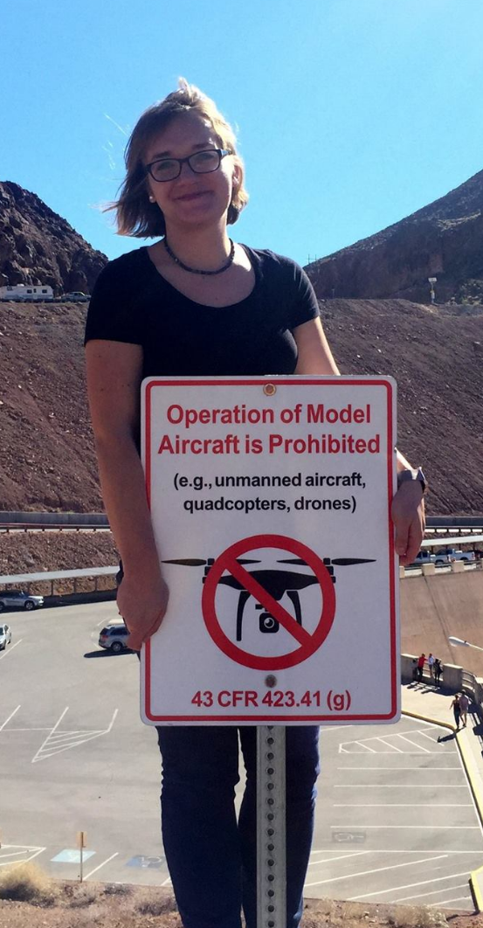
Where NOT to fly

Slide 20
AIRSPACE RESTRICTIONS:
Security Sensitive Airspace Restrictions
Temporary Flight Restrictions (TFRs)
Restricted or Special Use Airspace
Stadiums and sporting events
Wildfires
Airports

Slide 21
Security Sensitive Airspace Restrictions
prohibited all UAS flights within the airspace
restrictions extend from the ground up to 400 feet AGL,
apply to all types and purposes of UAS flight operations,
remain in effect 24 hours a day, 7 days a week.
14 CFR § 99.7

Slide 22
Temporary Flight Restrictions
area of airspace where air travel is limited because of a temporary hazardous condition, such as a wildfire or chemical spill; a security-related event
TFR contains the details about the restriction, including the size, altitude, time period that it is in effect, and what types of operations are restricted and permitted
http://tfr.faa.gov/tfr_map_ims/html/index.html TFR MAP
Tfr list http://tfr.faa.gov/tfr2/list.html

Slide 23
Restricted or Special Use Airspace
The airspace surrounding Washington DC is the most restricted in the country – more info https://www.faa.gov/uas/where_to_fly/no_drone_zone/
Types of Special Use Airspace include:
Prohibited areas
Restricted areas
Warning areas
Military operation areas (MOAs)
Alert areas
Controlled firing areas (CFAs)

Slide 24
Stadiums and sporting events
Flying UAS in and around stadiums is prohibited starting one hour before and ending one hour after the scheduled time of any of the following events:
Major League Baseball
National Football League
NCAA Division One Football
NASCAR Sprint Cup, Indy Car, and Champ Series races
Specifically, UAS operations are prohibited within a radius of three nautical miles of the stadium or venue.
More info in handout on sports TFRs https://www.faa.gov/uas/where_to_fly/airspace_restrictions/media/Sports_TFR-UAS_Handout.pdf

Slide 25
Wildfires
It is illegal to fly your UAS in or around a wildfire firefighting operation.

Slide 26
Airports
Recreational operators are required to give notice for flights within five miles of an airport to both the airport operator and air traffic control tower, if the airport has a tower.
However, recreational operations are not permitted in Class B airspace around most major airports without specific air traffic permission and coordination

Slide 27
PUBLIC ENTITIES
publicly funded university, law enforcement agency, fire department, or any other federal or state government agency
TWO OPTIONS:
Follow the same requirements and operating rules for business users. That is, the FAA’s small UAS rule (known as “Part 107”).
OR:
2. If you want to operate UAS for a government entity outside of these rules, you may apply for a blanket public Certificate of Authorization (COA) which allows flights at or below 400 feet in Class G airspace nationwide, self-certification of the UAS pilot and the ability to obtain emergency COAs under special circumstances.

Slide 28
WHO CAN OBTAIN COA?
Only government entities – such as federal and state government agencies, law enforcement agencies and public colleges and universities – can receive a COA for public UAS aircraft operations.
Public aircraft operations must be conducted for a governmental function.
COAs are issued for a specific period of time, usually two years, and include special provisions unique to each proposal, such as a defined block of airspace and time of day sUAS can be used.

Slide 29
HOW TO APPLY FOR COA?
Visit the FAA website for more information on how to apply for a COA online.
A sample application can be viewed here.
Since 2009, the FAA has taken steps to streamline the application process by transitioning online.
The average COA processing time is less than 60 days.
Expedited authorization is available in emergency and life-threatening situations.

Slide 30
EDUCATIONAL USE
As of May 5, 2016, according to a new legal interpretation from the FAA, the use of unmanned aircraft systems by students in accredited education institutions as part of their coursework will be allowed under recreational guidelines for model aircraft
This applies only to accredited educational institutions and does not apply to research efforts, which would too closely link operation of the UAS to faculty members’ professional duties and compensation.
FAA’s full interpretation for educational and community use of UAS
https://www.faa.gov/uas/resources/uas_regulations_policy/media/interpretation-educational-use-of-uas.pdf

Slide 31
UAS BEST PRACTICES (VOLUNTARY)
If you can, tell other people you’ll be taking pictures or video of them before you do so.
If you think someone has a reasonable expectation of privacy, don’t violate that privacy by taking pictures, video, or otherwise gathering sensitive data, unless you’ve got a very good reason.
Don’t fly over other people’s private property without permission if you can easily avoid doing so.
Don’t gather personal data for no reason, and don’t keep it for longer than you think you have to.

Slide 32
UAS BEST PRACTICES (VOLUNTARY)
If you keep sensitive data about other people, secure it against loss or theft.
If someone asks you to delete personal data about him or her that you’ve gathered, do so, unless you’ve got a good reason not to.
If anyone raises privacy, security, or safety concerns with you, try and listen to what they have to say, as long as they’re polite and reasonable about it.
Don’t harass people with your drone.
Important Note: the best practices do not apply to news-gatherers and news reporting organizations, which are protected by U.S. law and the First Amendment to the Constitution. These organizations should operate under the ethics rules and standards of their organization, and according to existing federal and state laws.

Slide 33
RESOURCES
U.S. Air Space map http://knowbeforeyoufly.org/air-space-map/
Register your drone https://registermyuas.faa.gov/
Are you reasy to fly a drone? – quiz http://knowbeforeyoufly.org/are-you-ready-to-fly-a-drone/
Applying for a waiver https://www.faa.gov/uas/beyond_the_basics/

