Slide 1

Seawolf III Acoustics Project
System Block Diagrams

Slide 2

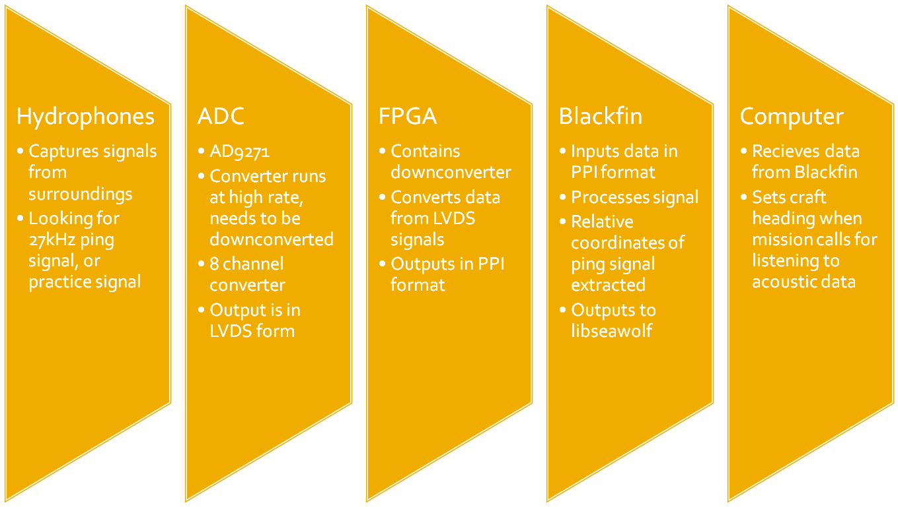

Slide 3

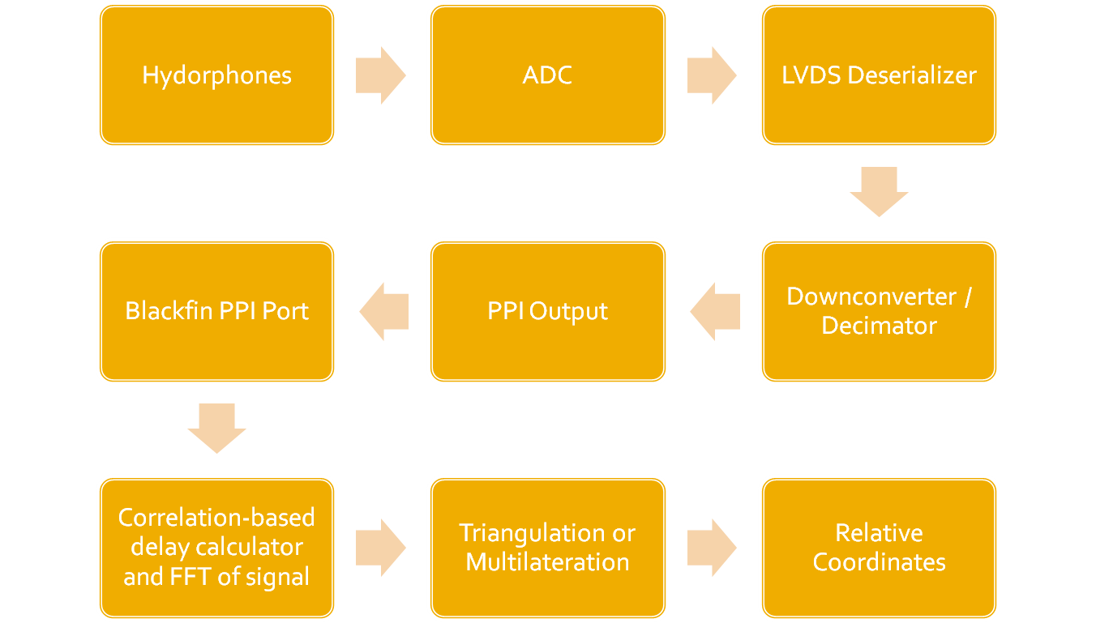

Slide 4

Channel A
Channel B
Array Flip
Array Flip
FFT
FFT
Multiplier
Magnitude of selected frequency
IFFT
Peak Detector
Validity of signal
Delay Out

