Slide 1

Quasar UI Builder
UI TOOL
Dev Guide
Example
License
Quasar UI Tool
Quasar UI TOOL
VS Code editor integration for Quasar UI page JSON files.
Quasar UI Tool VS Code Extension
This extension opens .src/pages/*.json files with a visual editor inside VS Code and provides a Quasar Tool Activity Bar container.
Run In Development
Open this repository in VS Code.
Run the Run Quasar UI Tool Extension launch configuration.
In the Extension Development Host, open .src/pages/IndexPage.json.
Choose Open With... -> Quasar UI Tool Editor if the visual editor is not selected automatically.
Open the Quasar Tool Activity Bar item to use Component Palette, Properties, Page Tree, and DataSet views.

Slide 2
Quasar UI Builder
UI TOOL
Dev Guide
Example
License

Slide 3
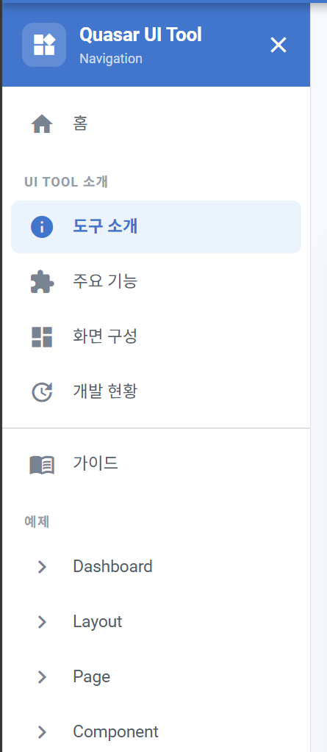


UI TOOL 소개
도구 소개

