Slide 2
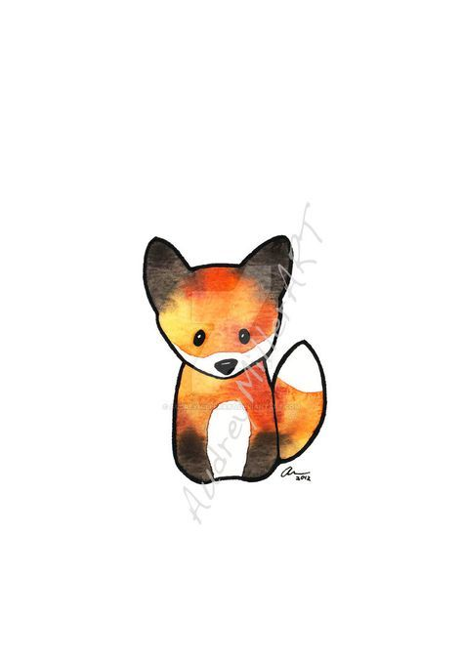
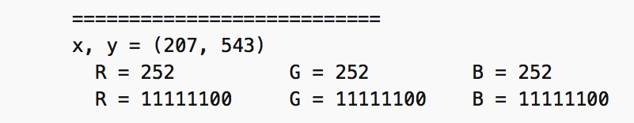
img.size = (474, 675)
= 319950 pixels
x3 = 959859 for RGB
workingPXLs = 38768
No white, black or almost white
38768 *3 = 116304 for RGB
We have 116304 bytes
Char = 1 byte
Average Word = 5 char + 1 space
116304 / 6 = 19384 words fit in our picture
Roughly, each page of a standard-format
hardcover book has about 300-350words.
Average word is five characters plus a space.
Book page has, 1,500 to 1,800 characters.
Average book is 250 pages
Low estimate is 375,000 characters per book

Slide 5


Types of Unintended Deformations
Pixel Edge Deformation
1-Bit Speckling
Full White to Black Change for Display
Minor LSB Change

Slide 6
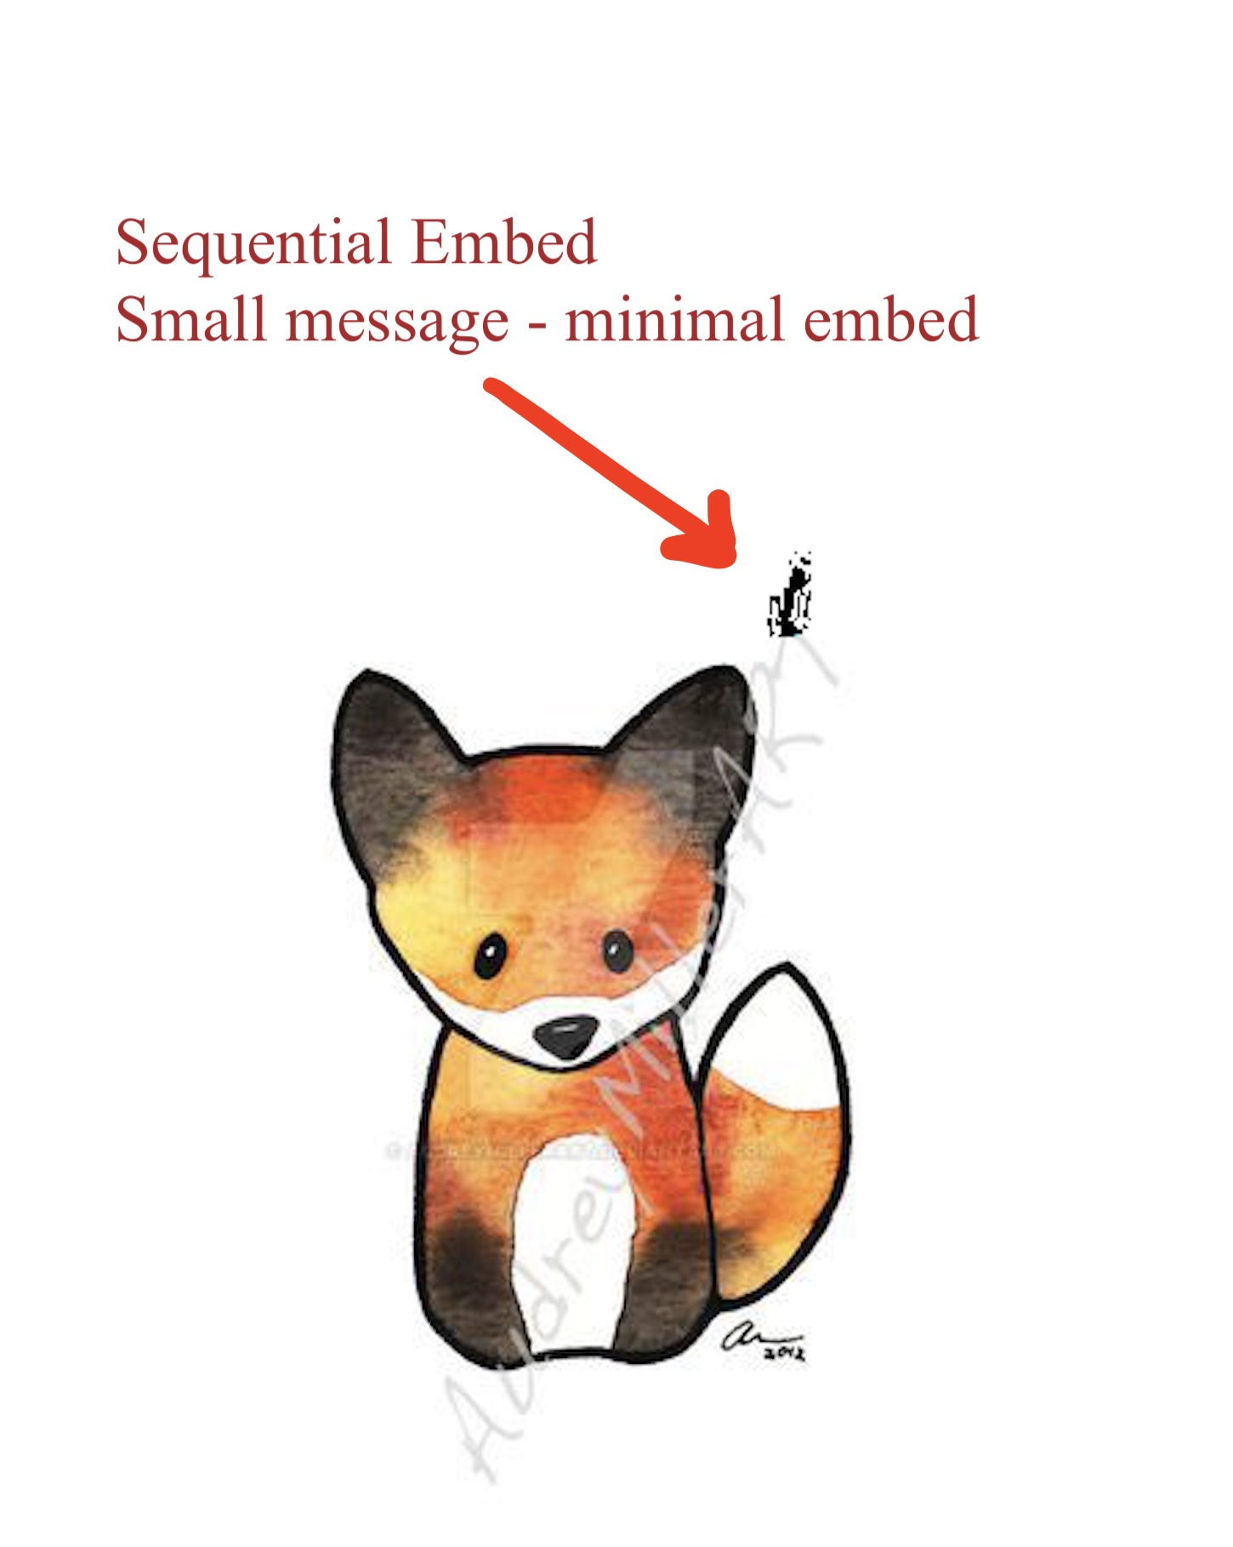
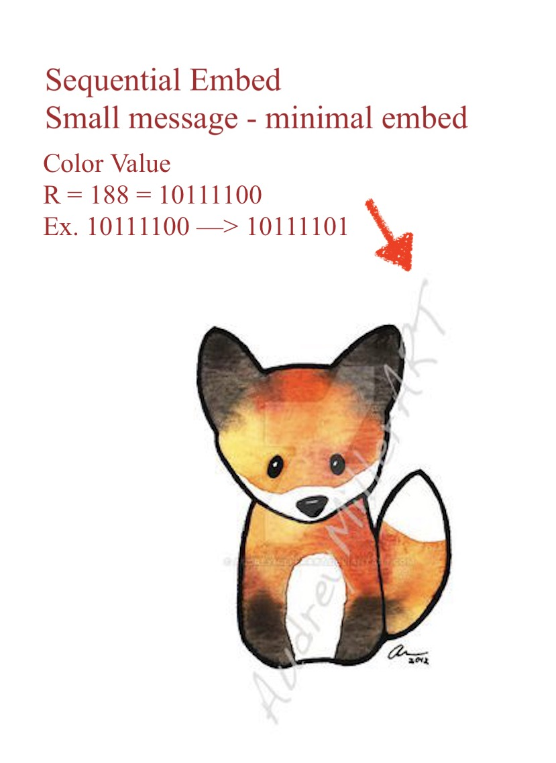
Message: “Nate’s LPL Financial Account: 11038273582877”
Length of = 44
01001110
01100001
01110100
01100101
00100111
01110011
00100000
01001100
01010000
01001100
00100000
01000110
01101001
01101110
01100001
01101110
01100011
01101001
01100001
01101100
00100000
01000001
01100011
01100011
01101111
01110101
01101110
01110100
00100000
00110001
00110001
00110001
00110000
00110010
00111001
00110011
00110100
00111000
00110100
00111000
00110010
00111000
00110011
00110010
00111000
00110011
Intentional
Black

