Slide 1
Clinical Data Visualization in R and Python
Wednesday, Nov 5
Workshop: noon to 1p
Open coding session: 1p to 2p
Notes:
Graphical representation of information and data
See and understand trends, outliers, and patterns in data

Slide 2
Outline
Welcome and introduction
  Sample dataset overview
Introduction to visualization
Types of and motivations for plots
Exploratory data analysis with visualization
Communicating time series and longitudinal perspectives using visualization
E

Slide 3
Welcome!
Who we are:
Emily Griffith
Professor of the Practice, Department of Statistics
Director of Consulting, Data Science and AI Academy, NC State
John Slankas
Senior Research Scholar, Laboratory for Analytic Sciences, NC State
We manage a subaward from NC TraCS to help provide support for clinical research using data science techniques.
E,J

Slide 4
Today’s goals
We will review
  Introduction to visualization
  Types of and motivations for plots
  Exploratory data analysis with visualization
  Communicating time series and longitudinal perspectives using visualization
At 1p, we will have open coding hours for you to stay and work if you’d like
We are using the same dataset for all examples, and code is available for you in R and Python
E

Slide 5
Sample data set
We are using a sample data set for all coding exercises so we can all look at the same examples.
Length of inpatient and non-outpatient hospital stay
Blood pressure (diastolic and systolic)
Sex
Oxygen Saturation
Respiratory Rate
Age at visit
And more!
E

Slide 6
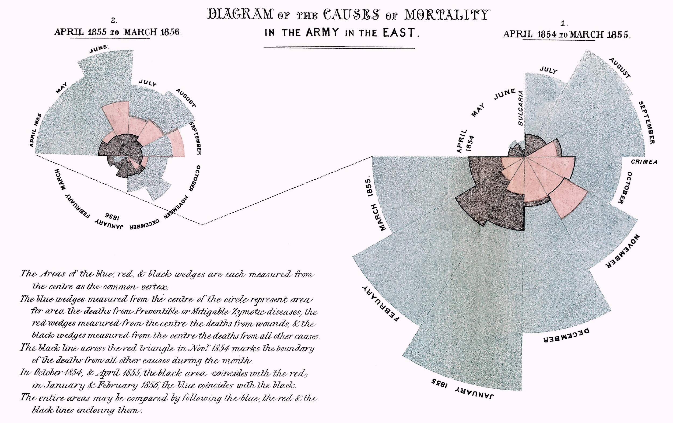
What is data visualization?
Graphical representation of information and data
Helps you see and understand trends, outliers, and patterns in data
Often supplemental to statistical analysis
J
Notes:
Florance Nightgale
Crimean War 1853-1858
polar area chart—a circular graph divided into 12 sectors, one for each month.
Each sector represents the number of deaths in that month, with the area (not radius) of the sector proportional to the mortality.
She used different colors to distinguish causes of death:
Blue for deaths from preventable or infectious diseases
Red for deaths from wounds
Black for deaths from other causes.
Because the area increases with the square of the radius, large blue sections dramatically emphasize the overwhelming number of deaths from disease
in the first year of the war, disease accounted for more than seven times as many deaths as battle injuries. After sanitary reforms were implemented—improved ventilation, sewage, and clean water—the number of deaths from disease dropped sharply

Slide 7
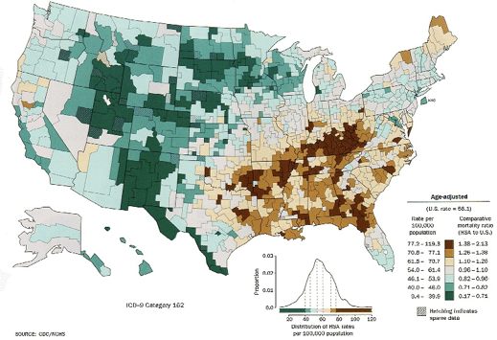
Why visualize your data?
•Answer questions
•Make decisions
•Find patterns
•Present argument
•Tell a story
•Inspire
https://www.cdc.gov/nchs/products/other/atlas/lcwm.htm
J
Notes:
Lung cancer for white male - High lung cancer death rates

Slide 8
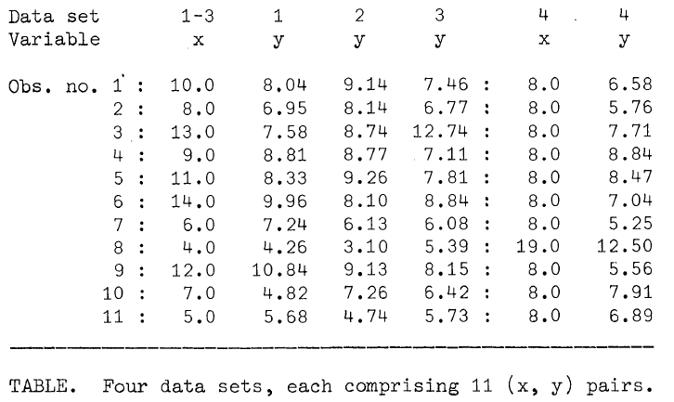
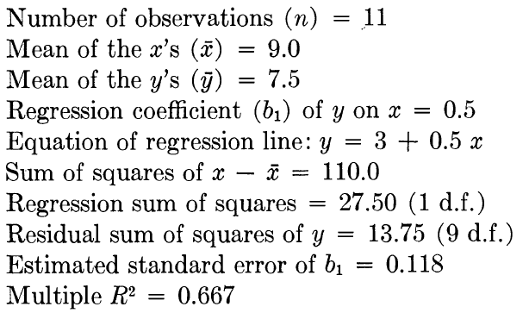
Why visualize your data?
Anscombe 1973
These four data sets have the same summary statistics!
E

Slide 9
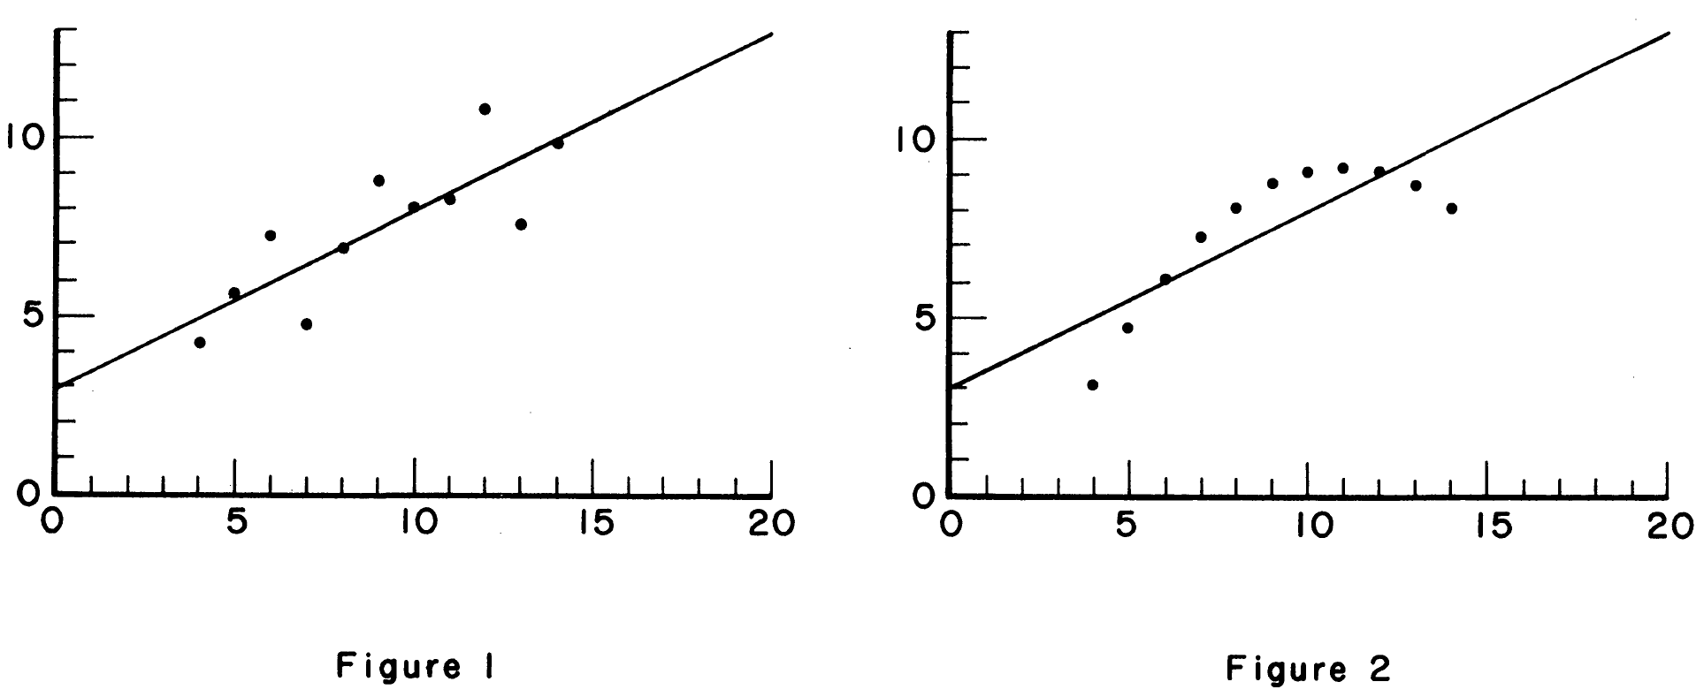
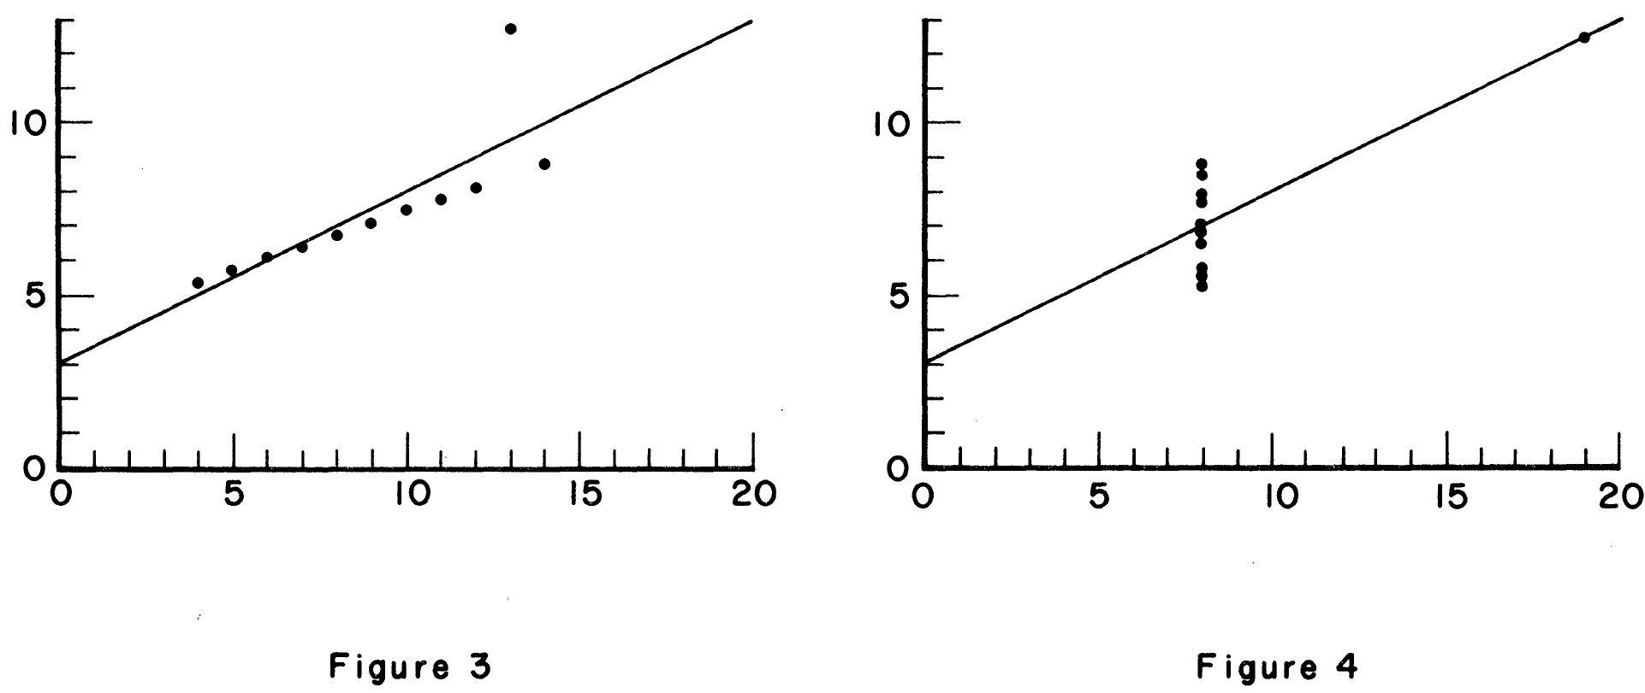
Why visualize your data?
Anscombe 1973
The differences between datasets are easy to see when visualized!
E

Slide 10
Motivation for Visualization:
Exploratory vs. Explanatory
Exploratory
Explore the data
Assess a situation
Determine how to proceed
Decide what to do
Explanatory
Present data and ideas
Explain and inform
Provide evidence and support
Influence and persuade
J
Notes:
Analyze – viewer driven
Communicate – explain. Editorally / creator driven. The person who created this visualization is largely dictating the message
Often, you’ll hear this referred to as exploratory and explanatory
Exploratory performed throughout the process seeks to understand what’s in the data. Generate tons of graphs quickly
Explanatory communicates the data to others. Refined.
Exploratory = individual contributor, explanatory -> impacting others

Slide 11
Quick aside: What is Exploratory Data Analysis?
Important first step in ANY data analysis project!
Used to answer these questions:
  What do your data look like?
  Do the values make sense?
  - Can you look into the values that don’t make sense?
  Do you see any patterns?
  Is there missing data?
  Are there data in all the categories you have?
  - Do the counts make sense? Do the categories make sense?
E

Slide 12
How to use visualization in EDA?
One variable:
Bar charts for categories
Distribution plots for continuous variables
  Histograms
  Distributions
Two + variables:
Scatterplot for correlations
  Scatterplot matrix for multiple variables
Heat map for correlations
Boxplots and violin plots for one continuous variable across levels of one or more categorical variables
E,J

Slide 13
Data Quality Checks using EDA
What do you look for in the visualizations from an EDA?
Do the values shown make sense?
  If not, which values don’t make sense– look into them! Don’t just delete.
Does the number of values or points make sense?
Are there any unusual or unexpected patterns in the data?
Are there any patterns in the data at all?
E

Slide 14
Types of Plots
J

Slide 15
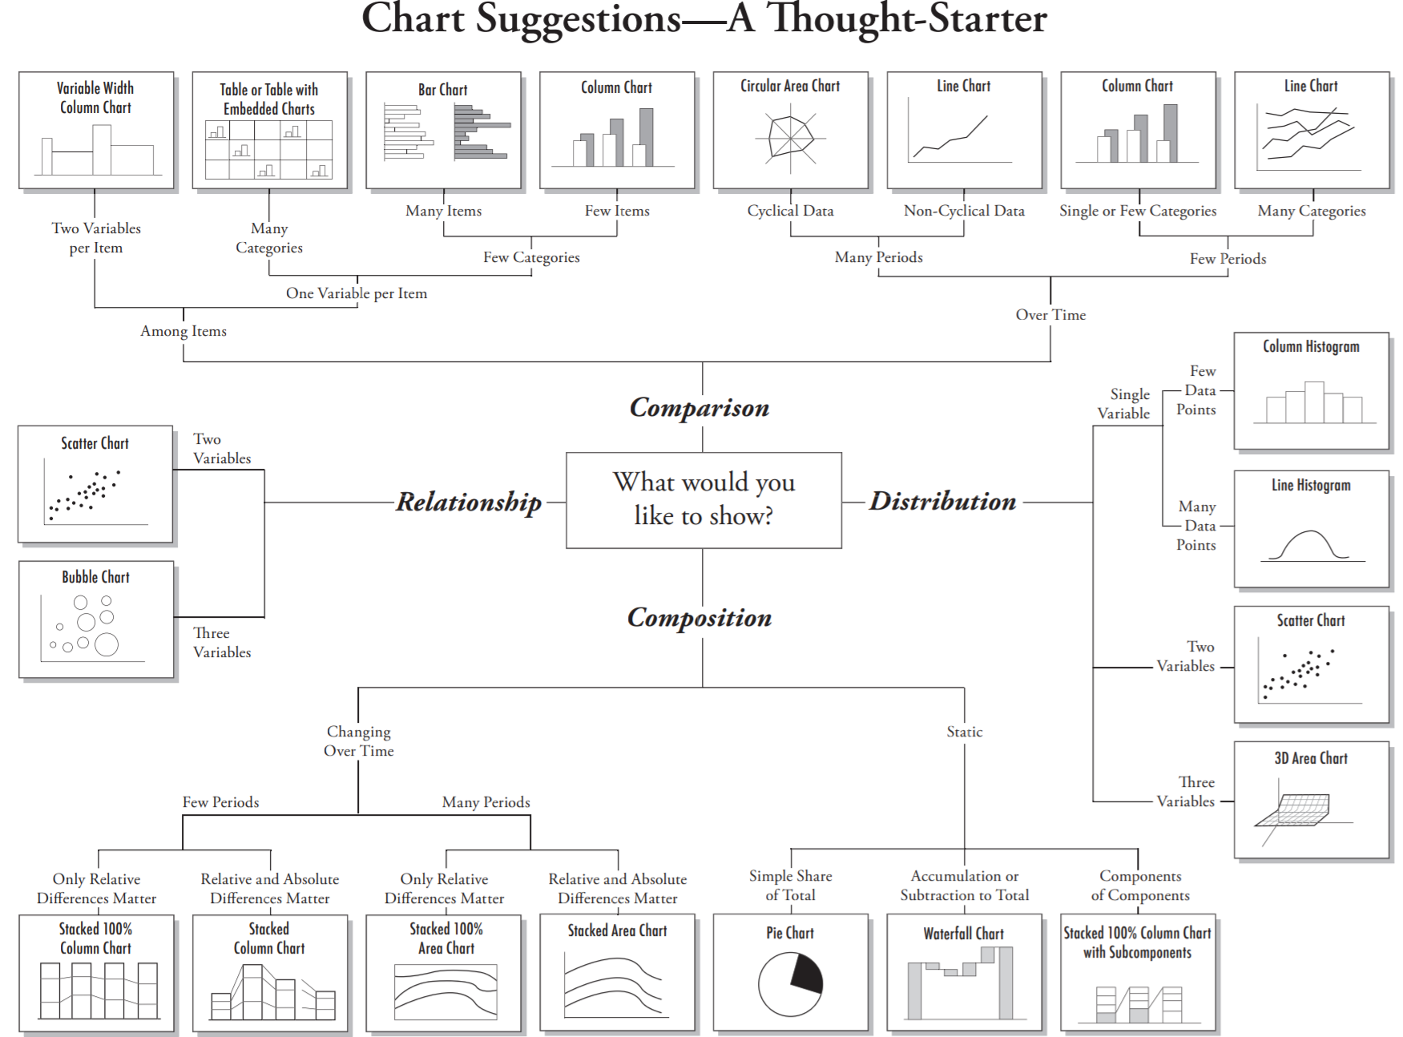
https://extremepresentation.com/wp-content/uploads/choosing-a-good-chart-09-1.pdf
J

Slide 16
Distribution
Comparison
Comparison over Time
Relationship
Composition
We will review examples in Python first, then share R code

Slide 17
Conveying Information: Aesthetics
Position (x, y) – usually the most accurate way to encode values
Length/size – bar length, point size, area, line width
Orientation/angle – less precise; used in some charts
Shape – categorical differences in scatterplots
Texture/line style – solid vs dashed, etc.
Area / Volume – encode magnitude in a given region / shape
Color – hue for categories; lightness/saturation for numeric magnitude
J,E
Notes:
aesthetics are the visual properties you use to encode data values—the channels through which numbers/categories become perceivable patterns.

Slide 18
Communicating Time Series and Longitudinal Perspectives using Visualization
Time ALWAYS goes on the x-axis
Think carefully about what makes sense
Keep in mind that data from one individual is not independent
  Be sure to show any dependence that you have in your data!
We’ve provided a few examples in R and Python for you to try.

Slide 19
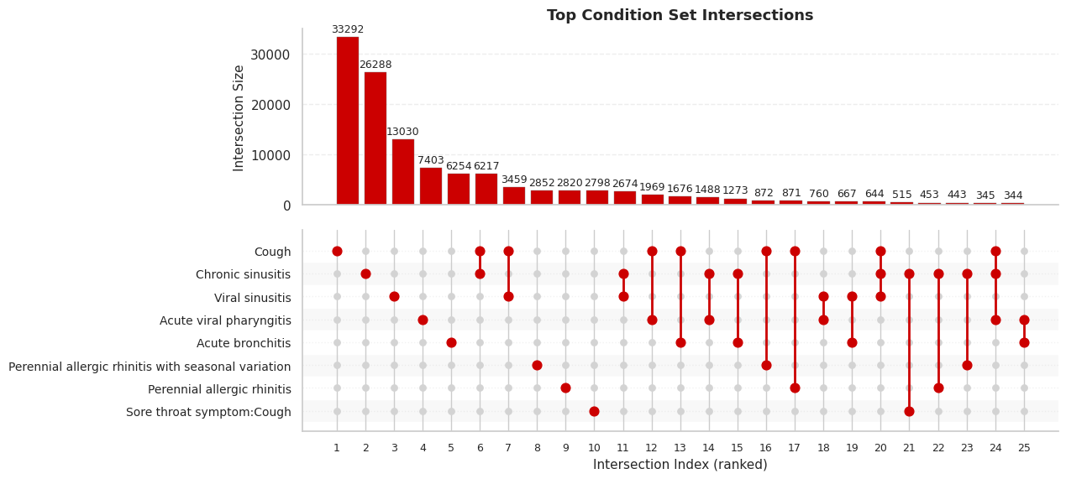
Finally, have fun with it, too!
Let the data tell its story visually.
Each bar shows how many patients share certain condition combinations.
Each dot line connects those co-occurring conditions, like a “friend group” of diseases.
The bold red highlights the most frequent intersections, clear and confident.
Works Best with:
Categorical datasets with multiple labels or attributes per record
Overlapping groups or sets (e.g., co-occurring diseases, shared features)
Medium-to-large samples where intersections reveal meaningful patterns
E

Slide 20
References and Suggested Resources
Communicating with Data: The Art of Writing for Data Science by D Nolan and S Stoudt
Effective Data Storytelling: How to Drive Change with Data, Narrative, and Visuals by Brent Dykes
Fundamentals of Data Visualization by Claus Wilke
Storytelling with Data: A Data Visualization Guide for Business Professionals by Cole Nussbaumer Knaflic
Good Charts: The HBR Guide to Making Smarter, More Persuasive Data Visualizations by Scott Bernator
The Visual Display of Quantitative Information by Edward Tufte
The Functional Art: An introduction to information graphics and visualization by Alberto Cairo
Data Visualization Catalog: https://datavizcatalogue.com/
Flowing Data: https://flowingdata.com/
Information is Beautiful: https://informationisbeautiful.net/
For R: ggplot2 documentation: https://ggplot2.tidyverse.org/
For Python: Python Graph Gallery: https://python-graph-gallery.com/
J,E

Slide 21

Please help us plan future workshops
We’d appreciate your feedback
Thanks to NC TraCS for supporting this work
Thank you for attending!
E

