Slide 1
Understanding Key Concepts in Statistical Inference Confidence Interval and Prediction Interval
NCTraCS Tutorial Series

Slide 2
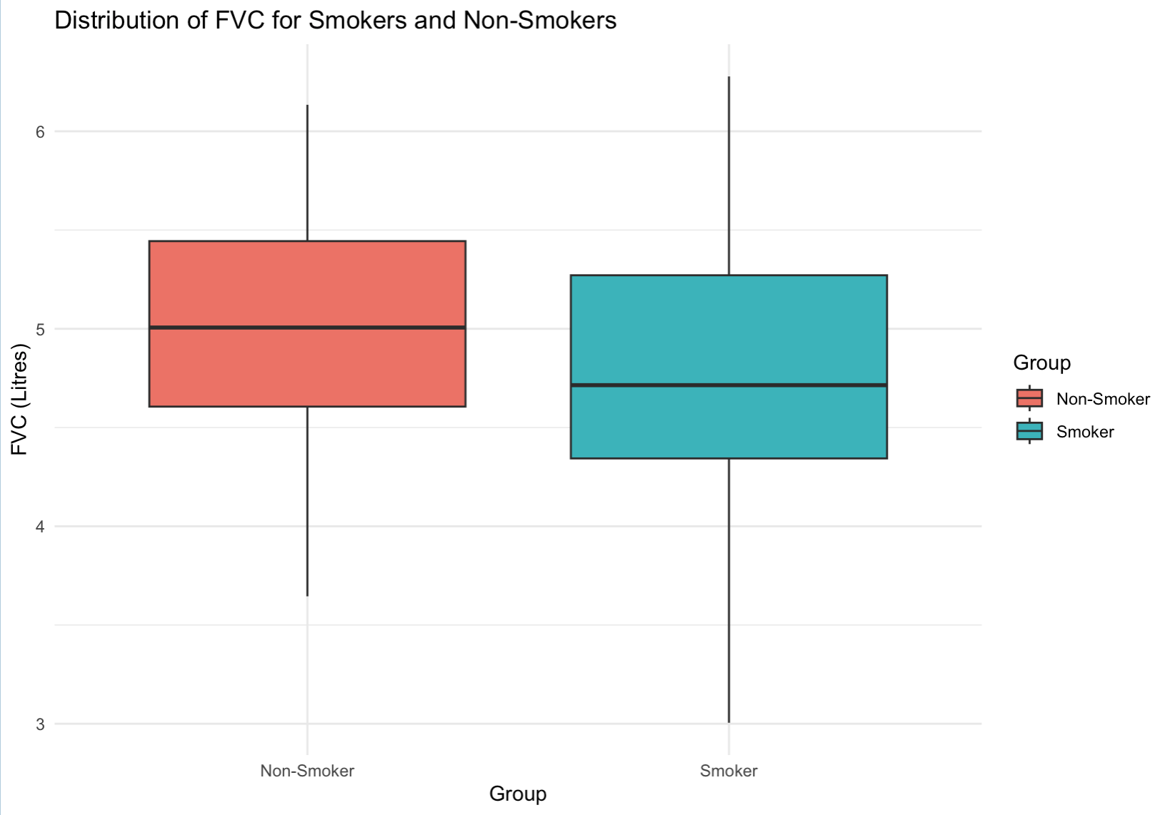
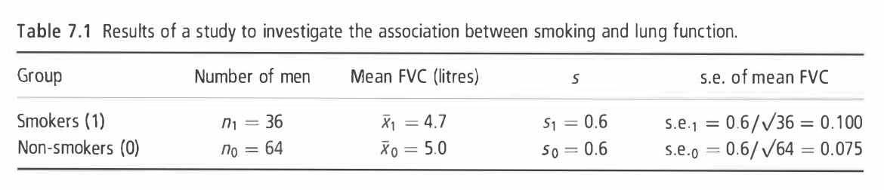
Example
To investigate whether smoking reduces lung function, forced vital capacity (FVC, a test of lung function) was measured in I00 men aged 25-29, of whom 36 were smokers and 64 were non-smokers. (Example 7.1 from Essential Medical Statistics [1])

Slide 3
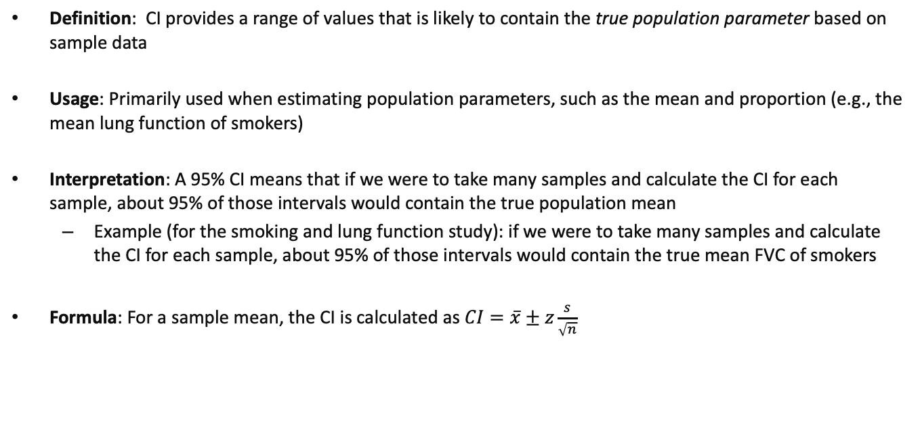
Confidence Interval (CI)
Definition: CI provides a range of values that is likely to contain the true population parameter based on sample data
Usage: Primarily used when estimating population parameters, such as the mean and proportion (e.g., the mean lung function of smokers)
Interpretation: A 95% CI means that if we were to take many samples and calculate the CI for each sample, about 95% of those intervals would contain the true population mean
Example (for the smoking and lung function study): if we were to take many samples and calculate the CI for each sample, about 95% of those intervals would contain the true mean FVC of smokers
Formula: For a sample mean, the CI is calculated as$CI=\overline{x}±z\frac{s}{\sqrt{n}}$

Slide 4
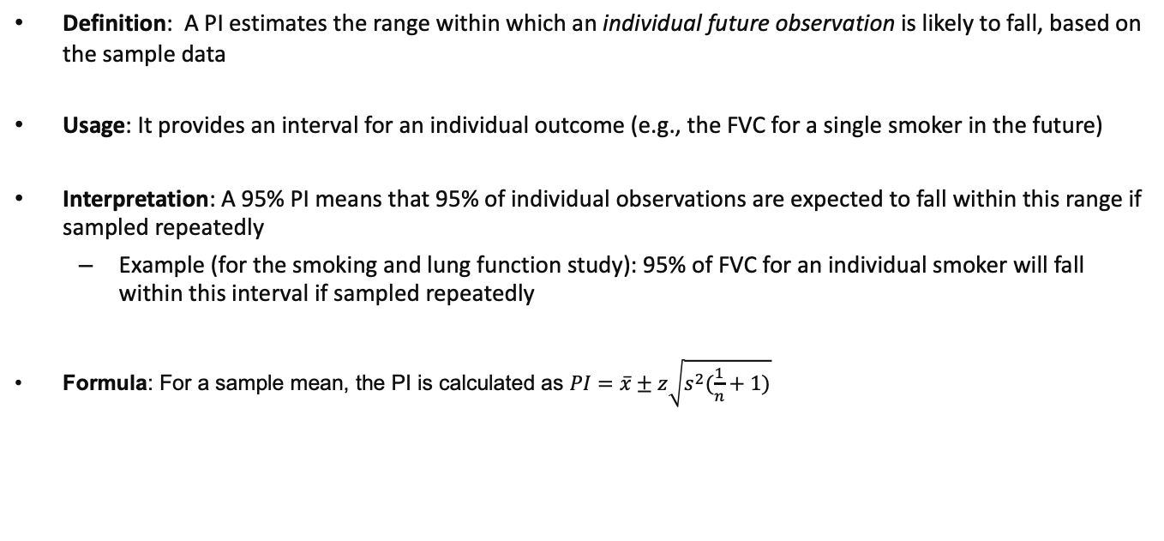
Prediction Interval (PI)
Definition: A PI estimates the range within which an individual future observation is likely to fall, based on the sample data
Usage: It provides an interval for an individual outcome (e.g., the FVC for a single smoker in the future)
Interpretation: A 95% PI means that 95% of individual observations are expected to fall within this range if sampled repeatedly
Example (for the smoking and lung function study): 95% of FVC for an individual smoker will fall within this interval if sampled repeatedly
Formula: For a sample mean, the PI is calculated as $PI=\overline{x}±z\sqrt{s^{2}(\frac{1}{n}+1)}$

Slide 5
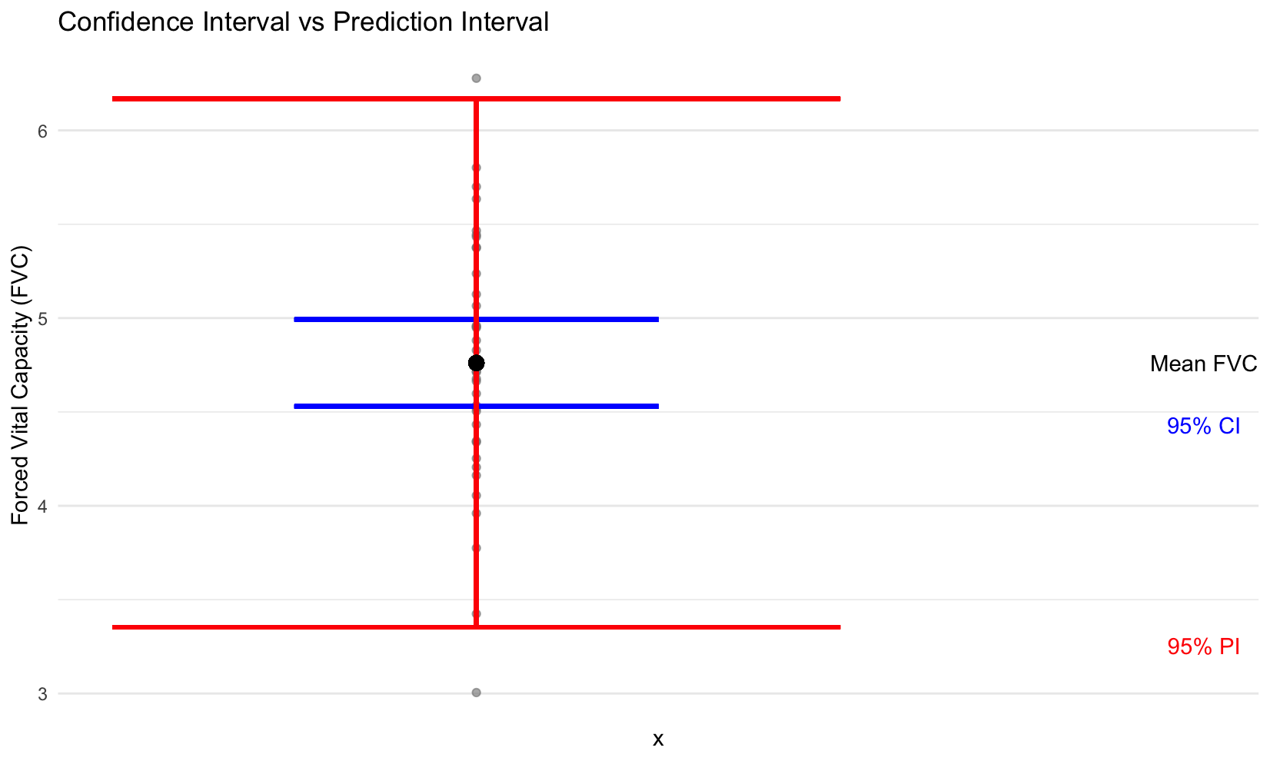
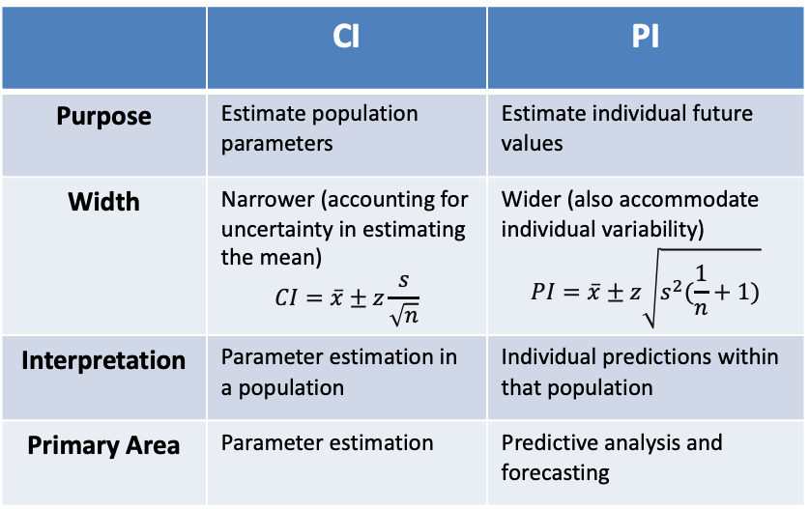
Confidence Interval vs Prediction Interval
 | CI | PI
Purpose | Estimate population parameters | Estimate individual future values
Width | Narrower (accounting for uncertainty in estimating the mean) $$CI=\overline{x}±z\frac{s}{\sqrt{n}}$$ | Wider (also accommodate individual variability) $$PI=\overline{x}±z\sqrt{s^{2}(\frac{1}{n}+1)}$$
Interpretation | Parameter estimation in a population | Individual predictions within that population
Primary Area | Parameter estimation | Predictive analysis and forecasting
Figure: CI vs PI using the FVC dataset

Slide 6
Reference
(Textbook) Kirkwood, Betty R., and Jonathan AC Sterne. Essential medical statistics. John wiley & sons, 2010.
(Textbook) Casella, George, and Roger Berger. Statistical inference. CRC Press, 2024.
(Online Tutorial) https://online.stat.psu.edu/stat500/lesson/6a
(Online Tutorial) https://online.stat.psu.edu/stat415/lesson/9
(Textbook) Lehmann, Erich Leo, Joseph P. Romano, and George Casella. Testing statistical hypotheses. Vol. 3. New York: springer, 1986.

