Slide 1
Understanding Key Concepts in Statistical Inference R-Squared vs Adjusted R-Squared
NCTraCS Tutorial Series

Slide 2
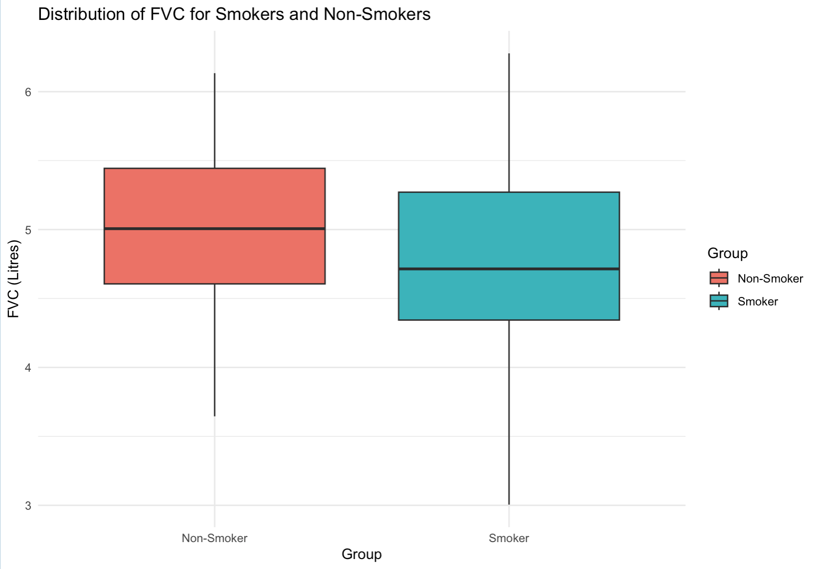
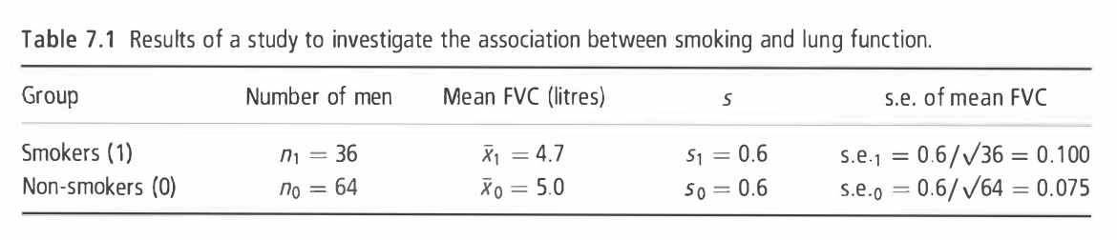
Example
To investigate whether smoking reduces lung function, forced vital capacity (FVC, a test of lung function) was measured in I00 men aged 25-29, of whom 36 were smokers and 64 were non-smokers. (Example 7.1 from Essential Medical Statistics [1])

Slide 3

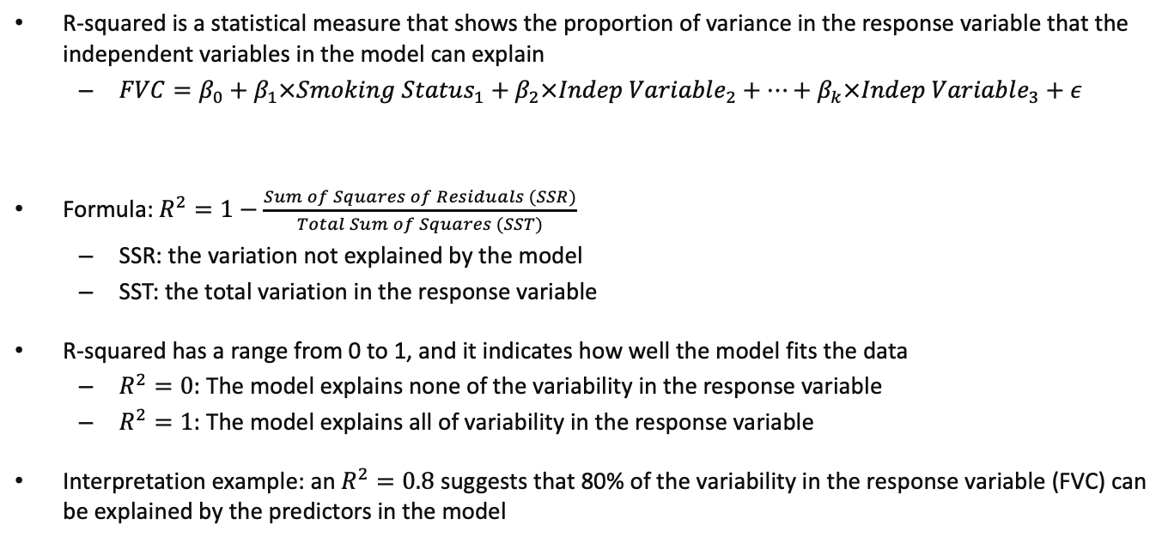
R-Squared ($R^{2 }$)
R-squared is a statistical measure that shows the proportion of variance in the response variable that the independent variables in the model can explain
$FVC=β_{0}+β_{1}×Smoking Status_{1}+β_{2}×Indep Variable_{2}+…+β_{k}×Indep Variable_{3}+ε$
Formula: $R^{2}=1−\frac{Sum of Squares of Residuals (SSR)}{Total Sum of Squares (SST)}$
SSR: the variation not explained by the model
SST: the total variation in the response variable
R-squared has a range from 0 to 1, and it indicates how well the model fits the data
$R^{2}=0:$ The model explains none of the variability in the response variable
$R^{2}=1:$ The model explains all of variability in the response variable
Interpretation example: an $R^{2}=0.8$ suggests that 80% of the variability in the response variable (FVC) can be explained by the predictors in the model
Response (dependent) variable
Independent variables/predictors
Smokers:1; Non-smokers: 0

Slide 4
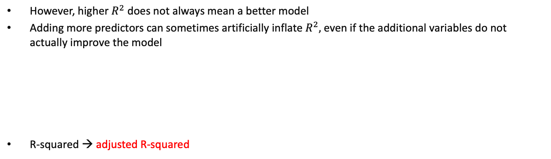
R-Squared ($R^{2 }$)
However, higher $R^{2}$ does not always mean a better model
Adding more predictors can sometimes artificially inflate $R^{2},$even if the additional variables do not actually improve the model
R-squared → adjusted R-squared
$$FVC=β_{0}+β_{1}×Smoking Status_{1}+β_{2}×Smoking Status_{2}+…+β_{k}×Smoking Status_{k}+ε$$

Slide 5

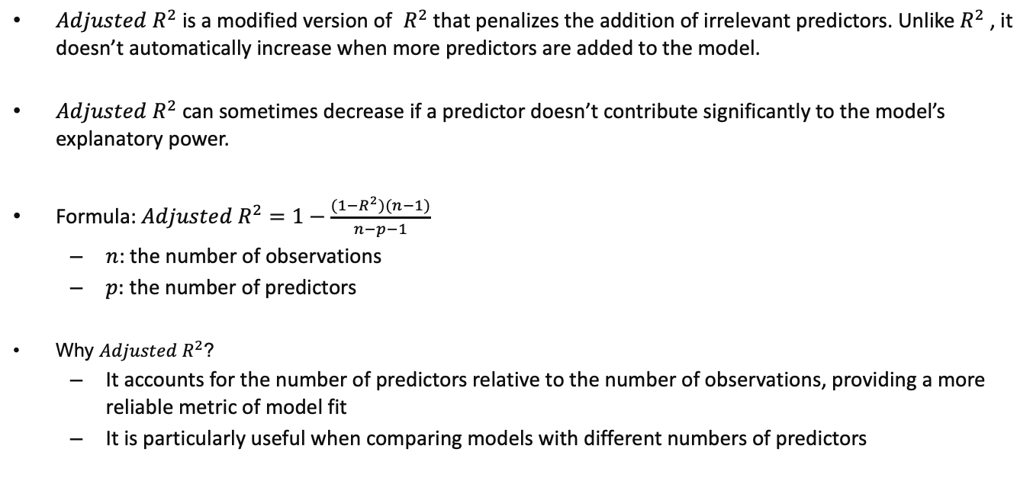
Adjusted R-Squared (Adjusted $R^{2 }$)
${Adjusted R}^{2}$is a modified version of $R^{2}$that penalizes the addition of irrelevant predictors. Unlike $R^{2}$ , it doesn’t automatically increase when more predictors are added to the model.
${Adjusted R}^{2}$ can sometimes decrease if a predictor doesn’t contribute significantly to the model’s explanatory power.
Formula: ${Adjusted R}^{2}=1−\frac{(1−R^{2})(n−1)}{n−p−1}$
$n$: the number of observations
$p:$ the number of predictors
Why ${Adjusted R}^{2}$?
It accounts for the number of predictors relative to the number of observations, providing a more reliable metric of model fit
It is particularly useful when comparing models with different numbers of predictors

Slide 6
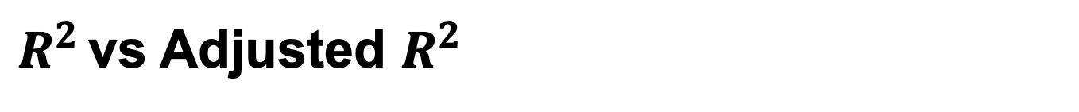
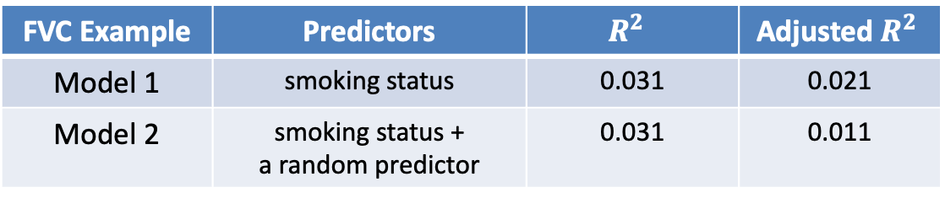
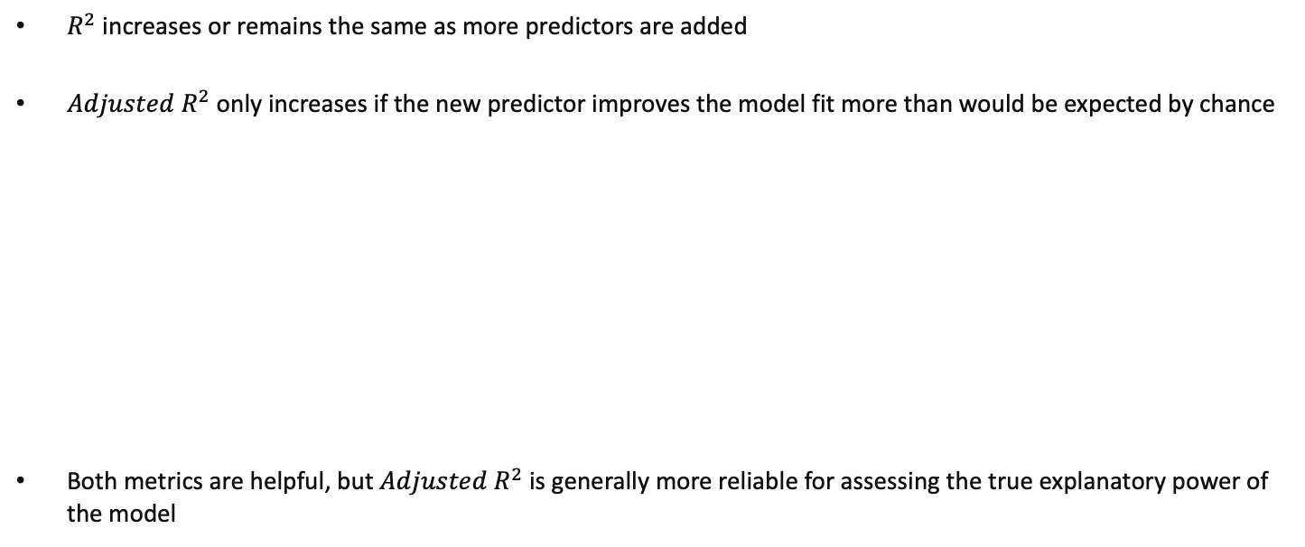
$R^{2 }$vs Adjusted $R^{2 }$
$R^{2}$ increases or remains the same as more predictors are added
${Adjusted R}^{2}$only increases if the new predictor improves the model fit more than would be expected by chance
Both metrics are helpful, but ${Adjusted R}^{2}$is generally more reliable for assessing the true explanatory power of the model
FVC Example | Predictors | $$R^{2 }$$ | Adjusted $R^{2 }$
Model 1 | smoking status | 0.031 | 0.021
Model 2 | smoking status + a random predictor | 0.031 | 0.011
Model 1: $FVC=β_{0}+β_{1} × Smokers or Not+ε$
Model 2: $FVC=β_{0}+β_{1} × Smokers or Not+β_{2} × A Random Predictor+ε$

Slide 7
Thank you!

