Slide 1
Understanding Key Concepts in Statistical Inference Bias, Variance, and Their Trade-Offs
NCTraCS Tutorial Series

Slide 2
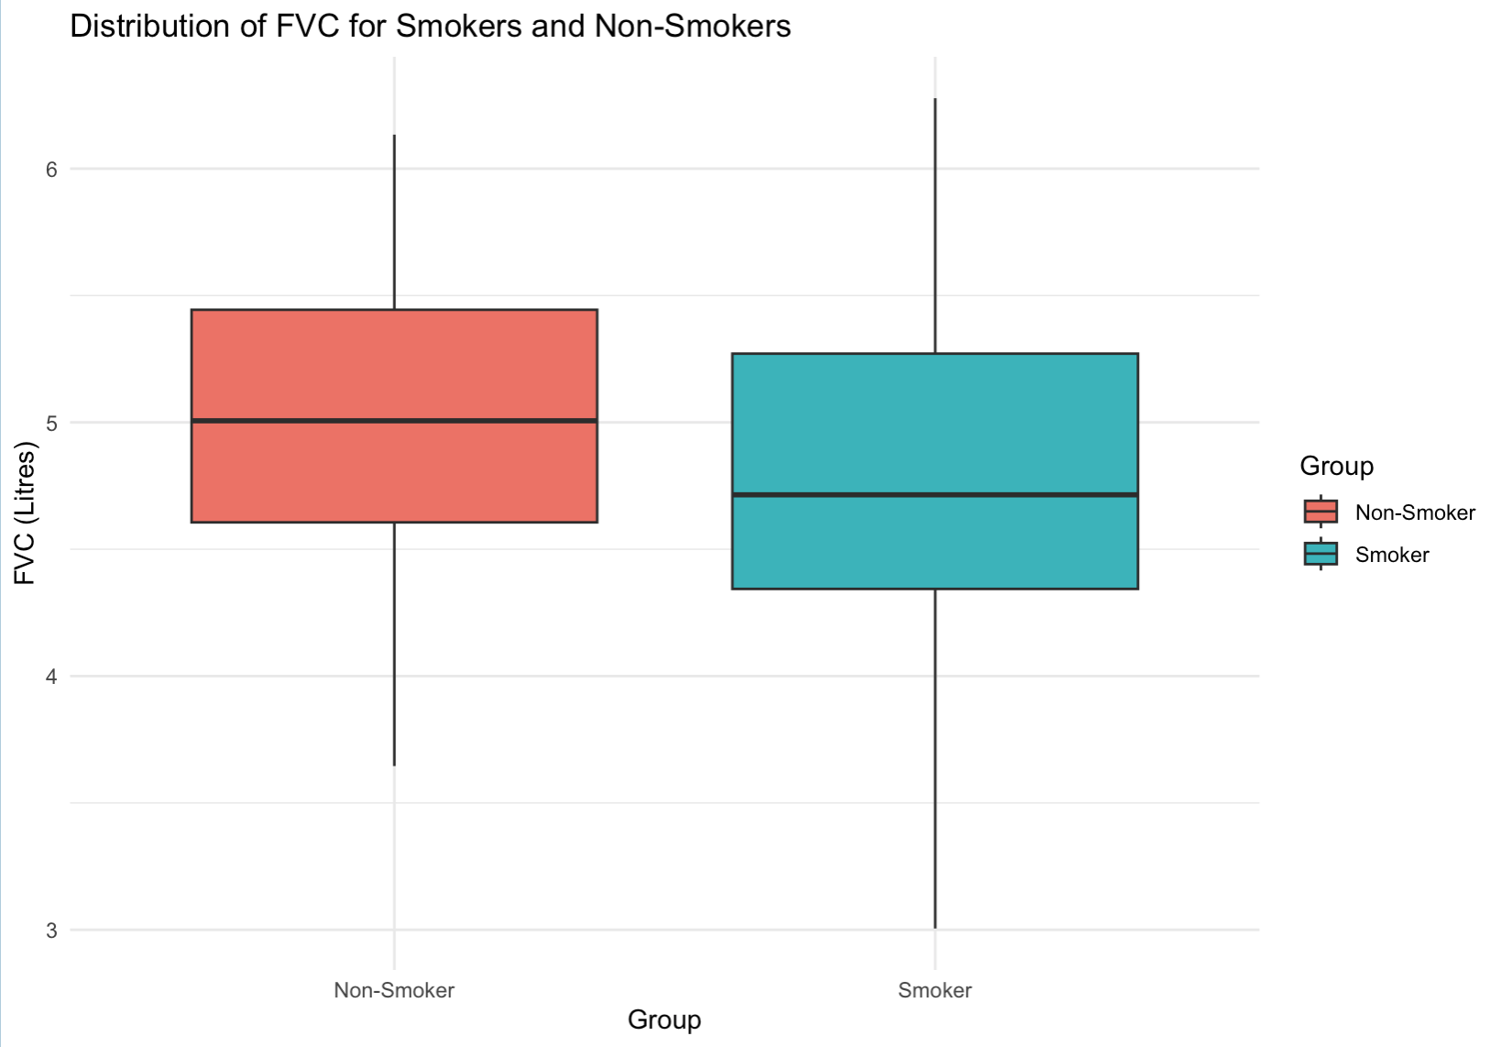
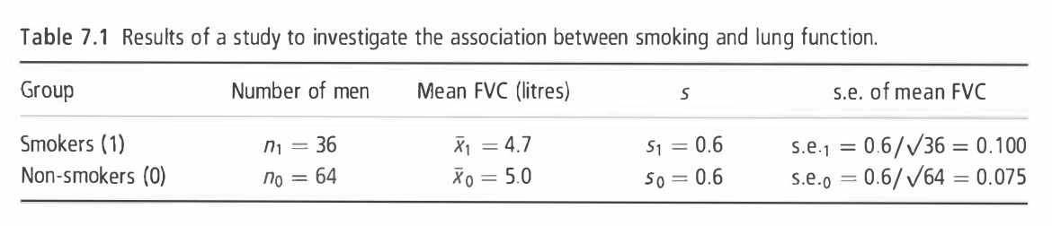
Example
To investigate whether smoking reduces lung function, forced vital capacity (FVC, a test of lung function) was measured in I00 men aged 25-29, of whom 36 were smokers and 64 were non-smokers. (Example 7.1 from Essential Medical Statistics [1])

Slide 3
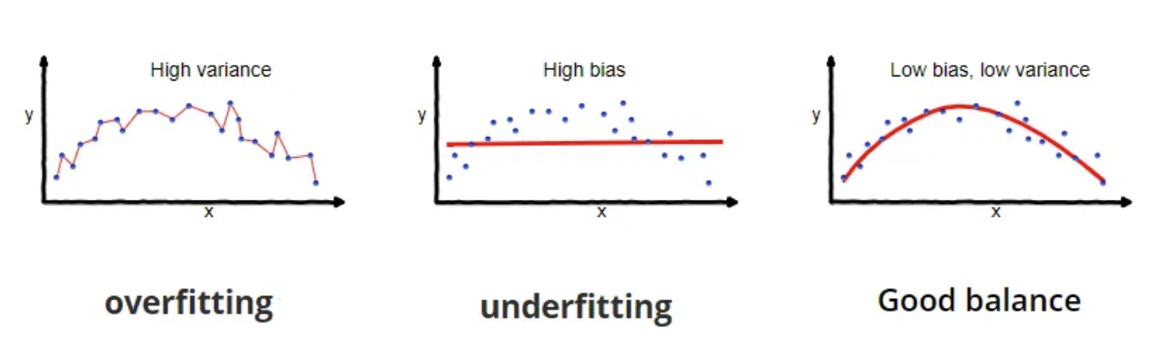
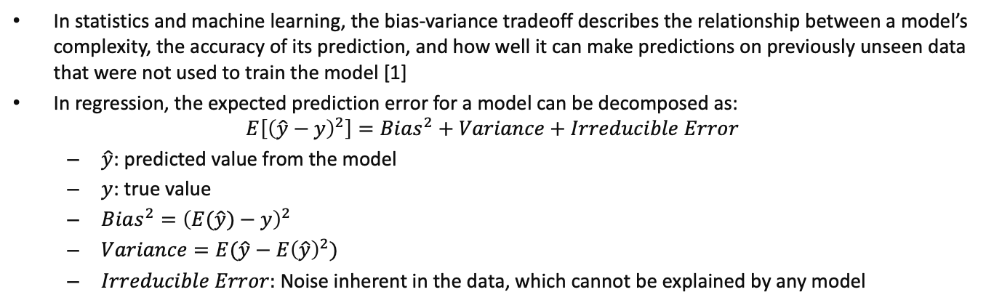
Bias, Variance, and Their Trade-Offs
In statistics and machine learning, the bias-variance tradeoff describes the relationship between a model’s complexity, the accuracy of its prediction, and how well it can make predictions on previously unseen data that were not used to train the model [1]
In regression, the expected prediction error for a model can be decomposed as:
$$E\left[{\left(\hat{y}−y\right)}^{2}\right]=Bias^{2}+Variance+Irreducible Error$$
$\hat{y}$: predicted value from the model
$y$: true value
$Bias^{2}={\left(E(\hat{y})−y\right)}^{2}$
$Variance=E(\hat{y}−E{\left(\hat{y}\right)}^{2})$
$Irreducible Error:$ Noise inherent in the data, which cannot be explained by any model
References: [1] Wikipedia: https://en.wikipedia.org/wiki/Bias–variance_tradeoff
[2] https://towardsdatascience.com/understanding-the-bias-variance-tradeoff-165e6942b229

Slide 4
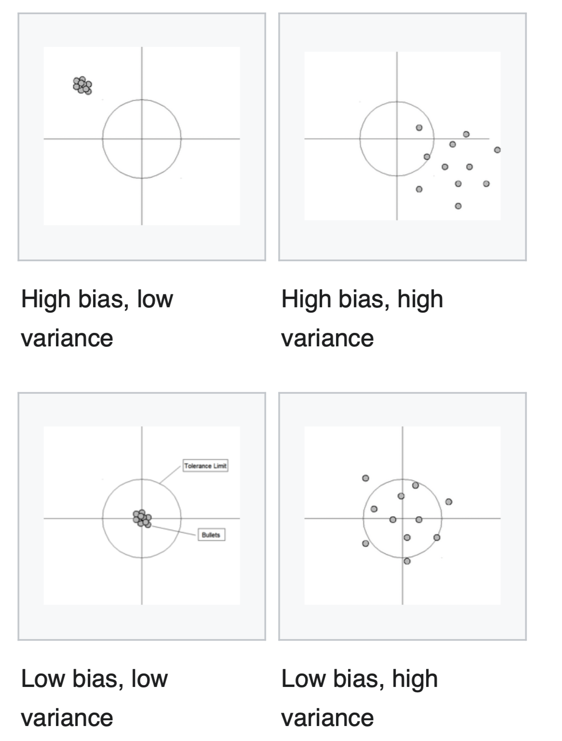
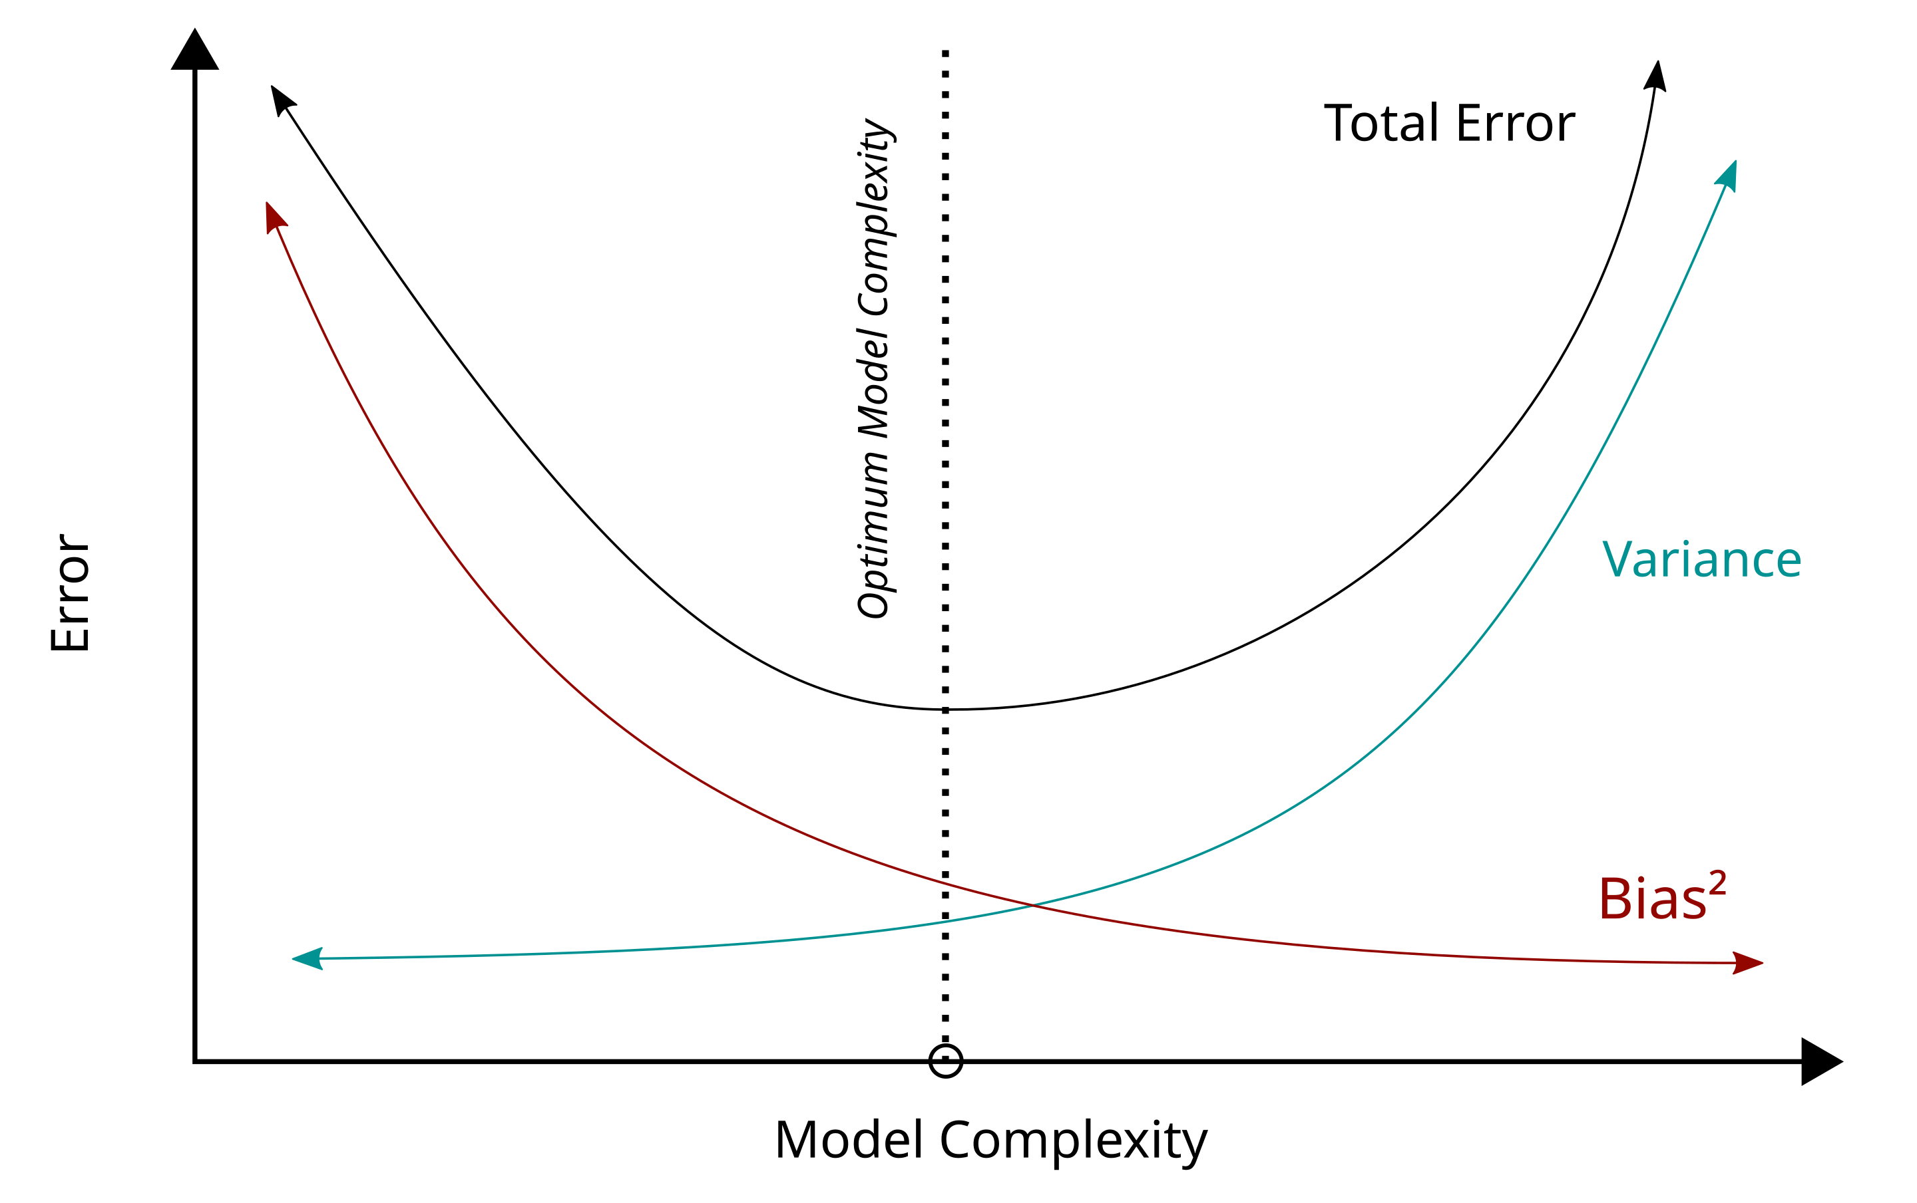
Bias, Variance, and Their Trade-Offs
Goal: Minimize both bias and variance for optimal prediction
$$E\left[{\left(\hat{y}−y\right)}^{2}\right]=Bias^{2}+Variance+Irreducible Error$$
Reference: https://en.wikipedia.org/wiki/Bias–variance_tradeoff

Slide 5
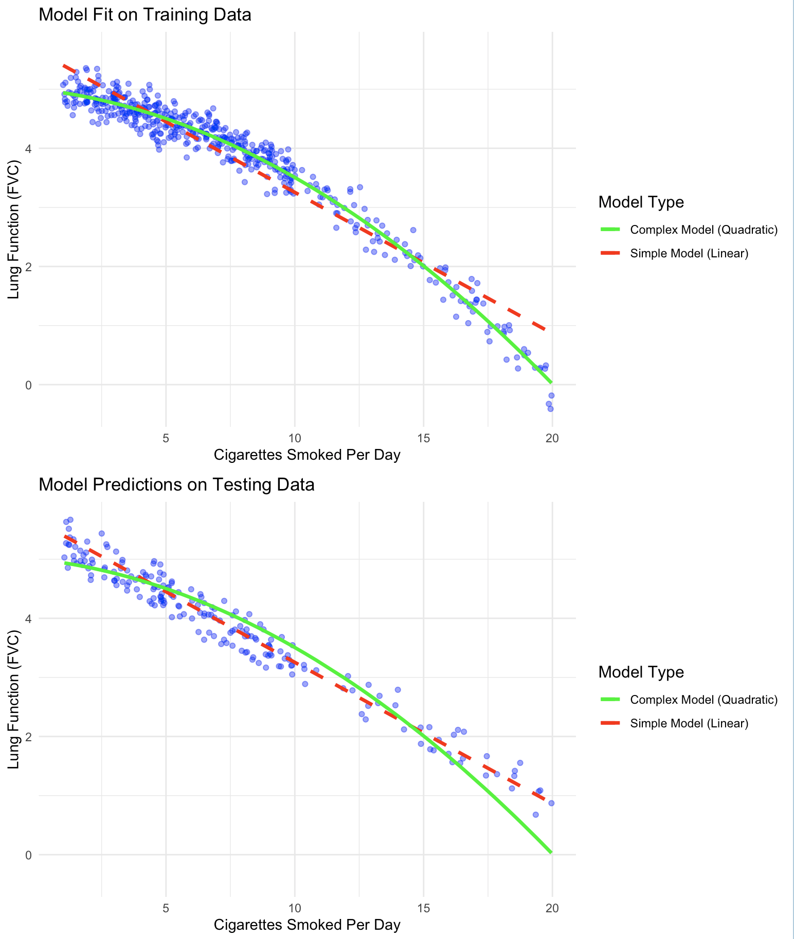
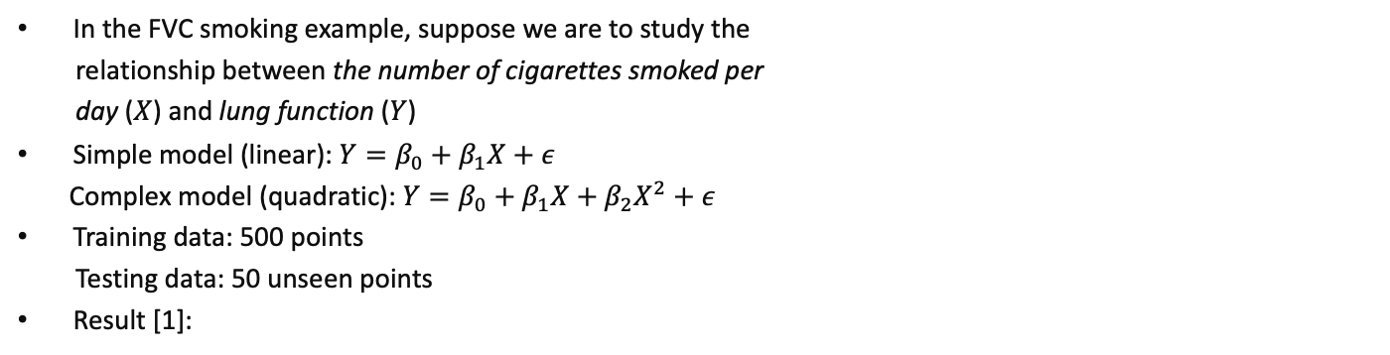
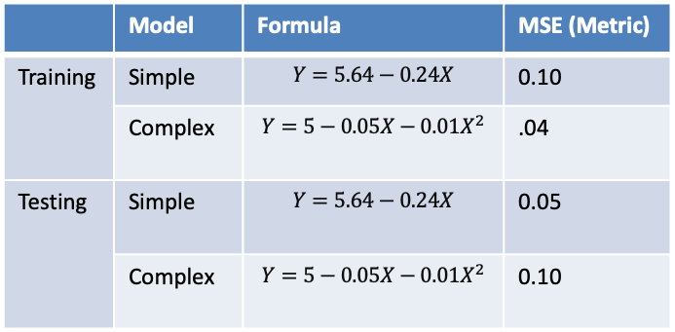
Example: FVC Smoking
In the FVC smoking example, suppose we are to study the
relationship between the number of cigarettes smoked per
day ($X$) and lung function ($Y$)
Simple model (linear):$Y=β_{0}+β_{1}X+ε$
Complex model (quadratic): $Y=β_{0}+β_{1}X+β_{2}X^{2}+ε$
Training data: 500 points
Testing data: 50 unseen points
Result [1]:
 | Model | Formula | MSE (Metric)
Training | Simple | $$Y=5.64−0.24X$$ | 0.10
 | Complex | $$Y=5−0.05X−0.01X^{2}$$ | .04
Testing | Simple | $$Y=5.64−0.24X$$ | 0.05
 | Complex | $$Y=5−0.05X−0.01X^{2}$$ | 0.10
[1] Dataset: please refer to “3_1_train_data.csv” and “3_1_test_data.csv”.

Slide 6
Thank you!

