Slide 1
Understanding Key Concepts in Statistical Inference ROC Curve and AUC
NCTraCS Tutorial Series

Slide 2
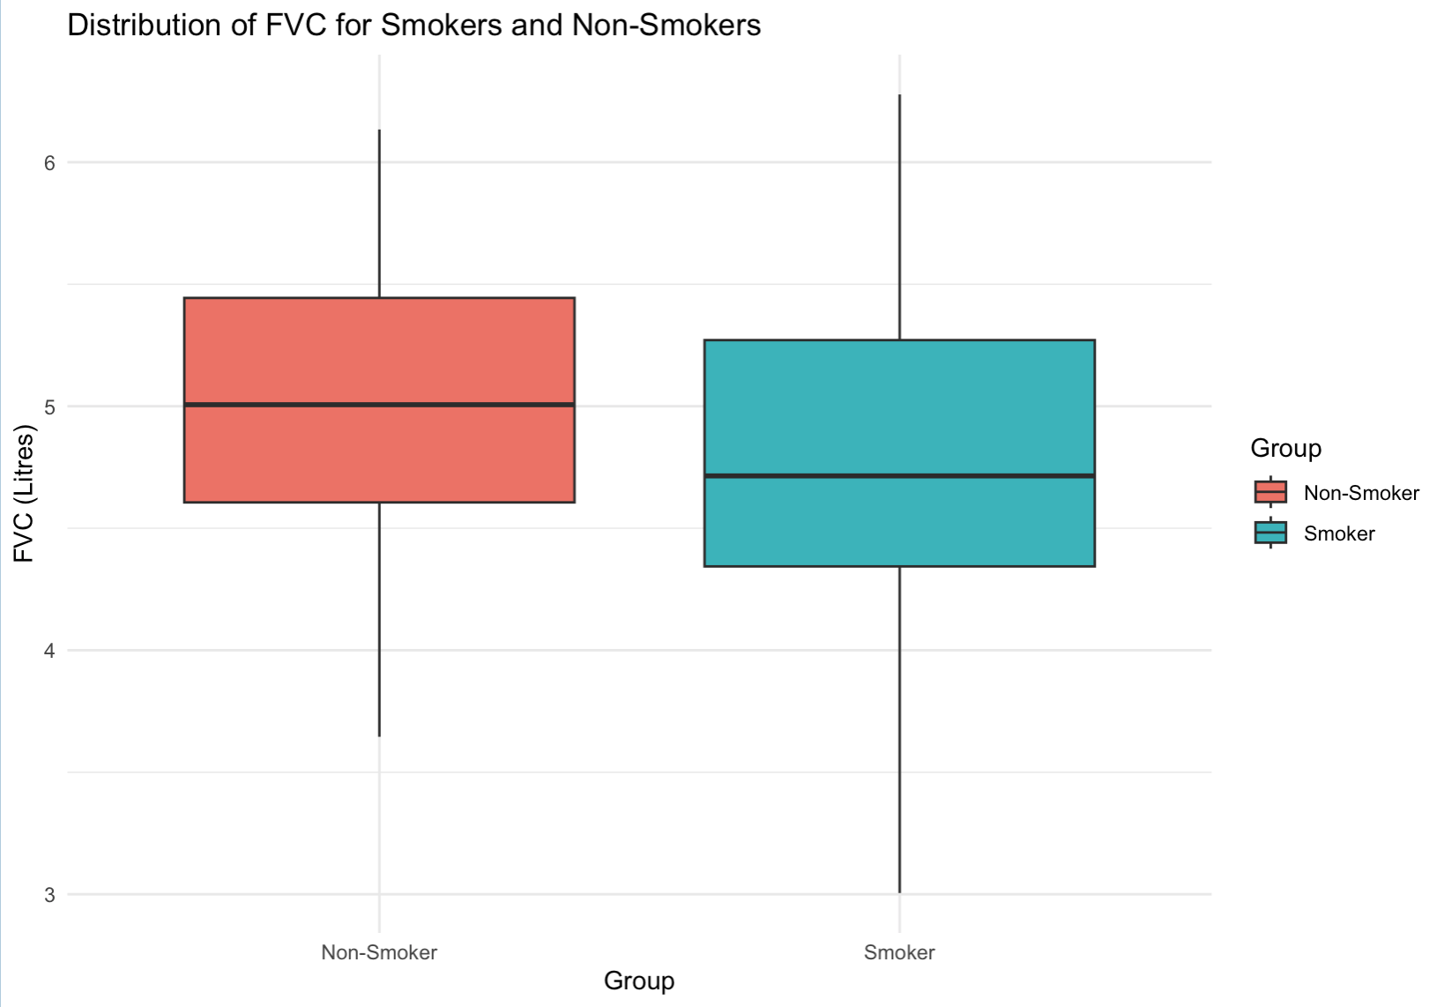
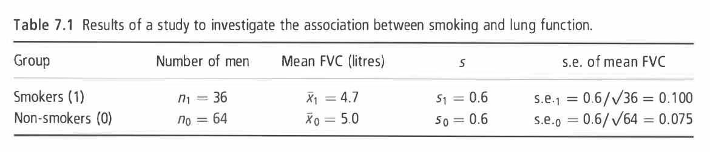
Example
To investigate whether smoking reduces lung function, forced vital capacity (FVC, a test of lung function) was measured in I00 men aged 25-29, of whom 36 were smokers and 64 were non-smokers. (Example 7.1 from Essential Medical Statistics)

Slide 3
Recap
 | Definition | Smoking Example
True Positive Rate (TPR, or Sensitivity)
False Positive Rate (FPR)
True Negative Rate (TNR, or Specificity)
False Negative Rate (FNR)

Slide 4
Recap
 | Definition | Smoking Example
True Positive Rate (TPR, or Sensitivity) | Proportion of actual positives that are correctly predicted as positive by the model | Suppose you have 50 individuals whose lung function is truly reduced by smoking. If your model correctly predicts that 40 of these individuals have reduced lung function, then the TPR is 80%
False Positive Rate (FPR)
True Negative Rate (TNR, or Specificity)
False Negative Rate (FNR)

Slide 5
Recall
 | Definition | Smoking Example
True Positive Rate (TPR, or Sensitivity) | Proportion of actual positives that are correctly predicted as positive by the model | Suppose you have 50 individuals whose lung function is truly reduced by smoking. If your model correctly predicts that 40 of these individuals have reduced lung function, then the TPR is 80%
False Positive Rate (FPR) | Proportion of actual negatives that are incorrectly predicted as positive by the model | Suppose there are 50 individuals whose lung function is not affected by smoking. If your model incorrectly predicts that 5 of these individuals have reduced lung function, the FPR is 10%
True Negative Rate (TNR, or Specificity)
False Negative Rate (FNR)

Slide 6
Recall
 | Definition | Smoking Example
True Positive Rate (TPR, or Sensitivity) | Proportion of actual positives that are correctly predicted as positive by the model | Suppose you have 50 individuals whose lung function is truly reduced by smoking. If your model correctly predicts that 40 of these individuals have reduced lung function, then the TPR is 80%
False Positive Rate (FPR) | Proportion of actual negatives that are incorrectly predicted as positive by the model | Suppose there are 50 individuals whose lung function is not affected by smoking. If your model incorrectly predicts that 5 of these individuals have reduced lung function, the FPR is 10%
True Negative Rate (TNR, or Specificity) | Proportion of actual negatives that are correctly predicted as negative by the model | Out of 50 individuals whose lung function is not reduced by smoking, if 45 are correctly predicted to have normal lung function, then the TNR is 90%
False Negative Rate (FNR)

Slide 7
Recall
 | Definition | Smoking Example
True Positive Rate (TPR, or Sensitivity) | Proportion of actual positives that are correctly predicted as positive by the model | Suppose you have 50 individuals whose lung function is truly reduced by smoking. If your model correctly predicts that 40 of these individuals have reduced lung function, then the TPR is 80%
False Positive Rate (FPR) | Proportion of actual negatives that are incorrectly predicted as positive by the model | Suppose there are 50 individuals whose lung function is not affected by smoking. If your model incorrectly predicts that 5 of these individuals have reduced lung function, the FPR is 10%
True Negative Rate (TNR, or Specificity) | Proportion of actual negatives that are correctly predicted as negative by the model | Out of 50 individuals whose lung function is not reduced by smoking, if 45 are correctly predicted to have normal lung function, then the TNR is 90%
False Negative Rate (FNR) | Proportion of actual positives that are incorrectly predicted as negative by the model | If among 50 individuals whose lung function is truly reduced by smoking, 10 are incorrectly predicted to have normal lung function, then the FNR is 20%

Slide 8
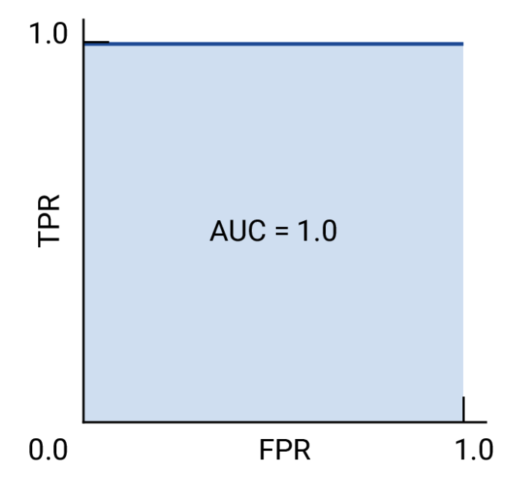
ROC Curve and AUC
The Receiver Operating Characteristic (ROC) curve is a graphical representation of a classification model’s performance across various decision thresholds.
ROC curve plots:
True Positive Rate (TPR): proportion of actual positives correctly predicted
False Positive Rate (FPR): proportion of actual negatives incorrectly predicted as positive
The Area Under the ROC Curve (AUC) quantifies the overall ability of the model to distinguish between classes.
Figure [1]: (a) perfect model

Slide 9
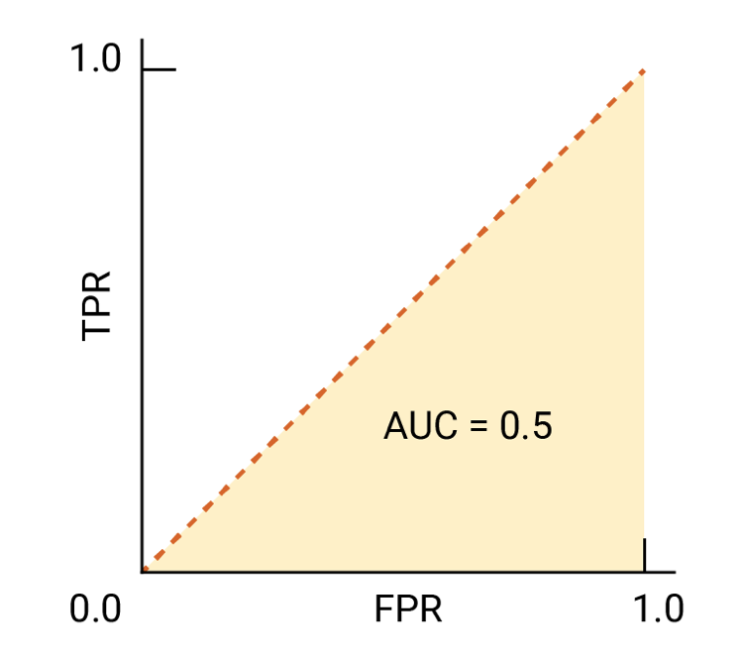
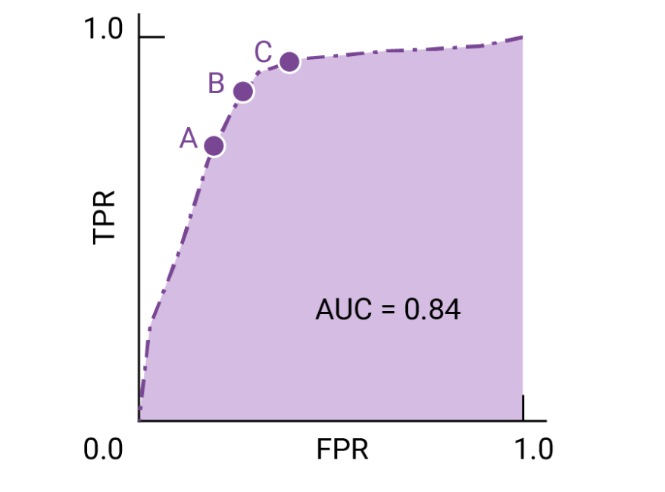
ROC Curve and AUC
Example: a smoker classifier with AUC of 1.0 always assigns a random smoker a higher probability of being a smoker than a random chosen test subject.
A smoker classifier with an AUC of 0.5 assigns a higher probability of being a smoker to a randomly chosen smoker than to a randomly chosen non-smoker only half the time.
AUC is a useful measure for comparing the performance of two different models, as long as the dataset is roughly balanced.
Figure [1]: (a) perfect model
(b) random guesses model
(c) model with AUC = 0.84

Slide 10
ROC Curve and AUC
If false negatives cost higher → point C
If false positives cost higher → point A
If false negatives and false positives are roughly equivalent → B
Figure [1]: model with AUC = 0.84

Slide 11
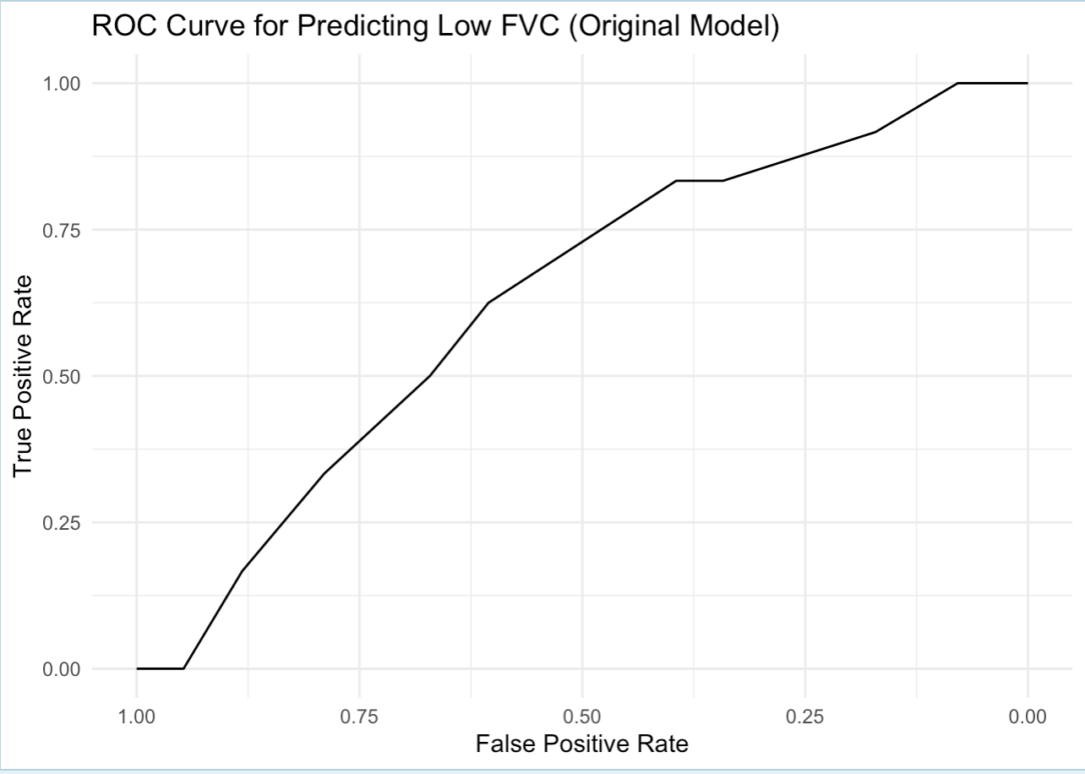
Example: FVC Smoking
In the FVC smoking example, we convert the “smoker” group into a binary classification problem:
smoker = 1 for actual smokers
smoker = 0 for non-smokers
Fit a logistic regression model predicting Smoker based on FVC with predictors Smoking Status, and Age
Generate probability scores from the model for each observation
Compute the ROC curve and AUC
Plot the ROC curve (here AUC = 0.629)
Generally speaking: AUC > 0.8 → good classification performance
Code: ”3_2_ROCAUC.R”

Slide 12
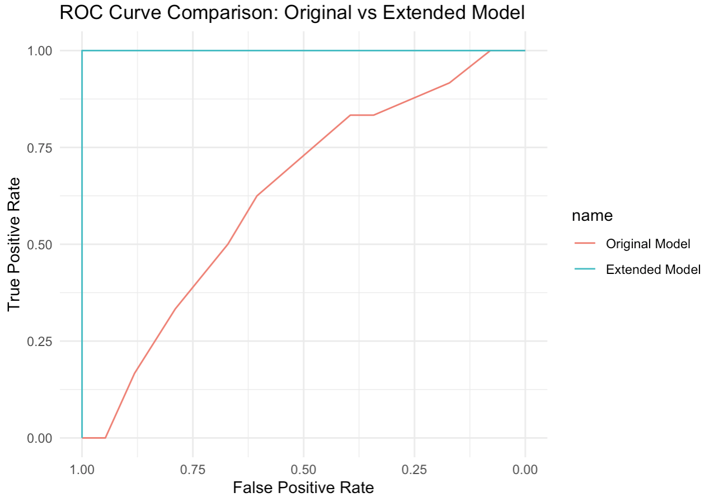
Example: FVC Smoking
In the FVC smoking example, we convert the “smoker” group into a binary classification problem:
smoker = 1 for actual smokers
smoker = 0 for non-smokers
Fit a logistic regression model predicting Smoker based on FVC with predictors Smoking Status, and Age
Generate probability scores from the model for each observation
Compute the ROC curve and AUC
Plot the ROC curve (here AUC = 0.629)
Generally speaking: AUC > 0.8 → good classification performance
Fit an improved logistic model including Smoking Status, Age and Biomaker
Improved AUC = 1
Code: ”3_2_ROCAUC.R”

