Slide 1
Data Science in OMOP
Analytics Workflow

Slide 2
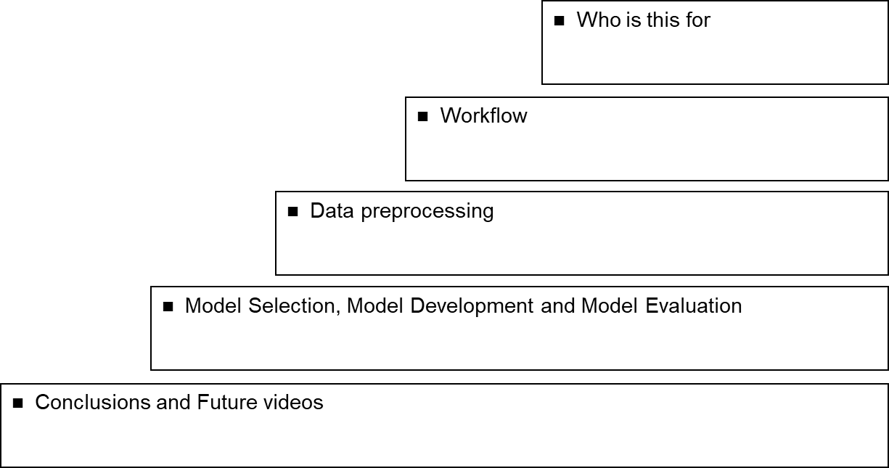
Agenda

Slide 3
Who is this for?
Researchers who are new to modelling.
Researchers that need a refresher on what are the next steps

Slide 4
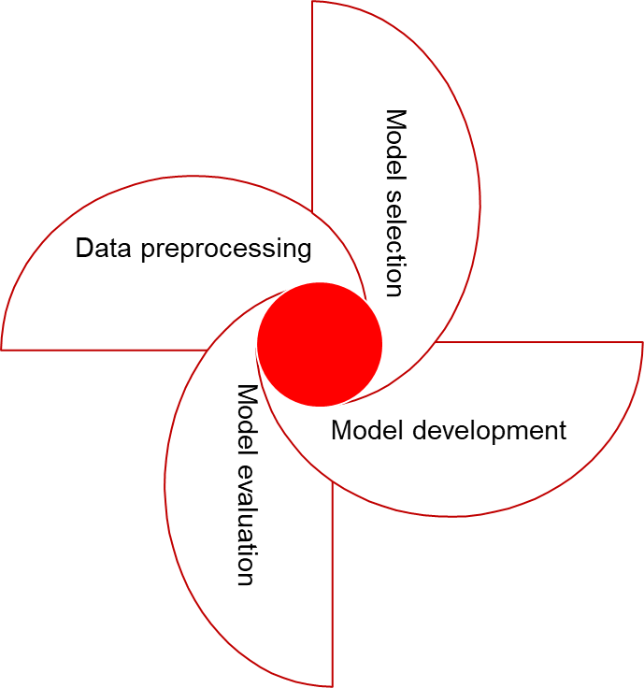
Data science Workflow
Every step should serve as a feedback to other phases.
Given insights in one given phase, it might be necessary to reconsider again other steps already visited

Slide 5
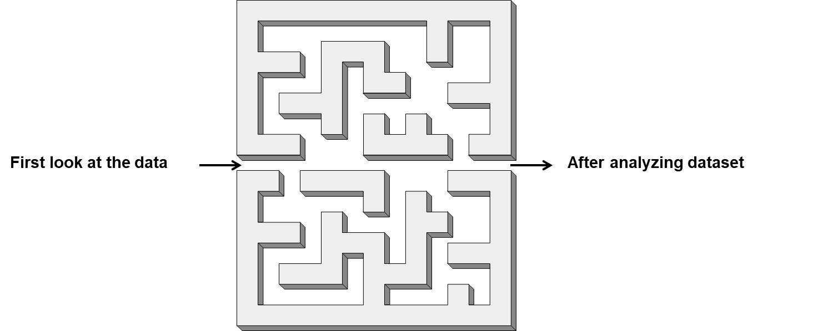
Data Preprocessing
Initially, the first look at the data is confusing.
The goal of this phase is to go through the maze and get a complete picture of your data and understand it very well.

Slide 6
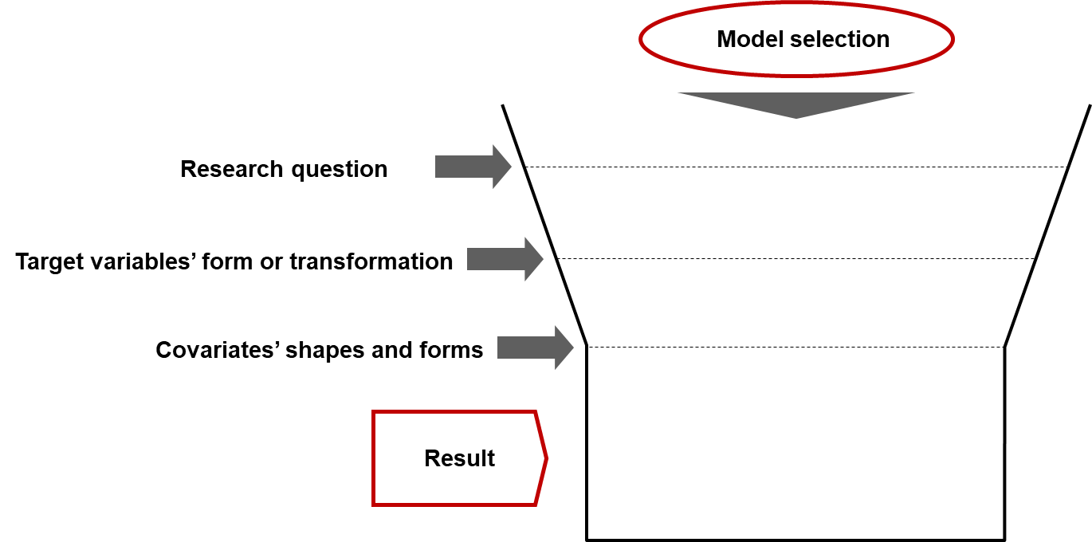
Model Selection
This step has to be based on multiple criteria to be successful
Best practice is to have multiple competing models, each following the chosen criterias.

Slide 7
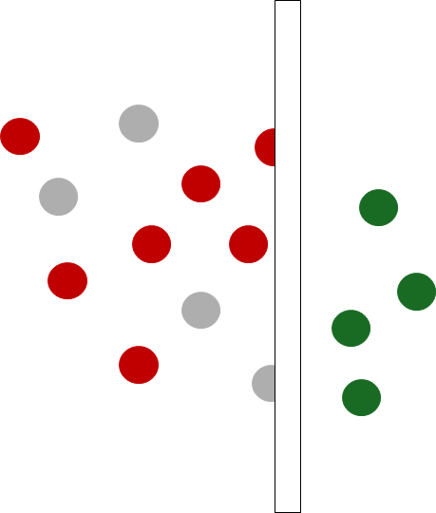
Model Development
In this stage you select which variables are important to your model.
In this step you also find the final functional form of the model, and understand what the stats/ML tests tell you

Slide 8
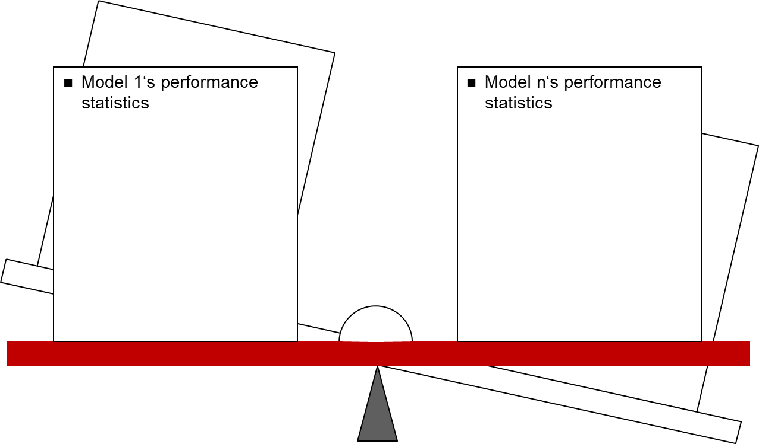
Model Evaluation
Select the best model between competing models
Assess how generalizable is your solution given sample (is it representative?) and model
Run on a validation dataset and investigate performance measures (e.g. AIC, BIC)

Slide 9
Conclusion
Following this modeling framework will allow you to: reach your goal and constantly question your intermediate and final results to understand if there are better solutions or models to your research question
The modelling process should be dynamic allowing to go back to previous steps given insights captured along the way.

Slide 10
Future Works
In future videos the team will go through this framework with a database taken from OMOP common data model to simulate how researchers are working with a hypothetical research question.
In future videos the team will also address common questions asked to the consulting team

