Slide 1
Understanding Key Concepts in Hypothesis Testing Rejection Region
NCTraCS Tutorial Series

Slide 2
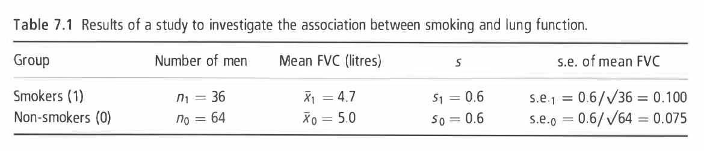
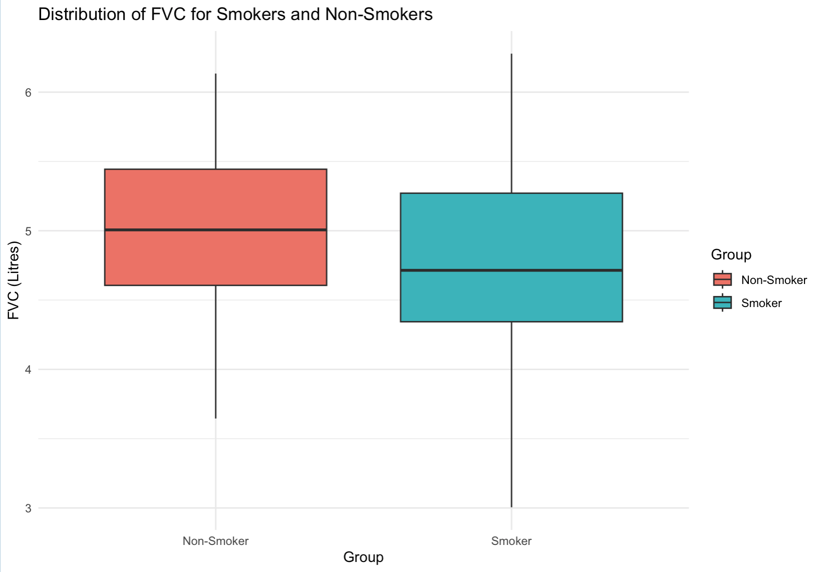

Example
To investigate whether smoking reduces lung function, forced vital capacity (FVC, a test of lung function) was measured in I00 men aged 25-29, of whom 36 were smokers and 64 non-smokers. (Example 7.1 from Essential Medical Statistics [1])
Null hypothesis $H_{0}:$ There is no difference in the mean FVC between
smokers and non-smokers.
${ H}_{0}:$ $μ_{1}=μ_{0}$
Alternative hypothesis $H_{a}:$ The mean FVC of smokers is lower than
that of non-smokers, indicating reduced lung
function in smokers.
${ H}_{a}:$ $μ_{1}<μ_{0}$

Slide 3
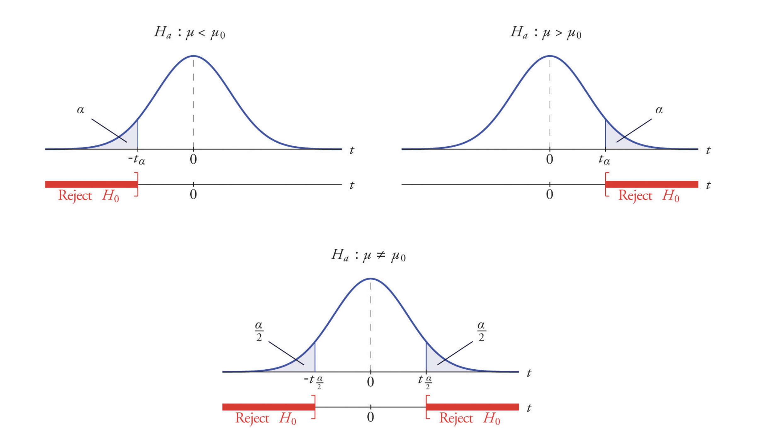

Rejection Region
Null hypothesis $H_{0}:θ∈Θ_{0}$ ($μ_{1}=μ_{0}$) v.s alternative hypothesis $H_{a}: θ∈Θ_{0}^{C}$ ($μ_{1}<μ_{0}$)
Shaded area: representing extreme values that are unlikely under the null hypothesis.
If the test statistic falls within this region, we reject the null hypothesis.
If we observe a difference in lung function that is so extreme that it is very unlikely to have occurred by chance, then we conclude that smoking indeed reduces lung function
Figure: Distribution of the Standardized Test Statistic and the Rejection Region (https://saylordotorg.github.io/text_introductory-statistics/)

Slide 4
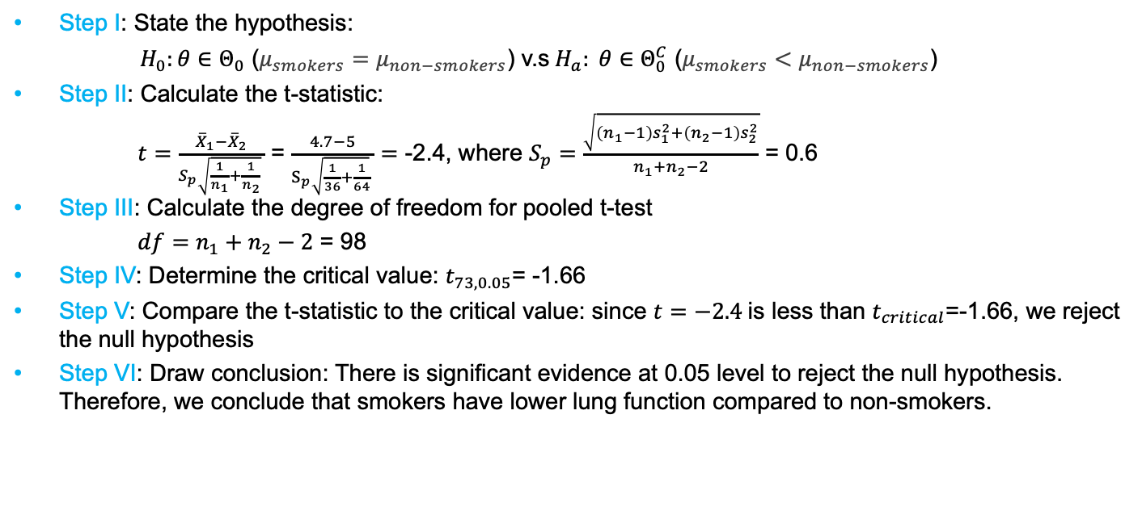
Rejection Region
Step I: State the hypothesis:
$H_{0}:θ∈Θ_{0}$ ($μ_{smokers}=μ_{non−smokers}$) v.s$H_{a}: θ∈Θ_{0}^{C}$ ($μ_{smokers}<μ_{non−smokers}$)
Step II: Calculate the t-statistic:
$t=\frac{{\overline{X}}_{1}−{\overline{X}}_{2}}{S_{p}\sqrt{\frac{1}{n_{1}}+\frac{1}{n_{2}}} }$ = $\frac{4.7−5}{S_{p}\sqrt{\frac{1}{36}+\frac{1}{64}} }=$ -2.4, where $S_{p}=\frac{\sqrt{\left(n_{1}−1\right)s_{1}^{2}+\left(n_{2}−1\right)s_{2}^{2}}}{n_{1}+n_{2}−2}$ = 0.6
Step III: Calculate the degree of freedom for pooled t-test
$df=n_{1}+n_{2}−2$ = 98
Step IV: Determine the critical value: $t_{73, 0.05}$= -1.66
Step V: Compare the t-statistic to the critical value: since $t=−2.4$is less than $t_{critical}$=-1.66, we reject the null hypothesis
Step VI: Draw conclusion: There is significant evidence at 0.05 level to reject the null hypothesis. Therefore, we conclude that smokers have lower lung function compared to non-smokers.

Slide 5
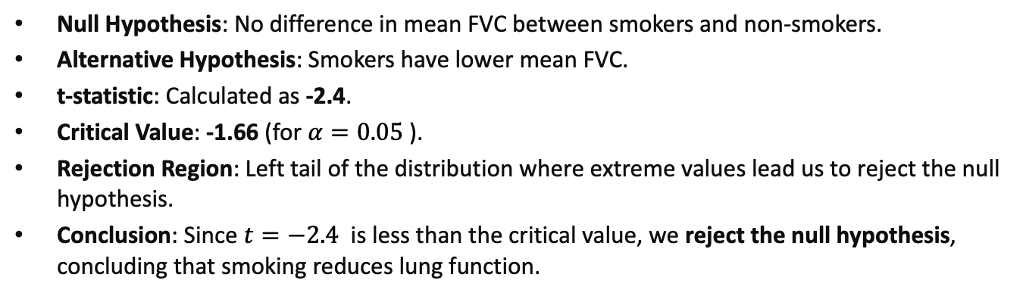
Rejection Region - Recap
Null Hypothesis: No difference in mean FVC between smokers and non-smokers.
Alternative Hypothesis: Smokers have lower mean FVC.
t-statistic: Calculated as -2.4.
Critical Value: -1.66 (for $α=0.05$).
Rejection Region: Left tail of the distribution where extreme values lead us to reject the null hypothesis.
Conclusion: Since $t=−2.4$ is less than the critical value, we reject the null hypothesis, concluding that smoking reduces lung function.

Slide 6
Reference
(Textbook) Kirkwood, Betty R., and Jonathan AC Sterne. Essential medical statistics. John wiley & sons, 2010.
(Textbook) Casella, George, and Roger Berger. Statistical inference. CRC Press, 2024.
(Online Tutorial) https://online.stat.psu.edu/stat500/lesson/6a
(Online Tutorial) https://online.stat.psu.edu/stat415/lesson/9
(Textbook) Lehmann, Erich Leo, Joseph P. Romano, and George Casella. Testing statistical hypotheses. Vol. 3. New York: springer, 1986.

