Slide 1
Understanding Key Concepts in Hypothesis Testing Type I Error, Type II Error
NCTraCS Tutorial Series

Slide 2
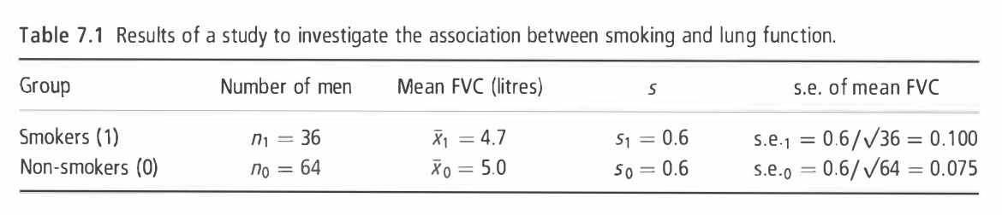
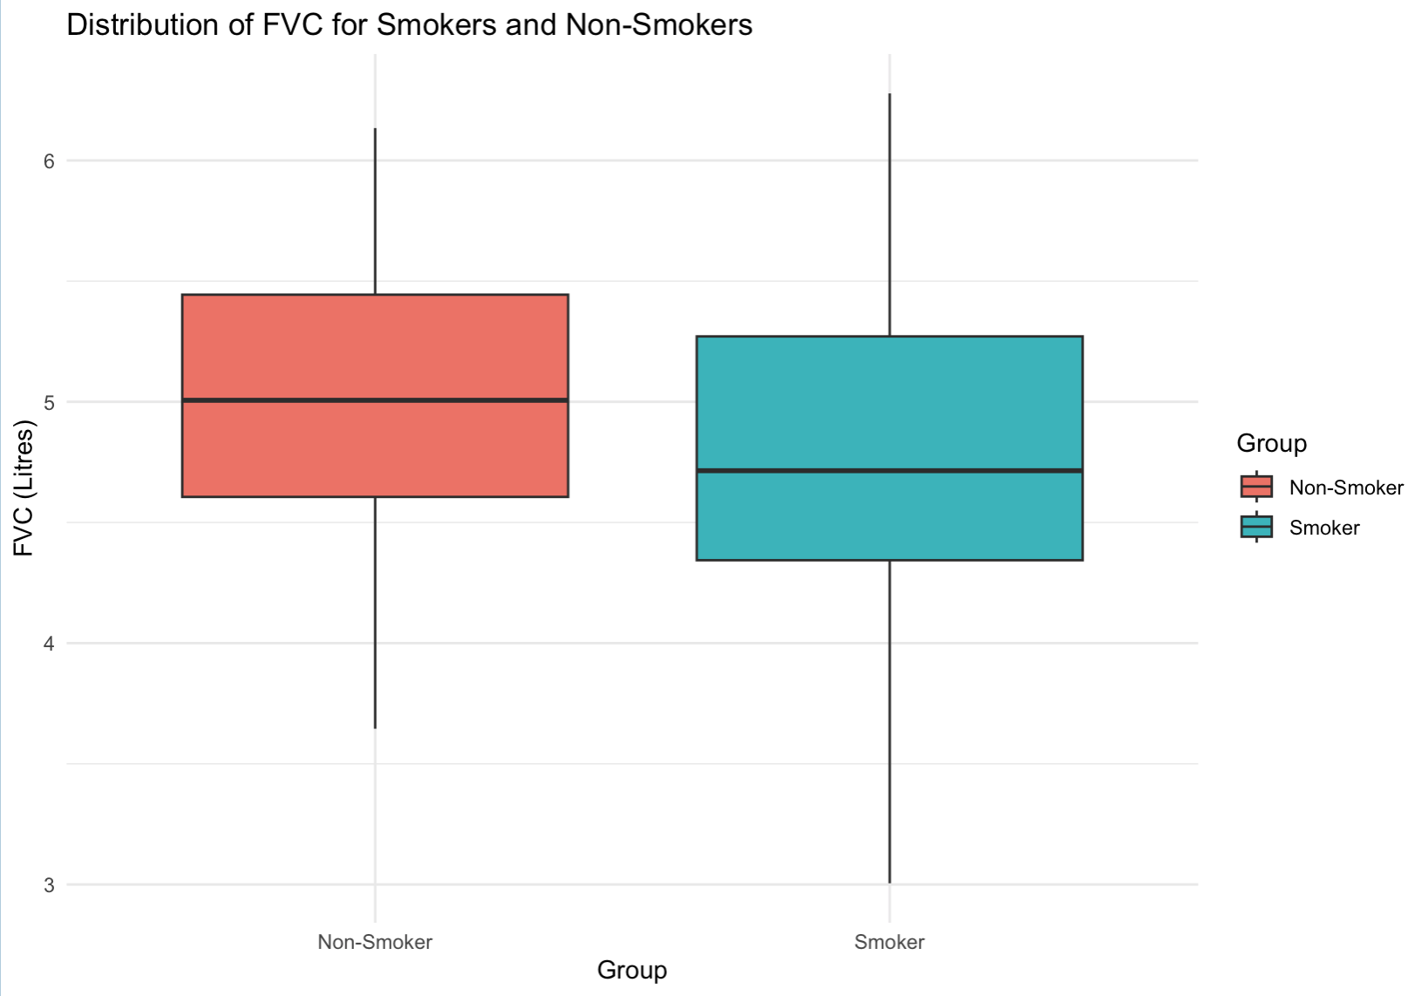

Example
To investigate whether smoking reduces lung function, forced vital capacity (FVC, a test of lung function) was measured in I00 men aged 25-29, of whom 36 were smokers and 64 non-smokers. (Example 7.1 from Essential Medical Statistics [1])
Null hypothesis $H_{0}:$ There is no difference in the mean FVC between
smokers and non-smokers.
${ H}_{0}:$ $μ_{1}=μ_{0}$
Alternative hypothesis $H_{a}:$ The mean FVC of smokers is lower than
that of non-smokers, indicating reduced lung
function in smokers.
${ H}_{a}:$ $μ_{1}<μ_{0}$

Slide 3
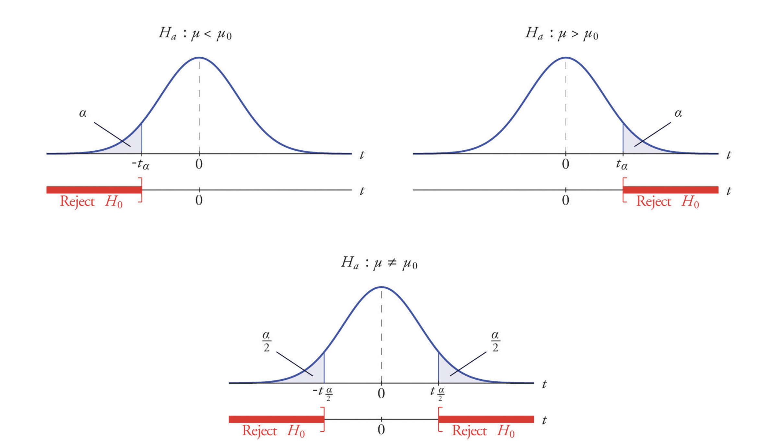
Type I Error, Type II Error

Slide 4
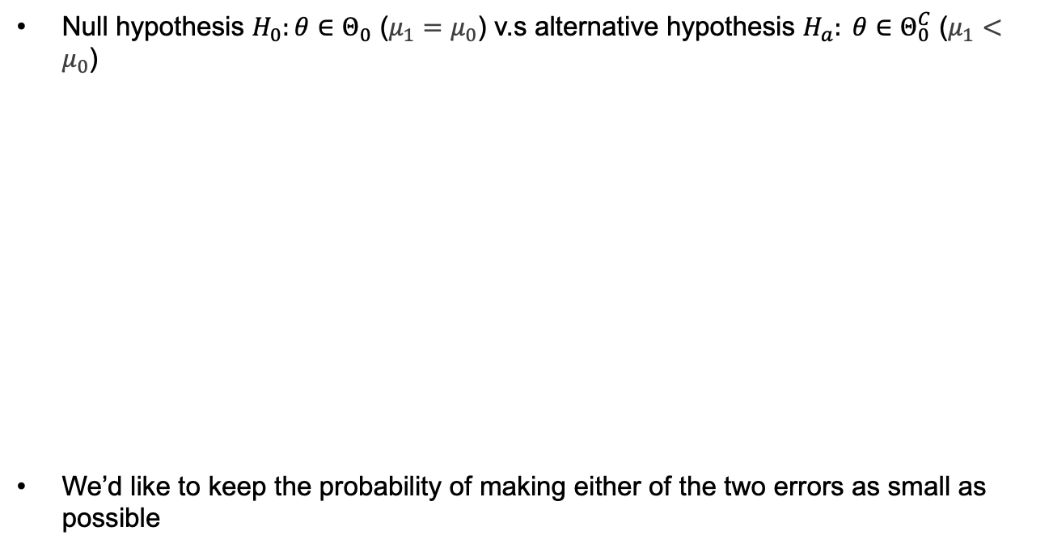

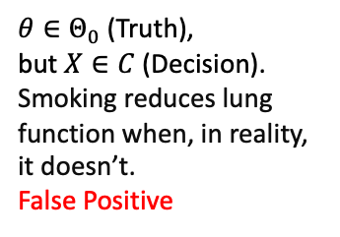
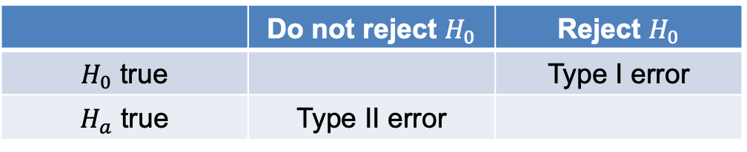
Type I Error, Type II Error
Null hypothesis $H_{0}:θ∈Θ_{0}$ ($μ_{1}=μ_{0}$) v.s alternative hypothesis $H_{a}: θ∈Θ_{0}^{C}$ ($μ_{1}<μ_{0}$)
We’d like to keep the probability of making either of the two errors as small as possible
 | Do not reject $H_{0}$ | Reject $H_{0}$
$H_{0}$ true |  | Type I error
$H_{a}$ true | Type II error
$θ∈Θ_{0}$ (Truth),
but $X∈C$ (Decision).
Smoking reduces lung function when, in reality, it doesn’t.
False Positive
$θ∈Θ_{0}^{C}$ (Truth),
but $X∉C$ (Decision).
Smoking does not reduce lung function when it actually does.
False Negative

Slide 5
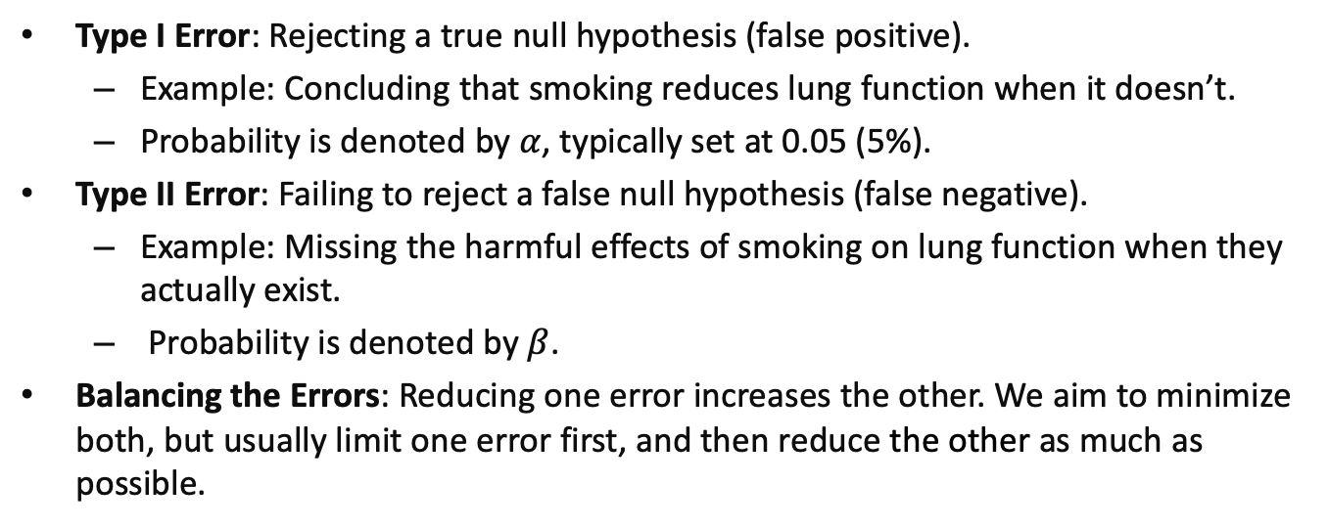
Type I Error, Type II Error- Recap
Type I Error: Rejecting a true null hypothesis (false positive).
Example: Concluding that smoking reduces lung function when it doesn’t.
Probability is denoted by $α$, typically set at 0.05 (5%).
Type II Error: Failing to reject a false null hypothesis (false negative).
Example: Missing the harmful effects of smoking on lung function when they actually exist.
Probability is denoted by $β$.
Balancing the Errors: Reducing one error increases the other. We aim to minimize both, but usually limit one error first, and then reduce the other as much as possible.

Slide 6
Reference
(Textbook) Kirkwood, Betty R., and Jonathan AC Sterne. Essential medical statistics. John wiley & sons, 2010.
(Textbook) Casella, George, and Roger Berger. Statistical inference. CRC Press, 2024.
(Online Tutorial) https://online.stat.psu.edu/stat500/lesson/6a
(Online Tutorial) https://online.stat.psu.edu/stat415/lesson/9
(Textbook) Lehmann, Erich Leo, Joseph P. Romano, and George Casella. Testing statistical hypotheses. Vol. 3. New York: springer, 1986.

