Slide 1
Understanding Key Concepts in Hypothesis Testing Power Function
NCTraCS Tutorial Series

Slide 2
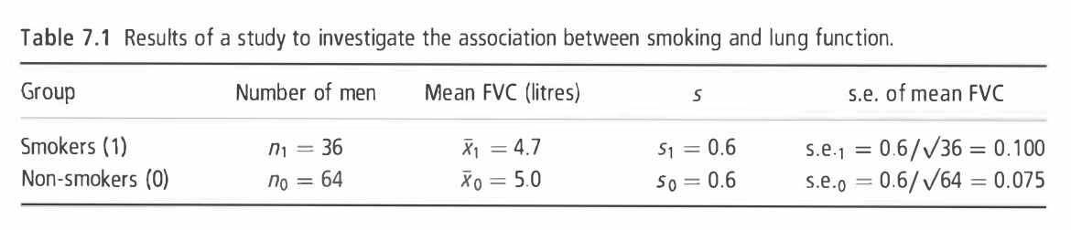
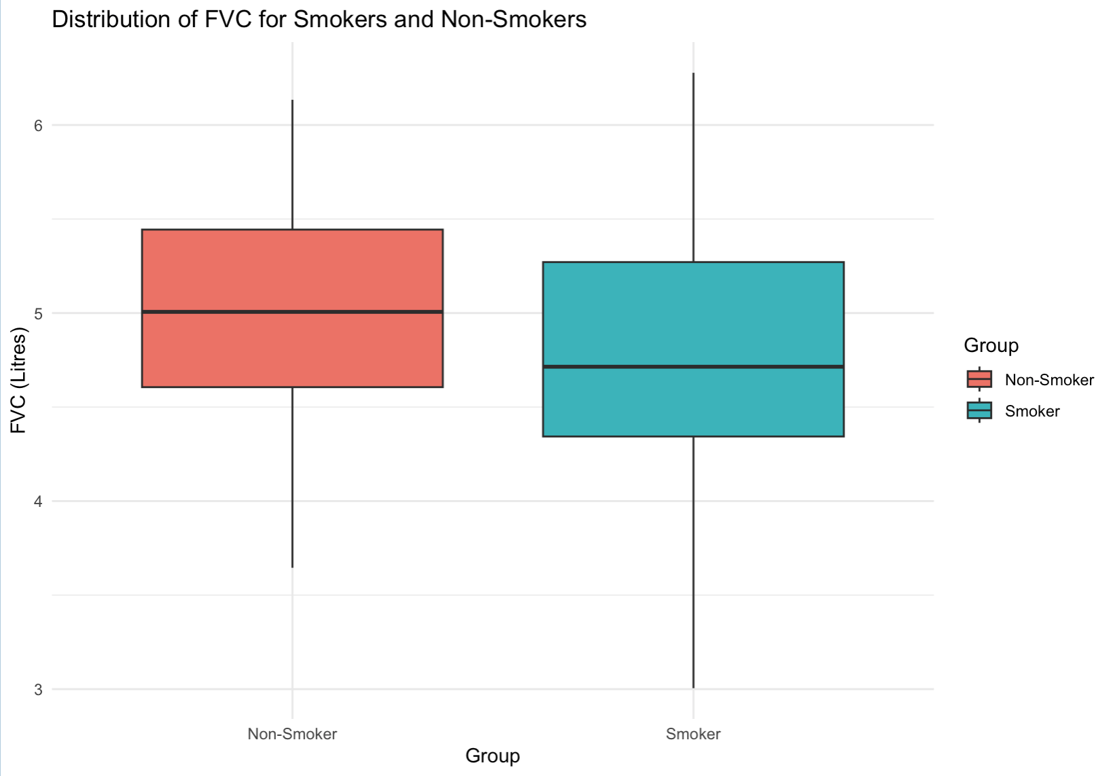

Example
To investigate whether smoking reduces lung function, forced vital capacity (FVC, a test of lung function) was measured in I00 men aged 25-29, of whom 36 were smokers and 64 non-smokers. (Example 7.1 from Essential Medical Statistics [1])
Null hypothesis $H_{0}:$ There is no difference in the mean FVC between
smokers and non-smokers.
${ H}_{0}:$ $μ_{1}=μ_{0}$
Alternative hypothesis $H_{a}:$ The mean FVC of smokers is lower than
that of non-smokers, indicating reduced lung
function in smokers.
${ H}_{a}:$ $μ_{1}<μ_{0}$

Slide 3
Power Function
The power of a test is the probability of correctly rejecting a false null hypothesis (in this case, reduced lung function due to smoking)
A higher power means the test is more effective at detecting a true effect
The common use of power analysis: priori power analysis
Power
sample size
significance level
effect size
type II error rate
Larger sample sizes increase the power
Lowering the threshold (typically 5%) reduces the power
Larger difference between groups increases power
Lowering the change of missing a real effect increases the power

Slide 4
Power Function
Power
sample size
significance level
effect size
type II error rate
Examples:
Increasing sample size of smokers from 36 to 36*2, and of non-smokers from 64 to 64*2, the power increases from 0.770 to 0.959
Decreasing significance level from 0.05 to 0.01, the power decreases from 0.770 to 0.516
Increasing the effect size from 0.5 to 0.7, the power increases from 0.770 to 0.955
Power = 1 – type II error rate

Slide 5
Reference
(Textbook) Kirkwood, Betty R., and Jonathan AC Sterne. Essential medical statistics. John wiley & sons, 2010.
(Textbook) Casella, George, and Roger Berger. Statistical inference. CRC Press, 2024.
(Online Tutorial) https://online.stat.psu.edu/stat500/lesson/6a
(Online Tutorial) https://online.stat.psu.edu/stat415/lesson/9
(Textbook) Lehmann, Erich Leo, Joseph P. Romano, and George Casella. Testing statistical hypotheses. Vol. 3. New York: springer, 1986.

