Slide 1
Understanding Key Concepts in Hypothesis Testing Significance Level
NCTraCS Tutorial Series

Slide 2
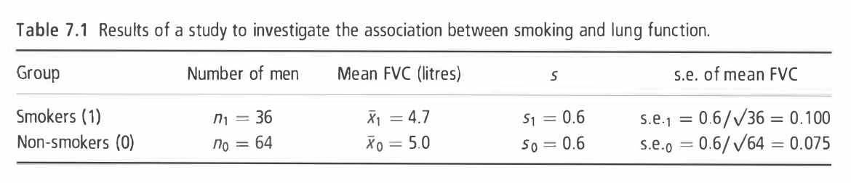
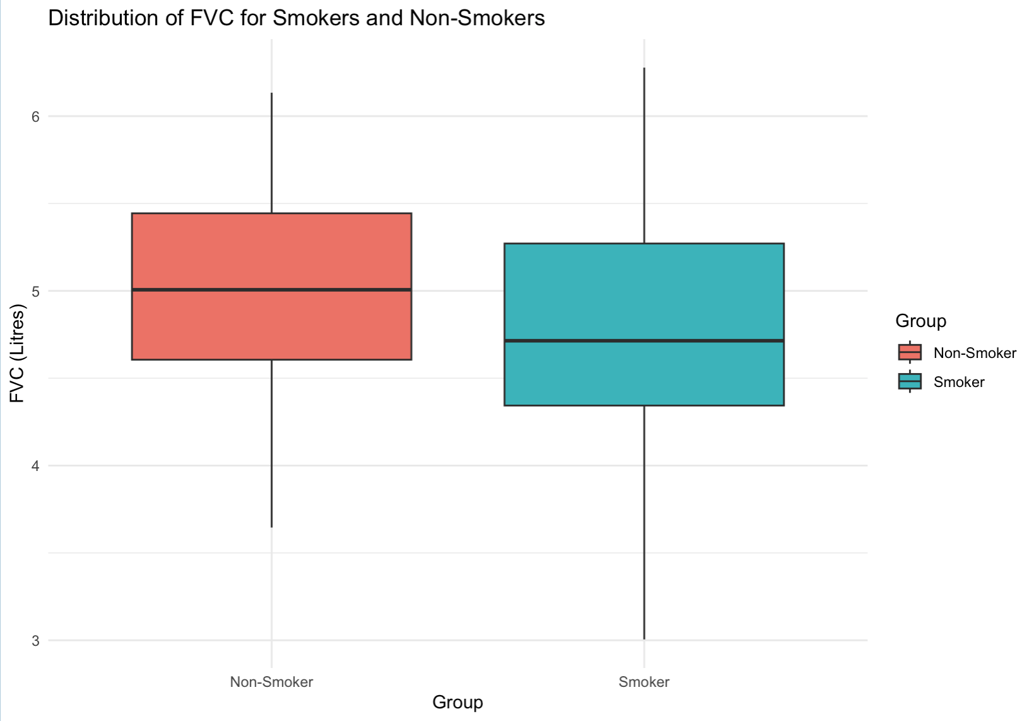

Example
To investigate whether smoking reduces lung function, forced vital capacity (FVC, a test of lung function) was measured in I00 men aged 25-29, of whom 36 were smokers and 64 non-smokers. (Example 7.1 from Essential Medical Statistics [1])
Null hypothesis $H_{0}:$ There is no difference in the mean FVC between
smokers and non-smokers.
${ H}_{0}:$ $μ_{1}=μ_{0}$
Alternative hypothesis $H_{a}:$ The mean FVC of smokers is lower than
that of non-smokers, indicating reduced lung
function in smokers.
${ H}_{a}:$ $μ_{1}<μ_{0}$

Slide 3
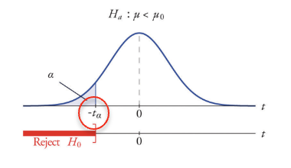
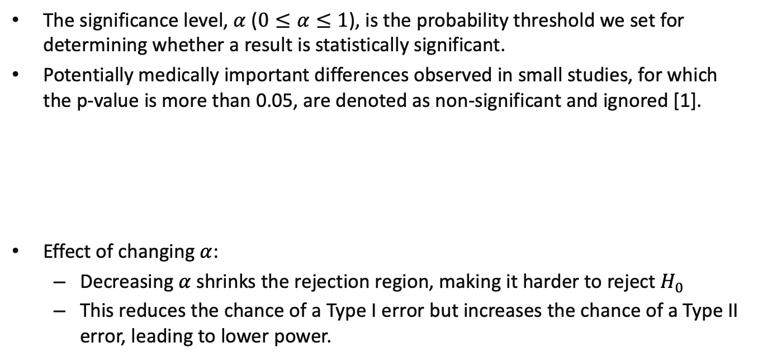
Significance Level
The significance level, $α$ ($0≤α≤1$), is the probability threshold we set for determining whether a result is statistically significant.
Potentially medically important differences observed in small studies, for which the p-value is more than 0.05, are denoted as non-significant and ignored [1].
Effect of changing $α$:
Decreasing $α$ shrinks the rejection region, making it harder to reject $H_{0}$
This reduces the chance of a Type I error but increases the chance of a Type II error, leading to lower power.

Slide 4
Reference
(Textbook) Kirkwood, Betty R., and Jonathan AC Sterne. Essential medical statistics. John wiley & sons, 2010.
(Textbook) Casella, George, and Roger Berger. Statistical inference. CRC Press, 2024.
(Online Tutorial) https://online.stat.psu.edu/stat500/lesson/6a
(Online Tutorial) https://online.stat.psu.edu/stat415/lesson/9
(Textbook) Lehmann, Erich Leo, Joseph P. Romano, and George Casella. Testing statistical hypotheses. Vol. 3. New York: springer, 1986.

