Slide 1
Understanding Key Concepts in Hypothesis Testing P-Value
NCTraCS Tutorial Series

Slide 2
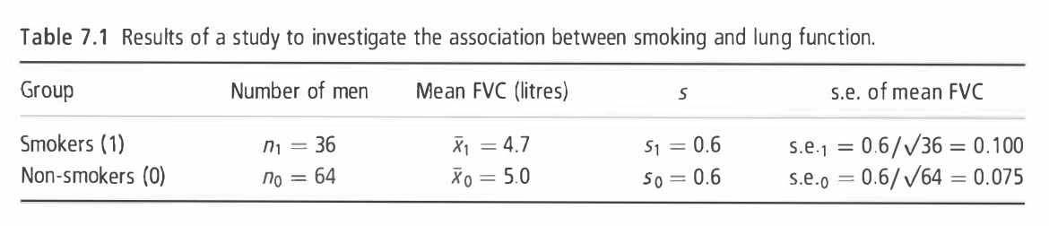
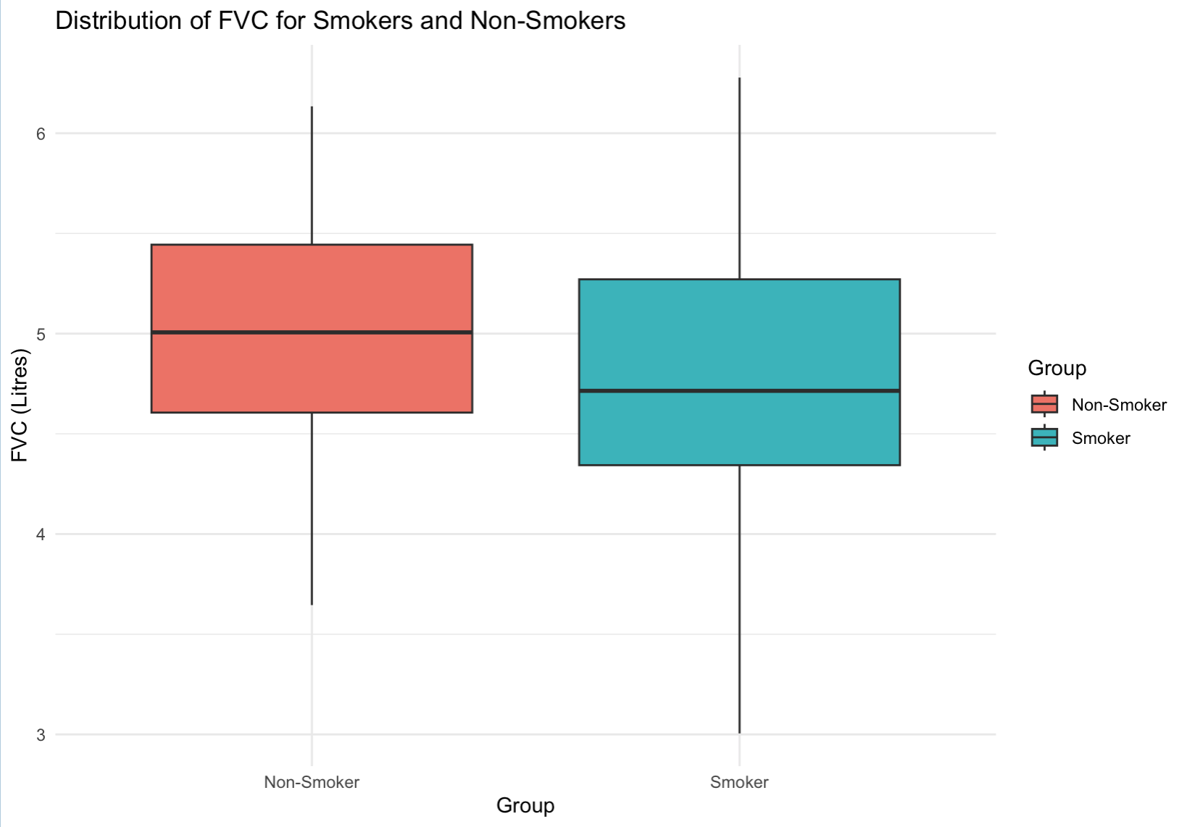

Example
To investigate whether smoking reduces lung function, forced vital capacity (FVC, a test of lung function) was measured in I00 men aged 25-29, of whom 36 were smokers and 64 non-smokers. (Example 7.1 from Essential Medical Statistics [1])
Null hypothesis $H_{0}:$ There is no difference in the mean FVC between
smokers and non-smokers.
${ H}_{0}:$ $μ_{1}=μ_{0}$
Alternative hypothesis $H_{a}:$ The mean FVC of smokers is lower than
that of non-smokers, indicating reduced lung
function in smokers.
${ H}_{a}:$ $μ_{1}<μ_{0}$

Slide 3
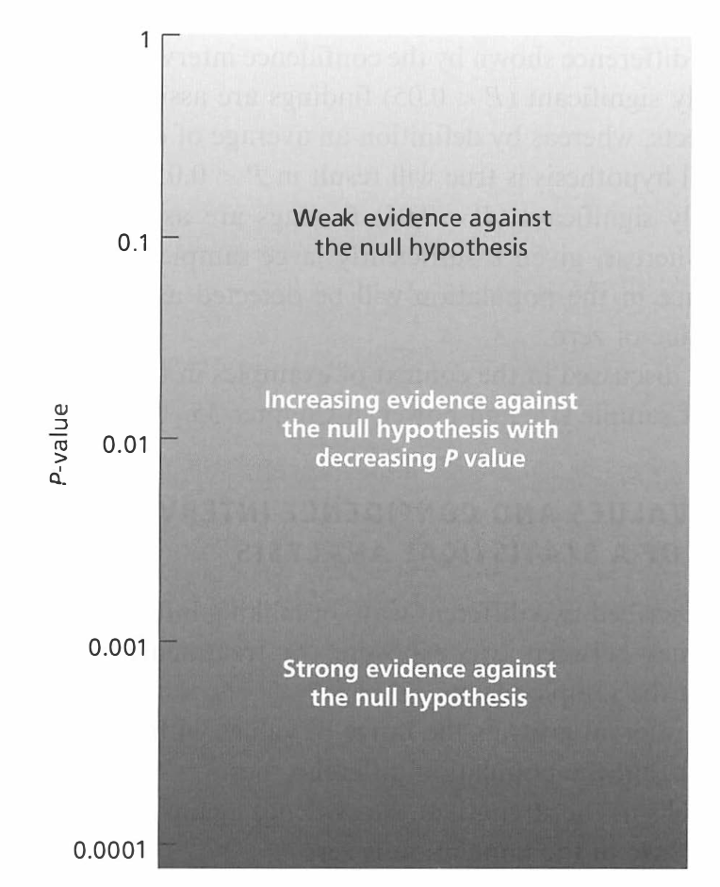
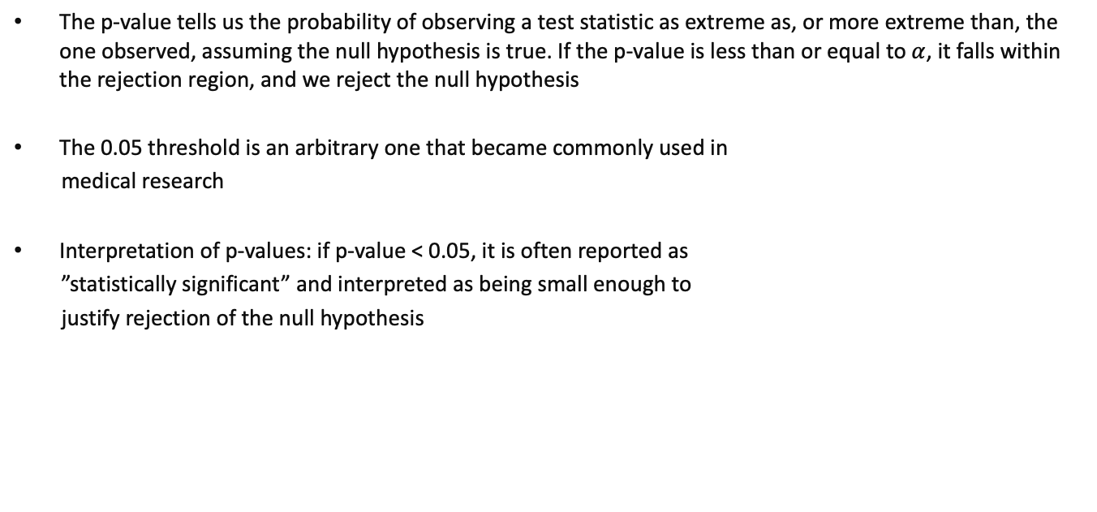
P-Value
The p-value tells us the probability of observing a test statistic as extreme as, or more extreme than, the one observed, assuming the null hypothesis is true. If the p-value is less than or equal to $α$, it falls within the rejection region, and we reject the null hypothesis
The 0.05 threshold is an arbitrary one that became commonly used in
medical research
Interpretation of p-values: if p-value < 0.05, it is often reported as
”statistically significant” and interpreted as being small enough to
justify rejection of the null hypothesis
Figure: Interpretation of p-values [1]

Slide 4
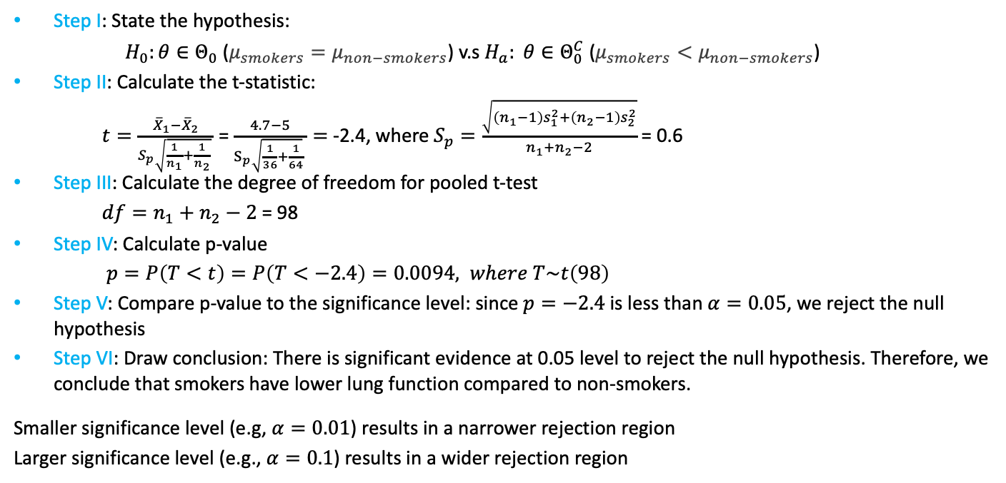
P-Value
Step I: State the hypothesis:
$H_{0}:θ∈Θ_{0}$ ($μ_{smokers}=μ_{non−smokers}$) v.s$H_{a}: θ∈Θ_{0}^{C}$ ($μ_{smokers}<μ_{non−smokers}$)
Step II: Calculate the t-statistic:
$t=\frac{{\overline{X}}_{1}−{\overline{X}}_{2}}{S_{p}\sqrt{\frac{1}{n_{1}}+\frac{1}{n_{2}}} }$ = $\frac{4.7−5}{S_{p}\sqrt{\frac{1}{36}+\frac{1}{64}} }=$ -2.4, where $S_{p}=\frac{\sqrt{\left(n_{1}−1\right)s_{1}^{2}+\left(n_{2}−1\right)s_{2}^{2}}}{n_{1}+n_{2}−2}$ = 0.6
Step III: Calculate the degree of freedom for pooled t-test
$df=n_{1}+n_{2}−2$ = 98
Step IV: Calculate p-value
$p=P\left(T<t\right)=P\left(T<−2.4\right)=0.0094, where T\sim t\left(98\right)$
Step V: Compare p-value to the significance level: since $p=−2.4$is less than $α=0.05$, we reject the null hypothesis
Step VI: Draw conclusion: There is significant evidence at 0.05 level to reject the null hypothesis. Therefore, we conclude that smokers have lower lung function compared to non-smokers.
Smaller significance level (e.g, $α=0.01$) results in a narrower rejection region
Larger significance level (e.g., $α=0.1$) results in a wider rejection region

Slide 5
Reference
(Textbook) Kirkwood, Betty R., and Jonathan AC Sterne. Essential medical statistics. John wiley & sons, 2010.
(Textbook) Casella, George, and Roger Berger. Statistical inference. CRC Press, 2024.
(Online Tutorial) https://online.stat.psu.edu/stat500/lesson/6a
(Online Tutorial) https://online.stat.psu.edu/stat415/lesson/9
(Textbook) Lehmann, Erich Leo, Joseph P. Romano, and George Casella. Testing statistical hypotheses. Vol. 3. New York: springer, 1986.

