Slide 1
Soft Computing Final Project
1
A genetic algorithm for the unrelated parallel machine scheduling problem with sequence dependent setup time
Presenter: 賴春匠
Student ID: R09546021

Slide 2
Introduction - Problem
2
Unrelated parallel machine with sequence dependent setup times
Job_1
M_1
M_1
Job_1
S_112
Job_2
Job_2
M_2
Job_2
S_121
Job_1
Job_3
M_3
M_m
Job_1
S_m12
Job_2
Job_2
S_m21
Job_1
Job_n
M_m
Notes:
Unrelated Parallel Machine
N 個 job M 台 Machine Job 在任何一台 Machine 上都可以做
但同一個 Job 在不同 Machine 上的作業時間不同
Sequence dependent setup time
Job 的順序會影響到 Setup time
Job 1 Job 2 <-> Job 2 Job 1
Job 1 Job 2 => m1 m2
舉例

Slide 3
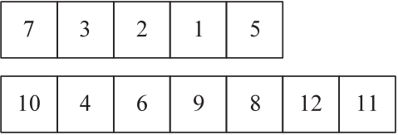
Genetic Algorithm
3
Representation of solution
M_1
M_2
Initialize population
Randomly generated (Population size)
Apply MI Heuristic (Random individuals)
Selection mechanism
n-tournament
[ [7, 3, 2, 1, 5, -1, -1, -1, -1, -1, -1, -1],
[10, 4, 6, 9, 8, 12, 11, -1, -1, -1, -1, -1] ]
Best
Notes:
Multiple Insertion heuristic (one individual)
P_i’ = p_i + 所有後續作業中 Setup time 最少的
Step 1. Create the modified processing times.
Step 2. Order the jobs in non-increasing order of the modified processing times.
Step 3. Examine every job in the order found in step 0. For each job i,
Step 3(a) insert job i into every position on each machine
Step 3(b) calculate the true partial makespan for each position of job I
Step 3(c) place job i in the position on the machine with the lowest resultant partial makespan using the actual set-up times.

Slide 4
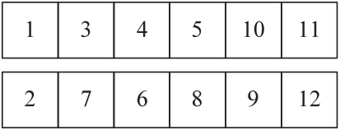
Genetic Algorithm - Crossover Operator
4
Parent 1
Parent 2
P1 = 3
M1
M2
M1
M2
M1
M2
M1
M2
P2 = 4
X
X
X
X
X
X
X
X
X
X
X
X
Offspring 1
Offspring 2
M1
M2
(5)
M1
M2
(7, 3, 2, 1)
(10, 9, 12, 11)
(4, 6, 8)
Notes:
Crossover operator with limited local search

Slide 5
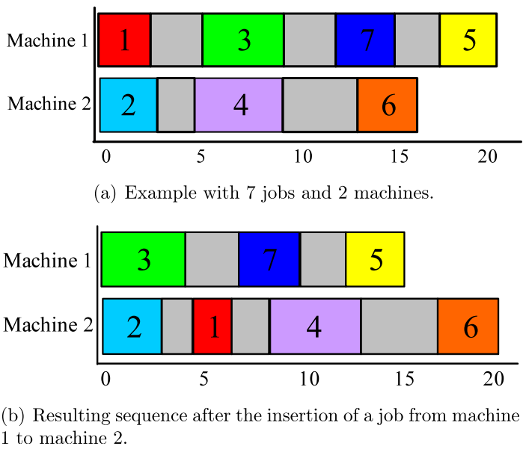

Genetic Algorithm - Local Search
5
Inter-machine insertion neighborhood (IMI)
Simple and Efficient speed up procedure
Number of steps

Slide 6
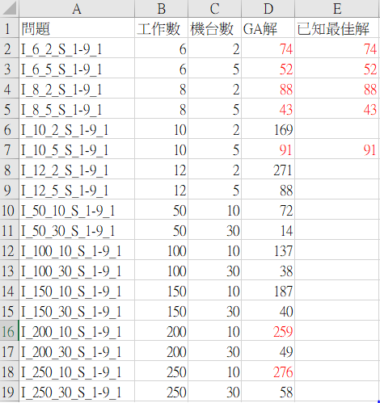
Computational Result
7
Parameter
Iteration limit: 1000
Population size: 80
Crossover rate: 0.5
Mutation rate: 0.5
Local search rate: 1
Pressure: 10
Benchmark Problem
Small: Job = {6, 8, 10, 12}
Machine = {2, 5} → 4 * 2 = 8
Large: Job = {50, 100, 150, 200, 250}
Machine = {10 ,30} → 5 * 2 = 10

Slide 7
Demo
6

Slide 8
Conclusion
7
A good performance GA for the unrelated parallel machine scheduling problem with sequence dependent setup times with the objective to minimize makespan
The algorithm converges very quickly
Good exploration method is needed to further improve the solution

Slide 9
Thank you for listening
9

