Slide 1
行動計算與寬頻網路實驗室
Mobile Computing and Broadband Networking Lab (MBL)
Prof. Kuochen Wang 王國禎
Department of Computer Science
National Chiao Tung University
Hsinchu, Taiwan
kwang@cs.nctu.edu.tw

Slide 2
Research Interests
(Adapted from http://newsroom.cisco.com/video/1170801)
Notes:
BBR means bottleneck bandwidth and Roundtrip time

Slide 3
Research Project
Software Defined IoT Networking with 3i

Slide 4
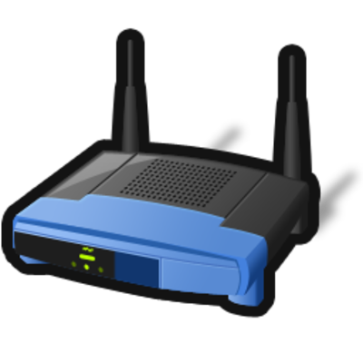
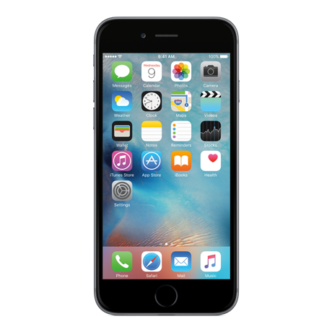
Research Project (collaborated with Prof. ChiYu Lee)
5G/Heterogeneous Networking
Linear Accelerator Assisted mmWave Link Adaptation Policy
Indoor Localization using mmWave
UE
WiGiG (mmWave) AP
WiGiG (mmWave) AP
WiGiG (mmWave) AP
Notes:
BBR means bottleneck bandwidth and Roundtrip time

Slide 5

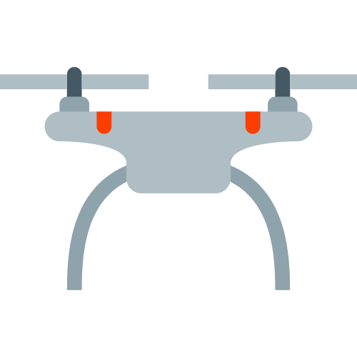
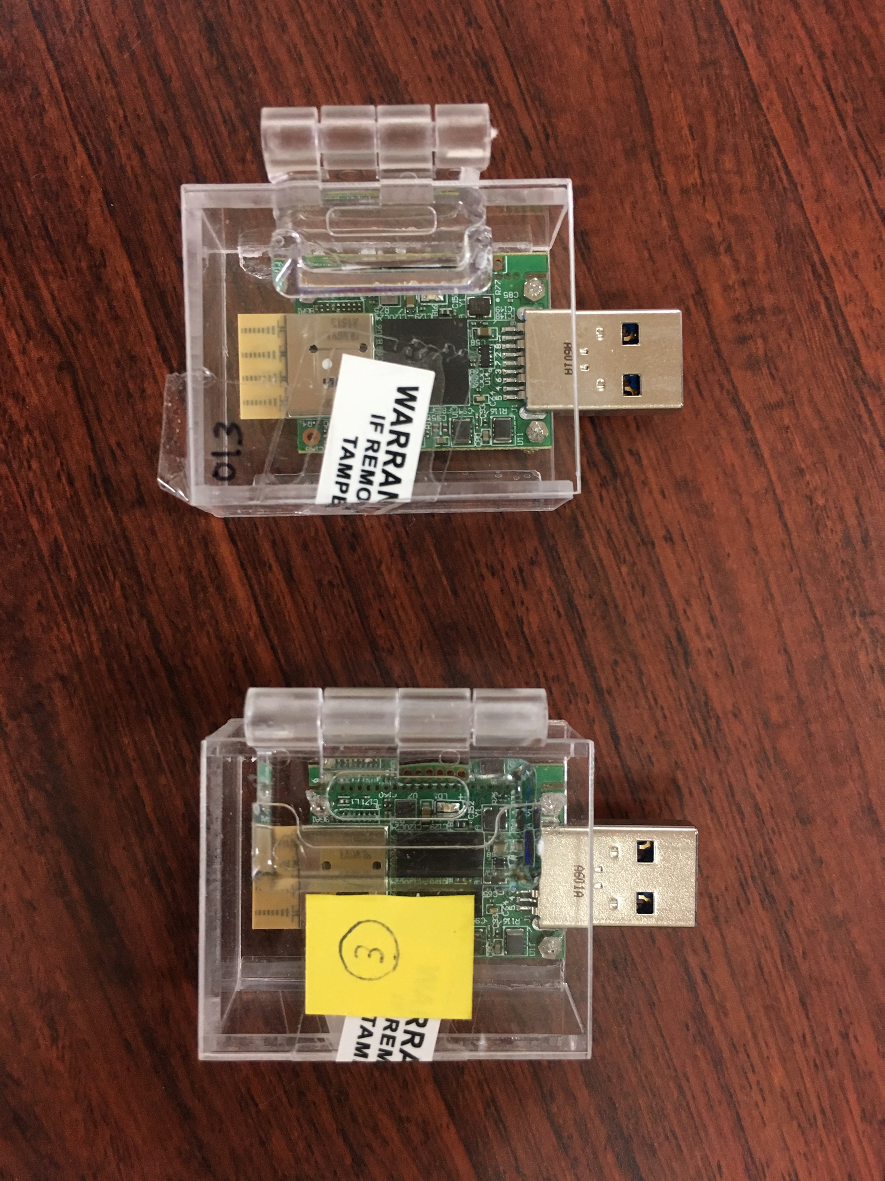
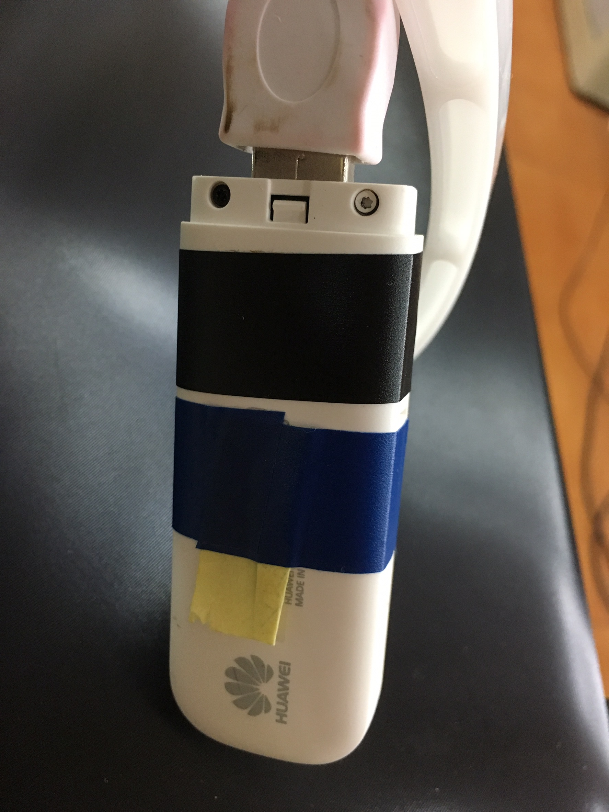

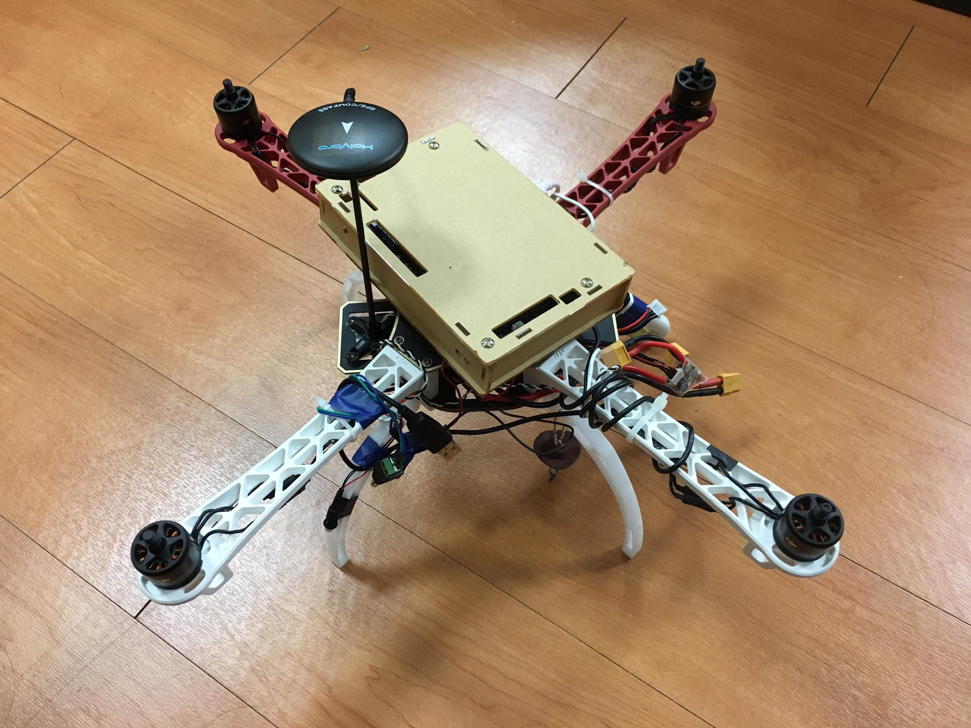
Research Project (collaborated with Prof. ChiYu Lee)
WiGiG/WiFi/LTE-U Integrated Radio Access
WiGiG dongle
LTE dongle
WiGiG dongle
LTE dongle
Drone

