Slide 1
Multidimensional Knapsack Problem
Using a Genetic Algorithm
Nicolò Vescera

Slide 2
Introduzione

Slide 3
Problema

Slide 4
Soluzione

Slide 5
Istanze del Problema
// MK01.TXT
6
100,600,1200,2400,500,2000
10
8,12,13,64,22,41
8,12,13,75,22,41
3,6,4,18,6,4
5,10,8,32,6,12
5,13,8,42,6,20
5,13,8,48,6,20
0,0,0,0,8,0
3,0,4,0,8,0
3,2,4,0,8,4
3,2,4,8,8,4
80,96,20,36,44,48,10,18,22,24
3800
Oggetti
Valori
Numero Vincoli
Parametri
Vincoli
Soluzione

Slide 6
Istanze del Problema
ID | f0 | f1 | f2 | f3 | f4 | f5 | f6 | f7 | f8 | f9 | Value
0 | 8.0 | 8.0 | 3.0 | 5.0 | 5.0 | 5.0 | 0.0 | 3.0 | 3.0 | 3.0 | 100.0
1 | 12.0 | 12.0 | 6.0 | 10.0 | 13.0 | 13.0 | 0.0 | 0.0 | 2.0 | 2.0 | 600.0
2 | 12.0 | 13.0 | 4.0 | 8.0 | 8.0 | 8.0 | 0.0 | 4.0 | 4.0 | 4.0 | 1200.0
3 | 64.0 | 75.0 | 18.0 | 32.0 | 42.0 | 48.0 | 0.0 | 0.0 | 0.0 | 8.0 | 2400.0
4 | 22.0 | 22.0 | 6.0 | 6.0 | 6.0 | 6.0 | 8.0 | 8.0 | 8.0 | 8.0 | 500.0
5 | 41 | 41.0 | 4.0 | 12.0 | 20.0 | 20.0 | 0.0 | 0.0 | 4.0 | 4.0 | 2000.0

Slide 7
Implementazione

Slide 8
Initial
Population
PROCEDURE initialize_population
INPUT:
num_elem: number of solution to generate
item_list: list of items
num_items: number of items
W: constraints upper bound
population <- empty list of Solutions
f_obj <- list of zeros with length num_elem
FOR i <- 0 TO num_elem - 1 DO
tmp_sol <- list of zeros with length num_items
// list of item indexes
T <- list of integers from 0 to num_items - 1
R <- list of zeros with length equal to the
number of constraints in the problem
j <- randomly select an integer from T
item <- item_list.pop(j)
WHILE all elements of (R + item) <= W DO
tmp_sol[j] <- 1
R <- R + item
IF length(T) <= 0 THEN
EXIT WHILE loop
END IF
j <- randomly select an integer from T
item <- item_list.pop(j)
END WHILE
APPEND tmp_sol to population
f_obj[i] <- calculate the objective function value for tmp_sol
END FOR
END PROCEDURE

Slide 9
Initial
Population
1 def init_population(self):
2 self.population: List[Solution] = []
3 self.f_obj: List[float] = list(np.zeros(self.num_elem))
4 self.best: Solution = None
5 self.best_f: float = float('-inf') # tiny number
6
7 for i in range(self.num_elem):
8 tmp_sol: Solution = np.zeros(self.num_items)
9
10 # list of indexes (e.g. 1 means df[1])
11 T: List[int] = list(range(self.num_items))
12
13 # temporary actual constrints sum
14 R = np.zeros(len(self.problem.W))
15
16 # randomly extract an item
17 j = T.pop(random.randint(0, len(T) - 1))
18 item = self.problem.df.loc[:, self.problem.df.columns !=
19 'Value'].loc[j].to_numpy()
20
21 # try to add extracted item, then extract a new one and so on
22 while all(R + item <= self.problem.W):
23 tmp_sol[j] = 1
24
25 R = R + item
26
27 # no more items left, continue to new solution
28 if len(T) <= 0:
29 break
30
31 j = T.pop(random.randrange(len(T)))
32 item = self.problem.df.loc[:, self.problem.df.columns !=
33 'Value'].loc[j].to_numpy()
34
35 self.population.append(tmp_sol)
36 self.f_obj[i] = self.problem.objective_function(tmp_sol)
37 self.update_best(tmp_sol, self.f_obj[i], 0)
38
39
40
41

Slide 10
Mating Pool
Selection
1 def select_mating_pool(self) -> List[Tuple[Solution, Solution]]:
2
3 def tournament(k: int = 5) -> Solution:
4 random_select_solutions = [
5 random.randint(0,
6 len(self.population) - 1) for _ in range(k)
7 ]
8
9 # generate a dictioray {solution index : solution fitness}
10 # e.g. solution 1/16 has fitness vale of 287
11 selected_objectivefunctions = {
12 i: self.f_obj[i]
13 for i in random_select_solutions
14 }
15
16 # find solution index with max fitless value
17 # e.g. solution 3/16 has the max fintess value
18 max_index = max(selected_objectivefunctions,
19 key=selected_objectivefunctions.get)
20
21 return self.population[max_index]
22
23 mating_pool = []
24
25 for i in range(len(self.population) // 2):
26 c1 = tournament()
27 c2 = tournament()
28 mating_pool.append((
29 c1,
30 c2,
31 ))
32
33 return mating_pool
34
35
36
37
38
39
40
41

Slide 11
Crossover
Operator
1 def do_crossover(self, mating_pool: List[Tuple[Solution,Solution]])
2 -> List[Solution]:
3
4 def uniform_crossover_operator(s1: Solution, s2: Solution)
5 -> Solution:
6 '''
7 From parents (s1 and s2) generate only 1 child (c) using
8 a random probability to choose a chromosome from s1 or s2
9 '''
10 c = np.zeros(len(s1))
11
12 for i in range(len(s1)):
13 # random True or False.
14 # faster than `random.choice([True, False])`
15 c[i] = s1[i] if bool(random.getrandbits(1)) else s2[i]
16
17 return c
18
19 children = []
20
21 for s1, s2 in mating_pool:
22 if random.random() < self.pcross:
23 c = uniform_crossover_operator(s1, s2)
24 children.append(c)
25
26 continue
27
28 children.append(s1)
29 children.append(s2)
30
31 return children
32
33
34
35
36
37
38
39
40
41

Slide 12
Mutation
Operator
1 def do_mutation(self, children: List[Solution]):
2 '''
3 Randomly flip bits according to pmut probability
4 '''
5 for child in children:
6 for i in range(len(child)):
7 if random.random() < self.pmut:
8 child[i] = int(not child[i])
9
10
11
12
13
14
15
16
17
18
19
20
21
22
23
24
25
26
27
28
29
30
31
32
33
34
35
36
37
38
39
40
41

Slide 13
Repair
Operator
1 def repair_operator(self, children: List[Solution]) -> Solution:
2 for child in children:
3 child_parameters = self.problem.df.loc[:,
4 self.problem.df.columns != 'Value'].
5 loc[child ==1].sum().to_numpy()
6 # good child, check next child
7 if all(child_parameters <= self.problem.W):
8 continue
9
10 old_child = child.copy()
11
12 # DROP PHASE
13 i = 0
14 while any(child_parameters > self.problem.W):
15 # delete item from solution
16 child[self.problem.sorted_value_objects_indexes[i]] = 0
17
18 # update parameters
19 child_parameters = self.problem.df.loc[:,
20 self.problem.df.columns != 'Value'].loc[
21 child == 1].sum().to_numpy()
22 i = i + 1
23
24 # ADD PAHSE
25 for i in reversed(range(len(child))):
26 # temporary edited child
27 tmp_child = child.copy()
28
29 # add item to solution
30 tmp_child[self.problem.sorted_value_objects_indexes[i]] = 1
31
32 # update parameters
33 tmp_child_parameters = self.problem.df.loc[:,
34 self.problem.df.columns !='Value'].loc[
35 tmp_child == 1].sum().to_numpy()
36 # update child with tmp mods
37 # if is feasible solution
38 if all(tmp_child_parameters <= self.problem.W):
39 child = tmp_child.copy()
40 child_parameters = tmp_child_parameters
41

Slide 14
Select New
Population
1 def select_new_population(self, children: List[Solution], gen: int):
2
3 def select_best():
4 total_solutions: List[Solution] = self.population + children
5 total_fintesses: List[float] = self.f_obj + [
6 self.problem.objective_function(c) for c in children
7 ]
8
9 assert len(total_solutions) == len(total_fintesses)
10
11 total_indexes: List[int] = list(range(len(total_solutions)))
12 total_indexes.sort(key=lambda i: total_fintesses[i],
13 reverse=True)
14 best_indexes: List[int] = total_indexes[:self.num_elem]
15
16 self.population = [total_solutions[i] for i in best_indexes]
17 self.f_obj = [total_fintesses[i] for i in best_indexes]
18
19 self.update_best(self.population[0], self.f_obj[0], gen)
20
21 select_best()
22
23
24
25
26
27
28
29
30
31
32
33
34
35
36
37
38
39
40
41

Slide 15
Tuning Phase

Slide 16
Tuning Dataset
File | Oggetti | Vincoli
MKP01.txt | 6 | 10
MKP03.txt | 15 | 10
MKP05.txt | 28 | 10
MKP07.txt | 50 | 5
MKP11.txt | 28 | 2
MKP17.txt | 105 | 2
MKP21.txt | 30 | 5
MKP23.txt | 40 | 5
MKP33.txt | 60 | 5
MKP41.txt | 80 | 5
MKP47.txt | 90 | 5

Slide 17
Output
,file,gen,found,target,success,diff
0,data/MKP01.txt,52,3800.0,3800.0,True,0.0
1,data/MKP01.txt,1,3800.0,3800.0,True,0.0
2,data/MKP01.txt,0,3800.0,3800.0,True,0.0
3,data/MKP01.txt,48,3800.0,3800.0,True,0.0
4,data/MKP01.txt,87,3800.0,3800.0,True,0.0
5,data/MKP03.txt,20,3915.0,4015.0,False,100.0
6,data/MKP03.txt,76,3525.0,4015.0,False,490.0
7,data/MKP03.txt,81,3850.0,4015.0,False,165.0
8,data/MKP03.txt,44,3965.0,4015.0,False,50.0
9,data/MKP03.txt,0,3820.0,4015.0,False,195.0
10,data/MKP05.txt,16,11880.0,12400.0,False,520.0
11,data/MKP05.txt,90,11940.0,12400.0,False,460.0

Slide 18
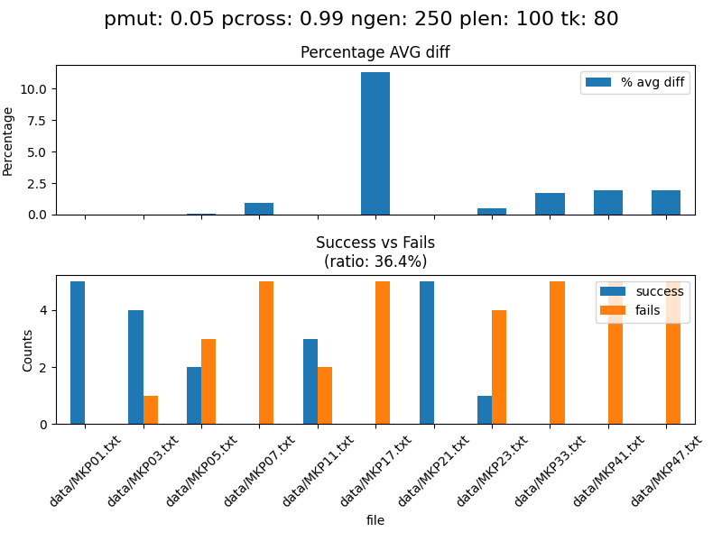
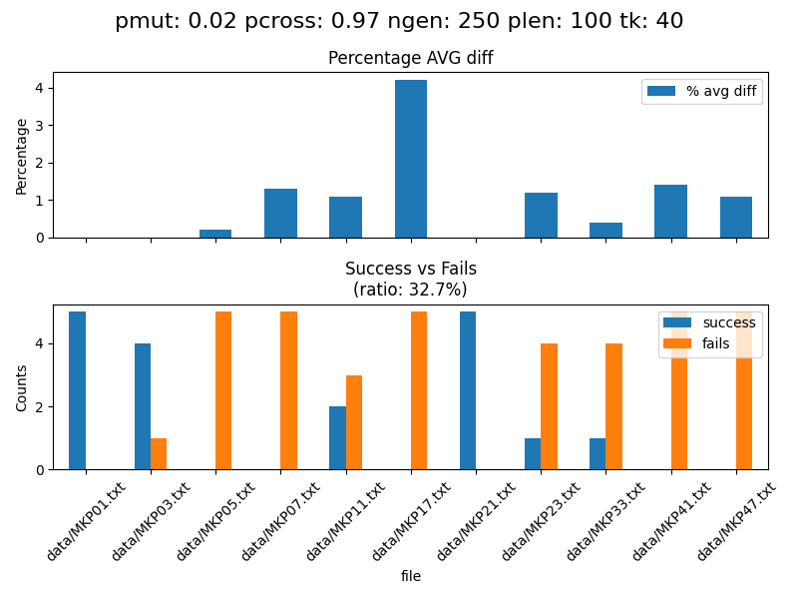
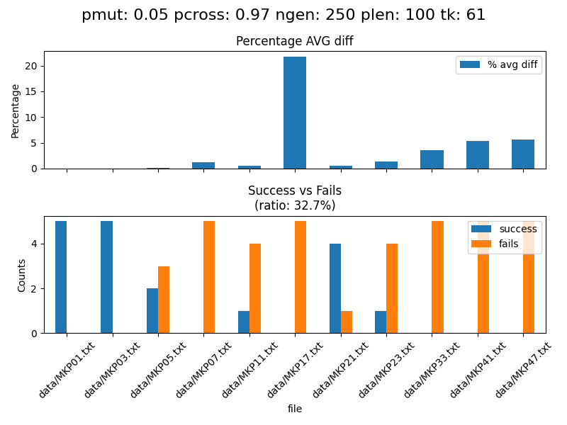
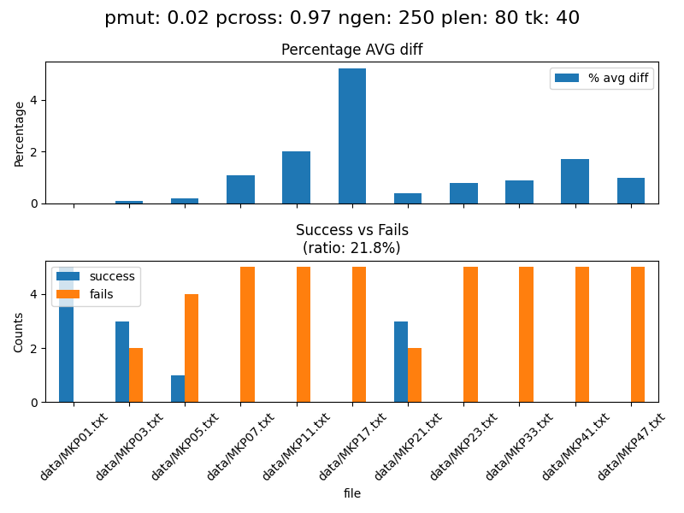
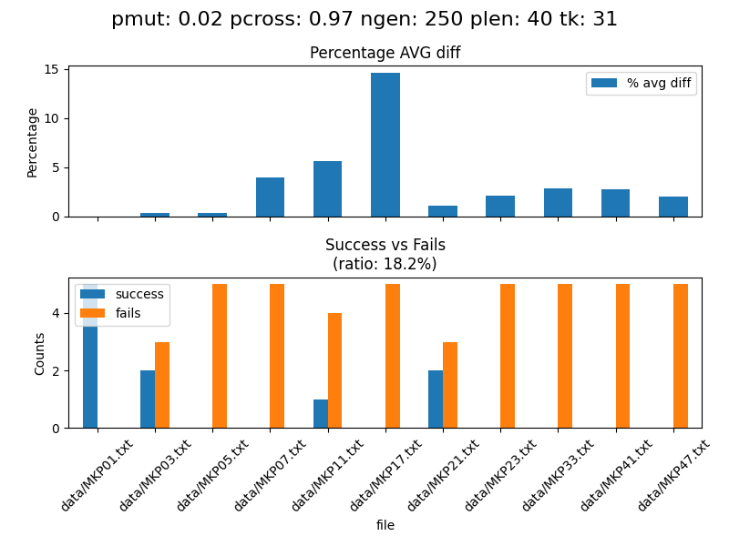
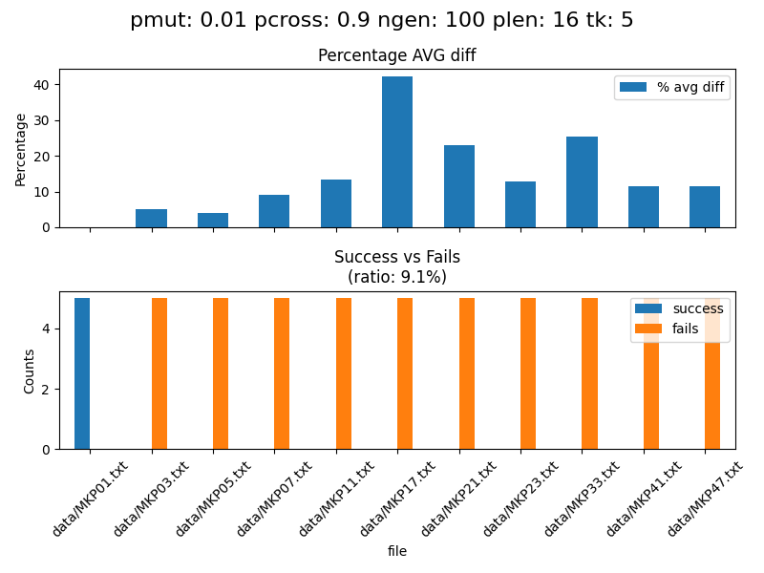
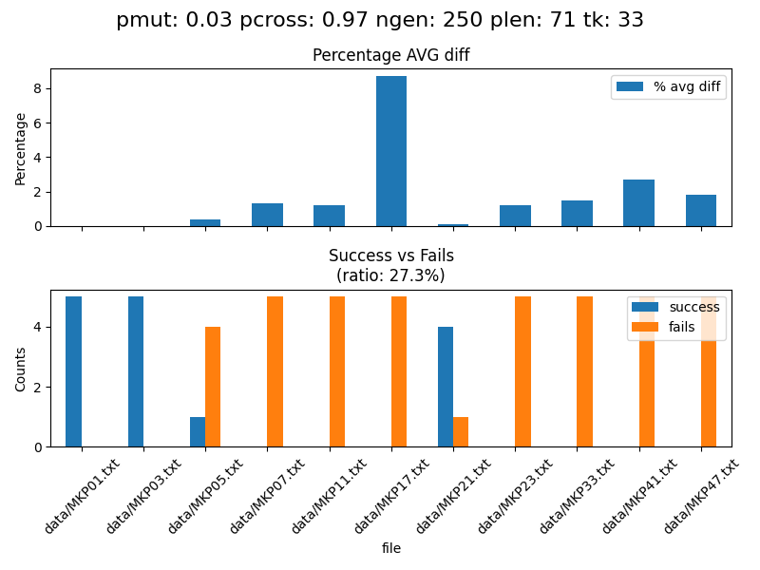
Risultati

Slide 19
Top 3
pmut | pcross | ngen | plen | tk | Success Ratio (%) | Max AVG Diff (%)
0.05 | 0.99 | 250 | 100 | 80 | 36.4 | 12.0
0.02 | 0.97 | 250 | 100 | 41 | 32.7 | 5.0
0.05 | 0.97 | 250 | 100 | 61 | 32.7 | 21.0

Slide 20
Testing Phase

Slide 21
Testing Dataset
File | Oggetti | Vincoli
MKP02.txt | 10 | 10
MKP04.txt | 20 | 10
MKP06.txt | 39 | 5
MKP08.txt | 60 | 30
MKP10.txt | 28 | 2
MKP12.txt | 28 | 2
MKP20.txt | 30 | 5
MKP22.txt | 30 | 5
MKP24.txt | 40 | 5
MKP30.txt | 50 | 5
MKP36.txt | 70 | 5
MKP40.txt | 80 | 5
MKP46.txt | 90 | 5
MKP48.txt | 27 | 4
MKP50.txt | 29 | 2
MKP54.txt | 28 | 4

Slide 22
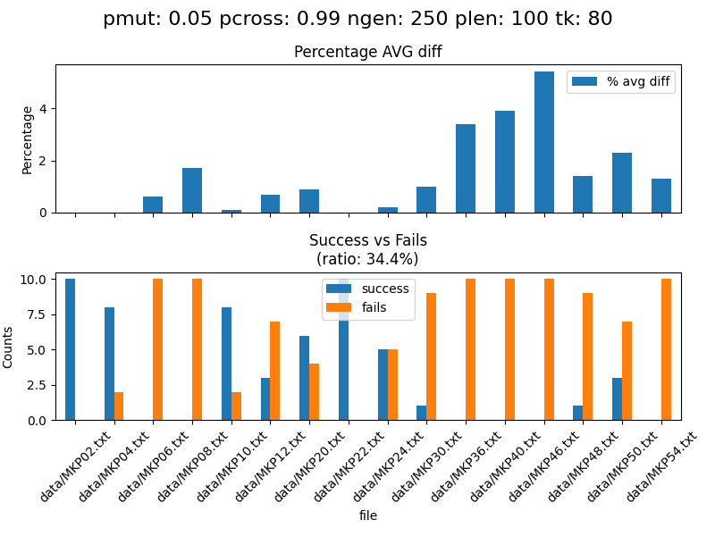
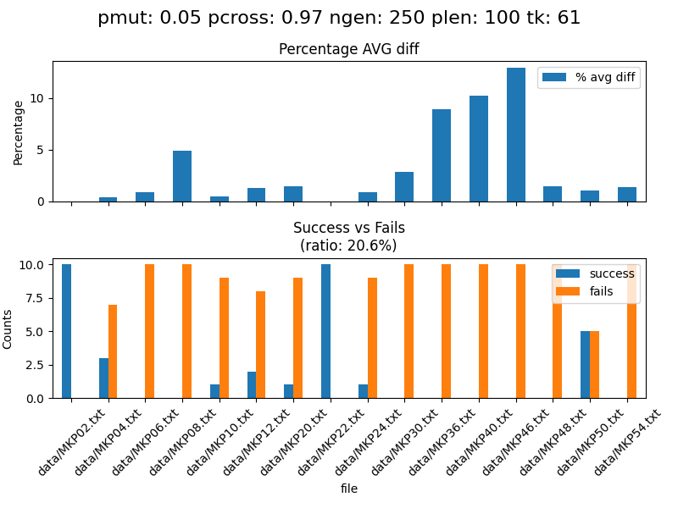
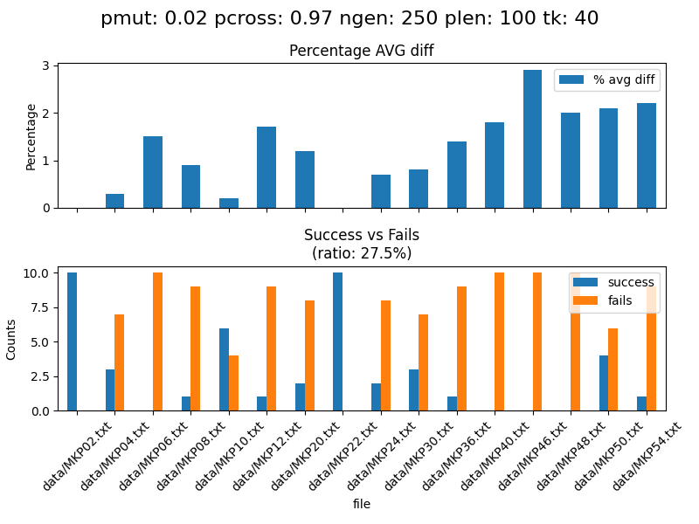
Risultati

