Slide 1
Towards a COMPOSITIONAL Session Logic for Communication Protocols
Andreea Costea, Florin Craciun, Shengchao Qin, Wei-Ngan Chin
School Of Computing, National University Of Singapore
@Northern Concurrency 2017
Notes:
This talk is about communication protocols and their formalization in an extension of separation logic

Slide 2
PROJECT
Under development since 2006 (200K lines of OCaml)
Currently : 3 current PhD students; 7 graduated PhD
Predicates
Code
Pre/Post
Lemmas
separation
logic prover
(SLEEK)
code verifier
(HIP)
range of pure provers …
Omega, MONA, Isabelle, Coq, SMT, Redlog, MiniSAT, Mathematica
2

Slide 3
Features of HIP/SLEEK
Can specify complex data structures to support symbolic verification.
expressive (shapes+size, term, //ism)
automation (with lemma, inference)
(iii) modular (per method)
(iv) more scalable (proof slicing)
http://loris-5.d2.comp.nus.edu.sg/Tut1/
3

Slide 4
Towards a COMPOSITIONAL Session Logic for Communication Protocols

Slide 5
Communication Protocols
Are everywhere: OS, parallel computation, transportation system, etc.
But,
writing such software is error-prone!
Therefore,
need support to formally specify and verify their correctness.

Slide 6
Communication Protocols
Session type theory^{1,2,3}
intensively studied: maturity (multiparty, delegation, hybrid solutions)
correct message type sequencing
deadlock freedom, progress and liveness
But, it should also be important to:
go beyond types and reason about the content of the message (value, resource)
support specialized protocols in a general context
add fewer constraints over the input language
K. Honda, N. Yoshida, M. Carbone. Multiparty Asynchronous Session Types. In POPL 2008
D. Orchard No. Yoshida. Effects as Sessions, Sessions as Effects. In POPL 2016
M. Carbone, S. Lindley, F. Montesi, C. Shürmann, and P. Wadler. Coherence generalises duality: a logical explanation of multiparty session types. In CONCUR 2016.

Slide 7
Towards a Session Logic for Communication Protocols

Slide 8
Key Issues
Type safety → Logic which treats communication as resource
Variance or Flow-Awareness
Higher-Order Predicates
Multiparty & Synchronization
Notes:
We’ve decided to go beyond type-safety and model the communication with the help of separation logic where we treat communication as a resource
Introduce support for flow awareness
We use HO predicates to describe messages
And where, similarly to type checking approaches, this logic offers the means to write global specs which are later locaaly projected into the communicating peers

Slide 9
COMMunication assumptions
Bidirectional channels / Mailbox channel per party
Asynchronous send and blocking receive
Explicit Synchronization

Slide 10
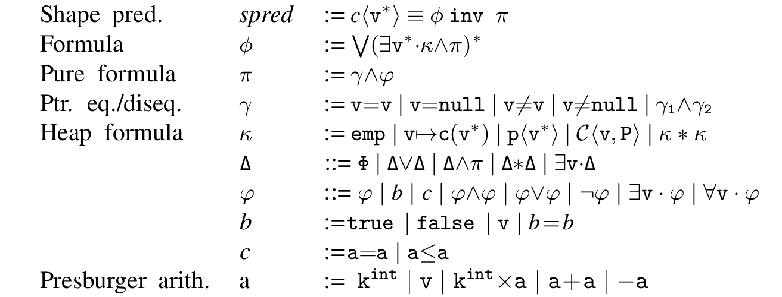
Session Logic – BINARY PROTOCOLS – Operators (extension of Separation Logic)
P =
?r · φ : input
!r · φ : output
P₁ ; P₂ : sequence
P₁ V P₂ : choice
P₁ * P₂ : non-determistic
C(v, P) – associates spec P to channel v
Notes:
Phi is spatial formula

Slide 11
Session Logic – BINARY PROTOCOLS – Example
!r · emp Λ r:String Λ true
Buyer
Seller
title : String
?r · emp Λ r:int Λ r>0
price>0 : int
Cond: price<= expectedPrice
1 : int
addr: Address
delivery: Date
!r · emp Λ r:int Λ r=1
0: int
a

Slide 12
Session Logic – BINARY PROTOCOLS – delegation
Buyer
Seller
Shipper
title : String
price>0 : int
Cond: price<= expectedPrice
1 : int
title : String
a: Channel
addr: Address
delivery: Date
a: Channel
0: int
a
b

Slide 13
plugging the logic into a software verifier⁴
W. N. Chin, C. David, H.H. Nguyen, S. Qin. Automated verification of shape, size and bag properties via user-defined predicates in separation logic. Science of Computer Programming, Volume 77, Number 9, August 2012

Slide 14
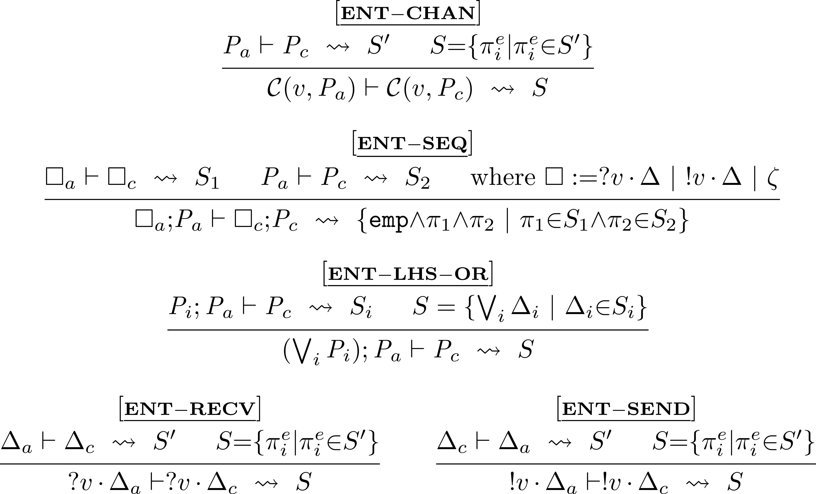
Session Logic – Selected Entailment Rules

Slide 15



Session Logic – BINARY PROTOCOLS – Variance
Example:
A: B:
C(v, !x· x≥1) || C(v, ?x· x≥1)
A
B
contravariant
covariant
Notes:
We’re given a channel v with its two end points and a specification which states that the exchanged message is an integer >=1

Slide 16
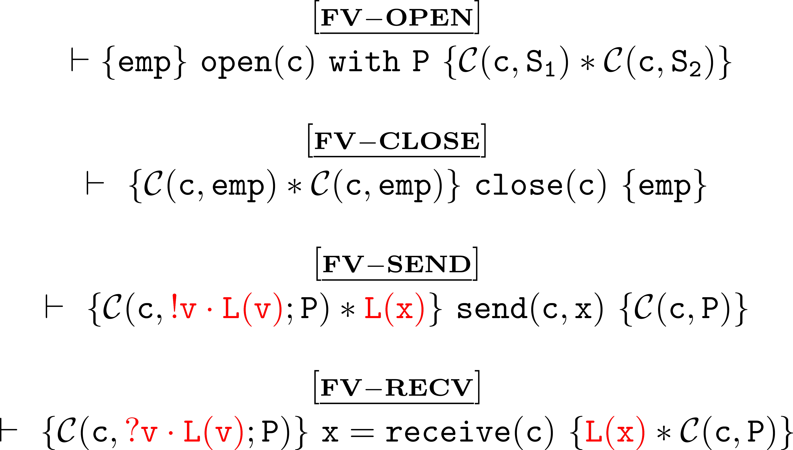
Communication primitives

Slide 17
MULti-PARTY Specification

Slide 18
Session Logic – Multiparty PROTOCOLS
Buyer1
Seller
Buyer2
title : String
price>0 : int
price>0 : int
share>=0: int
Cond: price-share<= expectedPrice
1
addr: Address
delivery: Date
0

Slide 19
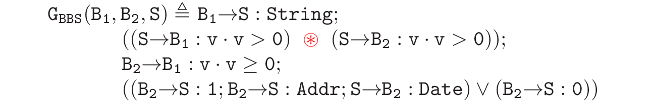
Session Logic – Multiparty PROTOCOLS – Specs
Buyer1
Seller
Buyer2
title : String
price>0 : int
price>0 : int
share>=0: int
Cond: price-share<= expectedPrice
1
addr: Address
delivery: Date
0
arbitrary order

Slide 20
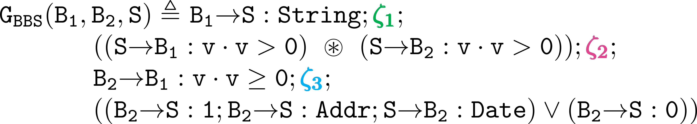

Session Logic – Multiparty PROTOCOLS – Specs (enforcing sequentiality between different channels)
Buyer1
Seller
Buyer2
title : String
price>0 : int
price>0 : int
share>=0: int
Cond: price-share<= expectedPrice
1
addr: Address
delivery: Date
0
- local or global sync instrument

Slide 21
Synchronization

Slide 22
Implicit (NO) synchronization
Consider:
A → B : t₁ ; C→ D : t₂
What are expected ordering?
A→ before →B
C→ before →D
Notes:
We’re given a channel v with its two end points and a specification which states that the exchanged message is an integer >=1

Slide 23
Explicit synchronization
Consider:
A → B : t₁ ; C→ D : t₂
How about the other sequencing?
SS: A→ before C→
SR: A→ before →D
RS: →B before C→
RR: →B before →D
Which is the strongest? cf sequential consistency..
Notes:
We’re given a channel v with its two end points and a specification which states that the exchanged message is an integer >=1

Slide 24
Explicit synchronization
Consider:
A → B : t₁ ;_{RS} C→ D : t₂
Strict Sequencing
RS: →B before C→
Explicit enforcement:
AWAIT(c)
A → : t₁
→ B : t₁
C→ : t₂
→ D : t₂
DEC(c)
Notes:
We’re given a channel v with its two end points and a specification which states that the exchanged message is an integer >=1

Slide 25
Strict sequencing
Advantage: simpler to understand
Disadvantage: less concurrency;
need for explicit synchronization
Notes:
We’re given a channel v with its two end points and a specification which states that the exchanged message is an integer >=1

Slide 26
Mailbox communication
Consider:
A → B : t₁ ; C→ B : t₂
Assume mailbox communication + no synchronization
A → : t₁
C→ : t₂
→ B : t₁
→ B : t₂
What if C sends before A to mailbox of B?
Type error in communication!
Notes:
We’re given a channel v with its two end points and a specification which states that the exchanged message is an integer >=1

Slide 27
Send-Send synchronization
Consider:
A → B : t₁ ; _{SS} C→ B : t₂
Enforce SS synchronization for mailbox communication
SS: A → before C→
Explicit synchronization:
A → : t₁
AWAIT(c)
→ B : t₁
DEC(c)
C→ : t₂
→ B : t₂
Notes:
We’re given a channel v with its two end points and a specification which states that the exchanged message is an integer >=1

Slide 28
Without synchronization
Consider:
A → B : t₁ ; A → C : t₂
Decomposition without synchronization
A → : t₁
A → : t₂
→ B : t₁
→C : t₂
What if B is our privileged customer whom we wish to notify ahead of our regular customer C?
Notes:
We’re given a channel v with its two end points and a specification which states that the exchanged message is an integer >=1

Slide 29
RECEIVE-RECEIVE synchronization
Consider:
A → B : t₁ ; _{RR} A→ C : t₂
Enforce RR synchronization for priority receive.
RR: → B before C→
Explicit synchronization:
AWAIT(c)
A → : t₁
A → : t₂
→ B : t₁
→C : t₂
DEC(c)
Notes:
We’re given a channel v with its two end points and a specification which states that the exchanged message is an integer >=1

Slide 30
Synchronization
Both explicit and implicit synchronization can be used.
Priority (i) safety (ii) correctness (iii) user requirement (iv) performance.
Expressive logic + spec synthesis provide flexibility

Slide 31
Take away
Type safety → Logic which treats communication as resource: concurrency, sequence, nondeterminism
Variance or Flow-Awareness: support for precise specification and verification
Higher-Order Predicates: expressive protocols
Multiparty → Locality: synchronization
Work in Progress
Synthesize local projections → Multiparty view
Explore more abstractions (e.g. specify security protocols)

