Slide 1
The Logic of Power Simulations

Slide 2
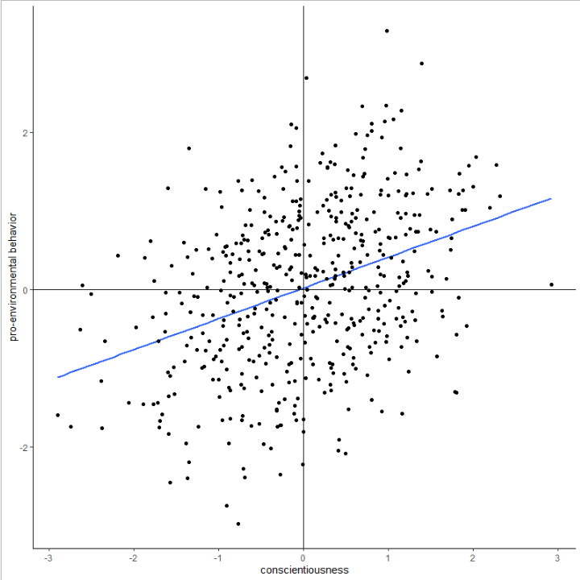
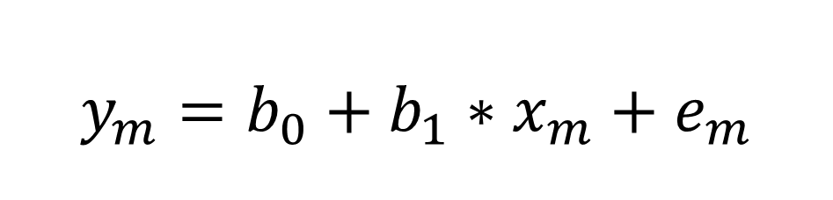
Regression Equation
$$y_{m}=b_{0}+b_{1}∗x_{m}+e_{m}$$

Slide 3
Regression Equation
$$y_{m}=b_{0}+b_{1}∗x_{m}+e_{m}$$

Slide 4
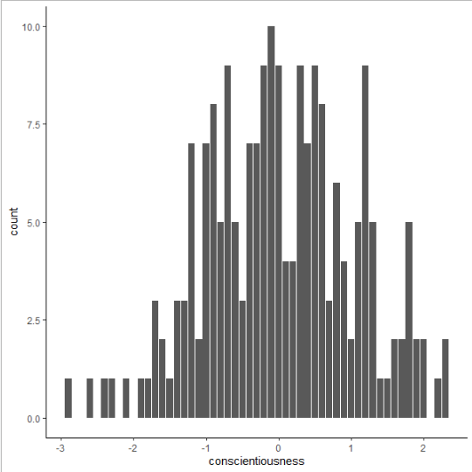
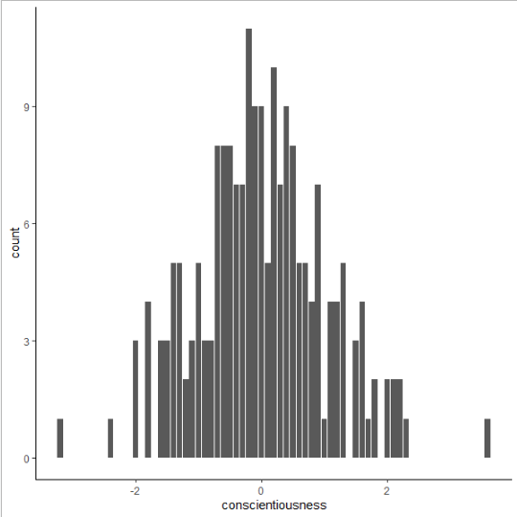
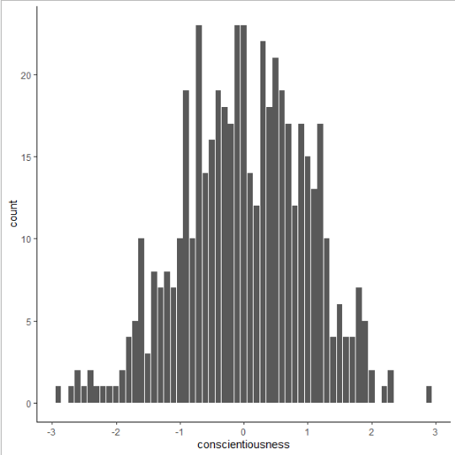
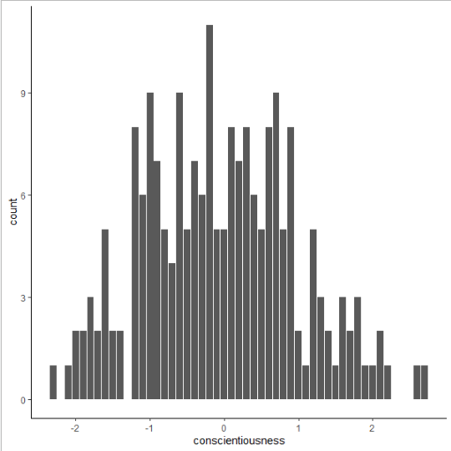
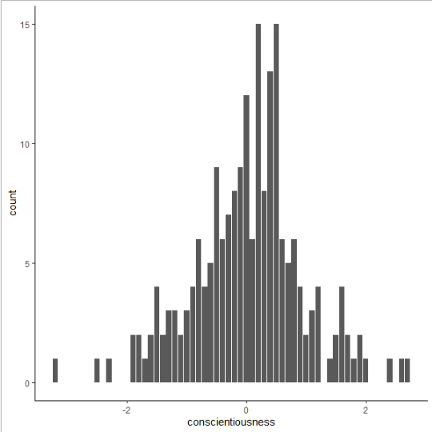

Varying $x_{m}$

Slide 5
Regression Equation
$$y_{m}=b_{0}+b_{1}∗x_{m}+e_{m}$$

Slide 6
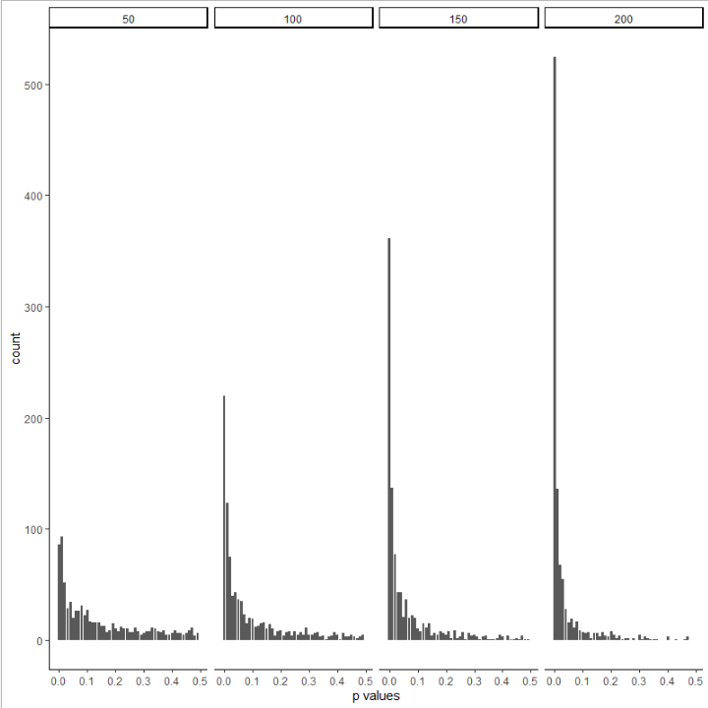
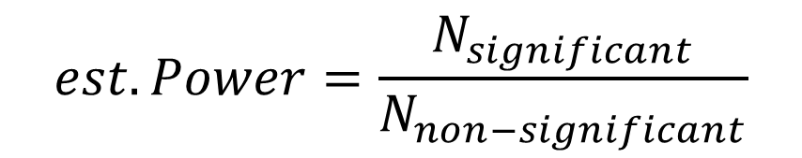
Lots of simulations
$$est. Power=\frac{N_{significant}}{N_{non−significant}}$$
0.30
0.52
0.67
0.82

