Slide 1
Overview
Theoretical Part:
Basics in Statistical Power
The Logic of Power Simulation
Practical Part
Session 1: Your First Simulation
Session 2: Advanced Simulations
Q&A

Slide 2
Basics in Statistical Power and how to assess it!

Slide 3


Goal of Inferential Statistics

Slide 4
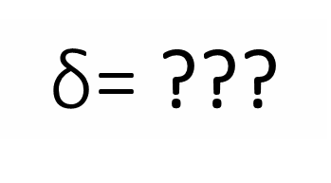
Goal of Inferential Statistics
$\text{δ}$= ???
d = .40

Slide 5
Two states of the world…
Our effect is FALSE at the population level
AVOID FALSE POSITIVES!
α = .05

Slide 6
Two states of the world…
Our effect is FALSE at the population level
AVOID FALSE POSITIVES!
α = .05

Slide 7
Two states of the world…
Our effect is FALSE at the population level
AVOID FALSE POSITIVES!
Our effect is TRUE at the population level
AVOID FALSE NEGATIVES!
α = .05
1 - β = .80

Slide 8
Two states of the world…
Our effect is FALSE at the population level
AVOID FALSE POSITIVES!
Our effect is TRUE at the population level
AVOID FALSE NEGATIVES!
α = .05
1 - β = .80

Slide 9
Our effect is TRUE at the population level
AVOID FALSE NEGATIVES!
Statistical Power
1 - β = .80

Slide 10
What does Statistical Power depend on?
Effect
Size
d for t-test,
rho (ρ) for correlation,
η_{p}² for ANOVA…
α
Usually α = .05
1 - β
Sample
Size (N)
Between-Subject Design
(i.e., number of participants)
Within-Subject Design
(i.e., number of observations)

Slide 11
Ways of Assessing Statistical Power
A PRIORI
POWER ANALYSIS
SENSITIVITY ANALYSIS
POWER-DETERMINATION ANALYSIS
INPUT:
Effect Size
Alpha
Desired Power
OUTPUT:
Sample Size
INPUT:
Sample Size
Alpha
Desired Power
OUTPUT:
(Minimum) Effect Size
INPUT:
Effect Size
Sample Size
Alpha
OUTPUT:
Estimated Power

Slide 12
When can we assess Statistical Power?
BEFORE
AFTER
A PRIORI
POWER ANALYSIS
DATA COLLECTION
SENSITIVITY ANALYSIS
SENSITIVITY ANALYSIS
POWER-DETERMINATION ANALYSIS
POWER-DETERMINATION ANALYSIS

Slide 13
When can we assess Statistical Power?
BEFORE DATA COLLECTION
A PRIORI
POWER ANALYSIS
d = .20, α = .05, 1 – β = .80
N = 788
POWER-DETERMINATION ANALYSIS
d = .20, α = .05, N = 500
1 – β = .61
SENSITIVITY ANALYSIS
α = .05, N = 500, 1 – β = .80
d = .25

Slide 14
The Logic of Power Simulations

Slide 15
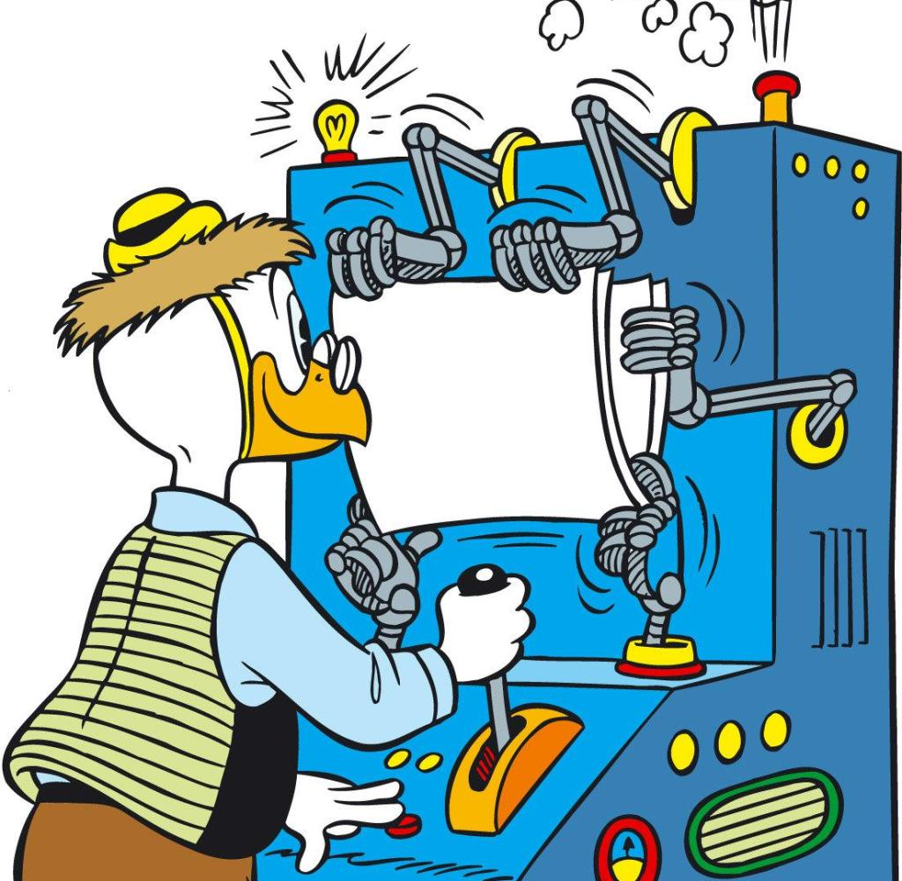
Power Simulations
Make up data based on prior assumptions lots and lots of times to see how often we find a significant result.
© 2017 Disney

Slide 16
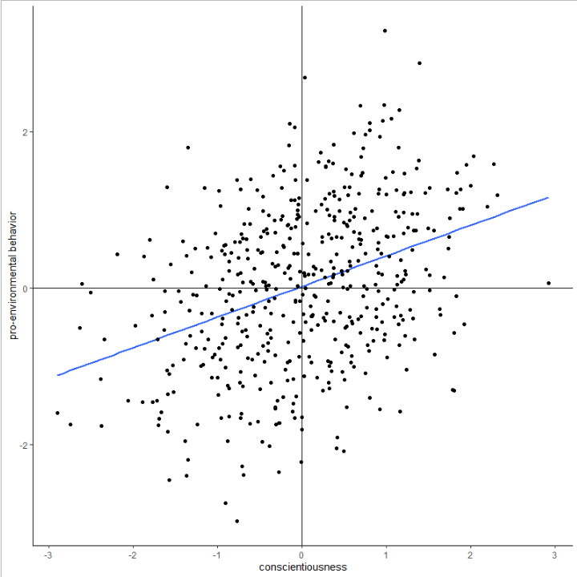
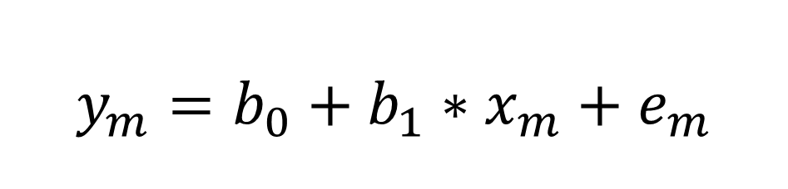
Regression Equation
$$y_{m}=b_{0}+b_{1}∗x_{m}+e_{m}$$

Slide 17
Regression Equation
$$y_{m}=b_{0}+b_{1}∗x_{m}+e_{m}$$

Slide 18
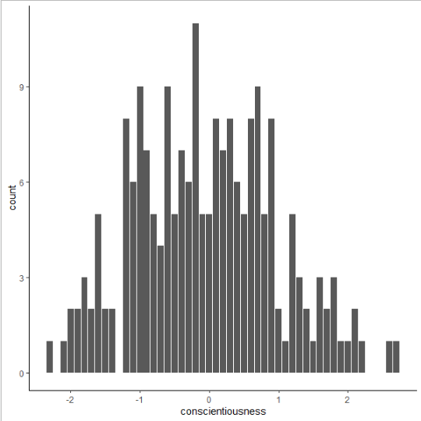
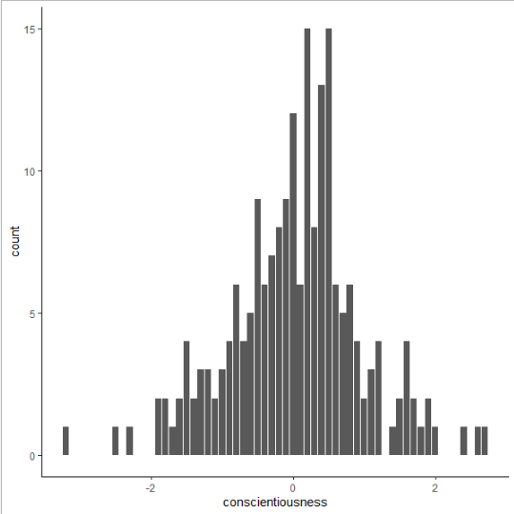
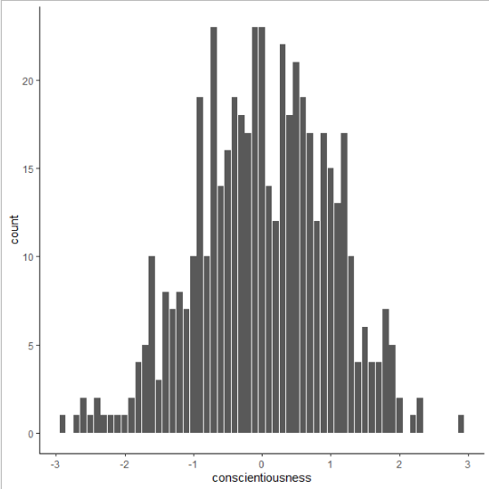

Varying $x_{m}$

Slide 19
Regression Equation
$$y_{m}=b_{0}+b_{1}∗x_{m}+e_{m}$$

Slide 20
Regression Equation
$$y_{m}=b_{0}+b_{1}∗x_{m}+e_{m}$$

Slide 21
Regression Equation
$$y_{m}=b_{0}+b_{1}∗x_{m}+e_{m}$$

Slide 22
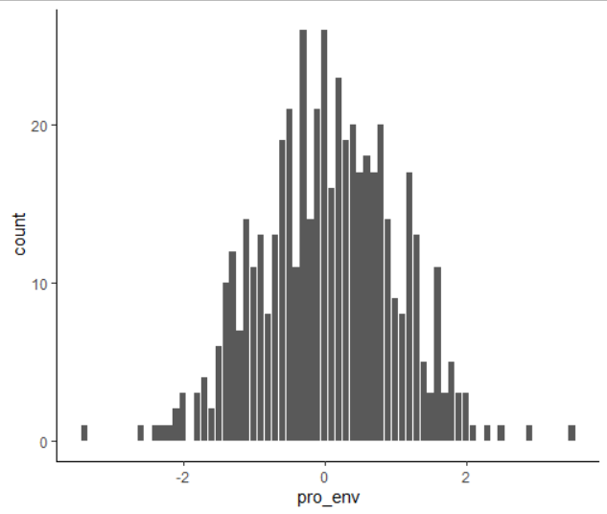
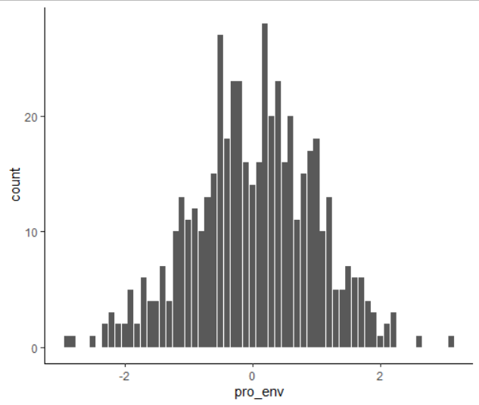
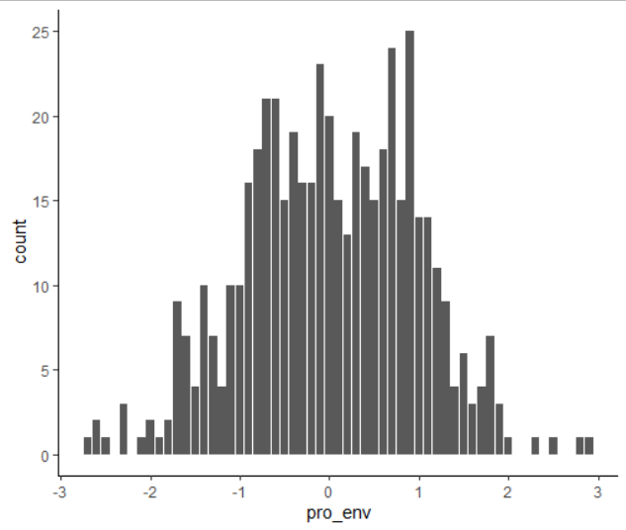

Varying $e_{m}$

Slide 23
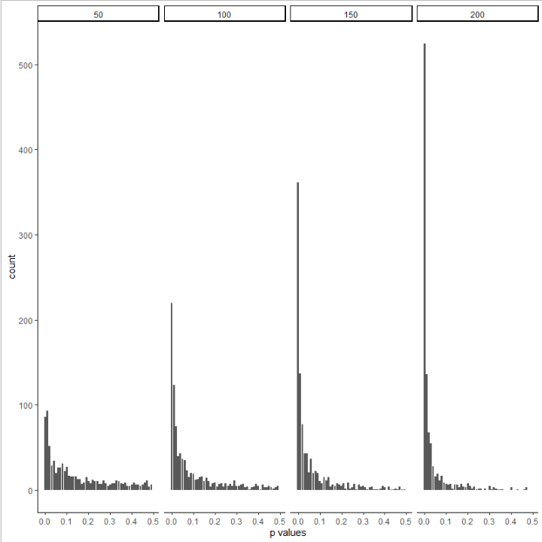
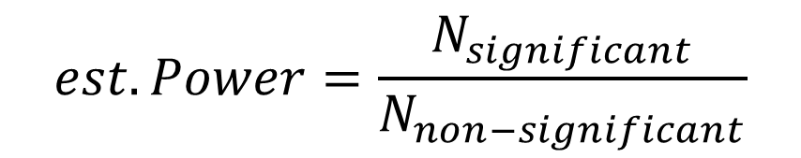
Lots of simulations
$$est. Power=\frac{N_{significant}}{N_{non−significant}}$$
0.30
0.52
0.67
0.82

Slide 24
Exercise 1: Your First Simulation!

Slide 25
References and Resources:
Some references on Statistical Power:
Neyman, J., & Pearson, E. S. (1933, October). The testing of statistical hypotheses in relation to probabilities a priori. In Mathematical Proceedings of the Cambridge Philosophical Society (Vol. 29, No. 4, pp. 492-510). Cambridge University Press.
Giner-Sorolla, R., Carpenter, T., Lewis, N. A.,… Sodesberg, C. (2020). Power to Detect What? Considerations for Planning and Evaluating Sample Size. OSF. https://osf.io/d3v8t/
R packages Tutorials:
Paramtest: https://cran.r-project.org/web/packages/paramtest/vignettes/Simulating-Power.html
Power Simulations with Multilevel Models:
DeBruine, L. M., & Barr, D. J. (2019). Understanding mixed effects models through data simulation. PsyArxiv. https://doi.org/10.31234/osf.io/xp5cy
Green, P., & MacLeod, C. J. (2015) SIMR: an R package for power analysis of generalized linear mixed models by simulation. Methods in Ecology and Evolution. Vol. 7, No. 4, pp-493-498. https://doi.org/10.1111/2041-210X.12504
Power Simulations with Structural Equation Modelling (e.g., Mediational Analyses):
Wang, Y. A., & Rhemtulla, M. (2020). Power analysis for parameter estimation in structural equation modeling: A discussion and tutorial. PsyArxiv. https://doi.org/10.31234/osf.io/pj67b

Slide 26
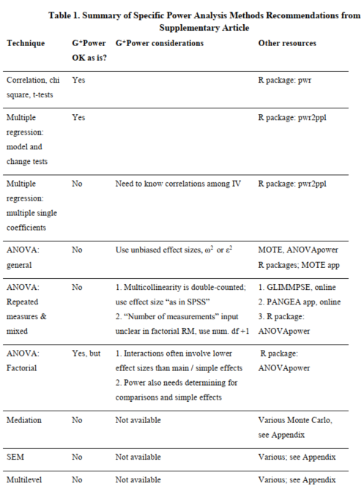
Giner-Sorolla, R., et al.(2020)

