Slide 1

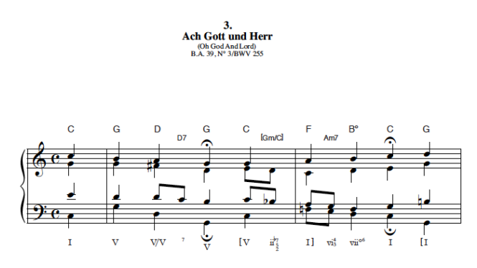
Predicting the Endings of Bach Chorales
Nicholas Czaban

Slide 2
Purpose/Data
Humans can hear dissonance/consonance in music
Create a computer model that can accurately predict endings
100 Bach chorales from UCI Machine Learning Repository
6 data fields per note in melody
  Starting time
  Pitch
  Length
  Key Signature
  Time Signature
  Fermata

Slide 3
Modeling Techniques
Naive Model
Assumed each chorale ends on tonic
49 total correct, 36 under, 15 over
Mostly underestimates
Human Model
User-defined patterns
Follow common resolutions to triad
56 total correct, 14 under, 30 over
Mostly overestimates

Slide 4
Computer Model
Classification tree model – looked at entire data set (excluding last note of each chorale)
80 training chorales, 20 testing chorales
  Each of the 100 chorales tested
55 total correct, 21 under, 24 over
Confusion matrix more compact than other models
  Other models covered entire range of MIDI values

Slide 5
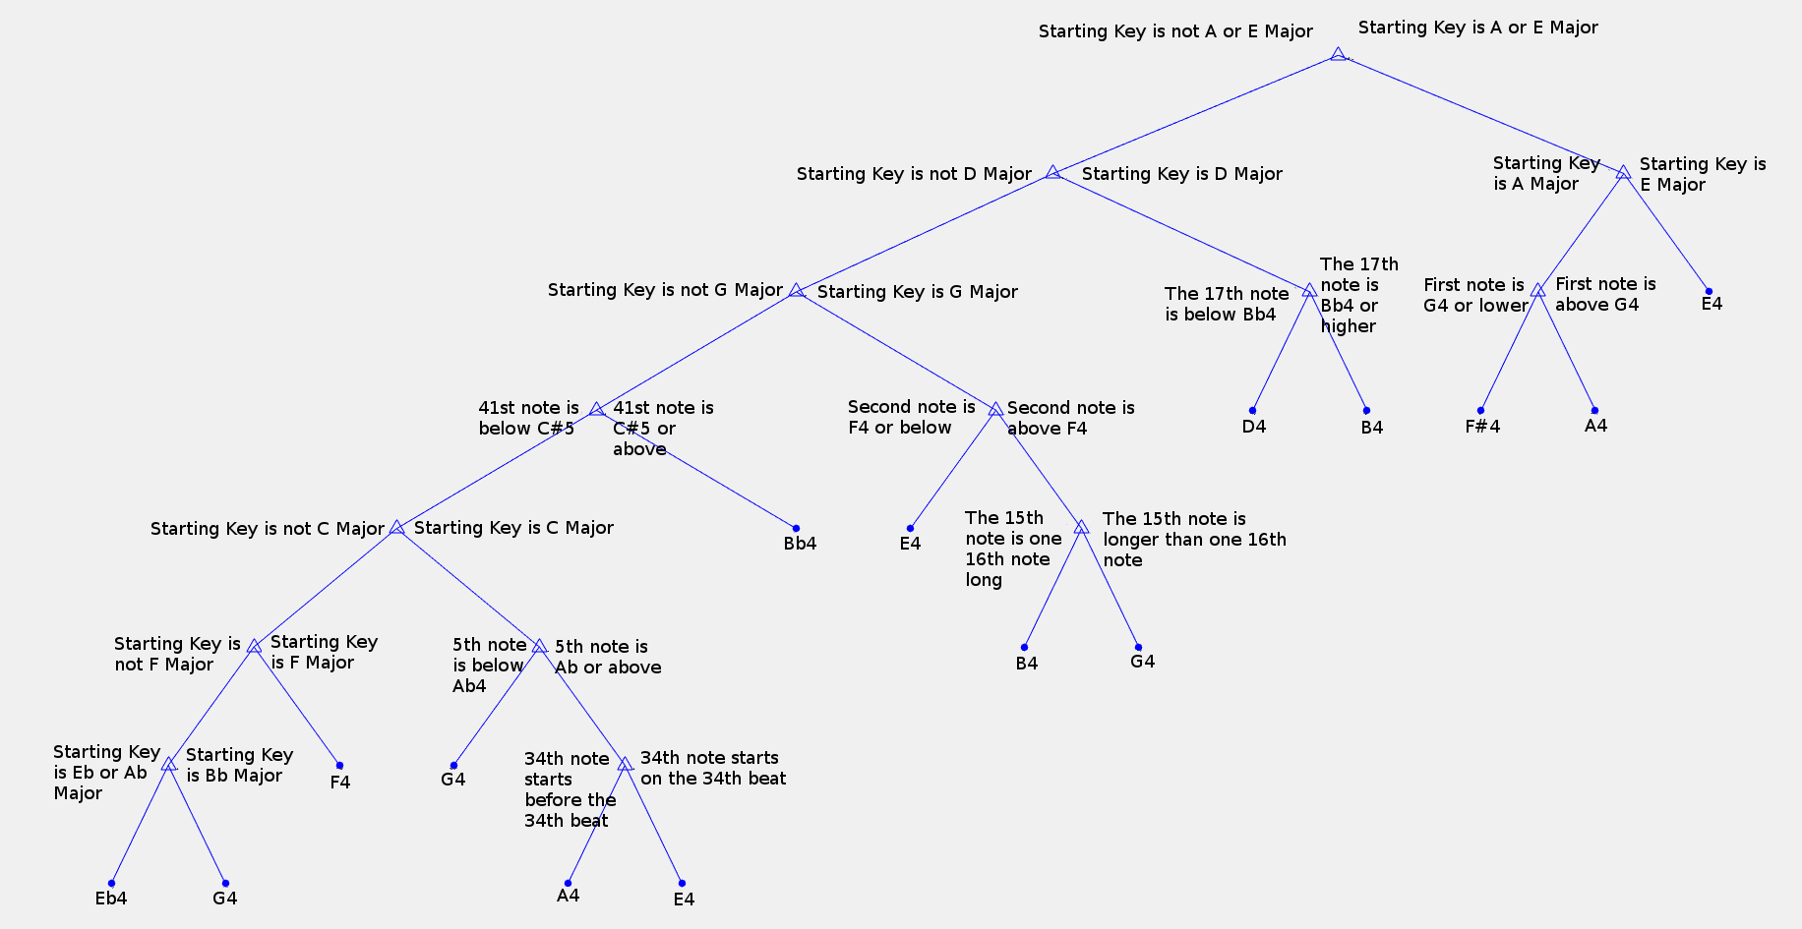
Initial Tree Setup (One of Five)

Slide 6
Further Work
Improve computer model
Remaining chorales
Contemporary composers
Other genres/traditions

