Slide 1
Next-Chord Prediction via Heterogeneous Graph Neural Networks
McGill Billboard Dataset · CES 941: Machine Learning on Graphs
April 14 / 16, 2026

Slide 2
Music Theory Primer
Everything you need to follow this talk — no prior music knowledge required
The 12 Notes (one octave)
Chord Types in This Dataset
C C♯/D♭ D D♯/E♭ E F F♯/G♭ G G♯/A♭ A A♯/B♭ B
144 unique chord types = 12 root notes × ~12 quality variants
• 12 equally-spaced pitches; the pattern repeats every octave
Name
Notes
Sound
• A semitone = one piano-key step (the smallest interval)
Major (C)
C – E – G
bright, stable — the "happy" default
• Sharp (♯) = one semitone up Flat (♭) = one semitone down
Minor (Cm)
C – E♭ – G
darker, "sadder" feel
• C♯ and D♭ are the same pitch — "enharmonic equivalents"
Dominant 7th (C7)
C – E – G – B♭
bluesy tension, wants to resolve
• After B the cycle restarts at C (one octave higher)
Major 7th (Cmaj7)
C – E – G – B
smooth, jazzy, open
Minor 7th (Cm7)
C – E♭ – G – B♭
mellow, soulful
Key Concepts
Diminished (Cdim)
C – E♭ – G♭
tense, unstable
• Chord — 3+ notes played simultaneously
Augmented (Caug)
C – E – G♯
dreamy, unresolved
• Root note — the base pitch that names the chord (e.g. C in "C major")
Suspended 4th (Csus4)
C – F – G
open, no major/minor quality
• Chord progression — a sequence of chords unfolding over time
Suspended 2nd (Csus2)
C – D – G
airy, spacious
• Chord occurrence (occ) — one instance of a chord at a specific beat
Power chord (C5)
C – G
root + 5th only; raw rock sound
• Section — a musical segment (verse, chorus, bridge, intro …)
Add9 (Cadd9)
C – E – G – D
colour tone added above the triad
No-chord (N)
—
silence or unidentifiable harmony

Slide 3
Chord Progressions You Already Know
Each box is one chord — the dataset encodes exactly these kinds of sequences
Bohemian Rhapsody
B♭
Gm
Cm
F7
Queen · B♭ major · Rock
Verse
Piano Man
C
F
Am
G7
Billy Joel · C major · Pop/Rock
Chorus
Africa
F♯m
D
A
E
Toto · A major · Pop
Chorus
Lose Yourself
Dm
B♭
C
A7
Eminem · D minor · Hip-hop
Main riff
Something in the Orange
G
D
Em
C
Zach Bryan · G major · Country
Verse
Chord quality:
Major
Minor
Dom 7th
Major 7th
Suspended
Diminished

Slide 4
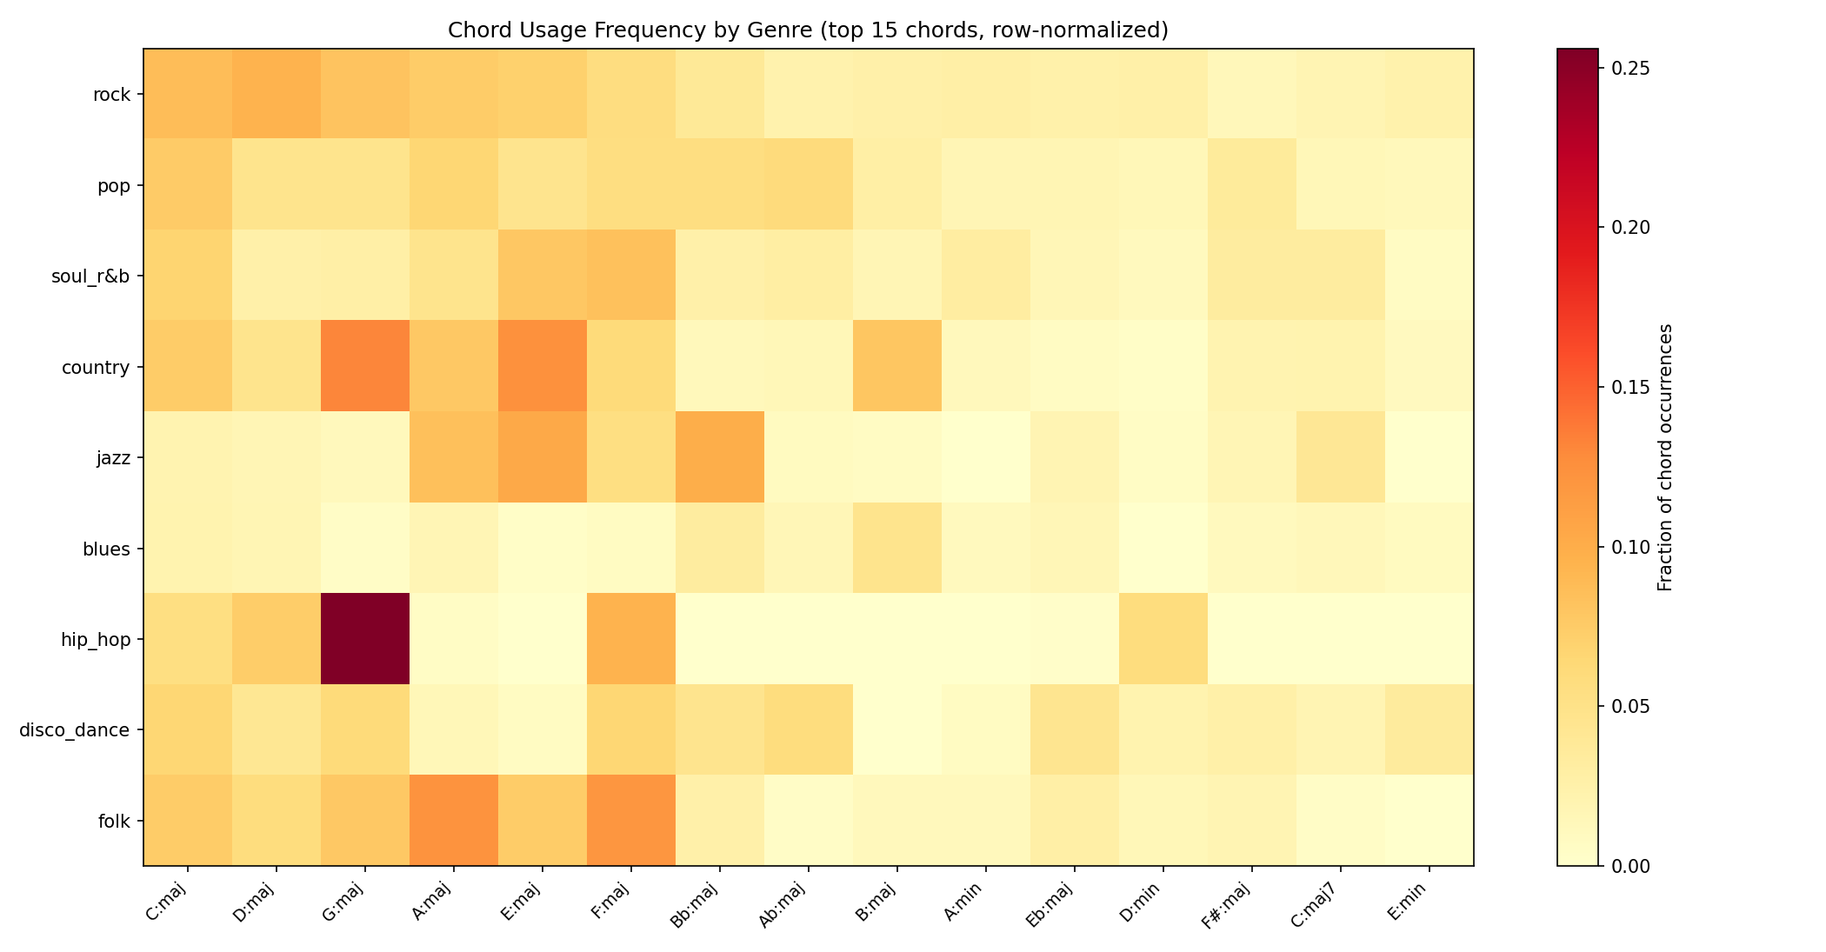
Problem & Dataset
• Task: given the current chord occurrence, predict the next chord
• McGill Billboard corpus: 890 pop/rock songs (~100K chord occurrences)
• 144 unique chord types + N (no-chord) = 145-class prediction
• Why graph?
– Chord progressions have rich hierarchical structure: occurrence → section → song
– Flat sequence models discard this structure entirely
– A heterogeneous graph can model all relationships simultaneously
Genre distribution: rock 52%, pop 19%, soul/R&B 7%, country 4%, other 18%

Slide 5
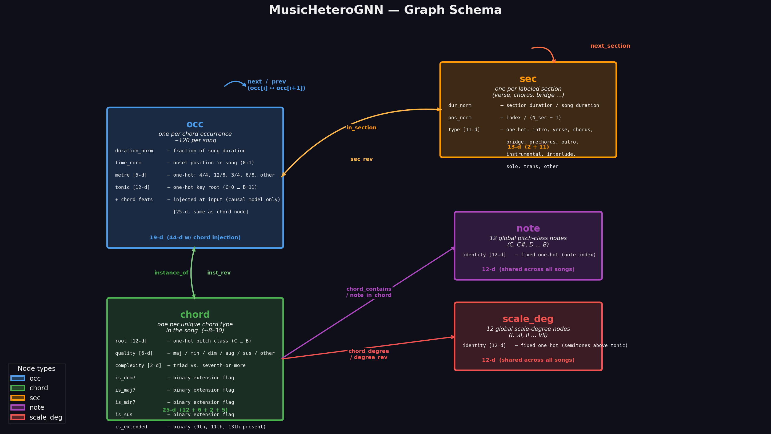
Graph Construction — Schema
5 node types · 10 directed edge types · all edges are within a single song graph

Slide 6
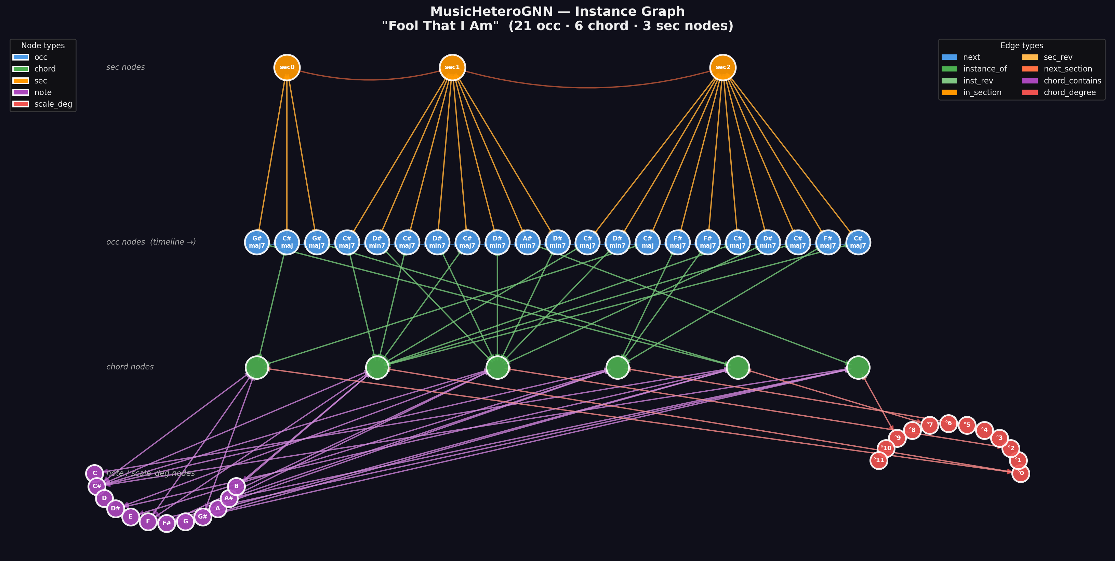
Graph Construction — Real Song Example
occ nodes form a timeline; chord nodes are shared within the song; note/scale_deg nodes are global music-theory anchors

Slide 7
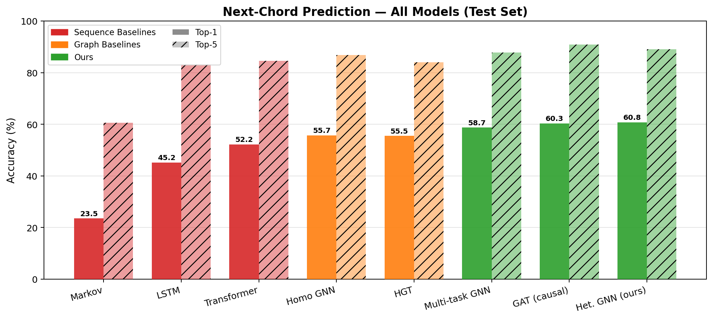
Sequence Baselines
• Markov (bigram + section-conditioned): 23.5% top-1
• LSTM (2-layer, hidden=256): 45.2% top-1
• Transformer (3-layer causal, embed=128): 52.2% top-1
• Transformer beats LSTM by +7pp — attention helps on chord sequences
• Both still far behind our GNN — the graph adds something real
All models trained on same 623/133/134 train/val/test split

Slide 8
The GNN Gets 99.8% — Something Is Wrong
• Initial full GNN (with prev edges): 99.8% top-1
• LSTM: 45.2%. Markov: 23.5%. This gap is suspicious.
• Root cause: the prev edge creates a 2-hop leakage path
– Layer 1: chord[i+1] →(inst_rev)→ occ[i+1]
– chord identity flows into occ[i+1] embedding
– Layer 2: occ[i+1] →(prev)→ occ[i]
– future chord identity reaches the node we are predicting from
• Ablation confirms it: remove instance_of → accuracy collapses to 7.5%
– Without chord identity in occ embeddings, the leak carries nothing
prev edge was added to allow bidirectional context — it accidentally enabled data leakage

Slide 9
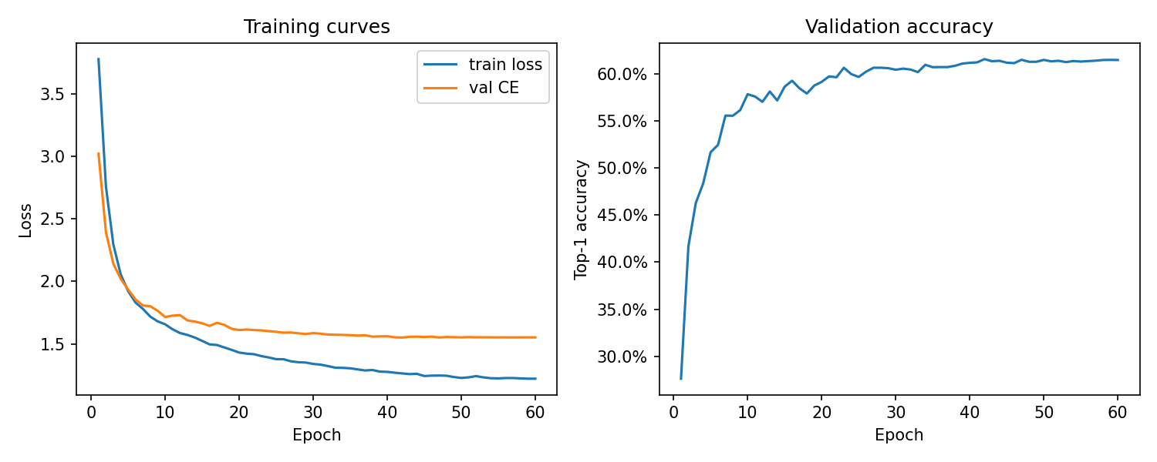
Fix: Causal Model (No prev Edges)
• Remove prev edges entirely → no future information can flow back
• Inject current chord features directly into occ input vector
– occ input: [timing(19-d) | chord_features(25-d)] = 44-d
– This gives the model the present chord without leaking the future
• 3 SAGEConv layers, hidden_dim=128, dropout=0.3
• Result: 60.7% top-1 · 89.0% top-5 · CE 1.44
• Legitimate learning — beats Transformer by +8.5pp
Checkpoint: results/causal_gnn_best.pt

Slide 10
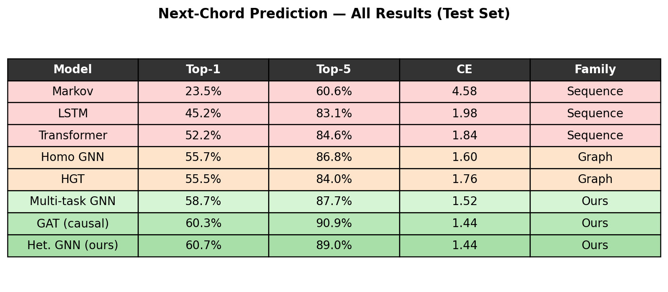
All Results — Test Set
Green = our models. Orange = graph baselines. Red = sequence baselines.

Slide 11
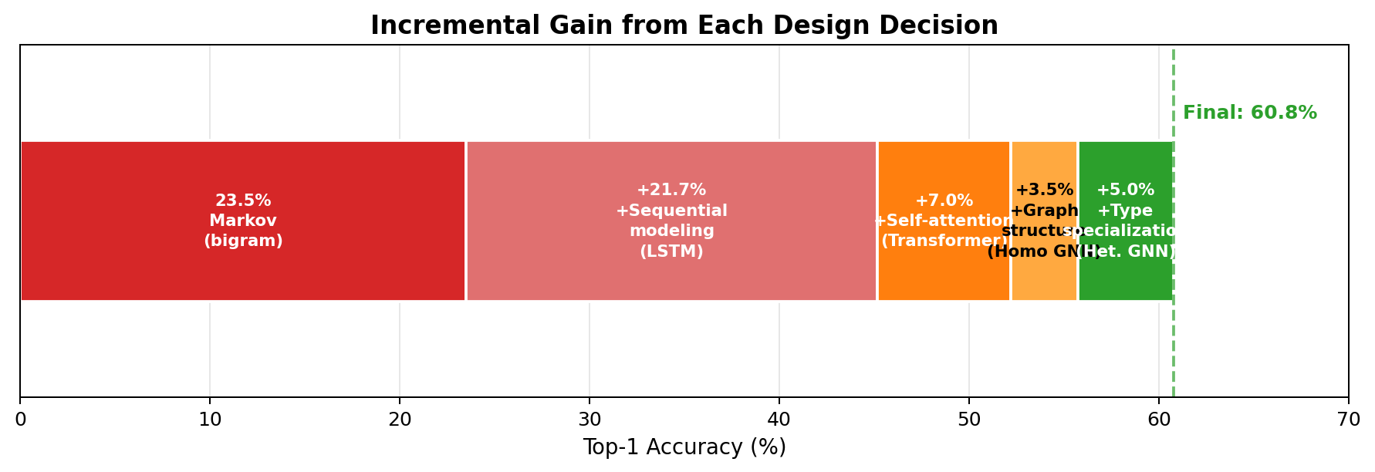
Incremental Gain from Each Design Decision
+37.2pp total gain from Markov → Het. GNN. Each architectural choice contributes.

Slide 12
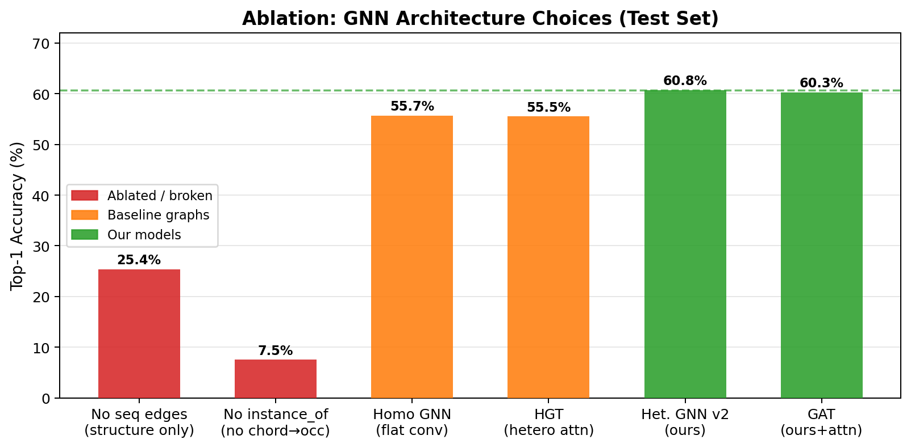
Ablation: What Actually Matters?
• Remove seq edges (next/prev): 25.4% — sequencing is essential
• Remove instance_of: 7.5% — chord identity is the dominant signal
• Homo GNN vs Het. GNN (key comparison):
– Homo GNN (flat conv, all edges same type): 55.7%
– Het. GNN v2 (type-specialised SAGEConv): 60.7%
– +5pp from heterogeneous type specialisation
• HGT (Hu et al. 2020) vs Het. GNN:
– HGT: 55.5% ≈ HomoGNN: 55.7%
– Graph structure matters more than the attention mechanism

Slide 13
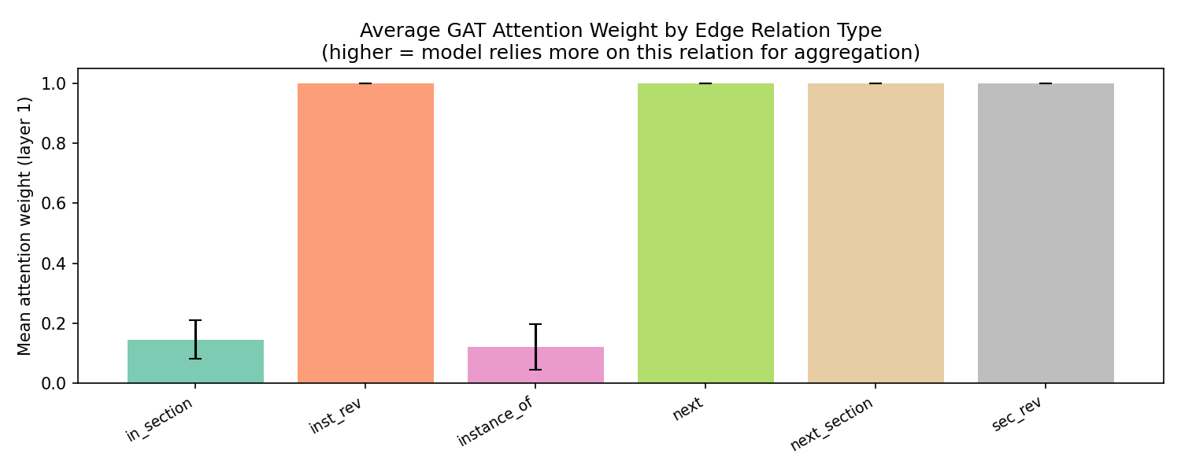
GAT Attention — What Does the Model Focus On?
• GAT (4 heads) replaces SAGEConv — learns per-edge attention weights
• Attention is normalised per destination node across all incoming edge types
• inst_rev (chord → occ): ≈ 1.0 — chord identity is the dominant signal
• next (prev occ → occ): ≈ 1.0 — sequential context equally important
• next_section: ≈ 1.0 — section transitions also attended to
• in_section (occ → sec): ≈ 0.13 — section context used but secondary
• instance_of: ≈ 0.13 — low weight (inst_rev carries same info)
• GAT top-1: 60.3% vs SAGEConv: 60.7% — marginal difference
– Attention learns meaningful weights but does not improve accuracy
– Confirms: graph structure matters more than weighting mechanism
Attention extracted from layer 0 across all edge types simultaneously

Slide 14
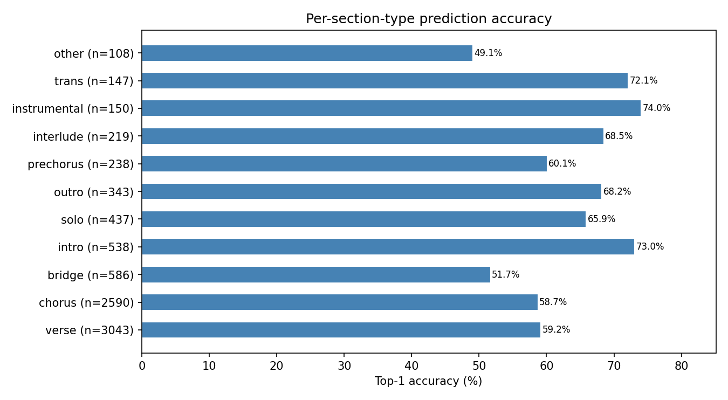
Section-Level Accuracy
• Instrumental / intro / outro: 73–74% (repetitive, predictable)
• Verse / chorus: 58–59% (moderate harmonic variety)
• Bridge: 51.7% (most harmonically diverse — hardest to predict)
• Trans / interlude / solo: 66–72% (shorter, often formulaic)
• Model captures musical structure: easier sections → higher accuracy
Section type decoded from sec node features via one-hot argmax

Slide 15
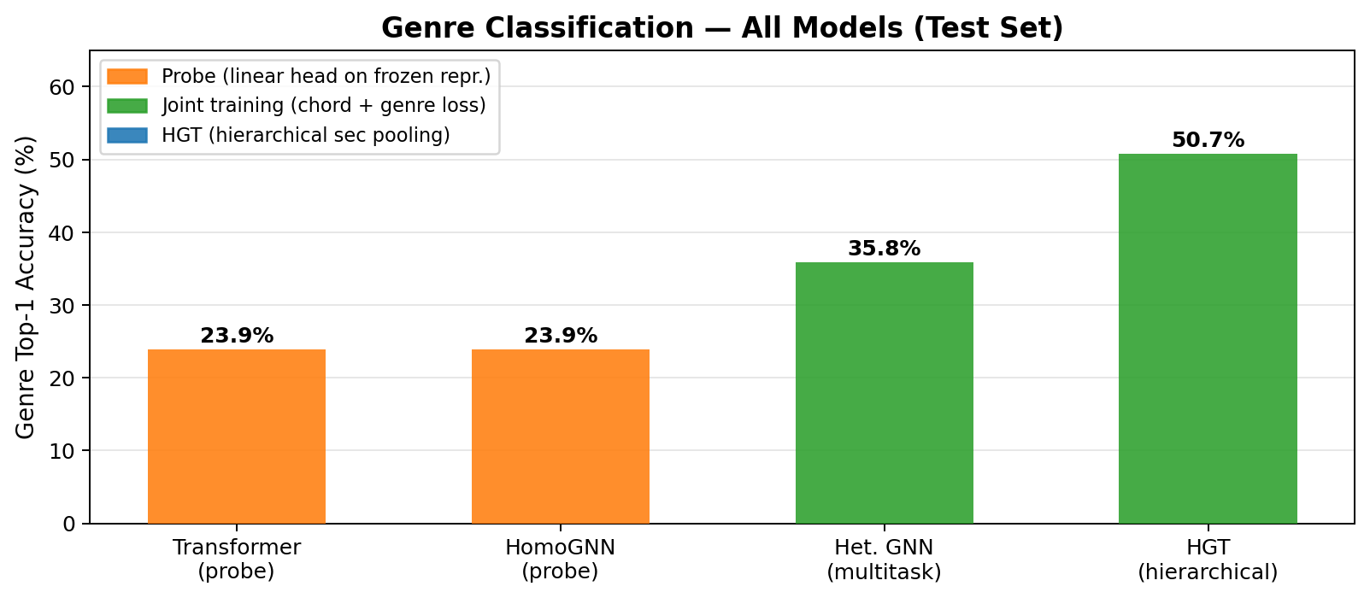
Genre Classification
• Transformer (linear probe, frozen): 23.9%
• Homo GNN (linear probe, frozen): 23.9% — near-random baseline ≈ 18%
– → chord-prediction models do not spontaneously encode genre
• Het. GNN + genre head (joint training): 35.8%
– → genre supervision adds +12pp over probe
• HGT + genre head (hierarchical sec pooling): 50.7%
– → pooling over sections (not raw occ) gives richer song-level repr.
– → sec nodes absorb occ harmonic context through in_section edges
Genre accuracy: 9-class classification on 134 test songs

Slide 16
Conclusion
• Heterogeneous graph > sequence models
– 60.7% vs 52.2% Transformer (+8.5pp)
• Type specialisation matters
– Het. GNN 60.7% vs Homo GNN 55.7% (+5pp)
• Graph structure > attention mechanism
– HGT 55.5% ≈ Homo GNN 55.7% — how you type edges beats how you weight them
• Leakage is detectable and diagnosable
– 99.8% → ablation → causal fix → 60.7% legitimate accuracy
• Section structure enables genre understanding
– Hierarchical sec pooling: 50.7% genre vs 23.9% probe baseline
• Future work: contrastive learning for genre-separable embeddings
Code + results: github.com/[repo] | Checkpoints: results/*.pt

