Slide 1


VIETNAM NATIONAL UNIVERSITY HO CHI MINH CITY
HO CHI MINH CITY UNIVERSITY OF TECHNOLOGY
FACULTY OF ELECTRICAL AND ELECTRONICS ENGINEERING
DEPARTMENT OF ELECTRONICS ENGINEERING
CAPSTONE PROJECT 2
DESIGN AND IMPLEMENTATION OF
A PIPELINED RISC-V PROCESSOR INTEGRATING TILELINK-UL BUS PROTOCOL
Instructor: Assoc. Prof. Dr. Trần Hoàng Linh
Student: Nguyễn Duy Ngọc
Student ID: 2251036
Ho Chi Minh City – January 5, 2026

Slide 2
Table of Contents
Introduction
Theoretical Background
Design and Implementation
Implementation Results
Conclusion and Future Vision
Department of Electronics Engineering Capstone Project 2 Nguyễn Duy Ngọc January 5, 2026

Slide 3
1. Introduction
Motivation
Legacy processor core with rigid dependency on custom memory connections
Significant limitations in system modularity and scalability
Obstacles in integrating additional peripheral devices
Necessity of adopting industry-standard bus protocols
Transitioning towards a robust System-on-Chip (SoC) foundation
Department of Electronics Engineering Capstone Project 2 Nguyễn Duy Ngọc January 5, 2026

Slide 4
1. Introduction
Project Objectives
Enable TileLink-UL communication within the RISC-V processor
Implement standardized Host and Device Adapters
Handle misaligned memory accesses via specialized logic
Execute rigorous functional verification through simulation
Validate hardware feasibility on Intel Cyclone V FPGA
Department of Electronics Engineering Capstone Project 2 Nguyễn Duy Ngọc January 5, 2026

Slide 5
2. Theoretical Background
RISC-V Architecture
Base integer instruction set: RV32I
Classic 5-stage pipeline microarchitecture
Standard stages: IF, ID, EX, MEM, and WB
Load-Store Unit (LSU) timing and signal requirements
Department of Electronics Engineering Capstone Project 2 Nguyễn Duy Ngọc January 5, 2026

Slide 6
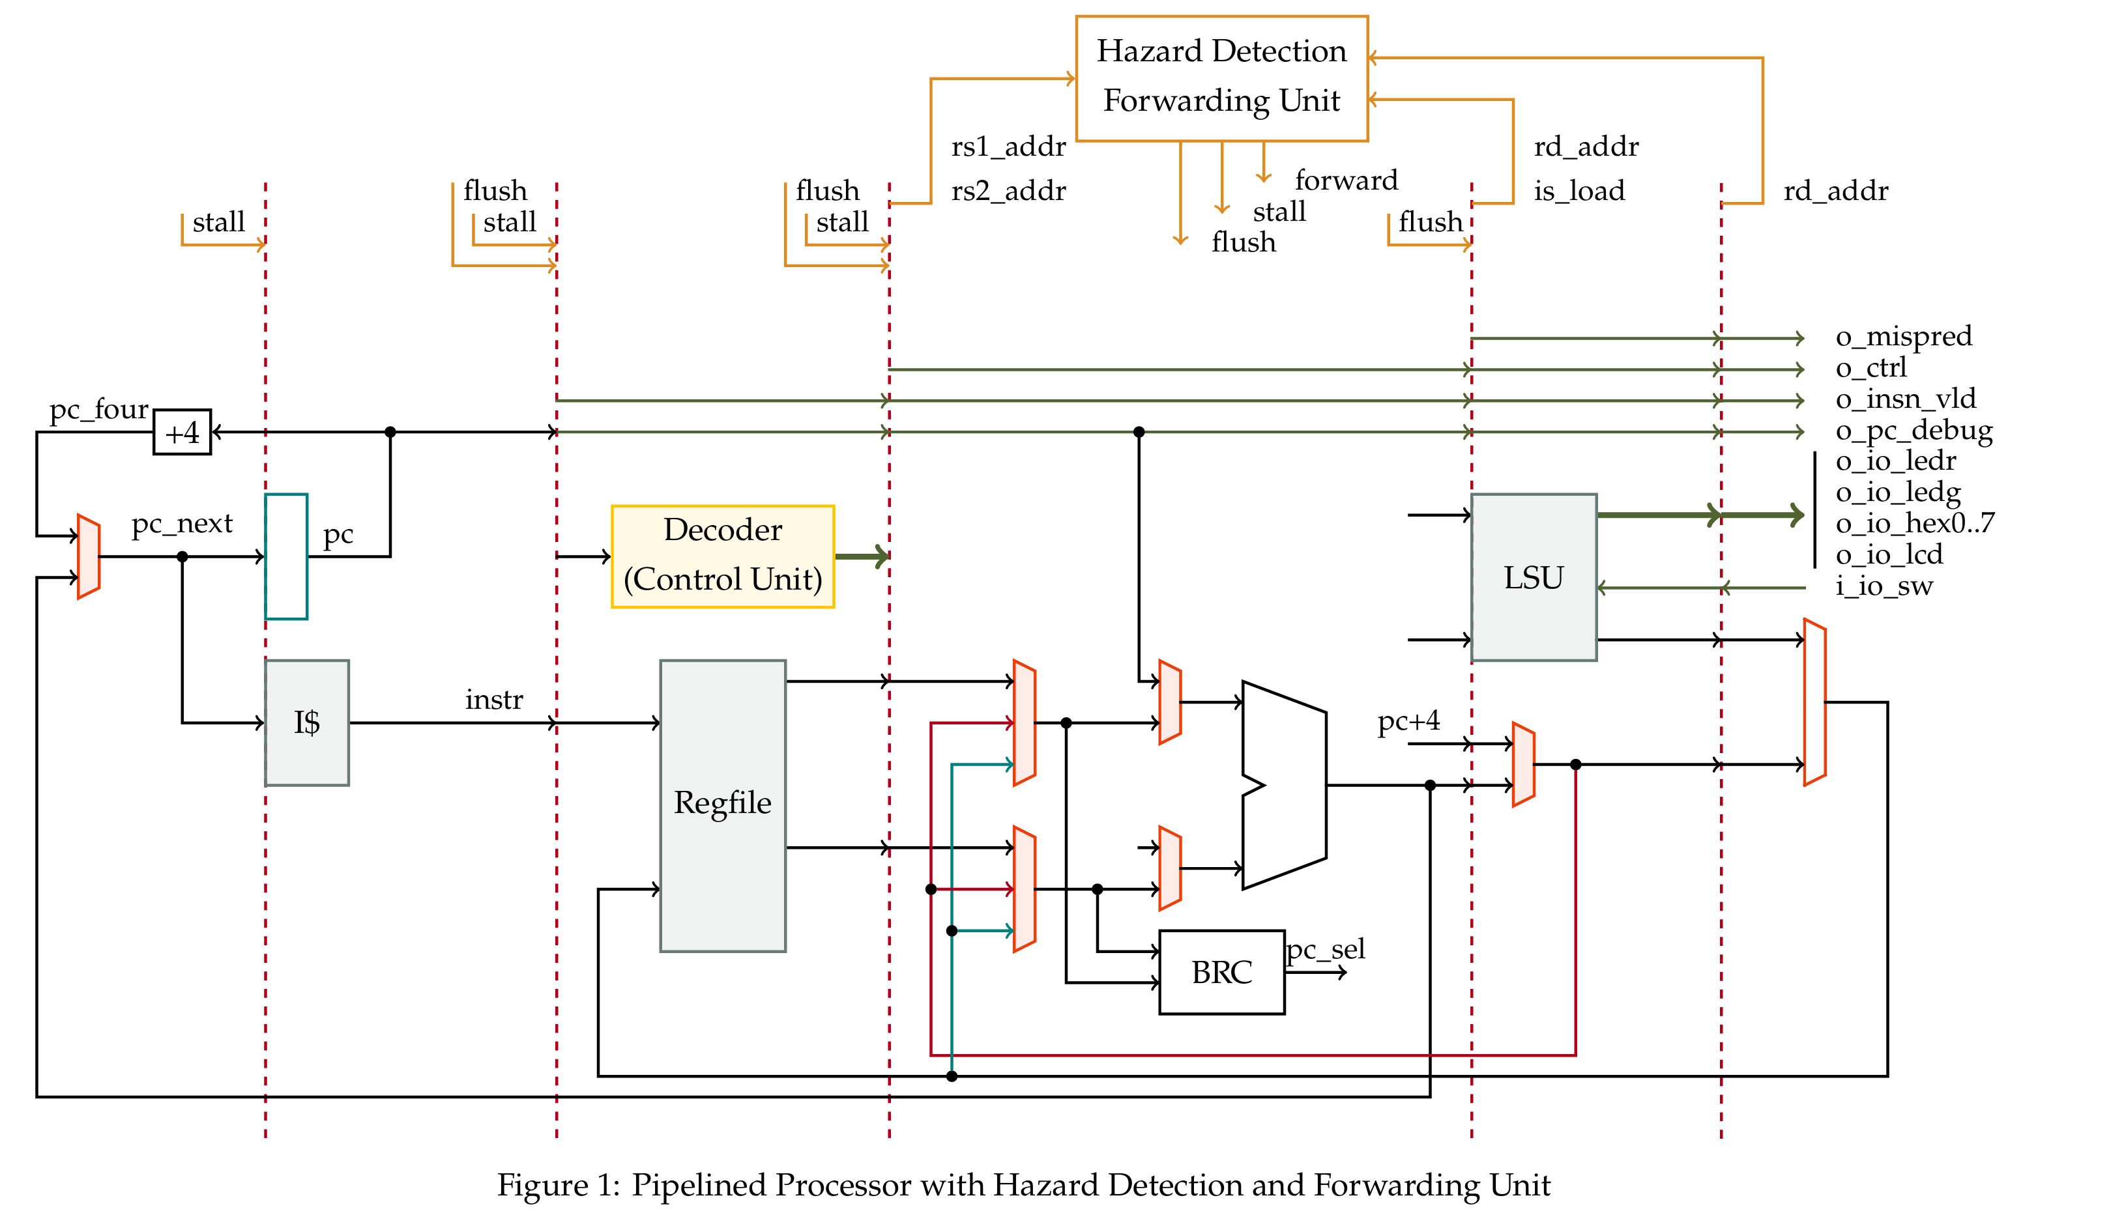
2. Theoretical Background
Datapath of 5-Stage RV32I Pipelined Processor
Department of Electronics Engineering Capstone Project 2 Nguyễn Duy Ngọc January 5, 2026

Slide 7
2. Theoretical Background
TileLink-UL Protocol
Master-slave communication topology
Independent Channel A (Request) and Channel D (Response)
Decoupled valid-ready handshake mechanism
Simplified operations: Get (Read) and Put (Write)
Department of Electronics Engineering Capstone Project 2 Nguyễn Duy Ngọc January 5, 2026

Slide 8
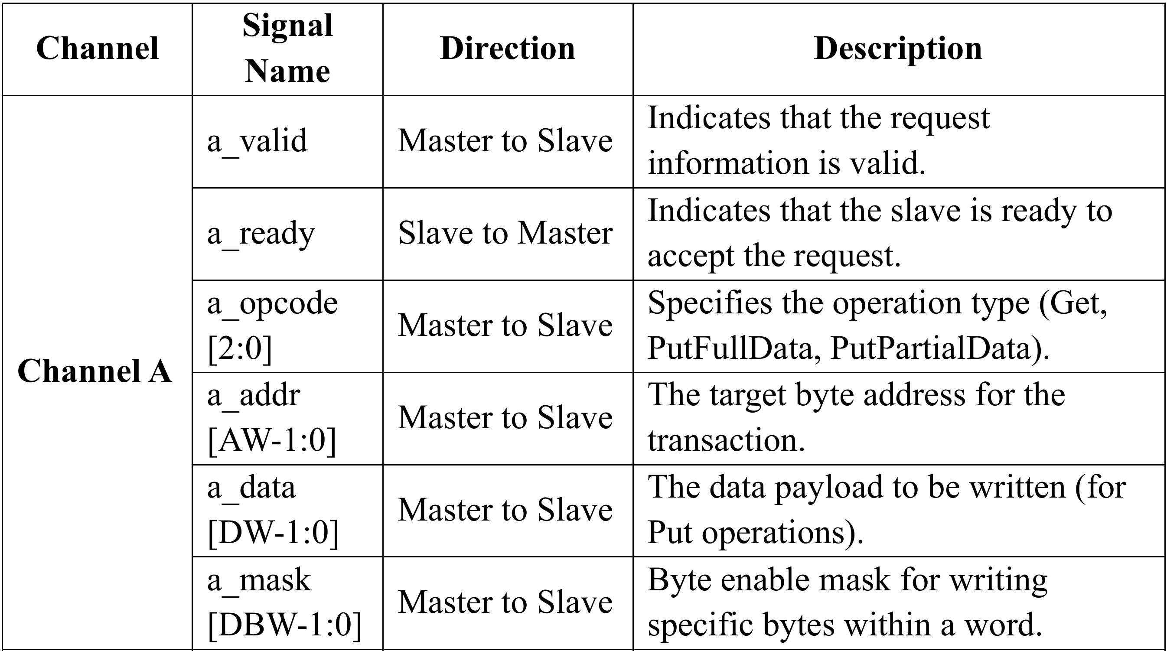
2. Theoretical Background
Key Signals of the TileLink-UL Protocol - Channel A
Department of Electronics Engineering Capstone Project 2 Nguyễn Duy Ngọc January 5, 2026

Slide 9
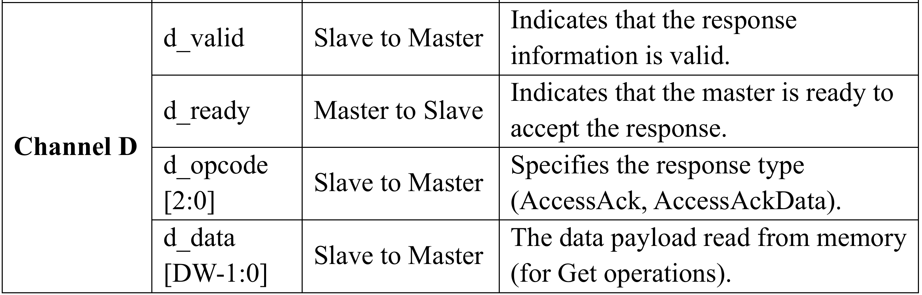
2. Theoretical Background
Key Signals of the TileLink-UL Protocol - Channel D
Department of Electronics Engineering Capstone Project 2 Nguyễn Duy Ngọc January 5, 2026

Slide 10
2. Theoretical Background
Interleaved Memory
Four independent 8-bit memory banks
Supports misaligned accesses across word boundaries
Requirement for address swizzling translation
Simultaneous access to different row indices
Bridging flat-addressed bus with interleaved banks
Department of Electronics Engineering Capstone Project 2 Nguyễn Duy Ngọc January 5, 2026

Slide 11
3. Design - Implementation
Top-Level Architecture
Integration of RISC-V core and Interconnect Manager
Standardized SoC abstraction layer
System clock source: 50 MHz
Department of Electronics Engineering Capstone Project 2 Nguyễn Duy Ngọc January 5, 2026

Slide 12
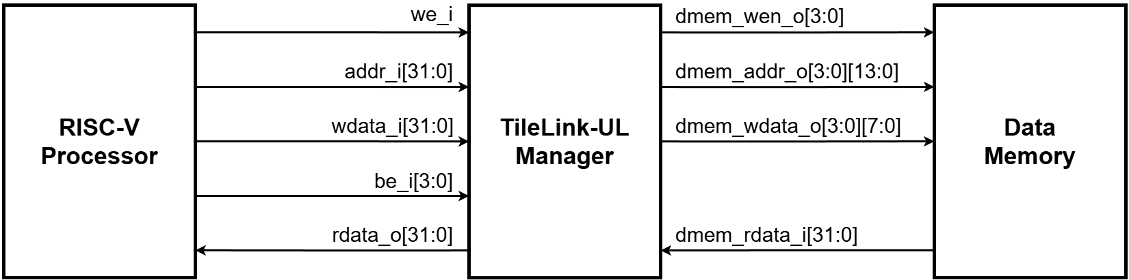
3. Design - Implementation
Top-Level System Architecture
Department of Electronics Engineering Capstone Project 2 Nguyễn Duy Ngọc January 5, 2026

Slide 13
3. Design - Implementation
TileLink Manager
Enforcement of standard interfaces between CPU and memory
Direct mapping of 32-bit addresses to Host Adapter
Byte-granularity support via write masks
Department of Electronics Engineering Capstone Project 2 Nguyễn Duy Ngọc January 5, 2026

Slide 14
3. Design - Implementation
TileLink Manager
Enforcement of standard interfaces between CPU and memory
Direct mapping of 32-bit addresses to Host Adapter
Byte-granularity support via write masks
Department of Electronics Engineering Capstone Project 2 Nguyễn Duy Ngọc January 5, 2026

Slide 15
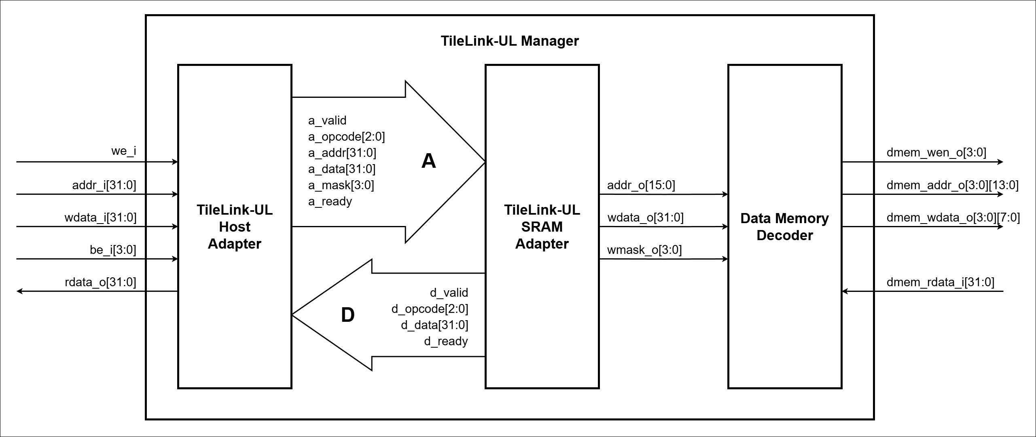
3. Design - Implementation
Internal Structure of TileLink Manager
Department of Electronics Engineering Capstone Project 2 Nguyễn Duy Ngọc January 5, 2026

Slide 16
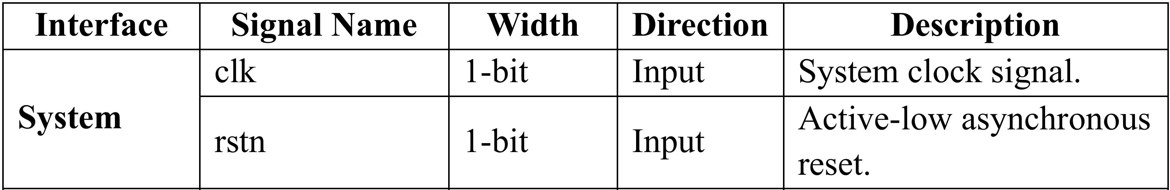
3. Design - Implementation
TileLink Manager Signals - System
Department of Electronics Engineering Capstone Project 2 Nguyễn Duy Ngọc January 5, 2026

Slide 17
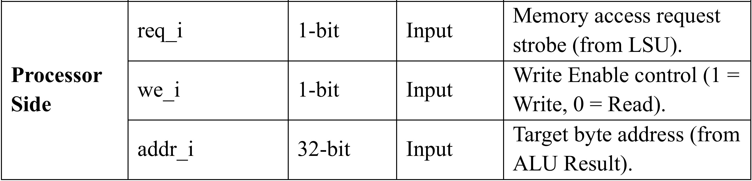
3. Design - Implementation
TileLink Manager Signals – Processor Side
Department of Electronics Engineering Capstone Project 2 Nguyễn Duy Ngọc January 5, 2026

Slide 18
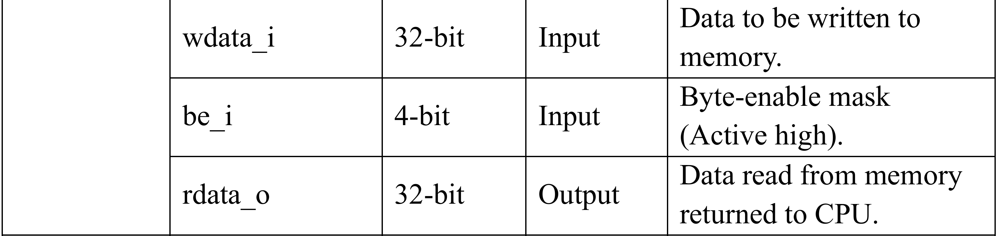
3. Design - Implementation
TileLink Manager Signals – Processor Side
Department of Electronics Engineering Capstone Project 2 Nguyễn Duy Ngọc January 5, 2026

Slide 19
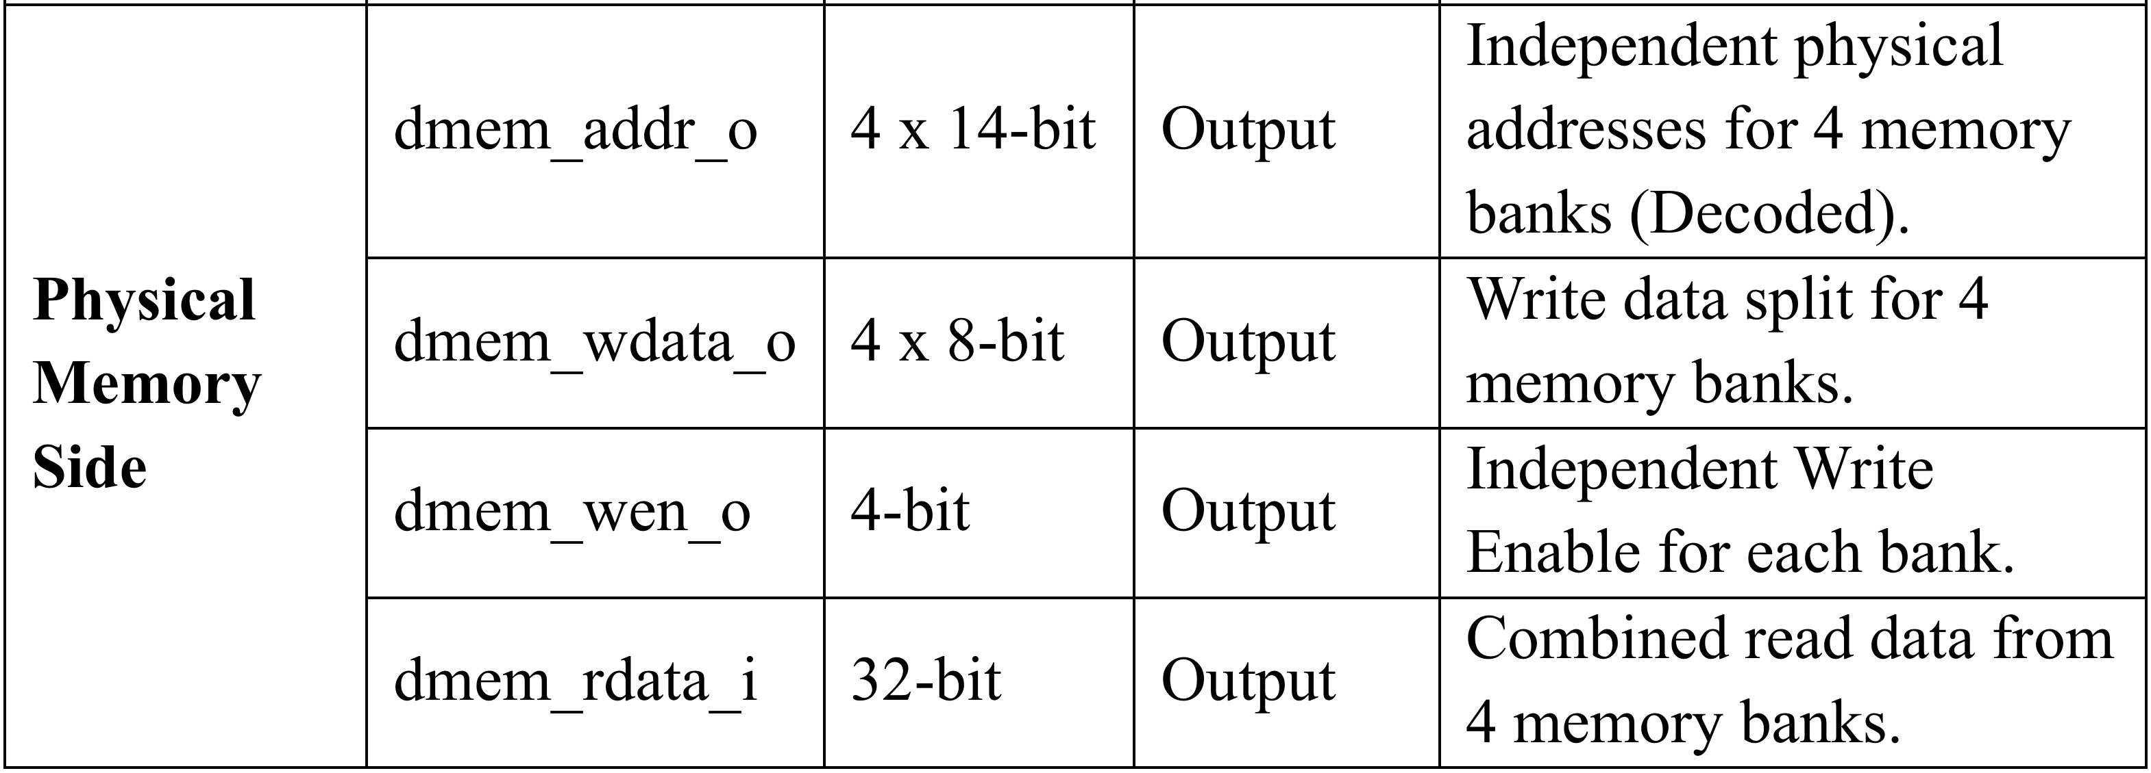
3. Design - Implementation
TileLink Manager Signals – Memory Side
Department of Electronics Engineering Capstone Project 2 Nguyễn Duy Ngọc January 5, 2026

Slide 20
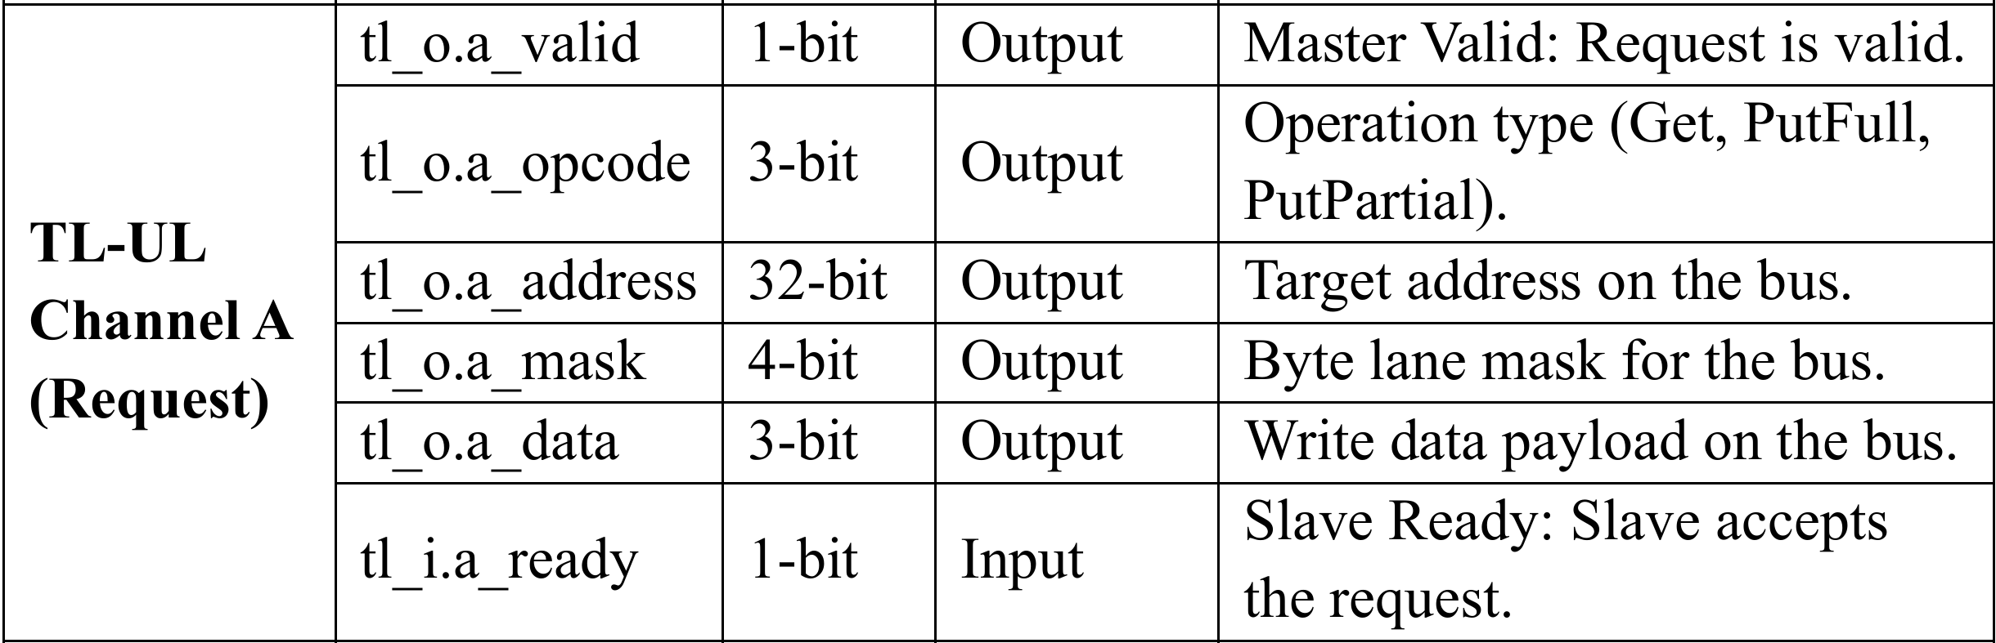
3. Design - Implementation
TileLink-UL Bus – Channel A
Department of Electronics Engineering Capstone Project 2 Nguyễn Duy Ngọc January 5, 2026

Slide 21
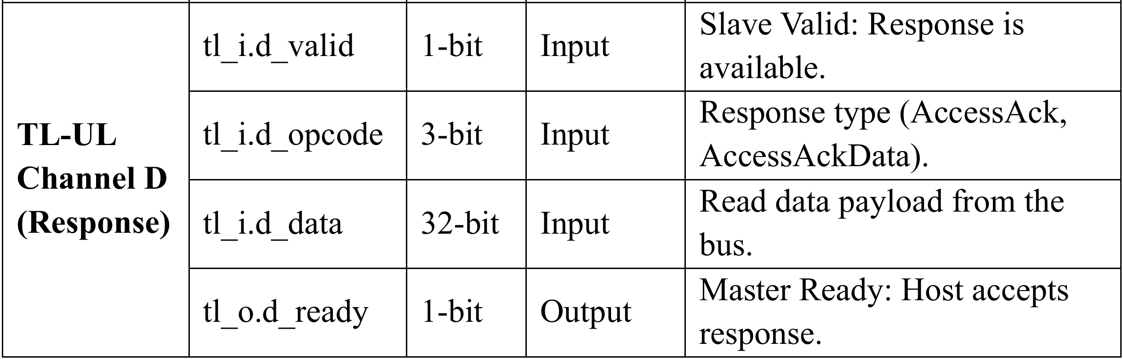
3. Design - Implementation
TileLink-UL Bus – Channel D
Department of Electronics Engineering Capstone Project 2 Nguyễn Duy Ngọc January 5, 2026

Slide 22
3. Design - Implementation
Host Adapter
Opcode generation logic (Get, PutFull, PutPartial)
Request phase control via a_valid and a_ready
Response monitoring for d_valid and data capture
Department of Electronics Engineering Capstone Project 2 Nguyễn Duy Ngọc January 5, 2026

Slide 23
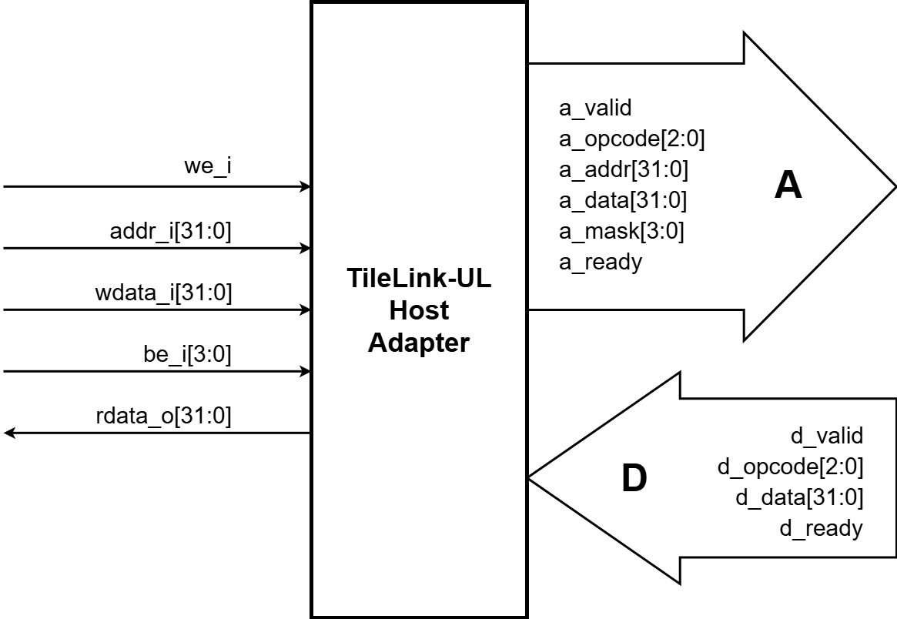
3. Design - Implementation
Host Adapter Logic Flow
Department of Electronics Engineering Capstone Project 2 Nguyễn Duy Ngọc January 5, 2026

Slide 24
3. Design - Implementation
Device Adapter
Automatic address truncation for 64 KB memory space
Command decoding for SRAM control lines
Synchronous acknowledgment loop for 1-cycle latency
Department of Electronics Engineering Capstone Project 2 Nguyễn Duy Ngọc January 5, 2026

Slide 25
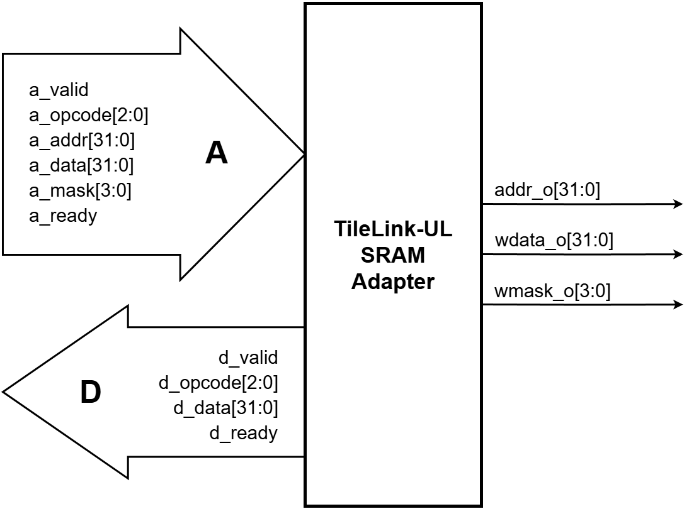
3. Design - Implementation
Device Adapter Logic Flow
Department of Electronics Engineering Capstone Project 2 Nguyễn Duy Ngọc January 5, 2026

Slide 26
3. Design - Implementation
Address Decoupling Logic
Misalignment handling for Offset = 0, 1, 2, 3
Dynamic calculation of idx_base and idx_next
Bank-specific write enable gating logic
Department of Electronics Engineering Capstone Project 2 Nguyễn Duy Ngọc January 5, 2026

Slide 27
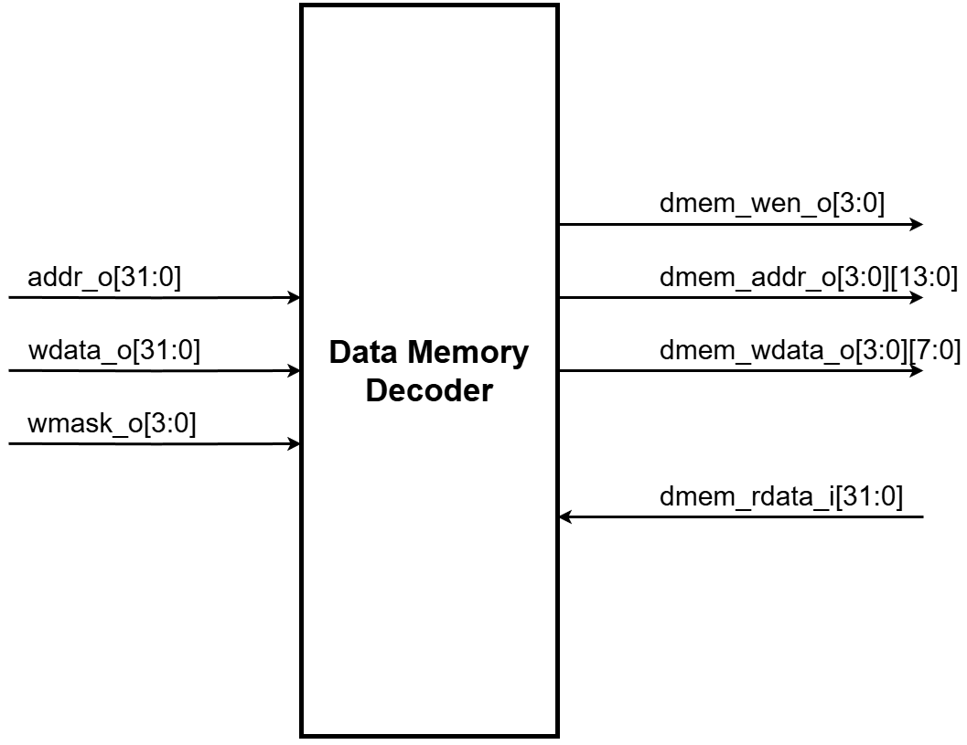
3. Design - Implementation
Address Decoupling Circuit
Department of Electronics Engineering Capstone Project 2 Nguyễn Duy Ngọc January 5, 2026

Slide 28
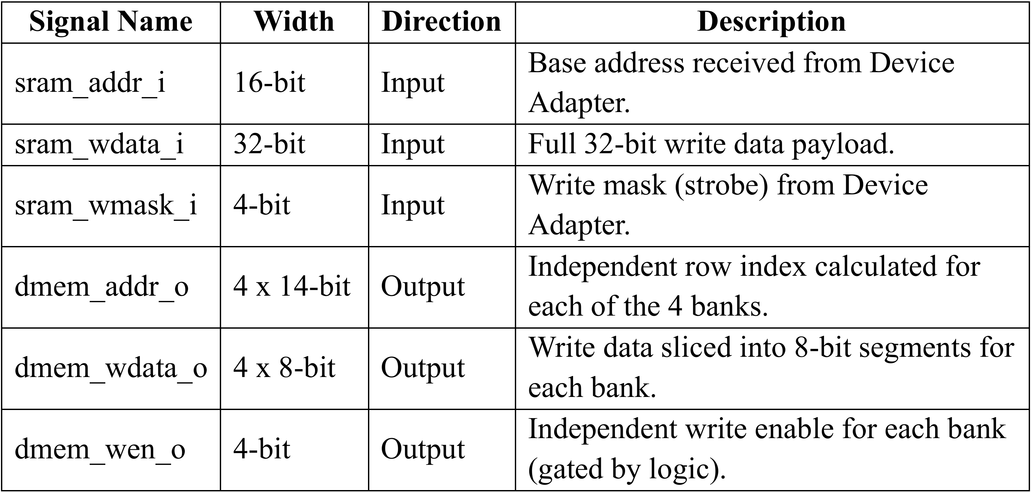
3. Design - Implementation
Address Decoupling Circuit
Department of Electronics Engineering Capstone Project 2 Nguyễn Duy Ngọc January 5, 2026

Slide 29
4. Implementation Results
Functional Verification
Visual timing verification using SimVision waveforms
Full RV32I compliance via automated test suites
Successful verification of misaligned accesses
Achieved Instruction Per Cycle (IPC) ratio of 0.62
Department of Electronics Engineering Capstone Project 2 Nguyễn Duy Ngọc January 5, 2026

Slide 30
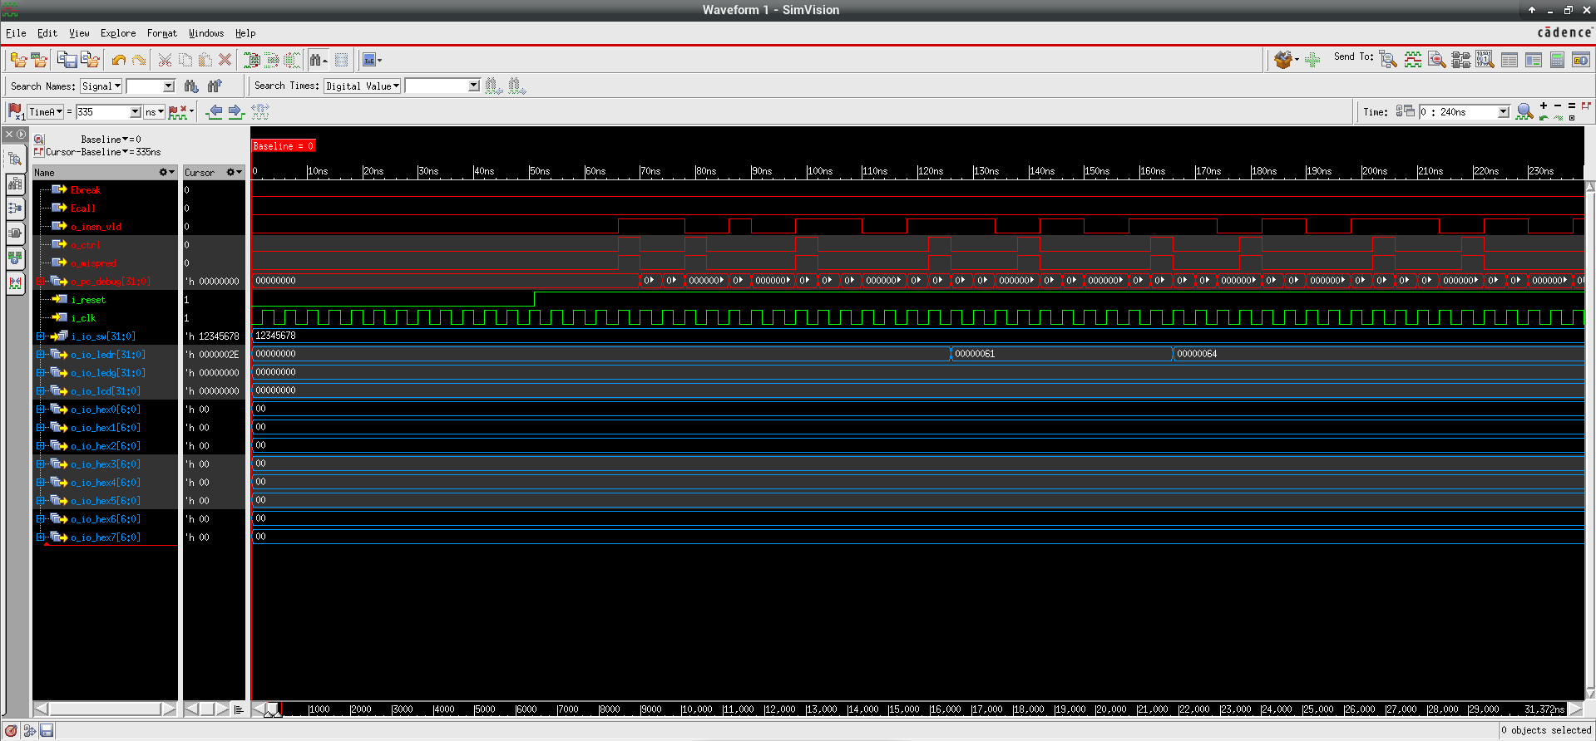
4. Implementation Results
SimVision Waveform demonstration
Department of Electronics Engineering Capstone Project 2 Nguyễn Duy Ngọc January 5, 2026

Slide 31
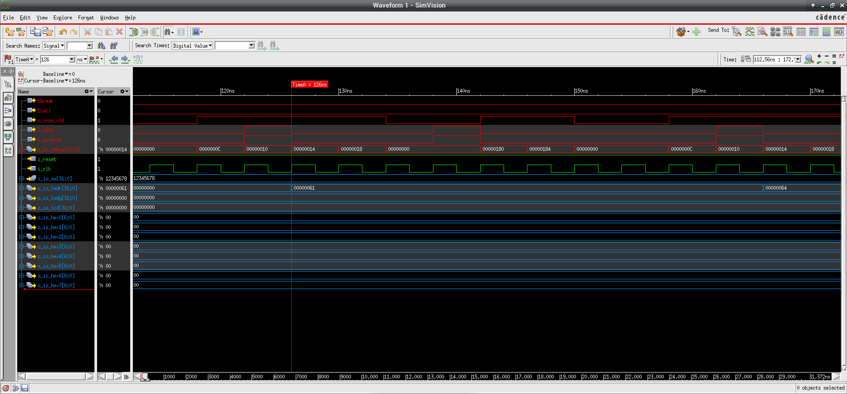
4. Implementation Results
SimVision Waveform demonstration (cont.)
Department of Electronics Engineering Capstone Project 2 Nguyễn Duy Ngọc January 5, 2026

Slide 32
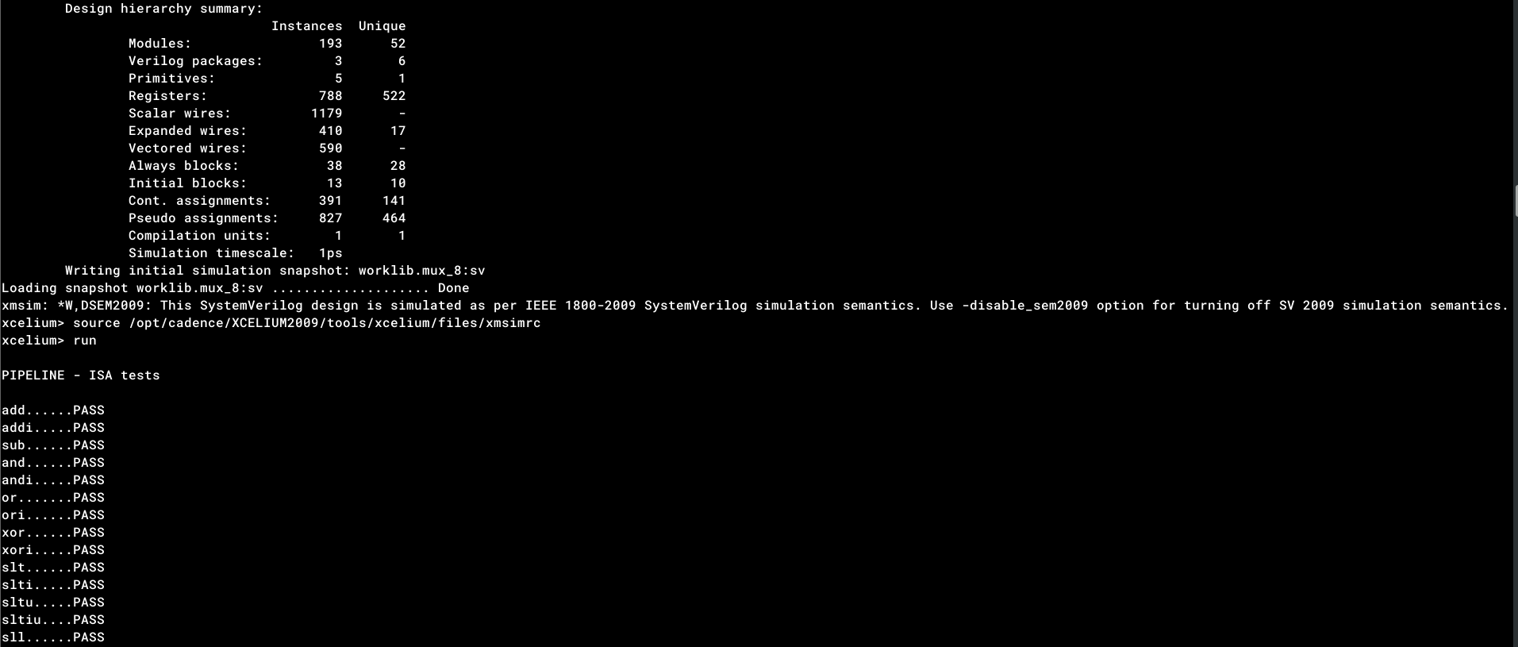
4. Implementation Results
Xcelium Simulation Log
Department of Electronics Engineering Capstone Project 2 Nguyễn Duy Ngọc January 5, 2026

Slide 33
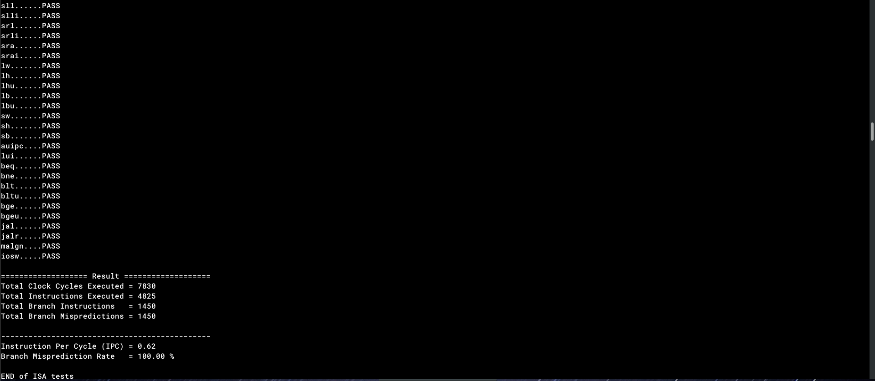
4. Implementation Results
Xcelium Simulation (cont.)
Department of Electronics Engineering Capstone Project 2 Nguyễn Duy Ngọc January 5, 2026

Slide 34
4. Implementation Results
Synthesis & Resources
Target Device: Intel Cyclone V 5CSXFC6D6F31C6
Low logic overhead: 5% ALM utilization (1,990 ALMs)
Memory usage: 9% Block RAM bits (526,336 bits)
Operating frequency: 60.16 MHz Fmax
Positive timing slack: 3.4 ns safety margin
Department of Electronics Engineering Capstone Project 2 Nguyễn Duy Ngọc January 5, 2026

Slide 35
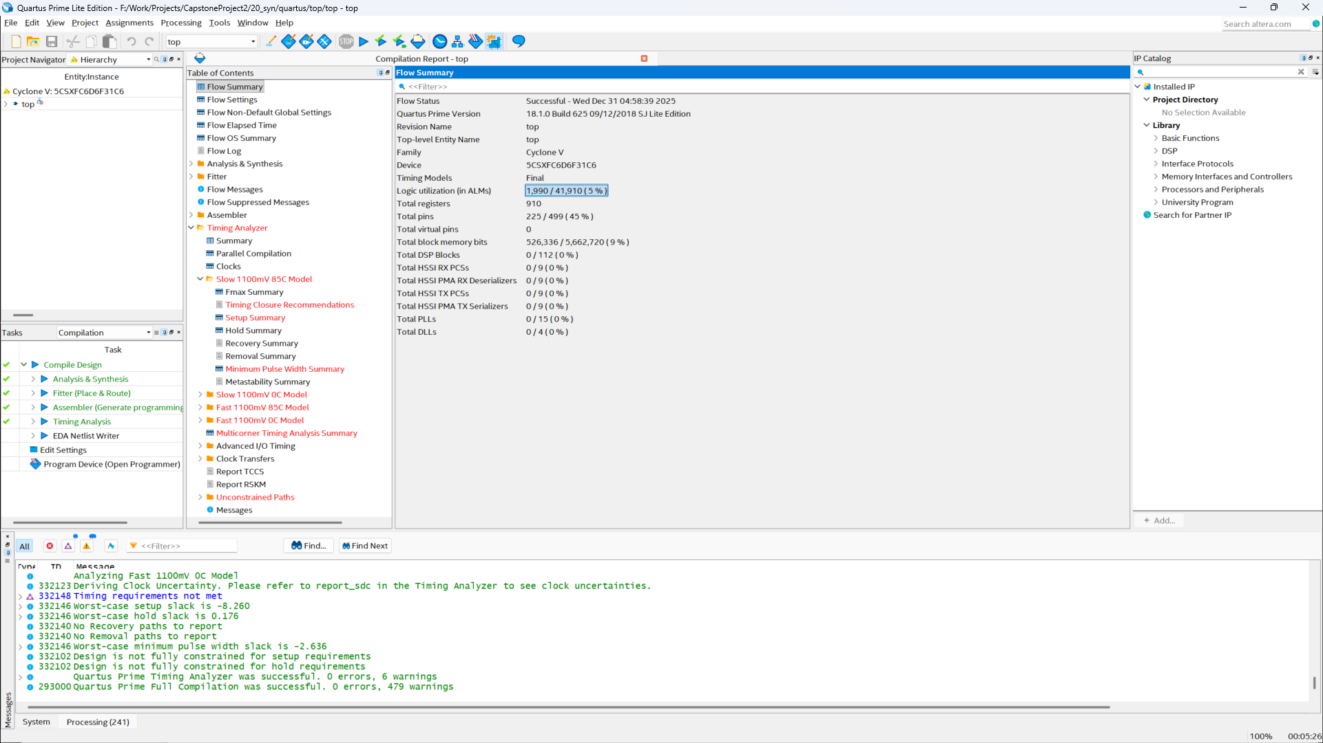
4. Implementation Results
Logic Resource Utilization Report
Department of Electronics Engineering Capstone Project 2 Nguyễn Duy Ngọc January 5, 2026

Slide 36
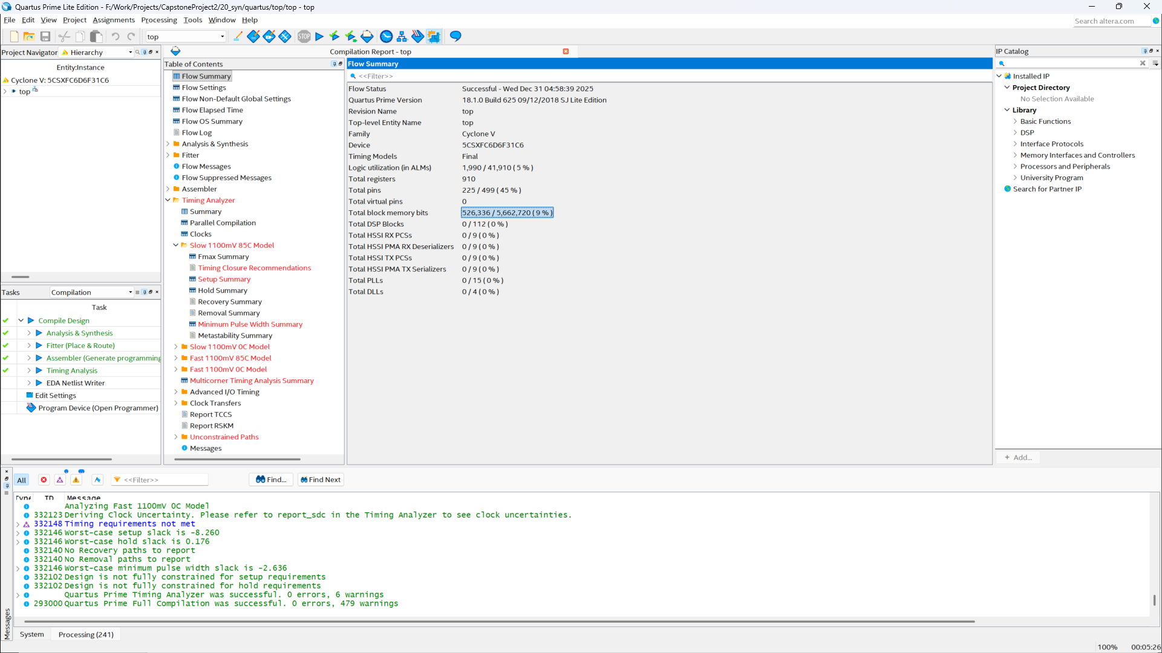
4. Implementation Results
Total Block Memory Bits Report
Department of Electronics Engineering Capstone Project 2 Nguyễn Duy Ngọc January 5, 2026

Slide 37
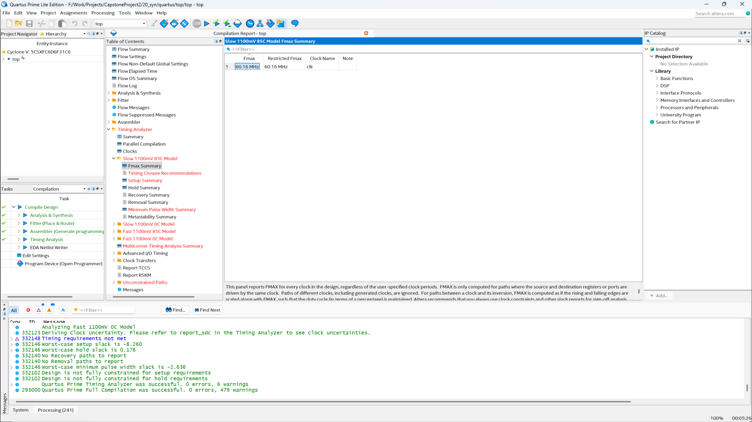
4. Implementation Results
Fmax Report
Department of Electronics Engineering Capstone Project 2 Nguyễn Duy Ngọc January 5, 2026

Slide 38
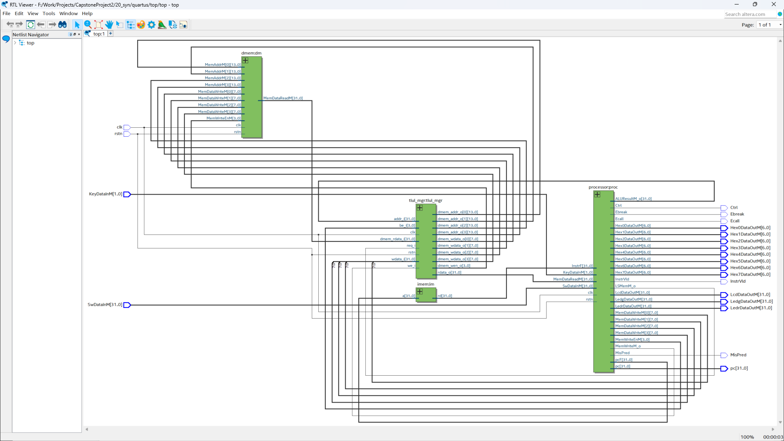
4. Implementation Results
Netlist of the interconnection between the RISC-V Core and the TileLink Manager
Department of Electronics Engineering Capstone Project 2 Nguyễn Duy Ngọc January 5, 2026

Slide 39
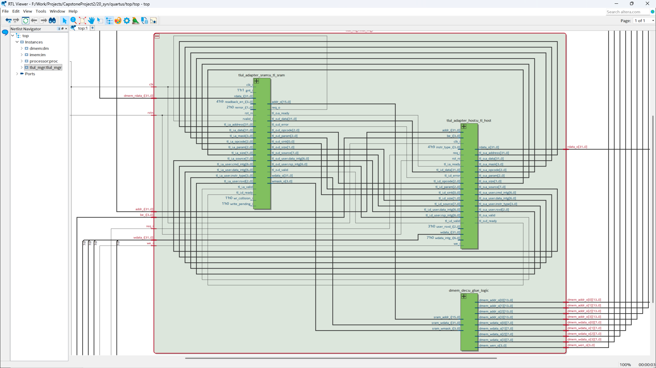
4. Implementation Results
Netlist of the TileLink Manager Module
Department of Electronics Engineering Capstone Project 2 Nguyễn Duy Ngọc January 5, 2026

Slide 40
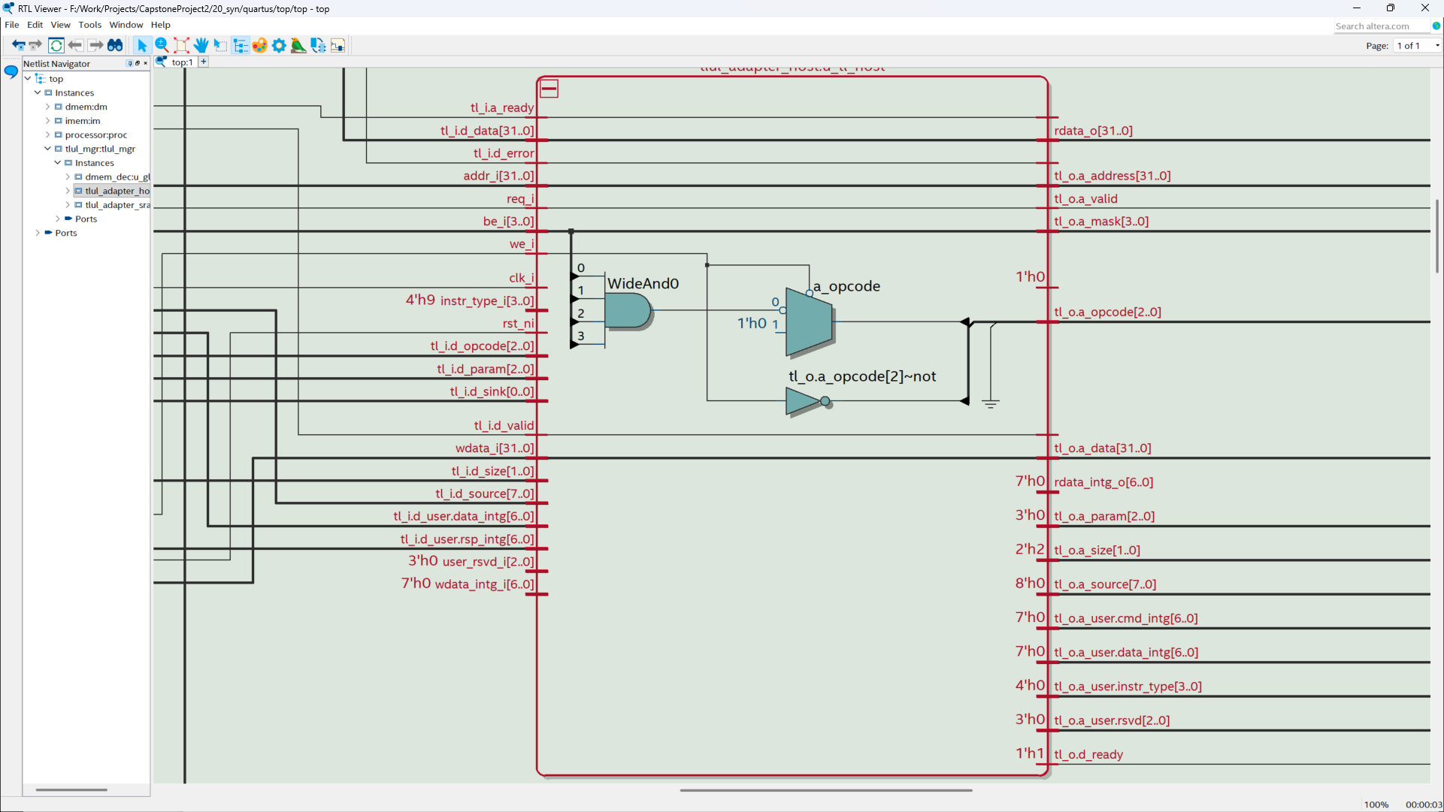
4. Implementation Results
Netlist of the Host Adapter Module
Department of Electronics Engineering Capstone Project 2 Nguyễn Duy Ngọc January 5, 2026

Slide 41
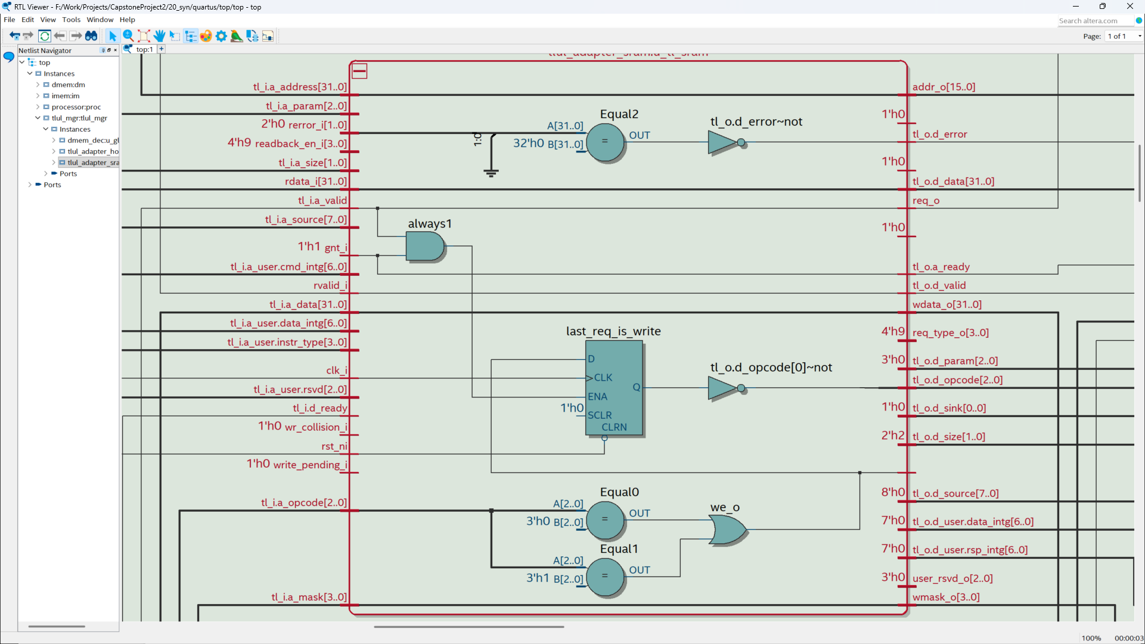
4. Implementation Results
Netlist of the Device Adapter Module
Department of Electronics Engineering Capstone Project 2 Nguyễn Duy Ngọc January 5, 2026

Slide 42
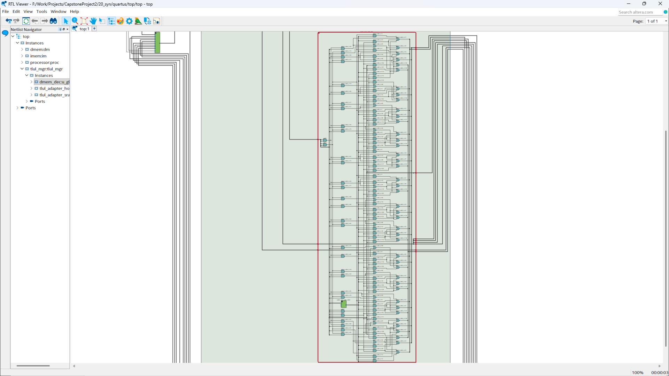
4. Implementation Results
Netlist of the Address Decoupling Logic
Department of Electronics Engineering Capstone Project 2 Nguyễn Duy Ngọc January 5, 2026

Slide 43
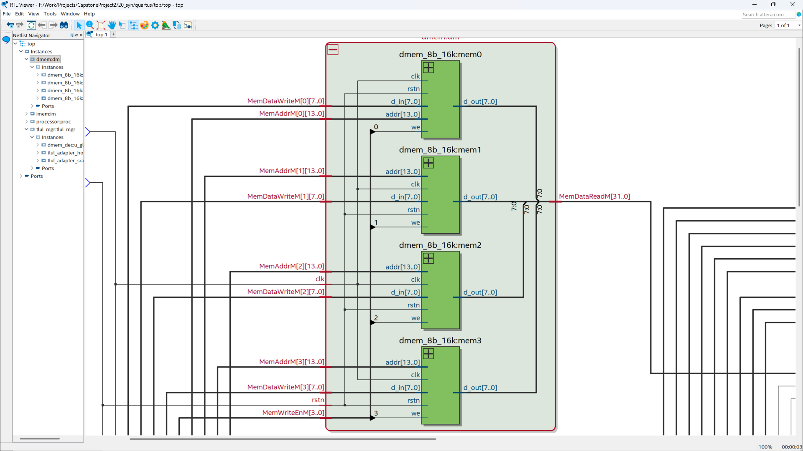
4. Implementation Results
Netlist of the Data Memory (64Kb)
Department of Electronics Engineering Capstone Project 2 Nguyễn Duy Ngọc January 5, 2026

Slide 44
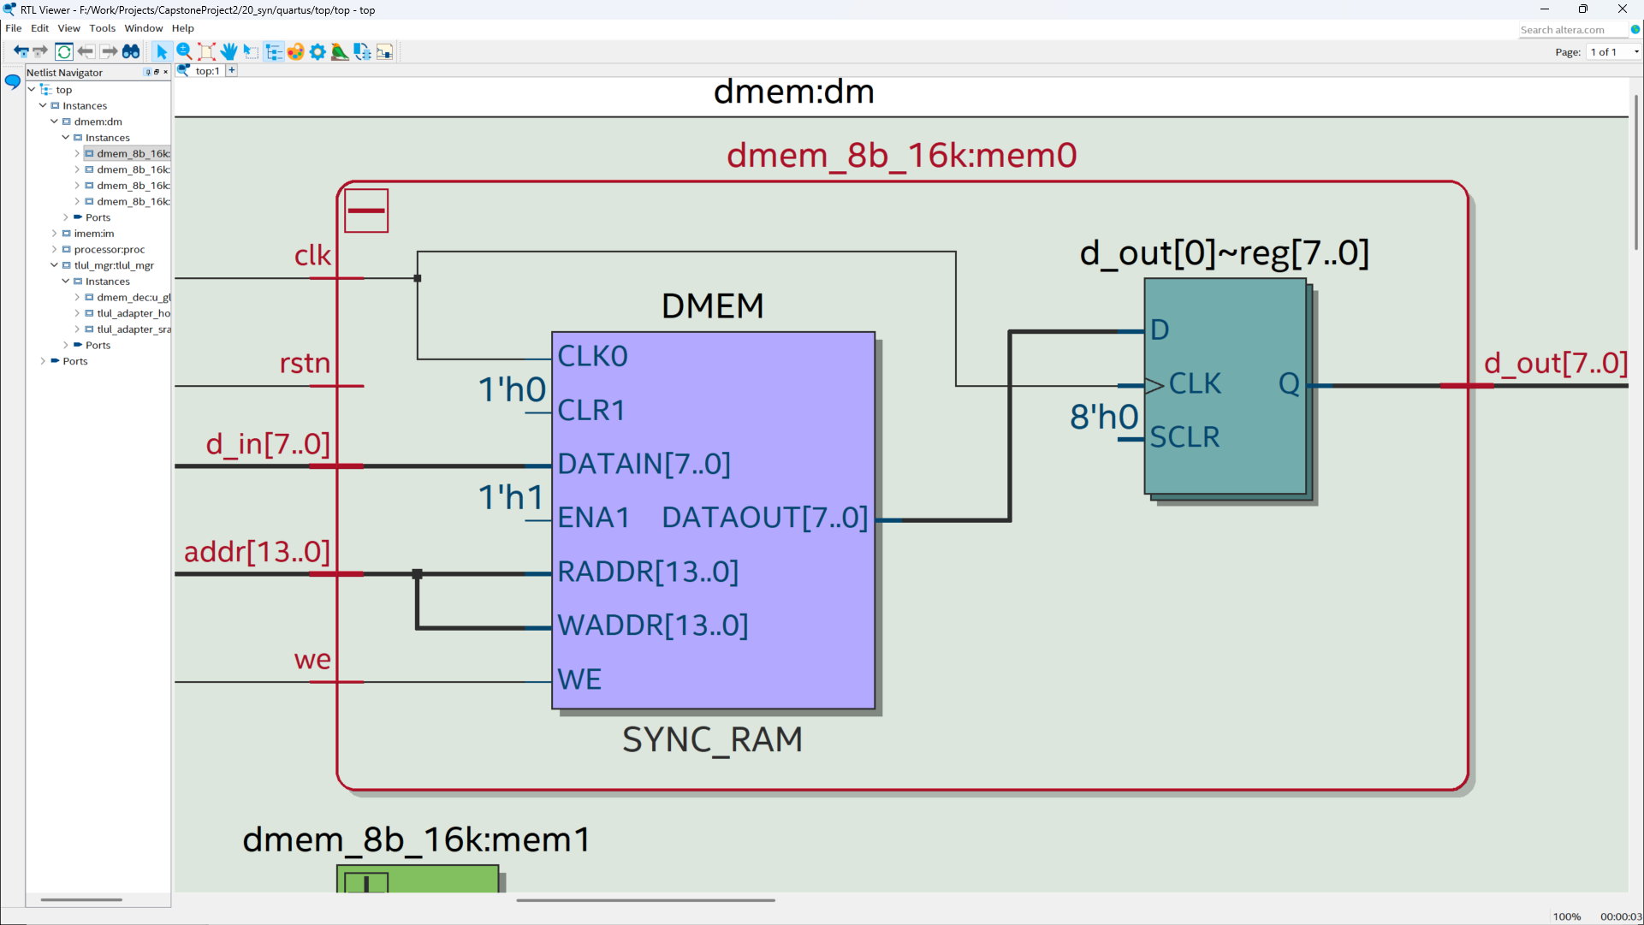
4. Implementation Results
Netlist of a 8-bit Memory Bank (16 Kb)
Department of Electronics Engineering Capstone Project 2 Nguyễn Duy Ngọc January 5, 2026

Slide 45
4. Implementation Results
Hardware Implementation
Successful deployment on DE10-Standard kit
Functional Stopwatch demo application
Real-time data display on LCD
Validated MMIO routing through TileLink adapters
Department of Electronics Engineering Capstone Project 2 Nguyễn Duy Ngọc January 5, 2026

Slide 46
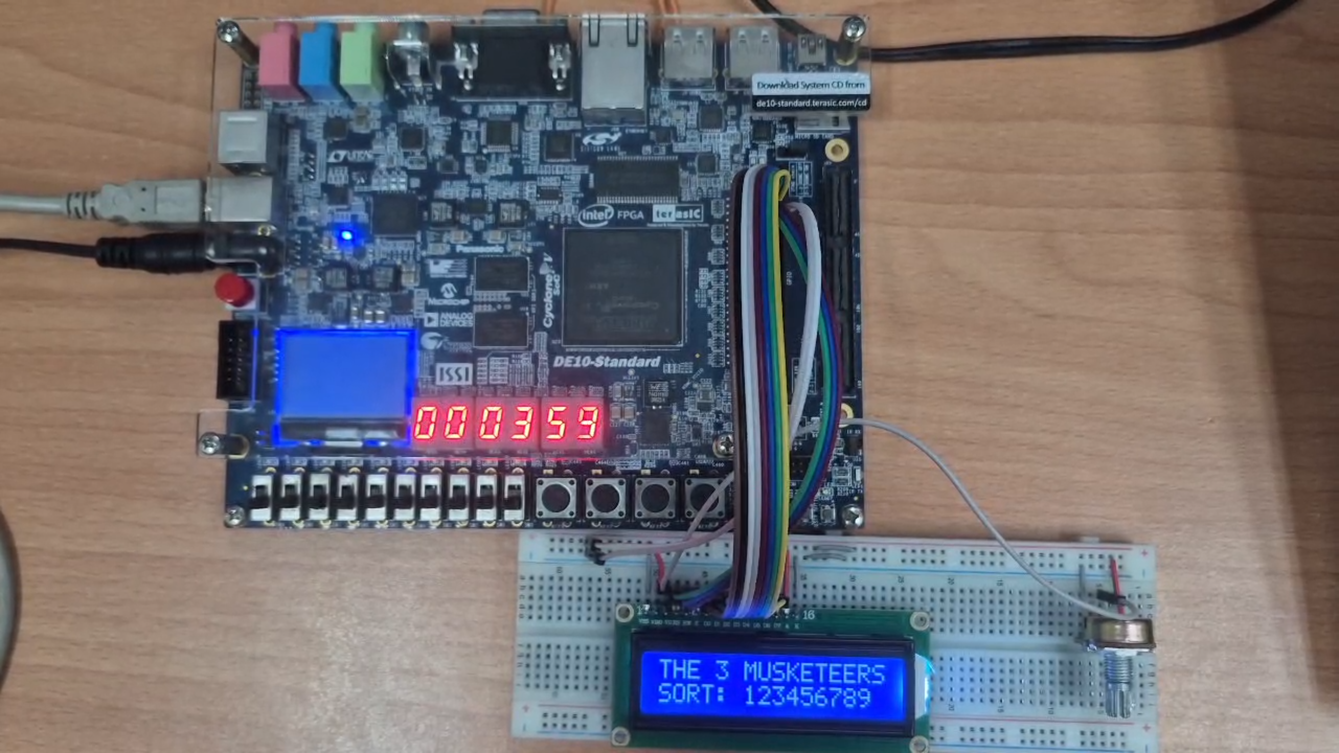
4. Implementation Results
Experimental setup utilizing the DE10-Standard development board
Department of Electronics Engineering Capstone Project 2 Nguyễn Duy Ngọc January 5, 2026

Slide 47
5. Conclusion - Future Vision
Conclusion
Achieved core-to-memory decoupling via TileLink-UL
Robust handling of misaligned accesses verified
Successful FPGA validation with minimal resource overhead
Compliant with industry standards for modular SoC
Established a scalable framework for future expansion
Department of Electronics Engineering Capstone Project 2 Nguyễn Duy Ngọc January 5, 2026

Slide 48
5. Conclusion - Future Vision
Future Vision
Implementation of a 1:N Bus Crossbar interconnect
Integration of Level-1 Instruction Cache
Support for Direct Memory Access (DMA) controllers
Exploration of TileLink-UH for burst transactions
Integration of communication peripherals (UART, SPI, I2C)
Department of Electronics Engineering Capstone Project 2 Nguyễn Duy Ngọc January 5, 2026

Slide 49
THANK YOU FOR YOUR ATTENTION.

