Slide 1

webProg
hw#5
201835476_유근혁

Slide 2
Concept
Concept
Structure
Contents
Coding

Slide 3











Concept

Slide 4





Slide 5
Contents
Profile
History
Gallery

Slide 6
Item2
Item3
Item1
Project

Slide 7
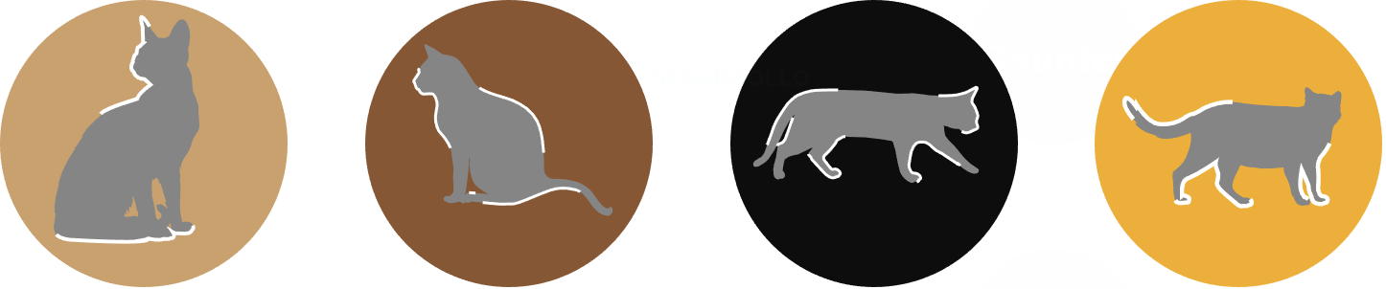

Slide 8
Blog

Slide 9




Structure
<header>
<aside>

Slide 10
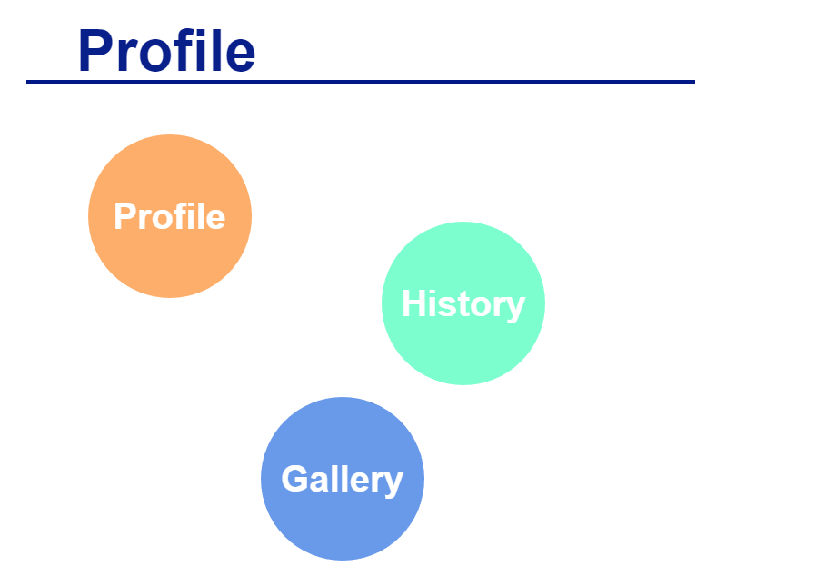
<nav>

Slide 11



Coding
HTML5 Structure
HTML Tags
Hyperlink

Slide 12
Design
Position: fixed;
Mouse hover animation
SVG scroll animation

Slide 13
Smooth scrolling
Scroll animation
Mouse click event

