Slide 1
EEG-Based Classification of Sleep Stages
Carolina Horey, Natalia Dadisman, Mariangel Benejam, and Amelia Lehel
Notes:
https://ufl.zoom.us/j/94248289320

Slide 2
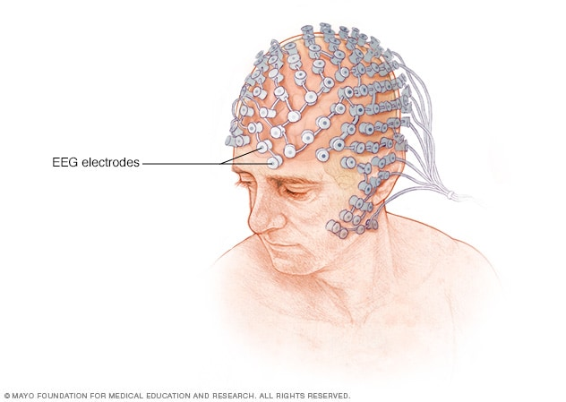
Our Problem
Sleep disorders can cause serious health complications
  Diabetes
  Increased risk of stroke
Impact patient quality of life
Electroencephalogram monitors brain activity
Researchers are able to understand processes essential for good mental and overall health
https://www.mayoclinic.org/tests-procedures/eeg/about/pac-20393875
Solution:
EEG-based sleep stage classification to enhance diagnosis and treatment of sleep disorders
Notes:
Carolina

Slide 3
Significance
Why does it matter?
Sleep disorders affect millions globally
Current diagnosis methods rely on subjective reports
  EEG-based solutions provide objective, physiological insights into abnormal sleep patterns
Impact
Enhances understanding of cognitive functions like memory, learning, and emotional regulation
Paves the way for personalized treatments for sleep disorders
Notes:
Carolina

Slide 4
Applications
Sleep Diagnosis/Management
Use EEG to analyze sleep pattern and identify abnormal patterns
Real-Time Monitoring
Included in wearable devices.
Collect continuous data for constant feedback.
Sleep-Tracking Apps
Visualize sleep stages.
Track sleep metrics over time.
Communicate with physician.
Notes:
Carolina

Slide 5
Methodology
Data Source:
Open-source dataset: St. Vincent's University Hospital/ University College Dublin Sleep Apnea Database
  (https://physionet.org/content/ucddb/1.0.0/)
Machine learning approach
Model inspired by hybrid CNN-LSTM model :
  Utilizes deep learning for efficient and accurate sleep stage classification
Steps: data processing, feature extraction, training, and validation

Slide 6
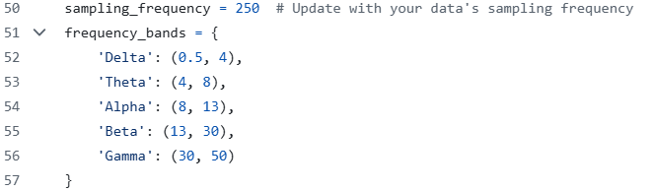
Code: Overview
1. Read EDF and Preprocessing
3. Combine Features
Combine EEG feature data into single data set in new CSV file
Read data as EDF file
Filtering of EEG data by bandpass filtering 1-50 Hz
4. Train
Split data into training and testing
Train classifier with Random Forests
2. Extract EEG Features
Calculates power in EEG frequency bands: Deltha, Theta, Alpha, Beta, and Gamma and assign sleep stages
Saves band power and sleep stage as csv
5. Evaluate
Evaluate the trained model on the test set using metrics: Accuracy, Precision, Recall, and F1 Score.

Slide 7
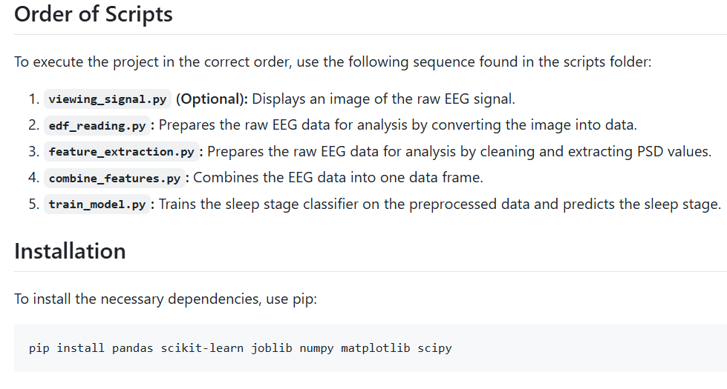
Code: Installation Demo

Slide 8
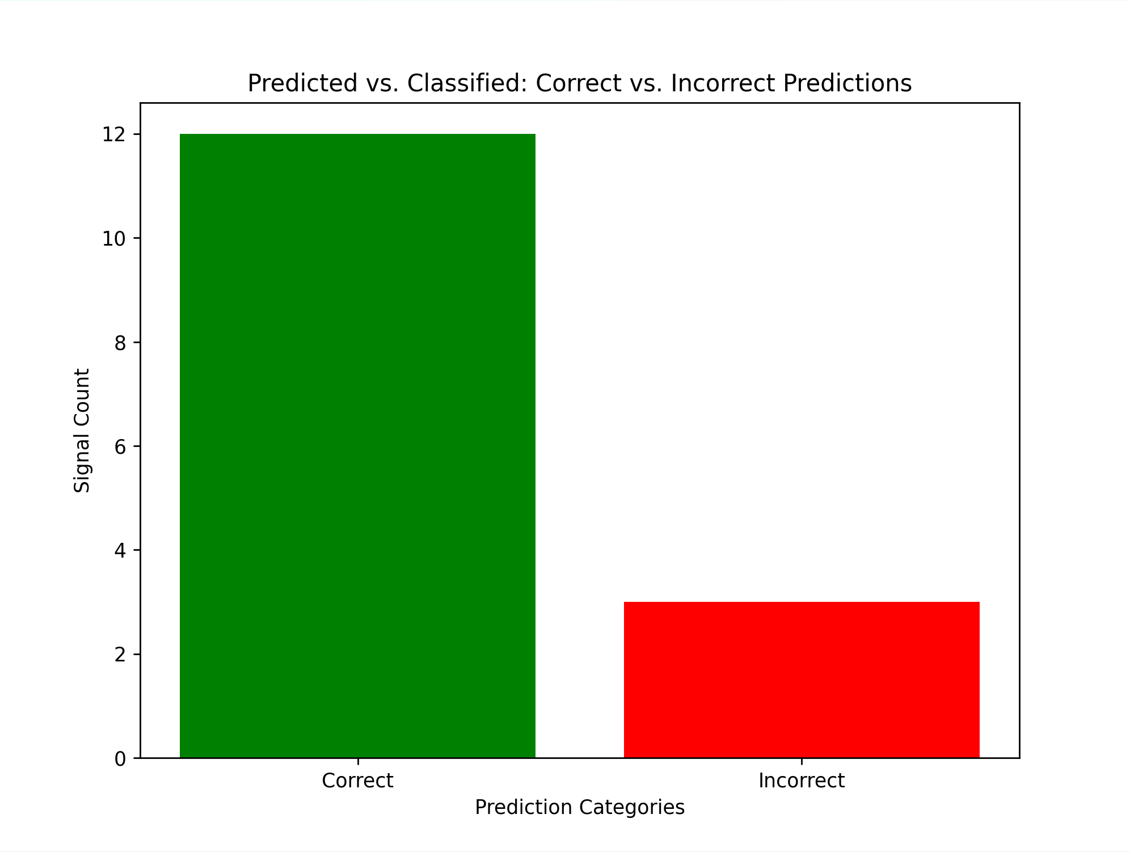
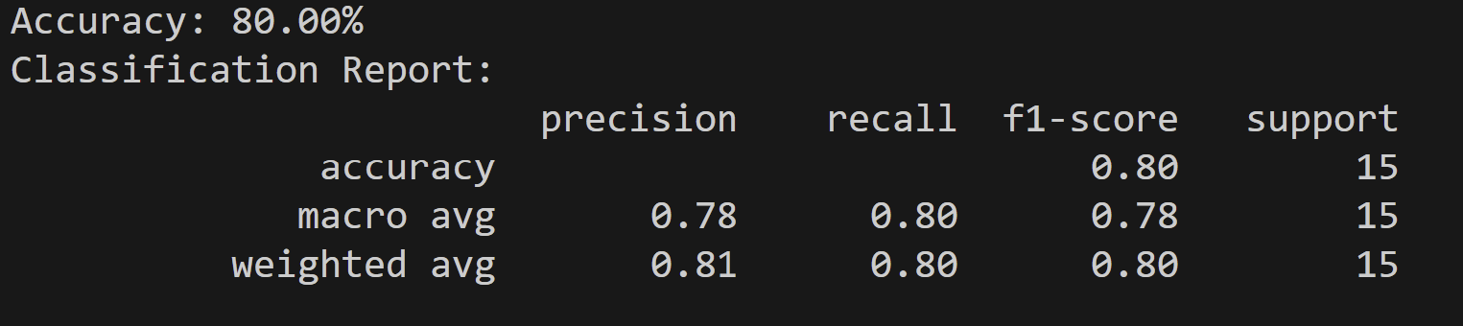
Results
Figure 2: Classification Report
Figure 1: Prediction Chart

