Slide 1

LLM-Based Intelligent Notification Composition
Reference Implementation: iOS SDK, Python Backend, and Sample App
Nilesh Agrawal
nilesh.d.agrawal@gmail.com • Seattle, WA
Swift 5.9
Python 3.11
FastAPI
SwiftUI

Slide 2







The Core Problem: WHO + WHEN + WHAT vs. HOW
The Solved Problems
The Unsolved Problem
WHO (Audience Selection)
HOW (Message Composition)
ML models predict which users have the highest propensity to convert.
Knowing the user and context still yields a static, slot-filled template.
WHEN (Send-Time Optimization)
// Status Quo: Slot-Filling "Hey {user.first_name}! Your favorite {item.name} is waiting. Order now!"
Contextual bandits and history determine when a user is most receptive.
WHAT (Content Ranking)
Recommendation systems match inventory to user preferences.
A jarring disconnect: smart targeting delivering a generic message that ignores why the user might act now.
The next evolution in notifications shifts from relevance (finding the right item) to intelligence (composing the right persuasive framing).

Slide 3
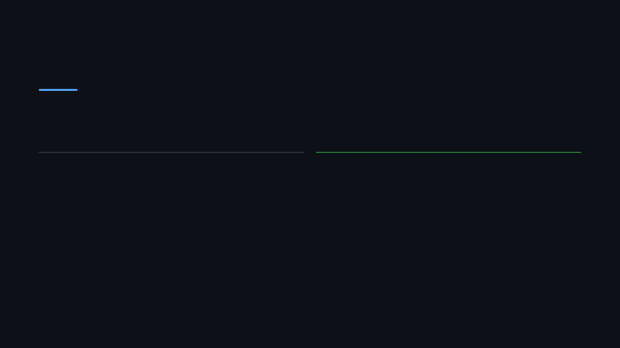






The Pizza Example: From Templates to Intelligence
SHARED SYSTEM CONTEXT
John (Late-night user)
11:30 PM
Raining
Pepperoni Pizza
Status Quo (Template)
LLM Composition
"Hey John! Your favorite Pepperoni Pizza is waiting for you. Order now!"
"Late night studying, John? It's pouring outside. Stay dry and let us bring a hot Pepperoni Pizza straight to your door."
WHY IT FAILS
Ignores the late-night context
WHY IT SUCCEEDS
Ignores the weather condition
Synthesizes time (late night) and weather (pouring)
Uses generic, pushy CTA ("Order now!")
Frames the product as a solution to the context
Replaces pushy CTA with empathetic framing

Slide 4















Full System Architecture
iOS SDK (Client)
FastAPI Backend
Online Learning
Signal Collector (Batched)
Budget Router (CLV-based)
KPI Tracking (Open/Convert)
CONTEXT & SIGNALS
DELIVERY OUTCOMES
NCNetworkClient
Counterfactual Logging
LLM Composer (OpenAI)
Domain Adapters
Reward Model Updates
Notification Renderer
Guardrail Filters
End-to-end implementation separating signal collection (edge) from heavy composition and ranking (cloud).
Frequency Capping
Reward Ranker

Slide 5



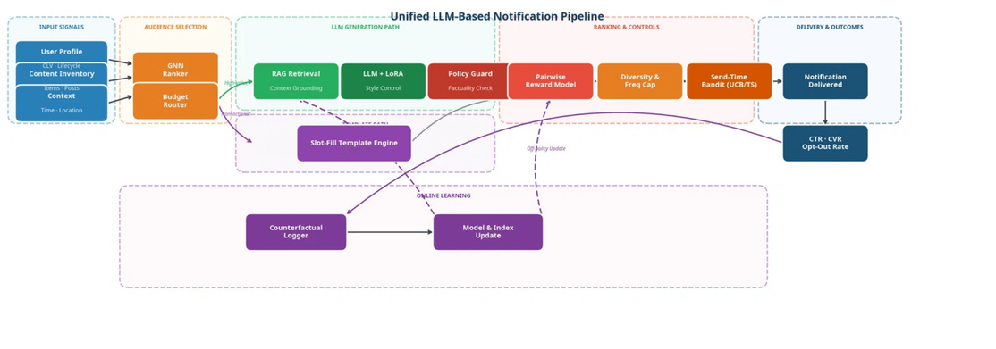



The FastAPI Backend: 9-Component Pipeline
Budget Router
CLV-tiered routing directing high-value users to LLM generation and others to templates.
Context Retriever (RAG)
Assembles user history, preferences, and real-time signals into a structured prompt.
Message Composer
OpenAI integration generating 5 diverse candidate messages per request.
Guardrail Filter
Blocks hallucinations, dark patterns, and false urgency before ranking.
Reward Ranker
Heuristic and LLM pairwise scoring to select the optimal candidate for delivery.

Slide 6



NotifyCompose iOS SDK (Swift Package)
NotifyComposeClient
let c = NotifyComposeClient.shared; c.configure(apiKey:"sk-...")
c.track(event:"app_opened", properties:["time":"night"])
let ctx = FoodDeliveryAdapter.buildContext(item:"Pizza", weather:"Rain")
let n = try await c.compose(userId:"user_123", context:ctx)
c.reportOpened(notificationId:n.id)
The main entry point for the SDK. Provides modern async/await APIs for requesting composed notifications and tracking user interactions.
Automatic Signal Batching
SignalCollector batches user context events and flushes them periodically to optimize battery and network usage.
Domain Adapters
Pre-built adapters (FoodDeliveryAdapter, ECommerceAdapter, SocialMediaAdapter) to construct domain-specific context payloads quickly.

Slide 7



SwiftUI Sample App: Three Domains
Food Delivery
E-Commerce
Social Media
Scenario:
Lunch/Dinner
Scenario:
Abandoned Cart
Scenario:
New Content & Activity
Interactive UI:
Weather & time sliders
Interactive UI:
Product selector & discounts
Interactive UI:
Activity simulator
Demonstrates:
Combine context & prefs
Demonstrates:
Summarize social signals
Demonstrates:
Urgency vs empathy
SocialMediaAdapter.buildContext(unreadCount: 5, topSignal: .friendPost)
FoodDeliveryAdapter.buildContext(weather: .raining, time: .lateNight)
ECommerceAdapter.buildContext(cartValue: 150, discountActive: true)

Slide 8
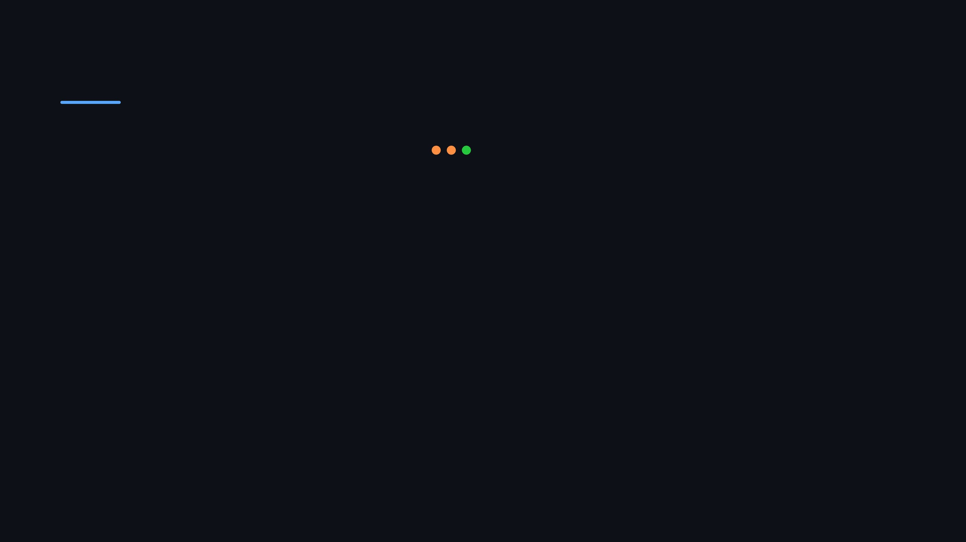



Real-Time Pipeline Inspector
pipeline_trace.log
Bridging Theory & Practice
11:30:01
[Sec 4.1]
BudgetRouter: CLV Tier = Gold -> Routing to LLM Path
The Sample App includes a dedicated Inspector tab that provides full transparency into the SDK's decision-making process.
11:30:02
[Sec 4.2]
ContextRetriever: Loaded 3 signals (Weather, Time, History)
11:30:04
[Sec 4.3]
MessageComposer: Generated 5 candidate messages
Paper Mapping:
Every execution step is mapped directly to its corresponding section in the ACM paper.
11:30:05
[Sec 4.4]
GuardrailFilter: Candidate 2 REJECTED (Policy: False Urgency)
11:30:06
[Sec 4.5]
RewardRanker: Scoring remaining 4 candidates...
Traceability:
View the exact context retrieved, candidates generated, and reward scores assigned.
11:30:06
[Sec 4.5]
RewardRanker: Candidate 4 selected (Score: 0.92)
11:30:07
[Sec 4.6]
FrequencyCapper: Check passed (1/3 daily touches)

Slide 9




Comprehensive Documentation & Research Paper
ACM Research Paper
System Architecture
The complete 11-page academic survey and architectural framework, formatted for WSDM '26. Includes all PRISMA methodology, evaluation frameworks, and ethical considerations.
Detailed technical design document mapping the paper's theoretical components to concrete software modules. Covers signal collection flow and API contracts.
ARCHITECTURE.md
diagrams/
.pdf
.tex
.docx
Integration Guide
Open-Source License
Comprehensive instructions for running the FastAPI backend locally, integrating the Swift Package into iOS apps, and running the SwiftUI sample application.
The entire repository—including the SDK, backend server, sample app, and documentation—is released under the permissive MIT License for academic and commercial use.
README.md
cURL examples
MIT License

Slide 10

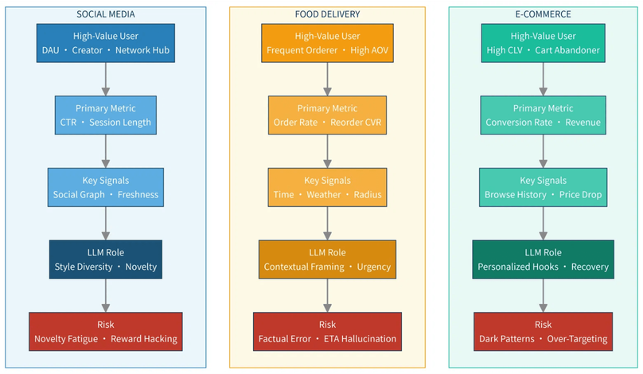



Conclusion & Open Source Release
Key Takeaways
From Theory to Practice:
The complete ACM paper pipeline is now a fully functional, open-source SDK.
Cross-Domain Ready:
Pre-built adapters for Social Media, Food Delivery, and E-Commerce.
Safe & Scalable:
Built-in guardrails, frequency capping, and CLV-based budget routing.
Get the Code
github.com/ndagrawal/LLMNotificationComposition
Nilesh Agrawal |
nilesh.d.agrawal@gmail.com
Figure: Domain Generalizability Matrix demonstrating cross-industry applicability.

