Slide 1
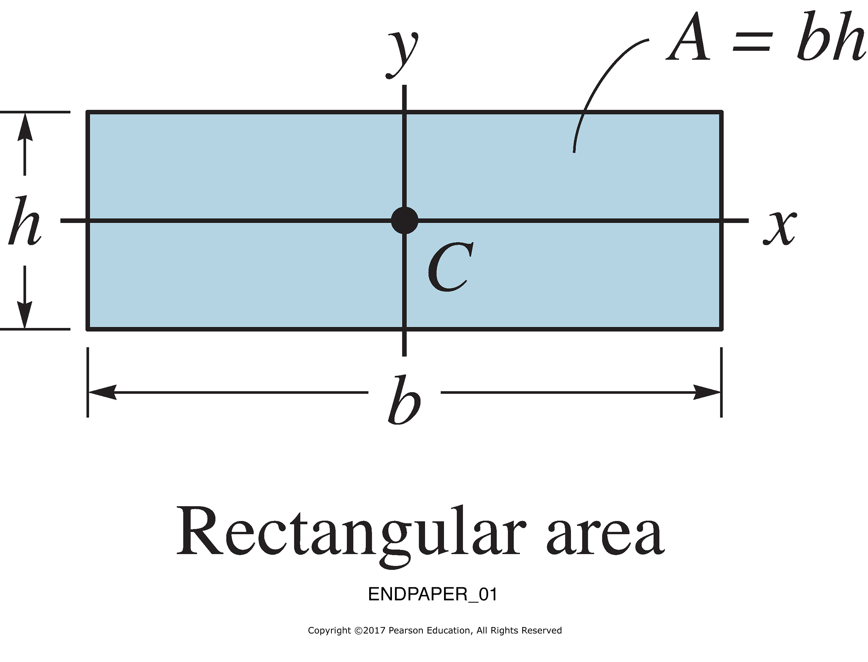
ENDPAPER_01

Slide 2
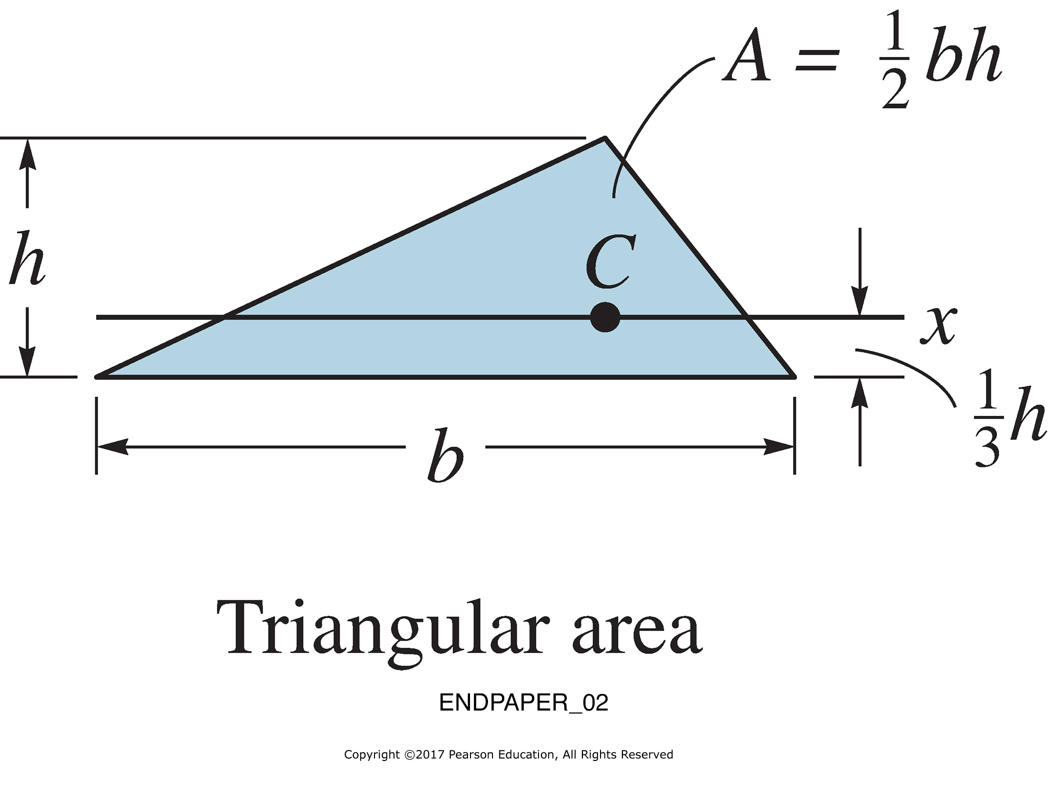
ENDPAPER_02

Slide 3
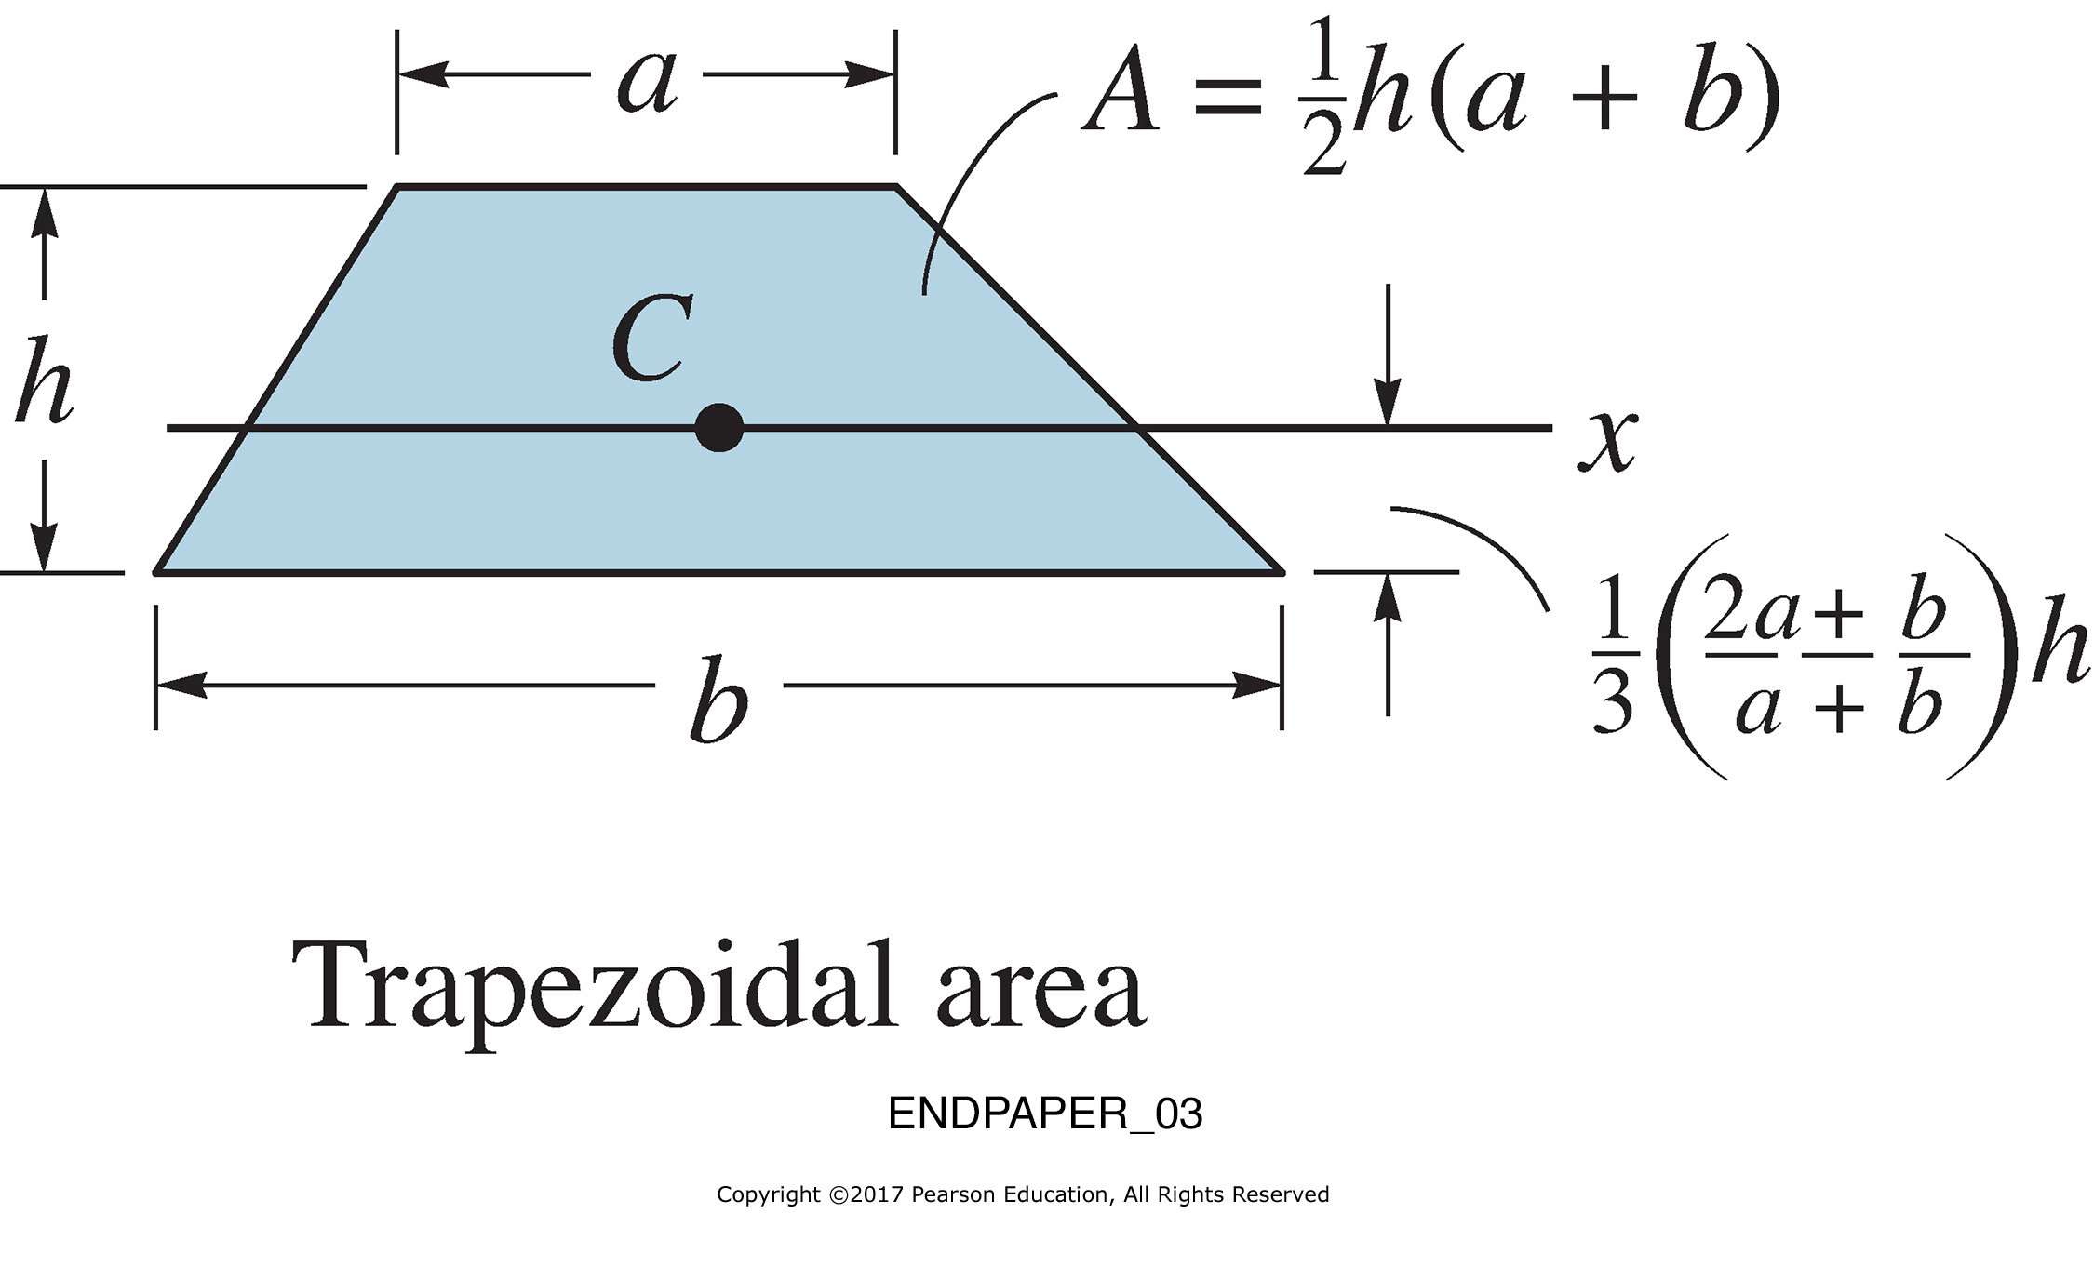
ENDPAPER_03

Slide 4
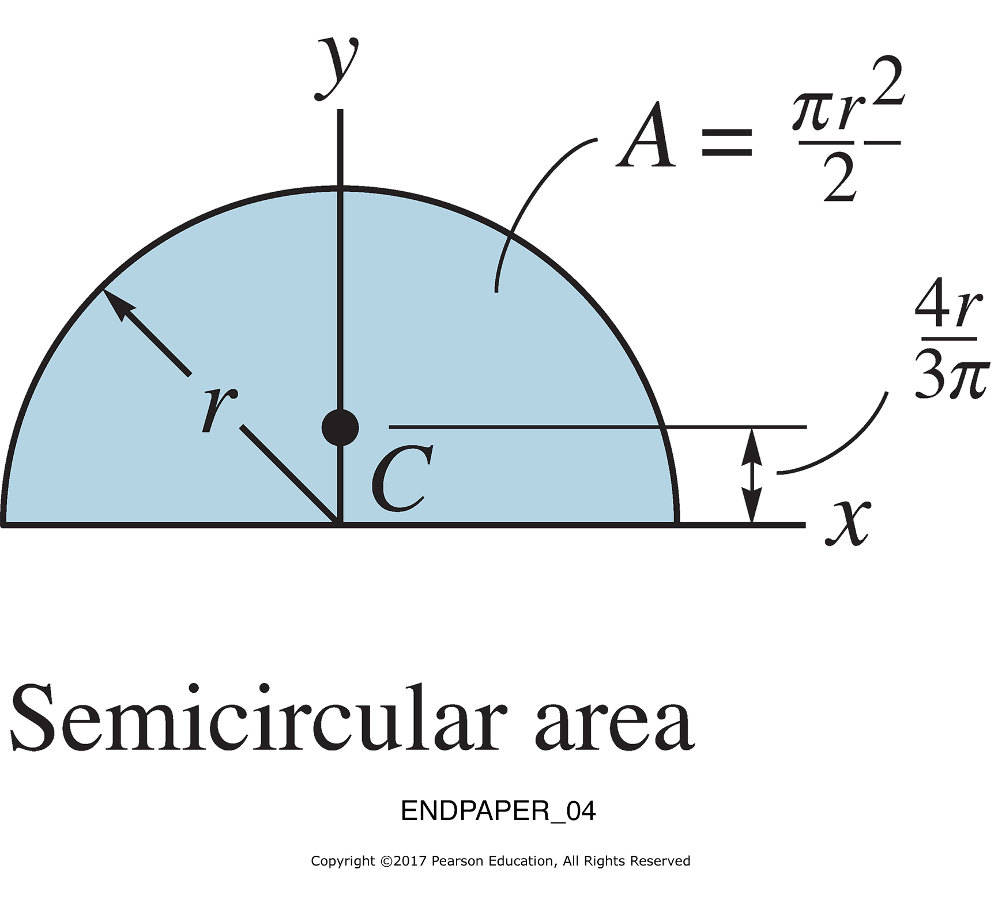
ENDPAPER_04

Slide 5
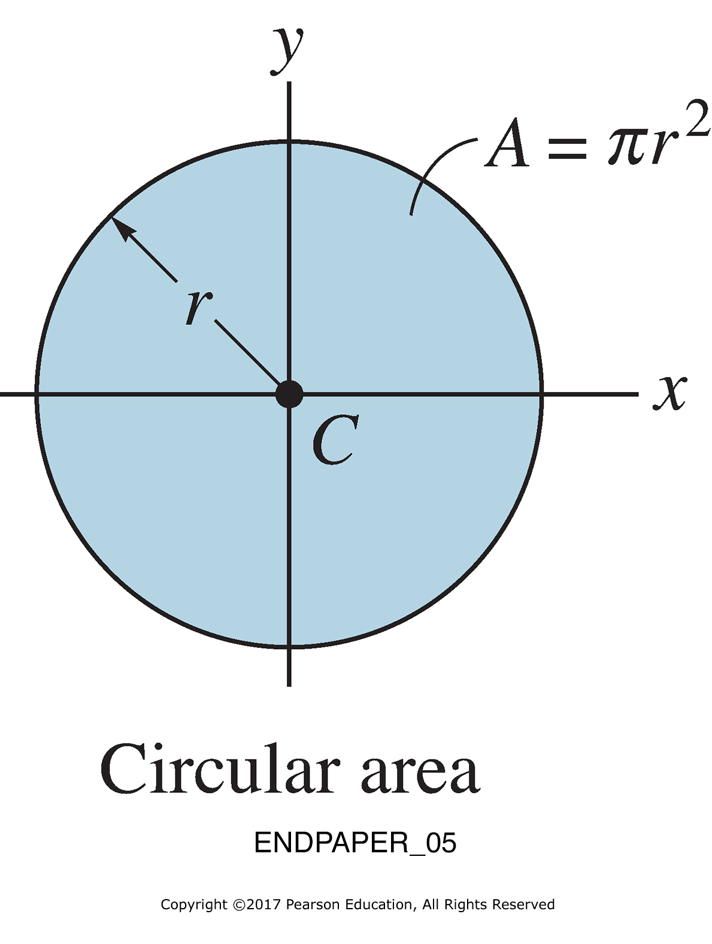
ENDPAPER_05

Slide 6
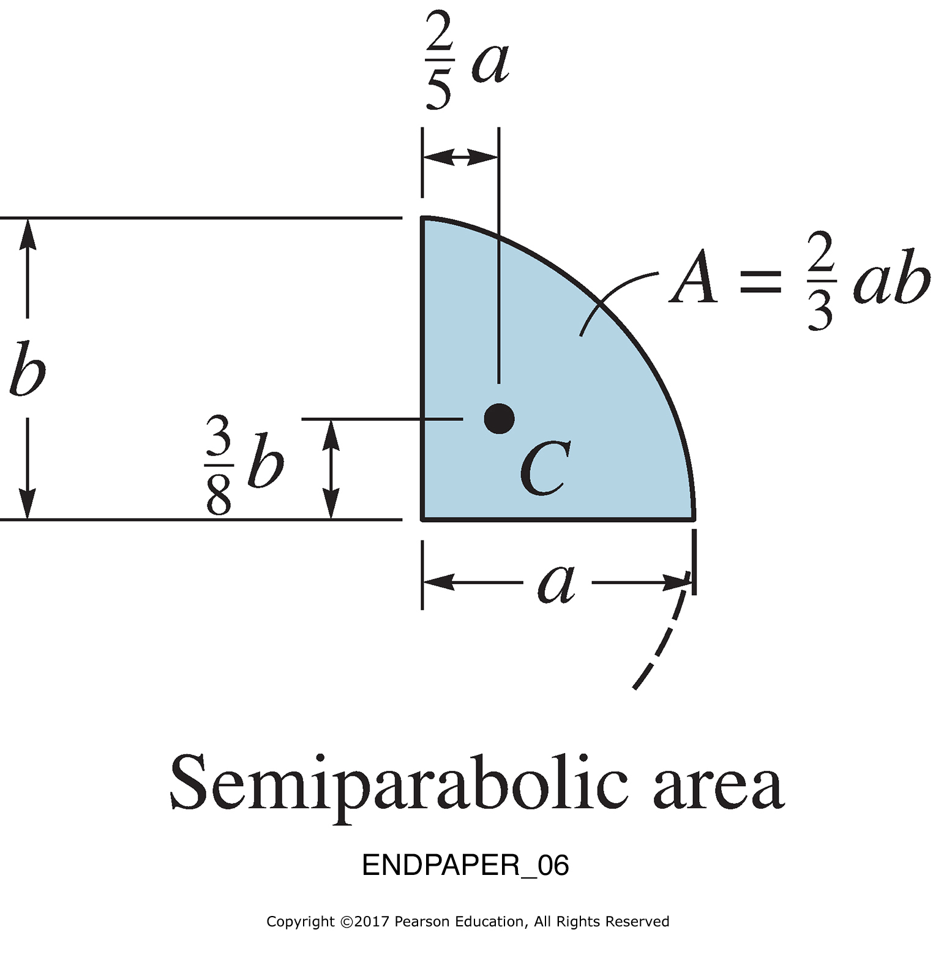
ENDPAPER_06

Slide 7
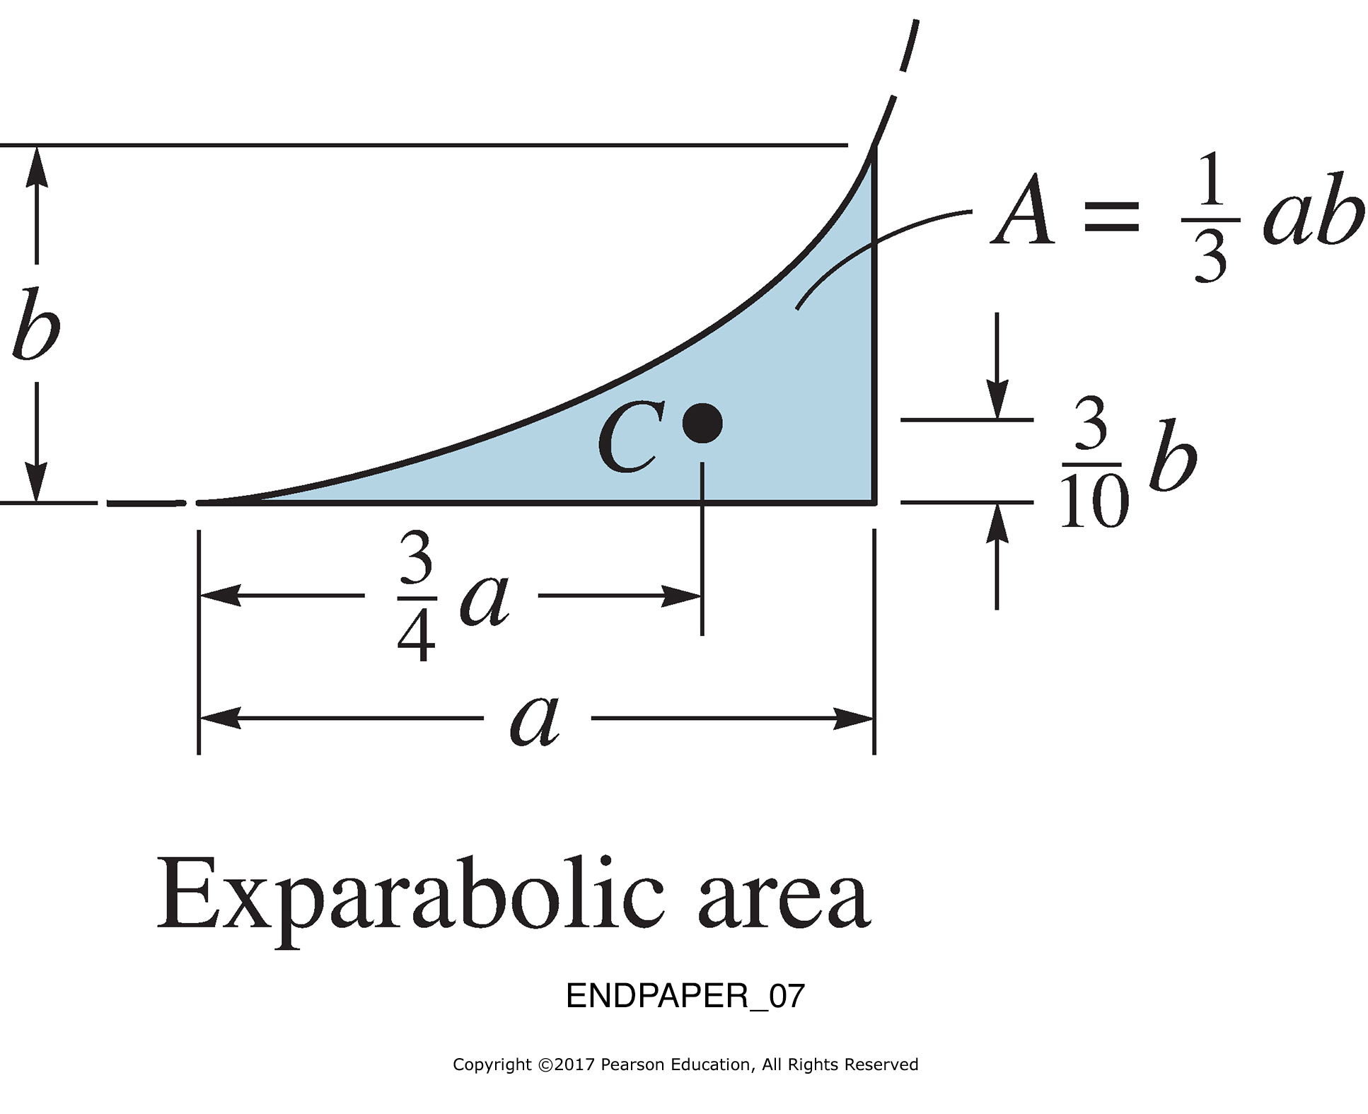
ENDPAPER_07

