Slide 1
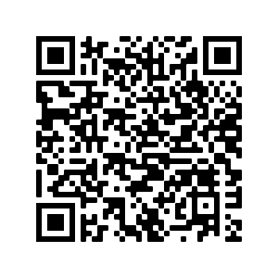
Learn more about the new AE Honors Program!
Scan here for full details!
Complete tasks in five areas:
Scholarship, Discovery, Service, Leadership, and Professionalism
Tailor the program to your interests.
Beat the competition, with AE Honors on your degree!

