Slide 1
EVSP–DR
Research update
Week of 21 September 2026
Integer routes, charging constraints, and next tests

Slide 2
What changed this week
All six chains now have paired CG, integer and MIP-time figures.
Their LPs agree; sequential pools give much better integer fleets.
New paired pricing test: eight buses in 7/8 runs, controls 0/8.
All 195 smaller-battery failures repair without changing trips.
New figures and code-backed explanations follow on slides 15–28.
Earlier pilot and constraint experiments remain for context.
Notes:
Updated 21 September 2026. New audited results and sources: https://github.com/ndandnd/EVSP-DR/tree/6fcc672b16db3255ec552294ff0f34a1b5c9290e/outputs/research_followup_20260921 . Current Doc tab: https://docs.google.com/document/d/1hDSWYb2KG-8pnLFN9BdSKkbXOjhytm4bxQz_MsBw_BY/edit?tab=t.fycml6be3fks . The k8 result is four selected cases × two seeds, treatment new columns plus own start, nominal one-hour shared charged budget. Battery repair is continuous and capacity-only under historical240kW/zero-reserve assumptions. Earlier pilot remains on slide7.

Slide 3
Four fresh pools exclude an 8-bus solution
Chain | LP weight | Pool MIP | Added* | After*
C1 | 8 | 9 | 8 | 8
C3 | 8 | 9 | 8 | 8
C4 | 8 | 9 | 8 | 8
C5 | 8 | 9 | 8 | 8
* Add known sequential routes to the fresh pool, then re-solve.
Both MIP columns show proved fleet minima within their pools.
Notes:
Source: outputs/week_20260921/evidence/k8_witness/. Full original Gurobi logs and SHA256 receipts are in the evidence index. LP fleet is fractional route weight; pricing-certified weighted-objective endpoint. Pool MIP: numerical optimality within a fixed finite column pool only. Adding witness routes is a diagnostic and uses known sequential solutions; it is not the autonomous diving algorithm. Four cases C1/C3/C4/C5.

Slide 4
Read the proof in Gurobi’s log
​​
Chain 1, k=8: stage 1 minimizes only the number of buses.
194 trip rows • 39,940 route variables
“Optimal solution found (tolerance 1.00e-04)”
“Best objective 9 … best bound 9 … gap 0.0000%”
Incumbent 9 + bound 9 ⇒ no 8-bus cover in this pool.
Adding eight witness routes: objective 8, bound 8.
The later charging-stage gap does not undo this fleet proof.
Notes:
C1 fleet proof, lines 155–156:
https://github.com/ndandnd/EVSP-DR/blob/ca1dda82247db995ffd0d524e045430ea197ec13/outputs/week_20260921/evidence/k8_witness/c1_k08/control/391804_r0/gurobi.log#L155
After adding eight sequential routes, line 112:
https://github.com/ndandnd/EVSP-DR/blob/ca1dda82247db995ffd0d524e045430ea197ec13/outputs/week_20260921/evidence/k8_witness/c1_k08/augmented/391805_r0/gurobi.log#L112
Local root: /Users/nadan/Documents/projects/demandresponse/outputs/week_20260921/evidence/
Model size: line 19; unit bus costs: line 24; root relaxation eight: line 53. Objective nine and bound nine prove the fixed-pool fleet optimum to Gurobi's numerical tolerance. The later charging-stage gap does not invalidate this proof. Full-model minimum nine is not claimed.

Slide 5
Why a good LP can give a poor integer pool
The LP spreads 8 units of route weight over 80–101 routes.
Whole buses need a compatible set of complete routes.
LP pricing looks for improvement in the fractional objective.
A route can cost slightly more fractionally, yet complete a better integer cover. Its reduced cost can be positive.
Sequential runs retain routes from earlier dual prices.
Diving changes the dual prices by fixing part of a cover.
Notes:
Evidence: outputs/week_20260921/evidence/witness_analysis.json and forthcoming WHY audit. Distinguish explanation from universal claim: positive reduced cost is relative to a particular LP dual. It does not prove all pricing/enrichment algorithms miss the route. Historical witness injection established missing compatible columns; autonomous diving tests whether altered duals can find them without importing a known solution.

Slide 6
A small example: fractional value versus compatibility
Six trips: A, B, C and D, E, F. Each route below costs 100.
Pool: AB, AC, BC, DE, DF, EF.
LP: take half of every route → 3 route units, cost 300.
Integer pool: two routes per triangle → 4 buses, cost 400.
Add AD at cost 101. Reduced cost = 101 − 50 − 50 = +1.
Now AD + BC + EF covers all trips with 3 buses, cost 301.
The better integer cover need not improve the LP.
Notes:
Illustrative set-covering example, not a GIRO instance. Dual trip prices50 for all6trips certify old and enlarged LP optimum300. New AD reducedcost+1. Original two disjoint triangles require2integer edges each; addingAD yields3edge perfectmatching. Proof demonstrates compatibility mechanism; not evidence that actual route structure is literally triangles.

Slide 7
Can new pricing recover eight buses?
Chain | Controls | Dive + MIP | Follow-up
C1 | 9 | 9 | 8
C3 | 9 | 8 | —
C4 | 9 | 8 | —
C5 | 9 | 8 | —
Original pilot: 3/4 successes. C1 follow-up: +29.6 minutes.
Same distinct routes; passing the dive incumbent recovered eight.
Notes:
Sources: outputs/week_20260921/evidence/pilot_summary.csv and c1_followup_summary.csv. This is autonomous pricing, separate from adding known sequential witnesses. Original pilot stays3/4. C1 followup628441 has63561unique routes,8 duplicate model columns introduced by generic MIP-start path, no new distinct routes. Same source hashes. Controls use saved pools. Full Gurobi log at evidence/c1_followup/628441_r0/gurobi.log.

Slide 8
Twelve 12-hour searches still miss 15
Chain | Plain MIP | Heuristics | Fleet bound
C1 | 18 | 18 | 15
C2 | 17 | 17 | 15
C3 | 17 | 16 | 15
C4 | 19 | 17 | 15
C5 | 16 | 16 | 15
C6 | 18 | 17 | 15
All searches timed out; none proved 15 impossible.
The charging stages have also finished. “Heuristics” changes MIP search settings.
Notes:
All 12 fleet searches ran to the 12-hour limit. Every bound is 15; none proves that 15 is impossible. All subsequent charging stages have also finished at their time limit.
Exact results and paths to all logs:
https://github.com/ndandnd/EVSP-DR/blob/ca1dda82247db995ffd0d524e045430ea197ec13/outputs/week_20260921/evidence/k15_12h_summary.csv
Local log folder: /Users/nadan/Documents/projects/demandresponse/outputs/week_20260921/evidence/k15_12h/
Plain and heuristic-focused arms use the same saved CG pool per chain. They change MIP search settings, not physics. These pools do not enforce shared charging capacity. The incumbents pass physical route replay; duplicate-service cleanup remains separate.

Slide 9
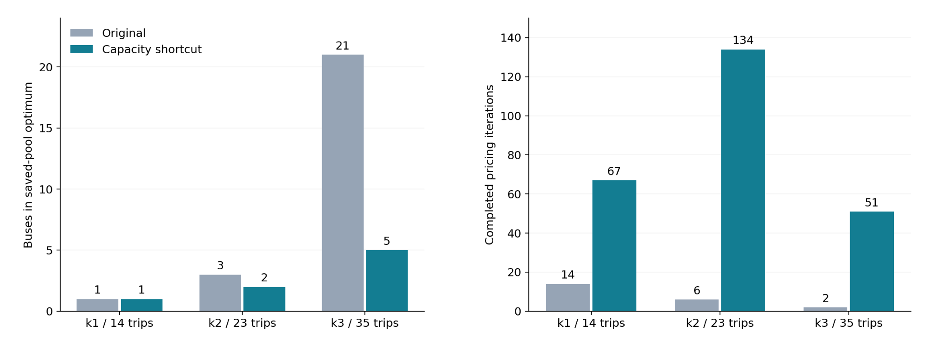
Capacity pricing: progress, but not yet convergence
4 h budgets. Only k=1 with the shortcut certified CG (26.9 min); the other five timed out.
Notes:
Sources: outputs/week_20260921/capacity_strict/capacity_summary.csv and capacity_on_off.png. Matched shortcut on/off physics; 4hourCG budgets. k1on certified26.87min, other5notcertified. All resulting fleetMIPs optimal only in saved pools; k1 1→1, k2 3→2, k3 21→5. k3on has6duplicates, not dispatchcleaned. Capacity feasibility separatelychecked.

Slide 10
The strict large run stalled before pricing
k=15: 4 h 17 min to build 260.7 million arcs; zero pricing.
k=16: six-hour timeout, peak memory 211.9 GiB.
Fix: packed arcs and deferred tie-break keys; physics unchanged.
44 tests pass, plus five fixed-dual and physical replay checks.
26-trip audit: graph build 121 → 42 s; memory 2.06 → 0.147 GiB.
The new k=16 CG is running; its large-case result is pending.
Notes:
Report: outputs/week_20260921/capacity_strict/README.md. Commit35770aae2c08e7d5a356cc3b673e67608e5b1036. Newcampaignstrict_packed_20260921:646674audit,646675k16CG,646676MIP. Packedrepresentationonlyforstrictno-capacityarm; do notconflatewithcapacityshortcut. MaxRSSk15=153.8GiB,k16=211.9GiB. Originalblockeddescendantspreservedonexplicitannotatedholds, historical537227untouched.

Slide 11
Remove duplicate service, then optimize charging
Choose exactly one bus to serve each duplicated trip.
Retain movement if needed; waiting at the wrong stop is invalid.
Try shorter connections, then check time, SOC and chargers.
Reoptimize charging after making the service assignment.
Tested k=5: 5 buses, 62 trips served exactly once.
Charging energy fell 80.87 kWh; electricity cost fell 2.58.
Notes:
Source: outputs/week_20260921/cleanup_physics/README.md. Thiscleanupresultusesitsrecordedconstant-powerphysics, notthelaternonlinearmatchedGIROreopt. Existingimplementation663ece9c plusnewopt-inrunnercodex/week-cleanup-20260921. Validatedfallbackretainstraversal; optionalshorteningreplayed. Approximatebounded120sMIP, gap0.0253%; notglobaloptimizationoverallroutings. Remove duplicatedtripservice, notentirebusroutes.

Slide 12
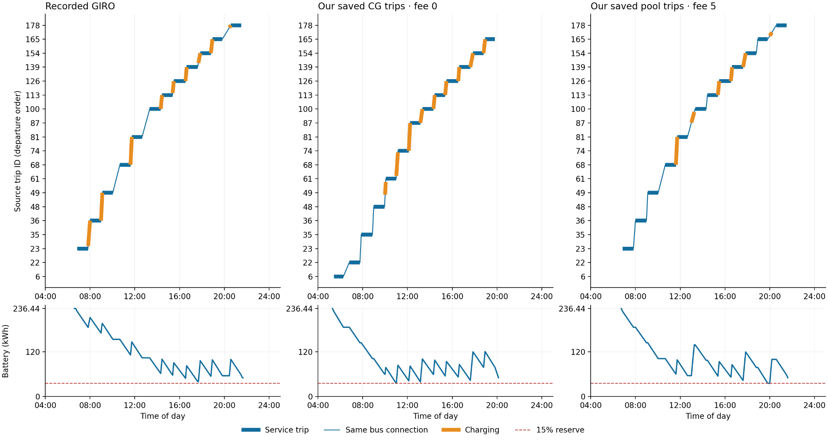
k=5: charging under matched vehicle physics
Notes:
Source: outputs/week_20260921/cleanup_physics/one_bus_k5_joint_matched.png andjoint_validation.json. GIRO original duty13414versus maximumoverlap savedCGfee0andsavedpoolfee5buses. Fullfleetall3are5buses/62trips; savedsequencesexactonce. 236.44kWh,15%reserve,PARX60kW,documentedtaper,3minutecharges,.1kWidle,group/sites,onechargerat2190L/4808,perbusterminalfloorsmatchedoriginal. This is posthoc chargingoptimizationofsavedtripsequences, notfreshfullCGundernewphysics. StaticDHDandplatformFIFO/crewnotvalidated. See nextslideforcostscope.

Slide 13
What is matched—and what this test measures
236.44 kWh battery • 15% reserve • PARX at 60 kW
Documented opportunity-charge taper • minimum 3 minutes
One charger per opportunity site • equal terminal energy
Five buses and the same 62 trips, served exactly once
Saved sequences differ: not fresh CG or a fee-only causal test.
Static deadhead; platform/FIFO and crew rules remain unchecked.
Capacity checked for these five buses, without the other duties.
Notes:
Figureandwholefleetmetrics: outputs/week_20260921/cleanup_physics/joint_figure_metrics.json, joint_validation.json, README.md. Baselinefee5total230.6447876705+5×52=490.6447876705. Synthetic08peak tariffunitsnotcurrencyclaim. Endenergytotal250.7183243524kWhallarmswithbijectivemaxoverlapmatching. Fee0GurobistatusOPTIMALwithin1e-4(gap0.00565%);fee5120stimelimitgap0.6504%. Limits: staticreferenceDHD, platform/FIFO/crewunvalidated; capacitiesonlyfivebuscohort,nobackground35buses. Originalfixed-windowchargingreoptremains230.645and52startswithbothfees. This is not proof of optimal GIRO duty charging over all possible windows/sites.

Slide 14
Matched k=5: charging costs and session counts
Schedule | Electricity | Starts | Start fees | Total
GIRO, fee 0 | 230.64 | 52 | 0 | 230.64
Ours, fee 0 | 158.71 | 42 | 0 | 158.71
GIRO, fee 5 | 230.64 | 52 | 260 | 490.64
Ours, fee 5 | 183.71 | 30 | 150 | 333.71
Tariff cost units; five-bus totals. Same terminal energy.
Original charging windows leave no material fixed-duty saving.
New sequences: post-hoc charging optimization, not a fresh CG test.
Notes:
Sources: outputs/week_20260921/cleanup_physics/joint_figure_metrics.json and joint_validation.json. Allcostsaregenerictariffcostunits,08peaktariff. Baseline230.6447876705/52starts; fee0electricity158.7068197/42starts;fee5electricity183.714825+150fees. Originalfixed-windowreoptcouldnotmateriallyreducecost. Newtripsequencesareposthocoptimizedwithsamephysics, capacitychecked5buscohort, staticdeadheadapproximation. Fee0gap0.00565%,fee5gap0.6504%.

Slide 15
Fresh versus sequential: what the times mean
Sequential CG time includes every earlier k in that chain.
Fresh CG time is one solve on the final trip set.
Both reach the same LP objective to numerical tolerance.
Their saved route pools give very different integer solutions.
The MIP plots show the final k only, split into fleet and charging.
One hour is the allowance. A proved optimum can stop earlier.
Notes:
Sources pinned at commit 6fcc672b16db3255ec552294ff0f34a1b5c9290e:
https://github.com/ndandnd/EVSP-DR/tree/6fcc672b16db3255ec552294ff0f34a1b5c9290e/outputs/research_followup_20260921/chain_comparison_mip_times
48 optimizer endpoints form 24 fresh/sequential pairs at k = 5, 8, 10, 15. Cumulative CG excludes graph construction, all earlier MIPs and queue time. MIP panels show only the final k. Stage times measure optimize calls, not first-incumbent timestamps. Pricing tolerance: 0.0001. Historical physics: 240 kWh / 240 kW, zero reserve, no shared capacity, flat tariff, start fee 5 and covering. Exact CSVs, statuses, source paths and plotting code are linked.

Slide 16
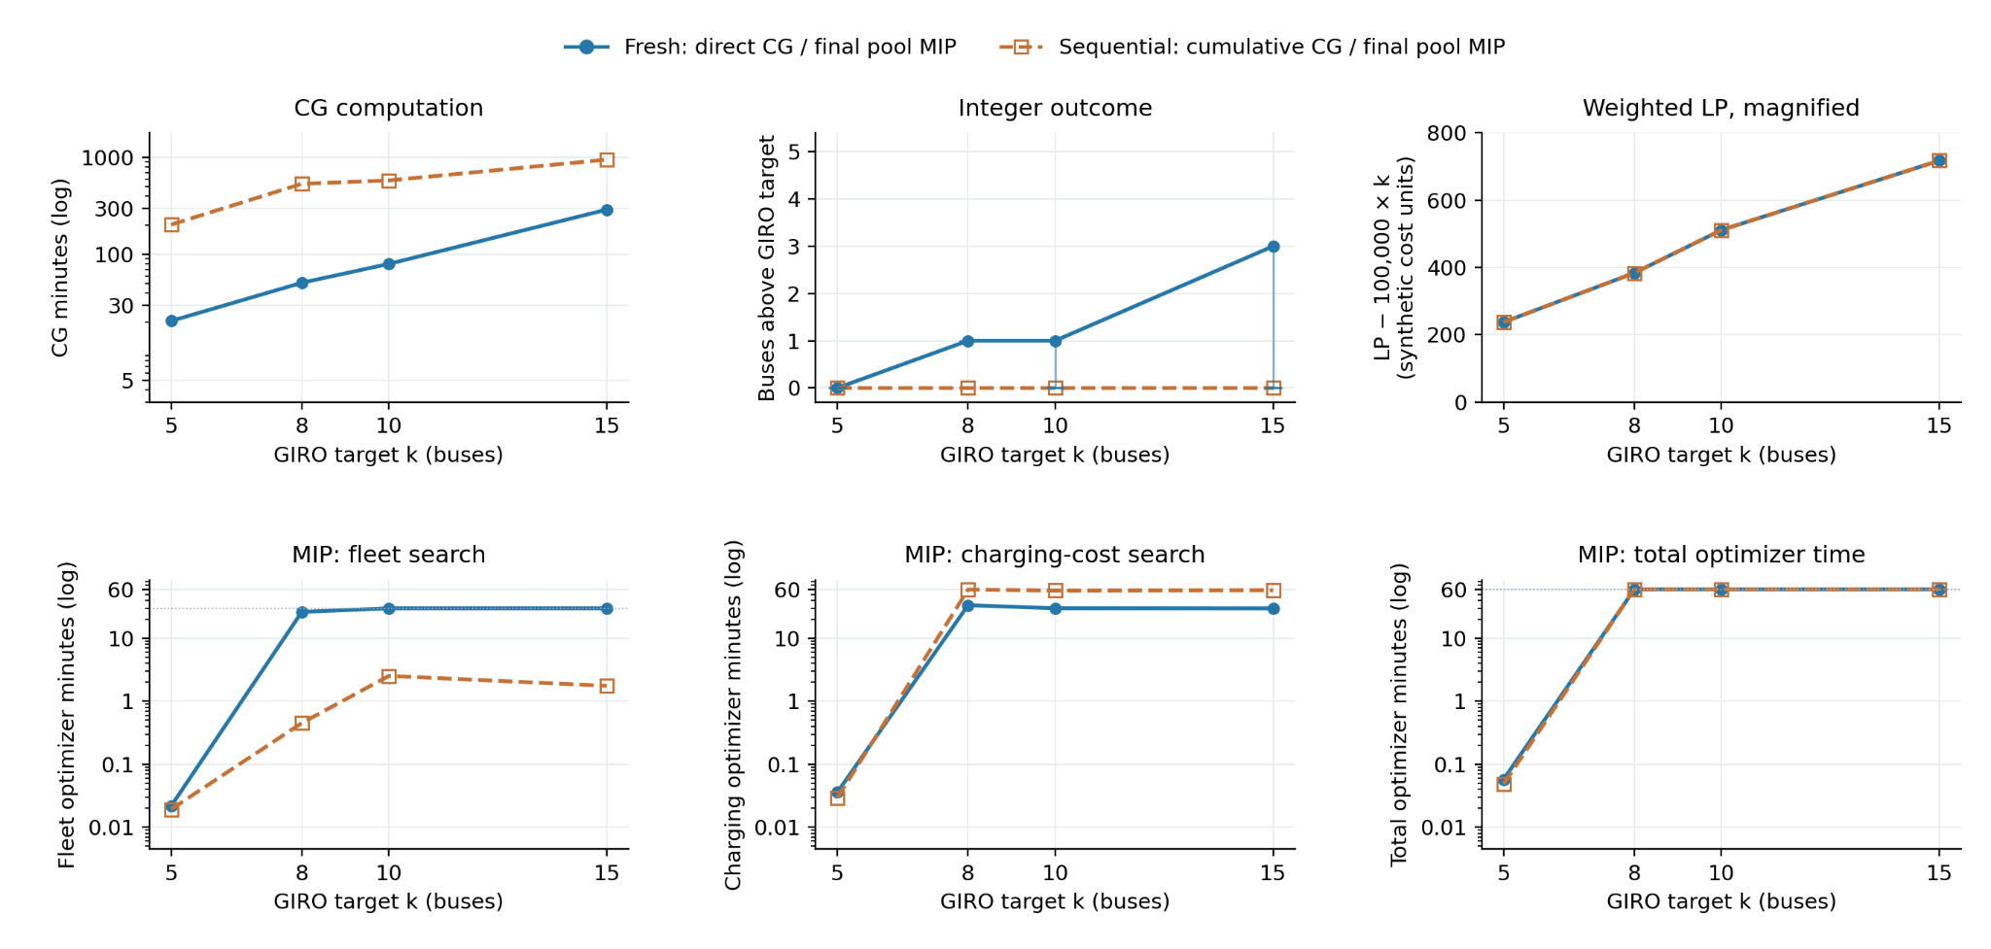
Chain 1: computation and solution quality
Notes:
Sources pinned at commit 6fcc672b16db3255ec552294ff0f34a1b5c9290e:
https://github.com/ndandnd/EVSP-DR/tree/6fcc672b16db3255ec552294ff0f34a1b5c9290e/outputs/research_followup_20260921/chain_comparison_mip_times
48 optimizer endpoints form 24 fresh/sequential pairs at k = 5, 8, 10, 15. Cumulative CG excludes graph construction, all earlier MIPs and queue time. MIP panels show only the final k. Stage times measure optimize calls, not first-incumbent timestamps. Pricing tolerance: 0.0001. Historical physics: 240 kWh / 240 kW, zero reserve, no shared capacity, flat tariff, start fee 5 and covering. Exact CSVs, statuses, source paths and plotting code are linked.

Slide 17
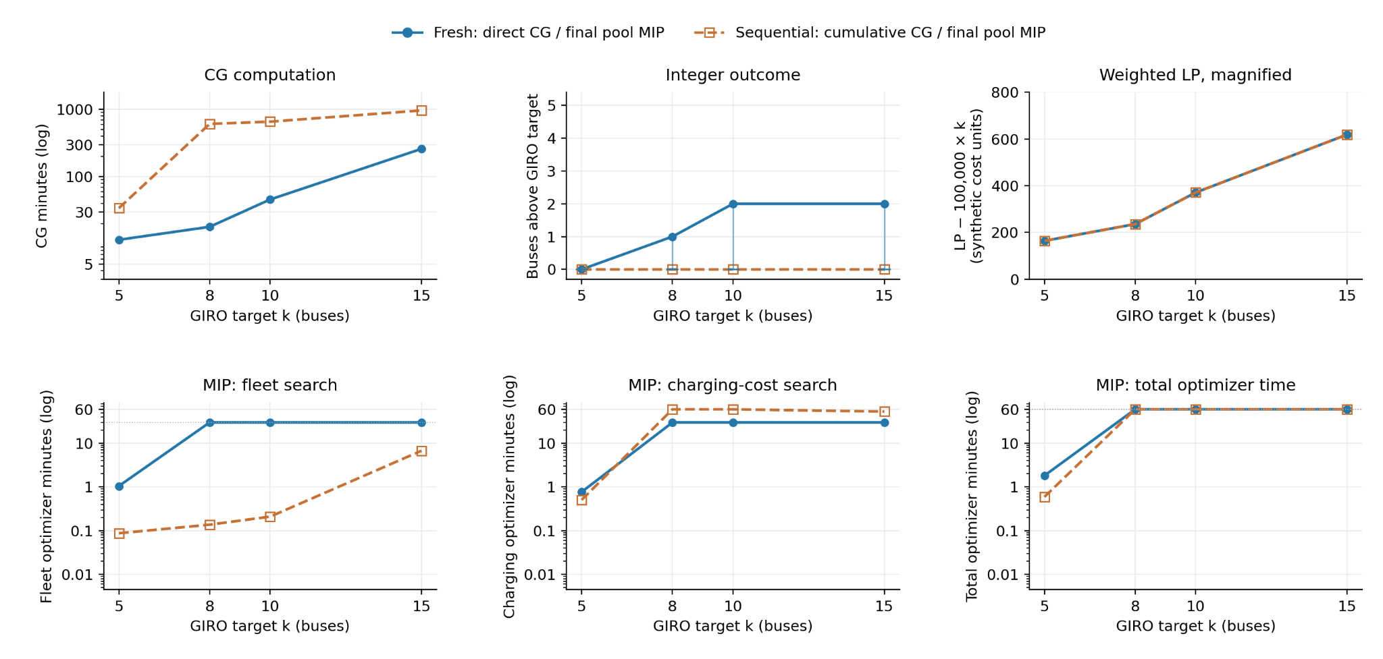
Chain 2: computation and solution quality
Notes:
Sources pinned at commit 6fcc672b16db3255ec552294ff0f34a1b5c9290e:
https://github.com/ndandnd/EVSP-DR/tree/6fcc672b16db3255ec552294ff0f34a1b5c9290e/outputs/research_followup_20260921/chain_comparison_mip_times
48 optimizer endpoints form 24 fresh/sequential pairs at k = 5, 8, 10, 15. Cumulative CG excludes graph construction, all earlier MIPs and queue time. MIP panels show only the final k. Stage times measure optimize calls, not first-incumbent timestamps. Pricing tolerance: 0.0001. Historical physics: 240 kWh / 240 kW, zero reserve, no shared capacity, flat tariff, start fee 5 and covering. Exact CSVs, statuses, source paths and plotting code are linked.

Slide 18
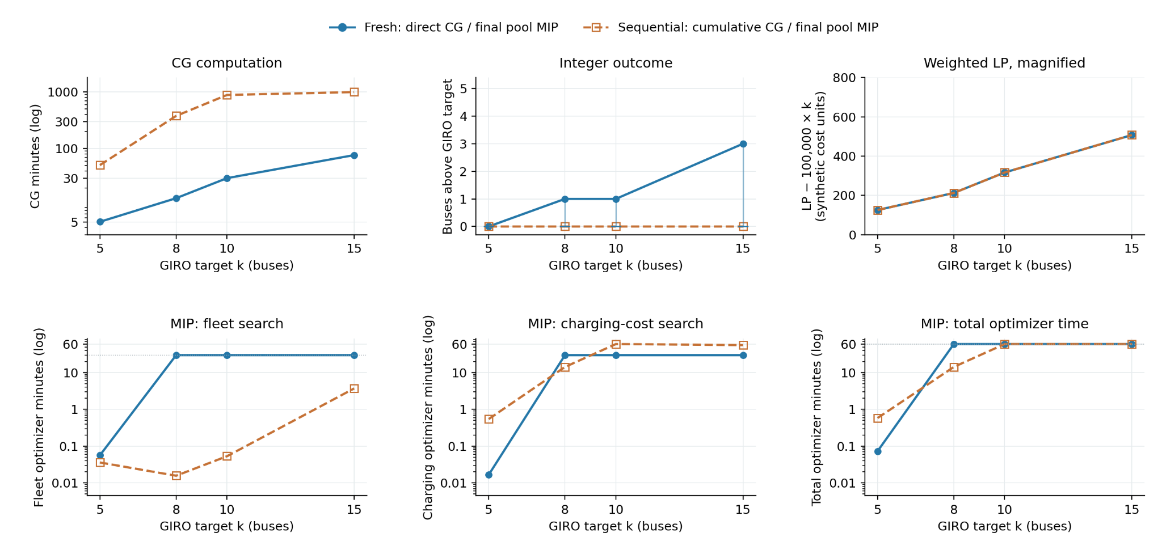
Chain 3: computation and solution quality
Notes:
Sources pinned at commit 6fcc672b16db3255ec552294ff0f34a1b5c9290e:
https://github.com/ndandnd/EVSP-DR/tree/6fcc672b16db3255ec552294ff0f34a1b5c9290e/outputs/research_followup_20260921/chain_comparison_mip_times
48 optimizer endpoints form 24 fresh/sequential pairs at k = 5, 8, 10, 15. Cumulative CG excludes graph construction, all earlier MIPs and queue time. MIP panels show only the final k. Stage times measure optimize calls, not first-incumbent timestamps. Pricing tolerance: 0.0001. Historical physics: 240 kWh / 240 kW, zero reserve, no shared capacity, flat tariff, start fee 5 and covering. Exact CSVs, statuses, source paths and plotting code are linked.

Slide 19
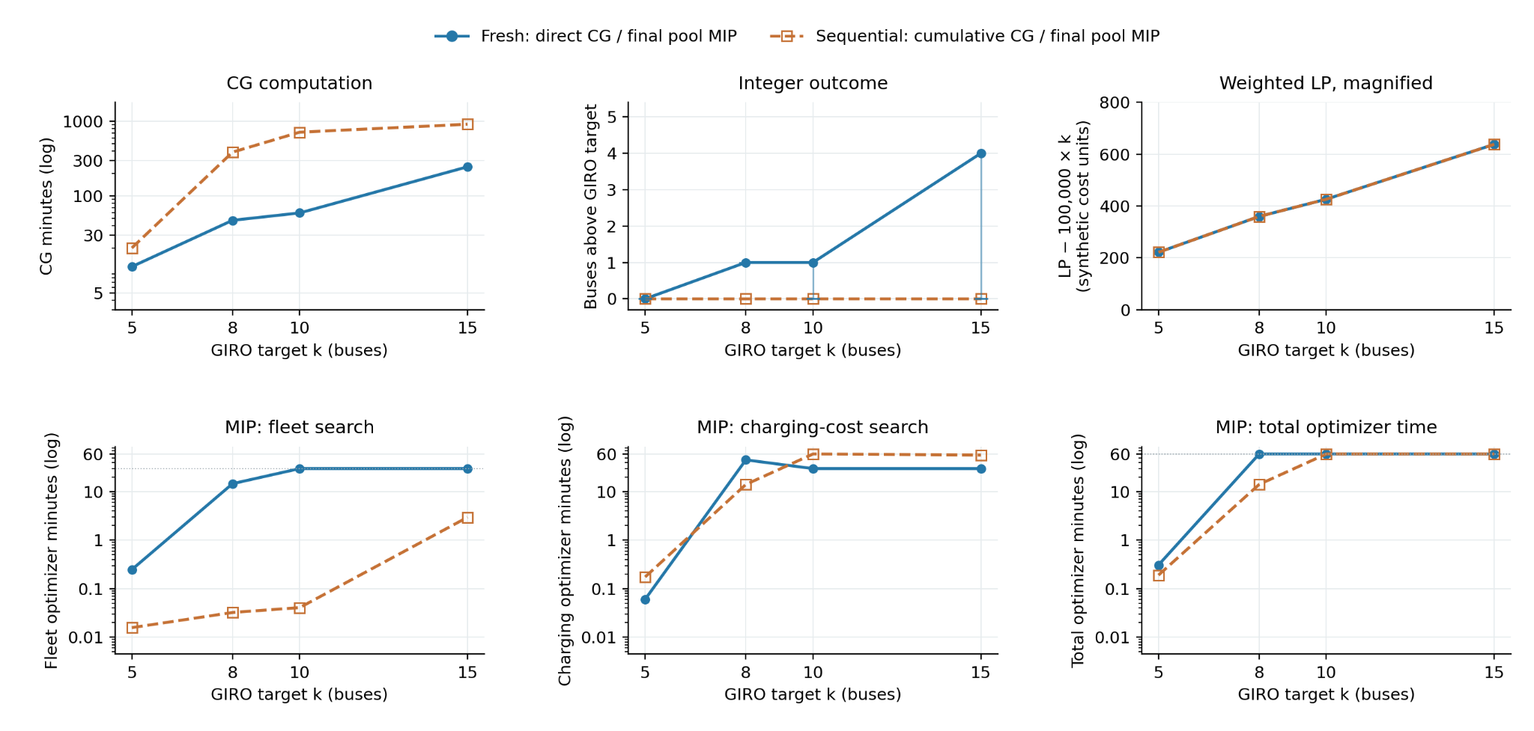
Chain 4: computation and solution quality
Notes:
Sources pinned at commit 6fcc672b16db3255ec552294ff0f34a1b5c9290e:
https://github.com/ndandnd/EVSP-DR/tree/6fcc672b16db3255ec552294ff0f34a1b5c9290e/outputs/research_followup_20260921/chain_comparison_mip_times
48 optimizer endpoints form 24 fresh/sequential pairs at k = 5, 8, 10, 15. Cumulative CG excludes graph construction, all earlier MIPs and queue time. MIP panels show only the final k. Stage times measure optimize calls, not first-incumbent timestamps. Pricing tolerance: 0.0001. Historical physics: 240 kWh / 240 kW, zero reserve, no shared capacity, flat tariff, start fee 5 and covering. Exact CSVs, statuses, source paths and plotting code are linked.

Slide 20
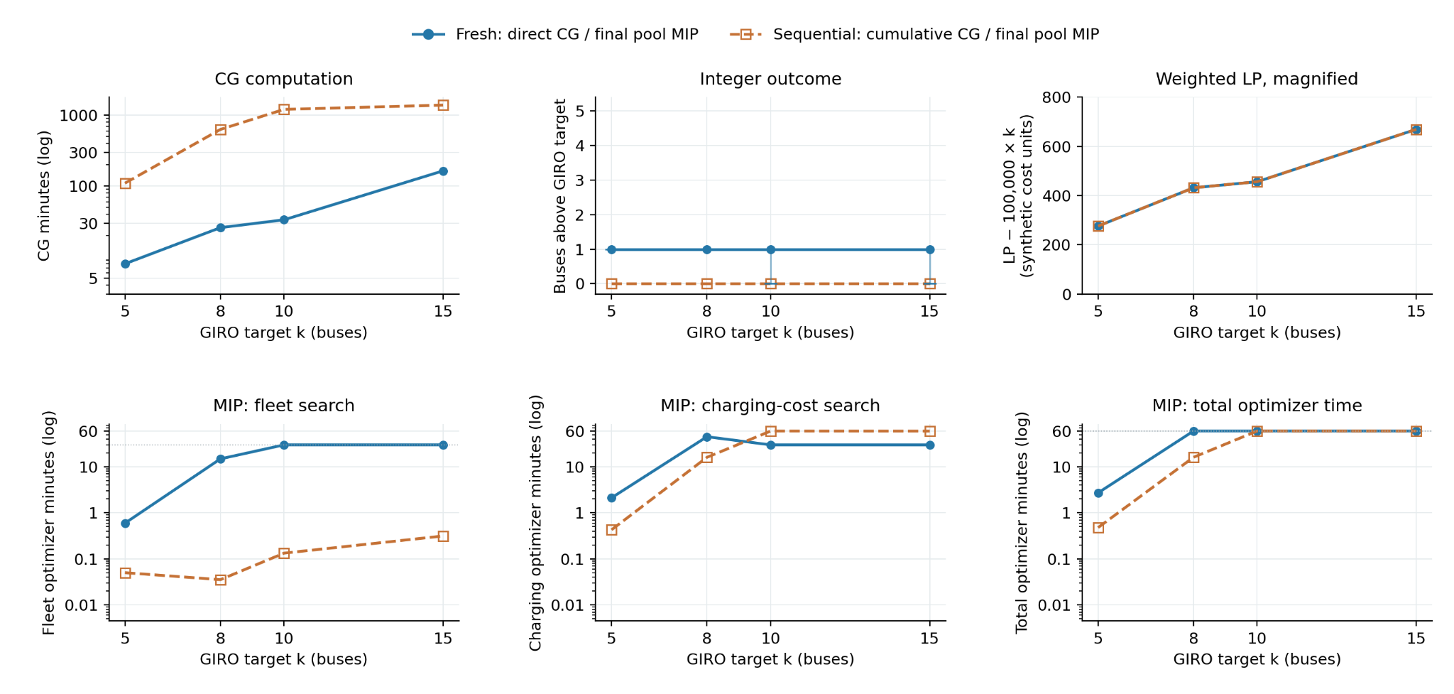
Chain 5: computation and solution quality
Notes:
Sources pinned at commit 6fcc672b16db3255ec552294ff0f34a1b5c9290e:
https://github.com/ndandnd/EVSP-DR/tree/6fcc672b16db3255ec552294ff0f34a1b5c9290e/outputs/research_followup_20260921/chain_comparison_mip_times
48 optimizer endpoints form 24 fresh/sequential pairs at k = 5, 8, 10, 15. Cumulative CG excludes graph construction, all earlier MIPs and queue time. MIP panels show only the final k. Stage times measure optimize calls, not first-incumbent timestamps. Pricing tolerance: 0.0001. Historical physics: 240 kWh / 240 kW, zero reserve, no shared capacity, flat tariff, start fee 5 and covering. Exact CSVs, statuses, source paths and plotting code are linked.

Slide 21
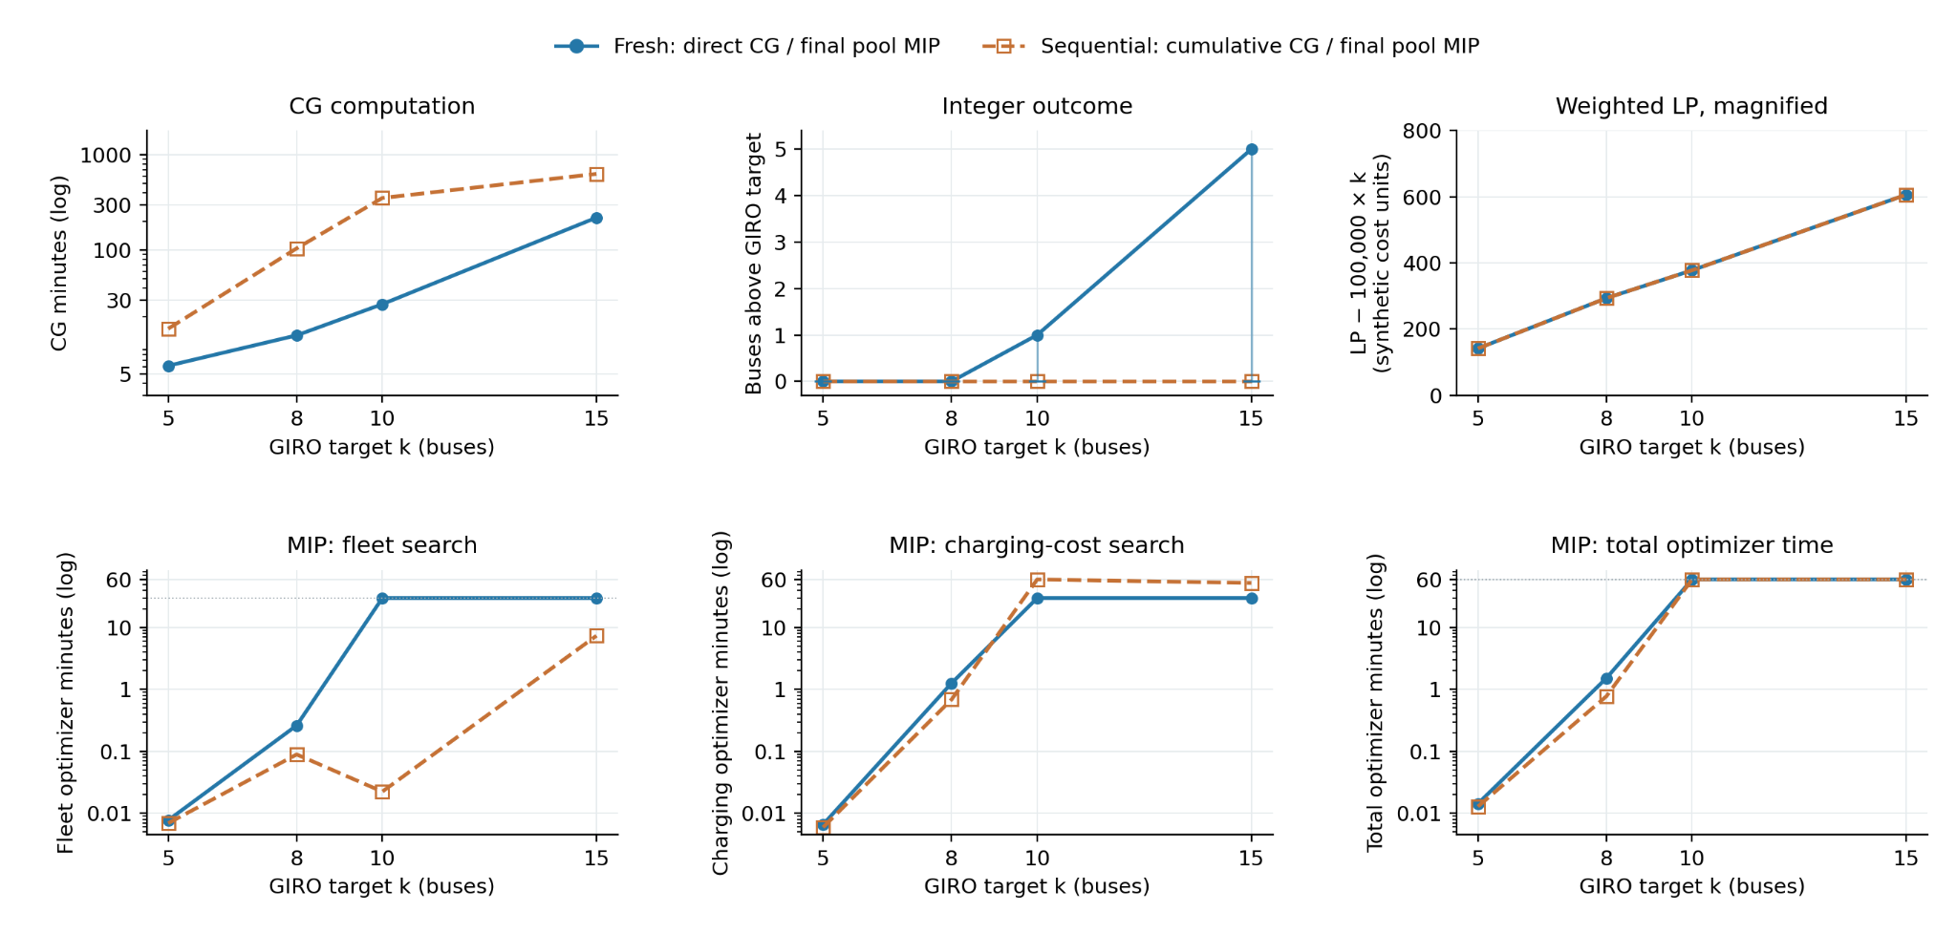
Chain 6: computation and solution quality
Notes:
Sources pinned at commit 6fcc672b16db3255ec552294ff0f34a1b5c9290e:
https://github.com/ndandnd/EVSP-DR/tree/6fcc672b16db3255ec552294ff0f34a1b5c9290e/outputs/research_followup_20260921/chain_comparison_mip_times
48 optimizer endpoints form 24 fresh/sequential pairs at k = 5, 8, 10, 15. Cumulative CG excludes graph construction, all earlier MIPs and queue time. MIP panels show only the final k. Stage times measure optimize calls, not first-incumbent timestamps. Pricing tolerance: 0.0001. Historical physics: 240 kWh / 240 kW, zero reserve, no shared capacity, flat tariff, start fee 5 and covering. Exact CSVs, statuses, source paths and plotting code are linked.

Slide 22
Fleet search is faster; charging uses the remaining time
Chain 1, k=8: fresh proves 9 buses in 26.3 minutes.
Sequential proves 8 buses in 27 seconds.
Both then run charging optimization until nearly one hour.
Across 24 cases: median fleet search is 30 minutes fresh,
versus 5.31 seconds sequential. All sequential fleets are proved.
Fresh k=5 is already fast: every MIP finishes within 3 minutes.
Notes:
Sources pinned at commit 6fcc672b16db3255ec552294ff0f34a1b5c9290e:
https://github.com/ndandnd/EVSP-DR/tree/6fcc672b16db3255ec552294ff0f34a1b5c9290e/outputs/research_followup_20260921/chain_comparison_mip_times
48 optimizer endpoints form 24 fresh/sequential pairs at k = 5, 8, 10, 15. Cumulative CG excludes graph construction, all earlier MIPs and queue time. MIP panels show only the final k. Stage times measure optimize calls, not first-incumbent timestamps. Pricing tolerance: 0.0001. Historical physics: 240 kWh / 240 kW, zero reserve, no shared capacity, flat tariff, start fee 5 and covering. Exact CSVs, statuses, source paths and plotting code are linked.

Slide 23
236.44 kWh: all 195 failures can be repaired
194 routes need only a charging-amount adjustment inside
the original intervals. One needs a 0.15-second extension.
All 487 route occurrences pass independent replay.
Trips, bus counts, charging stops and start counts stay fixed.
Median net extra energy per repaired route: 2.02 kWh.
Capacity-only test: 240 kW, zero reserve, no shared capacity.
Continuous repair establishes feasibility, not a new LP proof.
Notes:
Sources pinned at commit 6fcc672b16db3255ec552294ff0f34a1b5c9290e:
https://github.com/ndandnd/EVSP-DR/tree/6fcc672b16db3255ec552294ff0f34a1b5c9290e/outputs/research_followup_20260921/battery_repair
487 route occurrences represent 463 distinct schedules. The 195 failed occurrences contain 180 distinct schedules. 194 repairs fit their original intervals; one extends by 0.1499625 seconds. All 48 fleets pass individual route-time and energy replay. Charging power is bounded by 240 kW, with zero reserve and no terminal floor or shared capacity. These continuous witnesses do not inherit the event-grid certificates. A second reviewer independently confirmed replay. The repair minimizes absolute charging-energy changes, not charging cost.

Slide 24
Integer-directed pricing: how the search works
Start from the fresh pool and impose the target fleet cap K = 8.
Fix one promising fractional route at xᵣ = 1.
Re-solve the LP. Remaining trips and bus slots change the duals.
Price new routes that help complete this partial integer choice.
Fix another route, or release a fixing and try an alternative.
Keep new columns and pass any discovered cover to the final MIP.
No known sequential routes enter this test. The search is heuristic.
Notes:
Sources pinned at commit 6fcc672b16db3255ec552294ff0f34a1b5c9290e:
https://github.com/ndandnd/EVSP-DR/tree/6fcc672b16db3255ec552294ff0f34a1b5c9290e/outputs/research_followup_20260921/integer_pricing_explanation
Four selected cases (C1, C3, C4, C5), each with two paired seeds: 7/8 treatment hits versus 0/8 controls. Target K = 8 is supplied; no sequential or GIRO witness routes enter the treatment. New columns and the self-discovered incumbent start are tested together, without a separate ablation. All seven hits prove eight in their finite pools. Five controls prove nine. The treatment miss remains nine with bound eight. Nominal charged budget is 3,600 seconds of dive wall time plus MIP solver time, with MIP setup additional. Termination overruns are 0.68–4.70 seconds. Six hits retain duplicate service; shared capacity is absent. proof_links.md indexes the Gurobi logs. method_and_math.md gives the residual dual including fleet-cap price μ.

Slide 25
Why a useful integer route can have positive reduced cost
Covering LP: min cᵀx, subject to Ax ≥ 1 and x ≥ 0.
Dual: max 1ᵀπ, subject to Aᵀπ ≤ c and π ≥ 0.
For any integer cover y: cᵀy − zLP = rᵀy + πᵀ(Ay − 1),
where r = c − Aᵀπ is the vector of route reduced costs.
C1’s eight-route witness: 96.272 = 72.142 + 24.130.
The integer cover pays a small premium above the fractional LP.
Those positive reduced-cost routes can still reduce the integer fleet.
Notes:
Sources pinned at commit 6fcc672b16db3255ec552294ff0f34a1b5c9290e:
https://github.com/ndandnd/EVSP-DR/tree/6fcc672b16db3255ec552294ff0f34a1b5c9290e/outputs/research_followup_20260921/integer_pricing_explanation
Four selected cases (C1, C3, C4, C5), each with two paired seeds: 7/8 treatment hits versus 0/8 controls. Target K = 8 is supplied; no sequential or GIRO witness routes enter the treatment. New columns and the self-discovered incumbent start are tested together, without a separate ablation. All seven hits prove eight in their finite pools. Five controls prove nine. The treatment miss remains nine with bound eight. Nominal charged budget is 3,600 seconds of dive wall time plus MIP solver time, with MIP setup additional. Termination overruns are 0.68–4.70 seconds. Six hits retain duplicate service; shared capacity is absent. proof_links.md indexes the Gurobi logs. method_and_math.md gives the residual dual including fleet-cap price μ.

Slide 26
Fixing routes changes the pricing problem
For fixed routes F, free routes must cover 1 − A_F1,
using at most K − |F| remaining bus slots.
New reduced cost: rᵣ = cᵣ − aᵣᵀπ − μ, with μ ≤ 0.
π prices uncovered service; μ prices the remaining fleet cap.
A formerly positive reduced-cost route can now have negative reduced cost.
The search tries up to 3 alternatives per level and 2 restarts.
It is a bounded diving heuristic, not exhaustive branch-and-price.
Notes:
Sources pinned at commit 6fcc672b16db3255ec552294ff0f34a1b5c9290e:
https://github.com/ndandnd/EVSP-DR/tree/6fcc672b16db3255ec552294ff0f34a1b5c9290e/outputs/research_followup_20260921/integer_pricing_explanation
Four selected cases (C1, C3, C4, C5), each with two paired seeds: 7/8 treatment hits versus 0/8 controls. Target K = 8 is supplied; no sequential or GIRO witness routes enter the treatment. New columns and the self-discovered incumbent start are tested together, without a separate ablation. All seven hits prove eight in their finite pools. Five controls prove nine. The treatment miss remains nine with bound eight. Nominal charged budget is 3,600 seconds of dive wall time plus MIP solver time, with MIP setup additional. Termination overruns are 0.68–4.70 seconds. Six hits retain duplicate service; shared capacity is absent. proof_links.md indexes the Gurobi logs. method_and_math.md gives the residual dual including fleet-cap price μ.

Slide 27
Paired k=8 test: seven recoveries versus zero
Chain | New pricing hits | Unchanged-pool hits
C1 | 2 / 2 | 0 / 2
C3 | 2 / 2 | 0 / 2
C4 | 1 / 2 | 0 / 2
C5 | 2 / 2 | 0 / 2
All seven hits: 8 buses and finite-pool bound 8.
Treatment includes new columns and its own incumbent start.
Four selected instances, each repeated with two solver seeds.
Notes:
Sources pinned at commit 6fcc672b16db3255ec552294ff0f34a1b5c9290e:
https://github.com/ndandnd/EVSP-DR/tree/6fcc672b16db3255ec552294ff0f34a1b5c9290e/outputs/research_followup_20260921/integer_pricing_explanation
Four selected cases (C1, C3, C4, C5), each with two paired seeds: 7/8 treatment hits versus 0/8 controls. Target K = 8 is supplied; no sequential or GIRO witness routes enter the treatment. New columns and the self-discovered incumbent start are tested together, without a separate ablation. All seven hits prove eight in their finite pools. Five controls prove nine. The treatment miss remains nine with bound eight. Nominal charged budget is 3,600 seconds of dive wall time plus MIP solver time, with MIP setup additional. Termination overruns are 0.68–4.70 seconds. Six hits retain duplicate service; shared capacity is absent. proof_links.md indexes the Gurobi logs. method_and_math.md gives the residual dual including fleet-cap price μ.

Slide 28
What the new pricing test establishes
The method generated useful routes without importing known covers.
Five controls proved nine buses in their unchanged pools.
The treatment’s only miss ended at nine with bound eight, still open.
Each pair shares a nominal one-hour dive-plus-solver budget.
Seven successful runs took 14.1–35.4 minutes including setup.
Physics remains 240 kWh / 240 kW, with no shared capacity.
Duplicate service remains in six hits. Global optimality is unproved.
Notes:
Sources pinned at commit 6fcc672b16db3255ec552294ff0f34a1b5c9290e:
https://github.com/ndandnd/EVSP-DR/tree/6fcc672b16db3255ec552294ff0f34a1b5c9290e/outputs/research_followup_20260921/integer_pricing_explanation
Four selected cases (C1, C3, C4, C5), each with two paired seeds: 7/8 treatment hits versus 0/8 controls. Target K = 8 is supplied; no sequential or GIRO witness routes enter the treatment. New columns and the self-discovered incumbent start are tested together, without a separate ablation. All seven hits prove eight in their finite pools. Five controls prove nine. The treatment miss remains nine with bound eight. Nominal charged budget is 3,600 seconds of dive wall time plus MIP solver time, with MIP setup additional. Termination overruns are 0.68–4.70 seconds. Six hits retain duplicate service; shared capacity is absent. proof_links.md indexes the Gurobi logs. method_and_math.md gives the residual dual including fleet-cap price μ.

