Slide 1
EVSP–DR
Research update
Week of 21 September 2026
Integer routes, charging constraints, and next tests

Slide 2
What changed this week
Eight jobs finished; completion is not the same as convergence.
New pricing recovered 8 buses in 3 of 4 fresh k=8 cases.
Chain 1 also reaches 8 when its dive incumbent is passed to MIP.
Capacity pricing improved; k=2 and k=3 still hit the time limit.
The strict large case spent its budget building the graph.
Notes:
Updated week of21September. Sources: outputs/week_20260921/evidence/, outputs/week_20260921/capacity_strict/, outputs/research_execution_20260921/. Original pilot:3/4 final MIP target hits. C1 follow-up additional work, never combined into an equal-budget4/4 claim. Shared station capacity and duplicate-trip cleanup scopes differ across campaigns.

Slide 3
Four fresh pools exclude an 8-bus solution
Chain | LP weight | Pool MIP | Added* | After*
C1 | 8 | 9 | 8 | 8
C3 | 8 | 9 | 8 | 8
C4 | 8 | 9 | 8 | 8
C5 | 8 | 9 | 8 | 8
* Add known sequential routes to the fresh pool, then re-solve.
Both MIP columns show proved fleet minima within their pools.
Notes:
Source: outputs/week_20260921/evidence/k8_witness/. Full original Gurobi logs and SHA256 receipts are in the evidence index. LP fleet is fractional route weight; pricing-certified weighted-objective endpoint. Pool MIP: numerical optimality within a fixed finite column pool only. Adding witness routes is a diagnostic and uses known sequential solutions; it is not the autonomous diving algorithm. Four cases C1/C3/C4/C5.

Slide 4
Read the proof in Gurobi’s log
​​
Chain 1, k=8: stage 1 minimizes only the number of buses.
194 trip rows • 39,940 route variables
“Optimal solution found (tolerance 1.00e-04)”
“Best objective 9 … best bound 9 … gap 0.0000%”
Incumbent 9 + bound 9 ⇒ no 8-bus cover in this pool.
Adding eight witness routes: objective 8, bound 8.
The later charging-stage gap does not undo this fleet proof.
Notes:
C1 fleet proof, lines 155–156:
https://github.com/ndandnd/EVSP-DR/blob/ca1dda82247db995ffd0d524e045430ea197ec13/outputs/week_20260921/evidence/k8_witness/c1_k08/control/391804_r0/gurobi.log#L155
After adding eight sequential routes, line 112:
https://github.com/ndandnd/EVSP-DR/blob/ca1dda82247db995ffd0d524e045430ea197ec13/outputs/week_20260921/evidence/k8_witness/c1_k08/augmented/391805_r0/gurobi.log#L112
Local root: /Users/nadan/Documents/projects/demandresponse/outputs/week_20260921/evidence/
Model size: line 19; unit bus costs: line 24; root relaxation eight: line 53. Objective nine and bound nine prove the fixed-pool fleet optimum to Gurobi's numerical tolerance. The later charging-stage gap does not invalidate this proof. Full-model minimum nine is not claimed.

Slide 5
Why a good LP can give a poor integer pool
The LP spreads 8 units of route weight over 80–101 routes.
Whole buses need a compatible set of complete routes.
LP pricing looks for improvement in the fractional objective.
A route can cost slightly more fractionally, yet complete a better integer cover. Its reduced cost can be positive.
Sequential runs retain routes from earlier dual prices.
Diving changes the dual prices by fixing part of a cover.
Notes:
Evidence: outputs/week_20260921/evidence/witness_analysis.json and forthcoming WHY audit. Distinguish explanation from universal claim: positive reduced cost is relative to a particular LP dual. It does not prove all pricing/enrichment algorithms miss the route. Historical witness injection established missing compatible columns; autonomous diving tests whether altered duals can find them without importing a known solution.

Slide 6
A small example: fractional value versus compatibility
Six trips: A, B, C and D, E, F. Each route below costs 100.
Pool: AB, AC, BC, DE, DF, EF.
LP: take half of every route → 3 route units, cost 300.
Integer pool: two routes per triangle → 4 buses, cost 400.
Add AD at cost 101. Reduced cost = 101 − 50 − 50 = +1.
Now AD + BC + EF covers all trips with 3 buses, cost 301.
The better integer cover need not improve the LP.
Notes:
Illustrative set-covering example, not a GIRO instance. Dual trip prices50 for all6trips certify old and enlarged LP optimum300. New AD reducedcost+1. Original two disjoint triangles require2integer edges each; addingAD yields3edge perfectmatching. Proof demonstrates compatibility mechanism; not evidence that actual route structure is literally triangles.

Slide 7
Can new pricing recover eight buses?
Chain | Controls | Dive + MIP | Follow-up
C1 | 9 | 9 | 8
C3 | 9 | 8 | —
C4 | 9 | 8 | —
C5 | 9 | 8 | —
Original pilot: 3/4 successes. C1 follow-up: +29.6 minutes.
Same distinct routes; passing the dive incumbent recovered eight.
Notes:
Sources: outputs/week_20260921/evidence/pilot_summary.csv and c1_followup_summary.csv. This is autonomous pricing, separate from adding known sequential witnesses. Original pilot stays3/4. C1 followup628441 has63561unique routes,8 duplicate model columns introduced by generic MIP-start path, no new distinct routes. Same source hashes. Controls use saved pools. Full Gurobi log at evidence/c1_followup/628441_r0/gurobi.log.

Slide 8
Twelve 12-hour searches still miss 15
Chain | Plain MIP | Heuristics | Fleet bound
C1 | 18 | 18 | 15
C2 | 17 | 17 | 15
C3 | 17 | 16 | 15
C4 | 19 | 17 | 15
C5 | 16 | 16 | 15
C6 | 18 | 17 | 15
All searches timed out; none proved 15 impossible.
The charging stages have also finished. “Heuristics” changes MIP search settings.
Notes:
All 12 fleet searches ran to the 12-hour limit. Every bound is 15; none proves that 15 is impossible. All subsequent charging stages have also finished at their time limit.
Exact results and paths to all logs:
https://github.com/ndandnd/EVSP-DR/blob/ca1dda82247db995ffd0d524e045430ea197ec13/outputs/week_20260921/evidence/k15_12h_summary.csv
Local log folder: /Users/nadan/Documents/projects/demandresponse/outputs/week_20260921/evidence/k15_12h/
Plain and heuristic-focused arms use the same saved CG pool per chain. They change MIP search settings, not physics. These pools do not enforce shared charging capacity. The incumbents pass physical route replay; duplicate-service cleanup remains separate.

Slide 9
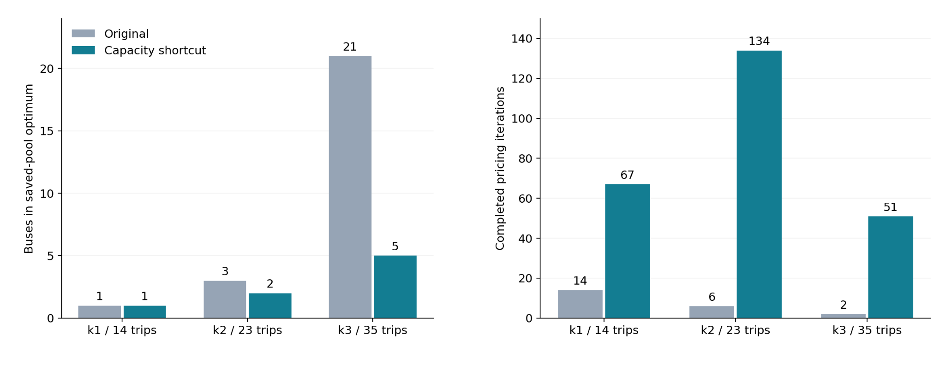
Capacity pricing: progress, but not yet convergence
4 h budgets. Only k=1 with the shortcut certified CG (26.9 min); the other five timed out.
Notes:
Sources: outputs/week_20260921/capacity_strict/capacity_summary.csv and capacity_on_off.png. Matched shortcut on/off physics; 4hourCG budgets. k1on certified26.87min, other5notcertified. All resulting fleetMIPs optimal only in saved pools; k1 1→1, k2 3→2, k3 21→5. k3on has6duplicates, not dispatchcleaned. Capacity feasibility separatelychecked.

Slide 10
The strict large run stalled before pricing
k=15: 4 h 17 min to build 260.7 million arcs; zero pricing.
k=16: six-hour timeout, peak memory 211.9 GiB.
Fix: packed arcs and deferred tie-break keys; physics unchanged.
44 tests pass, plus five fixed-dual and physical replay checks.
26-trip audit: graph build 121 → 42 s; memory 2.06 → 0.147 GiB.
The new k=16 CG is running; its large-case result is pending.
Notes:
Report: outputs/week_20260921/capacity_strict/README.md. Commit35770aae2c08e7d5a356cc3b673e67608e5b1036. Newcampaignstrict_packed_20260921:646674audit,646675k16CG,646676MIP. Packedrepresentationonlyforstrictno-capacityarm; do notconflatewithcapacityshortcut. MaxRSSk15=153.8GiB,k16=211.9GiB. Originalblockeddescendantspreservedonexplicitannotatedholds, historical537227untouched.

Slide 11
Remove duplicate service, then optimize charging
Choose exactly one bus to serve each duplicated trip.
Retain movement if needed; waiting at the wrong stop is invalid.
Try shorter connections, then check time, SOC and chargers.
Reoptimize charging after making the service assignment.
Tested k=5: 5 buses, 62 trips served exactly once.
Charging energy fell 80.87 kWh; electricity cost fell 2.58.
Notes:
Source: outputs/week_20260921/cleanup_physics/README.md. Thiscleanupresultusesitsrecordedconstant-powerphysics, notthelaternonlinearmatchedGIROreopt. Existingimplementation663ece9c plusnewopt-inrunnercodex/week-cleanup-20260921. Validatedfallbackretainstraversal; optionalshorteningreplayed. Approximatebounded120sMIP, gap0.0253%; notglobaloptimizationoverallroutings. Remove duplicatedtripservice, notentirebusroutes.

Slide 12
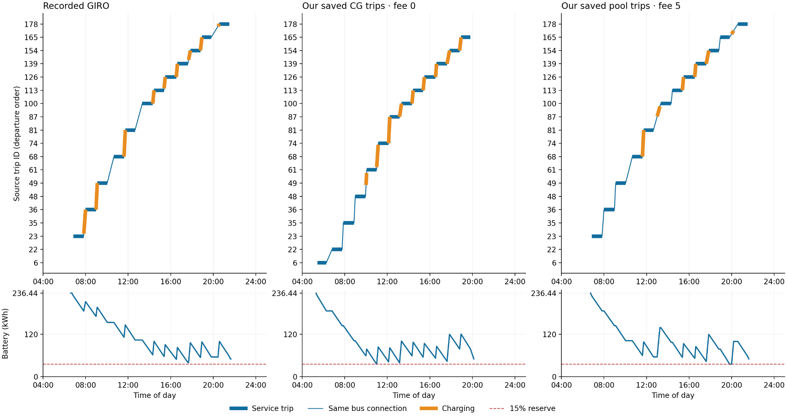
k=5: charging under matched vehicle physics
Notes:
Source: outputs/week_20260921/cleanup_physics/one_bus_k5_joint_matched.png andjoint_validation.json. GIRO original duty13414versus maximumoverlap savedCGfee0andsavedpoolfee5buses. Fullfleetall3are5buses/62trips; savedsequencesexactonce. 236.44kWh,15%reserve,PARX60kW,documentedtaper,3minutecharges,.1kWidle,group/sites,onechargerat2190L/4808,perbusterminalfloorsmatchedoriginal. This is posthoc chargingoptimizationofsavedtripsequences, notfreshfullCGundernewphysics. StaticDHDandplatformFIFO/crewnotvalidated. See nextslideforcostscope.

Slide 13
What is matched—and what this test measures
236.44 kWh battery • 15% reserve • PARX at 60 kW
Documented opportunity-charge taper • minimum 3 minutes
One charger per opportunity site • equal terminal energy
Five buses and the same 62 trips, served exactly once
Saved sequences differ: not fresh CG or a fee-only causal test.
Static deadhead; platform/FIFO and crew rules remain unchecked.
Capacity checked for these five buses, without the other duties.
Notes:
Figureandwholefleetmetrics: outputs/week_20260921/cleanup_physics/joint_figure_metrics.json, joint_validation.json, README.md. Baselinefee5total230.6447876705+5×52=490.6447876705. Synthetic08peak tariffunitsnotcurrencyclaim. Endenergytotal250.7183243524kWhallarmswithbijectivemaxoverlapmatching. Fee0GurobistatusOPTIMALwithin1e-4(gap0.00565%);fee5120stimelimitgap0.6504%. Limits: staticreferenceDHD, platform/FIFO/crewunvalidated; capacitiesonlyfivebuscohort,nobackground35buses. Originalfixed-windowchargingreoptremains230.645and52startswithbothfees. This is not proof of optimal GIRO duty charging over all possible windows/sites.

Slide 14
Matched k=5: charging costs and session counts
Schedule | Electricity | Starts | Start fees | Total
GIRO, fee 0 | 230.64 | 52 | 0 | 230.64
Ours, fee 0 | 158.71 | 42 | 0 | 158.71
GIRO, fee 5 | 230.64 | 52 | 260 | 490.64
Ours, fee 5 | 183.71 | 30 | 150 | 333.71
Tariff cost units; five-bus totals. Same terminal energy.
Original charging windows leave no material fixed-duty saving.
New sequences: post-hoc charging optimization, not a fresh CG test.
Notes:
Sources: outputs/week_20260921/cleanup_physics/joint_figure_metrics.json and joint_validation.json. Allcostsaregenerictariffcostunits,08peaktariff. Baseline230.6447876705/52starts; fee0electricity158.7068197/42starts;fee5electricity183.714825+150fees. Originalfixed-windowreoptcouldnotmateriallyreducecost. Newtripsequencesareposthocoptimizedwithsamephysics, capacitychecked5buscohort, staticdeadheadapproximation. Fee0gap0.00565%,fee5gap0.6504%.

