Slide 1
EVSP DR Current Research
12 September 2026
Inherited covering matches k=3–6 in all six chains.
Three chains now match ten buses at k=10.
Remaining questions: initialization cost, capacity pricing
and whether decomposition helps larger instances.
Notes:
Current status from 12 September00:20EDT snapshot. New overnight jobs are running,not completed scientific results. Main document: https://docs.google.com/document/d/1hDSWYb2KG-8pnLFN9BdSKkbXOjhytm4bxQz_MsBw_BY/edit . Historical document: https://docs.google.com/document/d/1f0orWtM1-_VWAqjj6GnWP78webCOnvoc01x2VQvaA_k/edit . Original21-slide meeting deck preserved in EVSP DR Slide Archive10September2026.

Slide 2
​​
Fresh starts need extra buses as k grows
Target buses | Chain 1 | Chain 2 | Chain 3 | Chain 4 | Chain 5 | Chain 6
5 | 5 | 5 | 5 | 5 | 6 | 5
8 | 9 | 9 | 9 | 9 | 9 | 8
10 | 11 | 11 | 11 | 11 | 11 | 11
15 | 18 | 17 | 18 | 19 | 16 | 19
Integer incumbents from all 84 completed fresh covering cases.
Each size starts independently. MIP proof status varies by cell.
The current document contains the full chain tables and source records.
Notes:
Source: current chain tables, 12 September 2026. Fresh covering, 240 kWh / 240 kW. Integer incumbents with varying finite-pool proof status. No shared-capacity or return-energy constraints.

Slide 3
Inherited columns improve integer fleet
Target buses | Chain 1 | Chain 2 | Chain 3 | Chain 4 | Chain 5 | Chain 6
2 | 2 | 2 | 2 | 2 | 3 | 2
5 | 5 | 5 | 5 | 5 | 5 | 5
6 | 6 | 6 | 6 | 6 | 6 | 6
8 | — | 8 | 8 | 8 | 8 | 8
10 | — | — | 10 | — | 10 | 10
Cells show integer buses. Grey means unfinished. k=11–15 is running.
All displayed fleet optima are proved within their saved pools.
240 kWh / 240 kW, covering. Shared charger capacity is not imposed.
Notes:
Snapshot 12 September 2026 00:20 EDT. Inherited columns, set covering, 240 kWh / 240 kW. All six chains match k=3 through 6. Three chains (3, 5, 6) match k=10. Chain 5 at k=2 uses three buses. Dashes mean no completed verified cell, not infeasibility. Displayed fleet minima are proved only within saved pools. Individual column physical replay passed; duplicate-trip cleanup and aggregate shared-charger validation are separate. Current experiments extend to k=15 using bounded replay as a new treatment. Full k=2–10 native table and records are in the Current results document.

Slide 4
Station capacity exposes a pricing bottleneck
Target | Baseline | PARX 60 kW | Capacity | Both
1, duty A | 1 | 1 | 1 | 1
1, duty B | 1 | 1 | 1 | 1
2 | 2 | 2 | 3 | 3
3 | 3 | 3 | 16 | 16
k=3: one pricing call took 7.15 hours; the LP took 0.006 seconds.
CG stopped uncertified with only three new columns.
The 16-bus pool result does not prove that 16 buses are necessary.
Notes:
Pilot:2 single-duty cases13408/13406, k2=23trips,k3=35trips. Opportunity sites have proposed documented capacities,PARX uncapped. Opportunity240kW;PARX60 only in named arms. Zero reserve,no65%return-SOC floor. Capacity sweeps passed for capacity solutions; duplicate removal remains unvalidated. Sources CURRENT_CHAIN_TABLES.md and capacity_deadline5_completed/records.json.

Slide 5
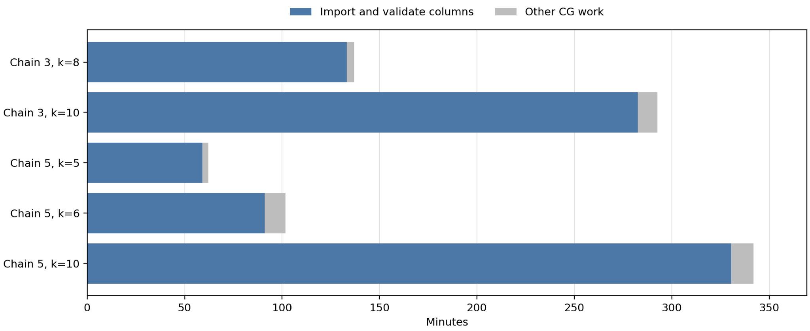
Importing columns dominates warm-run time
Full predecessor pools were replayed here. The new overnight treatment caps replay at 512 sequences / 15 minutes; results are pending.
Notes:
Completed full-pool inherited runs for chains 3 and 5. Import includes physical replay and validation. Other CG work includes optimization and remaining overhead; final MIP time is excluded. Source: outputs/overnight_extension_20260912/cluster_snapshot.json. New bounded replay is a changed initialization treatment, not a completed speedup claim.

Slide 6
The same LP can support different integer pools
Chain 3 at k=8 | Fresh pool | Inherited pool
Weighted LP objective | 800,212.68747 | 800,212.68747
Fractional route weight | 8 | 8
Integer fleet optimum in pool | 9 | 8
Both CG runs met the same reduced-cost stopping tolerance.
The unchanged fresh pool cannot reach eight buses with more MIP time.
This isolates a column-pool limitation for this case.
Notes:
Matched covering comparison, chain3 k8. Both final weighted LP objectives800212.68747, sum lambda8,zero artificial coverage,same reduced-cost tolerance. Fresh saved-pool optimum9 vs inherited8. Source existing current research doc export and register source records. Pricing certificate concerns represented LP; finite-pool fleet proof remains distinct from full-model integer optimality.

Slide 7
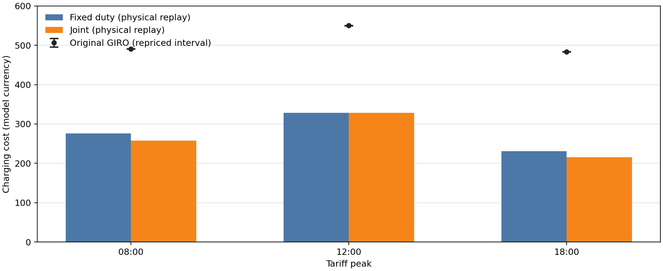
Charging savings with matched return energy
Five buses / 62 trips. Both optimized cases return ≥280.7833 kWh in total. At noon, grid objectives tie; physical replay costs differ slightly.
Notes:
240 kWh batteries, 350 kW charging, five buses, no shared charger capacity. Costs include electricity and five units per charging start. Original repriced charging interval: 490.287–490.981 at 08:00, 549.594–550.597 at 12:00, 483.447–483.723 at 18:00. Physical replay: fixed duties 275.873, 328.548, 230.782; joint 257.687, 328.359, 215.756. Both noon grid objectives are 332.025525. Fixed duties preserve each trip sequence and optimize charging with DP; joint changes trip assignment using the saved augmented route pool. Fleet and cost optimality are finite-pool claims. No full-model pricing certificate under the new terminal-energy constraint. Source: terminal_energy_fair_mip_retry_5cdb813_20260910 comparisons; figure_provenance.json.

Slide 8
The overnight experiments answer three questions
Question | Experiment
Can inheritance scale? | Six chains continue to k=15
Does decomposition help? | Ten partitions of 32 duties into groups of eight
Can recombination improve it? | Global CG starts from component routes
87 CG cases and 87 dependent one-hour MIPs, all on default_partition.
Bounded replay is a new treatment: ≤512 sequences and ≤15 minutes.
No new k=11–15 or decomposition result is claimed yet.
Notes:
Execution a29992196acb74d02b8c7891be4061718889999f. Campaign overnight_extension_20260912. Default partition,CPU-only excludes scaglione-compute-01. MIP requeue records job/restart attempts; no Gurobi search-tree resume. k data dependencies preserved. Baseline covering physics,no shared capacity or returnSOCfloor. GIRO duty membership defines groups; GIRO schedule columns are not injected.

Slide 9
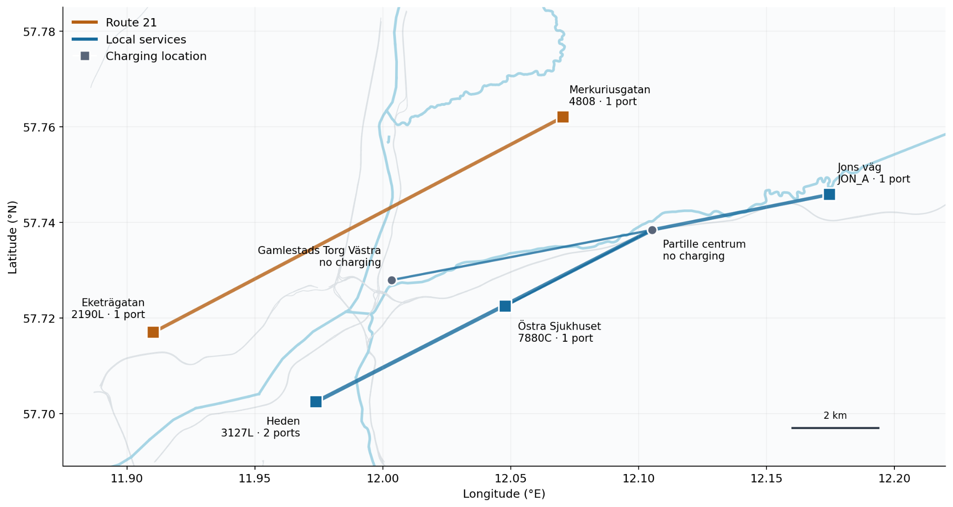
Geography suggests groups, not independence
838 of 948 trips mapped; lines join endpoints, not road paths. Timetable connections still cross groups. Map data: OpenStreetMap.
Notes:
Full GIRO parent: 40 duties, 948 trips. Map includes 838 trips; PARX and 110 trips with unmapped endpoints are omitted. Route 21 has 14 duties and 203 trips; local services have 26 duties and 745 trips. Optimistic <=30-minute-wait timetable screen finds 23,959 connections, including 7,561 cross-group (31.56%); all trips are in one undirected component. The screen ignores SOC and charging, so geography does not establish independent subproblems. Current decomposition pilot instead uses a 32-duty / 750-trip subset split into four groups of eight. Combine component columns, validate shared resources, and run global CG to allow cross-group exchanges.

