Slide 1
Sequential Programming
Interrupts & UART Programming
Our C++ programs are sequential (סדרתיים), they start at the first instruction and end at the last.
Wrong!!! Loops, branches, and function calls jump from instruction to instruction in a non-linear way.
However, the jumps are planned by the programmer. A function call or branch jumps to a known location.

Slide 2
Function Call
a = b + c;
d = f1(a);
e = a + 17;
int f1(int x){
x = x*7;
x = x + 1;
return(x);
}
The jump to the function occurs at a known position in the program.
But what if we are waiting for an external event, such as receiving a signal on the serial port?

Slide 3
Interrupting Execution
a = b + c;
d = b << 3;
OS interrupt
e = a + 17;
strcpy(str1,””);
if(c == ‘1’)
str1[0] = ‘_’;
str1[1] = c;
OS interrupt
The OS (Operating System) interrupts program execution all the time, switching to another users code (or to the system’s code).
However the user doesn’t notice this, it looks like the his/her program is being run exclusively (באופן בלעדי).

Slide 4
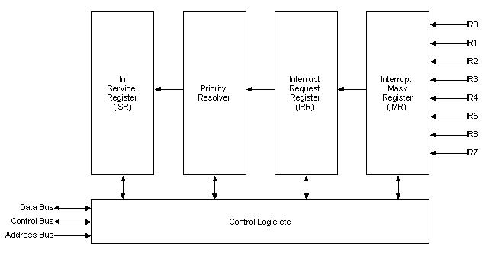
How is Code Interrupted on a PC?
IRQ (Interrupt ReQuest) lines are connected to various devices (parallel and serial ports, timer, disk controller, sound card …).
When the device sets its IRQ a signal is sent to the PIC (Programmable Interrupt Controller).

Slide 5
Notifying the Processor
When an IRQ is set the PIC receives a signal.
It then checks the Interrupt Mask Register (IMR). The IMR contains a bit for each IRQ. If the corresponding bit is set the IRQ is masked, the interrupt won’t be received.
The request is then transferred into the Interrupt Request Register (IRR). It is held there until it is serviced.
The IRR is transferred into the priority handler, which decides which interrupt to handle first (if there are several requests pending).
The highest priority interrupt is then moved into the In Service Register (ISR).
A signal is sent to the processor.
The processor finishes executing the current instruction, looks at the ISR and sees which IRQ has been signaled.
The processor jumps to a function which “handles” the interrupt, this is called an interrupt handler or Interrupt Service Routine (ISR).

Slide 6
The Interrupt Vector
The first 256 words (1024 bytes) of memory holds the Interrupt Vector. Each can hold the address of an ISR.
Each IRQ has a fixed address in the interrupt vector.
The IRQs and ISR entries for the serial ports are:
  COM1/COM3: IRQ 4 ISR 0xC
  COM2/COM4: IRQ3 ISR 0xB

Slide 7
Writing an ISR
First we have to write the ISR:
#define COM1 0x3F8
void interrupt COM1INT() /* ISR for COM1 */
{
int c;
c = inportb(COM1 + 5);
if (c & 1) { /* if the DR is set, read */
buffer[counter] = inportb(COM1);
counter++; /* buffer and counter are */
} /* global variables */
outportb(0x20,0x20); /* signal End of */
} /* Interrupt (EOI) */

Slide 8
Setting an ISR
In order to have the ISR activated we have to set the interrupt vector:
#define COM1VECT 0x0C
void interrupt (*oldcom1isr)();
oldcom1isr = getvect(INTVECT); /* Save old
Interrupt Vector.*/
setvect(COM1VECT, COM1INT); /* Set Interrupt
Vector Entry */
Now when IRQ 4 (COM1) is set the processor will jump to our ISR. Not yet.
The IRQ is still masked.

Slide 9
Unmasking the IRQ
The PIC’s IMR is accessed through Port 0x21:
outportb(0x21,(inportb(0x21) & 0xEF)); /* Set PIC to unmask IRQ 4 */
OxEF resets (zeros) the 5th bit of the IMR, leaving all other bits untouched.
Now will we jump to our ISR if IRQ 4 is set? Yes, but IRQ 4 won’t be set!
We have to enable Interrupts through the UART.

Slide 10
The Interrupt Enable Register (IER)
The IER is register 1 of the UART. It’s bits are:
  Bit 0: Interrupt when the DR is set.
  Bit 1: Interrupt when the THR is empty.
  Bit 2: Interrupt when the LSR (Line Status Register) is modified.
  Bit 3: Interrupt when the MSR (Modem Status Register) is modified.
  Bit 4-7: Reserved
So in order to jump to the ISR when the DR is set we must set bit 0 of the IER:
outportb(COM1 + 1 , 0x01); /* Set the IER to enable interrupts when data is pending. */

Slide 11
The Interrupt Identification Register (IIR)
If more than 1 bit is set in the IER, we won’t know why the interrupt occurred
The IIR has this information. Its bits are:
  Bit 0:
    0 - an interrupt is waiting to be handled.
    1 - no interrupt.
  Bits 2,1:
    00 - MSR change
    01 - THR empty
    10 - DR set
    11 - LSR change
  Bits 3-7: Reserved.

Slide 12
Why Use Interrupts?
Good question? The other alternative is to perform polling, in a loop read the MSR and LSR and check for changes.
Using interrupts the program can do other things or just wait until data is received.
But isn’t jumping to an ISR for every byte received wasteful? Indeed it is.
The solution is simple. Once in an ISR read until there aren’t any more bytes to read.

Slide 13
Buffered ISR
void interrupt COM1INT() /* ISR for COM1 */
{
int c;
do { c = inportb(COM + 5);
if (c & 1) {
buffer[counter] = inportb(COM1);
counter++;
if (counter == MAXBUF) {
counter = 0;
}
}
}while (c & 1);
outportb(0x20,0x20);
}

